Slide 1

Aeronautical Communications (2)
Performance Evaluation of Computer Networks and Systems
Federica Perrone
Riccardo Fiorini

Slide 2
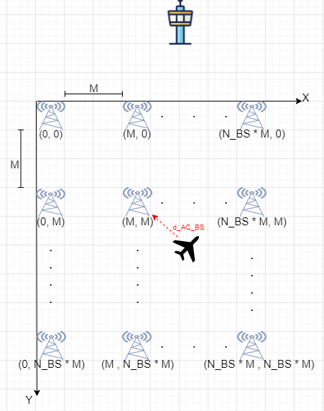
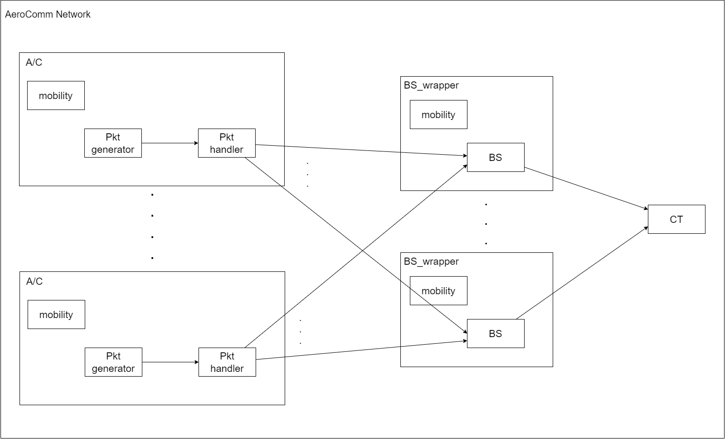
Introduction and Model
Objectives:
Study the end-to-end delay
Study the queue length
KPIs:
Mean response time E[R]
Mean number of packets in queue E[Nq]
Scenarios:
Results are obtained varying k (inter-arrival time) and t (handover period)
k uniform
k exponential
t deterministic
Repetitions:
30
CI:
99%

Slide 3
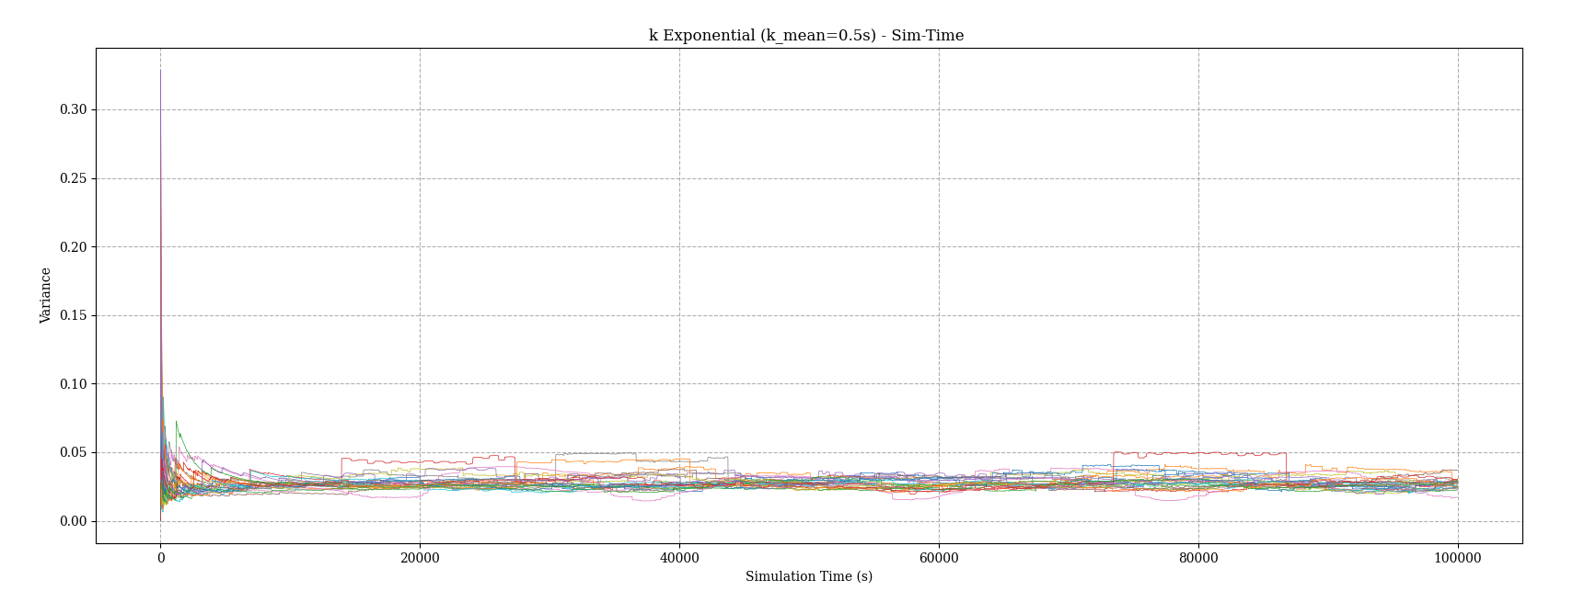
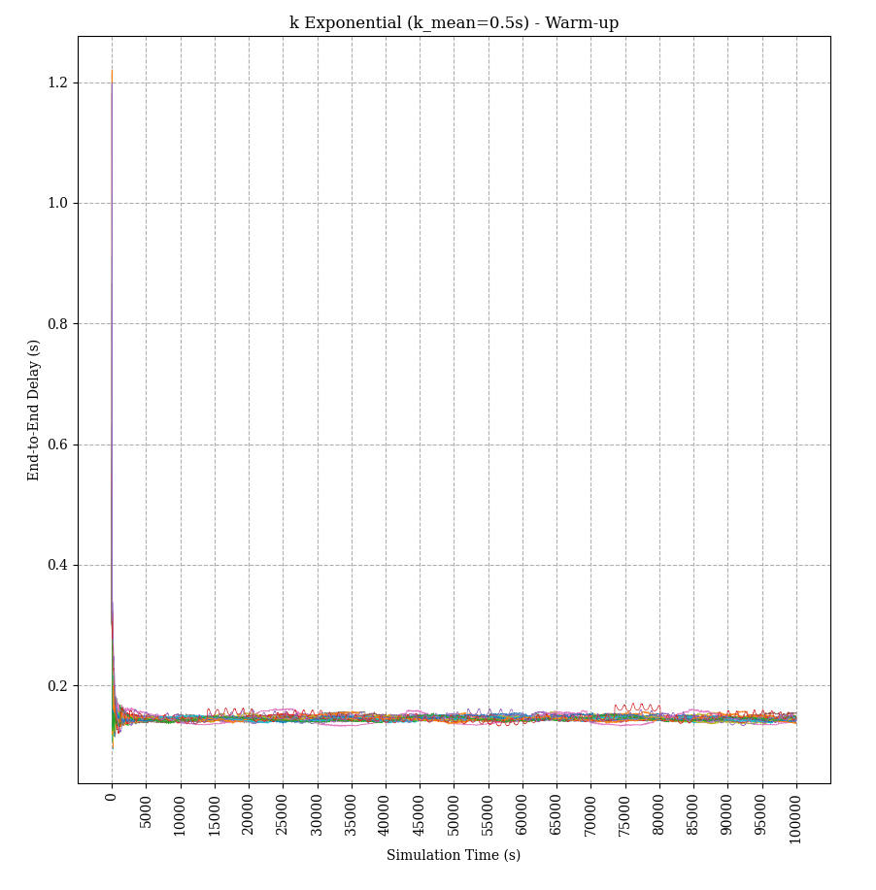
Warmup period and Simulation time Calibration
Reference: A/C end-to-end delay of the packets E[R]
Repetitions: 30
Warm-up time: 5000s
We observed the trajectory of the mean end-to-end delay to see when the transitory has passed
Simulation time: 20000s
We observed the trajectory of the variance among different repetitions
In both cases we considered the worst-case scenario, and we used them for all simulations

Slide 4
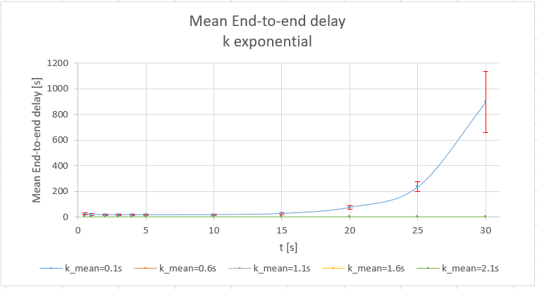
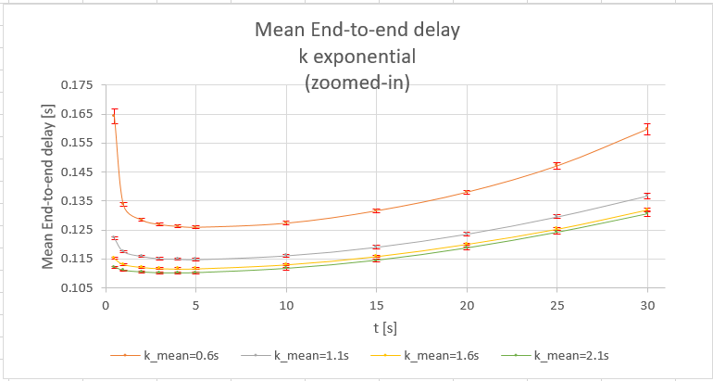
Factors Calibration
Parameter | Interval
t | [5s, 25s]
k_max | [0.2s, 4.2s]
k_mean | [0.1s, 2.1s]
t negatively affects the performance in two cases:
t small → unnecessary handover operations are performed, i.e. handover operations do not lead to an actual change in serving BS
t large → handover is done infrequently, so A/C is always too far away from its serving BS
We decided to set t between 5s and 25s and observe the overall behavior of the system

Slide 5
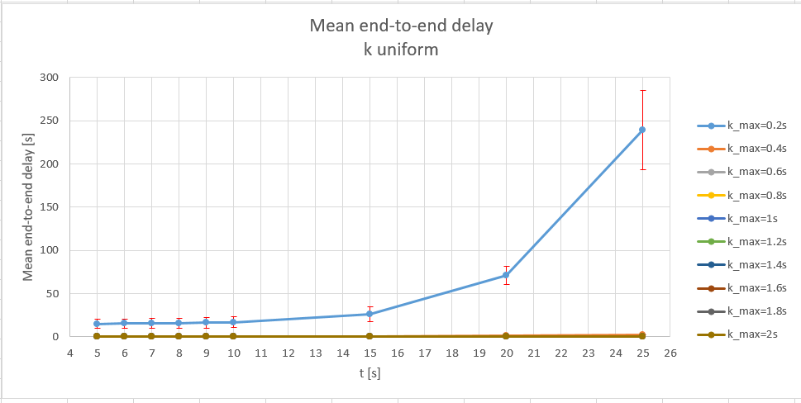
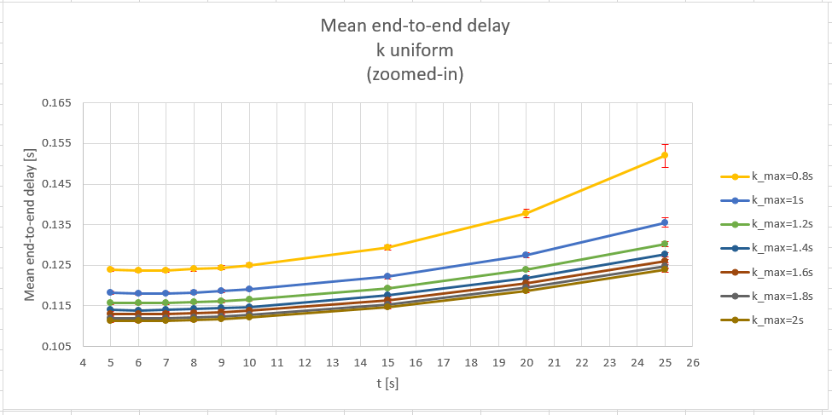
End-to-end Delay analysis (Uniform)
The mean end-to-end delay highly depend on the mean inter-arrival time (k).
The system becomes unstable for k_max ≤ 1s
The mean end-to-end delay increase for t ≥ 10s

Slide 6
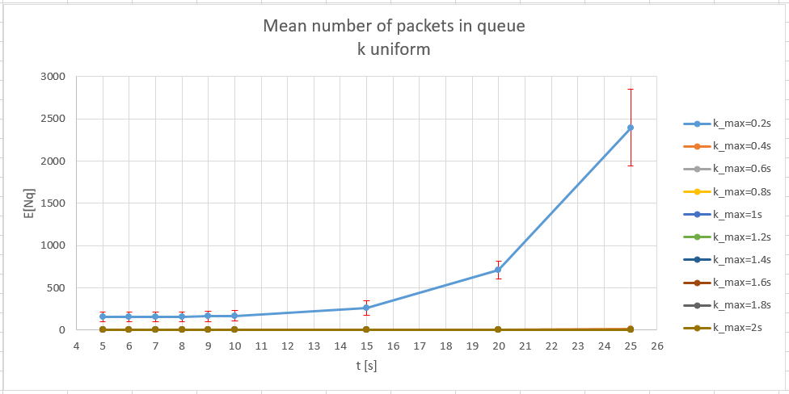
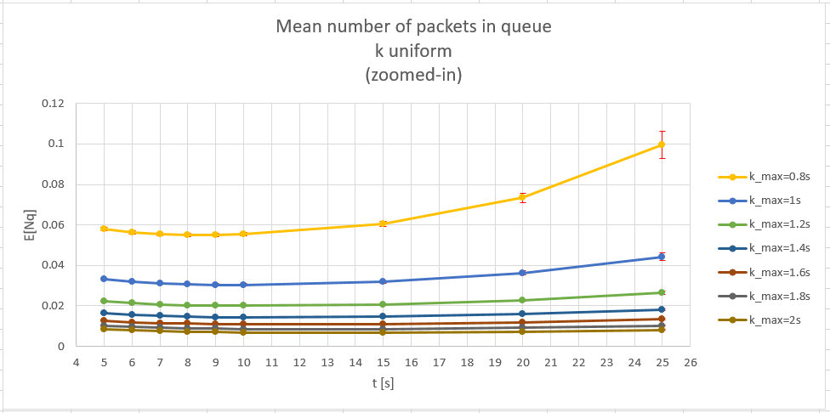
Number of packets in queue analysis (Uniform)
The mean number of packets in queue highly depend on the mean inter-arrival time (k).
The system becomes unstable for k_max ≤ 1s
The mean number of packets in queue increase for t ≥ 10s

Slide 7
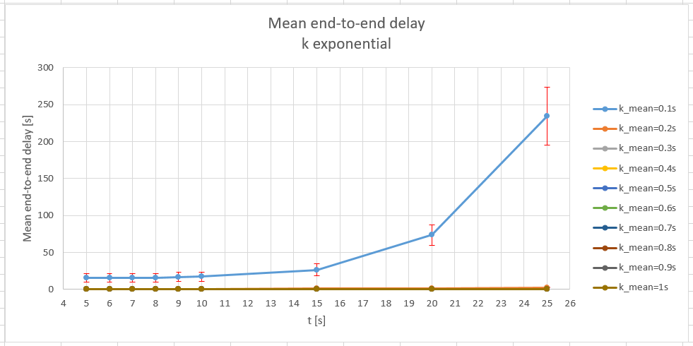
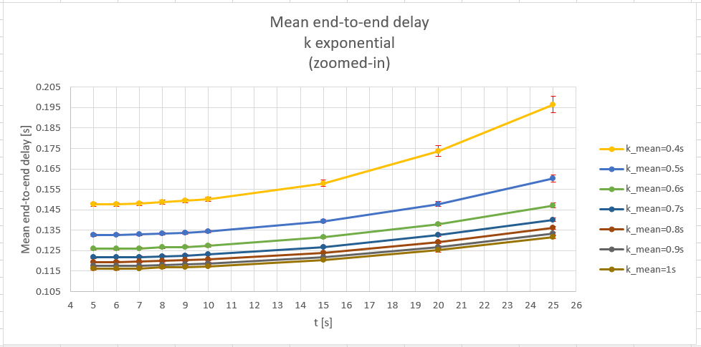
End-to-end Delay analysis (Exponential)
The mean end-to-end delay highly depend on the mean inter-arrival time (k).
The system becomes unstable for k_mean ≤ 0.5s
The mean end-to-end delay increase for t ≥ 10s

Slide 8
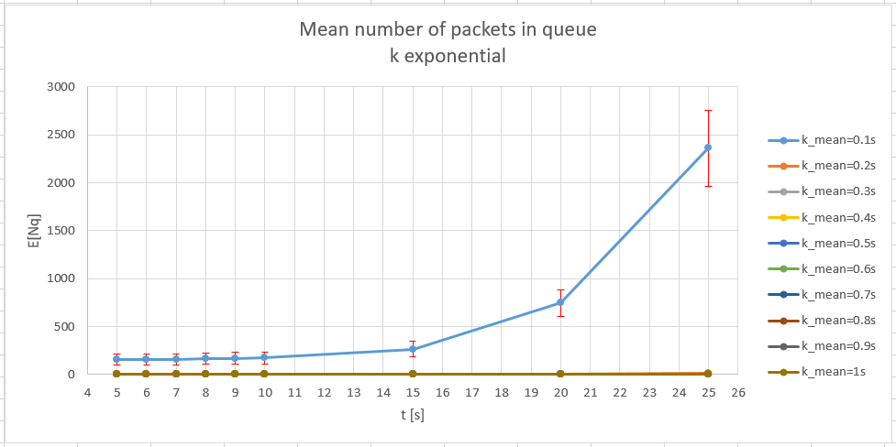
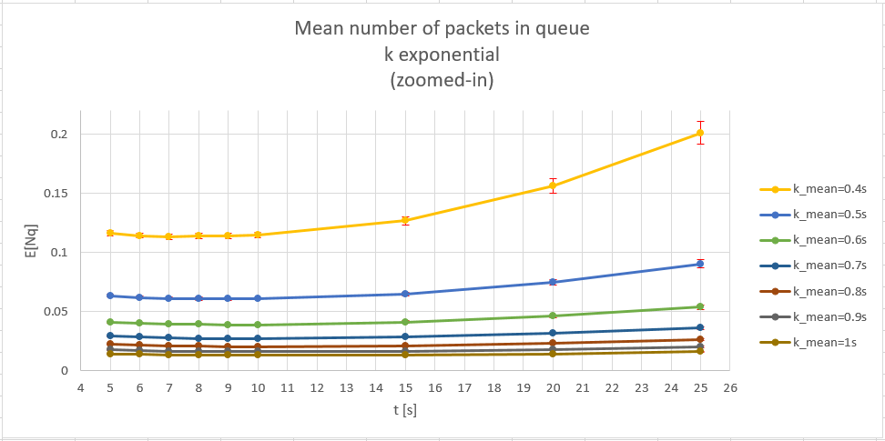
Number of packets in queue analysis (Exponential)
The mean number of packets in queue highly depend on the mean inter-arrival time (k).
The system becomes unstable for k_mean ≤ 0.5s
The mean number of packets in queue increase for t ≥ 10s

Slide 9
Conclusions
Uniform and exponential scenarios give us the same results
The best performances are observed for t between 5 and 10s, more specifically with t around 7s-8s
Suggested values for k mean are above 0.5s because, for lower values, end-to-end delay and queue length begin to be relevant
Any other consideration regarding k should be made by a flight expert, who should choose between having a fresher piece of information, but less frequently, or a less frequent piece of information but fresher

