Slide 1
2025.1.11 Electronic Eye Display
Goal:
Add expressive, animated electronic eyes to a fursuit head, under strong constraints:
The Eyes must:
Look like real “eyes” when powered off
Support animated expressions when powered on
Be safe, lightweight, and wearable
Key Constraint:
The main difference between design options is the display technology
Outer mechanical/optical structure is shared

Slide 2
Overall structure
The main message of this page – this is more important than the itemized list.
Overall fursuit eye structure:
Anti-glare (reduce reflections)
Anti-moire (camera friendliness)
Transparent plastic shell (as existing
Anti-fog (wearability)
Internal display Unit
three display options
Outside
inside
Display
Unit

Slide 3
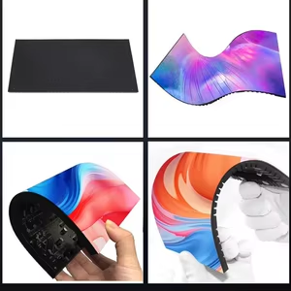
Flexible LED Matrix
Flexible RGB LED matrix shaped to eye curvature
Fully non-transparent display unit
Pros
Flexible, can be curved to real eye shape
Very bright (good for stage / photography)
Simple, many mature applications
Cons
low pixel density (~40px hori, ~25px verti)
Pixilated (very much like protogen)
Opaque → blocks any see-through capability
Include some informative visuals – diagrams, graphs, images, videos, etc.

Slide 4

Transparent Rigid Display + Backlight + White Perforated Background
Very complex, but may be the most effective: both see-through capability and power-off eye display
Led backlights
Transparent display panel (e.g. transparent OLED/LCD)
Dedicated backlight system
White perforated background plate
Can solve both:
quality animated eyes
Wearer seeing outside through eye region
Cons: Lower brightness, single color
Rigid, size-limited components
Fursuiter’s eye
Outer structure Display
Background

Slide 5
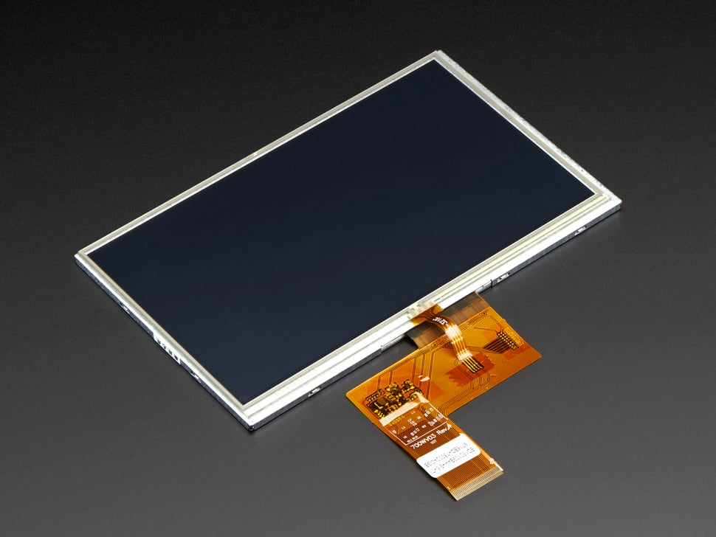
High-Resolution Rigid OLED / LCD
Standard small high-resolution OLED or LCD panel
Default eye handled via: Printed layer with tuned transparency, or Failsafe lighting
Pros
Best visual quality
Mature, reliable display technology
Simplest to engineer and scale
Cons
Rigid (no curvature)
Opaque (blocks see-through)
Requires design work to avoid “dead black eye”
Include some informative visuals – diagrams, graphs, images, videos, etc.

Slide 6
Aspect | Option 1: Flexible LED | Option 2: Transparent + Backlight | Option 3: Rigid OLED/LCD
Visual Detail | Low (~30x40 px) (like Protogens) | Medium(~200x150 px) (but single-color) | Very High (~720p)
Flexibility | High | Low | Low
Complexity | Low | Very High | Medium
Default Eye When power Off | Possible (design-dependent) | Yes | Possible (design-dependent)
See-Through Capability | No | Yes | No

Slide 7
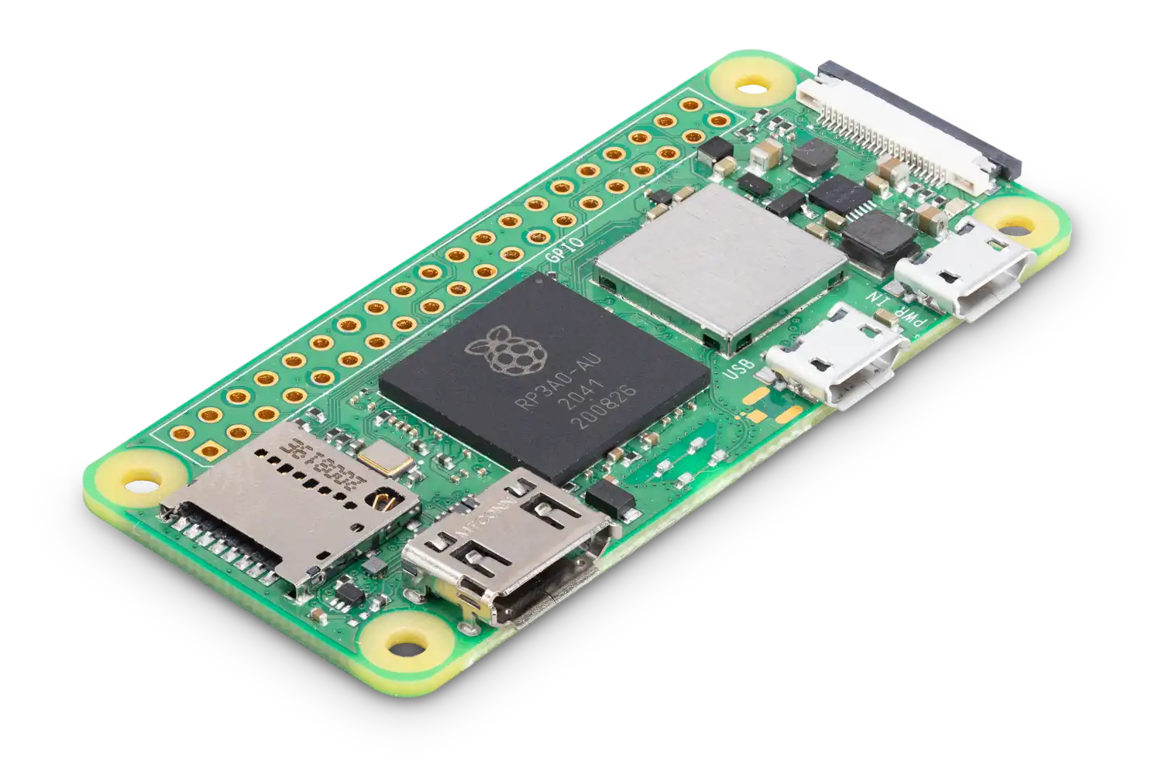
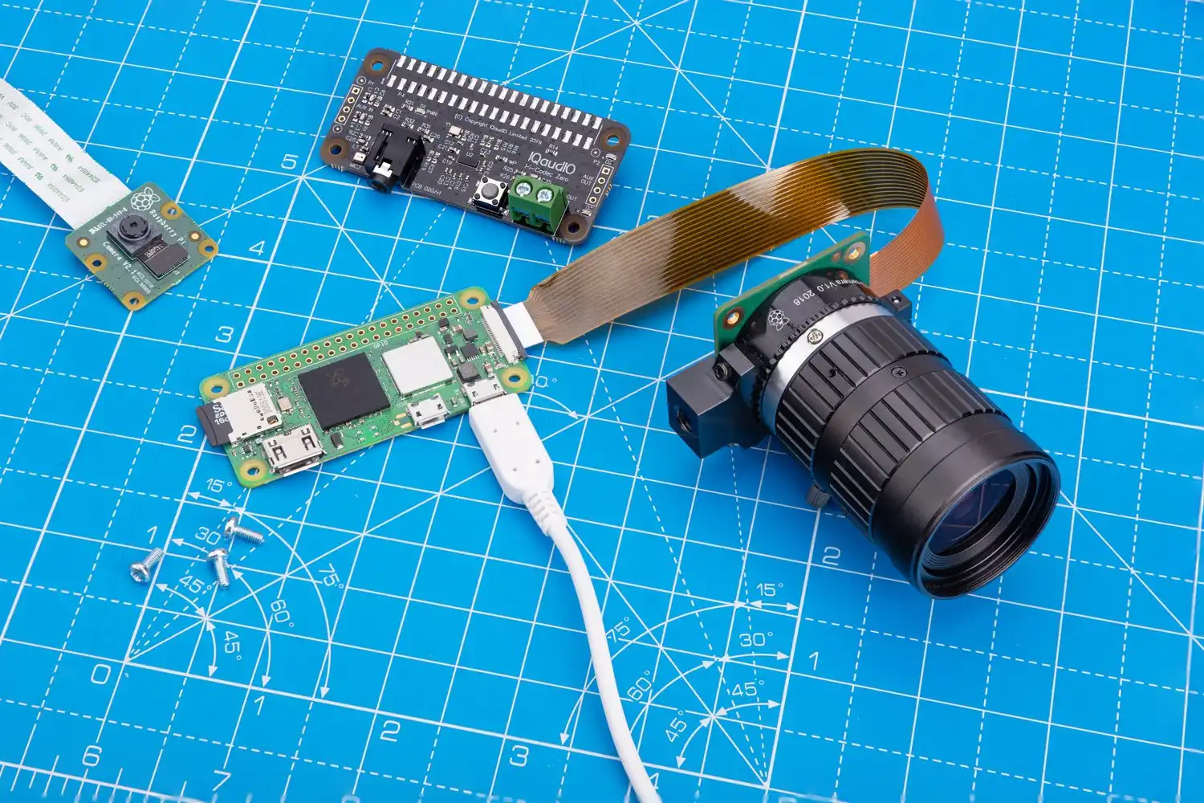
Main Control Unit (MCU)
Standard Raspberry Pi Zero 2 W [1]
Screens will come with Display Controller / Driver IC
For ini demo: Connect components to the MCU with cables/GPIO
[1] Source: https://www.raspberrypi.com/products/raspberry-pi-zero-2-w/

