Slide 1
Advance Databases
Mobile Database

Slide 2
You might have notice the ever increasing demands on mobile computing for providing the types of support required by a growing number of mobile workers and its technology.

Slide 3
What is Mobile database?
Mobile Database is a database that is transportable, portable and physically separate or detached from the corporate database server but has the capability to communicate with those servers from remote sites allowing the sharing of various kinds of data.
With mobile databases, users have access to corporate data on their laptop, PDA, or other Internet access device that is required for applications at remote sites.

Slide 4
The components of a mobile database environment includes:
Corporate database server and DBMS that deals with and stores the corporate data and provides corporate applications
Remote database and DBMS usually manages and stores the mobile data and provides mobile applications
mobile database platform that includes laptop, PDA, or other Internet access devices
Two-way communication links between the corporate and mobile DBMS.

Slide 5
Why Mobile Databases?
Mobile data-driven applications enable us to access any data from anywhere, anytime.
Examples:
Salespersons can update sales records on the move.
Reporters can update news database anytime.
Doctors can retrieve patient’s medical history from anywhere.
Mobile DBMSs are needed to support these applications data processing capabilities.

Slide 6
A mobile database is a database that can be connected to by a mobile computing device over a wireless mobile network.
Mobile databases:
Physically separate from the central database server. ✓ Resided on mobile devices.
Capable of communicating with a central database server or other mobile clients from remote sites.
Handle local queries without connectivity.

Slide 7
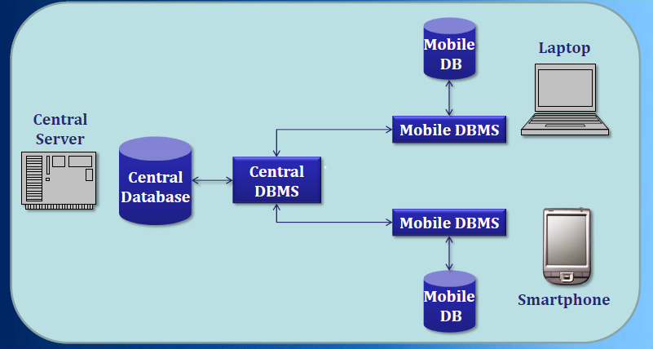

Slide 8
Client-Server Mobile Databases:
Client-server model is the traditional model of information systems.
It is the dominant model for existing mobile databases.
The server can become a single point of failure and performance bottleneck.
Even storing data on a cluster of machines to backup central database might cause performance bottleneck and data inconsistency.

Slide 9
Peer-to-Peer Mobile Databases:
In P2P mobile databases, the database maintenance activities are distributed among clients.
Every process plays part of the role of the server, besides its client role.
A client that wants to access a piece of data, sends a request to other peer clients and they forward the request until the data is found.
The major problem in this model is ensuring the availability of data .

Slide 10
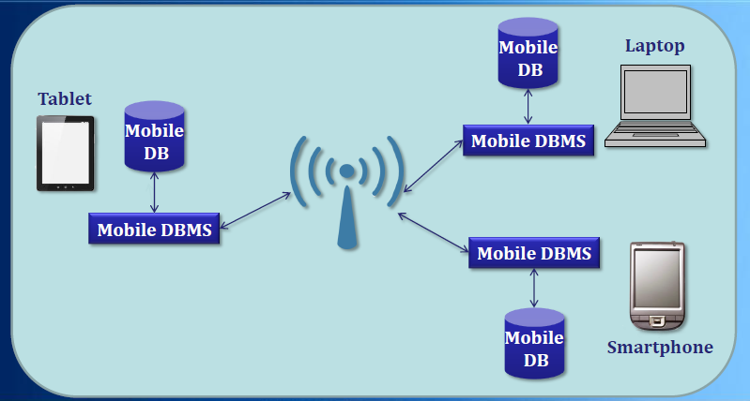

Slide 11
Characteristics of Mobile Environments:
Why not use an appropriate existing model of databases in a mobile environment?
Characteristics of mobile environments:
Restricted bandwidth of wireless networks.
Limited power supply.
Limited resources.
Mobility.
Disconnections.

Slide 12
Current Approach:
Currently most mobile application developers use “flat files” to store application data.
A “flat file” is a file containing records that have no structured interrelationship.
Advantages:
Smaller and easier to manage.
Disadvantages:
Applications need to know the organization of the records within the file.
Developers have to implement the required database functionalities.

Slide 13
Requirements of Mobile DBMSs:
Mobile DBMSs should satisfy the following requirements :
Small memory footprint.
Flash-optimized storage system.
Data synchronization.
Security.
Low power consumption.
Self-management.
Embeddable in applications.

Slide 14
Small Memory Footprint:
Memory footprint is amount of main memory that an application uses while running.
Mobile devices have limited memory, so the mobile database application should have a small footprint.
The size of mobile database affects the overall application footprint .
Mobile DBMSs should be customizable to include only the required database functionalities.

Slide 15
Flash-Optimized Storage System:
Flash memories are dominant storage devices for portable devices .
They have feature such as:
Small size.
Better shock resistance.
Low power consumption.
Fast access time.
No mechanical seek and rotational latency.
Mobile DBMSs need to be optimized to exploit the advantages of the new storage devices.

Slide 16
Data Synchronization:
Portable devices cannot stay connected all the time.
Users can access and manipulate data on their devices.
They are also unable to store a large amount of data due to lack of storage capacity.
Mobile DBMSs should have the synchronize functionality to integrate different versions of data into a consistent version.

Slide 17
Security:
Security is very important for data-centric mobile applications.
It is more important when the application works with critical data that its disclosure results in potential loss or damage.
Data that are transmitted over a wireless network are more prone to security issues.
Mobile DBMSs should implement a complete end-to-end security to ensures the secure transfer of data.

Slide 18
Low Power Consumption:
Portable devices have limited power supplies.
Battery life of mobile phones is expected to increase only 20% over the next 10 years.
Processor, display and network connectivity are the main power consumers in a mobile device.
Mobile DBMSs need to be optimized for efficient power consumption.

Slide 19
Self-Management:
In traditional databases, the database administrator (DBA) is responsible for databases maintenance.
In mobile DBMSs there can be no DBA to manage the database.
Mobile DBMSs need to support self-management and automatically perform the DBA tasks.
Some mobile DBMSs allow remote management that enables a DBA to manage the mobile databases from a remote location.

Slide 20
Embeddable in applications :
Administrators does not have direct access to mobile devices.
Mobile DBMSs should be an integral part of the application that can be delivered as a part of the applications.
The database must be embeddable as a DLL file in the applications.
It must be also possible to deploy the database as a stand-alone DBMS with support of multiple transaction.

Slide 21
Existing Mobile Databases:
Mobile databases:
Sybase SQL Anywhere
Oracle Lite
Microsoft SQL Server Compact
SQLite
IBM DB2 Everyplace (DB2e)
Embedded database:
TinyDB
PicoDBMS

Slide 22
The additional functionality required for mobile DBMSs includes the capability to:
communicate with the centralized or primary database server through modes
repeat those data on the centralized database server and mobile device
coordinate data on the centralized database server and mobile device
capture data from a range of sources such as the Internet
deal with those data on the mobile device
analyze those data on a mobile device
create customized and personalized mobile applications

