Slide 1
Advance Databases
BS(CS) 4th Semester
Dr. Farhan Shafiq

Slide 2
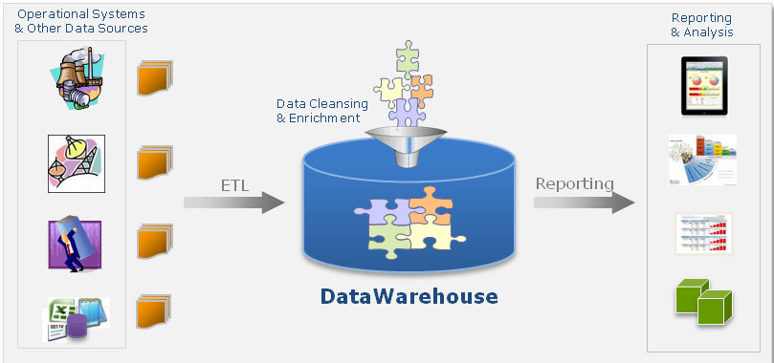
Data Warehouse

Slide 3
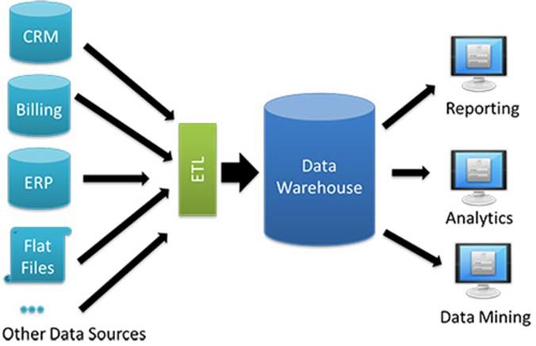

Slide 4
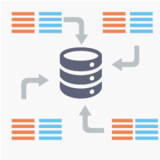
Data Warehouse
The term "Data Warehouse" was first coined by Bill Inmon in 1990.
According to Inmon, a data warehouse is a subject-oriented, integrated, time-variant, and non-volatile collection of data.
This data helps analysts to take informed decisions in an organization.

Slide 5
Data Warehouse
A data warehouse is a subject-oriented, integrated, time-variant, and non-volatile collection of data in support of management’s decision-making process (Inmon, 1993).

Slide 6
Subject-Oriented
The warehouse is organized around the major subjects of the enterprise (e.g. customers, products, and sales) rather than the major application areas (e.g. customer invoicing, stock control, and product sales).
This is reflected in the need to store decision-support data rather than application-oriented data.

Slide 7
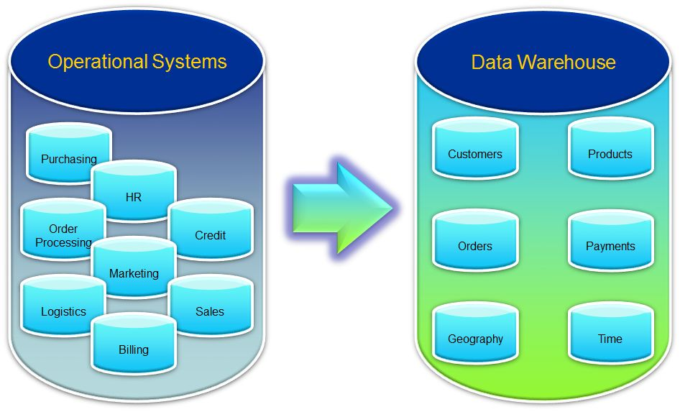
Subject-oriented
Optimized to give answers to Diverse Questions
Used by all functional areas

Slide 8
Integrated
The data warehouse integrates corporate application-oriented data from different source systems, which often includes data that is inconsistent.
The integrated data source must be made consistent to present a unified view of the data to the users.

Slide 9
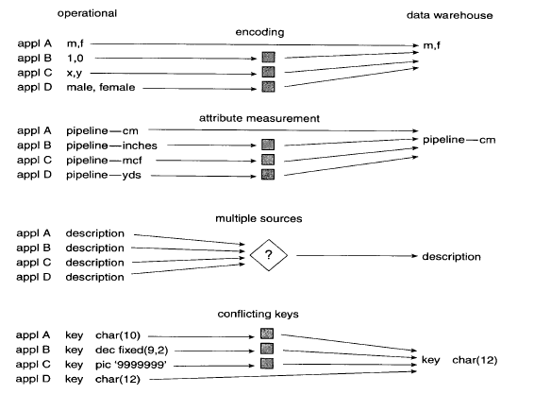
Holds data retrieved from entire organization

Slide 10
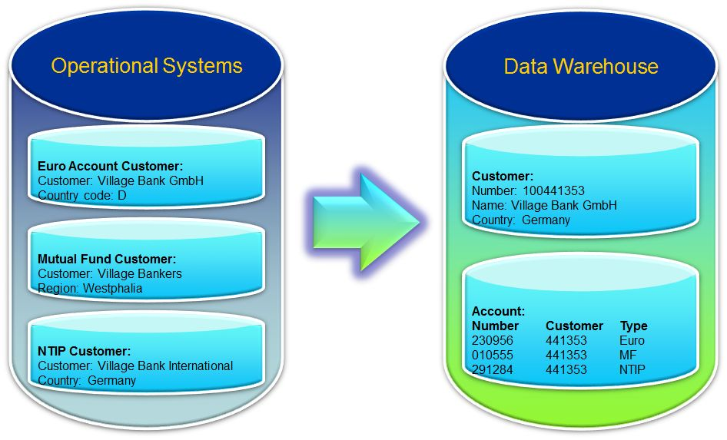
Integrated
Holds data retrieved from entire organization
Centralized

Slide 11
Time-variant data
Data in the warehouse is only accurate and valid at some point in time or over some time interval.
Time-variance is also shown in the extended time that the data is held, the implicit or explicit association of time with all data, and the fact that the data represents a series of snapshots.

Slide 12
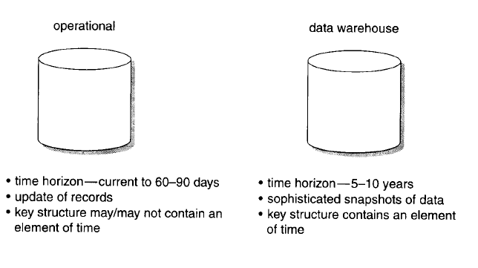

Slide 13
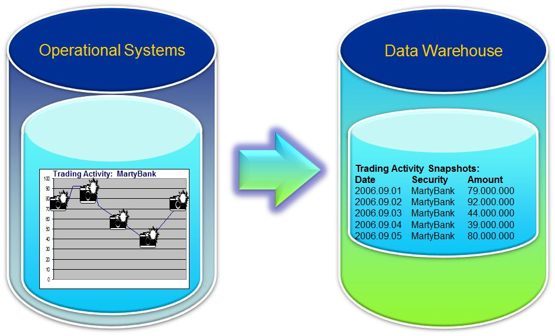
Time varient
Flow of Data Through Time

Slide 14
Non-Volatile
Data in the warehouse is not updated in real-time but is refreshed from operational systems on a regular basis.
New data is always added as a supplement to the database, rather than a replacement.

Slide 15
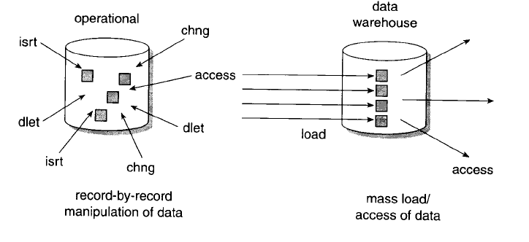
Data Never Removed

Slide 16
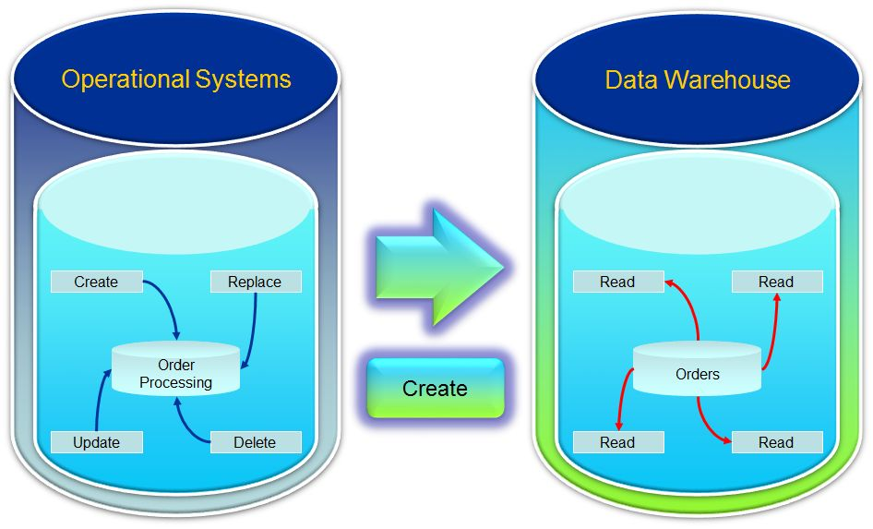
Always Growing

Slide 17
Understanding a Data Warehouse
A data warehouse is a database, which is kept separate from the organization's operational database.
There is no frequent updating done in a data warehouse.
It possesses consolidated historical data, which helps the organization to analyze its business.

Slide 18
A data warehouse helps executives to organize, understand, and use their data to take strategic decisions.
Data warehouse systems help in the integration of diversity of application systems.
A data warehouse system helps in consolidated historical data analysis.

