Slide 1
Microprocessor
Assembly Language

Slide 2
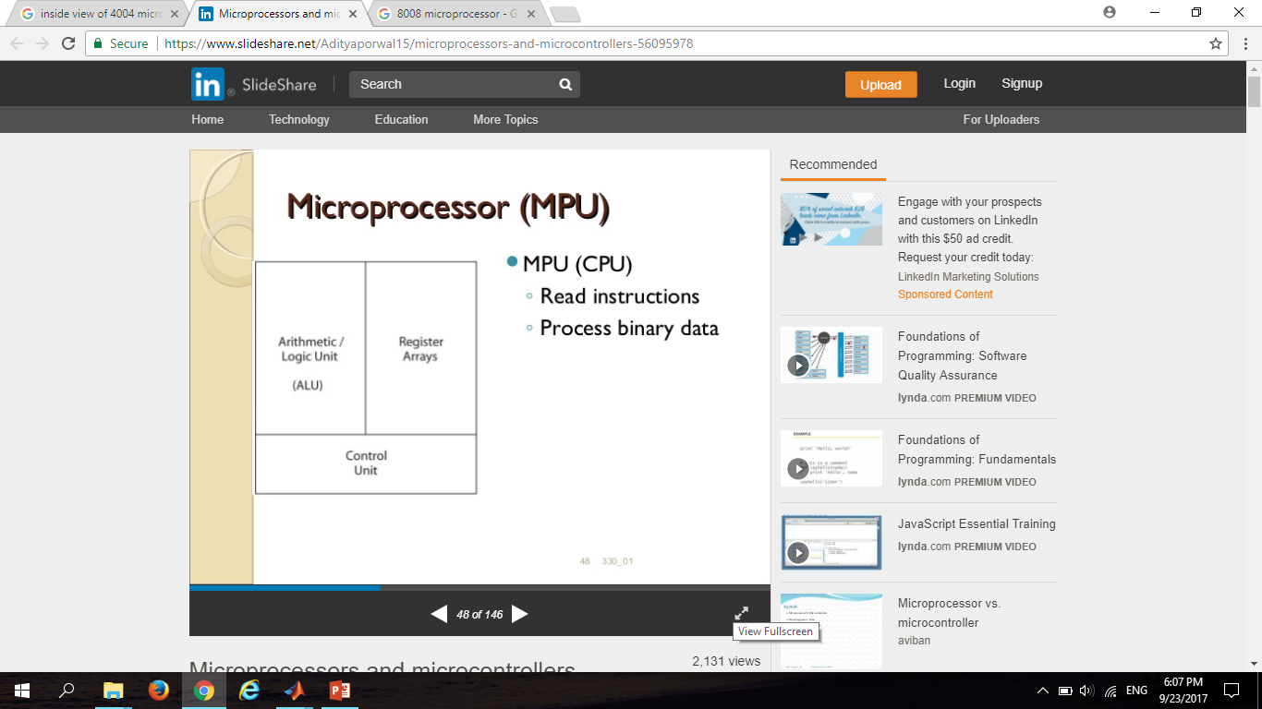
What is Microprocessor?
A microprocessor is a silicon chip that contains a CPU which is used by a computer to do its work.
The word comes from the combination micro and processor.
Read Instructions
Process Binary Data

Slide 3
Parts of Microprocessor
Arithmetic and Logic Unit
Control Unit
Registers

Slide 4
History of Intel Microprocessors
4-bit microprocessor
Intel 4004
Intel 4040
8-bit microprocessor
Intel 8008
Intel 8080
Intel 8085
16-bit microprocessor
Intel 8086
Intel 8088
Intel 80186
Intel 80188
Intel 80286
32-bit microprocessor
Intel 80386
Intel 80486
Intel Pentium
Intel Pentium II
Intel Pentium III
Intel Pentium IV
Intel dual core
64-bit microprocessor
Intel core 2
Intel core i3
Intel core i5
Intel core i7

Slide 5
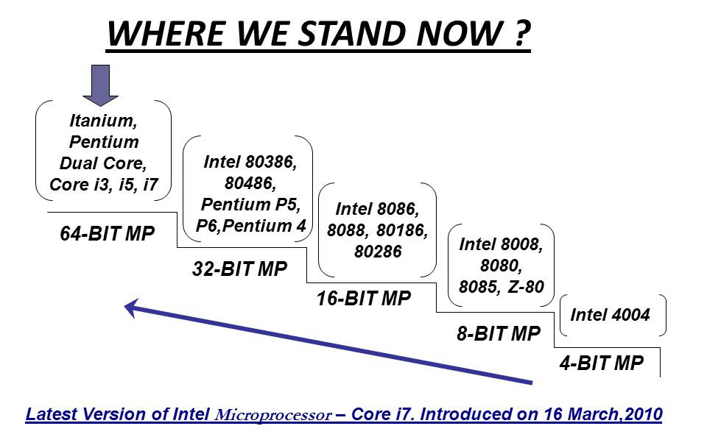

Slide 6
4 – bit Microprocessors
4004 & 4040 .
Was introduced in 1971
3000 transistors.
Clock speed was 740KHz.
640 bytes memory

Slide 7
8 – bit Microprocessors
8008, 8080, 8085 & Z-80
Was introduced in 1972
6500 transistors.
8 In / 24 Out ports
Clock speed was 5MHz
64 kilo bytes memory

Slide 8
16 – bit Microprocessors
8086, 8088, 80186, 80188 & 80286
Was introduced in 1978
135000 transistors
Clock speed was 6MHz
1 mega bytes memory

Slide 9
32 – bit Microprocessors
80386, 80486, Pentium, Pentium II, Pentium III, Pentium IV & Intel Core Duo
Was introduced in 1985
275000 transistors
Clock speed was 1.5GHz
4 giga bytes memory

Slide 10
64 – bit Microprocessors
Core 2, Intel i3, Intel i5 & Intel i7
Was introduced in 2006
1 million transistors
Clock speed was 3.33GHz
16 tera bytes memory

Slide 11
8086 Microprocessors
It has a CISC based architecture.
It has peripherals 32 I/O.
16 bit data bus
16 bit address bus
20 bit physical address bus
1 MB memory
14 registers

Slide 12
Functional Parts of 8086 Microprocessors
It is divided into two independent functional parts, the bus interface unit BIU, and the execution unit EU.
BIU handles all data and addresses on the buses for the execution unit such as it sends out addresses, fetches instructions from memory, reads and writes data to memory and calculating the address of the memory and so on.
EU tells the BIU where to fetch instructions or data from, decodes instructions and executes instructions. The functional part of EU is to control circuitry or system, instruction decoder and ALU.

Slide 13
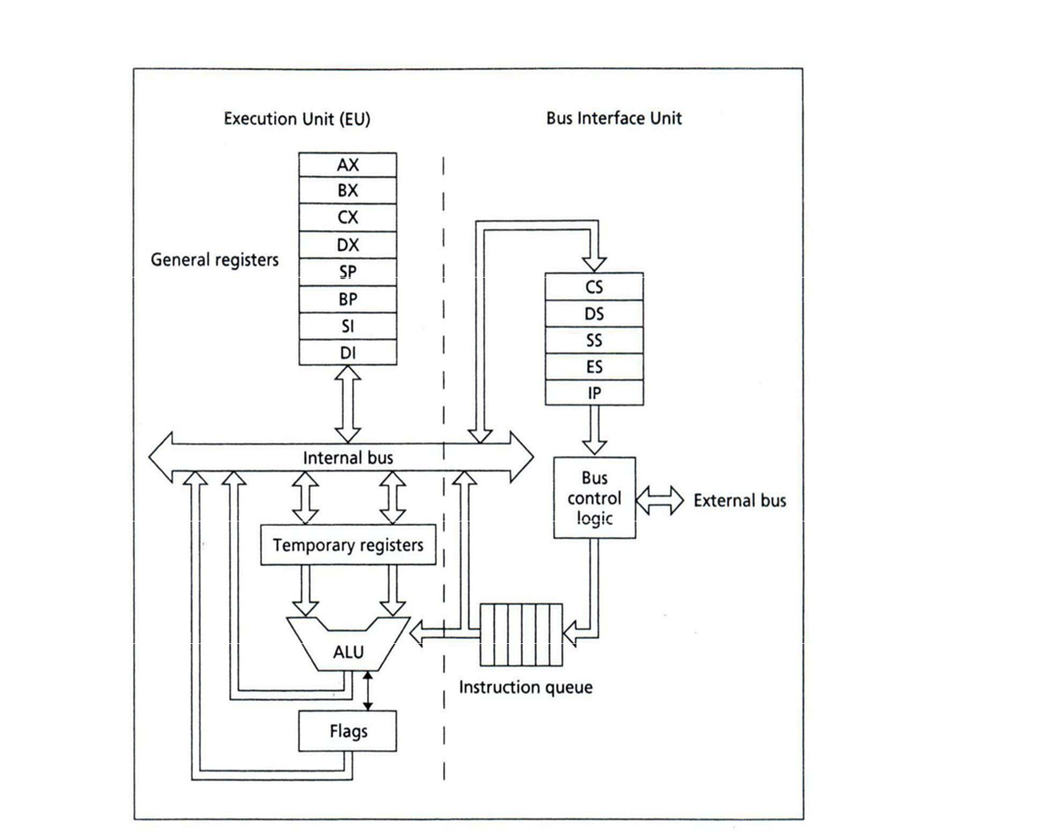

Slide 14
Registers of 8086 Microprocessors
Categories | Bits | Registers
General Purpose Register | 16 | AX, BX, CX, DX
Pointer Register | 16 | SP, BP
Index Register | 16 | SI, DI
Segment Register | 16 | CS, DS, SS, ES
Instruction Pointer | 16 | IP
Flag Register | 16 | FR

Slide 15
General Purpose Registers
AX Accumulator Register
BX Base Register
CX Count Register
DX Data Register

Slide 16
Accumulator Register
Multiplication & Division
I/O Operations
16-bit
AX
AH
AL
8-bit
8-bit

Slide 17
Base Register
Store Address Information
16-bit
BX
BH
BL
8-bit
8-bit

Slide 18
Count Register
Iterative code segments using the LOOP instruction
Repetitive operations on strings with the REP command
Count (in CL) of bits to shift and rotate
16-bit
CX
CH
CL
8-bit
8-bit

Slide 19
Data Register
Multiplication and Division.
I/O Operations.
16-bit
DX
DH
DL
8-bit
8-bit

Slide 20
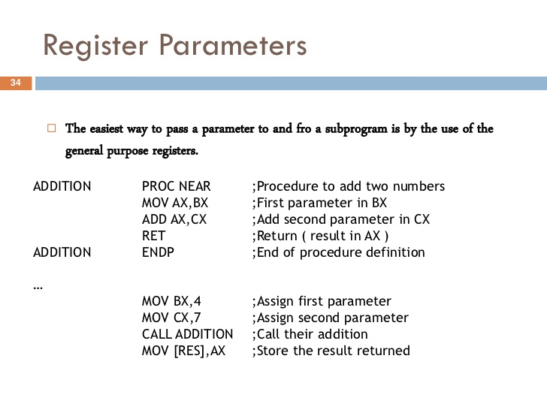
Register Parameter

Slide 21
Functional Parts of 8086 Microprocessors
ALU: It handles all Airthematic and Logical Operations like +, -, *, /, OR, AND, NOT operations.
FLAG REGISTER: It has 9 flags and they are divided into 2 groups − Conditional Flags and Control Flags.
Conditional Flag :
Parity Flag
Zero Flag
Sign Flag
Auxiliary Flag
Carry Flag
Overflow Flag
Control Flag
Trap Flag
Interrupt Flag
Direction Flag

