Slide 1
Books for Computer Architecture
Computer Architecture A Quantitative Approach By David A. Patterson & John L. Hennessy, Morgan & Kauffman Publishers, Fourth Edition.

Slide 2
Course Outline
Fundamentals of Computer Design including performance measurements & quantitative principles, principles of Instruction Set Design, Operands, addressing modes and encoding, pipelining of Processors: Issues and Hurdles, exception handling features, Instruction-Level Parallelism and Dynamic handling of Exceptions, Memory Hierarchy Design, Cache Design, Performance Issues and improvements, Main Memory Performance Issues, Storage Systems, Multiprocessors and Thread Level Parallelism. Case Studies.

Slide 3
CHAPTER - 1
Fundamental of Computer Design

Slide 4
Historical Perspective
Abacus 2000 yrs. ago
Napier’s Bones 1614
Slide Rule 1622
Schickard’s Calculating Clock 1623
Pascaline 1642
Stepped Reckoner 1673
Jacquard’s Loom 1804
Difference Engine 1822
Analytical Engine 1832
1st generation: 1942-1955 Vacuum tubes, Punch cards
2nd generation: 1955-1965 Transistors
3rd generation: 1965-1975 Integrated Circuits
4th generation: 1975-1990 Micro Chip
5th generation: 1990-onwards Artificial Intelligence

Slide 5
Introduction
Development of RISC (Reduced Instruction Set Computer) in early 1980s.
First, the virtual elimination of assembly language programming reduced the need for object-code compatibility.
Second, the creation of standardized, vendor-independent operating systems, such as UNIX and its clone, Linux, lowered the cost and risk of bringing out a new architecture.
RISC-based machine focused the attention of designers on two critical performance techniques
The exploitation of instruction level parallelism (initially through pipelining and later through multiple instruction issue)
The use of caches (initially in simple forms and later using more sophisticated organizations and optimizations).

Slide 6
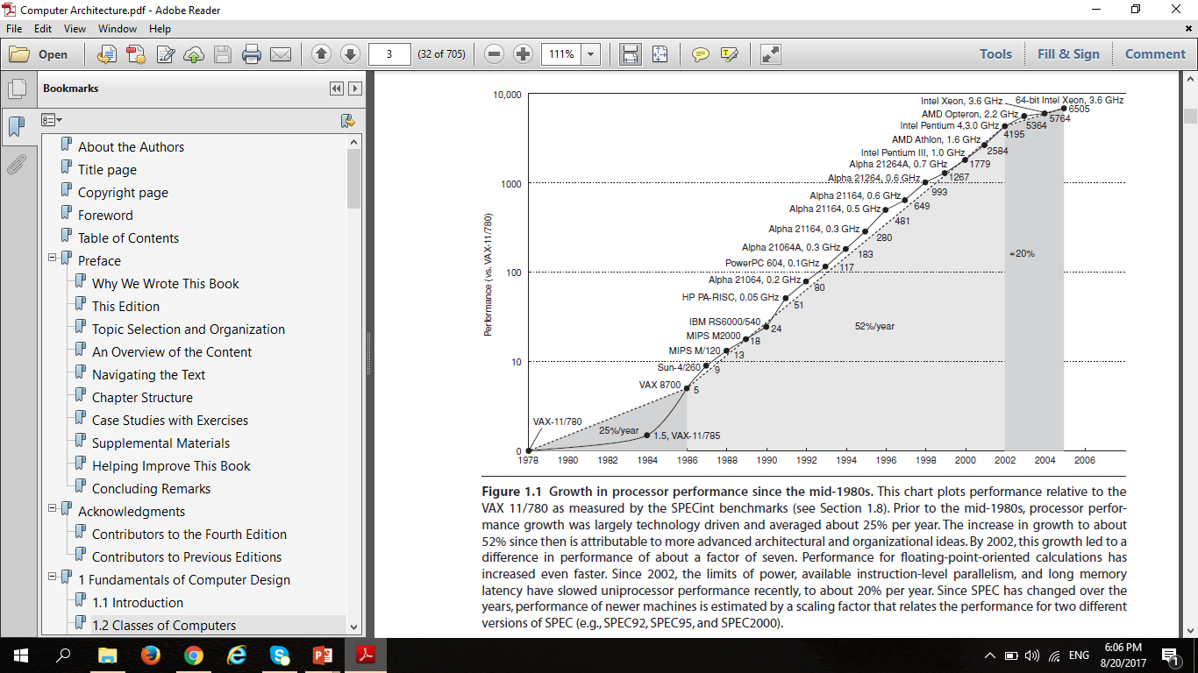
Introduction

Slide 7
Computer Organization & Computer Architecture
Organization deals with the working method of computer System But Architecture handles how working is performed by devices.
Organization Handles arrangement of Devices But Architecture Handles how devices are arranged (Connected).
Organization will depend upon technology not devices But Architecture depends upon nature of component, so different components can be in same technology.

Slide 8
Computer Organization & Computer Architecture
Organization user only knows where to give input and from where to take output But Architecture deals with actual manipulation of inputs or outputs of data from devices.
Organization is a software model But Architecture is the hardware implementation of this software model.
Organization includes physical components (Circuit design, Address, Signals, Peripherals) but Architecture includes Logic (Instruction set, Addressing modes, Data types, Cache optimization)

Slide 9
Computer Organization & Computer Architecture
By knowing organization users can only use the system ,like in languages But Architecture is used to design Systems.
Organization is how features are implemented "Control signals, interfaces, memory technology" But Architecture is those attributes visible to the programmer "Instruction set, no of bits used for data representation, I/O mechanisms, addressing techniques”.

Slide 10
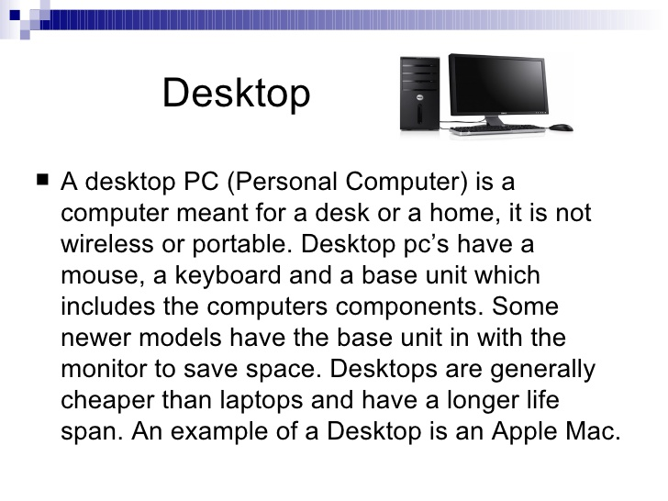
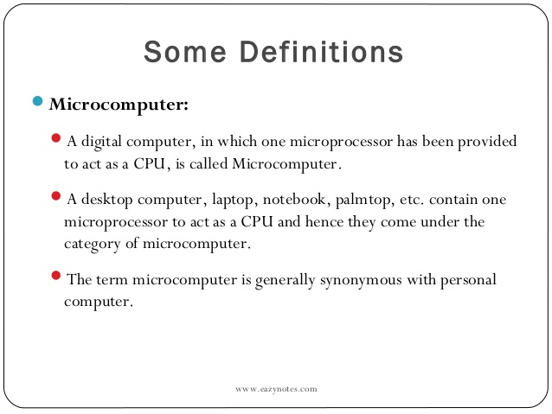
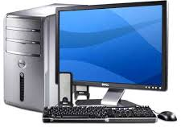
Classes of Computers
DESKTOP COMPUTERS

Slide 11
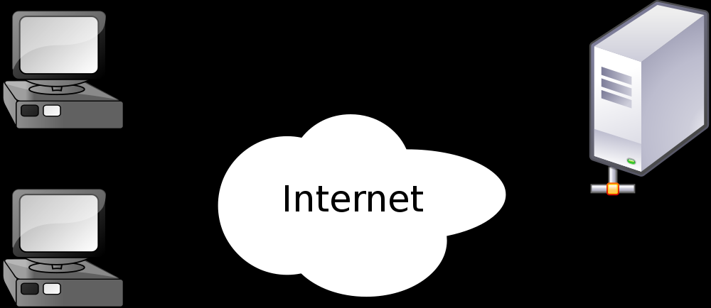
Classes of Computers
SERVERS COMPUTERS
A server is a computer program that accepts and responds to requests made by another program, known as a client. Less formally, any computer that runs server software could be considered a server as well. Servers are used to manage network resources.
It may serve data to systems on local area network (LAN) or wide area network (WAN) over the Internet. Many types of servers exist, including web servers, mail servers, and file servers.

Slide 12
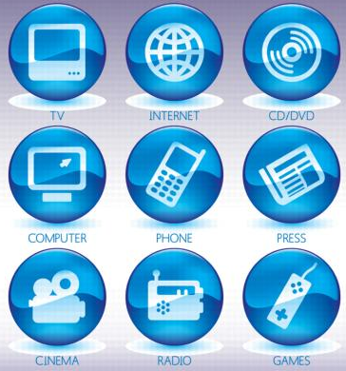
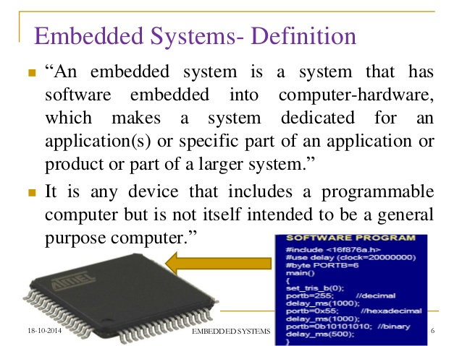
Classes of Computers
EMBEDDED COMPUTERS
Most microwaves, most washing machines, most printers, most networking switches, and all cars contain simple embedded microprocessors to handheld digital devices, such as cell phones and smart cards, to video games and digital set-top boxes.

Slide 13
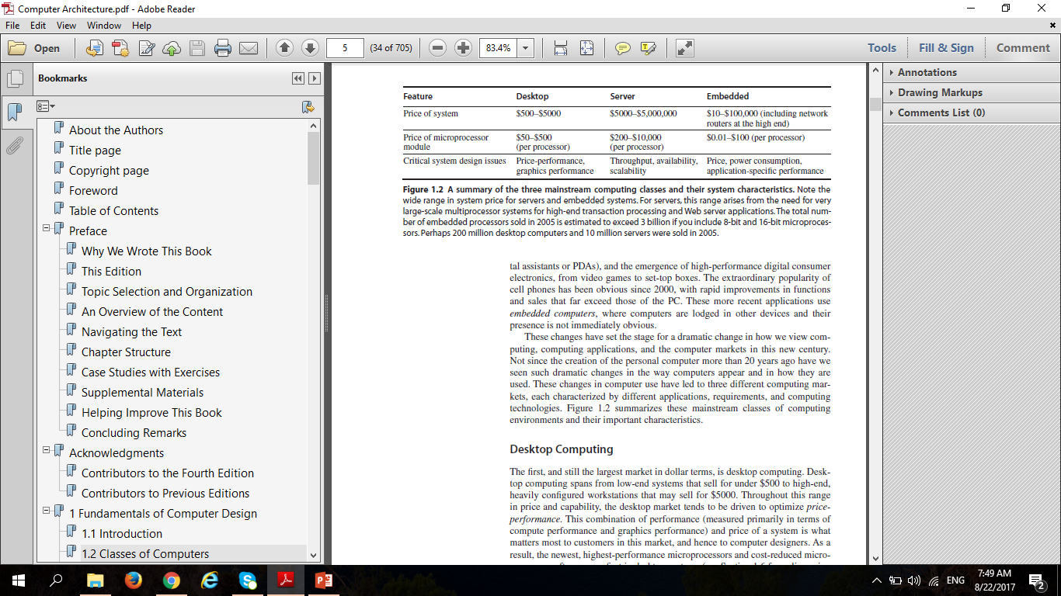
Classes of Computers

Slide 14
Instruction Set Architecture (ISA)
We use the term instruction set architecture (ISA) to refer to the actual programmer visible instruction set including the native data types, instructions, registers, addressing modes, memory architecture, interrupt and exception handling and external I/O.
E.g. R1, R2, …
E.g. MOV, ADD, INC, AND
The ISA serves as the boundary between the software and hardware.
ISA specifies the set of opcodes & native commands implemented by a particular processor.

Slide 15
Classes of Instruction Set Architecture (ISA)
There are three common classes in Instruction Set Architecture:
Stack
Accumulator Register
General Purpose Register
Stack Register is a small register in which operands are implicitly on top of the stack.
Accumulator Register is a special purpose register available in CPU which holds the operand or the result of some operation. It is a single address machine.
General Purpose Register are used to hold data and addresses before and after it is manipulated. Also used for many operation such as addition, subtraction, multiplication and logic operation.

Slide 16
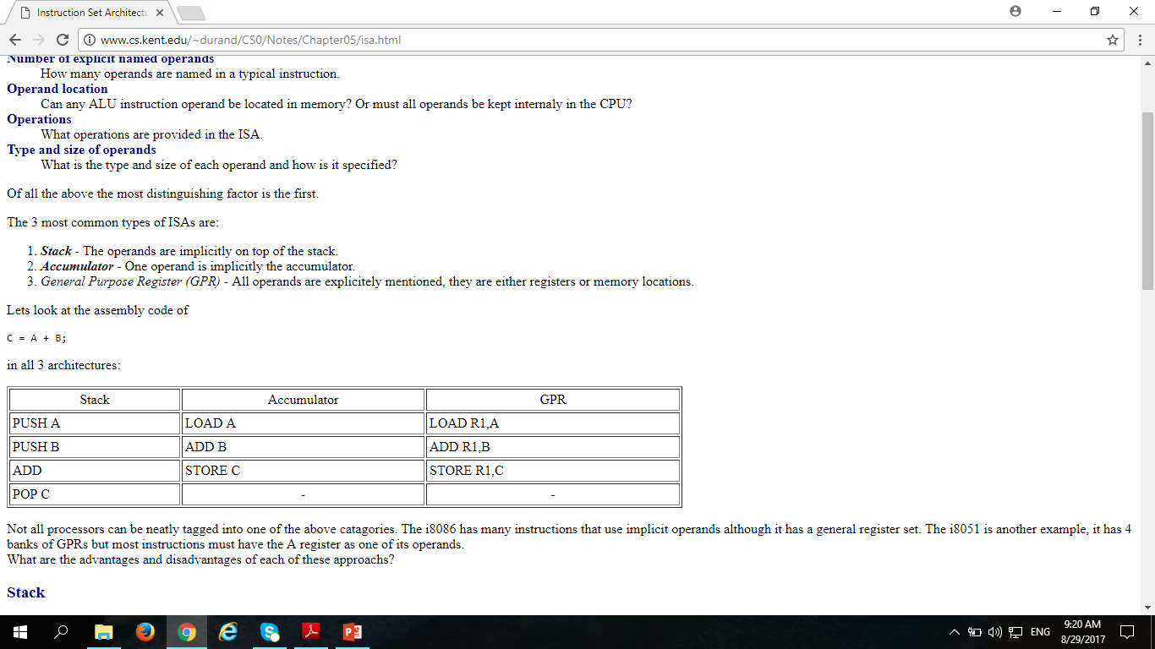
Classes of Instruction Set Architecture (ISA)

Slide 17
Classes of Instruction Set Architecture (ISA)
C = A + B
D = C – B
Stack | Accumulator | GPR
PUSH A | LOAD A | LOAD R1, A
PUSH B | ADD B | ADD R1, B
ADD | STORE C | STORE R1, C
POP C | LOAD C | LOAD R1, C
PUSH C | SUB B | SUB R1, B
PUSH B | STORE D | STORE R1, D
SUB
POP D

Slide 18
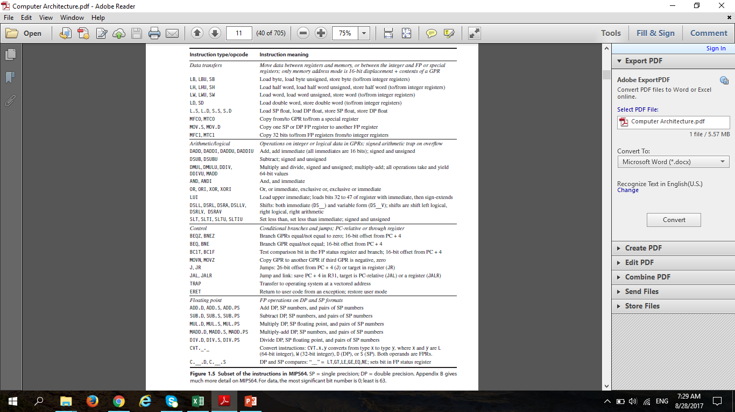

Slide 19
Classification of Instruction Set Architecture
Reduced Instruction Set Computer
Complex Instruction Set Computer
Very long Instruction Word
Explicitly Parallel Instruction Computing
Minimal Instruction Set Computer
One Instruction Set Computer

Slide 20
Reduced Instruction Set Computer
RISC is one whose instruction set architecture (ISA) has a set of attributes that allows it to have a lower cycles per instruction (CPI) than CISC. RISC architectures are also called LOAD/STORE architectures. It is a 32-bit and 64-bit microprocessor instruction set.
RISC ISAs include ARC, Alpha, Am29000, ARM, Atmel AVR, Blackfin, i860, i960, MIPS, M68000, PA-RISC, Power ISA, RISC-V, SuperH and SPARC.
One cycle execution time: RISC processors have a CPI (clock per instruction) of one cycle. This is due to the optimization of each instruction on the CPU and pipelining.
Pipelining: a technique that allows for simultaneous execution of parts, or stages, of instructions to more efficiently process instructions;
Large number of registers: the RISC design philosophy generally incorporates a larger number of registers to prevent in large amounts of interactions with memory.

Slide 21
Complex Instruction Set Computer
CISC is a processor design where single instructions can execute several low-level operations (such as a load from memory, an arithmetic operation and a memory store) or are capable of multi-step operations or addressing modes within single instructions. This is because early computer architects tried to bridge the so-called semantic gap, i.e. to design instruction sets that directly supported high-level programming constructs such as procedure calls, loop control, and complex addressing modes, allowing data structure and array accesses to be combined into single instructions.
Examples are Intel x86, IBM Z-Series Mainframes, Older CPU architectures

Slide 22
RISC vs. CISC
RISC | CISC
Instructions of same set with few formats | Multiple instruction sizes and formats
It requires registers. | It access memory directly
Fewer addressing modes | More addressing modes
Complexity in compiler | Extensive use of microprogramming
Instruction take one cycle time | Instruction take a varying amount of cycle time
Pipelining is easy. | Pipelining is difficult
More transistors used for storing instructions | Transistors used for storing instructions which are complex
Code size is longer but number of cycle are less | Code size is smaller but number of cycle are more.

Slide 23
Very long Instruction Word
Very Long Instruction word (VLIW) describe a computer processing architecture in which a language compiler or pre processor breaks program instruction down into basic operations that can be performed by the processor in parallel. (i.e. at the same time).
Multiple operations are packed into one instruction.
Each operation slot is for a fixed function
The Crusoe family of processors uses VLIW that are assembled by a pre-processor that is located in a flash memory chip.

Slide 24
Explicitly Parallel Instruction Computing
EPIC (Explicitly Parallel Instruction Computing) is a 64-bit microprocessor instruction set, jointly defined and designed by Hewlett Packard and Intel, that provides up to 128 general and floating point unit registers.
Smaller code size than VLIW, larger than x86/RISC
Examples are Intel Merced / Itanium
The Itanium family of processors uses EPIC

Slide 25
Minimal Instruction Set Computer
Minimal Instruction Set Computer (MISC) is a processor architecture with a very small number of basic operations and corresponding opcodes. Such instruction sets are commonly stack-based rather than register-based to reduce the size of operand specifiers.
MISC architecture have much in common with the Fourth programming language, and the Java Virtual Machine. Probably the most commercially successful MISC was the INMOS transputer.

Slide 26
One Instruction Set Computer
Sometimes called an ultimate reduced instruction set computer (URISC)
An abstract machine that uses only one instruction
With a judicious choice for the single instruction and given infinite resources, an OISC is capable of being a universal computer in the same manner as traditional computers that have multiple instructions
OISC have been recommended as aids in teaching computer architecture and have been used as computational models in structural computing research.

Slide 27
Trends in Technology
If an instruction set architecture is to be successful, it must be designed to survive rapid changes in computer technology.
To plan for the evolution of a computer, the designer must be aware of rapid changes in implementation technology. Four implementation technologies, which change at a dramatic pace, are critical to modern implementations:
Integrated Circuit Logic Technology
Semiconductor DRAM
Magnetic Disk Technology
Network Technology

Slide 28
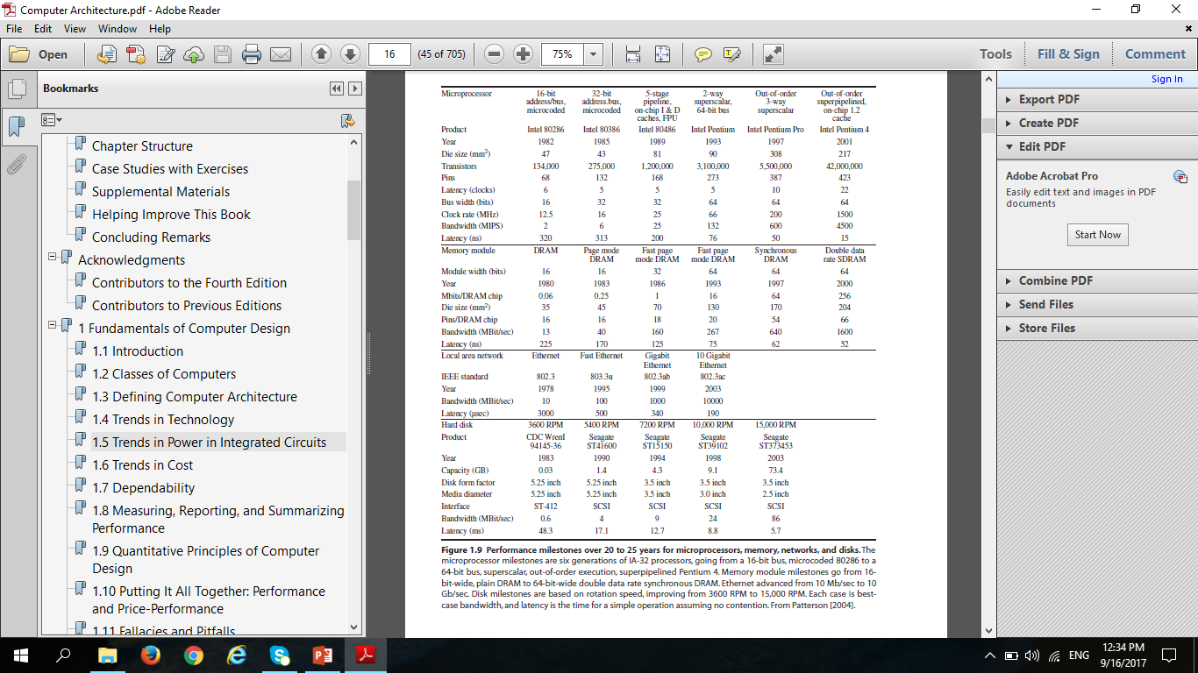
Trends in Performance

