Slide 1
Books for Computer Architecture
Computer Architecture A Quantitative Approach By David A. Patterson & John L. Hennessy, Morgan & Kauffman Publishers, Fourth Edition.

Slide 2
Course Outline
Fundamentals of Computer Design including performance measurements & quantitative principles, principles of Instruction Set Design, Operands, addressing modes and encoding, pipelining of Processors: Issues and Hurdles, exception handling features, Instruction-Level Parallelism and Dynamic handling of Exceptions, Memory Hierarchy Design, Cache Design, Performance Issues and improvements, Main Memory Performance Issues, Storage Systems, Multiprocessors and Thread Level Parallelism. Case Studies.

Slide 3
CHAPTER - 1
Fundamental of Computer Design

Slide 4
Historical Perspective
Abacus 2000 yrs. ago
Napier’s Bones 1614
Slide Rule 1622
Schickard’s Calculating Clock 1623
Pascaline 1642
Stepped Reckoner 1673
Jacquard’s Loom 1804
Difference Engine 1822
Analytical Engine 1832
1st generation: 1942-1955 Vacuum tubes, Punch cards
2nd generation: 1955-1965 Transistors
3rd generation: 1965-1975 Integrated Circuits
4th generation: 1975-1990 Micro Chip
5th generation: 1990-onwards Artificial Intelligence

Slide 5
Introduction
Development of RISC (Reduced Instruction Set Computer) in early 1980s.
First, the virtual elimination of assembly language programming reduced the need for object-code compatibility.
Second, the creation of standardized, vendor-independent operating systems, such as UNIX and its clone, Linux, lowered the cost and risk of bringing out a new architecture.
RISC-based machine focused the attention of designers on two critical performance techniques
The exploitation of instruction level parallelism (initially through pipelining and later through multiple instruction issue)
The use of caches (initially in simple forms and later using more sophisticated organizations and optimizations).

Slide 6
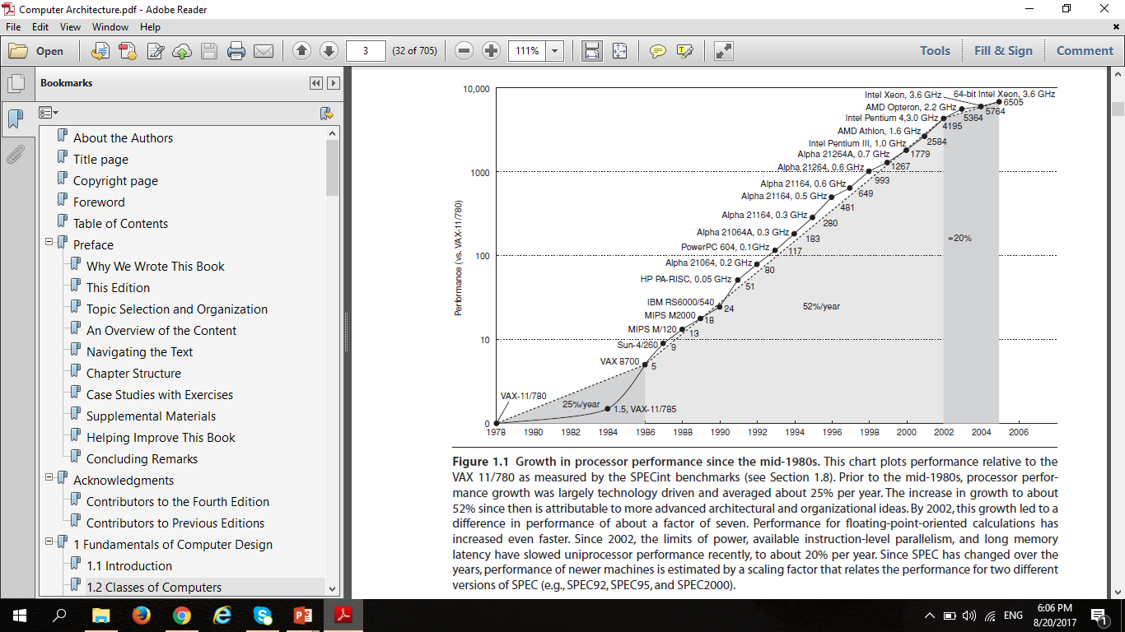
Introduction

Slide 7
Computer Organization & Computer Architecture
Organization deals with the working method of computer System But Architecture handles how working is performed by devices.
Organization Handles arrangement of Devices But Architecture Handles how devices are arranged (Connected).
Organization will depend upon technology not devices But Architecture depends upon nature of component, so different components can be in same technology.

Slide 8
Computer Organization & Computer Architecture
Organization user only knows where to give input and from where to take output But Architecture deals with actual manipulation of inputs or outputs of data from devices.
Organization is a software model But Architecture is the hardware implementation of this software model.
Organization includes physical components (Circuit design, Address, Signals, Peripherals) but Architecture includes Logic (Instruction set, Addressing modes, Data types, Cache optimization)

Slide 9
Computer Organization & Computer Architecture
By knowing organization users can only use the system ,like in languages But Architecture is used to design Systems.
Organization is how features are implemented "Control signals, interfaces, memory technology" But Architecture is those attributes visible to the programmer "Instruction set, no of bits used for data representation, I/O mechanisms, addressing techniques”.

Slide 10
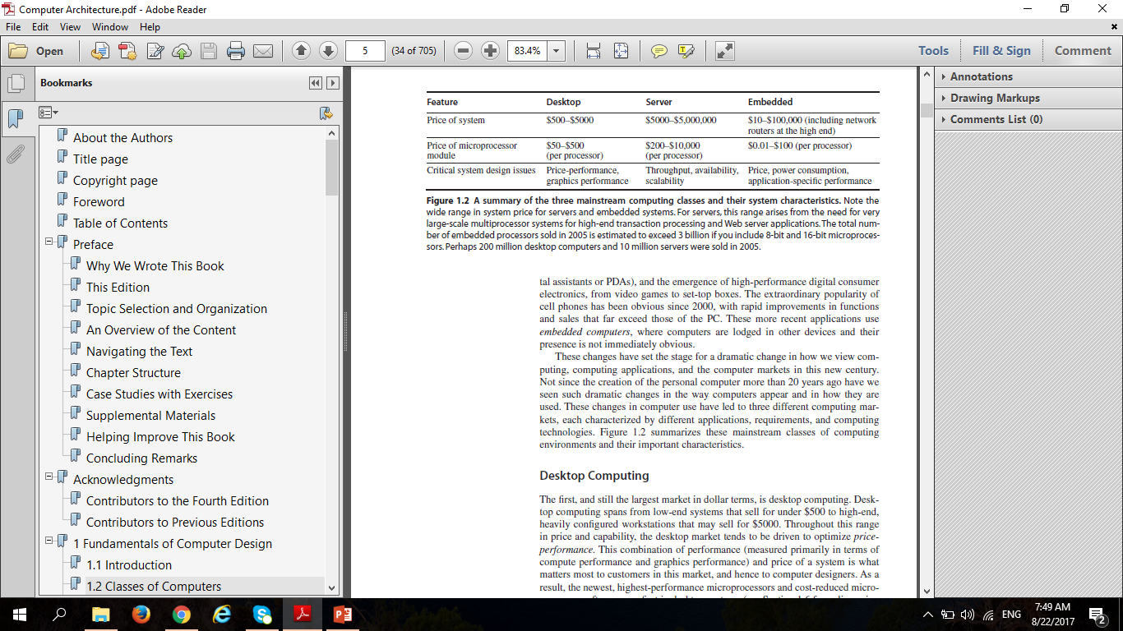
Classes of Computers

Slide 11
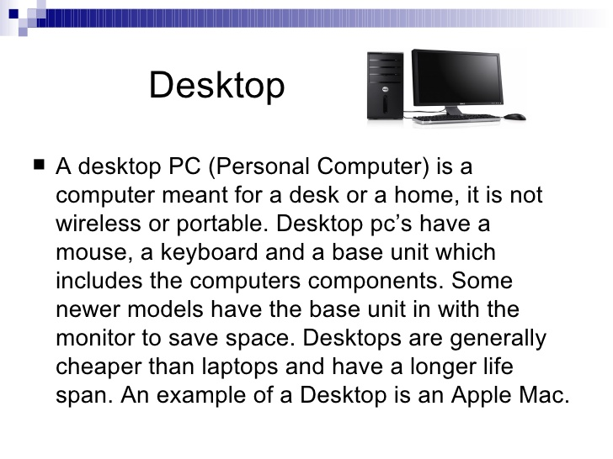

Classes of Computers
DESKTOP COMPUTERS
SERVERS COMPUTERS

Slide 12
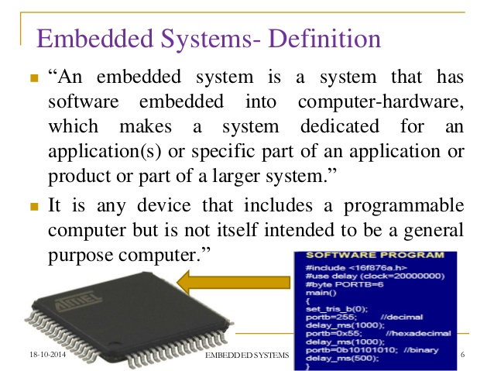
Classes of Computers
EMBEDDED COMPUTERS

