Slide 1
Assembly Language Programming in 8086 Microprocessor
Assembly Language

Slide 2
Program Conversion in CPU
High Level Language
Compiler
Assembly Code
Assembler
Object File (Contains Source Code )
Linker
Library File
Machine Code
Hardware

Slide 3
Addressing Modes
2 + 2
2 and 2 are operands
+ is an opcode (operational code).
In Assembly Language, Opcode would be come before registers
Registers Addressing – Both operands are registers
Immediate Addressing – One operand is constant term
Memory Addressing – Access static data directly

Slide 4
Data Transfer Instruction
MOV Instruction
The MOV instruction is the most important command in the 8086 because it moves data from one location to another
It also has the widest variety of parameters; so if the assembler programmer can use MOV effectively, the rest of the commands are easier to understand.
Example: MOV DL , 2
MOV Ah , 2

Slide 5
Service Routine
1 = input a character with echo
2 = Output or print a character
8 = Input a character without echo
9 = Output or print collection of characters (String)
4ch = Exit

Slide 6
Interrupt
Stop the current program and allow microprocessor to access hardware to take input or give output.
INT 21H = Interrupt for text handling
INT 20H for video or graphic handling
Example :
MOV Ah, 2 INT 21H | MOV Ah, 1 INT 21H | MOV Ah, 8 INT 21H

Slide 7
ASCII Code
American Standard Code for Information Interchange
Character Encoding Scheme
By American Standards Association
Published in 1963
A = 65 to Z = 90
a = 97 to z = 122
0 = 48 to 9 = 57

Slide 8
Program Structure
.Model memory-model
Reserve the space of the Assembly code in RAM.
Enables use of simplified segments
Determine the size of Code Segment and Data Segment
Memory Models | Code Size | Data Size
Tiny | Code <=32KB | Data <=32KB
Small | Code <=64KB | Data <=64KB
Medium | Code = Any size | Data <=64KB
Compact | Code <=64KB | Data = Any size
Large | Code = Any size | Data = Any size
Huge | Code = Any size | Data = Any size

Slide 9
Program Structure
.Stack size
Reserve 256 bytes of stack space
Specifies the storage for stack where the size is optional.
Default is 1024 bytes
Tells the assembler to define a runtime stack for the program
.Data
Define an area in memory for the program data
Program’s variables should be defined under this directive
Assembler will allocate and initialize the storage of variables in the data segment in the memory

Slide 10
Program Structure
.Code
Define the code section of a program containing executable instructions
Assembler will place the instructions in the code segment in the memory
Main procedure-name
Collection of instructions to which we can direct the flow of our program.
Once the flow of the program has been transferred and the procedure is done, One can return to the next line
dosseg
It is a DOS segment which manage all the arrangement of segments in a program, if in case we have forgot to write in programs in a sequence

Slide 11
Sample Program
.model small ;Model Directive
.stack 100h ;Stack Segment Directive
.data ;Data Segment Directive
.code ;Code Segment Directive
Main proc ;Procedure call
Main endp ;Procedure end
End Main ;Program exit

Slide 12
Syntax Rules
Space after Opcode
One operand must be general purpose register
Operands must be of same size
Comma between operands
Mov ‘B’, ‘A’ X
Mov 2, 3 X
Mov dl, AX X
Mov dl, ‘A’ √
Mov dx, AX √
Mov dh, al √
Mov dh, 3 √

Slide 13
Program to print a single character on screen?
dosseg
.model small
.stack 100h
.data
.code
Main proc
Mov dl, ‘A’
Mov ah, 2
Int 21h
Mov ah, 4ch
Int 21h
Main endp
End Main

Slide 14
Program to print a single character on screen?
dosseg
.model small
.stack 100h
.data
.code
Main proc
Mov ah, 1
Int 21h
Mov dl, al
Mov ah, 2
Int 21h
Mov ah, 4ch
Int 21h
Main endp
End Main

Slide 15
Program to print collection of characters on screen?
dosseg
.model small
.stack 100h
.data
msg db ‘Hello World$’
.code
Main proc
Mov ax, @data
Mov ds, ax
LEA dx, msg
Mov ah, 9
Int 21h
Mov ah, 4ch
Int 21h
Main endp
End Main

Slide 16
Program to print your name with character on screen?
dosseg
.model small
.stack 100h
.data
.code
Main proc
Mov dl, ‘S’
Mov ah, 2
Int 21h
Mov dl, ‘A’
Mov ah, 2
Int 21h
Mov dl, ‘L’
Mov ah, 2
Int 21h
Mov dl, ‘W’
Mov ah, 2
Int 21h
Mov dl, ‘A’
Mov ah, 2
Int 21h
Mov ah, 4ch
Int 21h
Main endp
End Main

Slide 17
Program to add two numbers?
dosseg
.model small
.stack 100h
.data
.code
Main proc
Mov bl, 1
Mov cl, 2
Add bl, cl
Add bl, 48
Mov dl, bl
Mov ah, 2
Int 21h
Mov ah, 4ch
Int 21h
Main endp
End Main

Slide 18
Program to subtract two numbers?
dosseg
.model small
.stack 100h
.data
.code
Main proc
Mov bl, 3
Mov cl, 1
Sub bl, cl
Add bl, 48
Mov dl, bl
Mov ah, 2
Int 21h
Mov ah, 4ch
Int 21h
Main endp
End Main

Slide 19
Program to take input of two numbers and add them?
dosseg
.model small
.stack 100h
.data
.code
Main proc
Mov ah, 1
Int 21h
Mov bl, al
Mov ah, 1
Int 21h
Add bl, al
Sub bl, 48
Mov dl, bl
Mov ah, 2
Int 21h
Mov ah, 4ch
Int 21h
Main endp
End Main

Slide 20
Program to take input of two numbers and subtract them?
dosseg
.model small
.stack 100h
.data
.code
Main proc
Mov ah, 1
Int 21h
Mov bl, al
Mov ah, 1
Int 21h
Sub bl, al
Add bl, 48
Mov dl, bl
Mov ah, 2
Int 21h
Mov ah, 4ch
Int 21h
Main endp
End Main

Slide 21
Program to convert capital letter into small letter?
dosseg
.model small
.stack 100h
.data
.code
Main proc
Mov ah, 1
Int 21h
Mov dl al
Add dl, 32
Mov ah, 2
Int 21h
Mov ah, 4ch
Int 21h
Main endp
End Main

Slide 22
Variables in programs
Variables are defined in .data directive in Assembly language of program structure.
The method to initialized variable in program would be
Write Variable-Name first.
Then, write Data-Size.
Then, write Value in single quotation‘ ’.
Syntax: Variable-Name Data-Size ‘Value’

Slide 23
Variable-Name in .data directive
Variable-Name is the identifier for each storage space.
Don’t use reserved keyword as Variable-Name
AL, BL, CL, DL, …. X
SUB, ADD, MUL, DIV, …. X
MOV, LEA, PUSH, POP, …. X
Always use keyword like Var1, Var2, …. msg1, msg2, ….

Slide 24

Data-Size in .data directive
Data-Size, also called Initialize directive which is used for reserving storage space for variables.
It can be used to reserve as well as initialize one or more bytes.
Directive | Purpose | Storage Space
db | Define Byte | 1 byte or 8 bits
dw | Define Word | 2 bytes or 16 bits
dd | Define Double Word | 4 bytes or 32 bits
dq | Define Quad Word | 8 bytes or 64 bits
dt | Define Ten Bytes | 10 bytes or 80 bits

Slide 25
Data-Size in .data directive
Each byte of character is stored as its ASCII value in hexadecimal.
? sign shows that there is nothing assigned in .data directive and you have to initialized in .code directive
$ sign, also called terminator must be used in end of the string.
Variable-Name | Data-Size | Value
Var1 | db | 49
Var1 | db | ‘1’
Var1 | db | ‘A’
Var1 | db | ?
Var1 | db | ‘1234$’

Slide 26
Program to print multiple variables on screen?
dosseg
.model small
.stack 100h
.data
Var1 db ‘1’
Var2 db ?
Var3 db ‘1234$’
.code
Main proc
Mov ax, @data
Mov ds, ax
Mov dl, Var1
Mov ah, 2
Int 21h
Mov Var2, bl
LEA dx, Var3 OR Mov dx, Offset Var3
Mov ah, 9
Int 21h
Mov ah, 4ch
Int 21h
Main endp
End Main

Slide 27
Program to print two different strings on two different lines
dosseg
.model small
.stack 100h
.data
msg1 db ‘HELLO$’
msg2 db ‘WORLD$’
.code
Main proc
Mov ax, @data
Mov ds, ax
LEA dx, msg1
Mov ah, 9
Int 21h
Mov dx, 10 ;NEW LINE FEED
Mov ah, 2
Int 21h
Mov dx, 13 ;CARRIAGE RETURN
Mov ah, 2
Int 21h
LEA dx, msg2
Mov ah, 9
Int 21h
Mov dx, 10
Mov ah, 2
Int 21h
Mov dx, 13
Mov ah, 2
Int 21h
Mov ah, 4ch
Int 21h
Main endp
End Main

Slide 28
Loops in programs
Series of instructions that is repeated until a terminating condition is reached is called Loop.
Counter Register CX is used as a loop counter.
Before the series of instruction, give the name at the beginning which is called Label.
Example:
LabelName: Identification of the below series of instructions
Mov dx, ‘a’
Mov ah, 2
Int 21h
Loop LabelName Loop is calling the series of instruction here

Slide 29
Label rules in programs
Label can be placed at the beginning of a statement, because the label is assigned the current value of line.
Label name must not be a reserved keyword. E.g. Mov, Add, DB, DW etc.
Colon : must be used with Label while initializing, but not while calling.

Slide 30
Program to print 0 to 9 numbers
dosseg
.model small
.stack 100h
.data
.code
Main proc
Mov cx, 10
Mov dx, 48
Label1:
Mov ah, 2
Int 21h
Inc dx OR Add dx, 1
Loop Label1
Mov ah, 4ch
Int 21h
Main endp
End Main

Slide 31
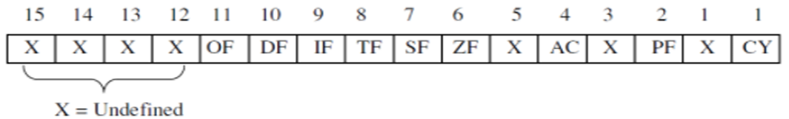
Flag Register
Holds the current status of the processor.
Controls the operations of CPU.
It consists of 9 bit active flags out of 16 bit. The remaining 7 bit flags marked ‘X’ are undefined flags. These 9 flags are of two types:
6 Status flags
3 Control flags

Slide 32
Status Flag
Carry Flag: This flag holds the carry after addition and holds the borrow after subtraction. This flag is set to 1 when there is an unsigned overflow and 0 when there is no overflow.
Parity Flag: This flag is normally used to verify the validity of transferred data. This flag is set to 1 when there is even number of 1 bits in result and 0 when there is odd number of 1 bits in result.
Auxiliary Flag: This flag is set to 1 when there is a carry from lower nibble to high nibble (3 bits) exist and 0 when there is a borrow from a high nibble to low nibble (3 bits) doesn’t exist.
Zero Flag: This flag is set to 1 when result is zero and 0 when result is non-zero.
Sign Flag: This flag is used when signed of two operands is changed in result. This flag is set to 1 if result is negative (signed interpretation) and 0 if result is positive.
Overflow Flag: This flag is set when result of signed operation overflows or underflows the destination operand. This flag is set to 1 when there is a signed overflow and 0 when there is no overflow.

Slide 33
Control Flag
Trap Flag: This flag is used to find the errors and bugs in system. This flag is set to 1 when single step mode (debugging) is needed and 0 when single step mode (debugging) is not needed.
Interrupt Flag: This flag is used to disable or enable the interrupts (INT). This flag is set to 1 when interrupt is called and 0 when interrupt is not called.
Direction Flag: This flag is used by some instructions to process data chains. This flag is set to 1 when the processing is done backward and 0 when the processing is done forward.

Slide 34
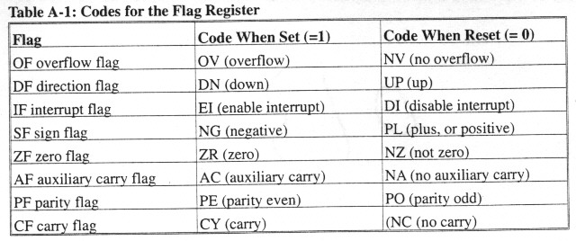
Codes for Flag Register

Slide 35
Flag Register Example
11010 1111 1111 0000
1101 0111 1011 1001
1101 0111 0111 1010
1010 1111 0011 0011
CF = 1
PF = 1
AF = 1
ZF = 0
SF = 1
OF = 1

Slide 36
Exercise
Find SF,ZF,PF,CF,AF,OF of the following instructions:
0010001101000101+0011001000011001=
0101010000111001+0100010101101010=
11110101+00001011=
92+197=
-10100100-10111011=

Slide 37
Assignment
Write a program to print lower case letter to upper case letter?

Slide 38
Jumps Instruction
Jump instruction allow the CPU to take decision according to information provided by the flag register.
It is also to be said as an instruction to control the program flow.
There are two types of jumps
Unconditional Jump
Conditional Jump
Example; Label1:INC ax
…
… do processing
Jmp Label1
This is an infinite loop without some way to exit out in the “do processing” code

Slide 39
Compare Instruction
Compare instruction subtracts operand one from operand two, but does not store the result, only changes the flag.
Syntax: Cmp reg1, reg2 Cmp dl, al
Cmp reg, constant Cmp dl, ‘3’
Cmp reg, [memory address] Cmp dl, [si]
Compare does not change the destination register value

Slide 40
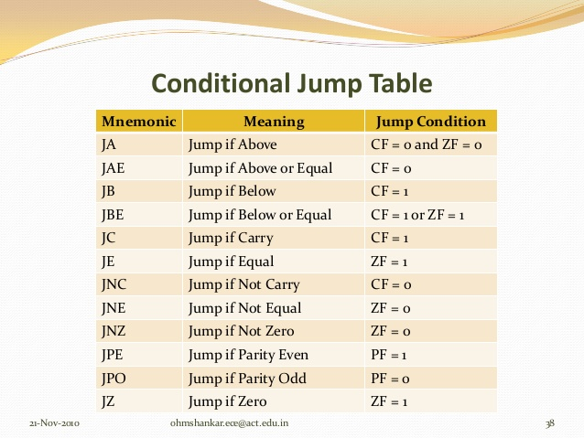
Conditional Jump Table

Slide 41
Unconditional Jump:
Jump to label without any condition
Syntax: JMP Label_name
Example: L1:
Mov dl, ‘a’
Mov ah, 2
Int 21h
Jmp L1
Mov ah, 4ch
Int 21h

Slide 42
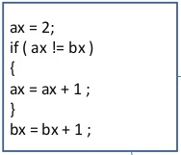
Conditional Jump:
Jump to label when condition occur
Syntax: Opcode Label_name
Example: L1:
Mov ah, 1
Int 21h
Mov dl, 3
Cmp al, dl
JE L1
Mov ah, 4ch
Int 21h
L1:
Mov ax, 2
Sub ax, bx
JZ L1
INC ax
INC bx
Mov ah, 4ch
Int 21h

Slide 43
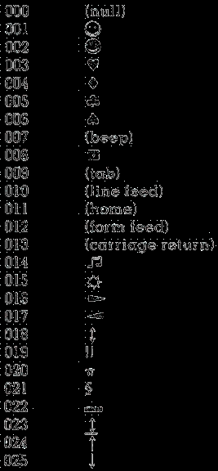
Conditional Jump:
Main proc
Mov cx, 26 ;NUMBER OF CHARACTERS DISPLAY FROM 0 TO 25 Mov dl, 0 ;dl HAS ASCII CODE OF NULL CHARACTER
L1:
Mov ah, 2 ;DISPLAY A CHARACTER
Int 21h
INC dl ;INCREMENT IN dl
DEC cx ;DECREMENT IN cx
JNZ L1
Mov ah, 4ch
Int 21h
Main Endp
End Main

Slide 44
Program to compare two numbers which is less than and print string ‘Condition is True’
dosseg
.model small
.stack 100h
.data
msg db ‘Condition is True$’
.code
Main proc
Mov ax, @data
Mov ds, ax
Mov al, 45
Mov bl, 50
Cmp al, bl
JL Jump
Jump:
LEA dx, msg
Mov ah, 9
Int 21h
Mov ah, 4ch
Int 21h
Main endp
End Main

Slide 45
Program to compare two numbers(1st is given & 2nd is user’s input) and print string ‘Number is Equal’ if it is equal and if it is not equal print string ‘Number is not Equal’
dosseg
.model small
.stack 100h
.data
msg1 db ‘Number is Equal$’
msg2 db ‘Number is not Equal$’
.code
Main proc
Mov ax, @data
Mov ds, ax
Mov dl, ‘3’
Mov ah, 1
Int 21h
Cmp al, dl
JE Equal
LEA dx, msg2
Mov ah, 9
Int 21h
Mov ah, 4ch
Int 21h
Equal:
LEA dx, msg1
Mov ah, 9
Int 21h
Mov ah, 4ch
Int 21h
Main endp
End Main

Slide 46
Array in programs
Collection of characters in sequence is called an array.
We need to learn array in assembly language to store many characters with single variable name in sequence in memory.
Array is defined in .data directive in Assembly language of program structure.
The method to initialized array in program would be the same as variable but with multiple values
Write Variable-Name first.
Then, write Data-Size.
Then, write Values.
Syntax: Variable-Name Data-Size Values

Slide 47
Array in programs
Arr1 db 1,2,3,4 √
Arr1 db ‘a’,’b’,’c’ √
Arr1 db ‘abc’ √
Arr1 db ‘a’,’a’,’a’… Χ
Arr1 db ‘aaa…’ Χ
Arr1 db ?,?,?,?… Χ

Slide 48
DUP instruction in programs
DUP means to duplicate the data.
The data in parenthesis could be initialized or uninitialized.
The method to initialized dup in program
Write Variable-Name first.
Then, write Data-Size.
Then, write Number of characters.
Then, write Duplicate instruction.
Then, write Value in parenthesis().
Syntax: Variable-Name Data-Size No. of Character Duplicate Instruction (Values)

Slide 49
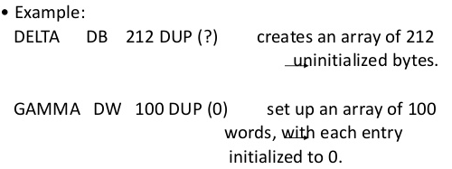
DUP instruction in programs

Slide 50
Program to print an array from number 1 to 4 manually
dosseg
.model small
.stack 100h
.data
array db 1,2,3,4
.code
Main proc
Mov ax, @data
Mov ds, ax
Mov si, offset array
Mov dx, [si]
Mov ah, 2
Int 21h
Inc si
Mov dx, [si]
Mov ah, 2
Int 21h
Inc si
Mov dx, [si]
Mov ah, 2
Int 21h
Inc si
Mov dx, [si]
Mov ah, 2
Int 21h
Mov ah, 4ch
Int 21h
Main endp
End Main

Slide 51
Program to print an array from number 1 to 4 using loop
dosseg
.model small
.stack 100h
.data
array db 1,2,3,4
.code
Main proc
Mov ax, @data
Mov ds, ax
Mov si, offset array
Mov cx, 4
L1:
Mov dx, [si]
Mov ah, 2
Int 21h
Inc si
Loop L1
Mov ah, 4ch
Int 21h
Main endp
End Main

Slide 52
Program to print input string using conditional and unconditional jumps
dosseg
.model small
.stack 100h
.data
array db 100 dup(‘$’) ;ARRAY OF 100 ‘$’
.code
Main proc
Mov ax, @data
Mov ds, ax
Mov si, offset array ;ACCESS AN ARRAY
L1:
Mov ah, 1
Int 21h
Cmp al, 13 ;COMPARE USER INPUT TO ENTER KEY
JE Program_End
Mov [si], al ;SEND ARRAY TO SOURCE INDEX REGISTER
Inc si
Jmp L1
Program_End:
Mov dx, offset array
Mov ah, 9
Int 21h
Mov ah, 4ch
Int 21h
Main endp
End Main

Slide 53
Assignment
Write a program to print an array of 1,2,3,a using loop?

Slide 54
Program to add five integers of array and print it
dosseg
.model small
.stack 100h
.data
array db 25,12,15,31,43
sum db 0
.code
Main proc
Mov ax, @data
Mov ds, ax
Mov ax, 0
Mov cx, 5
Mov si, offset array
L1:
Add al, [si]
Inc si
Dec cx
JNE L1
Mov sum, al
Mov dl, sum
Mov ah, 2
Int 21h
Mov ah, 4ch
Int 21h
Main endp
End Main
126 ~

Slide 55
Program to add two integers and print it
dosseg
.model small
.stack 100h
.data
Num1 db 9
Num2 db 7
Result ?
.code
Main proc
Mov ax, @data
Mov ds, ax
Mov al, Num1
Mov bl, Num2
Add al, bl
Mov Result, al
Mov dl, Result
Mov ah, 2
Int 21h
Mov ah, 4ch
Int 21h
Main endp
End Main
16 ►

Slide 56
Program to read two numbers and print the smallest number of the two
.data
Num1 db ?
Num2 db ?
msg1 db 10,13,”ENTER FIRST NUMBER TO COMPARE=$”
msg2 db 10,13,”ENTER SECOND NUMBER TO COMPARE=$”
msg3 db 10,13,”SMALLEST NUMBER=$”
.code
Main proc
Mov ax, @data
Mov ds, ax
Lea dx, msg1
Mov ah,9
Int 21h
Mov ah, 1
Int 21h
Mov Num1, al
Lea dx, msg2
Mov ah,9
Int 21h
Mov ah, 1
Int 21h
Mov Num2, al
Lea dx, msg3
Mov ah,9
Int 21h
Mov al, Num1
Cmp al, Num2
JG Second
First:
Mov ah, 2
Mov dl, Num1
Int 21h
Jmp Exit
Second:
Mov ah, 2
Mov dl, Num2
Int 21h
Exit:
Mov ah, 4ch
Int 21h
Main endp
End Main

