Slide 1

The Web: the http protocol
http: hypertext transfer protocol
Web’s application layer protocol
client/server model
  client: browser that requests, receives, “displays” Web objects
  server: Web server sends objects in response to requests
http1.0: RFC 1945
http1.1: RFC 2068
http request
PC running
Explorer
http response
http request
Server
running
Apache Web
server
http response
Mac running
Navigator
Rensselaer Polytechnic Institute Shivkumar Kalvanaraman, Biplab Sikdar

Slide 2
The http protocol: more
http is “stateless”
server maintains no information about past client requests
http: TCP transport service:
client initiates TCP connection (creates socket) to server, port 80
server accepts TCP connection from client
http messages (application-layer protocol messages) exchanged between browser (http client) and Web server (http server)
TCP connection closed
aside
Protocols that maintain “state” are complex!
past history (state) must be maintained
if server/client crashes, their views of “state” may be inconsistent, must be reconciled
Rensselaer Polytechnic Institute Shivkumar Kalvanaraman, Biplab Sikdar

Slide 3
http example
Suppose user enters URL www. School.edu/Department/home.index
(contains text,
references to 10
jpeg images)
1a. http client initiates TCP connection to http server (process) at www. School.edu. Port 80 is default for http server.
1b. http server at host www. School.edu waiting for TCP connection at port 80. “accepts” connection, notifying client
2. http client sends http request message (containing URL) into TCP connection socket
3. http server receives request message, forms response message containing requested object (Department/home.index), sends message into socket
time
Rensselaer Polytechnic Institute Shivkumar Kalvanaraman, Biplab Sikdar

Slide 4
http example (cont.)
4. http server closes TCP connection.
5. http client receives response message containing html file, displays html. Parsing html file, finds 10 referenced jpeg objects
time
6. Steps 1-5 repeated for each of 10 jpeg objects
Rensselaer Polytechnic Institute Shivkumar Kalvanaraman, Biplab Sikdar

Slide 5
Non-persistent and persistent connections
Non-persistent
HTTP/1.0
server parses request, responds, and closes TCP connection
2 RTTs to fetch each object
Each object transfer suffers from slow start
Persistent
default for HTTP/1.1
on same TCP connection: server, parses request, responds, parses new request,..
Client sends requests for all referenced objects as soon as it receives base HTML.
Fewer RTTs and less slow start.
But most 1.0 browsers use
parallel TCP connections.
Rensselaer Polytechnic Institute Shivkumar Kalvanaraman, Biplab Sikdar

Slide 6
http message format: request
two types of http messages: request, response
http request message:
  ASCII (human-readable format)
request line
(GET, POST,
HEAD commands)
GET /somedir/page.html HTTP/1.0
User-agent: Mozilla/4.0
Accept: text/html, image/gif,image/jpeg
Accept-language:fr
(extra carriage return, line feed)
header
lines
Carriage return,
line feed
indicates end
of message
Rensselaer Polytechnic Institute Shivkumar Kalvanaraman, Biplab Sikdar

Slide 7

http request message: general format
Rensselaer Polytechnic Institute Shivkumar Kalvanaraman, Biplab Sikdar

Slide 8
http message format: response
status line
(protocol
status code
status phrase)
HTTP/1.0 200 OK
Date: Thu, 06 Aug 1998 12:00:15 GMT
Server: Apache/1.3.0 (Unix)
Last-Modified: Mon, 22 Jun 1998 …...
Content-Length: 6821
Content-Type: text/html
data data data data data ...
header
lines
data, e.g.,
requested
html file
Rensselaer Polytechnic Institute Shivkumar Kalvanaraman, Biplab Sikdar

Slide 9
http response status codes
In first line in server->client response message.
A few sample codes:
200 OK
  request succeeded, requested object later in this message
301 Moved Permanently
  requested object moved, new location specified later in this message (Location:)
400 Bad Request
  request message not understood by server
404 Not Found
  requested document not found on this server
505 HTTP Version Not Supported
Rensselaer Polytechnic Institute Shivkumar Kalvanaraman, Biplab Sikdar

Slide 10
User-server interaction: cookies
server sends “cookie” to client in response msg
  Set-cookie: 1678453
client presents cookie in later requests
  cookie: 1678453
server matches presented-cookie with server-stored info
  authentication
  remembering user preferences
client
server
usual http request msg
usual http response +
Set-cookie: #
usual http request msg
cookie: #
cookie-
spectific
action
usual http response msg
usual http request msg
cookie: #
cookie-
spectific
action
usual http response msg
Rensselaer Polytechnic Institute Shivkumar Kalvanaraman, Biplab Sikdar

Slide 11
User-server interaction: conditional GET
Goal: don’t send object if client has up-to-date stored (cached) version
client: specify date of cached copy in http request
  If-modified-since: <date>
server: response contains no object if cached copy up-to-date:
  HTTP/1.0 304 Not Modified
client
server
http request msg
If-modified-since: <date>
object
not
modified
http response
HTTP/1.0
304 Not Modified
http request msg
If-modified-since: <date>
object
modified
http response
HTTP/1.1 200 OK
…
<data>
Rensselaer Polytechnic Institute Shivkumar Kalvanaraman, Biplab Sikdar

Slide 12
Web Caches (proxy server)
Goal: satisfy client request without involving origin server
user sets browser: Web accesses via web cache
client sends all http requests to web cache
  if object at web cache, web cache immediately returns object in http response
  else requests object from origin server, then returns http response to client
origin
server
Proxy
server
http request
http request
client
http response
http response
http request
http request
http response
http response
client
origin
server
Rensselaer Polytechnic Institute Shivkumar Kalvanaraman, Biplab Sikdar

Slide 13
Why Web Caching?
Assume: cache is “close” to client (e.g., in same network)
smaller response time: cache “closer” to client
decrease traffic to distant servers
  link out of institutional/local ISP network often bottleneck
origin
servers
public
Internet
1.5 Mbps
access link
institutional
network
10 Mbps LAN
institutional
cache
Rensselaer Polytechnic Institute Shivkumar Kalvanaraman, Biplab Sikdar

Slide 14
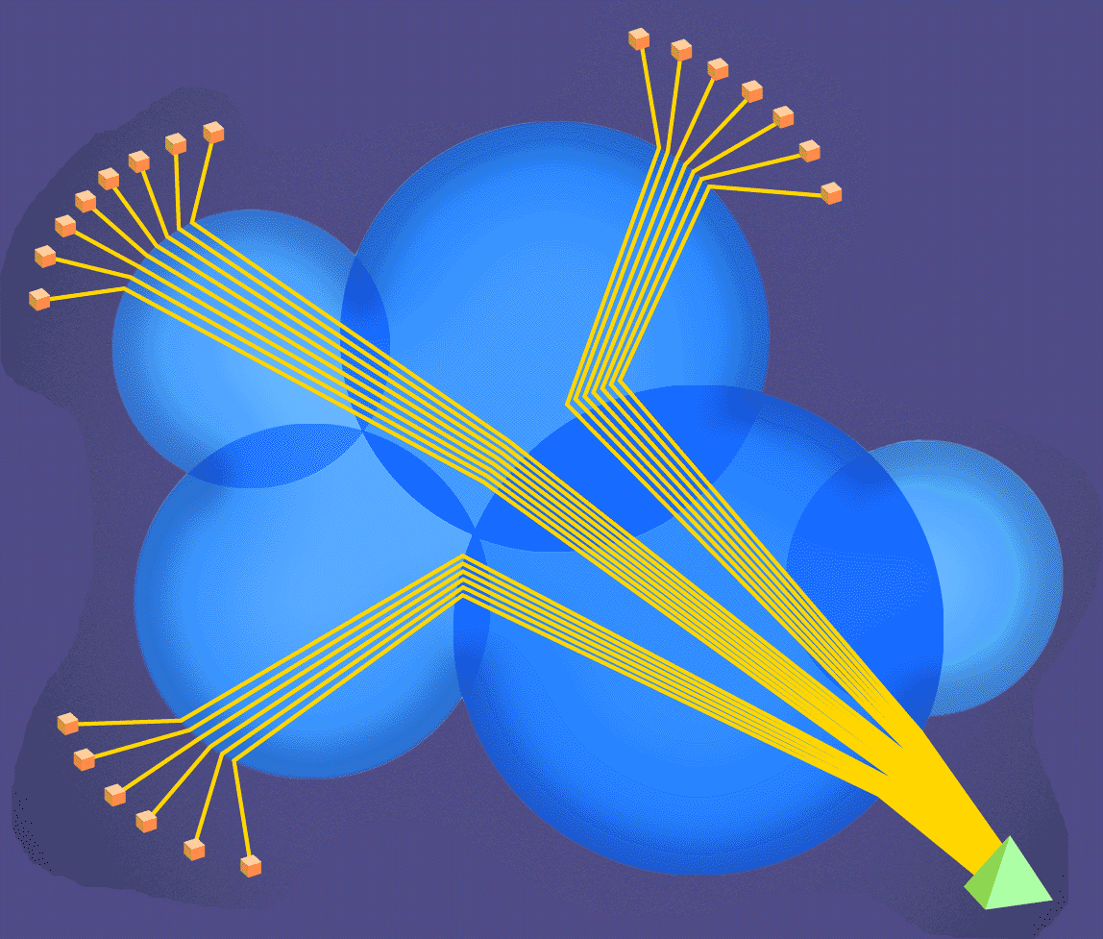
Content Delivery: motivation
Networks
Browsers
Web Server
Rensselaer Polytechnic Institute Shivkumar Kalvanaraman, Biplab Sikdar

Slide 15
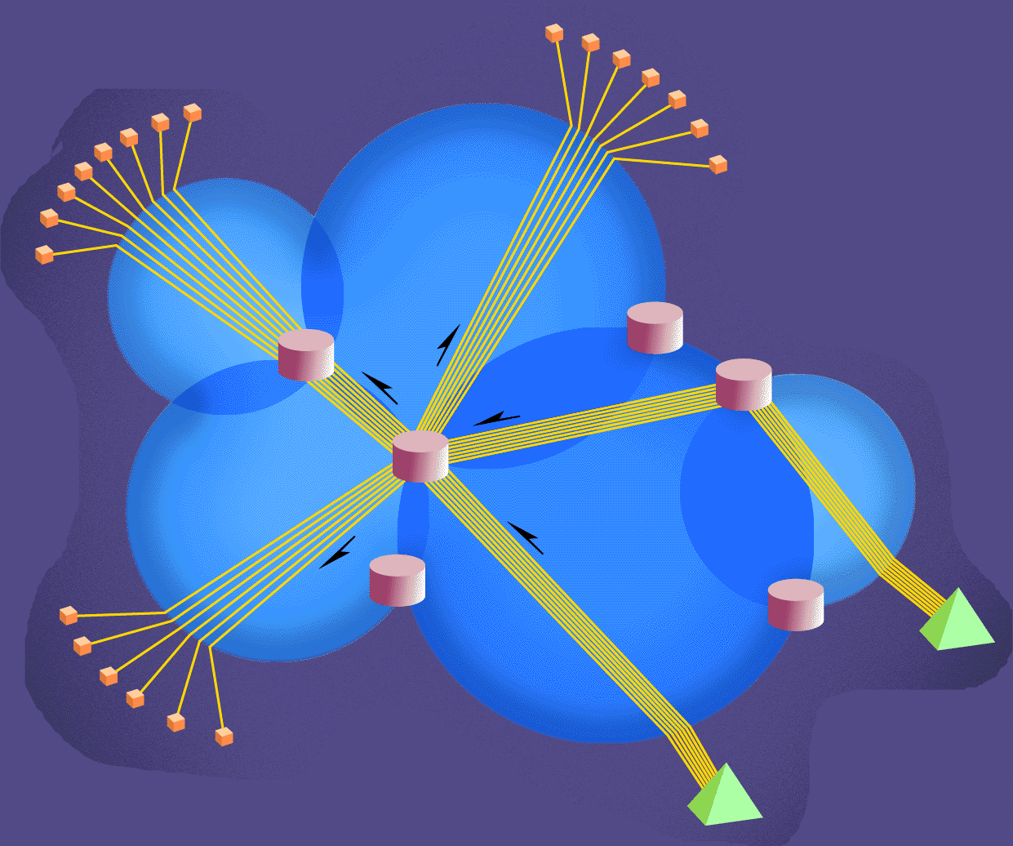
Content Delivery: congestion
Networks
Browsers
Routers
Rensselaer Polytechnic Institute Shivkumar Kalvanaraman, Biplab Sikdar
Web Servers

Slide 16
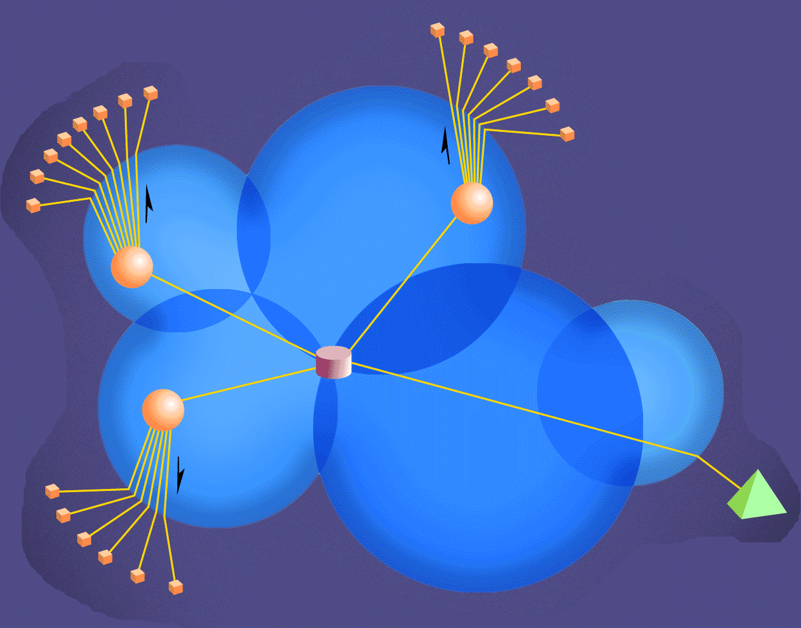
Content Delivery: idea
Reduces load on server
Avoids network congestion
“Inverse” Web Caching
Browsers
Replicated
content
Content Sink
Router
Content Source
Web Server
Rensselaer Polytechnic Institute Shivkumar Kalvanaraman, Biplab Sikdar

Slide 17

ftp: the file transfer protocol
FTP
user
interface
FTP
client
file transfer
FTP
server
user
at host
local file
system
remote file
system
transfer file to/from remote host
client/server model
  client: side that initiates transfer (either to/from remote)
  server: remote host
ftp: RFC 959
ftp server: port 21
Rensselaer Polytechnic Institute Shivkumar Kalvanaraman, Biplab Sikdar

Slide 18
ftp: separate control, data connections
ftp client contacts ftp server at port 21, specifying TCP as transport protocol
two parallel TCP connections opened:
  control: exchange commands, responses between client, server.
    “out of band control”
  data: file data to/from server
ftp server maintains “state”: current directory, earlier authentication
TCP control connection
port 21
FTP
client
TCP data connection
port 20
FTP
server
Rensselaer Polytechnic Institute Shivkumar Kalvanaraman, Biplab Sikdar

Slide 19
ftp commands, responses
Sample commands:
sent as ASCII text over control channel
USER username
PASS password
LIST returns list of file in current directory
RETR filename retrieves (gets) file
STOR filename stores (puts) file onto remote host
Sample return codes
status code and phrase (as in http)
331 Username OK, password required
125 data connection already open; transfer starting
425 Can’t open data connection
452 Error writing file
Rensselaer Polytechnic Institute Shivkumar Kalvanaraman, Biplab Sikdar

