Slide 1
Merge Sort

Slide 2
Divide And Conquer
Merging a two lists of one element each is the same as sorting them.
Merge sort divides up an unsorted list until the above condition is met and then sorts the divided parts back together in pairs.
Specifically this can be done by recursively dividing the unsorted list in half, merge sorting the right side then the left side and then merging the right and left back together.

Slide 3
Merging
The key to Merge Sort is merging two sorted lists into one, such that if you have two lists X (x₁≤x₂≤…≤x_{m}) and Y(y₁≤y₂≤…≤y_{n}) the resulting list is Z(z₁≤z₂≤…≤z_{m+n})
Example:
L₁ = { 3 8 9 } L₂ = { 1 5 7 }
merge(L₁, L₂) = { 1 3 5 7 8 9 }

Slide 4
Merging (cont.)
X:
3 | 10 | 23 | 54
Y:
1 | 5 | 25 | 75
Result:

Slide 5
Merging (cont.)
X:
3 | 10 | 23 | 54
Y:
 | 5 | 25 | 75
Result:
1

Slide 6
Merging (cont.)
X:
 | 10 | 23 | 54
Y:
 | 5 | 25 | 75
Result:
1 | 3

Slide 7
Merging (cont.)
X:
 | 10 | 23 | 54
Y:
 |  | 25 | 75
Result:
1 | 3 | 5

Slide 8
Merging (cont.)
X:
 |  | 23 | 54
Y:
 |  | 25 | 75
Result:
1 | 3 | 5 | 10

Slide 9
Merging (cont.)
X:
 |  |  | 54
Y:
 |  | 25 | 75
Result:
1 | 3 | 5 | 10 | 23

Slide 10
Merging (cont.)
X:
 |  |  | 54
Y:
 |  |  | 75
Result:
1 | 3 | 5 | 10 | 23 | 25

Slide 11
Merging (cont.)
X:
Y:
 |  |  | 75
Result:
1 | 3 | 5 | 10 | 23 | 25 | 54

Slide 12
Merging (cont.)
X:
Y:
Result:
1 | 3 | 5 | 10 | 23 | 25 | 54 | 75

Slide 13
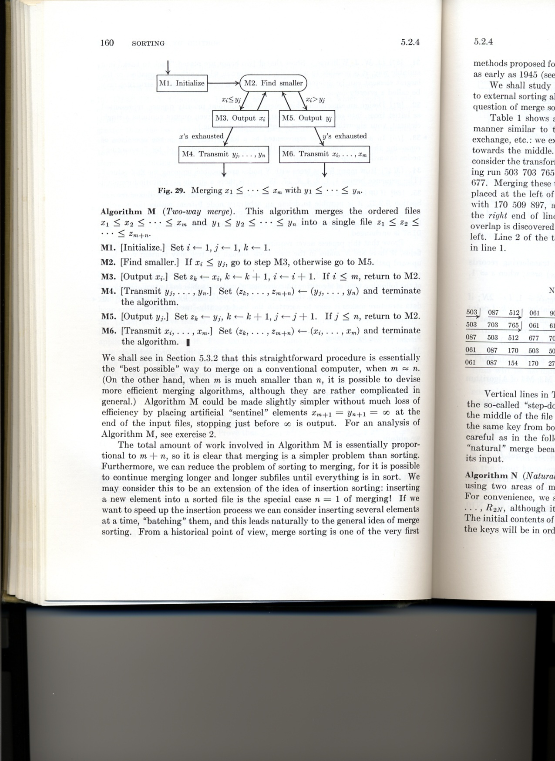
Merging (cont.)

Slide 14
Merge Sort Algorithm
Given a list L with a length k:
If k == 1 → the list is sorted
Else:
Merge Sort the left side (0 thru k/2)
Merge Sort the right side (k/2+1 thru k)
Merge the right side with the left side

Slide 15
Merge Sort Example
99 | 6 | 86 | 15 | 58 | 35 | 86 | 4 | 0

Slide 16
Merge Sort Example
99 | 6 | 86 | 15 | 58 | 35 | 86 | 4 | 0
99 | 6 | 86 | 15
58 | 35 | 86 | 4 | 0

Slide 17
Merge Sort Example
99 | 6 | 86 | 15 | 58 | 35 | 86 | 4 | 0
99 | 6 | 86 | 15
58 | 35 | 86 | 4 | 0
99 | 6
86 | 15
58 | 35
86 | 4 | 0

Slide 18
Merge Sort Example
99 | 6 | 86 | 15 | 58 | 35 | 86 | 4 | 0
99 | 6 | 86 | 15
58 | 35 | 86 | 4 | 0
99 | 6
86 | 15
58 | 35
86 | 4 | 0
99
6
86
15
58
35
86
4 | 0

Slide 19
Merge Sort Example
99 | 6 | 86 | 15 | 58 | 35 | 86 | 4 | 0
99 | 6 | 86 | 15
58 | 35 | 86 | 4 | 0
99 | 6
86 | 15
58 | 35
86 | 4 | 0
99
6
86
15
58
35
86
4 | 0
4
0

Slide 20
Merge Sort Example
99
6
86
15
58
35
86
0 | 4
Merge
4
0

Slide 21
Merge Sort Example
6 | 99
15 | 86
35 | 58
0 | 4 | 86
99
6
86
15
58
35
86
0 | 4
Merge

Slide 22
Merge Sort Example
6 | 15 | 86 | 99
0 | 4 | 35 | 58 | 86
6 | 99
15 | 86
35 | 58
0 | 4 | 86
Merge

Slide 23
Merge Sort Example
0 | 4 | 6 | 15 | 35 | 58 | 86 | 86 | 99
6 | 15 | 86 | 99
0 | 4 | 35 | 58 | 86
Merge

Slide 24
Merge Sort Example
0 | 4 | 6 | 15 | 35 | 58 | 86 | 86 | 99

Slide 25
Implementing Merge Sort
There are two basic ways to implement merge sort:
In Place: Merging is done with only the input array
Double Storage: Merging is done with a temporary array of the same size as the input array.

Slide 26
Heap Sort

Slide 27
Goals
To explore the implementation, testing and performance of heap sort algorithm

Slide 28
What is a “heap”?
Definitions of heap:
A large area of memory from which the programmer can allocate blocks as needed, and de-allocate them (or allow them to be garbage collected) when no longer needed
A balanced, left-justified binary tree in which no node has a value greater than the value in its parent
Heapsort uses the second definition

Slide 29
Heap
A heap is a data structure that stores a collection of objects, and has the property that
Complete Binary tree
Node is larger than its every child
It is implemented as an array where each node in the tree corresponds to an element of the array.

Slide 30
Size and depth
The size of a binary tree is the number of nodes in it
This tree has size 12
The depth of a node is its distance from the root
a is at depth zero
e is at depth 2
The depth of a binary tree is the depth of its deepest node
This tree has depth 4
a
b
c
d
e
f
g
h
i
j
k
l

Slide 31
Balanced binary trees
Recall:
The depth of a node is its distance from the root
The depth of a tree is the depth of the deepest node
A binary tree of depth n is balanced if all the nodes at depths 0 through n-2 have two children
n-2
n-1
n
Balanced
Balanced
Not balanced

Slide 32
Which one is a balanced binary tree?
Balanced
Not balanced
n-2
n-1
n
Balanced

Slide 33
Which one is balanced tree?
a
a
b
c
b
c
e
d
e
f
g
d
f
h
i
j
g
h
A balanced binary tree
i
j
An unbalanced binary tree
A binary tree is balanced if every level above the lowest is “full” (contains 2^{n} nodes)
In most applications, a reasonably balanced binary tree is desirable

Slide 34
Left-justified binary trees
A balanced binary tree is left-justified if:
all the leaves are at the same depth, or
all the leaves at depth n+1 are to the left of all the nodes at depth n
Left-justified
Not left-justified

Slide 35
Heap
The binary heap data structures is an array that can be viewed as a complete binary tree. Each node of the binary tree corresponds to an element of the array. The array is completely filled on all levels except possibly lowest.
19
12
16
1
4
7
19
12
16
1
4
7
Array A

Slide 36
Heap
The root of the tree A[1] and given index i of a node, the indices of its parent, left child and right child can be computed
PARENT (i) return floor(i/2) LEFT (i) return 2i RIGHT (i) return 2i + 1

Slide 37
Heap order property
For every node v, other than the root, the key stored in v is greater or equal (smaller or equal for max heap) than the key stored in the parent of v.
In this case the maximum value is stored in the root

Slide 38
Definition
Max Heap
Store data in ascending order
Has property of
A[Parent(i)] ≥ A[i]
Min Heap
Store data in descending order
Has property of
A[Parent(i)] ≤ A[i]

Slide 39
Max Heap Example
19
12
16
1
4
7
19
12
16
1
4
7
Array A

Slide 40
Min heap example
1
4
16
7
12
19
1
4
16
7
12
19
Array A

Slide 41
Insertion
Algorithm
Add the new element to the next available position at the lowest level
Restore the max-heap property if violated
General strategy is percolate up (or bubble up): if the parent of the element is smaller than the element, then interchange the parent and child.
OR
Restore the min-heap property if violated
General strategy is percolate up (or bubble up): if the parent of the element is larger than the element, then interchange the parent and child.

Slide 42
19
19
12
16
12
16
4
7
1
4
7
17
1
Insert 17
19
12
17
swap
1
4
7
16
Percolate up to maintain the heap property

Slide 43
The heap property
A node has the heap property if the value in the node is as large as or larger than the values in its children
12
12
12
8
3
8
12
8
14
Blue node has heap property
Blue node has heap property
Blue node does not have heap property
All leaf nodes automatically have the heap property
A binary tree is a heap if all nodes in it have the heap property

Slide 44
siftUp
Given a node that does not have the heap property, you can give it the heap property by exchanging its value with the value of the larger child
12
14
8
14
8
12
Blue node does not have heap property
Blue node has heap property
This is sometimes called sifting up
Notice that the child may have lost the heap property

Slide 45
Adding nodes in a heap
A tree consisting of a single node is automatically a heap
We construct a heap by adding nodes one at a time:
Add the node just to the right of the rightmost node in the deepest level
If the deepest level is full, start a new level
Examples:
Add a new node here
Add a new node here

Slide 46
Adding Nodes
Each time we add a node, we may destroy the heap property of its parent node
To fix this, we sift up
But each time we sift up, the value of the topmost node in the sift may increase, and this may destroy the heap property of its parent node
We repeat the sifting up process, moving up in the tree, until either
We reach nodes whose values don’t need to be swapped (because the parent is still larger than both children), or
We reach the root

Slide 47
Constructing a heap
8
8
10
10
10
8
8
5
1
2
3
10
10
12
8
5
12
5
10
5
12
8
8
4

Slide 48
Other children are not affected
12
12
14
10
5
14
5
12
5
8
14
8
10
8
10
The node containing 8 is not affected because its parent gets larger, not smaller
The node containing 5 is not affected because its parent gets larger, not smaller
The node containing 8 is still not affected because, although its parent got smaller, its parent is still greater than it was originally

Slide 49
A sample heap
Here’s a sample binary tree after it has been heapified
25
22
17
19
22
14
15
18
14
21
3
9
11
Notice that heapified does not mean sorted
Heapifying does not change the shape of the binary tree; this binary tree is balanced and left-justified because it started out that way

Slide 50
Removing the root
Notice that the largest number is now in the root
Suppose we discard the root:
11
22
17
19
22
14
15
18
14
21
3
9
11
How can we fix the binary tree so it is once again balanced and left-justified?
Solution: remove the rightmost leaf at the deepest level and use it for the new root

Slide 51
The reHeap method
Our tree is balanced and left-justified, but no longer a heap
However, only the root lacks the heap property
11
22
17
19
22
14
15
18
14
21
3
9
We can siftUp() the root
After doing this, one and only one of its children may have lost the heap property

Slide 52
The reHeap
Now the left child of the root (still the number 11) lacks the heap property
22
11
17
19
22
14
15
18
14
21
3
9
We can siftUp() this node
After doing this, one and only one of its children may have lost the heap property

Slide 53
The reHeap method
Now the right child of the left child of the root (still the number 11) lacks the heap property:
22
22
17
19
11
14
15
18
14
21
3
9
We can siftUp() this node
After doing this, one and only one of its children may have lost the heap property —but it doesn’t, because it’s a leaf

Slide 54
The reHeap method
Our tree is once again a heap, because every node in it has the heap property
22
22
17
19
21
14
15
18
14
11
3
9
Once again, the largest (or a largest) value is in the root
We can repeat this process until the tree becomes empty
This produces a sequence of values in order largest to smallest

Slide 55
Heap Sort
A sorting algorithm that works by first organizing the data to be sorted into a special type of binary tree called a heap

Slide 56
Example: Convert the following array to a heap
16
4
7
1
12
19
Picture the array as a complete binary tree:
16
4
7
1
12
19

Slide 57
16
16
4
7
4
19
swap
12
19
1
12
7
1
16
19
swap
12
19
12
16
swap
4
7
1
4
7
1

Slide 58
Heap Sort
The heapsort algorithm consists of two phases: - build a heap from an arbitrary array - use the heap to sort the data
To sort the elements in the decreasing order, use a min heap
To sort the elements in the increasing order, use a max heap
19
12
16
1
4
7

Slide 59
Example of Heap Sort
Take out biggest
19
12
16
Move the last element
to the root
1
4
7
Sorted:
Array A
12
16
1
4
7
19

Slide 60
7
swap
HEAPIFY()
12
16
1
4
Sorted:
Array A
7
12
16
1
4
19

Slide 61
16
12
7
1
4
Sorted:
Array A
16
12
7
1
4
19

Slide 62
Take out biggest
16
Move the last element
to the root
12
7
1
4
Sorted:
Array A
12
7
1
4
16
19

Slide 63
4
12
7
1
Sorted:
Array A
4
12
7
1
16
19

Slide 64
swap
4
HEAPIFY()
12
7
1
Sorted:
Array A
4
12
7
1
16
19

Slide 65
12
4
7
1
Sorted:
Array A
12
4
7
1
16
19

Slide 66
Take out biggest
12
Move the last
element to the
root
4
7
1
Sorted:
Array A
4
7
1
12
16
19

Slide 67
1
swap
4
7
Sorted:
Array A
1
4
7
12
16
19

Slide 68
7
4
1
Sorted:
Array A
7
4
1
12
16
19

Slide 69
Take out biggest
7
Move the last
element to the
root
4
1
Sorted:
Array A
1
4
7
12
16
19

Slide 70
swap
1
HEAPIFY()
4
Sorted:
Array A
4
1
7
12
16
19

Slide 71
Take out biggest
Move the last
element to the
root
4
1
Sorted:
Array A
1
4
7
12
16
19

Slide 72
Take out biggest
1
Sorted:
Array A
1
4
7
12
16
19

Slide 73
Sorted:
1
4
7
12
16
19

Slide 74
Heapify
Heapify picks the largest child key and compare it to the parent key. If parent key is larger than heapify quits, otherwise it swaps the parent key with the largest child key. So that the parent is now becomes larger than its children.
Heapify(A, i)
{ l ← left(i) r ← right(i) if l <= heapsize[A] and A[l] > A[i] then largest ←l else largest ← i if r <= heapsize[A] and A[r] > A[largest] then largest ← r if largest != i then swap A[i] ←→ A[largest] Heapify(A, largest) }

Slide 75
BUILD HEAP
We can use the procedure 'Heapify' in a bottom-up fashion to convert an array A[1 . . n] into a heap. Since the elements in the subarray A[n/2 +1 . . n] are all leaves, the procedure BUILD_HEAP goes through the remaining nodes of the tree and runs 'Heapify' on each one. The bottom-up order of processing node guarantees that the subtree rooted at children are heap before 'Heapify' is run at their parent.
Buildheap(A)
{ heapsize[A] ←length[A] for i ←|length[A]/2 //down to 1 do Heapify(A, i) }

Slide 76
Heap Sort Algorithm
The heap sort algorithm starts by using procedure BUILD-HEAP to build a heap on the input array A[1 . . n]. Since the maximum element of the array stored at the root A[1], it can be put into its correct final position by exchanging it with A[n] (the last element in A). If we now discard node n from the heap than the remaining elements can be made into heap. Note that the new element at the root may violate the heap property. All that is needed to restore the heap property.
Heapsort(A)
{ Buildheap(A) for i ← length[A] //down to 2 do swap A[1] ←→ A[i] heapsize[A] ← heapsize[A] - 1 Heapify(A, 1) }

Slide 77
Radix Sort
Extra information: every integer can be represented by at most k digits
d₁d₂…d_{k} where d_{i} are digits in base r
d₁: most significant digit
d_{k}: least significant digit

Slide 78
Radix Sort
Algorithm
sort by the least significant digit first (counting sort)
=> Numbers with the same digit go to same bin
reorder all the numbers: the numbers in bin 0 precede the numbers in bin 1, which precede the numbers in bin 2, and so on
sort by the next least significant digit
continue this process until the numbers have been sorted on all k digits

Slide 79
Radix Sort
Least-significant-digit-first
Example: 275, 087, 426, 061, 509, 170, 677, 503

Slide 80
The End

