Slide 1
Solving Inequalities

Slide 2
Quadratic and Rational Inequalities

Slide 3
Solving Quadratic Inequalities
Step 1: write the inequality in standard form.
Step 2: solve the related quadratic equation.
Step 3: locate the boundary points on a number line.
Step 4: construct a sign chart.
Step 5: the solution set is the interval that produced a true statement.
Step 6: Check the end points

Slide 4
Example 1: Solve a Quadratic Inequality

Slide 6
Take a test point within each interval and check the sign.
Test Interval | Test Point | X+1 | X-3 | (x+1)(x-3)

Slide 8
Practice Exercises

Slide 9
Solving Rational Inequalities

Slide 10
Example 2:

Slide 12
Intervals | Test Points | X+5 | X-2

Slide 14
Practice Exercises

Slide 15
Functions
A function is a rule that assigns to each object in a set A exactly one object in a set B.
Set A is called the domain.
The set of assigned objects in B is called the range.
Domain
Range
f
a
f(c)
A
b
f(a)
B
c
f(b)
d
f(d)

Slide 16
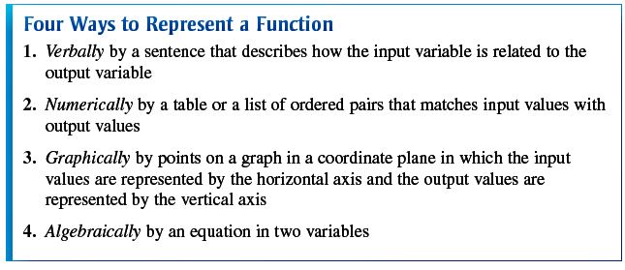

Slide 17
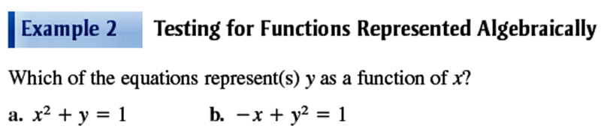
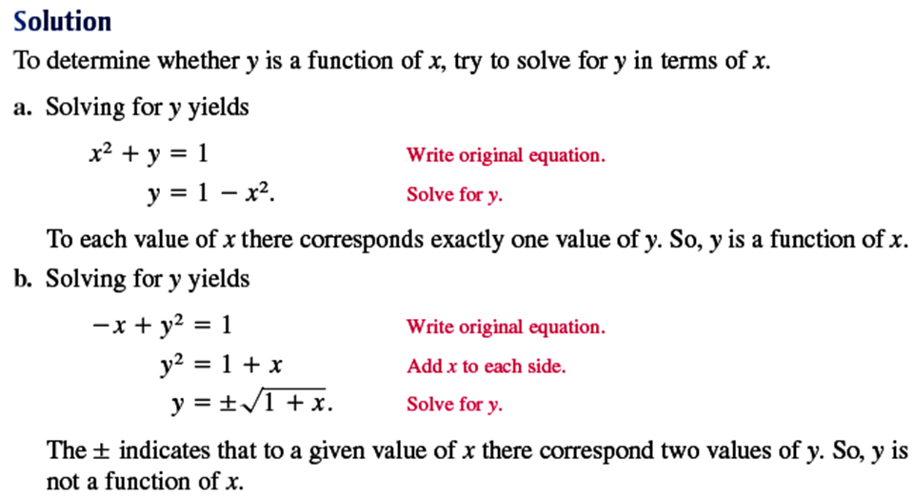

Slide 18
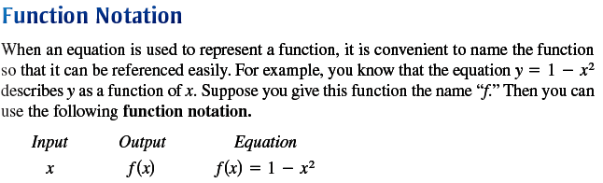

Slide 19
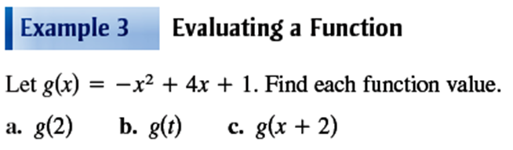
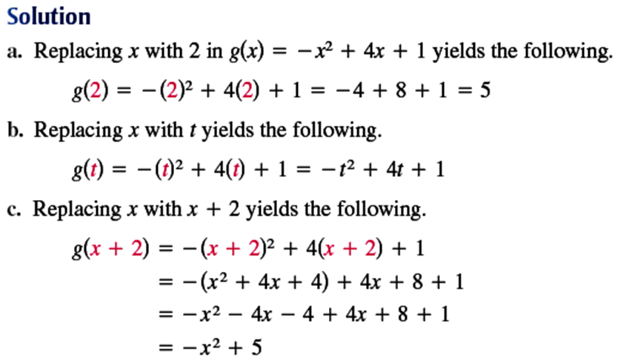

Slide 20
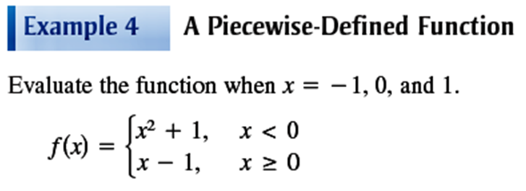
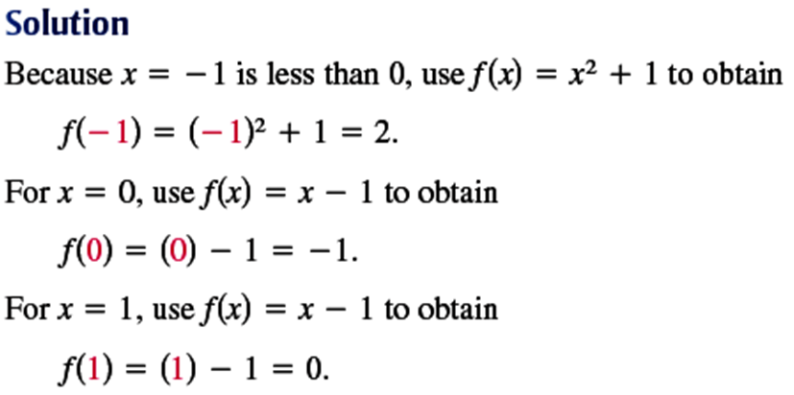

Slide 21
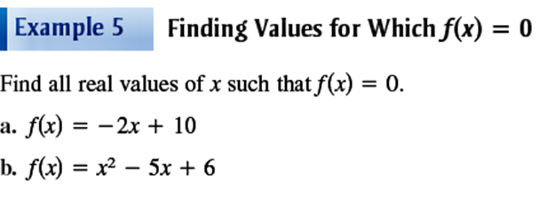
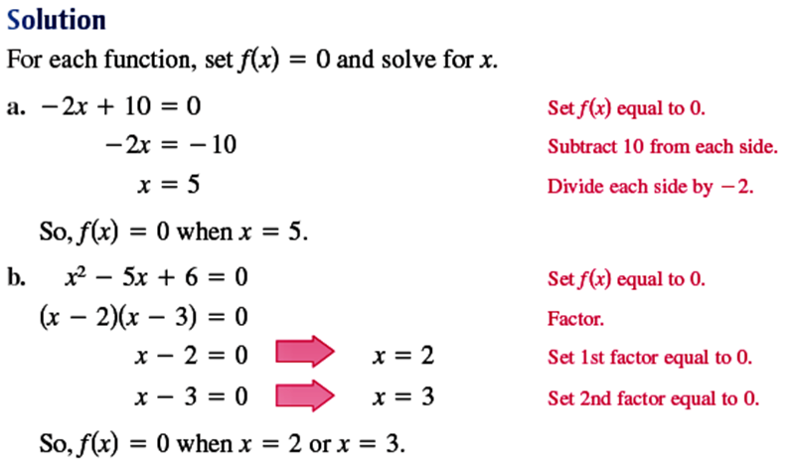

Slide 22
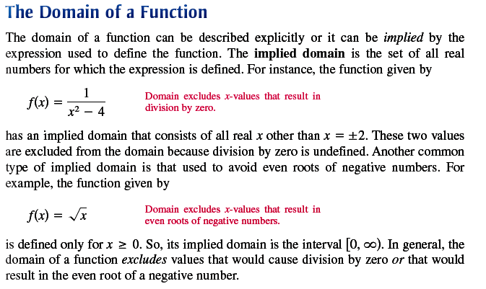

Slide 23
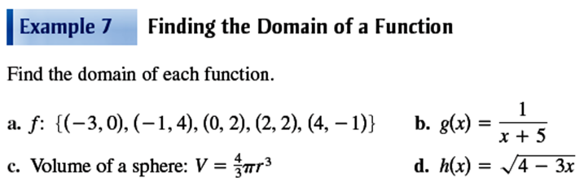
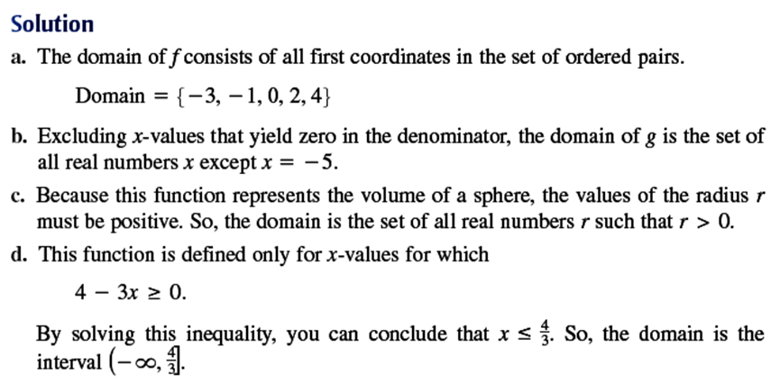

Slide 24
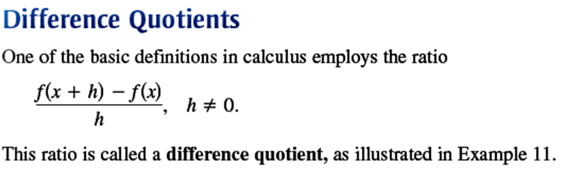
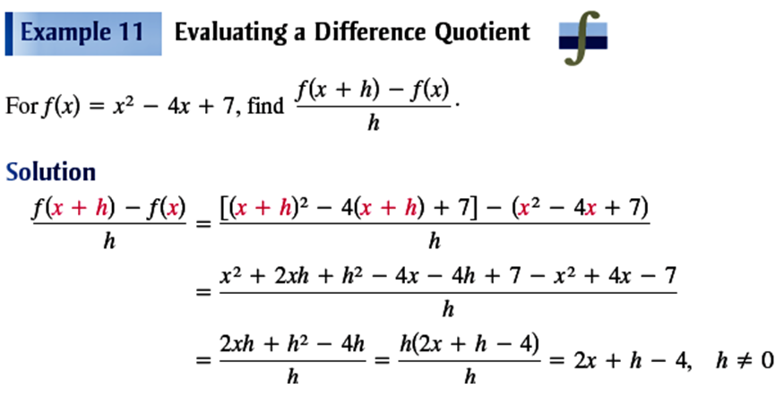

Slide 25
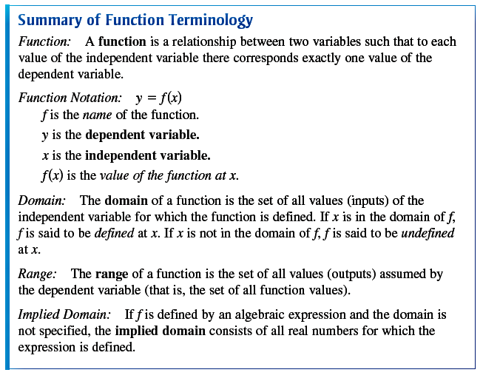

Slide 26
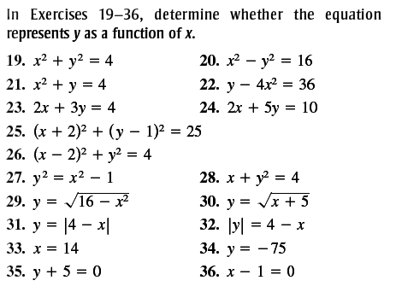

Slide 27
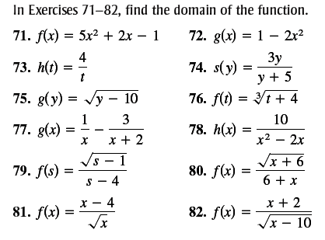

Slide 28
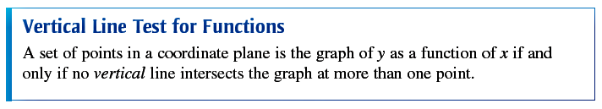
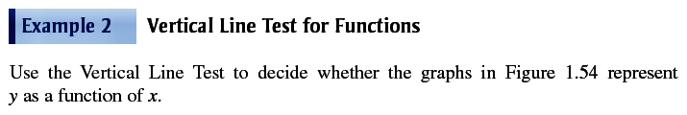
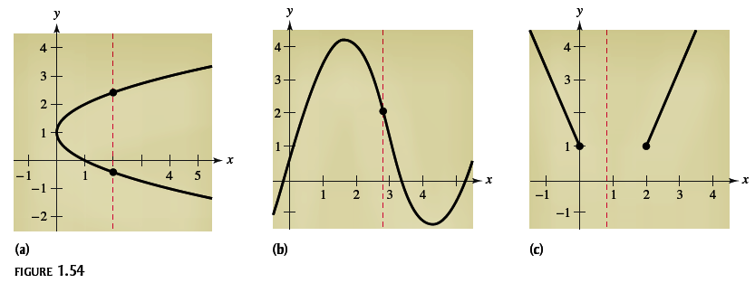

Slide 29
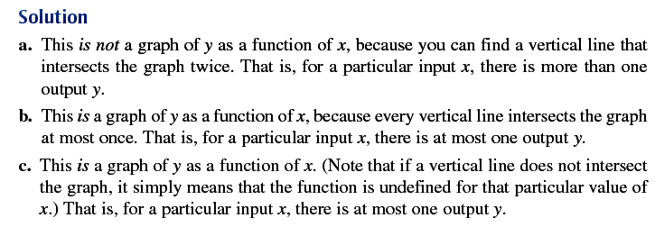

Slide 30
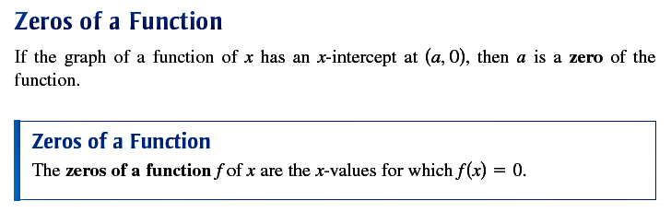
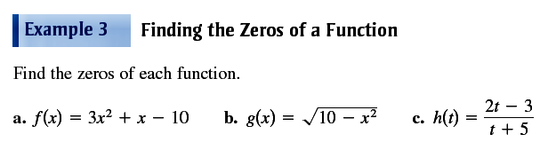

Slide 31
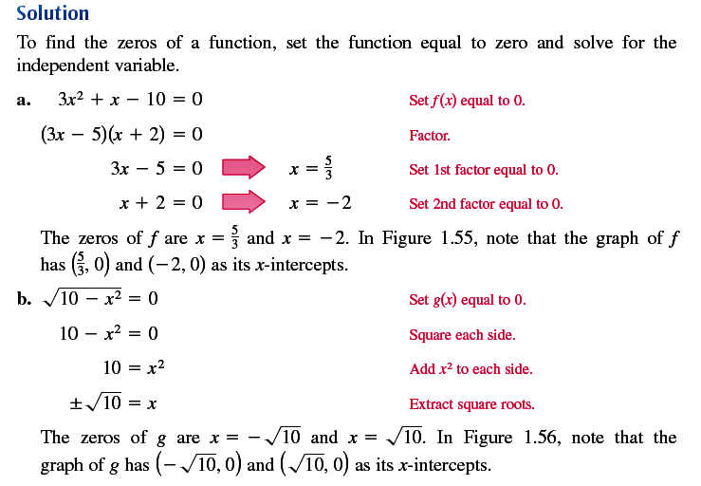

Slide 32
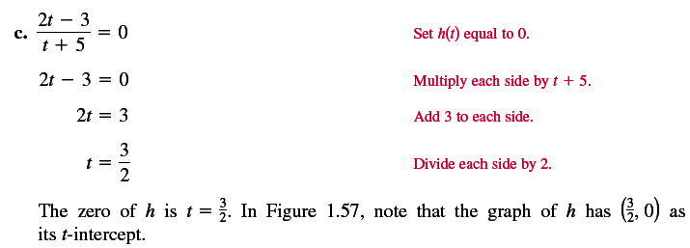
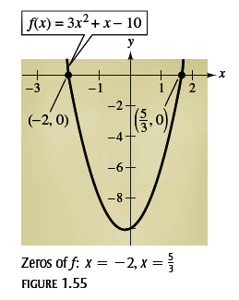
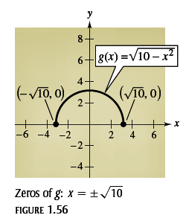
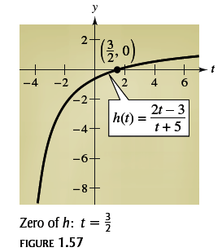

Slide 33
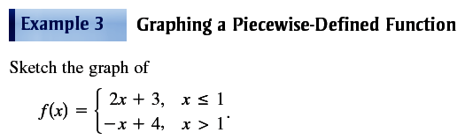
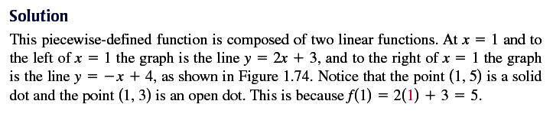
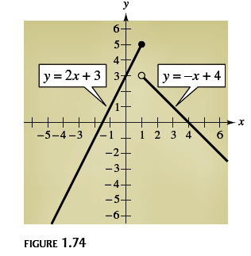

Slide 34
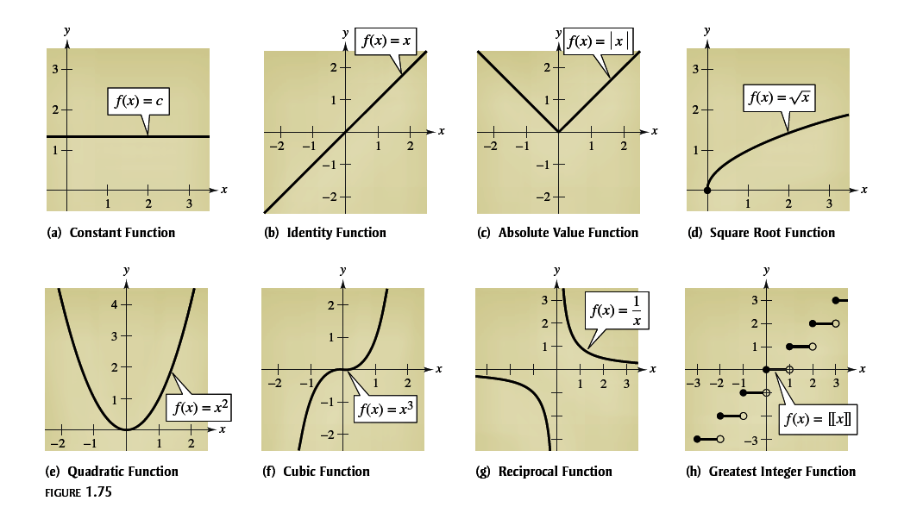
Eight Parent Functions

Slide 35
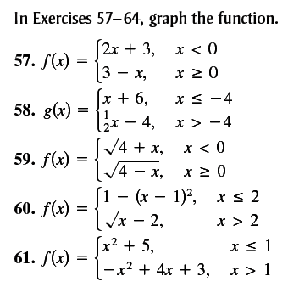

Slide 36
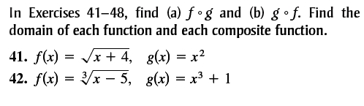
Solve the followings

Slide 37
Limits Continuity and Differentiation

Slide 38
Limits & their properties
Definition & Introduction
Properties of limits
Techniques of evaluating limits
Continuity and one sided limits
Infinite limits
Practices
Assignment

Slide 39
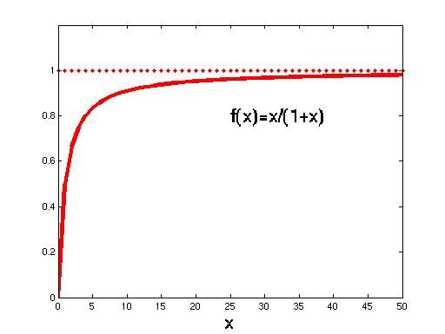
Limits
The function
converges to a single value (1), called the limit of f.
We write
lim_{x→ +∞} f(x) = 1

Slide 40
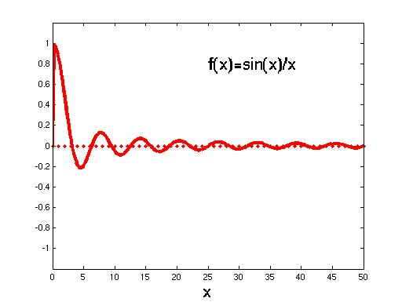
Limits
The function
converges to a single value (0), called the limit of f.
We write
lim_{x→ +∞} f(x) = 0

Slide 41
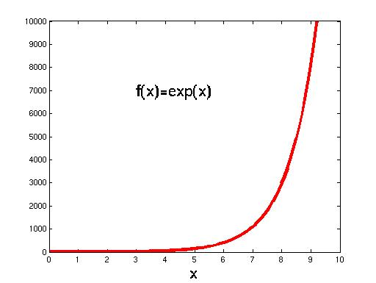
Limits
The function doesn’t converge to a single value but keeps growing.
It diverges.
We can write
lim_{x→ +∞} f(x) = +∞

Slide 42
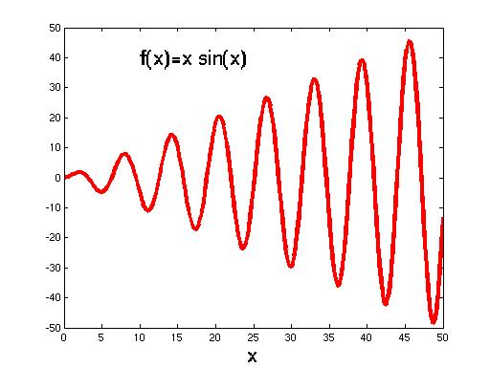
Limits
The function doesn’t
converge to a single value but
its amplitude
keeps growing.
It diverges.

Slide 43
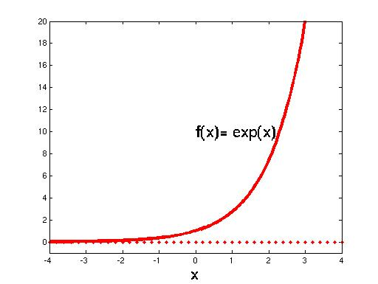
Limits
The function converges at -∞ and diverges at + ∞.
We can write
lim_{x→ +∞} f(x) = +∞
lim_{x→ -∞} f(x) = 0

Slide 44
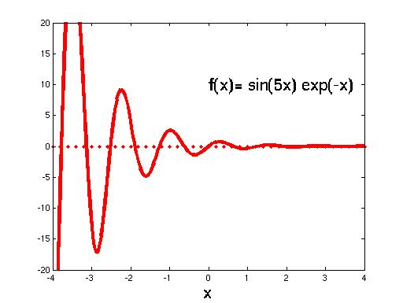
Limits
The function converges at +∞ and diverges at -∞.
We can write
lim_{x→ +∞} f(x) = 0

Slide 45
Definition
If f(x) becomes arbitrary close to single number L as x approaches c from either side, then the limit of f(x), as x approaches c, is L. This limit is written as

Slide 46
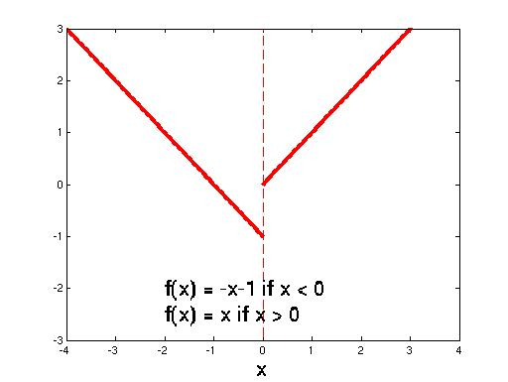
Limits
The function can have a gap! The limit at 0 doesn’t exist…

Slide 47
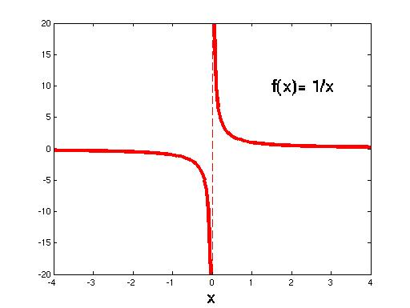
Limits
The function can have asymptotes (it diverges). The limit at 0 doesn’t exist…

Slide 48
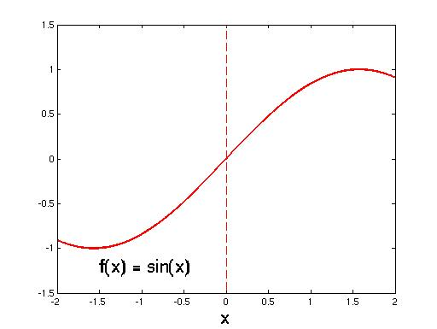
Limits
The function has a limit when x tends to 0 and that limit is 0. We write
lim_{x → 0} f(x) = 0

Slide 49
Left hand Limit
The notation is used to represents the limit of as x approaches “a” from the left end
Right hand Limit
The notation is used to represents the limit of as x approaches “a” from the right end

Slide 50
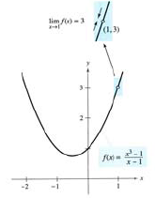
Limits
X | 0.75 | 0.9 | 0.99 | 0.999 | 1 | 1.001 | 1.01 | 1.1 | 1.25
f(x) | 2.313 | 2.710 | 2.970 | 2.997 | ? | 3.003 | 3.030 | 3.310 | 3.813
X | 0.75 | 0.9 | 0.99 | 0.999 | 1 | 1.001 | 1.01 | 1.1 | 1.25
f(x) |  |  |  |  | ?
Conclusion

Slide 51
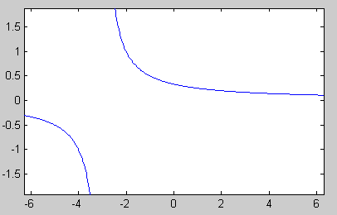
Limits
X | 2.75 | 2.9 | 2.99 | 2.999 | 3 | 3.001 | 3.01 | 3.1 | 3.25
f(x) | 0.1739 | 0.1695 | 0.1669 | 0.1667 | ? | 0.1666 | 0.1664 | 0.1639 | 0.1600
X | 2.75 | 2.9 | 2.99 | 2.999 | 3 | 3.001 | 3.01 | 3.1 | 3.25
f(x) |  |  |  |  | ?
Conclusion

Slide 52
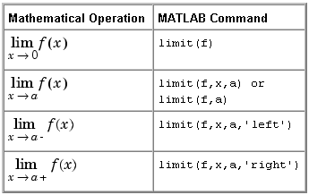
MatLab commands
syms x
f=(x-3)/(x^2-9)
ezplot(f)
lim(f,x,3)
b=[2.75 2.9 2.99 2.999 3.001 3.01 3.1 3.25]
subs(f,x,b)
f = factor(f)
simple(f)

Slide 53
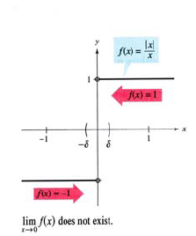
Limits
X | -0.75 | -0.9 | -0.99 | -0.999 | 0 | 0.001 | 0.01 | 0.1 | 0.25
f(x) |  |  |  |  | ?
X | -0.75 | -0.9 | -0.99 | -0.999 | 0 | 0.001 | 0.01 | 0.1 | 0.25
f(x) | -1 | -1 | -1 | -1 | ? | 1 | 1 | 1 | 1
Conclusion
lim_{x → 0} f(x) does not exist

Slide 54
Theorem:- Some Basic limits

Slide 55
Theorem:- Properties of limits

Slide 56
Theorem:- Properties of limits

Slide 57
Finding Limits
By Graph
Direct Substitution
Numerical Method (approaching)
Factorize and Reduce
Conjugate
Absolute value tricks

Slide 58
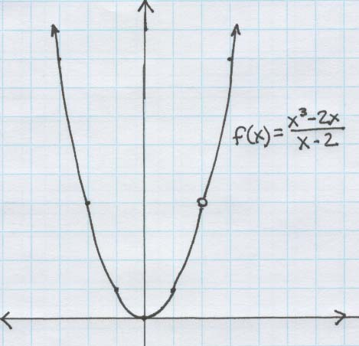
Finding Limits By Graph

Slide 59
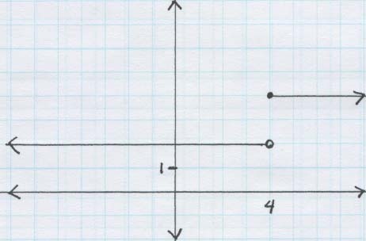
Finding Limits By Graph

Slide 60
Direct Substitution
Solution
Conclusion
lim_{x → 2} f(x) exist and it is 10

Slide 61
Direct Substitution Not Applied
Solution
Conclusion
Not an appropriate method try other method

Slide 62
Numerical approach
X | -0.1 | -0.01 | -0.001 | -0.0001 | 0 | 0.0001 | 0.001 | 0.01 | 0.1
f(x) |  |  |  |  | ?

Slide 63

Numerical approach
X | -0.1 | -0.01 | -0.001 | -0.0001 | 0 | 0.0001 | 0.001 | 0.01 | 0.1
f(x) | 0.9983 | 0.999 | 0.9999 | 1 | ? | 1 | 0.9999 | 0.999 | 0.9983
Conclusion

Slide 64
Factorize & Reduce

Slide 65
Factorize & Reduce

Slide 66
Factorize & Reduce

Slide 67
Factorize & Reduce

Slide 68
Conjugate!

Slide 69
Conjugate!

Slide 70
Absolute value!

Slide 71
Absolute value!

Slide 72
Absolute value!
As left and right limits are different therefore total limit does not exist

Slide 73
Practice Exercises
Find the Limits by using an appropriate method

Slide 74

Continuity or “Without interruption”
The intuitive idea of continuity is the path of the function is unbroken, and without gaps.
The function to the right is continuous.

Slide 75
Test of Continuity
For a function to be continuous at a point, three things must be true given on the next slide.

Slide 76
Testing Continuity

Slide 77
Continuous?
Is this function continuous at x=2?
No, because f(x) is not defined at x=2.
This a special kind of discontinuity called “removable discontinuity” because the discontinuity could be “plugged”.
Plugged with what?

Slide 78
Continuous?
Is this function continuous at x=4?
No, because the limit DNE.
Could it be plugged?
No. Because it can not be plugged, we call this “jump discontinuity”.

Slide 79
Continuity at end points
A function f is continuous at a left end point x=a of its domain if
A function f is continuous at a right end point x=b of its domain if

Slide 80
Continuity on a closed interval
A function f is continuous on the closed interval [a, b] if it is continuous on the open interval (a, b) and

Slide 81
More kinds of continuities
We can have one sided continuity (especially for end points)
We say this function is “continuous from the right at 4”
We say this function is “discontinuous from the left at 4”

Slide 82
Example:- Find domain, intercepts, symmetry, vertical asymptotes

Slide 83
Example: Domain

Slide 84
Example: Intercepts

Slide 85
Example: Symmetry

Slide 86
Example: Asymptote

Slide 87
Example: A

Slide 88

Difference Quotient (DQ)
Consider two points A & B as shown in the figure. In moving from A to B the change in x is Δx=(x+ Δx)-x and change in y is Δy=f(x+ Δx)-f(x). The ratio of these changes is referred to as Difference Quotient

Slide 89
END?

