Slide 1

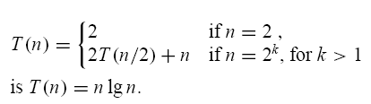

Slide 2

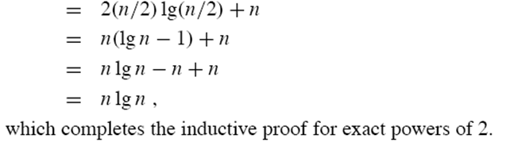

Slide 3
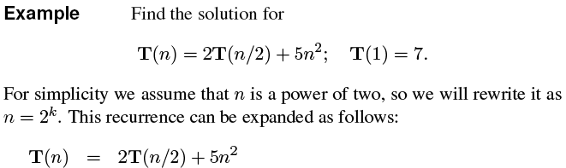
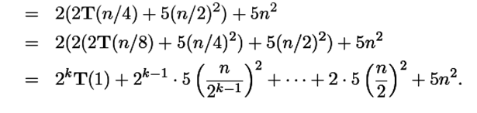

Slide 4
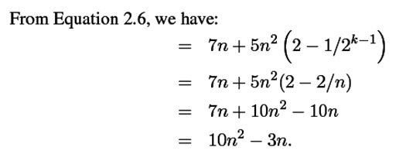


Slide 5
Sterling's Approximation

Slide 6
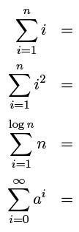




Slide 7
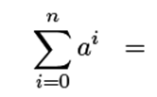



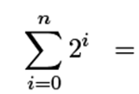

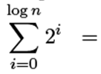




Slide 8

Fibonacci Sequence

Slide 9
Prove by induction
Show that 1+2+3+…+n=

Slide 10
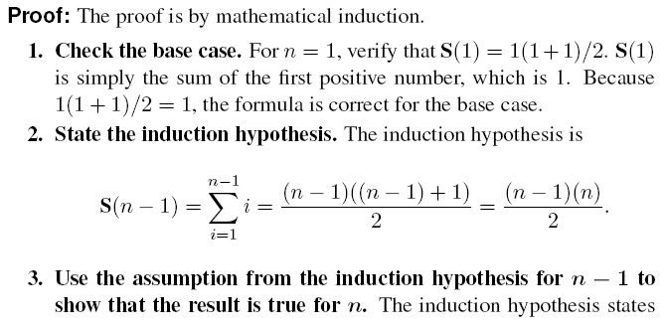

Slide 11
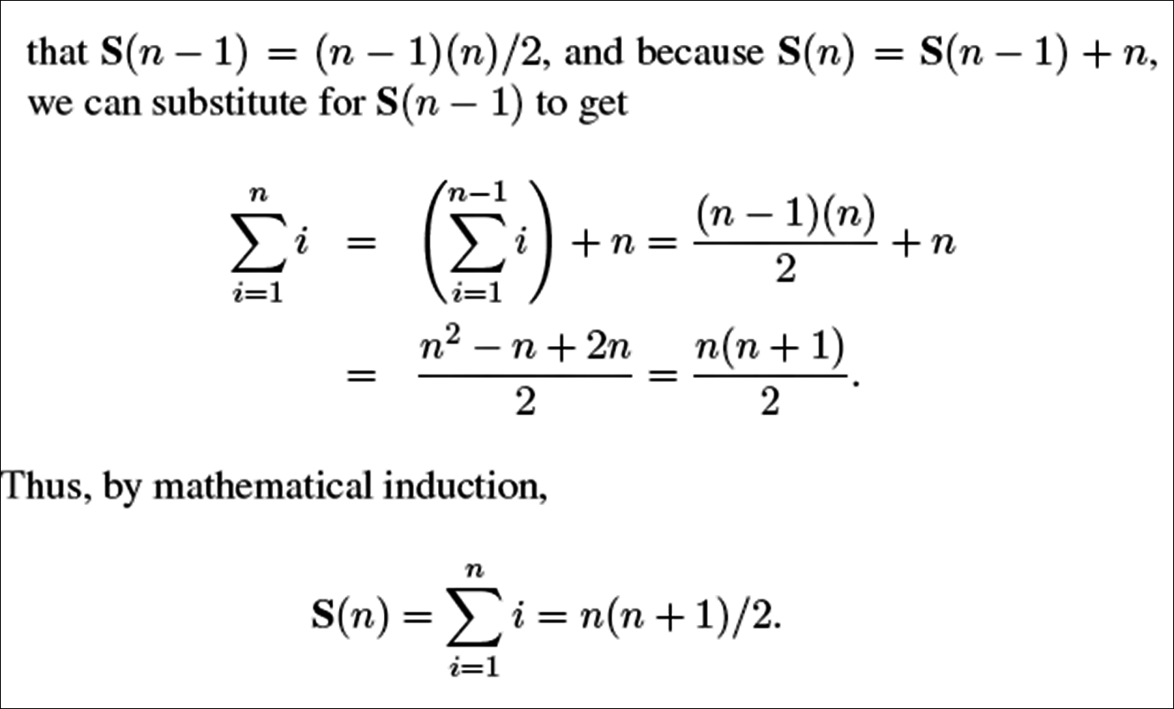

Slide 12
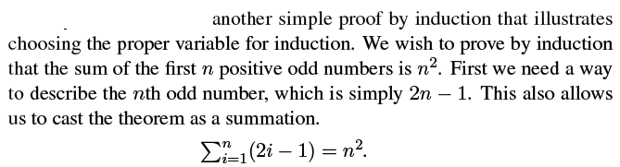
Prove by induction

Slide 13
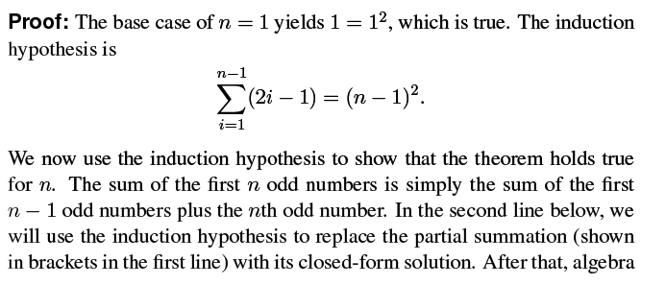

Slide 14
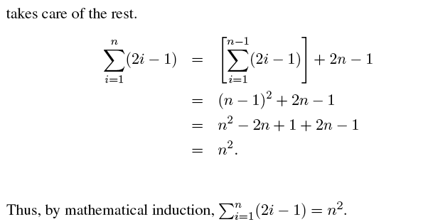

Slide 15
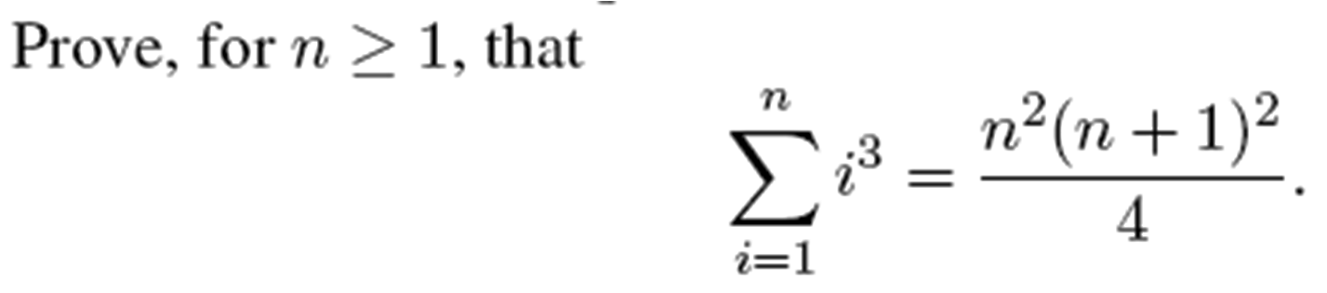
Prove by induction

Slide 16
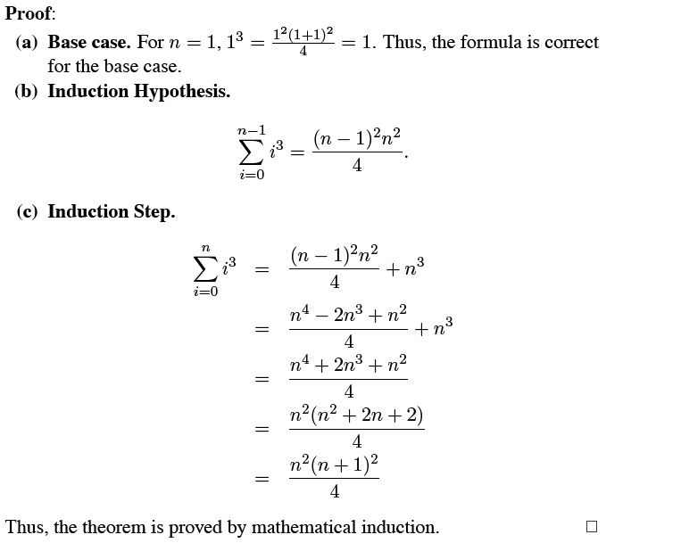

Slide 17

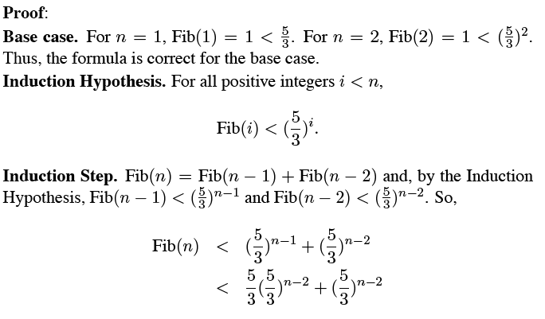

Slide 18
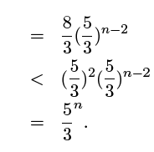

Slide 19
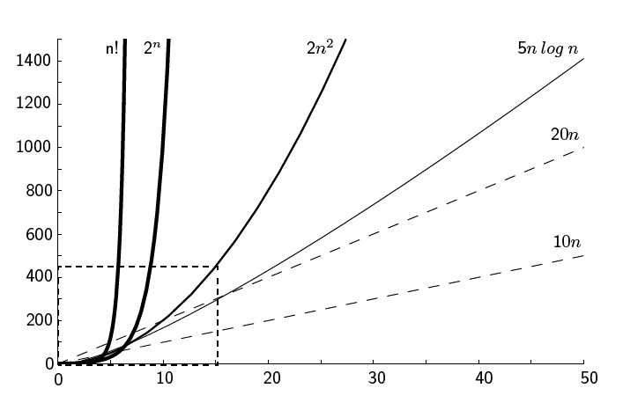

Slide 20
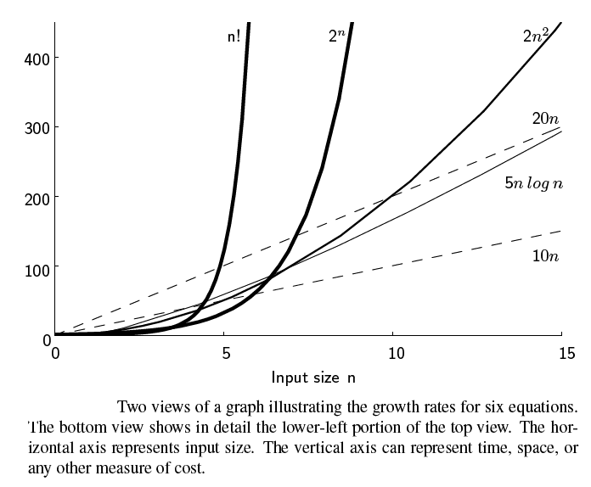

Slide 21
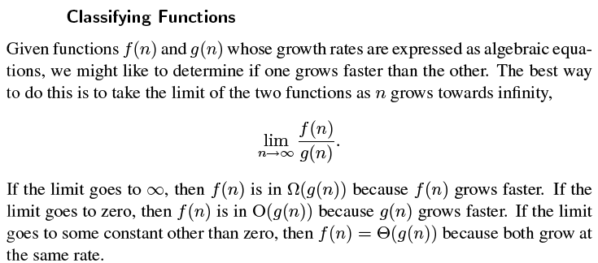

Slide 22
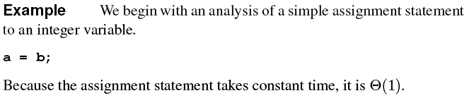

Slide 23
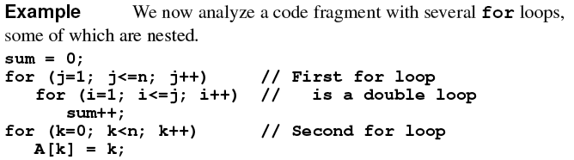

Slide 24
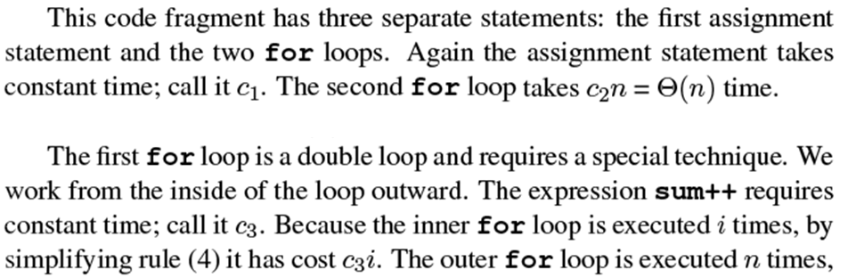

Slide 25
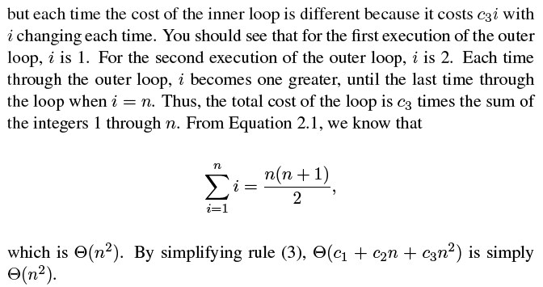

Slide 26
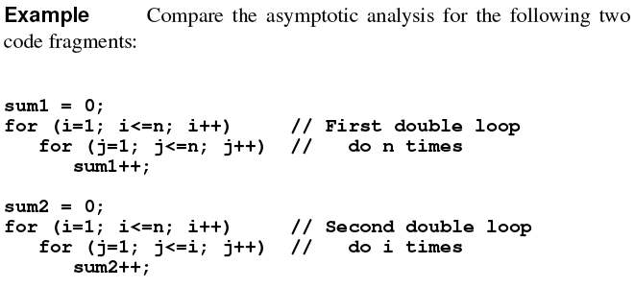

Slide 27
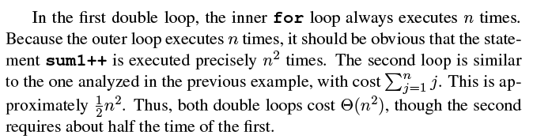

Slide 28
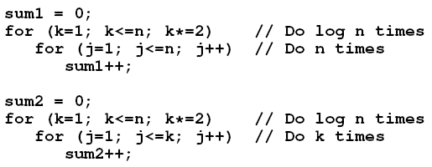

Slide 29
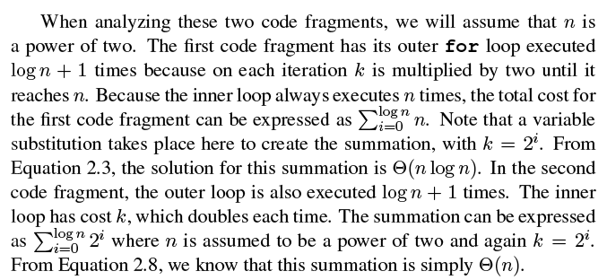

Slide 30
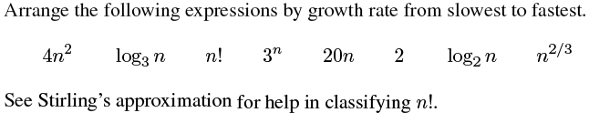
Exercise
Answer

Slide 31
Hashing
Use hash function to map keys into positions in a hash table
Ideally
If element e has key k and h is hash function, then e is stored in position h(k) of table
To search for e, compute h(k) to locate position. If no element, dictionary does not contain e.

Slide 32
Example
Student Records
Keys are ID numbers (951000 - 952000), no more than 100 students
Hash function: h(k) = k-951000 maps ID into distinct table positions 0-1000
array table[1001]
hash table
...
0
1
2
3
1000
buckets

Slide 33
Ideal Case is Unrealistic
Works for implementing dictionaries, but many applications have key ranges that are too large to have 1-1 mapping between buckets and keys!
Example:
Suppose key can take on values from 0 .. 65,535 (2 byte unsigned int)
Expect ≈ 1,000 records at any given time
Impractical to use hash table with 65,536 slots!

Slide 34
Hash Functions
If key range too large, use hash table with fewer buckets and a hash function which maps multiple keys to same bucket:
h(k₁) = β = h(k₂): k₁ and k₂ have collision at slot β
Popular hash functions: hashing by division
h(k) = k%D, where D number of buckets in hash table
Example: hash table with 11 buckets
h(k) = k%11
80 → 3 (80%11= 3), 40 → 7, 65 → 10
58 → 3 collision!

Slide 35
Collision Resolution Policies
Two classes:
(1) Open hashing, a.k.a. separate chaining
(2) Closed hashing, a.k.a. open addressing
Difference has to do with whether collisions are stored outside the table (open hashing) or whether collisions result in storing one of the records at another slot in the table (closed hashing)

Slide 36
Closed Hashing
Associated with closed hashing is a rehash strategy:
“If we try to place x in bucket h(x) and find it occupied, find alternative location h₁(x), h₂(x), etc. Try each in order, if none empty table is full,”
h(x) is called home bucket
Simplest rehash strategy is called linear hashing
h_{i}(x) = (h(x) + i) % D
In general, our collision resolution strategy is to generate a sequence of hash table slots (probe sequence) that can hold the record; test each slot until find empty one (probing)

Slide 37
Example Linear (Closed) Hashing
D=8, keys a,b,c,d have hash values h(a)=3, h(b)=0, h(c)=4, h(d)=3
Where do we insert d? 3 already filled
Probe sequence using linear hashing:
h₁(d) = (h(d)+1)%8 = 4%8 = 4
h₂(d) = (h(d)+2)%8 = 5%8 = 5*
h₃(d) = (h(d)+3)%8 = 6%8 = 6
etc.
7, 0, 1, 2
Wraps around the beginning of the table!
0
b
1
2
3
a
4
c
5
d
6
7

Slide 38
Operations Using Linear Hashing
Test for membership: findItem
Examine h(k), h₁(k), h₂(k), …, until we find k or an empty bucket or home bucket
If no deletions possible, strategy works!
What if deletions?
If we reach empty bucket, cannot be sure that k is not somewhere else and empty bucket was occupied when k was inserted
Need special placeholder deleted, to distinguish bucket that was never used from one that once held a value
May need to reorganize table after many deletions

Slide 39
Improved Collision Resolution
Linear probing: h_{i}(x) = (h(x) + i) % D
all buckets in table will be candidates for inserting a new record before the probe sequence returns to home position
clustering of records, leads to long probing sequences
Linear probing with skipping: h_{i}(x) = (h(x) + ic) % D
c constant other than 1
records with adjacent home buckets will not follow same probe sequence
(Pseudo)Random probing: h_{i}(x) = (h(x) + r_{i}) % D
r_{i} is the i^{th} value in a random permutation of numbers from 1 to D-1
insertions and searches use the same sequence of “random” numbers

Slide 40
Hash Functions - Numerical Values
Better, mid-square method
The key k is squared. Then the hash function H is defined by “extracts middle r bits of x^{2”}
better, because most or all of bits of key contribute to result

Slide 41
Hash Function Folding method
The key k is partitioned into a number of parts k₁, K₂, K₃,… , except possible the last, has the same number of digits as the required address. Then the parts are added together, ignoring the last carry. That is
H(k)= k₁+K₂+K₃+… +K_{r}

Slide 42
Open Hashing
Each bucket in the hash table is the head of a linked list
All elements that hash to a particular bucket are placed on that bucket’s linked list
Records within a bucket can be ordered in several ways
by order of insertion, by key value order, or by frequency of access order

Slide 43
Open Hashing Data Organization
0
...
1
...
2
3
4
D-1
...

Slide 44
Analysis
Open hashing is most appropriate when the hash table is kept in main memory, implemented with a standard in-memory linked list
We hope that number of elements per bucket roughly equal in size, so that the lists will be short
If there are n elements in set, then each bucket will have roughly n/D
If we can estimate n and choose D to be roughly as large, then the average bucket will have only one or two members

Slide 45
Hashing Problem
Draw the 11 entry hashtable for hashing the keys 12, 44, 13, 88, 23, 94, 11, 39, 20 using the function (2i+5) mod 11, closed hashing, linear probing
Pseudo-code for listing all identifiers in a hashtable in lexicographic order, using open hashing, the hash function h(x) = first character of x. What is the running time?

