Slide 1
Theory of Automata and Formal Language

Slide 2
FINITE AUTOMATA

Slide 3
Deterministic Finite Automata:
A Deterministic Finite Automata is defined by 5 Tuples as
M = (Q,Σ,δ, q0, F), where
Q = A finite set of States
Σ = A finite set of Input Symbols
δ = The Transition Function where δ: Q × ∑ → Q
q0 = The Initial/ Start State
F = The Final/ Accepting States

Slide 4
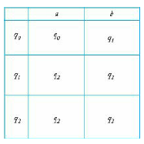

Deterministic Finite Automata:
M = ({q0,q1,q2},{0,1},δ, q0, {q1}), where δ is given by
δ (q0, 0) = q0
δ (q0, 1) = q1
δ (q1, 0) = q0
δ (q1, 1) = q2
δ (q2, 0) = q2
δ (q2, 1) = q1
0
1

Slide 5
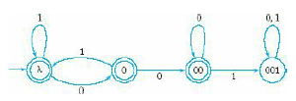
Deterministic Finite Automata:
M = ({λ,0,00,001},{0,1},δ,{λ}, {λ,0,00}), where δ is given by
δ (λ, 1) = λ
δ (λ, 0) = 0
δ (0, 1) = λ
δ (0, 0) = 00
δ (00, 0) = 00
δ (00, 1) = 001
δ (001, 0) = 001
δ (001, 1) = 001

Slide 6
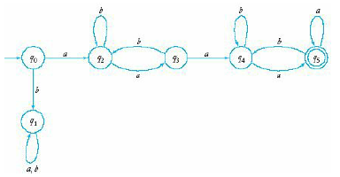
Deterministic Finite Automata:

Slide 7
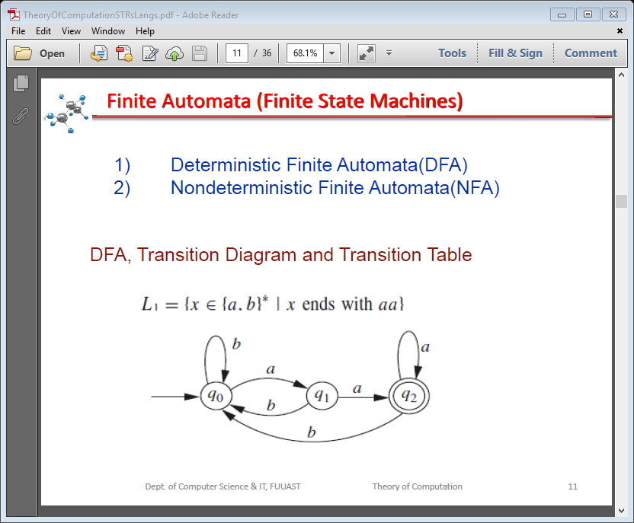
Deterministic Finite Automata:
L = {x  {a.b}* | x ends with aa}
δ (q0, b) = q0
δ (q0, a) = q1
δ (q1, b) = q0
δ (q1, a) = q2
δ (q2, a) = q2
δ (q2, b) = q0
States | Inputs
 | a | b
q0 | q1 | q0
q1 | q2 | q0
q2 | q2 | q0

Slide 8
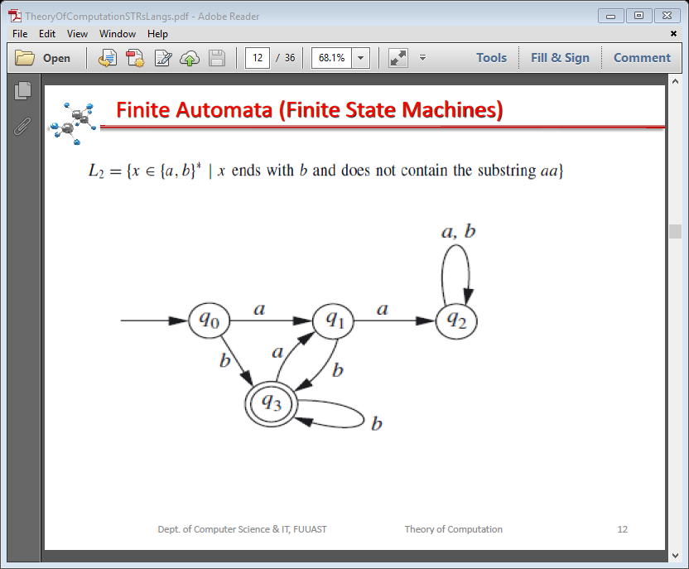
Deterministic Finite Automata:
L = {x  {a.b}* | x ends with b and does not
contain the substring aa}
δ (q0, a) = q1
δ (q0, b) = q3
δ (q1, a) = q2
δ (q1, b) = q3
δ (q2, a) = q2
δ (q2, b) = q2
δ (q3, a) = q1
δ (q3, b) = q3
States | Inputs
 | a | b
q0 | q1 | q3
q1 | q2 | q3
q2 | q2 | q2
q3 | q1 | q3

Slide 9
Deterministic Finite Automata:
Binary representations of integers divisible by 3.
0
1
q0
q1
q3
1
1
1
0
0
q2
1

Slide 10
Non-Deterministic Finite Automata:
A Non-deterministic Finite Automata is defined by 5 Tuples as
M = (Q,Σ,δ, q0, F), where
Q = A finite set of States
Σ = A finite set of Input Symbols
δ = The Transition Function where δ: Q × ∑ → 2^{Q}
q0 = The Initial/ Start State
F = The Final/ Accepting States

Slide 11
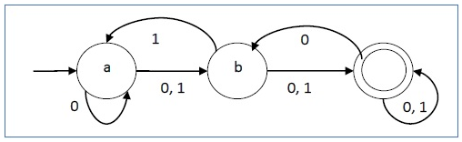
Non-Deterministic Finite Automata:
M = ({a, b, c},{0,1},δ, {a}, {c}), where δ is given by
δ (a, 0) = {a, b}
δ (a, 1) = b
δ (b, 0) = c
δ (b, 1) = {a, c}
δ (c, 0) = {b, c}
δ (c, 1) = c
States | Inputs
 | 0 | 1
a | a, b | b
b | c | a, c
c | b, c | c
c

Slide 12
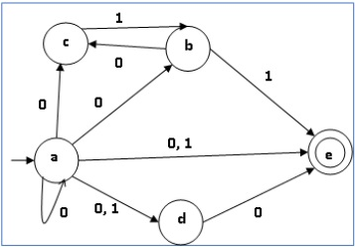
Non-Deterministic Finite Automata:
M = ({a, b, c, d, e},{0,1},δ, {a}, {e}), where δ is given by
States | Inputs
 | 0 | 1
a | {a, b, c, d} | e
b | c | e
c | ø | b
d | e | ø
e | ø | ø

Slide 13
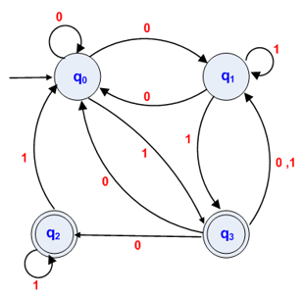
Non-Deterministic Finite Automata:
M = ({a, b, c, d, e},{0,1},δ, {a}, {e}), where δ is given by
States | Inputs
 | 0 | 1
q0 | {q0, q1} | Q3
q1 | q0 | {q1, q3}
q2 | ø | q2
q3 | {q0, q1, q2} | q1

Slide 14
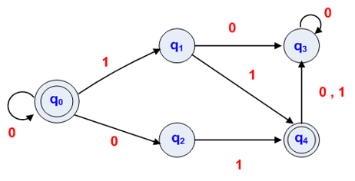

Non-Deterministic Finite Automata:
L = {$0^{n},$ $0^{n}$01, $0^{n}$11 | n ≥ 0}

Slide 15
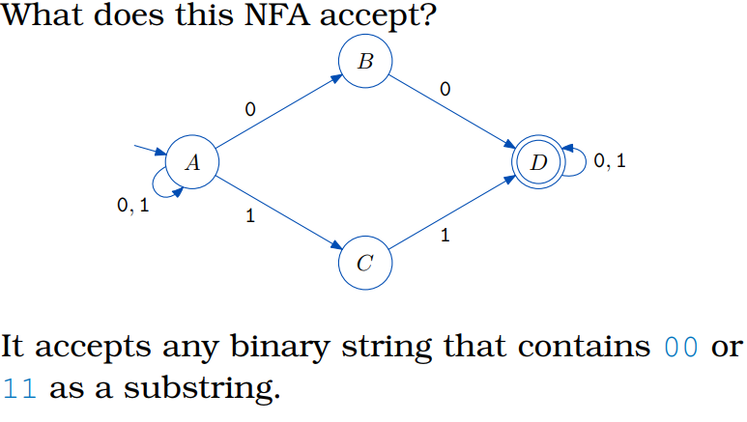
Non-Deterministic Finite Automata:

