Slide 1
Theory of Automata and Formal Language

Slide 2
REGULAR LANGUAGES AND REGULAR GRAMMARS

Slide 3
Regular Language
A regular language is a language that can be expressed with a regular expression or a deterministic or non-deterministic finite automata or state machine.
A language is a set of strings which are made up of characters from a specified alphabet, or set of symbols.
Regular languages are used in parsing and designing programming languages and are one of the first concepts taught in automata theory.
Regular Languages are the most restricted types of languages and are accepted by finite automata.

Slide 4
Regular Expressions
Regular Expressions are used to denote regular languages. An expression is regular if:
ɸ is a regular expression for regular language ɸ.
ɛ is a regular expression for regular language {ɛ}.
If a ∈ Σ (Σ represents the input alphabet), a is regular expression with language {a}.
If a and b are regular expression, a + b is also a regular expression with language {a,b}.
If a and b are regular expression, ab (concatenation of a and b) is also regular expression.
If a is regular expression, a* (0 or more times a) is also regular expression.

Slide 5
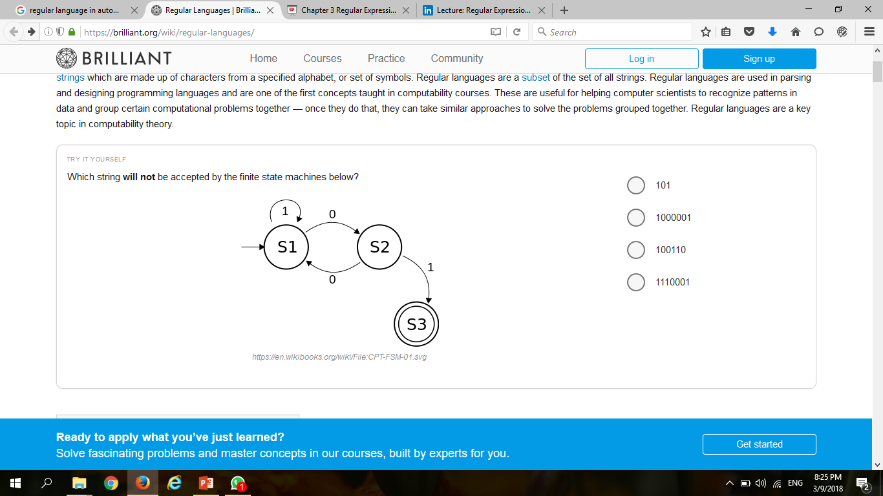
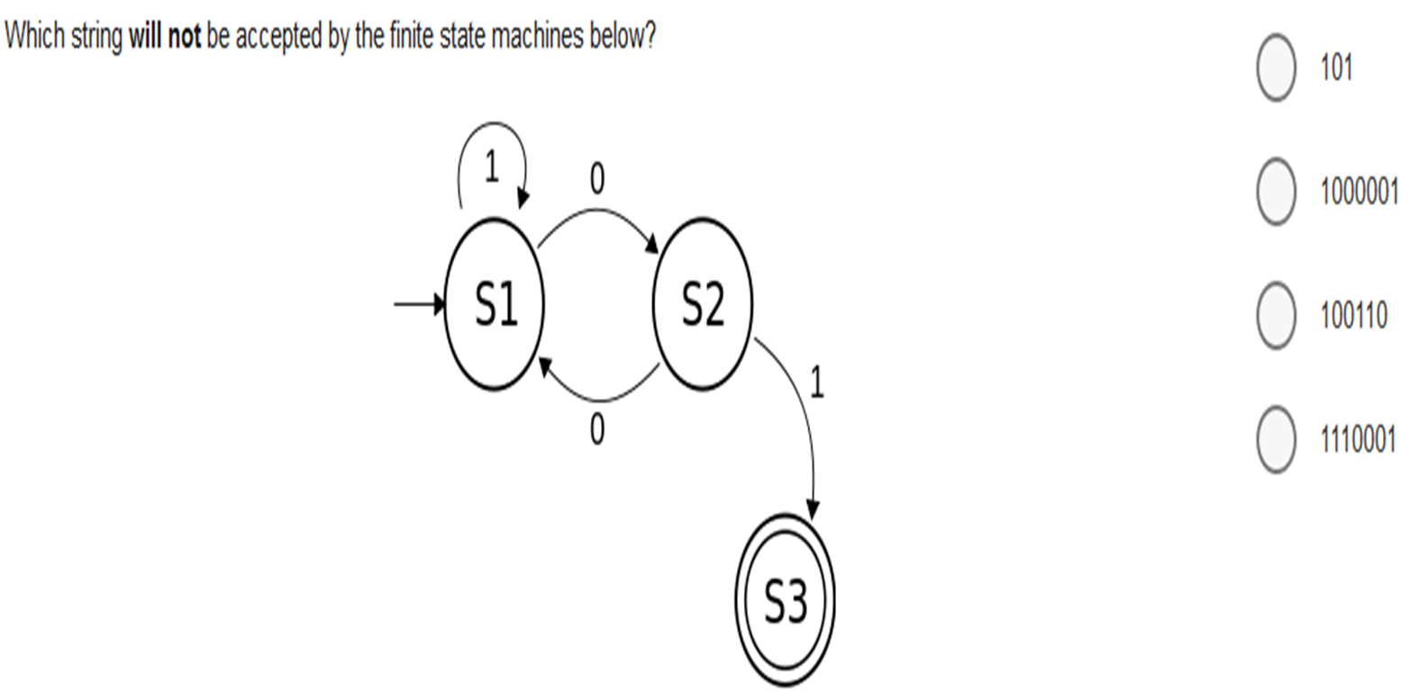
Regular Expressions

Slide 6
Regular Expressions
Example:
If Σ = {a}, write regular expression for all string.
L = {ɛ, a, aa, aaa, aaaa, aaaaa, …}
R.E = a*
If Σ = {a}, write regular expression for all string without ɛ.
L = {a, aa, aaa, aaaa, aaaaa, …}
R.E = a+
If Σ = {a, b}, write regular expression for all string.
L = {ɛ, a, b, ab, ba, aaa, aab, aba, baa, bba, bab…}
R.E = (a+b)*

Slide 7
Regular Expressions
If Σ = {a, b}, write regular expression for all string which starts with a.
L = {a, aa, ab, aaa, aab, …}
R.E = a(a+b)*
R.E = (a+b)* + (ab)*
(a+b)* = {ɛ, a, b, aa, ab, bb, ba, aaa, …}
(ab)* = {ɛ, ab, abab, ababab, …}
If Σ = {a, b}, write regular expression for all string which starts and end with b.
L = {bb, bab, bbb, baab, babb, …}
R.E = b(a+b)* b
If Σ = {a, b}, write regular expression for all string which contain aa.
L = {aa, baa, aba, aab, abab, baba, …}
R.E = b* a b* a b*

Slide 8
Regular Expressions
If Σ = {a, b}, write regular expression for all string which contain bb.
L = {bb, abb, bba, bbb, ababb, bbaba, …}
R.E = (a+b)* bb (a+b)*
If Σ = {0, 1}, write regular expression for all string whose third letter is 1.
L = {001, 111, 011, 101, 1011, 0110, 0010, 1111, 0111, 1011,…}
R.E = (0+1)(0+1) 1 (0+1)*
If Σ = {a, bb}, write regular expression for all string.
L = {a, bb, aa, abb, ba, bbb, …}
R.E = (a+b)*(a+bb)
If Σ = {0, 1}, write regular expression for all string which contain at least two consecutive zeros.
L = {00, 001, 100, 000, 0010, 1001, 1000, 0000, …}
R.E = (0+1)* 00 (0+1)*

Slide 9
Regular Expressions
If Σ = {a, b}, write regular expression for all string of even length.
L = {aa+bb+ab+ba…}
R.E = ((a+b)(a+b))* OR (aa+bb+ab+ba)*
If Σ = {a, b}, write regular expression for all string of odd length.
L = {aaa+bbb+aab+bba…}
R.E = (a+b)((a+b)(a+b))* OR (a+b)(aa+bb+ab+ba)*

Slide 10
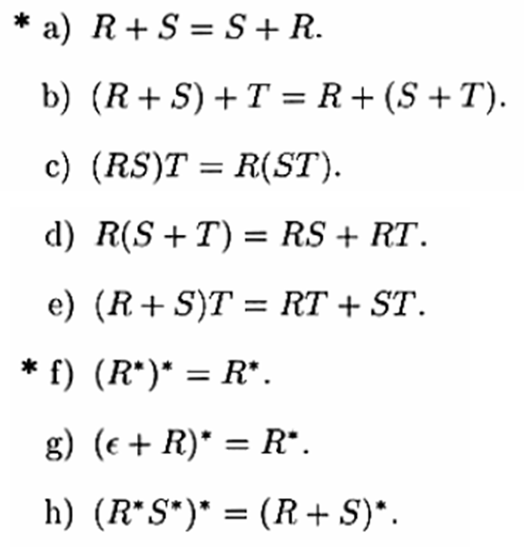
Identities of Regular Expression

Slide 11
Automaton accepts Regular Language
L(ab*a)
b
S0
S1
S2
a
a

Slide 12
Automaton accepts Regular Language
L(ac+bc)
a
S0
S1
S2
c
b

Slide 13
Automaton accepts Regular Language
L(a(bc)*)
b
S0
S1
S2
a
c

Slide 14
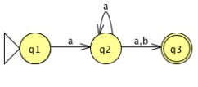
Automaton accepts Regular Language
L(aa*(a+b))

Slide 15
Automaton accepts Regular Language
c
S1
S2
L(ab(c)*)(j.k)
b
a
S0
S3
S4
j
k

Slide 16
Automaton accepts Regular Language
L(w(x+y)*z)
x
S0
S1
S2
w
z
y

Slide 17
Regular Language accepts Automaton
(a.b)
q0
q1
q2
a
b

Slide 18
Regular Language accepts Automaton
a
(a+b)
q0
q1
b

Slide 19
Regular Language accepts Automaton
b
(a.b*.c)
q0
q1
q2
a
c

Slide 20
Regular Language accepts Automaton
a
(a.b)*
q0
q1
b

Slide 21
Regular Language accepts Automaton
a
a+a(b.a)*
q0
q1
b

Slide 22
Regular Language accepts Automaton
a
b
(a+bc)*
q0
q1
c

Slide 23
Regular Language accepts Automaton
b
a
a.(b+ca)*
q0
q1
c

Slide 24
Regular Language accepts Automaton
a
c
b
a*b.(c+da*b)*
q0
q1
d

Slide 25
Regular Language accepts Automaton
a
c
b
(a+bc*d)*
q0
q1
d

Slide 26
Regular Language accepts Automaton
a
a(ba)*c
q0
q1
q2
c
b

Slide 27
Regular Language accepts Automaton
b
a
a.(ca+b)*.d
q0
q1
q2
d
c

Slide 28
Regular Language accepts Automaton
(ɛ.a.(b+c))*
q0
q1
ɛ
b,c
q2
a

Slide 29
Regular Language accepts Automaton
(((b.a.ɛ)*+(ɛ.a.b)*)*
q0
q1
q0
b
b
a
q2
ɛ
ɛ
q2
a

Slide 30
Regular Language accepts Automaton
a,b
a
((a+b)²)*
q0
q1
q2
b
a,b

