Slide 1
Theory of Automata and Formal Language

Slide 2
CONTEXT FREE LANGUAGES

Slide 3
Context Free Language:
In formal language theory, a Context Free Language (CFL) is a language generated by some Context Free Grammar.
It is more powerful than Finite Automata or Regular Expression , but still cannot define all possible languages.
The set of all CFL is identical to the set of languages accepted by Pushdown Automata.
CFL is considered to be a higher level language as compared to regular languages.

Slide 4
Context Free Language:
Context Free Grammar is defined by 4 tuples as G={V,T,S,P}, where
V= Set of variables or Non-terminal Symbols
T= Set of Terminal Symbols
S= Start Symbol
P= Production Rule
Context Free Grammar has production rule of the form
Α α
Where, Α € V and α € (V U T)*

Slide 5
Non-Terminals vs Terminals in Context Free Grammar:
Non-Terminals | Terminals
Which can be replaced | Which can’t replaced
Represented by capital letters | Represented by small letters
Which can’t lie on right side | Which can’t lie on left side

Slide 6
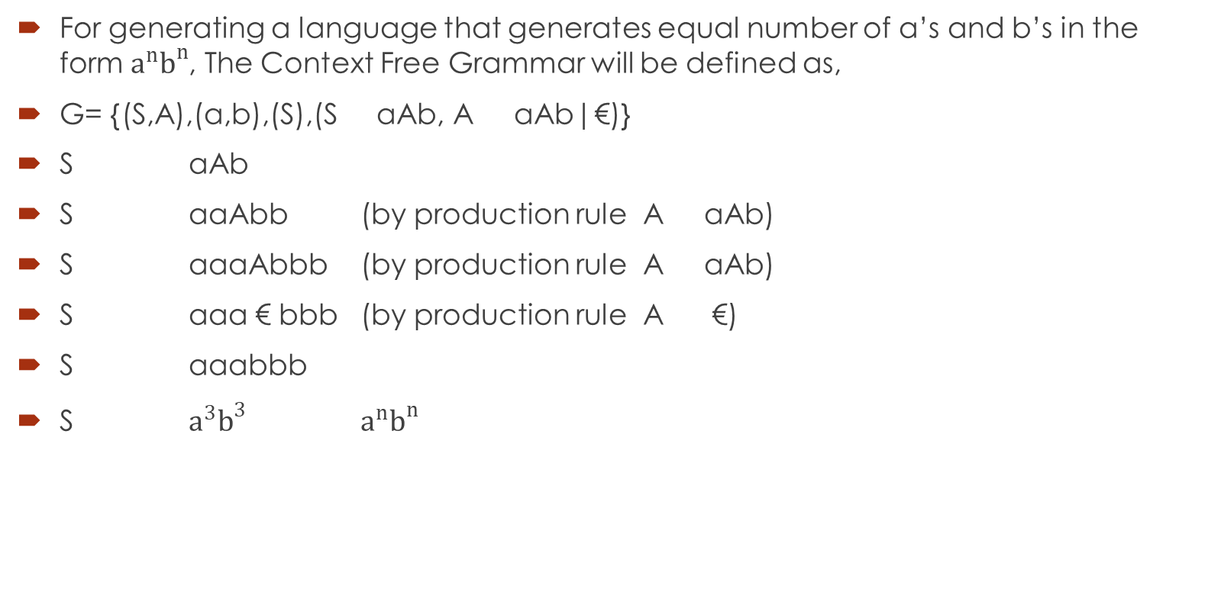
Context Free Language Example:
For generating a language that generates equal number of a’s and b’s in the form $a^{n}b^{n}$, The Context Free Grammar will be defined as,
G= {(S,A),(a,b),(S),(S aAb, A aAb|€)}
S aAb
S aaAbb (by production rule A aAb)
S aaaAbbb (by production rule A aAb)
S aaa € bbb (by production rule A €)
S aaabbb
S $a^{3}b^{3}$ $a^{n}b^{n}$

Slide 7
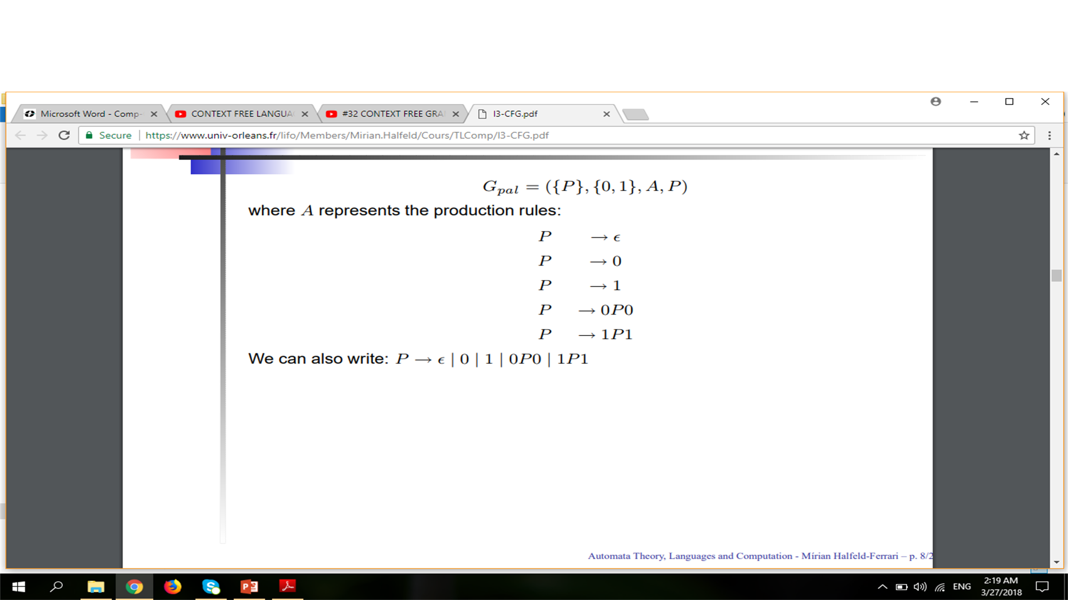
Context Free Language Example:

Slide 8
Convert Regular Expression to Context Free Grammar:
R.E = a
S a
R.E = a+b
S a | b
OR
S a
S b
OR
S X|Y
X a
Y b
R.E = (a+b)(a+b)
S YY
Y a | b
R.E = (a+b)(a+c)(a+b)
S YXY
Y a | b
X a | c
R.E = (a+b)a+(a+b)
S X | Y
X ZA
Z a| b
A a
Y A|B
B b

Slide 9
Convert Regular Expression to Context Free Grammar:
R.E = ab+(a+b)
S X|Y
X AB
Y A | B
A a
B b
R.E = (a+b)(aa+bb)(a+b)
S XYX
X A | B
Y AA| BB
A a
B b
R.E = a*
S €
S AS
A a
R.E = (a+b)*
S €
S AS
S BS
A €
A a
B €
B b

Slide 10
Convert Regular Expression to Context Free Grammar:
R.E = (a+b)*a(a+b)*
S XYX
X €
X YX
X ZX
Y a
Z b
R.E = a* +a(a+b)
S X|Y
X €
X AX
Y AZ
Z A| B
A a
B b
R.E = (a+b)*(a+b)+(ab+ba)*(a+b)*B(a+b)+a
S X|Y|Z
X PQ
P €
P ZP
P RP
Q Z|R
Y LPNQ
N B

Slide 11
Convert Regular Expression to Context Free Grammar:
L €
L ZRL
L RZL
R b
Z a

Slide 12
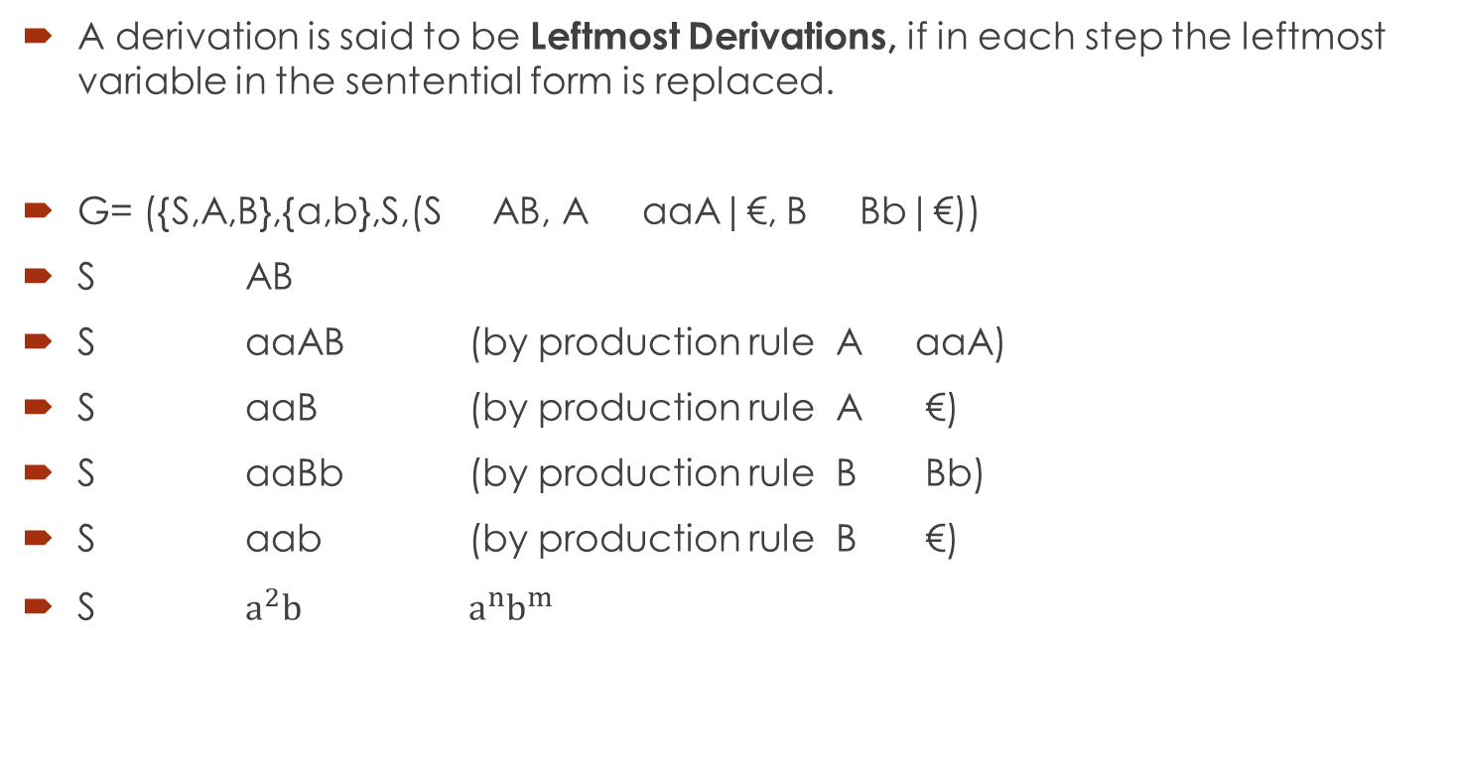
Leftmost Derivations:
A derivation is said to be Leftmost Derivations, if in each step the leftmost variable in the sentential form is replaced.
G= ({S,A,B},{a,b},S,(S AB, A aaA|€, B Bb|€))
S AB
S aaAB (by production rule A aaA)
S aaB (by production rule A €)
S aaBb (by production rule B Bb)
S aab (by production rule B €)
S $a^{2}b^{}$ $a^{n}b^{m}$

Slide 13
Leftmost Derivations:
S= S+S|S*S|a|b|c
W= a+b*c
S S+S
S a+S
S a+S*S
S a+b*S
S a+b*c

Slide 14
Leftmost Derivations:
S aAB
A bBb
B A| €
S aAB
S abBbB
S abAbB
S abbBbbB
S abb€bbB
S abbbb€
S abbbb

Slide 15
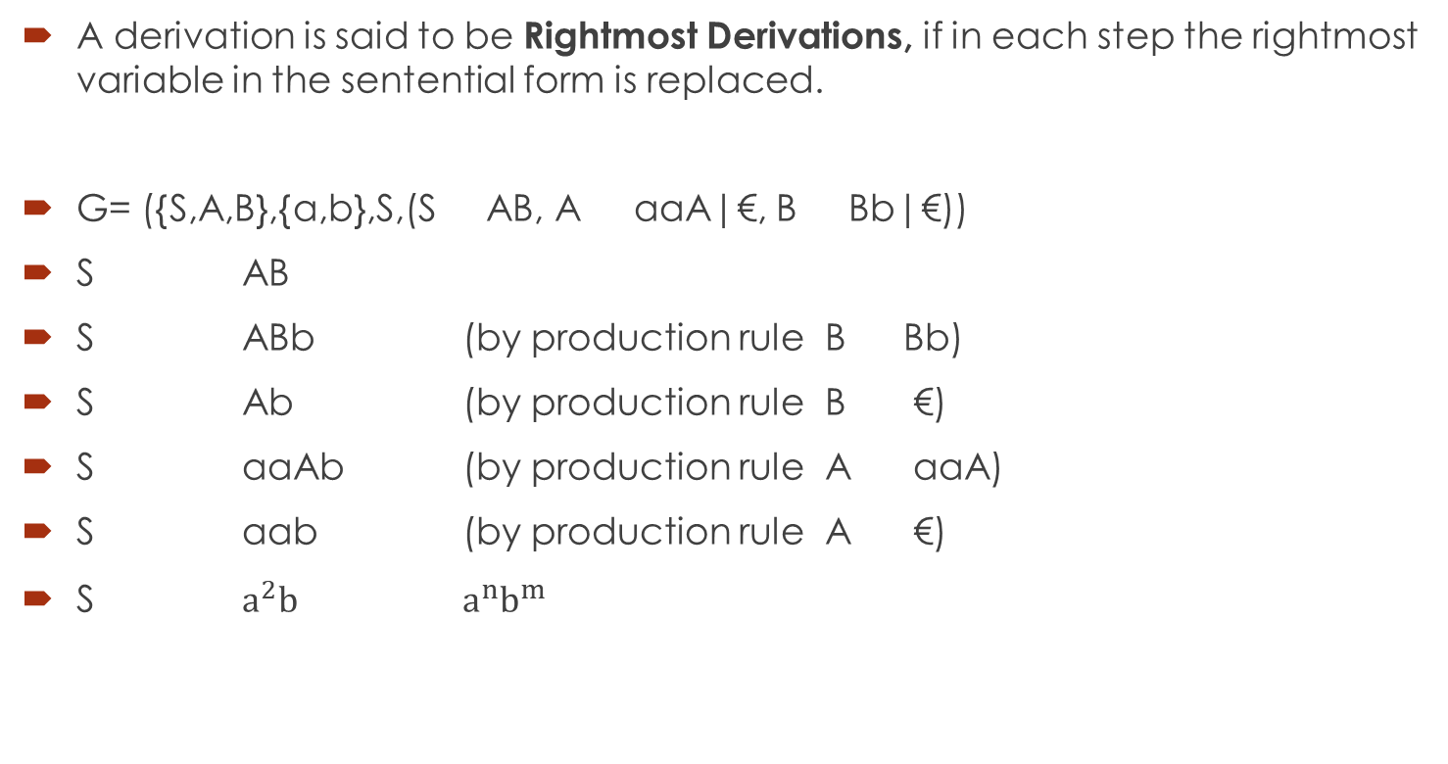
Rightmost Derivations:
A derivation is said to be Rightmost Derivations, if in each step the rightmost variable in the sentential form is replaced.
G= ({S,A,B},{a,b},S,(S AB, A aaA|€, B Bb|€))
S AB
S ABb (by production rule B Bb)
S Ab (by production rule B €)
S aaAb (by production rule A aaA)
S aab (by production rule A €)
S $a^{2}b^{}$ $a^{n}b^{m}$

Slide 16
Rightmost Derivations:
S= S+S|S*S|a|b|c
W= a+b*c
S S*S
S S*c
S S+S*c
S S+b*c
S a+b*c

Slide 17
Rightmost Derivations:
S aAB
A bBb
B A| €
S aAB
S aA€
S abBb
S abAb
S abbBbb
S abb€bb
S abbbb

Slide 18
Leftmost and Rightmost Derivations:
Find the leftmost derivation and rightmost derivation
S aB|bA
A a|aS|bAA
B b|bS|aBB
For the string baaabbabba

Slide 19
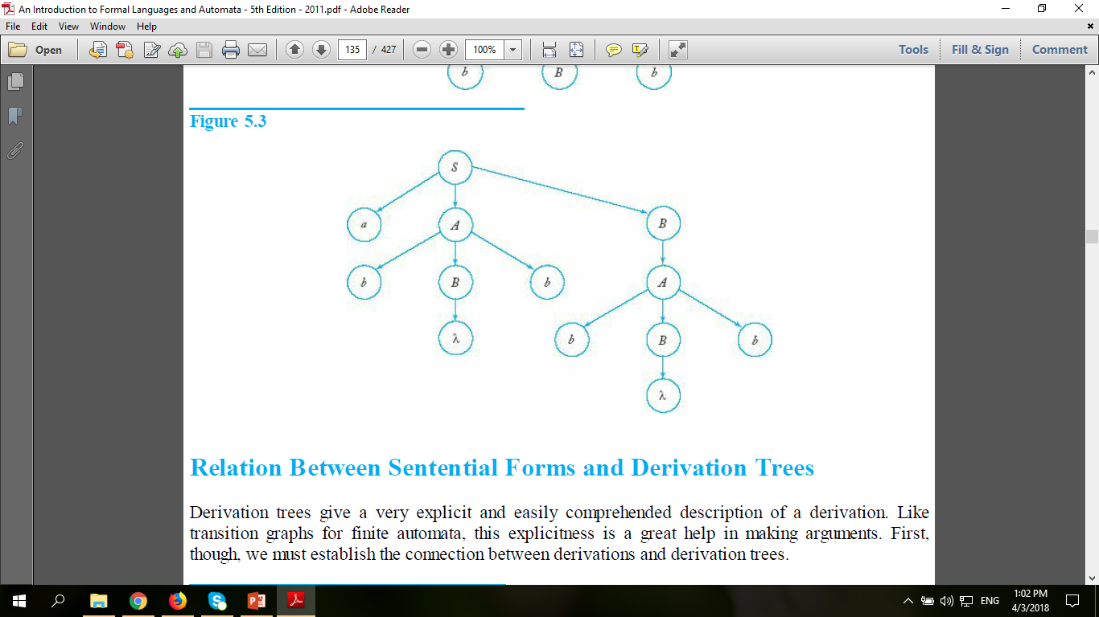
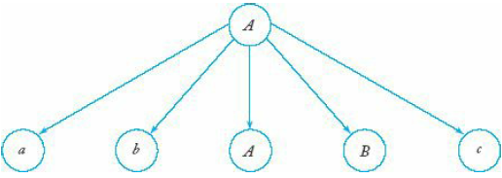
Derivation Trees:
A second way of showing derivations, independent of the order in which productions are used, is by a derivation or parse tree. A derivation tree is an ordered tree in which nodes are labeled with the left sides of productions and in which the children of a node represent its corresponding right sides.
Root Vertex must be labelled by the start symbol and vertex must be labelled by Non-Terminal symbol and leaves must be labelled by Terminal smbol or ε.

Slide 20
Derivation Trees:
A context-free grammar G is said to be ambiguous if there exists some w  L(G) that has at least two parse trees. Alternatively, ambiguity implies the existence of two or more leftmost or rightmost derivations.
S
S
S
S
S
S
+
*
S
S
S
a
*
S
+
b
b
a
b
b

Slide 21
Left Derivation Trees:
A CFG has a production rules given below, Compute the string w = acbabc with left most derivation.
S aAB
A Bba
B c
B bB
S aAB (Rule:1)
aBbaB (Rule:2)
acbaB (Rule:4)
acbabB (Rule:3)
acbabc (Rule:4)
S
a
B
A
B
a
b
c
b
c

Slide 22
Left Derivation Trees:
A CFG has a production rules given below, Compute the string w = abaabaa with left most derivation.
S a
S aAS
A bS
S aAS (Rule:2)
abSS (Rule:3)
abaS (Rule:1)
abaaAS (Rule:2)
abaabSS (Rule:3)
abaabaS (Rule:1)
abaabaa (Rule:1)
S
a
S
A
a
S
A
b
S
b
S
a
a
a

Slide 23
Right Derivation Trees:
A CFG has a production rules given below, Compute the string w = aab with right most derivation.
S AB
A aaA
A ε
B Bb
B ε
S AB (Rule:1)
ABb (Rule:4)
Ab (Rule:5)
aaAb (Rule:2)
aab (Rule:2)
S
a
B
a
A
a
B
b
ε
ε

Slide 24
Right Derivation Trees:
A CFG has a production rules given below, Compute the string w = abbcde with right most derivation.
S aTRe
T Tbc
T b
R d
S aTRe (Rule:1)
aTde (Rule:4)
aTbcde (Rule:2)
abbcde (Rule:3)
S
a
T
R
e
T
c
b
d
b

Slide 25
Ambiguity in Grammars:
A terminal string W  L(G) is ambiguous if there exists two or more derivation tree for W. {either leftmost or rightmost}.
S AB, S aaB, A a, A Aa, B b ; W=aab
S aaB aab
S AB AaB aaB aab
S
a
B
a
S
b
A
B
A
a
b
a

Slide 26
Ambiguity in Grammars:
1.
S
b
b
S
3.
S
2.
S
Y
Generate three sentential forms of the given
production rules:
S bSb
S Y
Y bXb
Y X
X aXa
X b
S bSb bYb bXb bbb
S Y X aXa aba
S bSb bYb bXb baXab baaab
S
Y
X
b
b
Y
X
b
X
a
a
X
a
a
X
b
a

Slide 27
Ambiguity in Grammars:
Give two ambiguous trees that can end in the same grammar?
production rules:
S aABc
S ε
A cSB
A Ab
B bB
B a
STRING: acabac

Slide 28
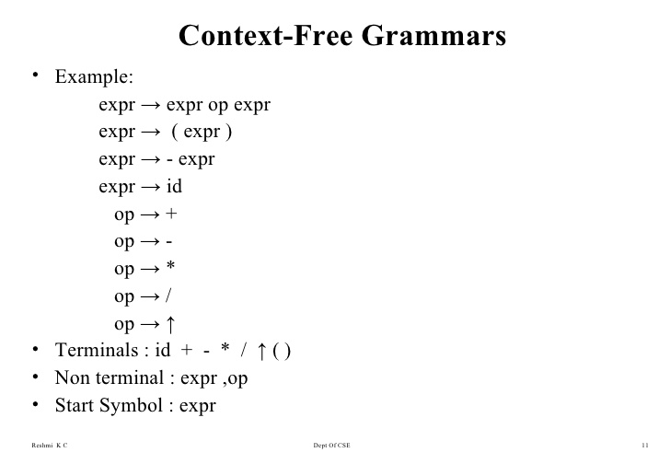
Context Free Grammars and Programming Languages:

Slide 29
Context Free Grammars and Programming Languages:
As with most other languages, we can define a programming language by a grammar. It is traditional in writing on programming languages to use a convention for specifying grammars called the Backus-Naur form or BNF. This form is in essence the same as the notation we have used here, but the appearance is different. In BNF, variables are enclosed in triangular brackets. Terminal symbols are written without any special marking. BNF also uses subsidiary symbols such as |.

Slide 30
Context Free Grammars and Programming Languages:
For instance, expressions like (2+3)*5 or 3+8+2*7 can be describes by the CFG.
3+8+2*7
<expr> <expr> + <expr>
<expr> <expr> * <expr>
<expr> (<expr>)
<expr> 0,1,2……..,9
Where non-terminals <expr>
and Terminals +,*,(,),0,1,2…..,9

Slide 31
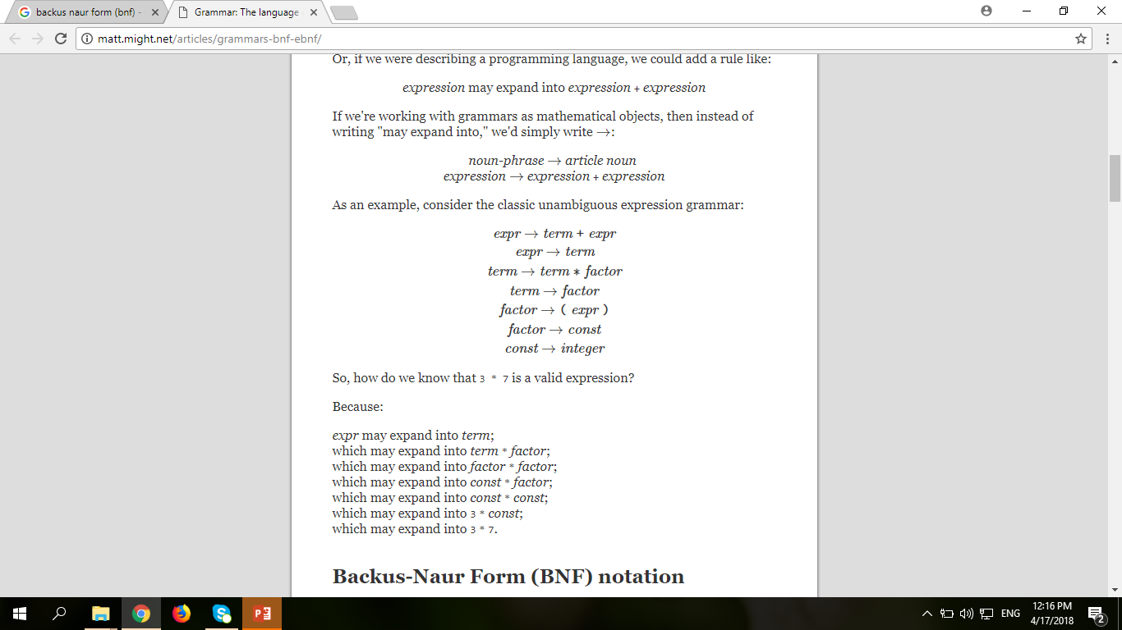
Context Free Grammars and Programming Languages:

Slide 32
Context Free Grammars and Programming Languages:
main()
{
<statements>
}
function fn()
{
<variable declaration>
<statements>
<variable declaration>
}
start main <sp> <left circle bracket> <right circle bracket> <nl> <left parenthesis> <nl> <statement part> <nl> <right parenthesis> <nl> <fn>
<fn> function <sp> <fn> <left circle bracket> <right circle bracket> <nl> <left parenthesis> <nl> <variable declaration> <nl> <statement part> <nl> <variable declaration> <nl> <right parenthesis>

Slide 33
Context Free Grammars and Programming Languages:
int i;
for (i=1; i<=10; i++)
{
printf(“Hello World”,i);
}
start <variable declaration> <nl> <for loop> <nl> <left parenthesis> <nl> <printf> <nl> <right parenthesis>
<variable declaration> <data type> <sp> <variable name> <terminator>
<for loop> for <sp> <left circle bracket> <variable initialization> <terminator> <condition> <terminator> <increment> <right circle bracket>
<variable initialization> <variable name> <assignment operator> <number>
<condition> <variable name><comparison operator> <number>
<increment> <variable name> <assignment operator> <variable name> <addition operator> <number>
<printf> <left circle bracket> <double quotation> <string> <double quotation> <separator> <variable name> <right circle bracket> <terminator>

Slide 34
Context Free Grammars and Programming Languages:
main()
{
int i;
int j, k;
char c[20];
}
start main <sp> <left circle bracket> <right circle bracket> <nl> <left parenthesis> <nl> <variable declaration> <nl> <right parenthesis>
<variable declaration> <data type> <sp> <variable name> <terminator>
<variable declaration> <data type> <sp> <variable list> <terminator>
<variable list> <variable name> <separator> <variable name>
<variable declaration> <data type> <sp> <variable name> <left square bracket> <number> <right square bracket> <terminator>

Slide 35
Context Free Grammars and Programming Languages:
main()
{
int alpha, alpha123;
float alpha;
char ch[50];
}
alpha=find sqr(alpha 123);

Slide 36
Context Free Grammars and Programming Languages:
i<=j;
(i+j)<=0;
<condition> <variable name> <less than> <assignment operator> <variable name> <terminator>
<expression> <left circle bracket> <variable name> <addition operator> <variable name> <right circle bracket>

