Slide 1
Theory of Automata and Formal Language

Slide 2
CONTEXT FREE LANGUAGES

Slide 3
Context Free Language:
In formal language theory, a Context Free Language (CFL) is a language generated by some Context Free Grammar.
It is more powerful than Finite Automata or Regular Expression , but still cannot define all possible languages.
The set of all CFL is identical to the set of languages accepted by Pushdown Automata.
CFL is considered to be a higher level language as compared to regular languages.

Slide 4
Context Free Language:
Context Free Grammar is defined by 4 tuples as G={V,T,S,P}, where
V= Set of variables or Non-terminal Symbols
T= Set of Terminal Symbols
S= Start Symbol
P= Production Rule
Context Free Grammar has production rule of the form
Α α
Where, Α € V and α € (V U T)*

Slide 5
Non-Terminals vs Terminals in Context Free Grammar:
Non-Terminals | Terminals
Which can be replaced | Which can’t replaced
Represented by capital letters | Represented by small letters
Which can’t lie on right side | Which can’t lie on left side

Slide 6
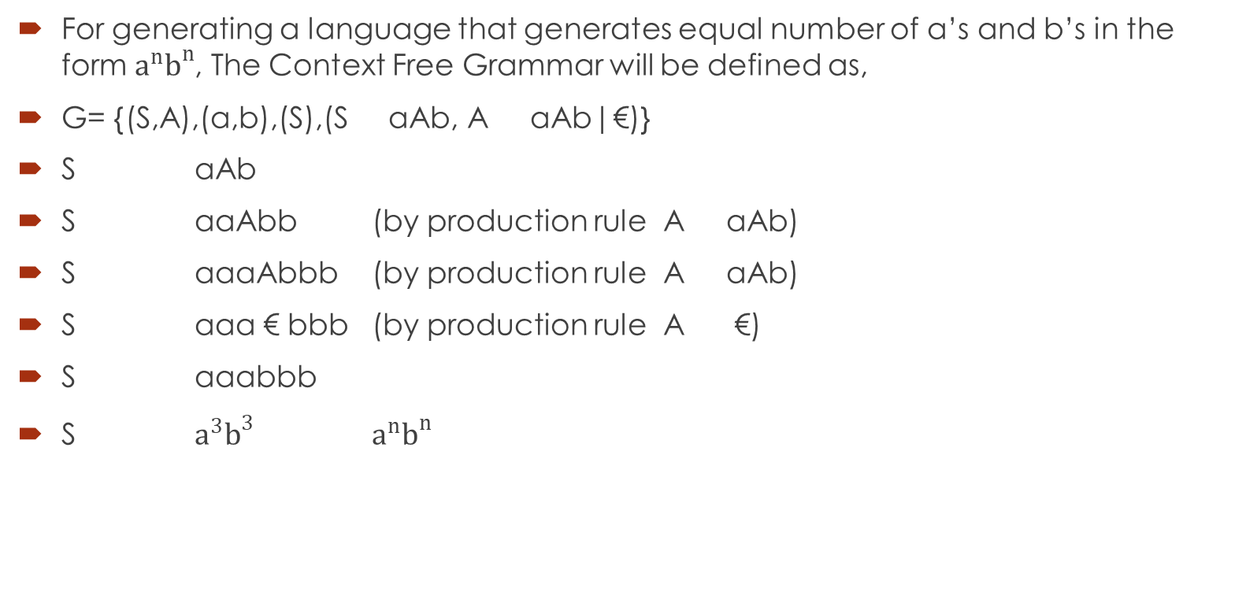
Context Free Language Example:
For generating a language that generates equal number of a’s and b’s in the form $a^{n}b^{n}$, The Context Free Grammar will be defined as,
G= {(S,A),(a,b),(S),(S aAb, A aAb|€)}
S aAb
S aaAbb (by production rule A aAb)
S aaaAbbb (by production rule A aAb)
S aaa € bbb (by production rule A €)
S aaabbb
S $a^{3}b^{3}$ $a^{n}b^{n}$

Slide 7
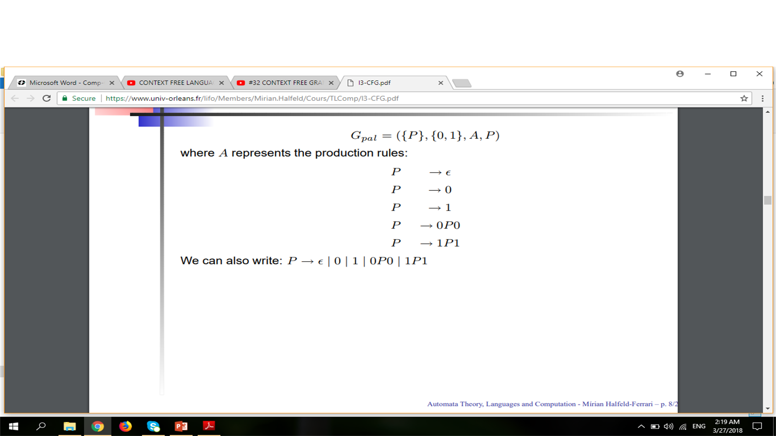
Context Free Language Example:

Slide 8
Convert Regular Expression to Context Free Grammar:
R.E = a
S a
R.E = a+b
S a | b
OR
S a
S b
OR
S X|Y
X a
Y b
R.E = (a+b)(a+b)
S YY
Y a | b
R.E = (a+b)(a+c)(a+b)
S YXY
Y a | b
X a | c
R.E = (a+b)a+(a+b)
S X | Y
X ZA
Z a| b
A a
Y A|B
B b

Slide 9
Convert Regular Expression to Context Free Grammar:
R.E = ab+(a+b)
S X|Y
X AB
Y A | B
A a
B b
R.E = (a+b)(aa+bb)(a+b)
S XYX
X A | B
Y AA| BB
A a
B b
R.E = a*
S €
S AS
A a
R.E = (a+b)*
S €
S AS
S BS
A €
A a
B €
B b

Slide 10
Convert Regular Expression to Context Free Grammar:
R.E = (a+b)*a(a+b)*
S XYX
X €
X YX
X ZX
Y a
Z b
R.E = a* +a(a+b)
S X|Y
X €
X AX
Y AZ
Z A| B
A a
B b
R.E = (a+b)*(a+b)+(ab+ba)*(a+b)*B(a+b)+a
S X|Y|Z
X PQ
P €
P ZP
P RP
Q Z|R
Y LPNQ
N B

Slide 11
Convert Regular Expression to Context Free Grammar:
L €
L ZRL
L RZL
R b
Z a

Slide 12
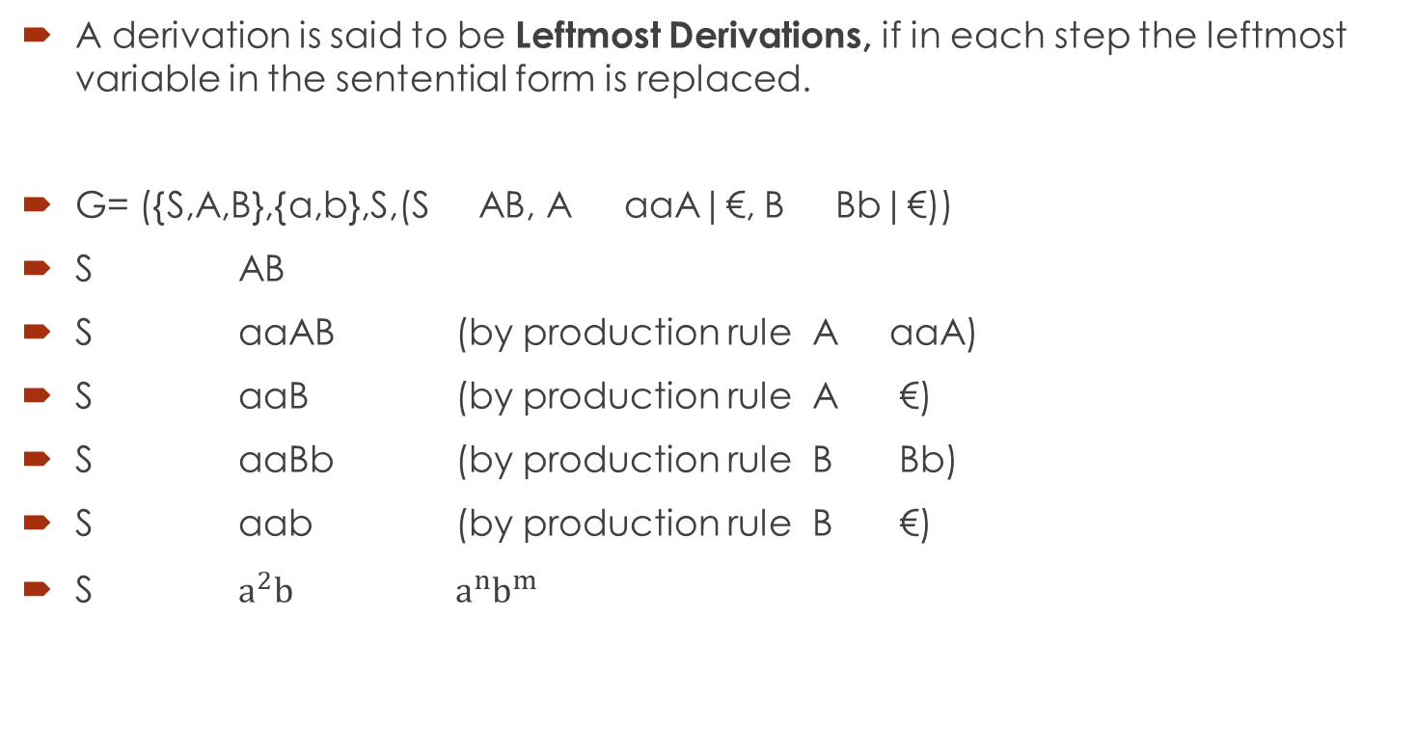
Leftmost Derivations:
A derivation is said to be Leftmost Derivations, if in each step the leftmost variable in the sentential form is replaced.
G= ({S,A,B},{a,b},S,(S AB, A aaA|€, B Bb|€))
S AB
S aaAB (by production rule A aaA)
S aaB (by production rule A €)
S aaBb (by production rule B Bb)
S aab (by production rule B €)
S $a^{2}b^{}$ $a^{n}b^{m}$

Slide 13
Leftmost Derivations:
S= S+S|S*S|a|b|c
W= a+b*c
S S+S
S a+S
S a+S*S
S a+b*S
S a+b*c

Slide 14
Leftmost Derivations:
S aAB
A bBb
B A| €
S aAB
S abBbB
S abAbB
S abbBbbB
S abb€bbB
S abbbb€
S abbbb

Slide 15
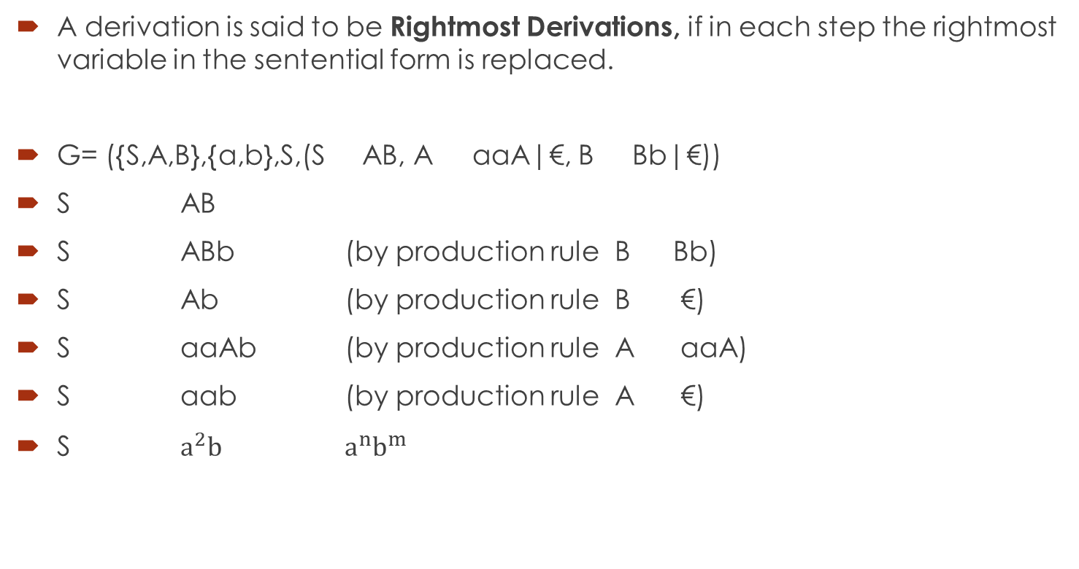
Rightmost Derivations:
A derivation is said to be Rightmost Derivations, if in each step the rightmost variable in the sentential form is replaced.
G= ({S,A,B},{a,b},S,(S AB, A aaA|€, B Bb|€))
S AB
S ABb (by production rule B Bb)
S Ab (by production rule B €)
S aaAb (by production rule A aaA)
S aab (by production rule A €)
S $a^{2}b^{}$ $a^{n}b^{m}$

Slide 16
Rightmost Derivations:
S= S+S|S*S|a|b|c
W= a+b*c
S S*S
S S*c
S S+S*c
S S+b*c
S a+b*c

Slide 17
Rightmost Derivations:
S aAB
A bBb
B A| €
S aAB
S aA€
S abBb
S abAb
S abbBbb
S abb€bb
S abbbb

Slide 18
Leftmost and Rightmost Derivations:
Find the leftmost derivation and rightmost derivation
S aB|bA
A a|aS|bAA
B b|bS|aBB
For the string baaabbabba

Slide 19
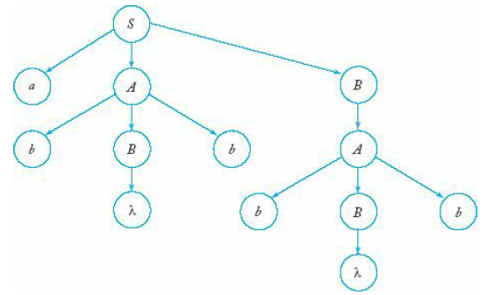
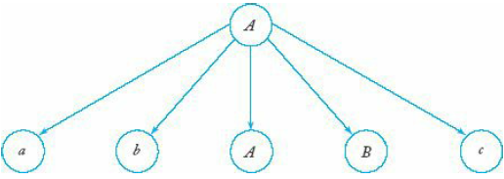
Derivation Trees:
A second way of showing derivations, independent of the order in which productions are used, is by a derivation or parse tree. A derivation tree is an ordered tree in which nodes are labeled with the left sides of productions and in which the children of a node represent its corresponding right sides.

