Slide 1
Theory of Automata and Formal Language

Slide 2
PUSHDOWN AUTOMATA

Slide 3
Pushdown Automata:
A Pushdown Automata (PDA) is a technique used to implement a Context Free Grammar (CFG) in a similar manner we design Finite Automata for Regular Grammar.
It is more powerful computation device that can recognize Context Free Languages than Finite State Machine because it has more memory due to stack but Finite State Machine has limited memory.
Only the nondeterministic PDA defines all the CFL’s while the deterministic PDA accepts only a subsets of the CFLs.

Slide 4
Nondeterministic Pushdown Automata:
A Pushdown Automata is defined by 7 Tuples as P = (Q, Σ, Γ, δ, q0 , z0 , F), where
Q = A finite set of States
Σ = A finite set of Input Symbols
Γ = A finite Stack Alphabet
δ = The Transition Function
q0 = The Start State
z0 = The Start Stack Symbol
F = The Final/ Accepting States

Slide 5
Pushdown Automata:
A Pushdown Automata has three components:
An input tape: that contain finitely many cells. Each cell contains an input letter.
A finite Control Unit: that consist of start, read, push, pop and accept and reject.
Push is used to insert letter into stack
Pop is used to delete letter from stack
Read is used for tape
Start is used to begin the machine and stack is always empty in the beginning.
Accept is used to end the machine and stack is always empty at the end.
Reject is used when the string is not in accepting state
A stack: that is used for string processing, initially stack will be empty.

Slide 6
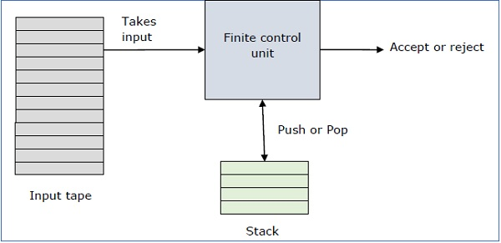
Pushdown Automata:
Tape head
Stack head

Slide 7
Pushdown Automata:
A Pushdown Automata can be divided into two PDA:
A Deterministic PDA
A Non-Deterministic PDA

Slide 8
Non Deterministic PDA:
a, b, ... are input symbols but sometimes we allow  as a possible value.
…, X, Y, Z are stack symbols.
…, w, x, y, z are strings of input symbols.
, β, … are strings of stack symbols.
For transition function, take three arguments:
A state in Q
An input which is either a letter in Σ or .
A stack in .
δ (q, a, Z) is a set of zero or more actions of the form (p, ) where p is a state and  is a string of stack symbol.

Slide 9
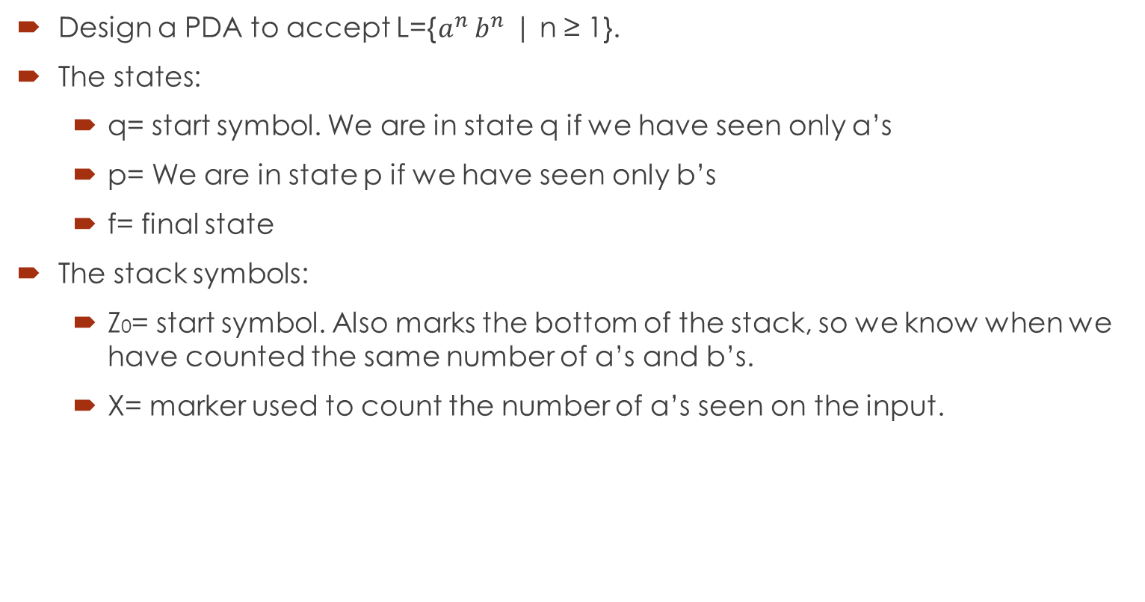
Example of Non Deterministic PDA:
Design a PDA to accept L={$a^{n}$ $b^{n}$ | n ≥ 1}.
The states:
q= start symbol. We are in state q if we have seen only a’s
p= We are in state p if we have seen only b’s
f= final state
The stack symbols:
Z0= start symbol. Also marks the bottom of the stack, so we know when we have counted the same number of a’s and b’s.
X= marker used to count the number of a’s seen on the input.

Slide 10
Example of Non Deterministic PDA:
The transitions:
δ (q, , ) = {(q, Z0)}
δ (q, a, Z0) = {(q, XZ0)}
δ (q, a, X) = {(q, XXZ0)}
δ (q, a, X) = {(q, XXXZ0)}
δ (q, b, X) = {(p, )}
δ (p, b, X) = {(p, )}
δ (p, b, X) = {(p, )}
δ (p, , Z0) = {(f, Z0)}
S.No. | States | Unread Inputs | Stack
1 | q | aaabbb | Z0
2 | q | aabbb | XZ0
3 | q | abbb | XXZ0
4 | q | bbb | XXXZ0
5 | p | bb | XXZ0
6 | p | b | XZ0
7 | p |  | Z0
8 | f |  | Z0

Slide 11

Example of Non Deterministic PDA:
The State Diagram of L={$a^{n}$ $b^{n}$ | n ≥ 1}.
, , / Z0
a, Z0 / XZ0
a, X / XXZ0
b, X / 
q
b, X / 
p
, Z0 / Z0
f

Slide 12
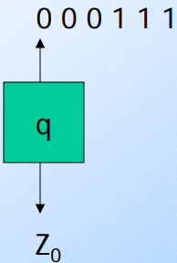
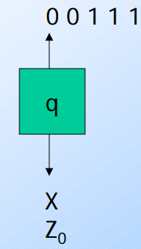
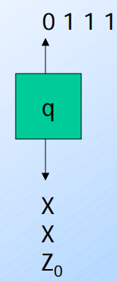
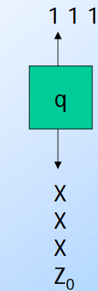
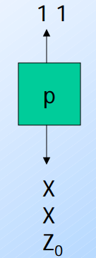
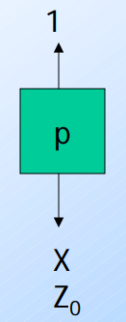
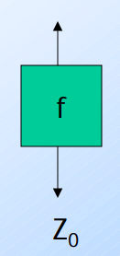
Example of Non Deterministic PDA:

Slide 13
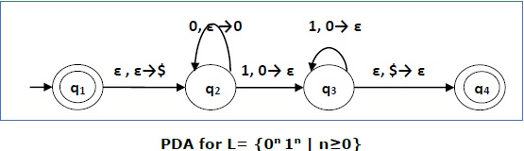

Example of Non Deterministic PDA:
The State Diagram of L={$0^{n}$ $1^{n}$ | n ≥ 0}.
The transitions (Instantaneous Descriptions):
δ (q1, , ) = {(q1, $)}
δ (q2, 0, $) = {(q2, 0$)}
δ (q2, 1, 0) = {(q3, $)}
δ (q3, 1, 0) = {(q3, $)}
δ (q3, , $) = {(q4, )}

Slide 14
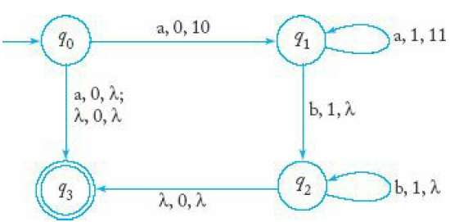
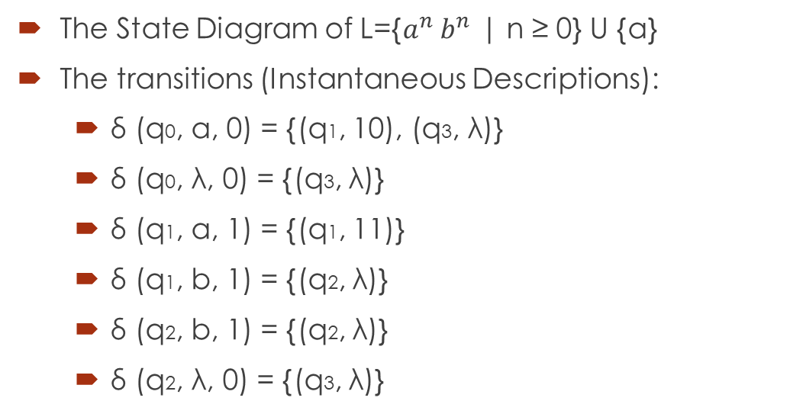
Example of Non Deterministic PDA:
The State Diagram of L={$a^{n}$ $b^{n}$ | n ≥ 0} U {a}
The transitions (Instantaneous Descriptions):
δ (q0, a, 0) = {(q1, 10), (q3, λ)}
δ (q0, λ, 0) = {(q3, λ)}
δ (q1, a, 1) = {(q1, 11)}
δ (q1, b, 1) = {(q2, λ)}
δ (q2, b, 1) = {(q2, λ)}
δ (q2, λ, 0) = {(q3, λ)}

Slide 15

Example of Non Deterministic PDA:
The State Diagram of L={$a^{n}$ $b^{2n}$ | n ≥ 1}.
a, Z0 / aZ0
a, a / aaZ0
q0
q1
q2
qf
b, a / a
b, a / λ
λ, Z0 / Z0
b, a / a

Slide 16
Example of Non Deterministic PDA:
The transitions (Instantaneous Descriptions):
δ (q0, a, Z0) = {(q0, aZ0)}
δ (q0, a, a) = {(q0, aaZ0)}
δ (q0, a, a) = {(q0, aaaZ0)}
δ (q0, b, a) = {(q1, aaaZ0)}
δ (q1, b, a) = {(q2 , λ)}
δ (q2, b, a) = {(q1, aaZ0)}
δ (q1, b, a) = {(q2 , λ)}
δ (q2, , Z0) = {(qf, Z0)}

Slide 17

Example of Non Deterministic PDA:
The State Diagram of L={$wcw^{R}$ | w (a,b)*}.
a, Z0 / aZ0
a, a / aaZ0
a, b / abZ0
b, Z0 / bZ0
b, b / bbZ0
b, a / baZ0
b, b / 
a, a / 
q
p
, Z0 / Z0
f
c, Z0 / Z0
c, a / a
c, b / b

Slide 18
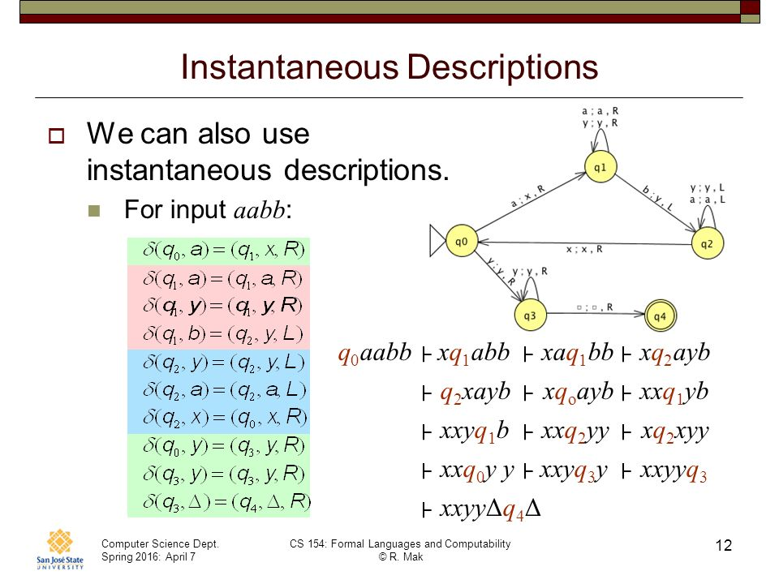
Stack Movie of String aabb:

