Slide 1
Theory of Automata and Formal Language

Slide 2
Course Outline
Finite State Models: Language definitions preliminaries, Regular expressions/Regular languages, FAs, Transition graphs, NFAs, Kleene’s theorem, Transducers (automata with output), Pumping lemma and non regular language Grammars and PDA: Context free grammars, Derivations, derivation trees and ambiguity, Simplifying CFLs , Normal form grammars and parsing, Decidability, Chomsky’s hierarchy of grammars Turing Machines Theory: Turing machines, Post machine, Variations on TM, TM encoding, Universal Turing Machine, Context sensitive Grammars, Defining Computers by TMs.

Slide 3
Text Books
An Introduction to Formal Languages and Automata, By Peter Linz, 4th edition, Jones & Bartlett Publishers, 2006
Theory of Automata, Formal Languages and Computation, By S. P. Eugene, Kavier, 2005, New Age Publishers, ISBN (10): 81-224-2334-5, ISBN (13) : 978-81-224-2334-1.
John Hopcroft and Jeffrey Ullman, Introduction to Automata Theory, Languages, and Computation, 2nd edition, 2001, Addison-Wesley.
Introduction to Languages and the Theory of Computation, By John C. Martin3rd edition, 2002, McGraw-Hill Professional.

Slide 4
INTRODUCTION

Slide 5
What is Automata?
Automata is derived from the word ‘automaton’ (Greek word) which means to automate or mechanize. By mechanize we mean the machine to process or work on its own without much human intervention or you can say anything that works itself is called automata.
Generally speaking, an automaton (plural: automata) is a self-operating machine.
It accepts input, produces output, may have some temporary storage, and can make decisions in transforming the input into the output.

Slide 6
What is Automata Theory?
Automata theory is the study of abstract computational devices.
Before the invention of computers a genius scientist known as ALAN TURING introduced an abstract machine that has the capability of computing as of todays machines, he named it TURING MACHINE which is the most advance machine recognizing an advanced set of language which we will see in later.
In general, this theory of automata focuses on the theoretical aspect of computer science.
In automata theory, we study formal languages.

Slide 7
Why we study Automata Theory?
It plays an important role when we are making softwares for designing and checking the circuits behavior.
Lexical analyzer of the typical compiler
Designing softwares that scans large bodies of text.
Designing application to creating compilers, programming languages, designing applications.
Useful process for processing of natural languages.

Slide 8
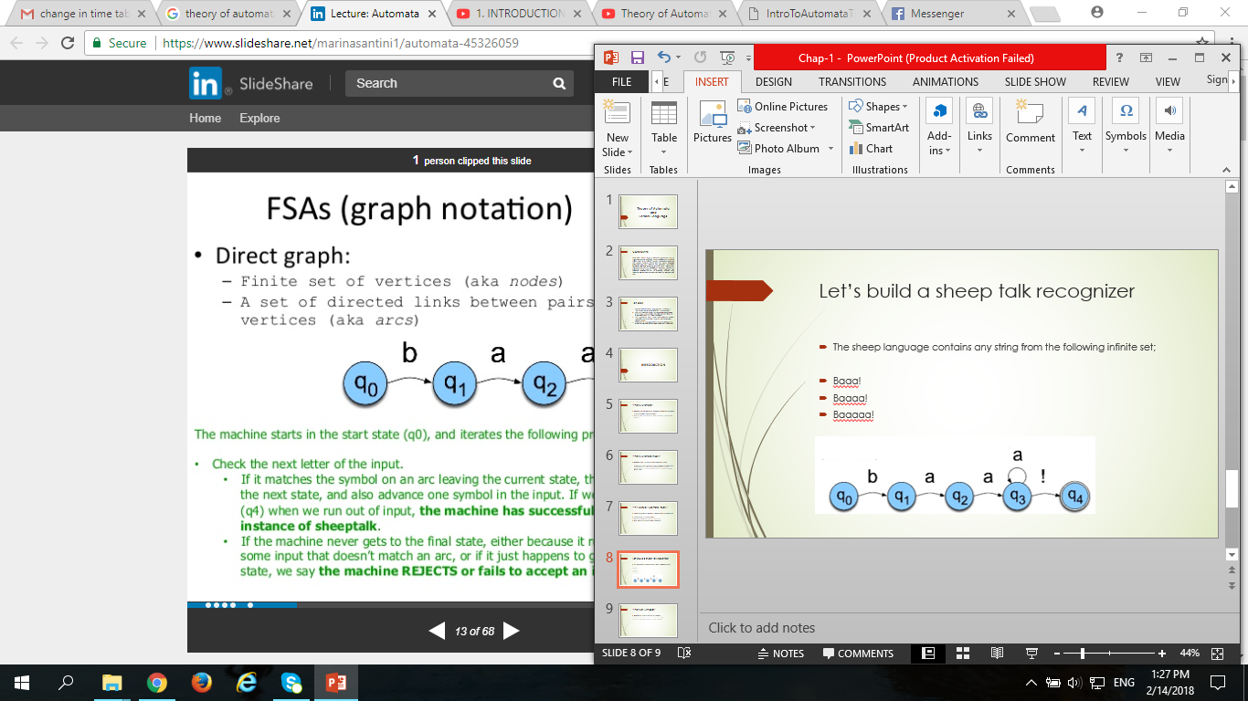
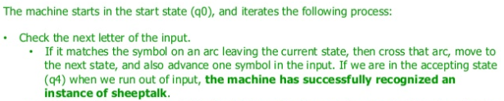
Let’s build a sheep talk recognizer
The sheep language contains any string from the following infinite set;
baaa!
baaaa!
baaaaa!

Slide 9
State Transition table
State | Input
 | b a !
0 | 1 0 0
1 | 0 2 0
2 | 0 3 0
3 | 0 3 4
4 | 0 0 0
If you are in State-1 and you are
looking at a, go to State-2
We can say the following things about this machine:
b,a and ! are its alphabet
q0 is the start state
q4 is the accept state

Slide 10
Alphabet
Alphabets are defined as the finite or non-empty set of symbols.
The set of alphabets is enclosed by the curly braces ‘{}’
The set of alphabets is stored in the sigma variable ‘Σ’
Example:
The binary digits alphabet: Σ= {0,1}
The set of all lower-case letters: Σ= {a,b,…,z}
The set of all ASCII characters.

Slide 11
Letter
Letters are the symbols in the set alphabet
Example
Σ= {0,1} , where 0 is a letter and 1 is another letter.
Σ= {a,b} , where a is a letter and b is another letter.
Σ= {a,1} , where a is a letter and 1 is another letter.

Slide 12
String
A string (or sometimes a word) is a finite sequence of symbols chosen from some alphabet.
An empty string or null string is a string without symbols, and is denoted by λ or Λ or ε
Let L be a string, then its length, denoted by |L|, is a number of symbols of L.
Example:
The language L of strings of odd length, defined over Σ={a} can be written as L = {a, aaa, aaaaa, …..}
The language L of strings of binary numbers, defined over Σ={0, 1} can be written as L = λ, |L| = 0 ; L = 01, |L| = 2 ; W = 010110, |L| = 6
The language L of strings that does not start with a, defined over Σ={a, b, c} can be written as L={b, c, ba, bb, bc, ca, cb, cc, …}

Slide 13
Word
Word is a string that belongs to the language
Example:
If Σ= {a,b} , All words ending with a
Strings would be {aaa, aba, bbb, bbba, bbbbab}
Word are aaa, aba and bbba because these strings are following the rule.
Every string is not a word but every word is a string.

Slide 14
String Length
Length of a string is the number of positions for symbols in the string.
Length means how many number of letters are there in the string.
Example:
If Σ= {0,1} , find length of a string 01101 ; (0)(1)(1)(0)(1) has 5 length of string.
Notation of length of w: |w| ; |011| = (0)(1)(1) = 3
If Σ= {aa, bab} , find length of a string babaabab ; (bab)(aa)(bab) has 3 length of string.

Slide 15
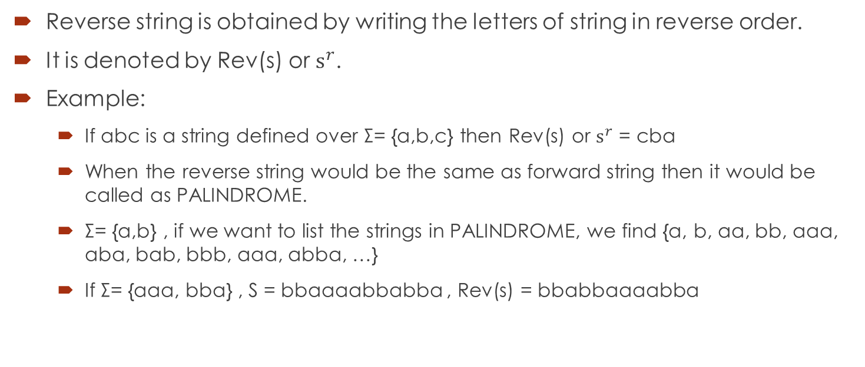
Reverse String
Reverse string is obtained by writing the letters of string in reverse order.
It is denoted by Rev(s) or ${\text{s}}^{r}$.
Example:
If abc is a string defined over Σ= {a,b,c} then Rev(s) or ${\text{s}}^{r}$ = cba
When the reverse string would be the same as forward string then it would be called as PALINDROME.
Σ= {a,b} , if we want to list the strings in PALINDROME, we find {a, b, aa, bb, aaa, aba, bab, bbb, aaa, abba, …}
If Σ= {aaa, bba} , S = bbaaaabbabba , Rev(s) = bbabbaaaabba

Slide 16
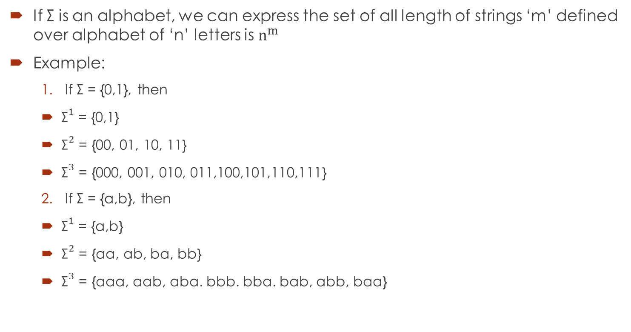
Length of string over n Alphabets
If Σ is an alphabet, we can express the set of all length of strings ‘m’ defined over alphabet of ‘n’ letters is ${\text{n}}^{m}$
Example:
If Σ = {0,1}, then
${\text{Σ}}^{1}$ = {0,1}
${\text{Σ}}^{2}$ = {00, 01, 10, 11}
${\text{Σ}}^{3}$ = {000, 001, 010, 011,100,101,110,111}
If Σ = {a,b}, then
${\text{Σ}}^{1}$ = {a,b}
${\text{Σ}}^{2}$ = {aa, ab, ba, bb}
${\text{Σ}}^{3}$ = {aaa, aab, aba. bbb. bba. bab, abb, baa}

Slide 17
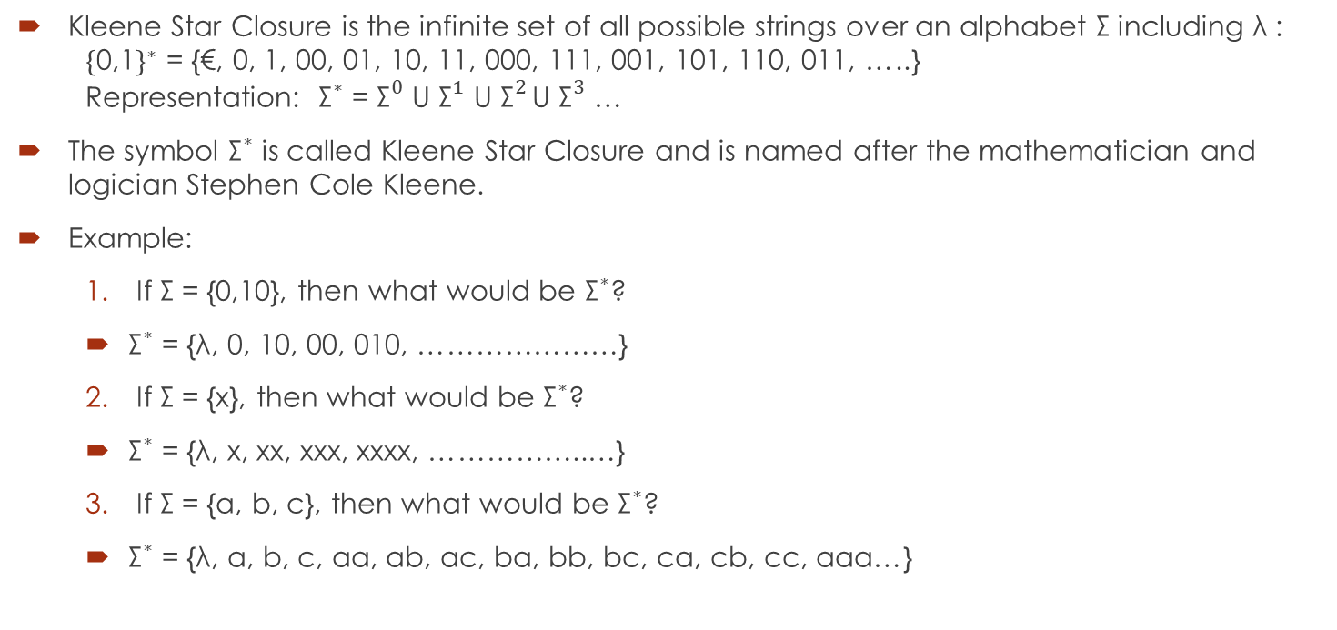
Kleene Star Closure:
Kleene Star Closure is the infinite set of all possible strings over an alphabet Σ including λ : ${\text{\{}\text{0,1}\text{\}}}^{∗}$ = {€, 0, 1, 00, 01, 10, 11, 000, 111, 001, 101, 110, 011, …..} Representation: ${\text{Σ}}^{∗}$ = ${\text{Σ}}^{0}$ U ${\text{Σ}}^{1}$ U ${\text{Σ}}^{2 }$U ${\text{Σ}}^{3}$ …
The symbol ${\text{Σ}}^{∗}$ is called Kleene Star Closure and is named after the mathematician and logician Stephen Cole Kleene.
Example:
If Σ = {0,10}, then what would be ${\text{Σ}}^{∗}$?
${\text{Σ}}^{∗}$ = {λ, 0, 10, 00, 010, …………………}
If Σ = {x}, then what would be ${\text{Σ}}^{∗}$?
${\text{Σ}}^{∗}$ = {λ, x, xx, xxx, xxxx, ……………..…}
If Σ = {a, b, c}, then what would be ${\text{Σ}}^{∗}$?
${\text{Σ}}^{∗}$ = {λ, a, b, c, aa, ab, ac, ba, bb, bc, ca, cb, cc, aaa…}

Slide 18
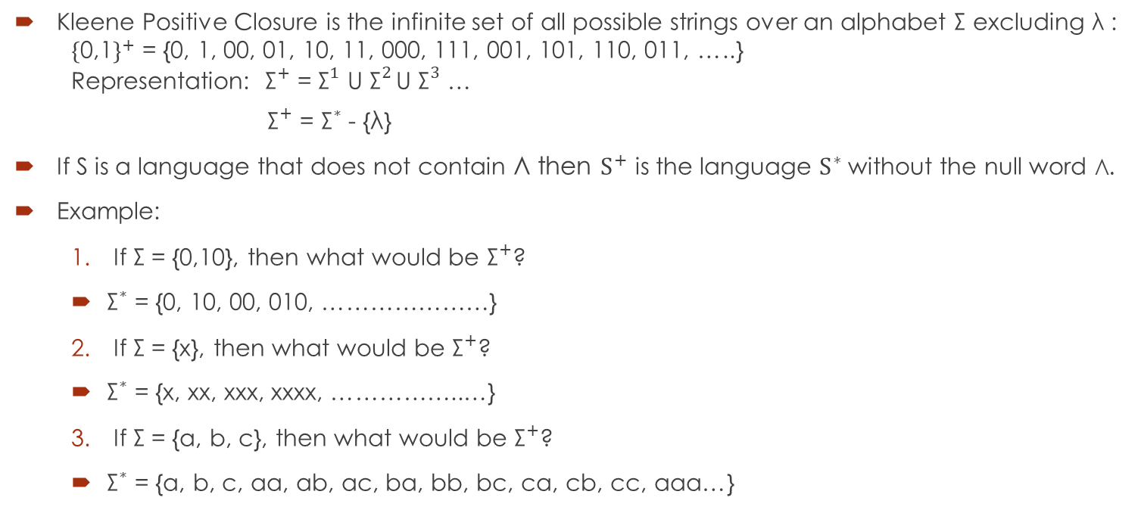
Kleene Positive Closure:
Kleene Positive Closure is the infinite set of all possible strings over an alphabet Σ excluding λ : ${\text{\{}\text{0,1}\text{\}}}^{+}$ = {0, 1, 00, 01, 10, 11, 000, 111, 001, 101, 110, 011, …..} Representation: ${\text{Σ}}^{+}$ = ${\text{Σ}}^{1}$ U ${\text{Σ}}^{2 }$U ${\text{Σ}}^{3}$ …
${\text{Σ}}^{+}$ = ${\text{Σ}}^{∗}$ - {λ}
If S is a language that does not contain Λ then ${\text{S}}^{+}$ is the language ${\text{S}}^{∗}$without the null word Λ.
Example:
If Σ = {0,10}, then what would be ${\text{Σ}}^{+}$?
${\text{Σ}}^{∗}$ = {0, 10, 00, 010, …………………}
If Σ = {x}, then what would be ${\text{Σ}}^{+}$?
${\text{Σ}}^{∗}$ = {x, xx, xxx, xxxx, ……………..…}
If Σ = {a, b, c}, then what would be ${\text{Σ}}^{+}$?
${\text{Σ}}^{∗}$ = {a, b, c, aa, ab, ac, ba, bb, bc, ca, cb, cc, aaa…}

