Slide 1
Theory of Automata and Formal Language

Slide 2
REGULAR LANGUAGES AND REGULAR GRAMMARS

Slide 3
Regular Language
A regular language is a language that can be expressed with a regular expression or a deterministic or non-deterministic finite automata or state machine.
A language is a set of strings which are made up of characters from a specified alphabet, or set of symbols.
Regular languages are used in parsing and designing programming languages and are one of the first concepts taught in automata theory.
Regular Languages are the most restricted types of languages and are accepted by finite automata.

Slide 4
Regular Expressions
Regular Expressions are used to denote regular languages. An expression is regular if:
ɸ is a regular expression for regular language ɸ.
ɛ is a regular expression for regular language {ɛ}.
If a ∈ Σ (Σ represents the input alphabet), a is regular expression with language {a}.
If a and b are regular expression, a + b is also a regular expression with language {a,b}.
If a and b are regular expression, ab (concatenation of a and b) is also regular expression.
If a is regular expression, a* (0 or more times a) is also regular expression.

Slide 5
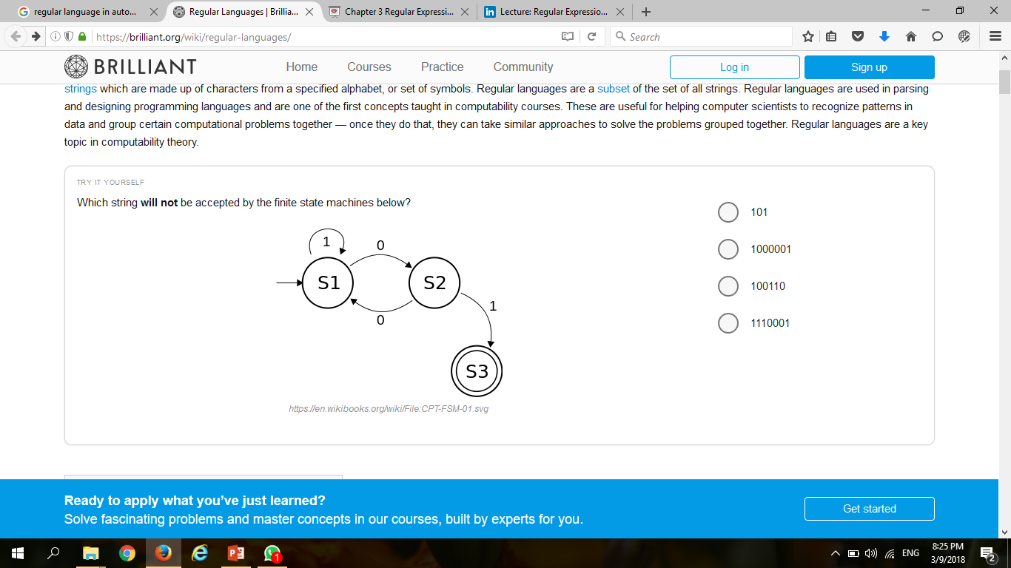
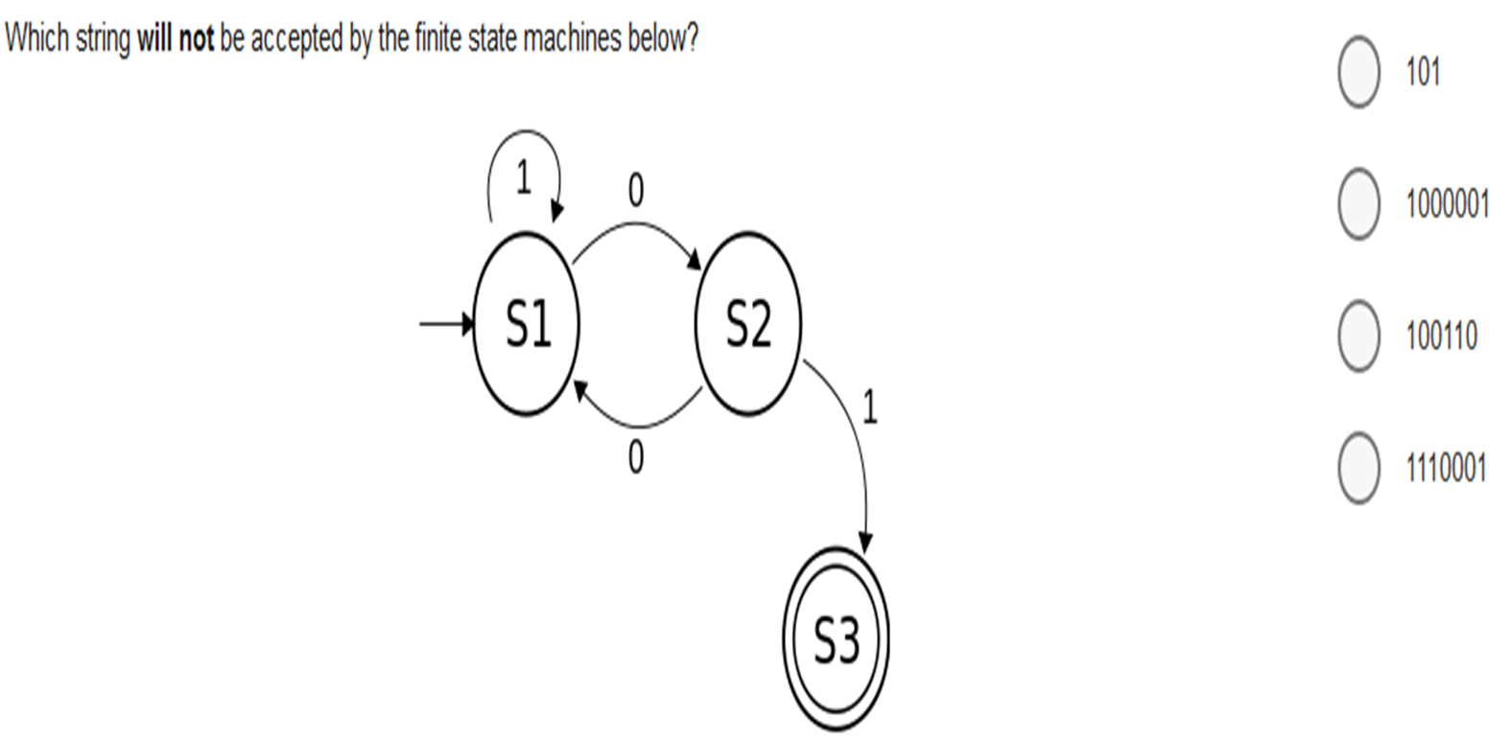
Regular Expressions

Slide 6
Regular Expressions
Example:
If Σ = {a}, write regular expression for all string.
L = {ɛ, a, aa, aaa, aaaa, aaaaa, …}
R.E = a*
If Σ = {a}, write regular expression for all string without ɛ.
L = {a, aa, aaa, aaaa, aaaaa, …}
R.E = a+
If Σ = {a, b}, write regular expression for all string.
L = {ɛ, a, b, ab, ba, aaa, aab, aba, baa, bba, bab…}
R.E = (a+b)*

Slide 7
Regular Expressions
If Σ = {a, b}, write regular expression for all string which starts with a.
L = {a, aa, ab, aaa, aab, …}
R.E = a(a+b)*
R.E = (a+b)* + (ab)*
(a+b)* = {ɛ, a, b, aa, ab, bb, ba, aaa, …}
(ab)* = {ɛ, ab, abab, ababab, …}
If Σ = {a, b}, write regular expression for all string which starts and end with b.
L = {bb, bab, bbb, baab, babb, …}
R.E = b(a+b)* b
If Σ = {a, b}, write regular expression for all string which contain aa.
L = {aa, baa, aba, aab, abab, baba, …}
R.E = b* a b* a b*

Slide 8
Regular Expressions
If Σ = {a, b}, write regular expression for all string which contain bb.
L = {bb, abb, bba, bbb, ababb, bbaba, …}
R.E = (a+b)* bb (a+b)*
If Σ = {0, 1}, write regular expression for all string whose third letter is 1. .
L = {001, 111, 011, 101, 1011, 0110, 0010, 1111, 0111, 1011,…}
R.E = (0+1)(0+1) 1 (0+1)*

