Slide 1
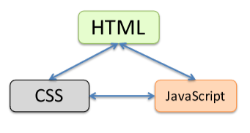
Web Programming
Lect-1

Slide 2
Web terminologies
Internet:
a connection of computer networks using the Internet Protocol (IP)
web server:
software that listens for web page requests Apache Microsoft Internet Information Server (IIS) (part of Windows)
web browser:
fetches/displays documents from web servers
Mozilla Firefox
Microsoft Internet Explorer (IE) Apple
Safari
Google Chrome
Opera

Slide 3
Web Fundamentals
Client: web browsers, used to surf the Web
Server systems: used to supply information to these browsers
Computer networks: used to support the browser-server communication
Request “document A”
document A
Client
Server

Slide 4
Internet v.s. Web
The Internet: a inter-connected computer networks, linked by wires, cables, wireless connections, etc.
Web: a collection of interconnected documents and other resources.
The world wide web (WWW) is accessible via the Internet, as are many other services including email, file sharing, etc.

Slide 5
How does the Internet Work?
Through communication protocols
A communication protocol is a specification of how communication between two computers will be carried out
IP (Internet Protocol): defines the packets that carry blocks of data from one node to another
TCP (Transmission Control Protocol) and UDP (User Datagram Protocol): the protocols by which one host sends data to another.
Other application protocols: DNS (Domain Name Service), SMTP (Simple Mail Transmission Protocol), and FTP (File Transmission Protocol)

Slide 6
The Internet Protocol (IP)
A key element of IP is IP address, a 32-bit number
The Internet authorities assign ranges of numbers to different organizations
IP is responsible for moving packet of data from node to node
A packet contains information such as the data to be transferred, the source and destination IP addresses, etc.
Packets are sent through different local network through gateways
A checksum is created to ensure the correctness of the data; corrupted packets are discarded
IP-based communication is unreliable

Slide 7
The Transmission Control Protocol (TCP)
TCP is a higher-level protocol that extends IP to provide additional functionality: reliable communication
TCP adds support to detect errors or lost data and to trigger retransmission until the data is correctly and completely received

Slide 8
The World Wide Web (WWW)
WWW is a system of interlinked, hypertext documents that runs over the Internet
Two types of software:
Client: a system that wishes to access the information provided by servers must run client software (e.g., web browser)
Server: an internet-connected computer that wishes to provide information to others must run server software
Client and server applications communicate over the Internet by following a protocol built on top of TCP/IP – HyperText Transport Protocol (HTTP)

Slide 9
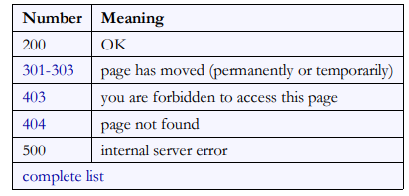
Hypertext Transport Protocol (HTTP)
the set of commands understood by a web server and sent from a browser some HTTP commands (your browser sends these internally):
GET filename : download
POST filename : send a web form response
PUT filename : upload
HTTP error codes
when something goes wrong, the web server returns a special "error code" number to the browser, possibly followed by an HTML document common error codes:

Slide 10
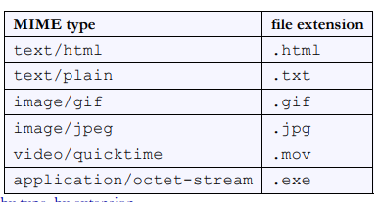
Internet media ("MIME") types
sometimes when including resources in a page (style sheet, icon, multimedia object), we specify their type of data

Slide 11
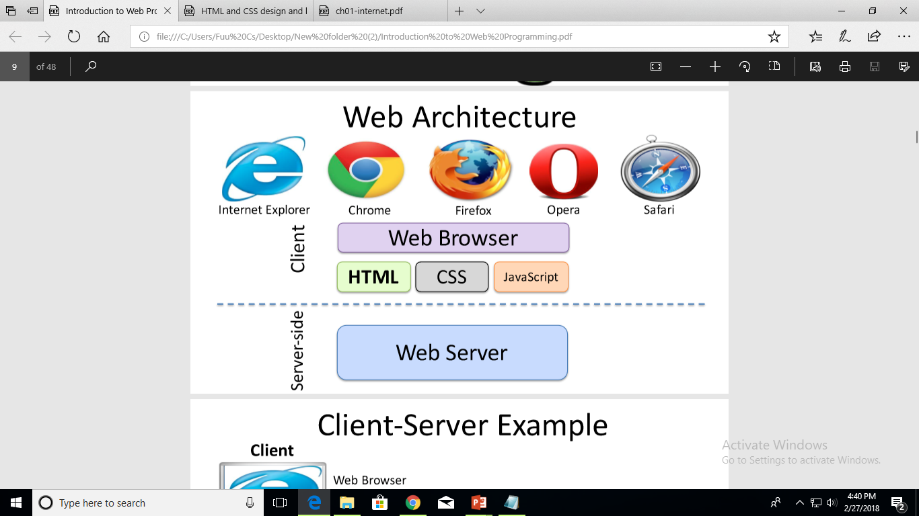

Slide 12
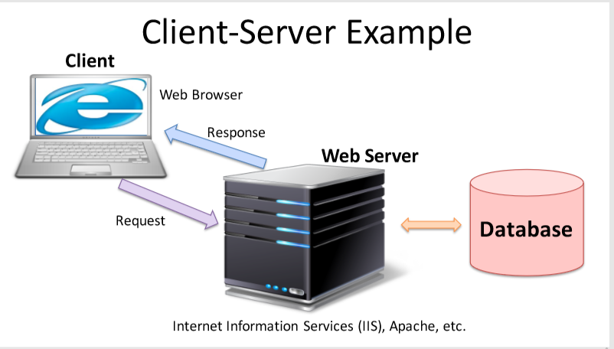

Slide 13
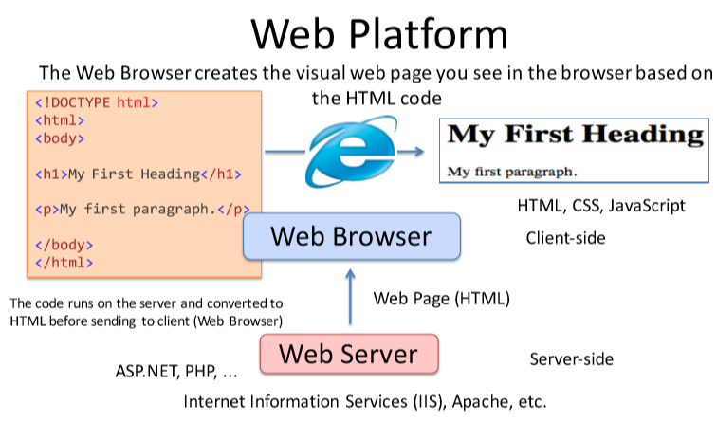

Slide 14
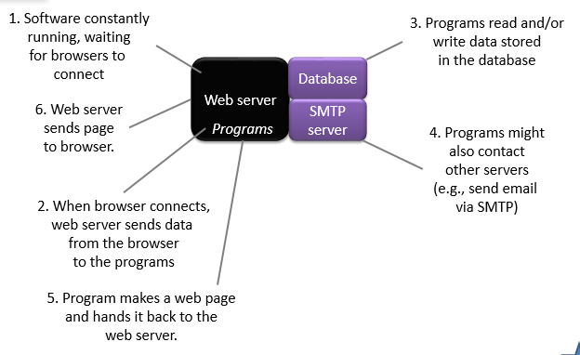
web application
Browser

Slide 15
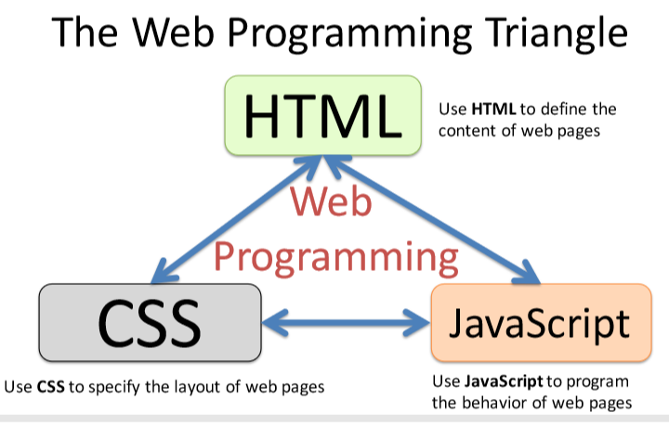
PHP
SQL

Slide 16
Primary technologies for the web
Basic Web Programming
HTML
CSS
JavaScript
PHP
SQL
For more Dynamic Web Programming we use e.g.,
ASP.NET
AJAX

Slide 17
Description
Hypertext Markup Language (HTML): used for writing web pages
Cascading Style Sheets (CSS): stylistic info for web pages PHP Hypertext
Processor (PHP): dynamically create pages on a web server
JavaScript: interactive and programmable web pages Asynchronous
JavaScript and XML (Ajax): accessing data for web applications eXtensible
Markup Language (XML): metalanguage for organizing data Structured
Query Language (SQL): interaction with databases

Slide 18
Hypertext markup language (HTML)
This is the language used to “write” web pages
It describes what is “on” a web page
HTML is necessary because without it, your web page is empty.

Slide 19
Cascading style sheets (CSS)
This is the language used to control the appearance of web pages.
You can control appearance of web pages using just HTML (so CSS is optional).
But web pages that don’t use CSS are ugly.

Slide 20
JavaScript (JS)
This is the language used to write the programs than run in the browser.
JavaScript is awesome because enables web pages to “feel” very interactive.
Anything you can do in JS you can also do in PHP, but it “feels” less responsive.

Slide 21
Personal home page (PHP)
This is the language used to write programs that run on the server.
There are very very many quite worthy alternatives (including Java, Ruby, and C#).
But PHP is easy to learn and widely available, so we will use it in this intro course.

Slide 22
Structured query language (SQL)
This is the language used to tell the database what to do (including read and write data).
There are alternatives, but none of them are as widely supported or standardized.
SQL (or one of those alternatives) is typically used when you need to manage lots of data.

