Slide 1
Interconnect Interoperabiltiy knowledge Graph
Dena Tahvildari

Slide 2
Glossary of terms
Term,
Definition,
Relevant to the ontology (competency questions) -- (yes, No),
Existing reference (standard),
Notes:
The glossary that I have in minf has 5 main fields:
Terms (any terms that we need to know),

Slide 3
Glossary functionality
Reference glossary of all the terms and defintions in ontlogy,
Reference glossary of all the terms (phrases) and defitnions in the iterconnect project,
Documentation
Lookup
…
We should go through some previouse steps in order to populate it.

Slide 4
Unified process for ontology building De Nicola, Missikof, Navgili (2005)
Based on Unified process (UP) methdology in software development and UML space,
Use-case driven, more suitable for application ontologies than for domain ontologies,
Goals
reduction of time and cost in the development of large scale ontologies,
Quality improvment of the developed ontology via progressive validation of intermidiate result.
Methodology for efficient collabroation of Knowledge engineers and domain experts with clear separation of roles.
Notes:
The idea is to ensure that the resulting system has sufficient background knowledge to successfully fulfill it mission.

Slide 5
Cycles- phases – workflows - protoype
Development is divided into cycles, which are subdivived into 4 phases of iterations (inception, elaboration, construction, transition).
Each iteration consists of 5 workflows:
requirement
Analysis,
Design,
Implementation, and
Test,

Slide 6
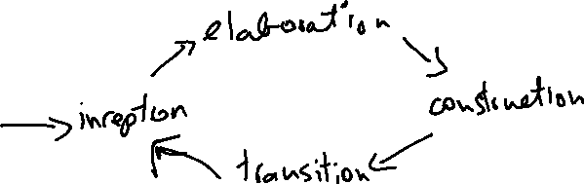


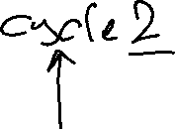
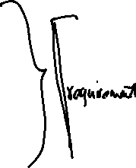



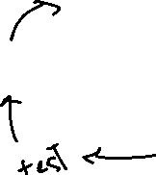


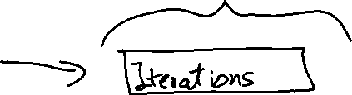



Slide 7





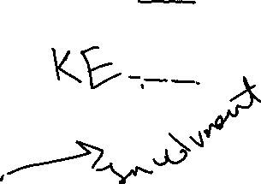


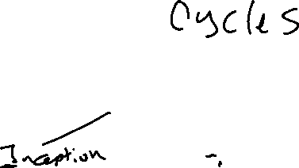


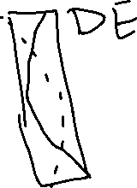
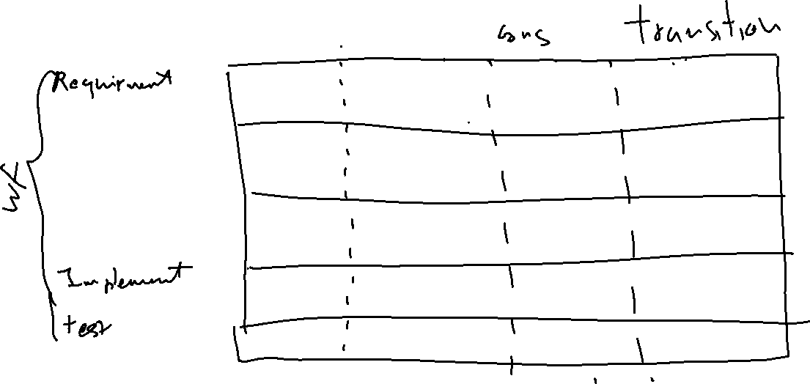


Slide 8






Slide 9
Requirement workflow
Input:
Interviews with the domain experts,
application specific documents,
standards, reference models (reuse, or integration)
Output:
Use-cases
userstories
Goal
Scope, out of scope
Event and activity diagrams
Actors, interfaces involved,
Non functional requirements,
Competency question

Slide 10
Competency Questions
Questions the knowledge base, application or ontology should be able to answer in fulfillment of the use case and a representation set of sample answers.
DerivedFrom:
Userstories,
Sequence diagrams

Slide 11
An example
From the garden-oriented user story interested in oak-root fungus susceptible trees:
Question
? From the set of approved trees for the city of Newyork, identify all those that are oak root fungus resistant, that flower, that are deciduous, and whose leaves turn colors in the fall.
Answer:
>> Koelreuteria paniculata (golden rain tree), melaleuca stypheloides (prickly paperbark), lagerstroemia indicus (crepe myrtle), malus ” Robinson” and ….
MoreAnswers:
>> Definitely not a cinnamomum camphora (camphone tree_

Slide 12
The answers entail:
(1) Onboard the list of trees, (what data)
(2) analyse to see which of the trees on the list are oak-root fungus resistant (needs some sort of confirmatin from authories or garden sites),
(3) which are deciduous ( there might be a classificaitons ),
(4) which are flowering (may require a separate reference),
(5) which showy fall foliage (reference),
(6) spatial indicators of geographic location, (newyork)
(7) rules or regulations,
Not be cinnamum (restrictions on types)
Defintions of each types

Slide 13
Considerations in answering the CQ
considerations for encoding the information,
checking values and, threshold of property values .
data
Types and definitions,
Inference might be needed, (constrainsts)

Slide 14
(2) Analysis workflow
Input
Existing external sources (standards, documents, ontologies,)
Application Lexicons
Analysis of the competency answers and questions,
Output
Domain and application lexicon,
Reference model,
Identifying the architectural modules
Reference glossary standard --reference for all the terms in the ontology

Slide 15
(3) Design Workflow
Input
Reference glossary,
Type diagrams (UML diagram),
We know architectural components
Output
Ontology (semantic network) – not yet formal
Identified (constructs – hierarchies, specific relations),

Slide 16
(4) Implementation workflow
Input:
Semantic network / ontology
Output
Owl or other owl dialects
Presentation patterns, naming conventions,
Logical patterns
Representing validation and inference rules

Slide 17
(5) Test
Input
formal ontology,
Example instantitions (Abox)
Output
Tested owl ontology
Verify the coverage (measure)
Answering comeptency question
THEN WE HAVE TO ADAPT

Slide 18
Where are we:
We have:
Usecases,
Sequence diagram,
Interoperabilty layers
Platform interoperability,
Network interoperability,
Service interoperability,
Device interoperability,
Building interoperability,
We should have:
Set of question– [interoperabilty clusters],
Set of answers to the questions,
Analysis of the answers,
Identify term, and nomreferences, vocabualries eclatures,

Slide 19
Reuse:
Once we have seeded our usecases (and came up with the comepetency questions), the next step is to gather resources we can Reuse as the basis for terms, definitions, and relationships.
Reuse, extend,
The terms in the user storeis and competency questions will provide guidance and additional content, but SMEs should be able to provide a list of relevant standards and other references to start with.
Controlled vocabualries and nomeclatures already exists in the domain,
Any standards or reference models (Saref),
Standard dictionaries,
We always try to reuse, if there is a gap we extend

Slide 20
Inference

