Slide 1
Logistic Knowledge Graph

Slide 2
Why a Formal model
Interoperability support,
Data Integration
Create a shared understanding of logistic domain,
Consistency checking,
Automatic Inference,
Forward Compatibility,

Slide 3

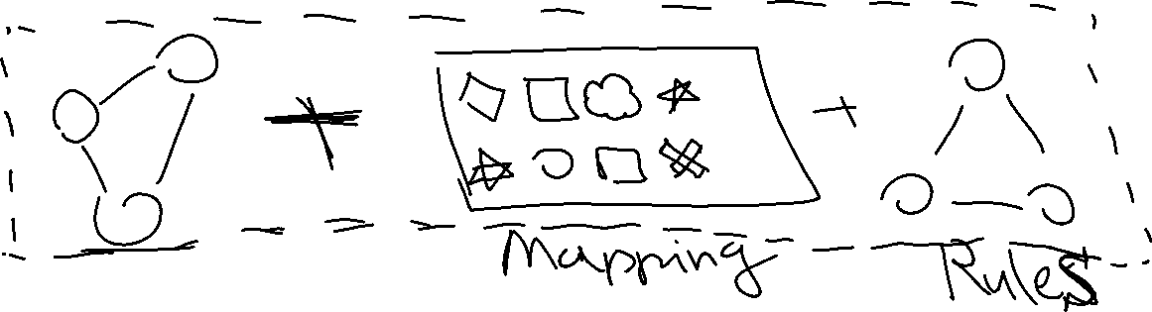
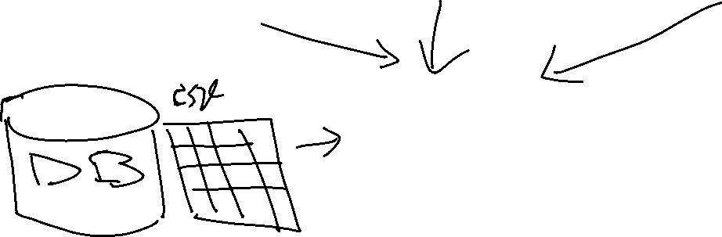

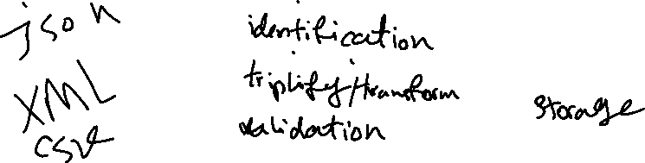
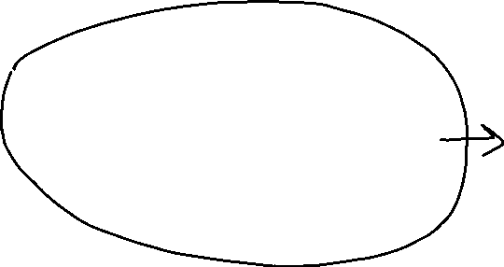
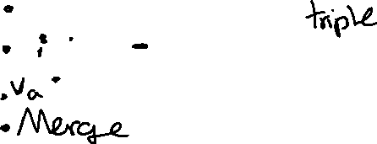

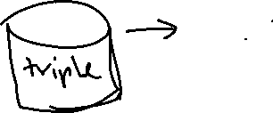


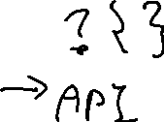
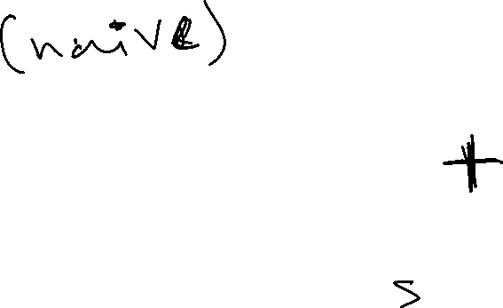

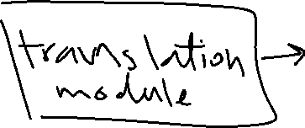



Architecture components

Slide 4
Architecture component
Somewhat known
Core model,
Mappings,
Rules
Data
Transformation pipeline,
Storage,
Endpoint,
Unknown:
How the semantic Ledger interacts with the core model?
How the core model is being used in the a choreography? Is choreography a formal model?
How the data is streamed? What data do we onboard?

Slide 5
Ontology Core components
Logistic Digital Twins
Logistic Event
Logistic Service
Logistic Business Transaction
Classifications
Address
Logistic Governance

Slide 6
https://app.lucidchart.com/invitations/accept/636635f6-7388-4e3a-bc38-77dedeb06d96

Slide 7
Digital Twins
Any real-world physical object.
Attributes
It can be defined per type and subtype

Slide 8
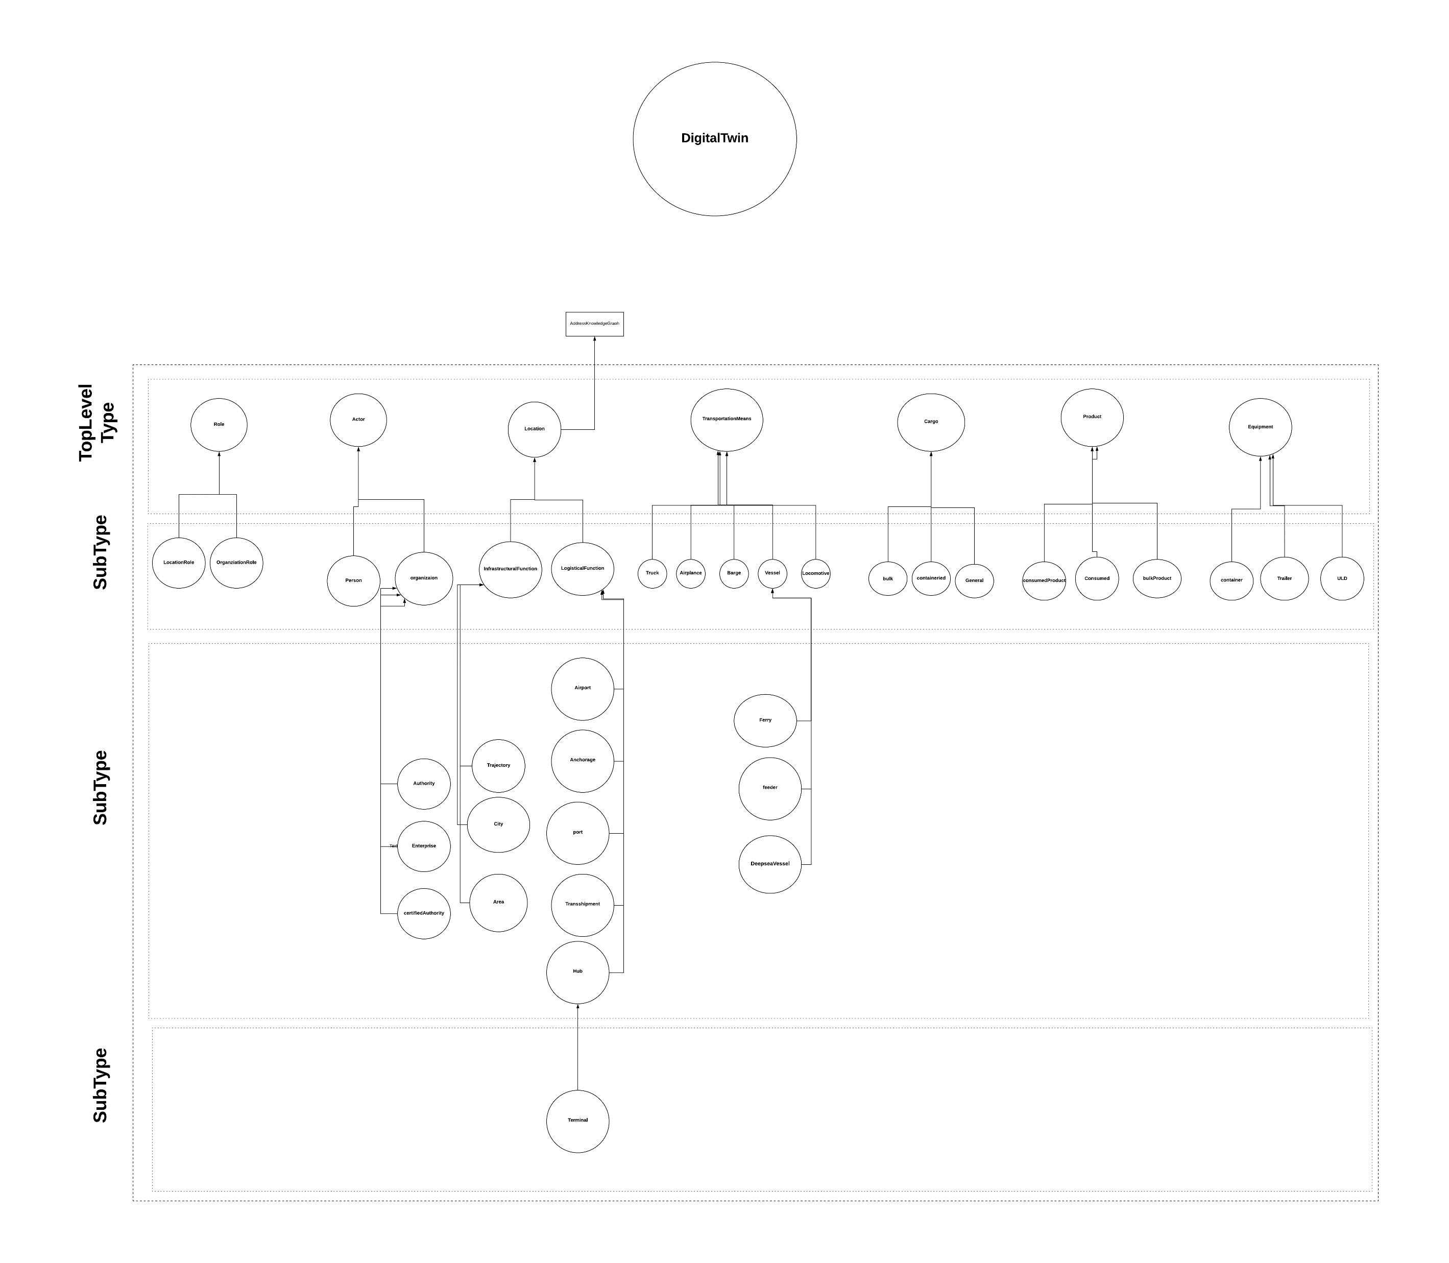

Slide 9
Event
Represent actions, milestones, transactions or any other real-world activity. These will typically involve one or more interactions or associations between location, business service, transport means and cargo.
Attributes
Date
Time
Milestone

Slide 10
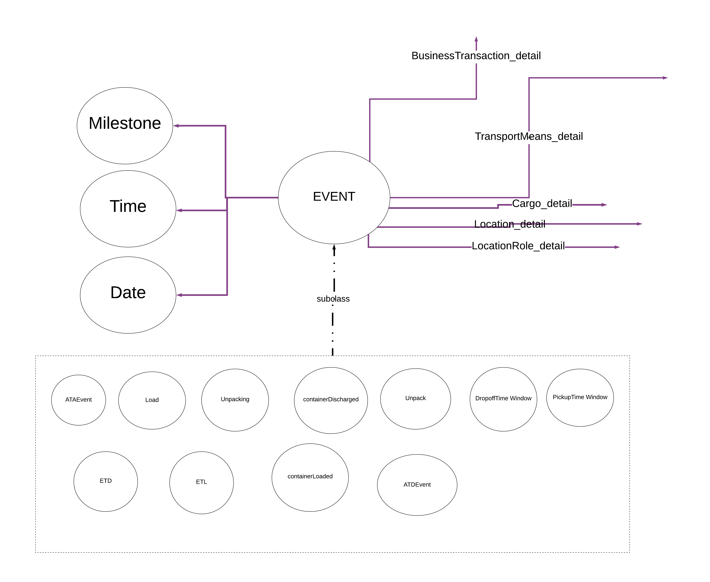

Slide 11
LogisticBusiness
Logistic Service,
Logistic Transaction,

Slide 12
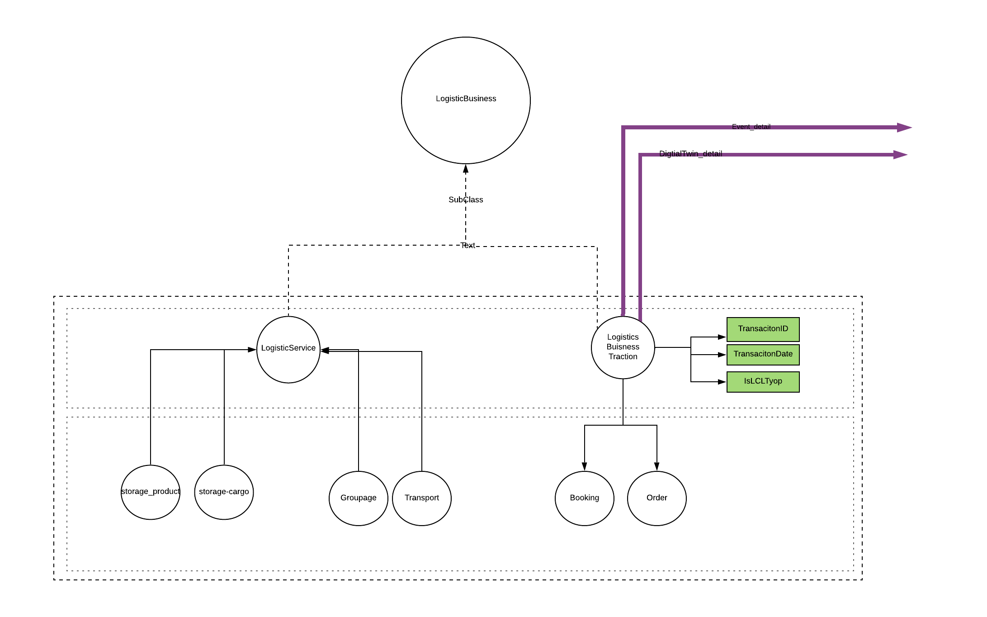

Slide 13
Classification
Dangerous Goods,
Hazard code,
…

Slide 14
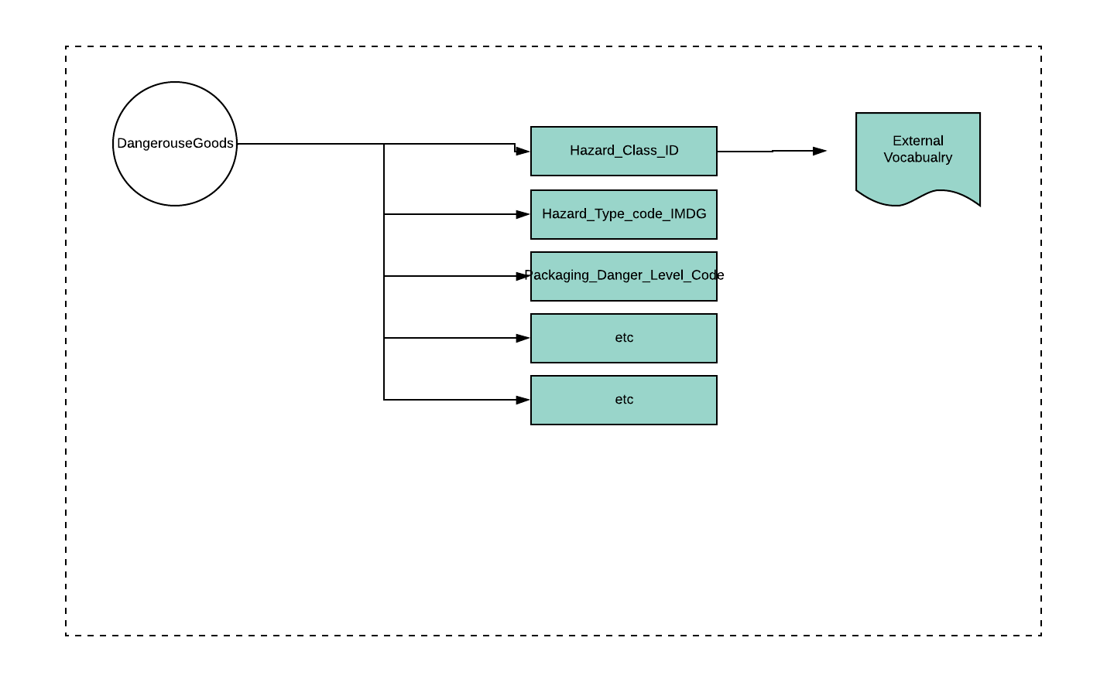

Slide 15
Address
Address is related to the location,
Any location sub-type has an address that can be identified via:
Address (string),
Lat and long,
Administrative level (codes),
Country,
Region,

Slide 16
Logistic Governance
Provnenace,
Governance Roles,

Slide 17
To do
Find and link external controlled vocabulary (code list)
Unambiguous definition of classes and term relationship,
Strict hierarchical subcleass relationships between classes,
Property specification on a per-class basis,
Value restriction specification on a per-class basis,
Individual inclusion,
Specification of disjoint classes,
Specification of arbitrary logical relationships between terms,
Distinguished relationships such as inverse and part-whole,

Slide 18
Milestones and roadmap
Usecase Development,
Modeling per usecase,
Coverage of standards by the core model
Mappings
Proof of Concept,

Slide 19
We can end here for Thursday

Slide 20
Ontology Engineering Method

Slide 21
Requirement workflow
Input:
Interviews with the domain experts,
application specific documents,
standards, reference models (reuse, or integration)
Output:
Use-cases
userstories
Goal
Scope, out of scope
Event and activity diagrams
Actors, interfaces involved,
Non functional requirements,
Competency question

Slide 22
Competency Question
Questions the knowledge base, application or ontology should be able to answer in fulfillment of the use case and a representation set of sample answers.
DerivedFrom:
Userstories,
Sequence diagrams

Slide 23
An example
From the garden-oriented user story interested in oak-root fungus susceptible trees:
Question
? From the set of approved trees for the city of Newyork, identify all those that are oak root fungus resistant, that flower, that are deciduous, and whose leaves turn colors in the fall.
Answer:
>> Koelreuteria paniculata (golden rain tree), melaleuca stypheloides (prickly paperbark), lagerstroemia indicus (crepe myrtle), malus ” Robinson” and ….
MoreAnswers:
>> Definitely not a cinnamomum camphora (camphone tree_

Slide 24
The answers entail:
(1) Onboard the list of trees, (what data)
(2) analyse to see which of the trees on the list are oak-root fungus resistant (needs some sort of confirmatin from authories or garden sites),
(3) which are deciduous ( there might be a classificaitons ),
(4) which are flowering (may require a separate reference),
(5) which showy fall foliage (reference),
(6) spatial indicators of geographic location, (newyork)
(7) rules or regulations,
Not be cinnamum (restrictions on types)
Defintions of each types

Slide 25
Considerations in answering the CQ
considerations for encoding the information,
checking values and, threshold of property values .
data
Types and definitions,
Inference might be needed, (constrainsts)

Slide 26
(2) Analysis workflow
Input
Existing external sources (standards, documents, ontologies,)
Application Lexicons
Analysis of the competency answers and questions,
Output
Domain lexicon,
Reference model,
Identifying the architectural modules
Reference glossary standard --reference for all the terms in the ontology

Slide 27
(3) Design Workflow
Input
Reference glossary,
Type diagrams (UML diagram),
We know architectural components
Output
Ontology (semantic network) – not yet formal
Identified (constructs – hierarchies, specific relations),

Slide 28
(4) Implementation workflow
Input:
Semantic network / ontology
Output
Owl or other owl dialects
Presentation patterns, naming conventions,
Logical patterns
Representing validation and inference rules

Slide 29
(5) Test
Input
formal ontology,
Example instantitions (Abox)
Output
Tested owl ontology
Verify the coverage (measure)
Answering comeptency question
THEN WE HAVE TO ADAPT

