Slide 1
Logistic Knowledge Graph
Creator: Dena Tahvildari
Collaborators: Cornelis Bouter
and Maaike Burghoorn

Slide 2
Outline
Why a formal model,
Logistic Knowledge Graph,
Examples for “Whys”
Architecture Components,
Roadmap and Milestones,
Open questions

Slide 3
Why a Formal model
Create a shared understanding of Logistics domain,
Interoperability support,
Data, standards, protocol Integration
Consistency checking,
Automatic Inference and knowledge discovery,
Forward Compatibility,
Notes:
Explain that you will explain them later through the presentaiton,

Slide 4
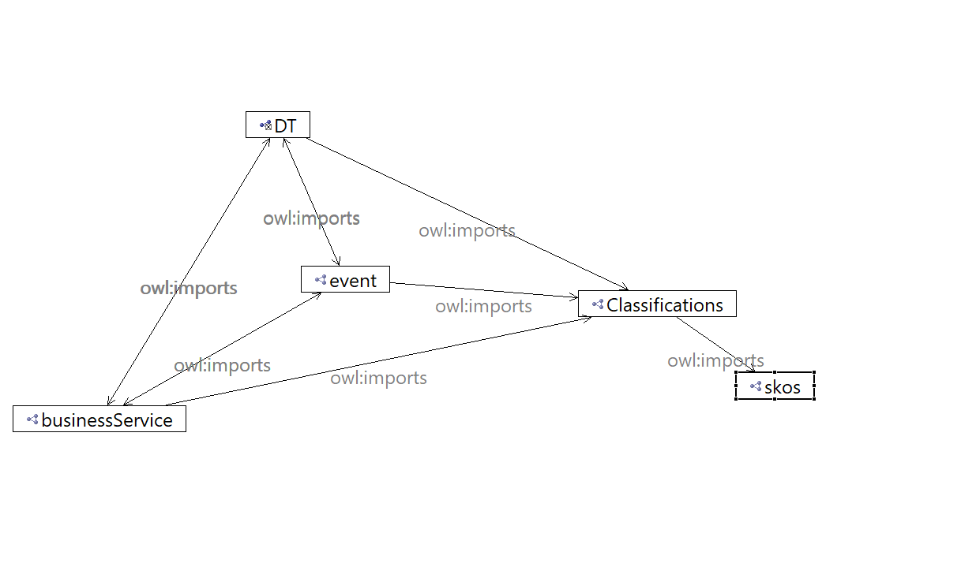
Knowledge Graph
Logistics Digital Twins
Logistics Event
Logistics Business
Classifications (to do)
Governance (to do)
Shape Graphs (to do)

Slide 5
Digital Twins
Any real-world physical object.
Attributes
It can be defined per type and subtype

Slide 6
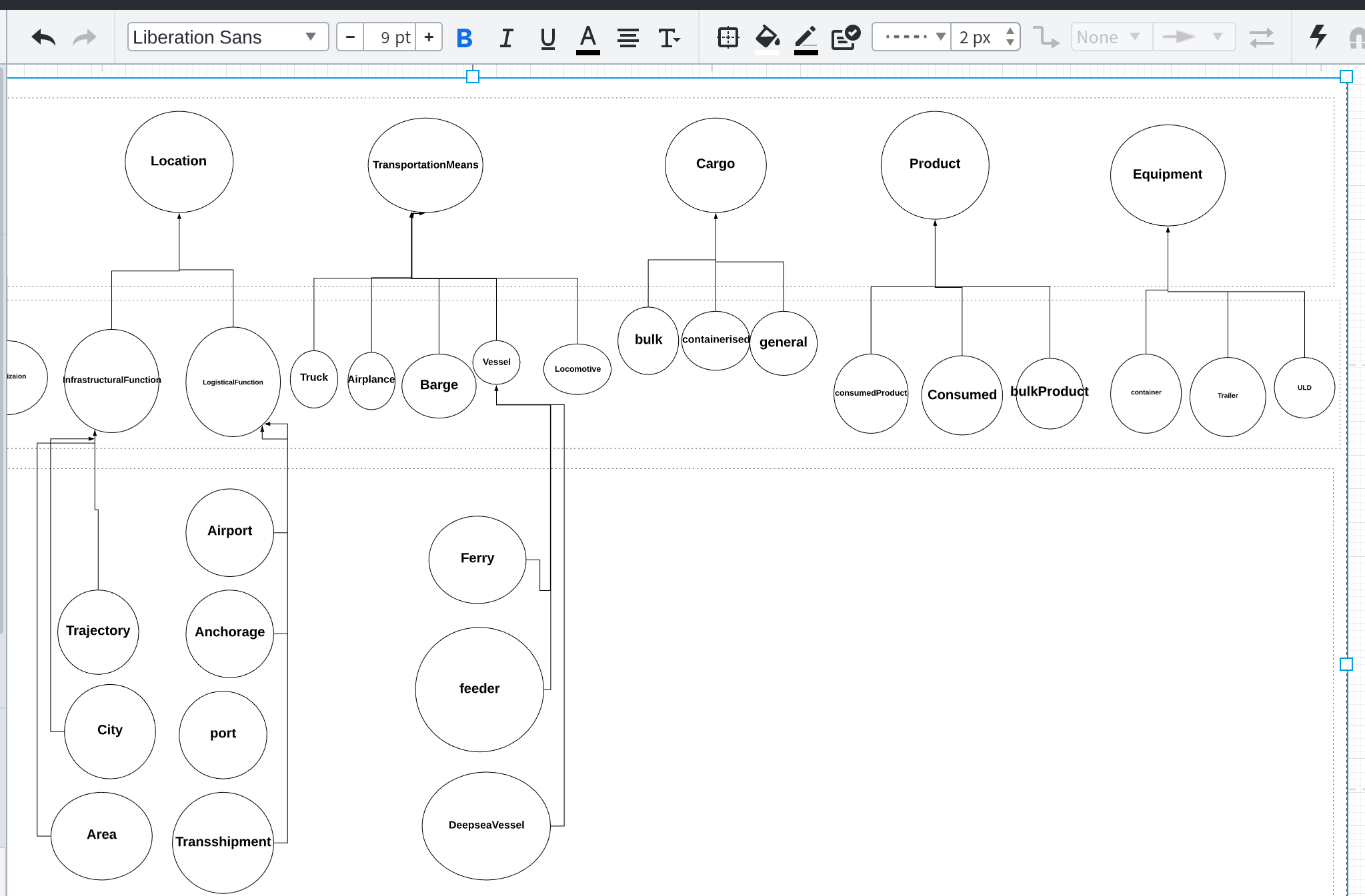
https://app.lucidchart.com/invitations/accept/c45b2933-815d-40a5-83cf-3709cdae3bde

Slide 7
Event
Represent actions, milestones, transactions or any other real-world activity. These will typically involve one or more interactions or associations between location, business service, transport means and cargo.
Attributes
Date
Time
Milestone

Slide 8
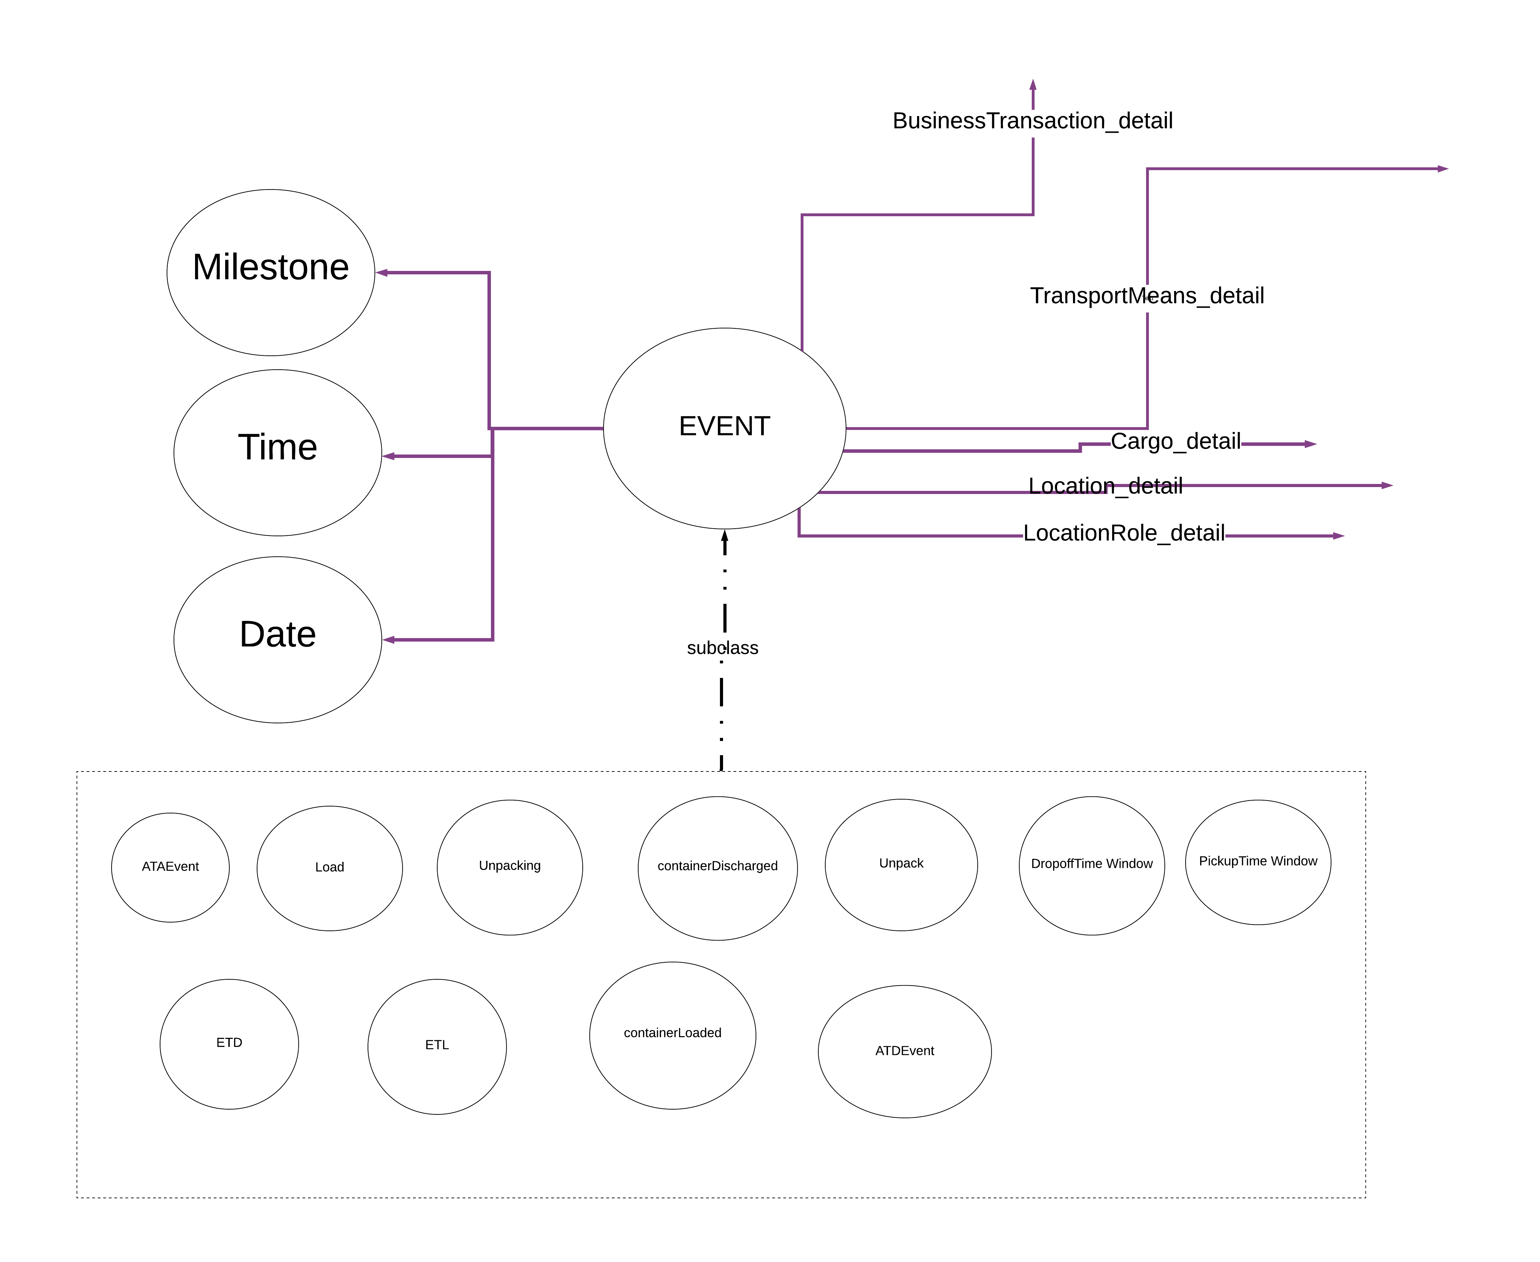

Slide 9
LogisticBusiness
Logistic Service,
Logistic Transaction,

Slide 10
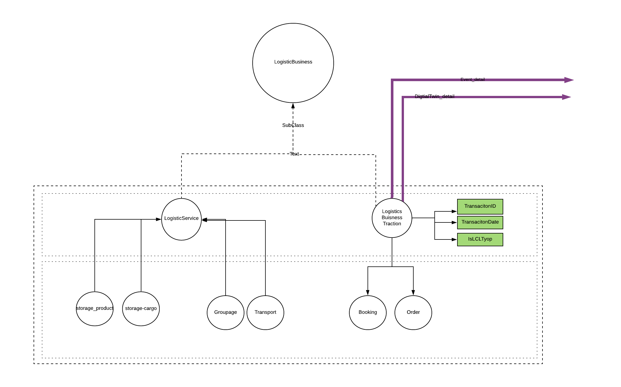

Slide 11
https://app.lucidchart.com/invitations/accept/636635f6-7388-4e3a-bc38-77dedeb06d96

Slide 12
Classification
Dangerous Goods,
Hazard code,
…

Slide 13
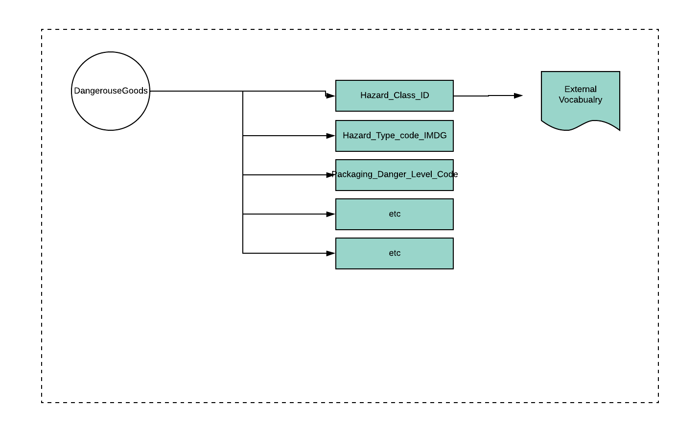

Slide 14
Shape Graphs -- shacl
A shape graph that uses the core model (a rdf file) an enable us to define:
DataTypes constraints,
String constraints,
Property Constraints,
Data Format,
Rules, If then else,
If then,

Slide 15
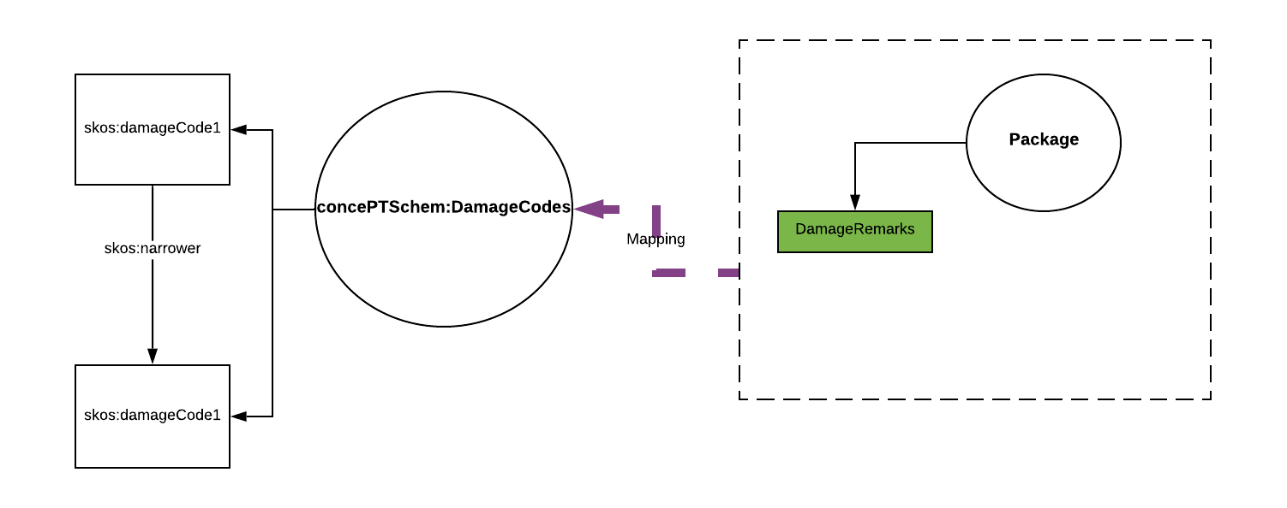
Interoperability
interoperability by aligning and mapping same entities between external models and our core model

Slide 16
Create a shared understanding
Reference lexcion,
One terminology,
Unambiguous,

Slide 17
Abox Consistency Checking
Property specification, Value range restriction specification on a per-class basis,
:Product sh:property [ :path dt:productName ; :minLength 4 ; :datatype xsd:string ; ] ; and sh:property [ sh:path dt:productID ; sh:pattern “p\\d{3,4}” ; ] .
Given the following graph:
Product_1 a :Product ; dt:productName “TG2” . #Fails as :product dt:productID “P567“ . product_2 dt:productName “TGSH” . dt:productID “P567“ . #passes as a :product
Validation Report: A processor verifies that product_2 conforms but product_1 does not conform.

Slide 18
Allow for Inferencing
ATA event
If the milestone is start, and
If the date and time is actual, and
Then the associated event between Location X and transportmeans Y is ATA (Actual time of arrival)
event:event_location_detail
rdfs:domain event:Event ; rdfs:range DT:Location .
event:event_transportMeans_detail
rdfs:domain event:Event ; rdfs:range DT:transportMeans .
event:event_milestones_detail
rdfs:domain event:Event ; rdfs:range event:Milestone .
event:event_milestones_detail
rdfs:domain event:Event ; rdfs:range event:Date.
event:ATA_event rdfs:subClassOf event:Event .

Slide 19
Project Milestones and roadmap
Usecase Development,
Modeling per usecase,
Coverage of the existing standards by the core model
Integration,
Notes:
Visualize with process scheme
Integration,

Slide 20
Identified Components in the architecture
Core model– Logistic Knowledge Graph
Incoming Data (data lake),
Mapping module
Pipeline for Transformation, Validation, identification, deduplication moduels,
Storage (semantic Ledgers),
Validation and inference Rules engine
Query service,
API(s)
Services and Applications

Slide 21
Open Questions
How does semantic ledger store the data stream?
What components includes in the pipeline?
In which component the reasoning and consistency checkings occure? How?
What is a typical scenario and which queries are involved in the backend? How?

Slide 22
Here we end and the rest is related to methodology

Slide 23
Ontology Engineering Method

Slide 24
Requirement workflow
Input:
Interviews with the domain experts,
application specific documents,
standards, reference models (reuse, or integration)
Output:
Use-cases
userstories
Goal
Scope, out of scope
Event and activity diagrams
Actors, interfaces involved,
Non functional requirements,
Competency question

Slide 25
Competency Question
Questions the knowledge base, application or ontology should be able to answer in fulfillment of the use case and a representation set of sample answers.
DerivedFrom:
Userstories,
Sequence diagrams

Slide 26
An example
From the garden-oriented user story interested in oak-root fungus susceptible trees:
Question
? From the set of approved trees for the city of Newyork, identify all those that are oak root fungus resistant, that flower, that are deciduous, and whose leaves turn colors in the fall.
Answer:
>> Koelreuteria paniculata (golden rain tree), melaleuca stypheloides (prickly paperbark), lagerstroemia indicus (crepe myrtle), malus ” Robinson” and ….
MoreAnswers:
>> Definitely not a cinnamomum camphora (camphone tree_

Slide 27
The answers entail:
(1) Onboard the list of trees, (what data)
(2) analyse to see which of the trees on the list are oak-root fungus resistant (needs some sort of confirmatin from authories or garden sites),
(3) which are deciduous ( there might be a classificaitons ),
(4) which are flowering (may require a separate reference),
(5) which showy fall foliage (reference),
(6) spatial indicators of geographic location, (newyork)
(7) rules or regulations,
Not be cinnamum (restrictions on types)
Defintions of each types

Slide 28
Considerations in answering the CQ
considerations for encoding the information,
checking values and, threshold of property values .
data
Types and definitions,
Inference might be needed, (constrainsts)

Slide 29
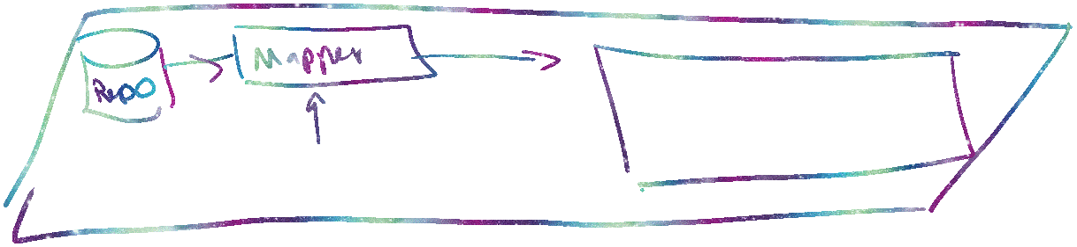







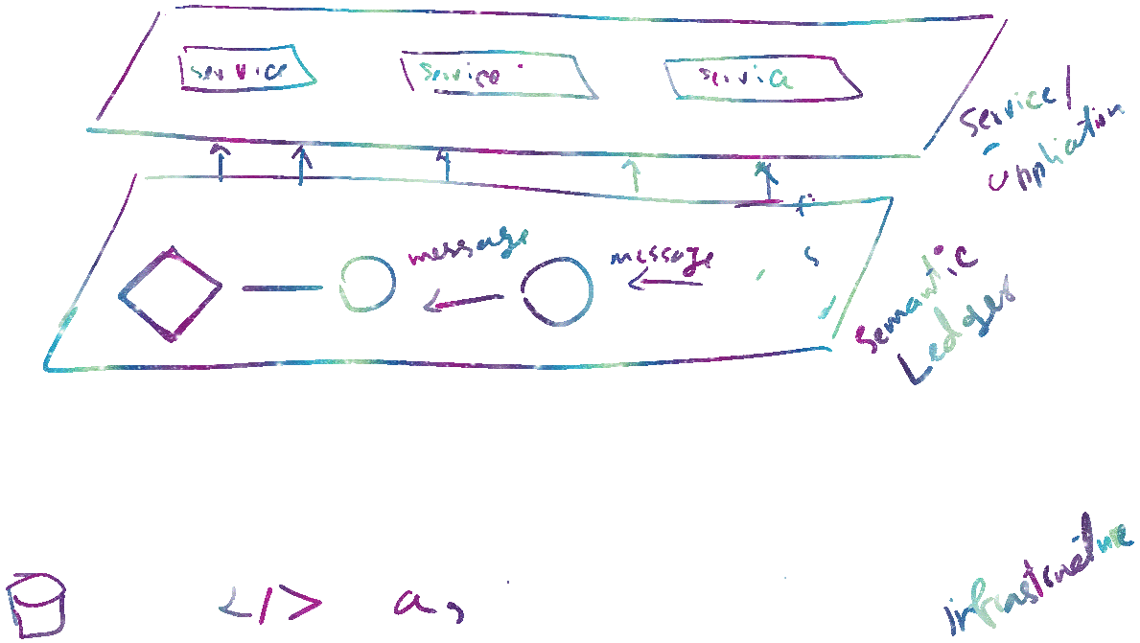

Slide 30
(2) Analysis workflow
Input
Existing external sources (standards, documents, ontologies,)
Application Lexicons
Analysis of the competency answers and questions,
Output
Domain lexicon,
Reference model,
Identifying the architectural modules
Reference glossary standard --reference for all the terms in the ontology

Slide 31
(3) Design Workflow
Input
Reference glossary,
Type diagrams (UML diagram),
We know architectural components
Output
Ontology (semantic network) – not yet formal
Identified (constructs – hierarchies, specific relations),

Slide 32
(4) Implementation workflow
Input:
Semantic network / ontology
Output
Owl or other owl dialects
Presentation patterns, naming conventions,
Logical patterns
Representing validation and inference rules

Slide 33
(5) Test
Input
formal ontology,
Example instantitions (Abox)
Output
Tested owl ontology
Verify the coverage (measure)
Answering comeptency question
THEN WE HAVE TO ADAPT

