Slide 1
Convolution on neural network for high-frequency trend prediction of cryptocurrency exchange rates using technical indicators Saúl Alonso-Monsalve, Andrés L. Suárez-Cetrulo, Alejandro Cervantes, David Quintana Expert Systems With Applications 149 (2020) 113250
Presenters: Federica Russo

Slide 2
Motivation
The aim of this paper is contributing with new evidence on the suitability of using neural networks with a convolutional component to make intraday trend classification for cryptocurrencies based on technical indicators.
The approach is needed because, despite being one of the techniques obtaining best results on financial prediction in the literature, image processing-based architectures are the least explored between RNN, DNN and CNN. On top of it, there is a gap regarding the application of Convolutional Neural Networks for cryptocurrency forecasting and price prediction at high frequencies.
Evolution of exchange rates vs. USD at a 1-min resolution from Q3 2018 to Q2 2019. Data scaled to base 100.

Slide 3
Limitations
A frequent issue of CNNs is they tend to ignore the latent dynamics existing in the data.
Given its nature, the study is more focused on the performance of the instrumental in the domain, and less on the design and implementation of profitable trading systems. The latter practical application would require, in addition to the implementation of a decision component, controlling for aspects like response time, liquidity issues, or transaction costs, among others.

Slide 4
State of the art
Cryptocurrencies since they were first proposed have attracted the attention of many researchers. This is demonstrated by the wide variety of recent studies covering financial aspects of different cryptocurrency.
Many systems based on neural networks for trading strategies in cryptocurrency markets using prices have been proposed ( Atsalakis et al ^{[1]} ; Nakano et al ^{[2]} ; Vo & Yost-Bremm ^{[3]} ).
There are also few recent papers applying different architectures for price prediction and trend classification on the short-term, in mid and high frequencies. We could distinguish them in three groups.
[1]. Atsalakis, G. S., Atsalaki, I. G., Pasiouras, F., & Zopounidis, C. (2019). Bitcoin price forecasting with neuro-fuzzy techniques. European Journal of Operational Research, 276 (2), 770–780.
[2]. Nakano, M. , Takahashi, A. , & Takahashi, S. (2018). Bitcoin technical trading with artificial neural network. Physica A: Statistical Mechanics and Its Applications , 510 , 587–609.
[3]. Vo, A., & Yost-Bremm, C. (2018). A high-frequency algorithmic trading strategy for cryptocurrency. Journal of Computer Information Systems , 4417 .

Slide 5
State of the art
The first about recurring neural networks (RNNs), especially Long-Short-Term Memory neural networks (LSTMs).
The second group of architectures widely used in the literature are Deep Neural Networks (DNN) such as feed-forward networks, or more specifically, MLPs.
The third group architectures studied are the ones based on principles of the field of image processing, such as Convolutional Neural Networks.
Of the latter group, there are some inspiration for the authors as they compare CNNs with various architectures.
There are those who, for example, compare LSTMs, RNNs, and CNN architectures using a sliding window approach for short-term future stock price prediction ^{[4]}.
Others compare LSTMs and MLPs on Bitcoin and Litecoin exchange time-series at 1-min intervals and proposed their own algorithm, Random Sampling Method (RSM), based on deep learning developments in the field of image processing^{[5]}.
Hiransha et al. compare Multilayer Perceptron (MLP), RNN, LSTM and CNN architectures for predicting the stock price of highly traded companies in the National Stock Exchange (NSE) of India and the New York Stock Exchange (NYSE) ^{[6]}.
In all of these researches CNNs beat other state-of-the-art algorithms for the same purpose.
[4]. Selvin, S., Vinayakumar, R., Gopalakrishnan, E. A., Menon, V. K., & So- man, K. P. (2017). Stock price prediction using lstm, rnn and cnn-sliding window model. In 2017 International conference on advances in computing, communications and informatics (icacci) (pp. 1643–1647).
[5]. Shintate, T., & Pichl, L. (2019). Trend prediction classification for high frequency bitcoin time series with deep learning. Journal of Risk and Financial Management , 12 (1), 17.
[6]. Hiransha, M., Gopalakrishnan, E. A., Menon, V. K., & Soman, K. P. (2018). Nse stock market prediction using deep-learning models. Procedia Computer Science, 132 , 1351–1362.

Slide 6
Proposed approach
The first stage is to decide the values for some parameters that affected the construction of the data sets.
The second stage entails identifying appropriate network structures and learning hyperparameters for each of the models. To this end, they will run exploratory experiments and the best configuration will be selected for each model, using the result on the validation set.
The third and final stage will compare the performance of all four neural network types across the six cryptocurrencies. In this case we shall use the models of each type with the best configurations selected as defined above, but results will be reported on the accuracy on the test set data (instead of the validation set) that had been not been used in the previous stages.
Notes:
The overall idea

Slide 7
Proposed approach
The number of periods n, on which relies the computation for the technical indicators, was set to 10 min.
For the two technical indicators that are moving averages, they consider an extended set of periods of 5, 10, 20, 30 and 60 min.
The value of the window size (or the number of lags) l, after several test, was set l = 15 . The authors found an inverse relationship between the value of this parameter and performance.
Notes:
The overall idea

Slide 8
Proposed approach
MLP: for each of the six cryptocurrencies authors validated 60 combinations of learning rate, number of hidden layers and number of neurons per layer;
RBFNN: for each cryptocurrency they validated the result of 42 combinations of the number of neurons and values of the width parameter β;
CNN: they shall explore five different architectures, with four values for the Learning rate, but tests will be performed on a single cryptocurrency, Bitcoin, because of the much higher computational cost of training and testing. The best configuration will then be used for all cryptocurrencies.
CLSTM: based on the one used in (Stoye, 2018 ^{[7]}),which authors modify to reduce computational cost. This architecture has five Convolutional layers plus a single LSTM layer and 8 fully connected MLP as output.
[7]. Stoye, M. (2018). Deep learning in jet reconstruction at CMS. Journal of Physics: Conference Series, 1085 , 042029.
Notes:
Model’s architecture

Slide 9
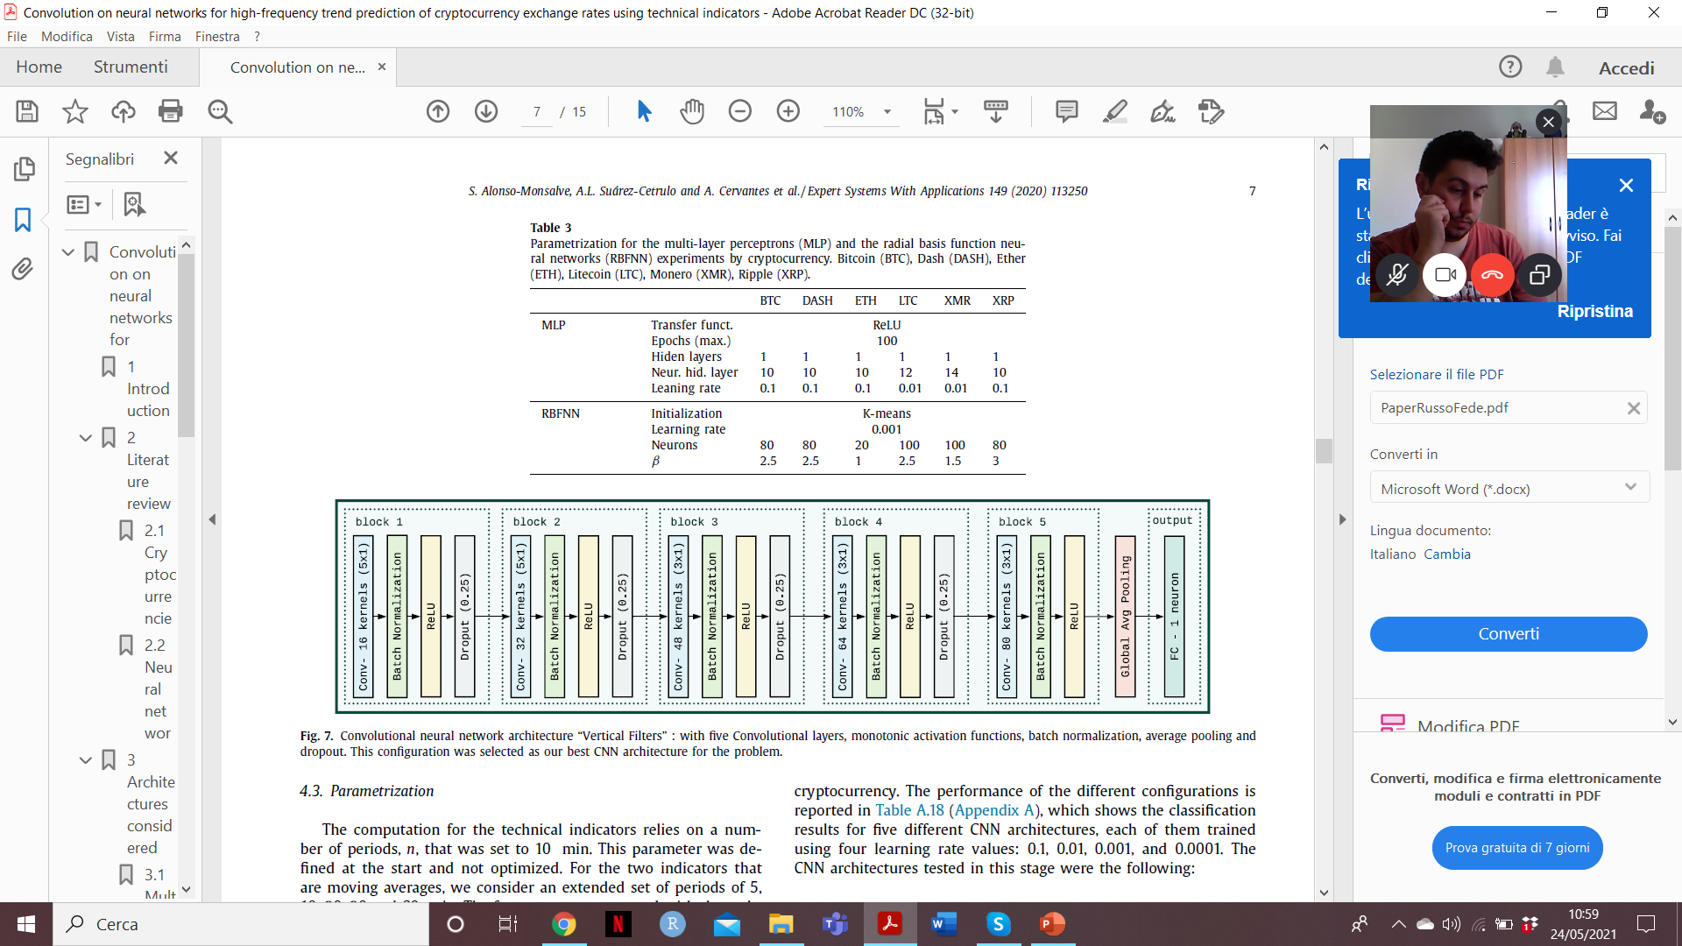
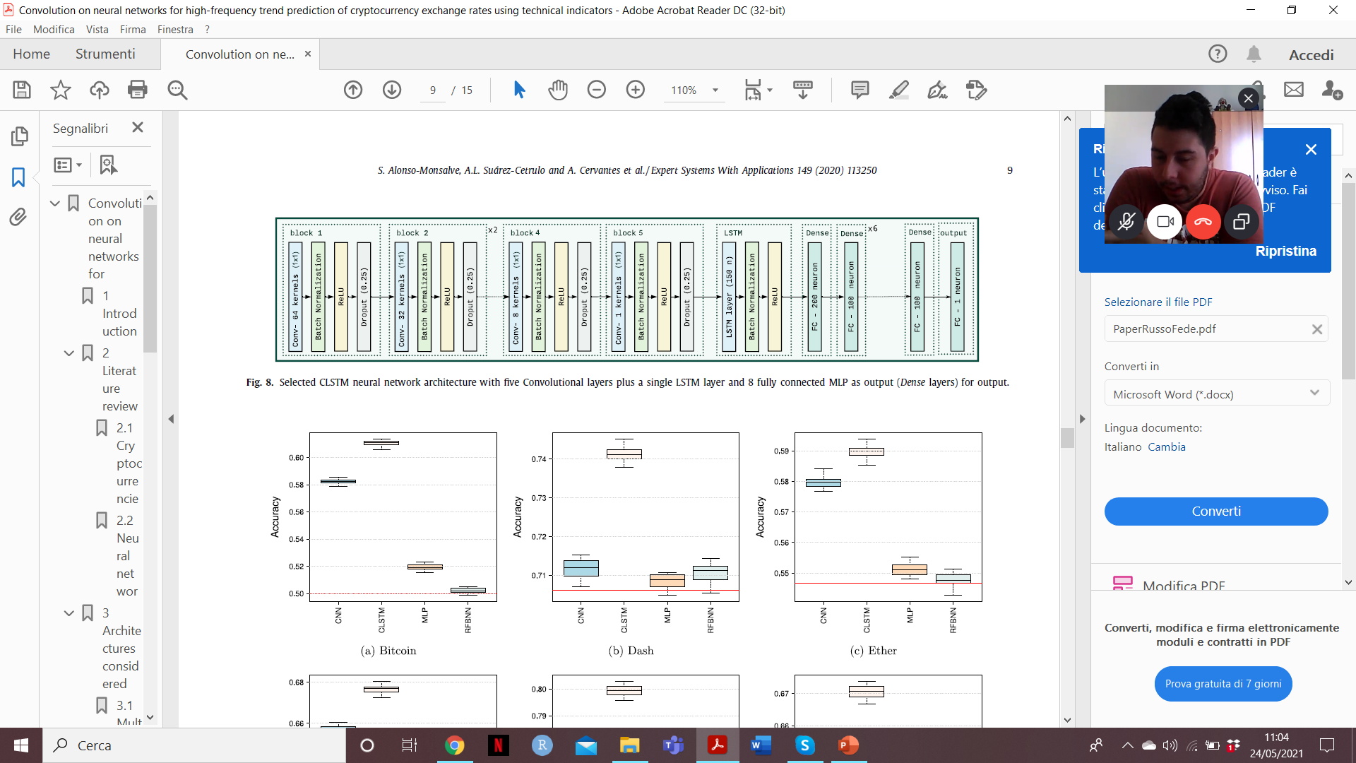
The chosen architectures:
Bitcoin (BTC), Dash (DASH), Ether (ETH), Litecoin (LTC), Monero (XMR), Ripple (XRP)
MLP
RBFNN
CNN
CLSTM
Notes:
Model’s architecture

Slide 10
Experimental Results
Datasets:
The authors have constructed the data set, where each pattern contains the values for the i indicators for “l” consecutive lags for each pattern plus the trend (that is, whether the value appreciated or not) as the class to be predicted.
The core data set used cover six of the most popular cryptocurrencies (Bitcoin, Dash, Ether, Litecoin, Monero, and Ripple) over a year of data (third quarter of 2018 to second quarter of 2019).
The price series vs. USD, sampled at 1- min intervals, was sourced from Cryptocompare.
The 18 technical indicators used includes popular momentum-based indicators such as Commodity Channel Index, Momentum, Moving Average Convergence/Divergence, Relative Strength Index, Stochastic, and Williamsâ R.

Slide 11
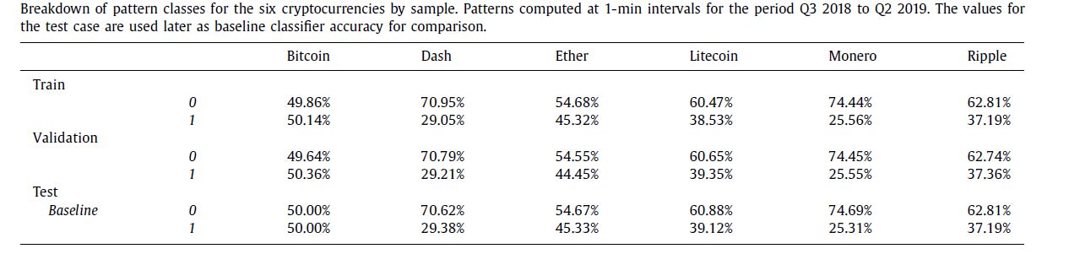
Experimental Results
The application of the mentioned approach on the data set described above resulted in the generation of 525,600 patterns to be split into three samples.
The first one consisted of 70% used for training. The second one included 15% used for the validation set. Finally, the remaining 15% was reserved for testing purposes.

Slide 12
Experimental Results
Metrics:
The authors will perform a series of 20 experiments for each configuration of the four neural network and the statistical significance for the average performance differences will be formally tested.
They will start testing the normality of the distribution of accuracy with a Kolmogorov–Smirnov test, using the Lilliefors correction: -Normality is rejected apply a non-parametric test, Wilcoxon signed-rank test; -Otherwise test for homoskedasticity using Levene test. Depending on the result, they would test for equality of means either using a Welch test, or a standard t-test.
In addition to that, they will test the statistical significance of the relative predictive performance of the median models on test sample by cryptocurrency using the Giacomini and White test.

Slide 13
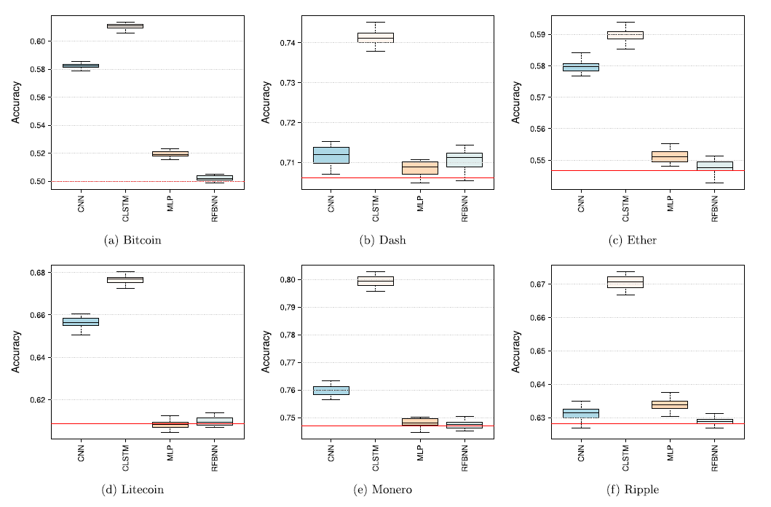
Experimental Results
Results:
Boxplots of accuracy on test data sets. Results over 20 experiments. Red horizontal line corresponds to a trivial classifier that always predicted the most frequent class for each currency.
Results clearly show that the CLSTM architecture clearly outperforms the rest for all of the cryptocurrencies.
Generally speaking, Bitcoin seems to be more predictable than the rest.

Slide 14
Conclusion
The experimental results support the conclusion that CNNs and specially Convolutional LSTM are suitable as predictors for the price trend when using the defined indicators and parameters on most cryptocurrencies. This was especially true for Bitcoin, Ether and Litecoin.
Results of the CLSTM architecture were always significantly better than the rest, and this network was the only one that could predict the trends of Dash and Ripple with some margin (about 4%) over the trivial classifier.

Slide 15
Conclusion
There is still a wide range of possibilities to improve these results: we may select more specific data generation parameters for these data sets, with different values for the time period of indicators, window size and/or network structure.
The study is focused on short-term trend prediction and is subject to limitations that should be addressed to operate in production in a trading setting. The practical application would require the implementation of a decision component and control for additional aspects like time management, market liquidity, or transaction costs.

Slide 16
Take-home message
This paper made me realize that it's always important to not be fossilized on a certain use of particular architectures just because that's how it has always been done.
It is important to experiment not only with architecture itself but also with the different fields in which it can be applied.
From my point of view, it would be interesting to continue this line of research opened by the authors in order to create a model that is also a source of profit.

Slide 17
Thanks for the attention!
Federica Russo

