Slide 1
Analyzing NYC Parking Violations — Fiscal Year 2024
Team Members: Federico Ciandri, Sabrina Zhu, Yongheng Guan
CIS 9650
Zicklin School of Business- Baruch College CUNY
Prof. Ecem Basak

Slide 2
Dataset
Parking Violations Issued - Fiscal Year 2024
https://dev.socrata.com/foundry/data.cityofnewyork.us/8zf9-spf8

Slide 3
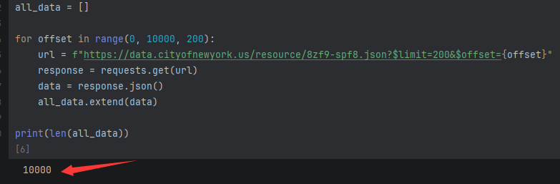
API & Pagination
200 rows per page, total 10,000 rows
Pagination using $limit and $offset
Saved to CSV to avoid repeated API calls
Incremental testing: 5 -> 200 -> 400 -> 10,000 rows

Slide 4


Data Cleaning
Dropped columns that > 56% missing
Standardized violation descriptions
Cleaned vehicle makes (TOYOT -> TOYOTA)
Mapped county codes to boroughs (QN -> Queens)
Before:
After:

Slide 5
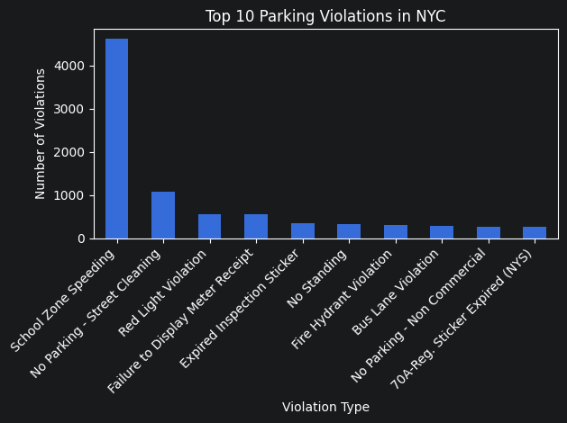
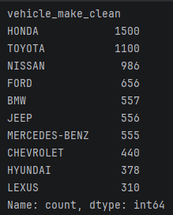
Analysis 1: Violation Type & Vehicle Brand
Top violation: No Parking – Street Cleaning
Top vehicle makes: Honda, Toyota, Nissan
Distribution reflects overall brands in NYC, no targeting bias

Slide 6
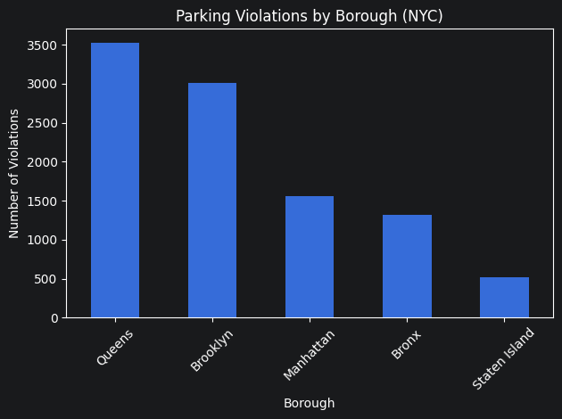
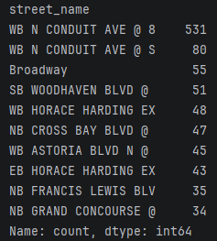
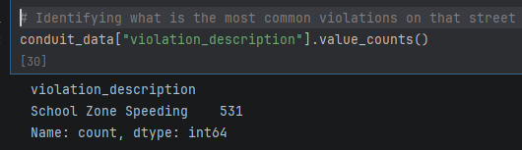
Analysis 2: Counties & Borough
Boroughs: Queens highest, Brooklyn second
Top street: WB N CONDUIT AVE @ 8 -> school zone speed camera
Precincts: Queens dominates

Slide 7
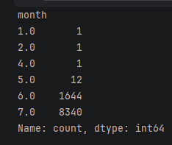
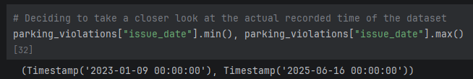
Analysis 3: Temporal analysis
Temporal limitation: data only covers June‑July
Date range: 2023‑01‑09 to 2025‑06‑16
Possible cause: API default ordering or sampling bias limited other months in the 10,000 rows
Cannot analyze yearly or seasonal trends, it only reveals concentration in June‑July within this sample

Slide 8
Conclusion
Limited: Temporal data limited to two months (June ‑ July).
Who benefits?
School zone speeding hotspot -> benefits traffic safety agencies
Queens/Brooklyn enforcement density -> benefits local policymakers & residents

