Slide 1
TherMike Statistical Learning Final Project
Federico Alvetreti
Ioan Corrias
Lucia Dicunta
Leonardo Di Nino

Slide 2





TherMike - Hearing hot loud
Data Collection
Feature Engineering
11
Statistical Framework
Failures and Successes

Slide 3
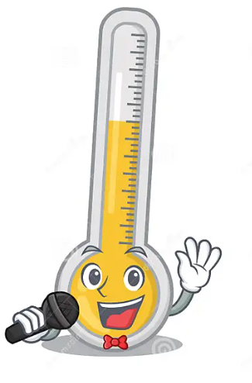
TherMike- Hearing hot loud
3
3
We were inspired by Mr.Brutti sound experiments and we decided to dig deeper in the problem. TherMike arises as the opportunity to deploy a machine learning model that can interpret or explain a phenomenon that is actually well known in neurosciences and psychoacoustics:
<<how is it possible for our ear and brain to collect and decode information that are apparently unrelated with what we are actually hearing? >>
Mike

Slide 4




So, we decided not to build a model “simply” capable of classifying if the water is cold or hot given its splashing sound: we wanted to build a real thermometer able to listen to temperature.
This makes our problem a regression one: given a pouring sound, we want to predict the temperature. And now lots of questions arises!

Slide 5
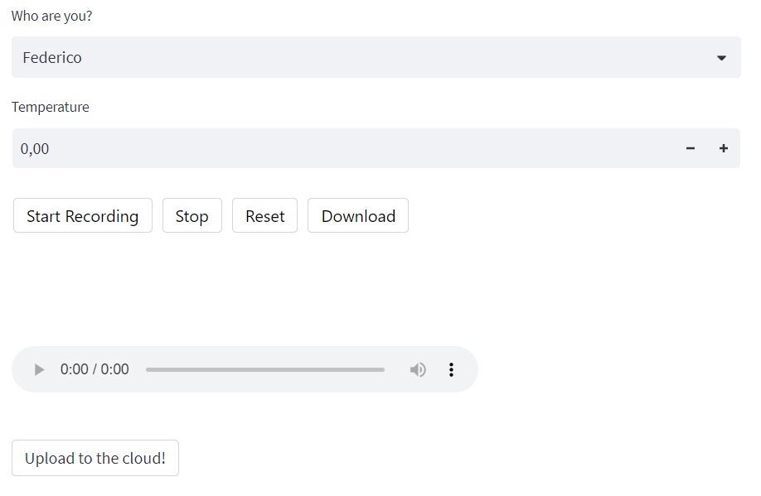
Data Collection
Strictly from a practical perspective, Ioan built an app on StreamLit to allow each of us to collect data on our own. The data stream was processed and stored on a shared Google Drive and each file has been labeled with the author name and the detected temperature.

Slide 6
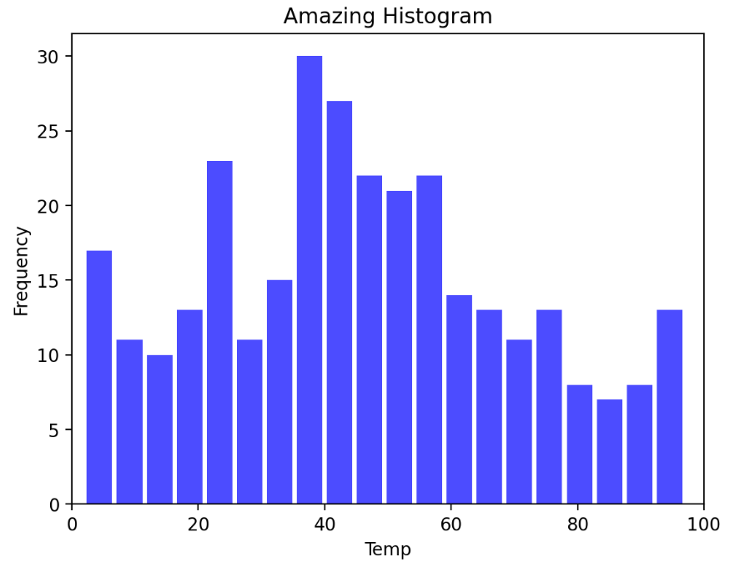
Data Collection
A histogram updating after each update shows the distribution of the labels: this was an implementation that has been inserted in order to keep us from building an unbalanced dataset.

Slide 7
Data Collection
The experiment was easy in its guiding lines: pour some water, record its splash, detect the temperature. We just decided for some parameters to be similar in order to gather homogenenous data:
We used two metal vessels;
We poured water from no more than 10 cm away;
We detected the temperature right after pouring the water;
We recorded audio lasting between 5 and 7 seconds.
In the end we collected 309 audio samples on our own. Additionally, we also used as benchmark dataset the one from the similar study we read about, that consisted of 333 audio samples.

Slide 8
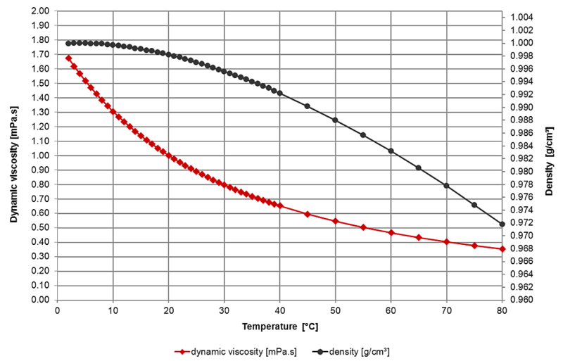
Feature Engineering
There clearly is an empirical evidence in discerning between hot and cold water: the viscosity and density of the liquid change with respect to the temperature, so it is expected to cast different sounds when poured. This is a good starting point, but at the same time it is not enough to explain acoustic phenomena.

Slide 9
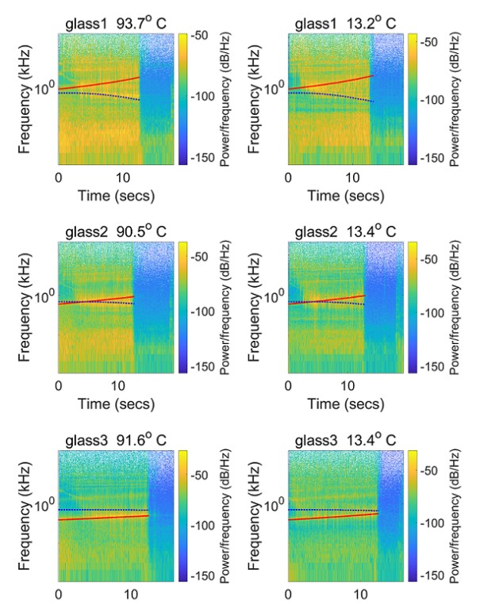
Feature Engineering
Infact when comparing spectrograms of audio recording of liquid poured at the different temperature there is no apparent difference between the two scenarios.
This meant to us that the interesting findings were not in the harmonic content per se but somewhere else.

Slide 10
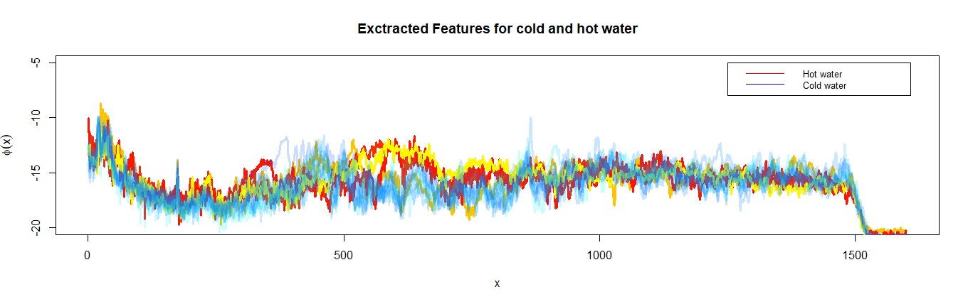
Feature Engineering
We tried to model the perception of tone color with respect to temperature designing a customized feature extraction pipeline inspired by Mel filters cepstrum coefficients and the human hearing mechanism.
We did the following:
Filter the power spectrum with a Mel-Filter-bank to return an estimate of the perceived pitch;
Apply Weber-Fechner law of psychophysics that models the intensity of the perception as a logarithm.

Slide 11
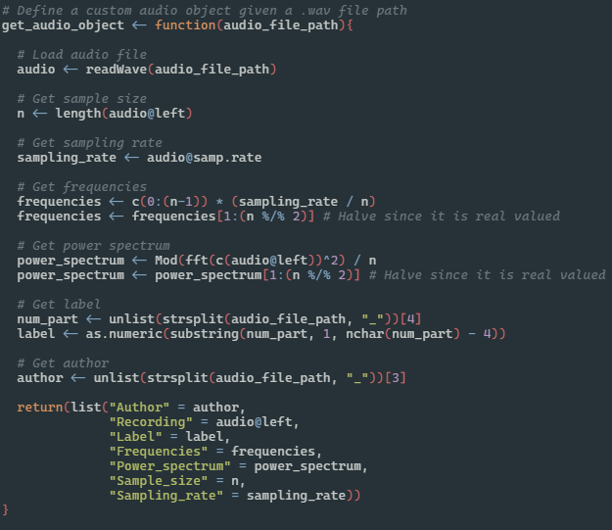
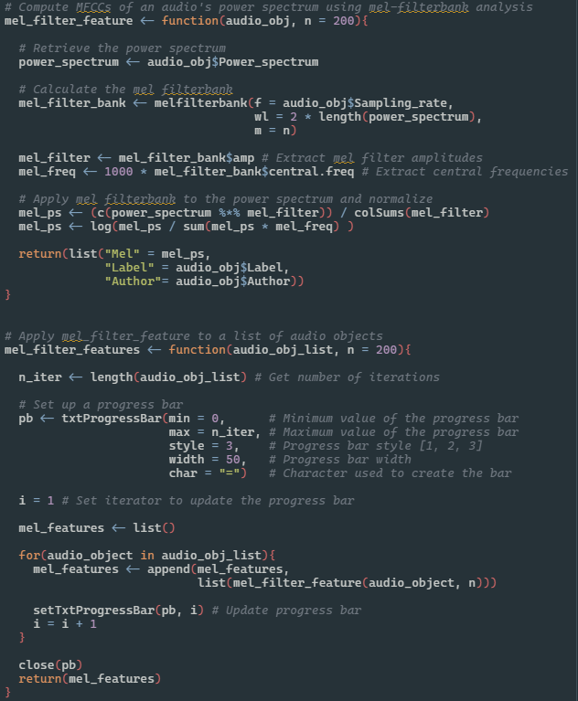
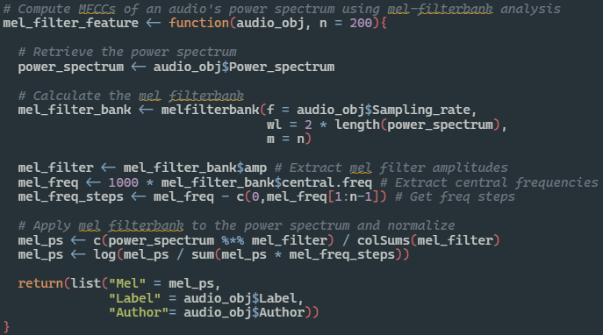
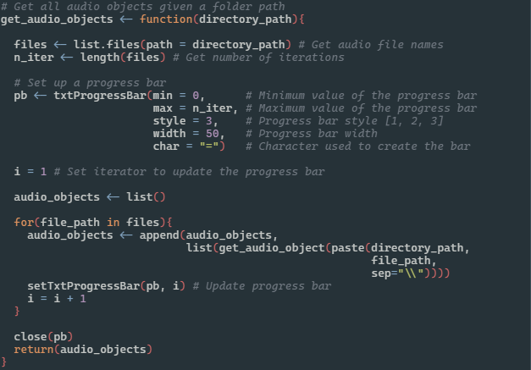

Slide 12
Statistical Framework
1
2
3
4
5
Define the functional setting
Rebuild distances
Rebrand nonparametric models
Validate hyperparameters
Deploy the model!

Slide 13
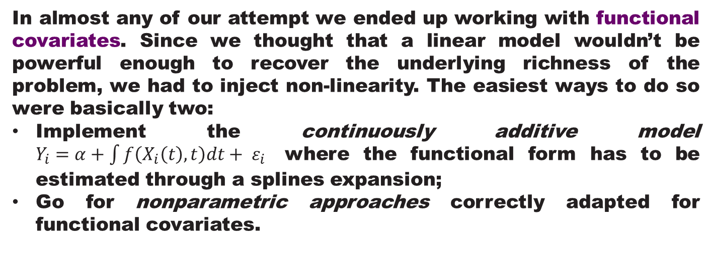
In almost any of our attempt we ended up working with functional covariates. Since we thought that a linear model wouldn’t be powerful enough to recover the underlying richness of the problem, we had to inject non-linearity. The easiest ways to do so were basically two:
Implement the continuously additive model $Y_{i}=α+\int{f\left(X_{i}\left(t\right),t\right)dt+ ε_{i}}$ where the functional form has to be estimated through a splines expansion;
Go for nonparametric approaches correctly adapted for functional covariates.

Slide 14
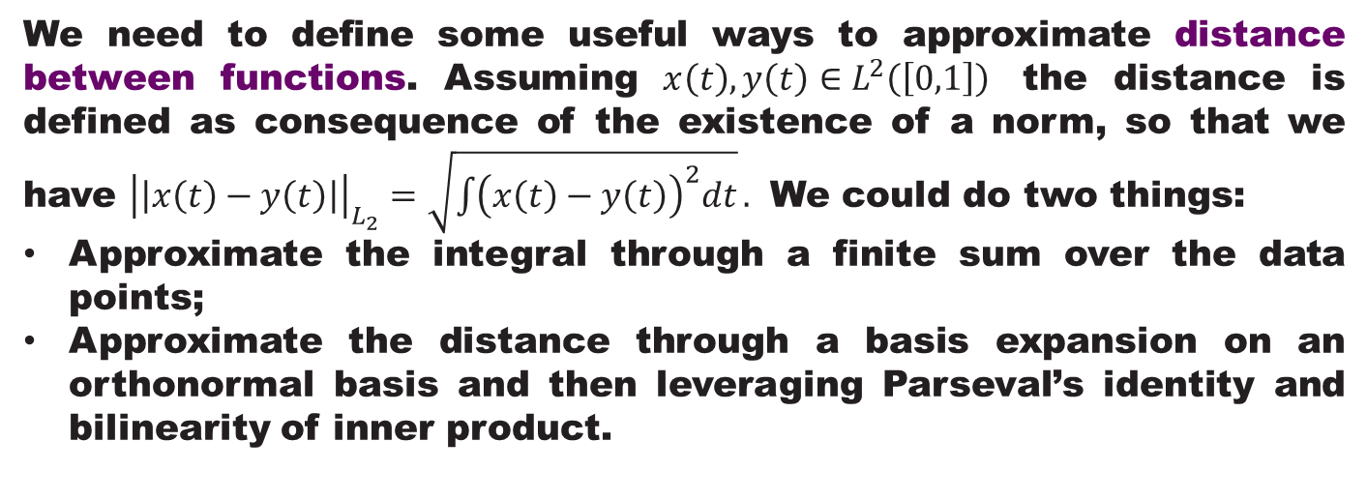
We need to define some useful ways to approximate distance between functions. Assuming $x\left(t\right), y\left(t\right)∈L^{2}\left(\left[0,1\right]\right)$ the distance is defined as consequence of the existence of a norm, so that we have ${\left|\left|x\left(t\right)−y\left(t\right)\right|\right|}_{L_{2}}=\sqrt{\int{{\left(x\left(t\right)−y\left(t\right)\right)}^{2}dt}}.$ We could do two things:
Approximate the integral through a finite sum over the data points;
Approximate the distance through a basis expansion on an orthonormal basis and then leveraging Parseval’s identity and bilinearity of inner product.

Slide 15
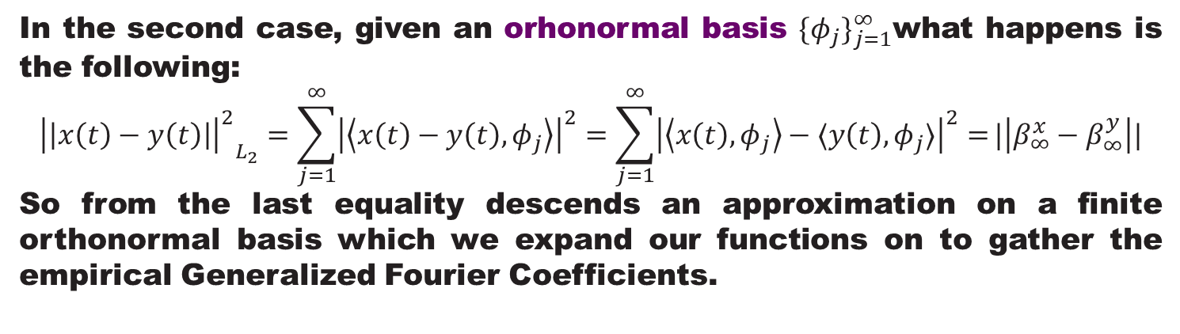
In the second case, given an orhonormal basis ${\{φ_{j}\}}_{j=1}^{∞}$what happens is the following:
$${{\left|\left|x\left(t\right)−y\left(t\right)\right|\right|}^{2}}_{L_{2}}=\sum_{j=1}^{∞}{{\left|\left\langle x\left(t\right)−y\left(t\right),φ_{j}\right\rangle \right|}^{2}=\sum_{j=1}^{∞}{{\left|\left\langle x\left(t\right),φ_{j}\right\rangle −⟨y\left(t\right),φ_{j}⟩\right|}^{2}=}}|\left|β_{∞}^{x}−β_{∞}^{y}\right||$$
So from the last equality descends an approximation on a finite orthonormal basis which we expand our functions on to gather the empirical Generalized Fourier Coefficients.

Slide 16
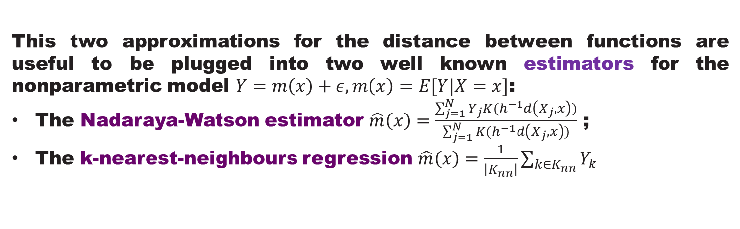
This two approximations for the distance between functions are useful to be plugged into two well known estimators for the nonparametric model $Y=m\left(x\right)+ε, m\left(x\right)=E[Y|X=x]$:
The Nadaraya-Watson estimator $\hat{m}\left(x\right)=\frac{\sum_{j=1}^{N}{Y_{j}K(h^{−1}d\left(X_{j},x\right))}}{\sum_{j=1}^{N}{K(h^{−1}d\left(X_{j},x\right))}}$ ;
The k-nearest-neighbours regression $\hat{m}\left(x\right)=\frac{1}{\left|K_{nn}\right|}\sum_{k∈K_{nn}}{Y_{k}}$

Slide 17
Failures and Successes
​
Before presenting our successful model it is important to quickly go through our many failures. We tried many approaches in solving the problem: we are quickly going to have a look to what happened when we tried to generalize non-parametric Nadaraya-Watson estimator to a multivariate case after a full MFCC feature extraction.

Slide 18
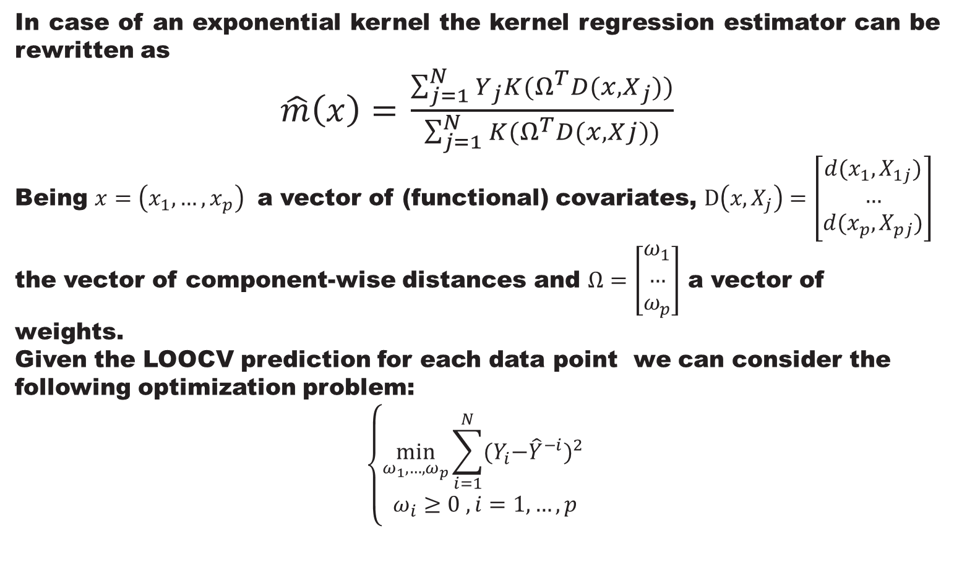
Data Collection
In case of an exponential kernel the kernel regression estimator can be rewritten as
$\hat{m}\left(x\right)=$ $\frac{\sum_{j=1}^{N}{Y_{j}K(Ω^{T}D(x,X_{j}))}}{\sum_{j=1}^{N}{K(Ω^{T}D(x,Xj)})}$
Being $x=\left(x_{1},…,x_{p}\right)$ a vector of (functional) covariates, $D\left(x,X_{j}\right)=\left[\begin{matrix}d(x_{1},X_{1j}) \\ … \\ d(x_{p},X_{pj})\end{matrix}\right]$ the vector of component-wise distances and $Ω=\left[\begin{matrix}ω_{1} \\ … \\ ω_{p}\end{matrix}\right]$ a vector of weights.
Given the LOOCV prediction for each data point we can consider the following optimization problem:
$$\left\{\begin{aligned}\min_{ω_{1},…,ω_{p}}{\sum_{i=1}^{N}{{{(Y}_{i}−{\hat{Y}}^{−i})}^{2} }} \\ ω_{i}≥0 , i=1,…,p\end{aligned}\right.$$

Slide 19
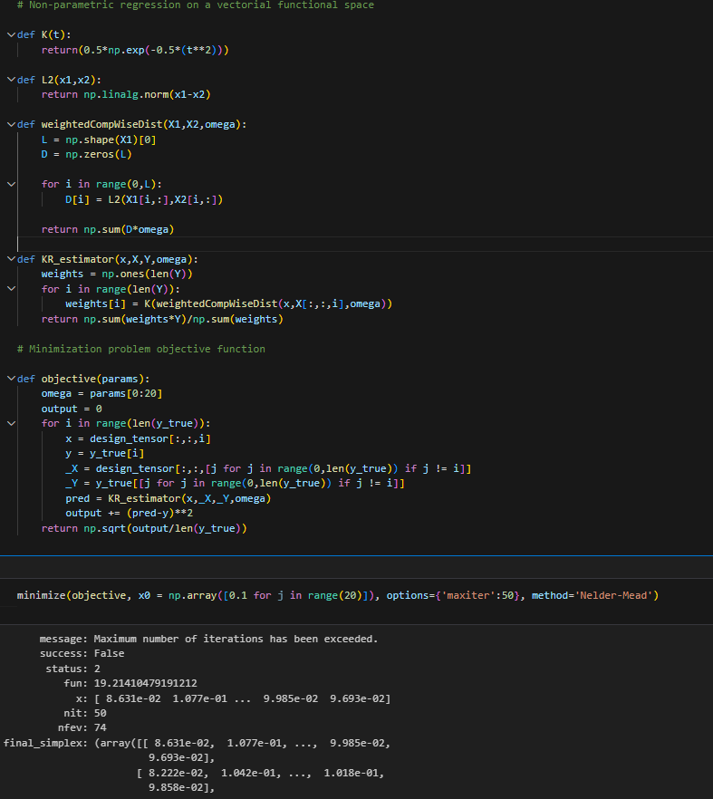
Data Collection
The result after all the implementation (full implementation of the pipeline is on the report) are quite weak. This might be due to several reasons:
The dataset needed more preprocessing;
The eGFC have to be regularized;
The optimizer lacks in precision because of the initializiation.

Slide 20
The working model

Slide 21
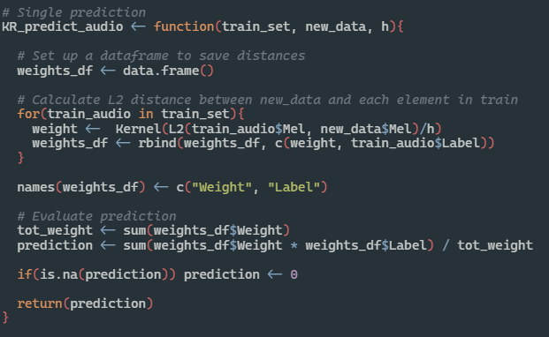
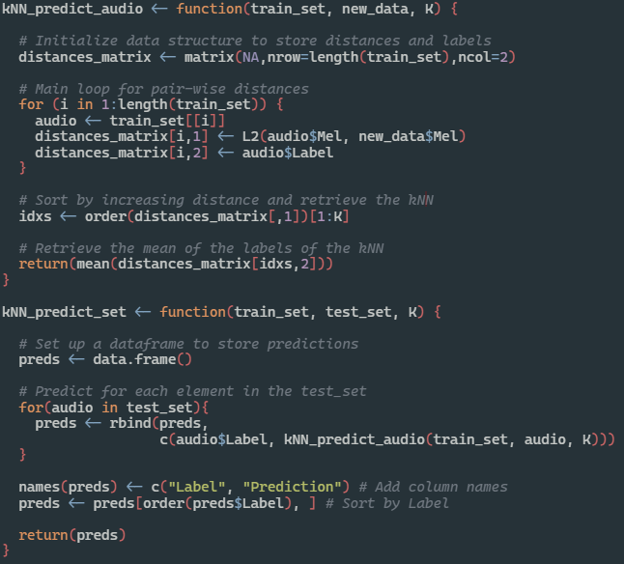
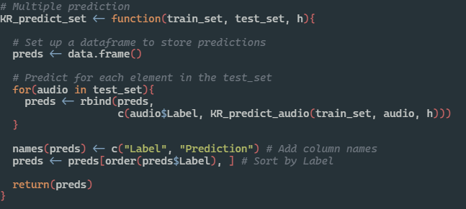
The models
Nadaraya-Watston Kernel Regression
KNN Regression

Slide 22
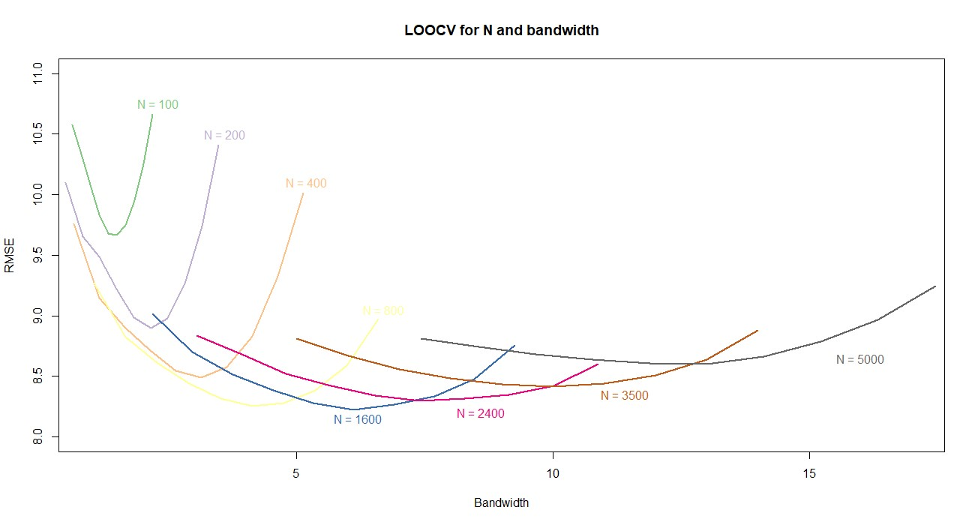
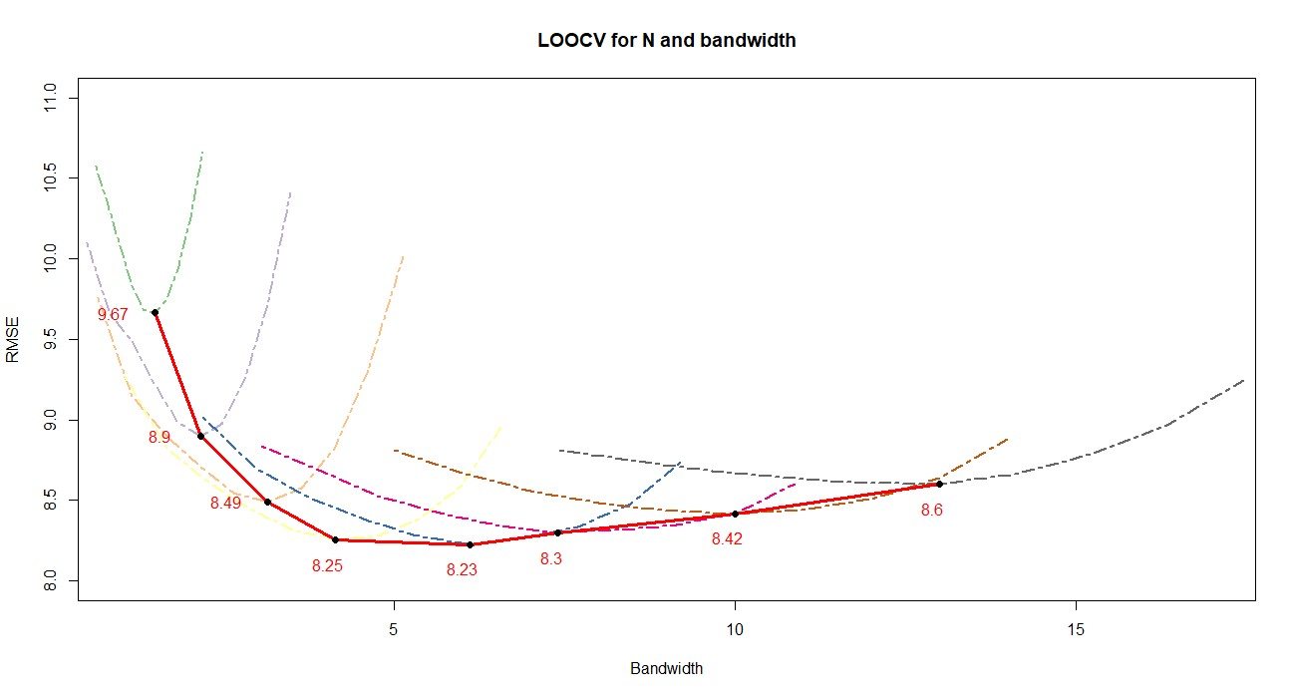
LOOCV
We optimized the parameters of our model: in this case in particular we are talking about kernel regression. The parameters to be considered are the number of filters in the feature extraction and the bandwidth for the kernel.

Slide 23
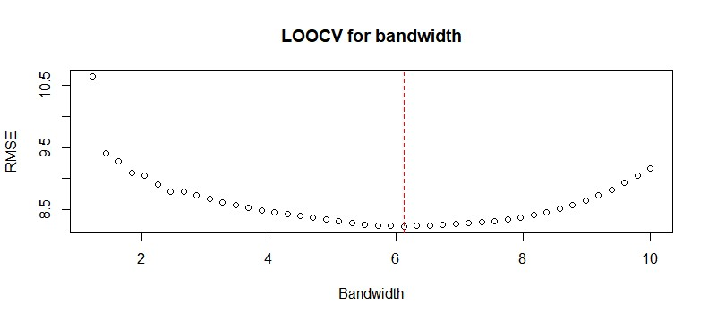
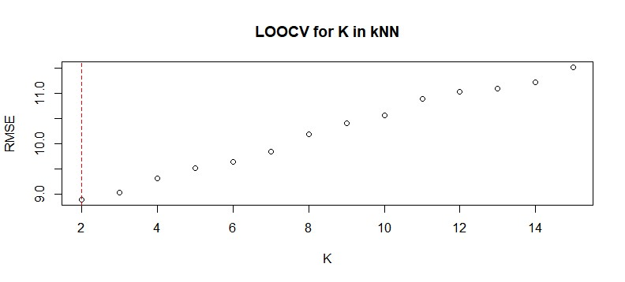
LOOCV
h = 6.12
RMSE = 8.22
K = 2
RMSE = 8.90

Slide 24

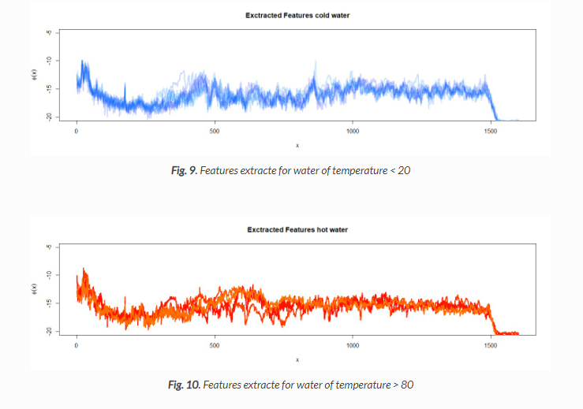
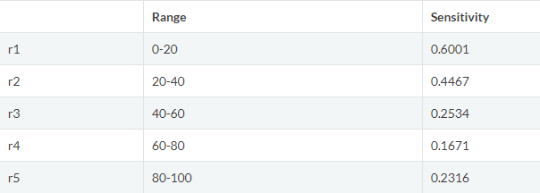
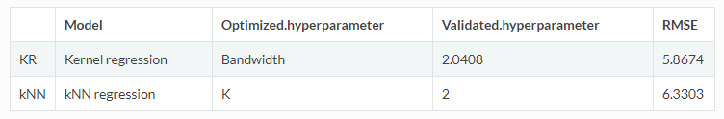
Interpretation
By looking at a sensitivitity metric, we notice that the model performs better at lower temperatures.
Visually we can see that the feature extracted for cold water are less dispersive for the central filters than the one extracted for hot water, and it is also more populated.

Slide 25
Thank you!

