Slide 1
Strategic thinking Bank market campaign federico ariton higher diploma data analyst lecturer: james garza

Slide 2
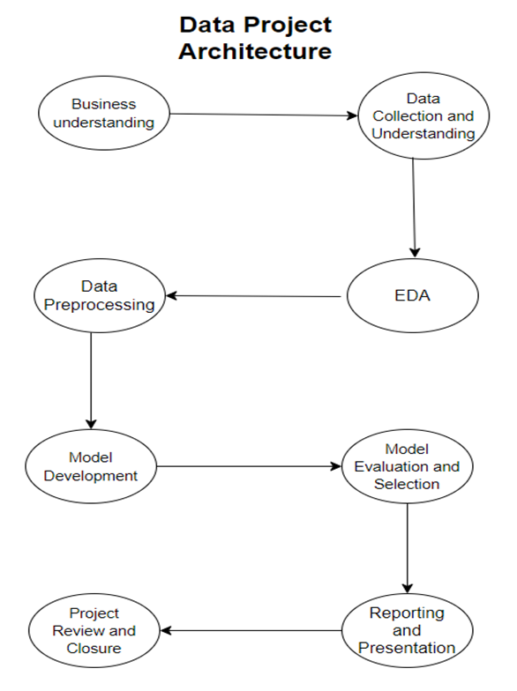
structure of the project and Business understanding

Slide 3
Business understanding
The objective is to develop a predictive model to forecast the likelihood of a customer subscribing to a term deposit. This model can be used to target potential subscribers more effectively, optimizing resources and improving campaign success rates.
Hypothesis
Older clients and those with higher education levels are more likely to subscribe to term deposits.
Null hypotheses (H0) state no significant difference in subscription rates, while alternative hypotheses (H1) suggest older age groups and clients with higher education have significantly higher rates.
General goal
Analyze the data to identify the key factors that influence a customer’s decision to subscribe to a bank term deposit.

Slide 4
machine learning algorithms
Logistic Regression
KneigborsClassifier
Decision Tree
Random Forest
Libraries
Different Python libraries were used to facilitate data manipulation, visualization, and machine learning model development. Pandas and NumPy were employed for data handling and numerical operations, while Matplotlib and Seaborn were utilized for creating insightful visualizations

Slide 5
Data set
The data for the bank marketing campaign contain:
41,188 observations
21 variables
7 variables are numerical, and 14 variables are categorical
Source
The dataset was obtained from the UC Irvine Machine Learning Repository, a online resource that hosts a variety of datasets commonly used for academic and research purposes in machine learning.

Slide 6
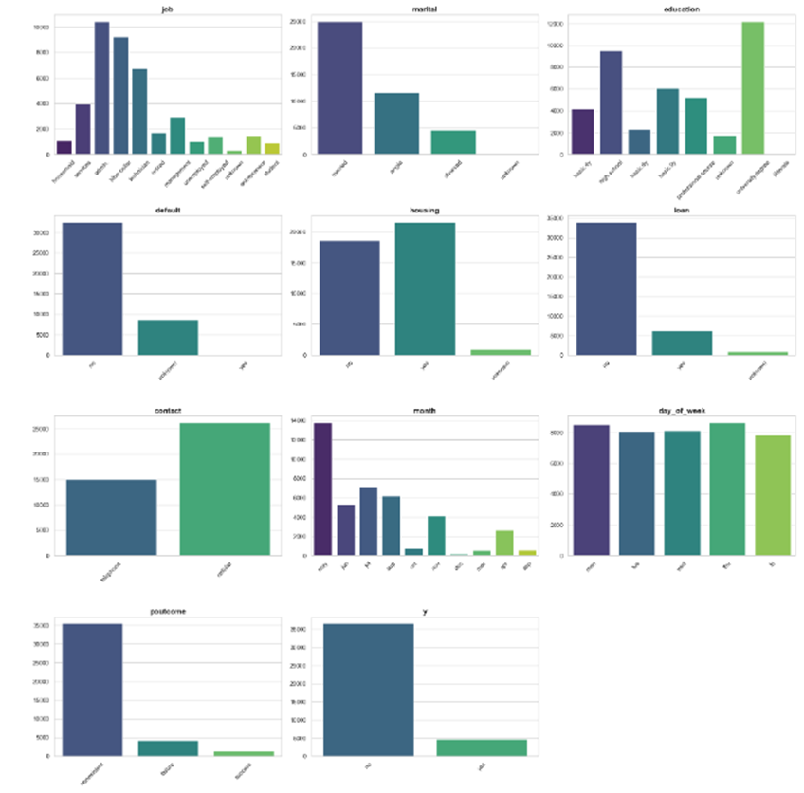
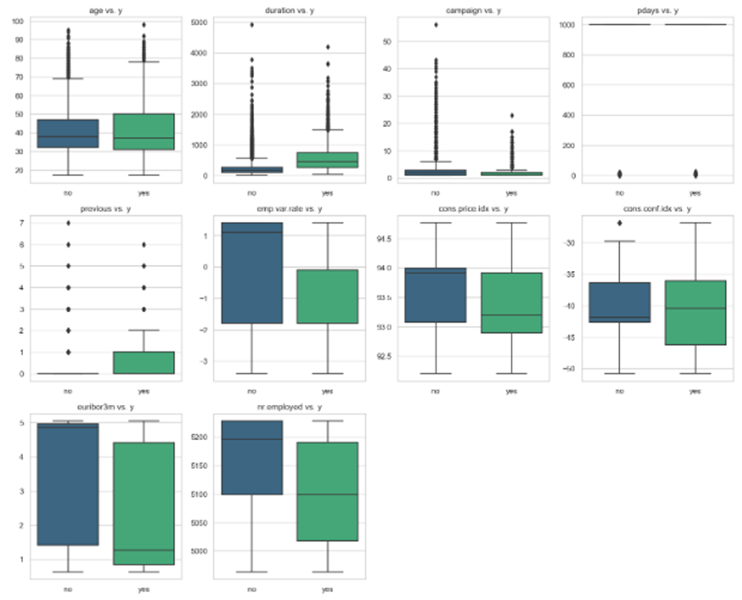
EDA

Slide 7
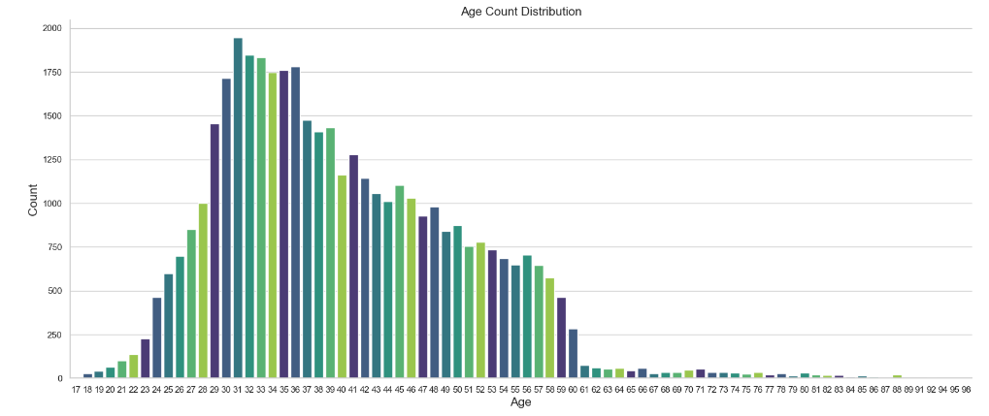
Data preparation
Implementing Labelencoder for categorical data
For the age distribution we examining the plot and categorized into four distinct gropus
Group 1: Clients aged 32 and below (1)
Group 2: Clients aged between 33 and 47 (2)
Group 3: Clients aged between 48 and 70 (3)
Group 4: Clients aged between 71 and 98 (4)

Slide 8
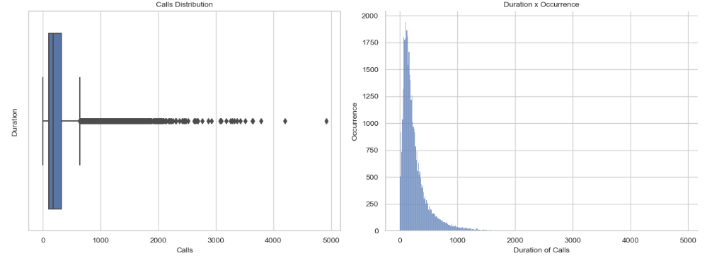
Data preparation
To analyse call durations in the bank marketing dataset, a box plot and histogram were created, showing that the distribution is right-skewed with many outliers. To simplify analysis, the call durations were grouped into five categories
Group 1: Calls with a duration of 102 seconds or less.
Group 2: Calls with a duration between 102 and 180 seconds.
Group 3: Calls with a duration between 180 and 319 seconds.
Group 4: Calls with a duration between 319 and 644.5 seconds.
Group 5: Calls longer than 644.5 seconds.

Slide 9
Feature selection and feature scaling
We used an ExtraTreesClassifier to identify and select the most important features for predicting term deposit subscriptions. This process is crucial because it reduces the feature set to only the most relevant predictors, improving model performance and interpretability while reducing overfitting risk.
AFTER SPLITTING THE DATA
We standardized the training and test sets using StandardScaler

Slide 10
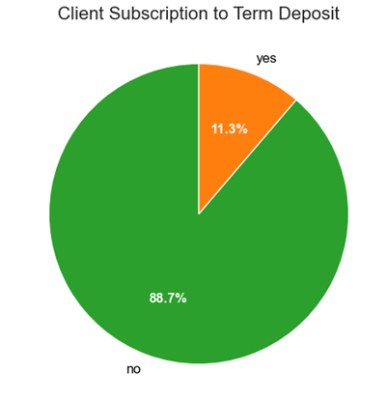
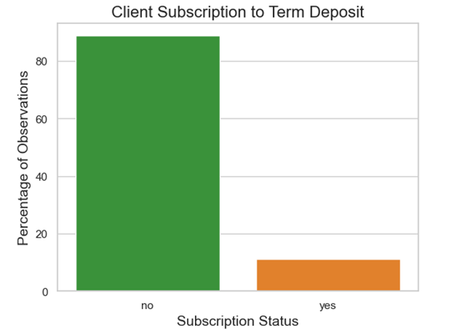
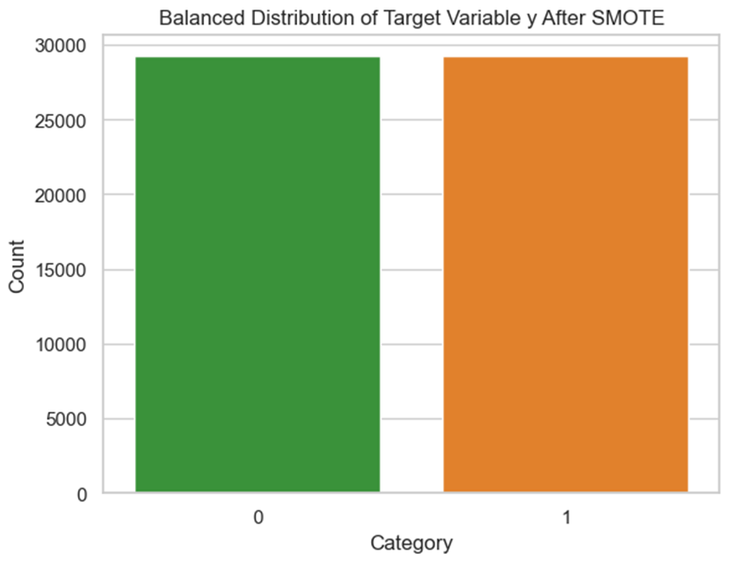
smote
A pie chart revealed significant class imbalance in the target variable, with only a small percentage of clients subscribing to term deposits. The majority of clients did not subscribe, indicating a skewed distribution that could lead to biased model predictions
To address this imbalance, we applied SMOTE (Synthetic Minority Oversampling Technique) to the training set, ensuring balanced representation of both classes. This balancing process is crucial because it prevents model bias toward the majority class, leading to improved prediction accuracy and fairer evaluation.

Slide 11
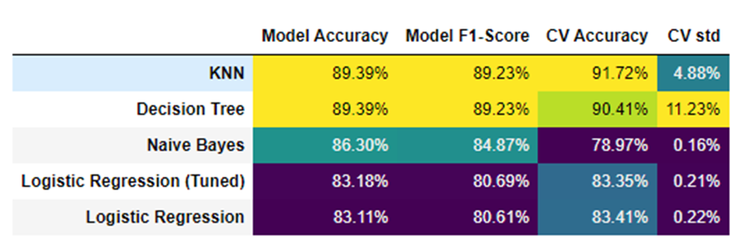
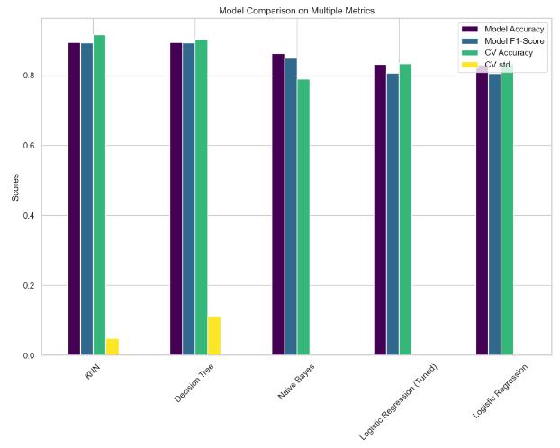
Model Comparison

Slide 12
Conclusion
Among the five models analyzed:
- The K-Nearest Neighbors (KNN) model stands out with an accuracy of 89.39% and a cross-validation (CV) accuracy of 91.72%, offering reliable and consistent predictions.
- The Decision Tree model is a close competitor, delivering similar accuracy but with higher variability.
-Naive Bayes is effective in resource-constrained environments due to its simplicity and consistency,
- The Logistic Regression models require further optimization.
- Overall, KNN emerges as the best model for predicting term deposit subscriptions, striking an optimal balance between accuracy and stability.

Slide 13
THANK YOU

