Slide 1

Università della Calabria
Department of Mathematics and Computer Science
Approximating Graph Edit Distance through Graph Neural Networks: Methods, Limitations, and Proposals
Master’s Degree in Artificial Intelligence and Computer Science
Supervisors
Ch.mo. Prof Giorgio Terracina Dott. Sebastiano A. Piccolo
Candidate
Federico Calabrò 247976

Slide 2
Context and Motivation
Graph Edit Distance (GED) is crucial in comparing graphs, useful in fields like bioinformatics, social networks, and computer vision.
GED calculation is NP-Hard, meaning exact computation is infeasible for large graphs. Hence, it needs to be approximated.
Classical approximations rely on heuristic algorithms such as A* search and graph matching techniques.
Recently, Graph Neural Networks (GNNs) have emerged as promising methods for faster and more accurate GED computation.

Slide 3
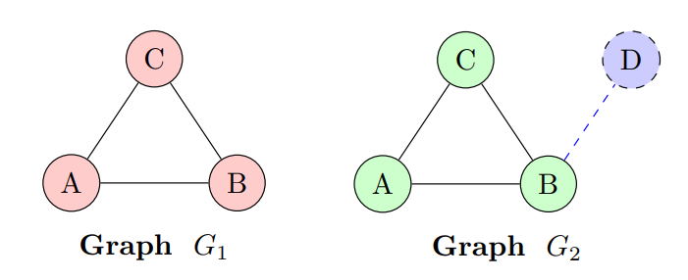
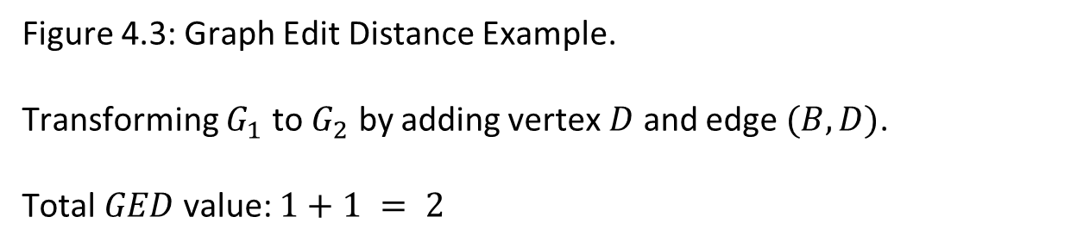
Example
Figure 4.3: Graph Edit Distance Example. Transforming $G_{1}$ to $G_{2}$ by adding vertex $D$ and edge $(B,D)$. Total $GED$ value: $1+1 = 2$

Slide 4
Contribution (1)
A literature review was conducted, identifying 20 key papers on GNN-based GED approximation and their trends. Four significant approaches were selected as the most representative:
SimGNN The foundational GNN model, introducing core features later adopted by other approaches.
GPN Proposing an innovative hybrid approach for GED approximation.
TaGSim The first to re-think GED as the sum of 3 values: $ged_nc, ged_in, ged_ie$
TaGSim The first to re-think GED as the sum of 3 values: 𝑔𝑒𝑑_𝑛𝑐, 𝑔𝑒𝑑_𝑖𝑛, 𝑔𝑒𝑑_𝑖𝑒
GedGNN Current state-of-the-art model in performance which combines the previous three.
2019
2022
2022
2023

Slide 5
Contribution (2)
Development of a more flexible and robust codebase on top of GedGNN’s one by enhancing its code and removing some of its limitations.
Development of an algorithm to generate artificial datasets with graphs (pairs) at known GED distance for both training and testing.
Set of experiments (64 combinations) showing that models lack the ability to generalize out of distribution.

Slide 6
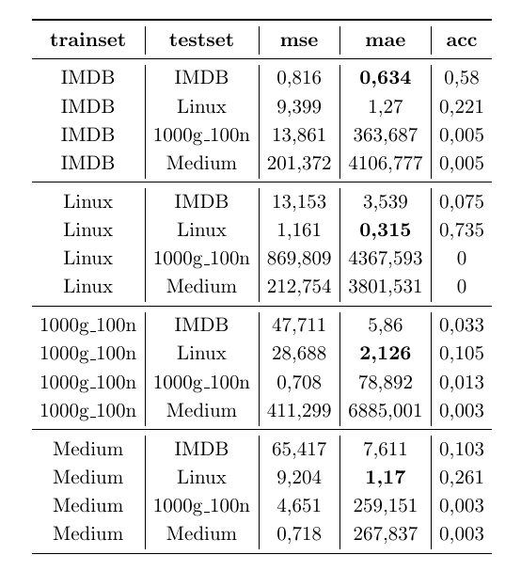
Conclusion
Models trained on specific data (IMDB and Linux) show strong performance but only within their original data distribution.
Future work: Increase the density of synthetic datasets to further improve model performance and generalization.
Table 6.4: Results for GedGNN models

Slide 7
Thanks for your attention!!

