Slide 1

Computer Architecture
Barbieri Giovanni
Cavedoni Federico
Di Ricco Alessio

Slide 2
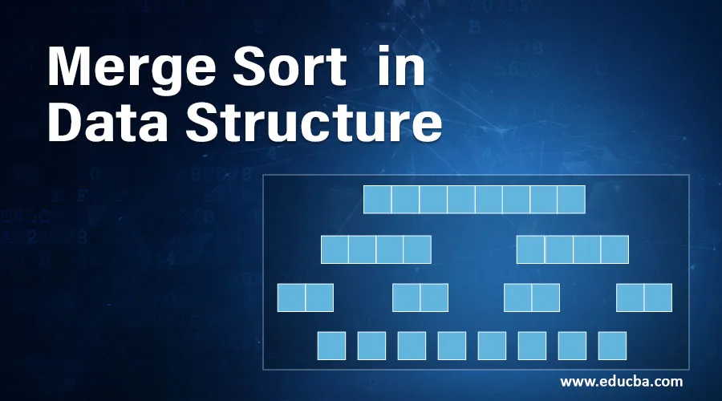
INTRODUCTION OF MERGE SORT
Merge sort is a popular sorting algorithm that uses the divide and conquer technique to sort an array of elements.
The basic idea behind merge sort is to divide the array into smaller sub-arrays, sort them individually, and then merge them back together to form the final sorted array.

Slide 3
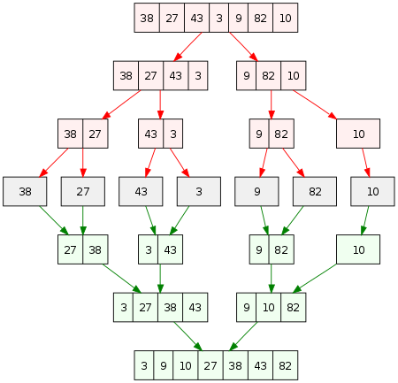
DIVIDE AND CONQUER TECHNIQUE
Merge sort uses the divide and conquer technique to sort an array. This means that it breaks down the problem into smaller sub-problems and solves them individually.
In merge sort, the array is divided into two equal halves and each half is sorted separately. Once both halves are sorted, they are merged back together to form the final sorted array.

Slide 4
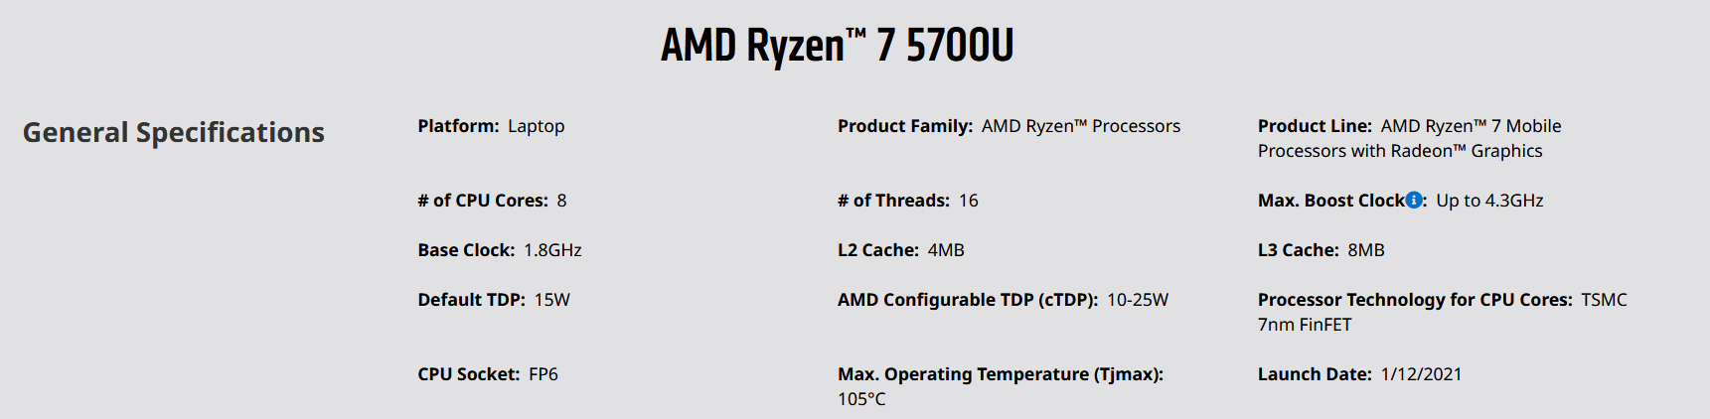
HARDWARE SPECIFICS

Slide 5
PERFORMANCE ANALYSIS
#Physical Threads
Analyzed using 10M elements

Slide 6
PERFORMANCE ANALYSIS
#Physical Threads
Analyzed using 10M elements

Slide 7
PERFORMANCE ANALYSIS
#Max Step SpeedUP
Analyzed using 10M elements

Slide 8
PERFORMANCE ANALYSIS
16 Threads
8 Threads
4 Threads

Slide 9

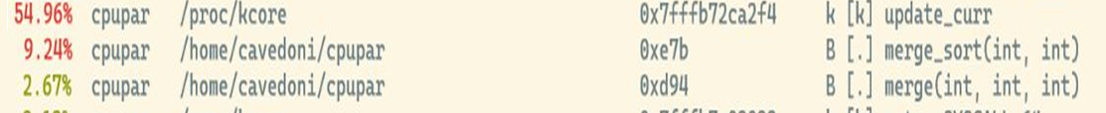
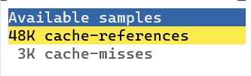
BOTTLENECK ANALYSIS USING PERF
After analiyzing our code with PERF we get this results
Most of the cache misses are due to Update_curr,
that is a linux kernel function that handle recurrency

Slide 10
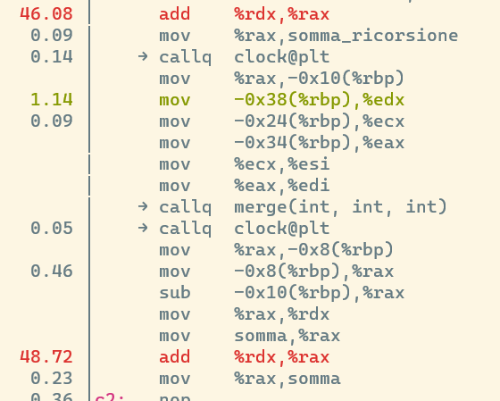
BOTTLENECK ANALYSIS USING PERF
Two instructions inside the merge_sort function cause more than 90% of the cache misses of all the code.
The bottleneck of our algorithm are the recursive calls which are the key to our algorithm
kk

Slide 11
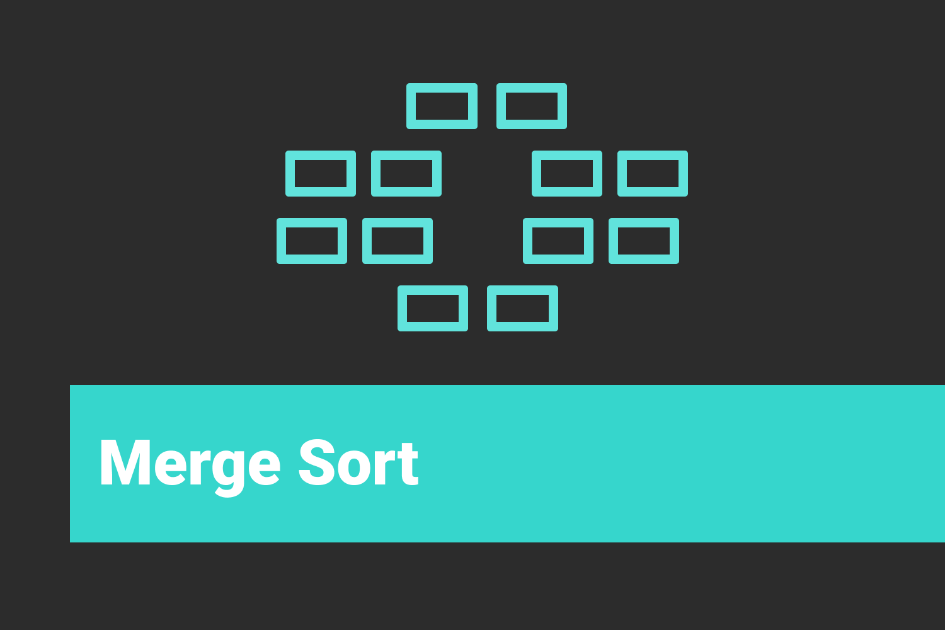
RESULTS
The most advantageous number of threads to use is 16 which corresponds to the number of physical threads
For arrays with size less than or equal to 10K it is better to use the sequential approach, because with a small array the overhead due to thread management is greater than the gain obtained

Slide 12
GPU IMPLEMENTATION

Slide 13
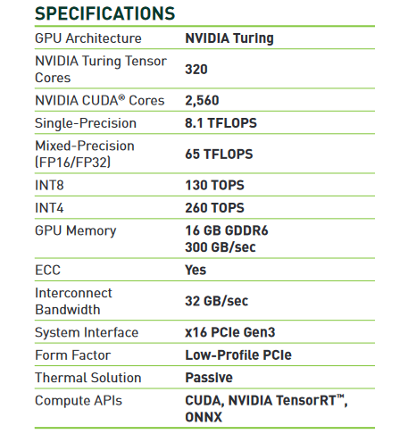

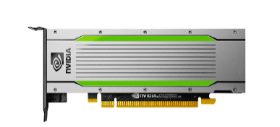
HARDWARE SPECIFICS

Slide 14
PERFORMANCEANALYSIS
#Max SpeedUP
Num blocks
8 32 64 128 256 512 1024
256
Num threads per block
Recursive
Iterative

Slide 15
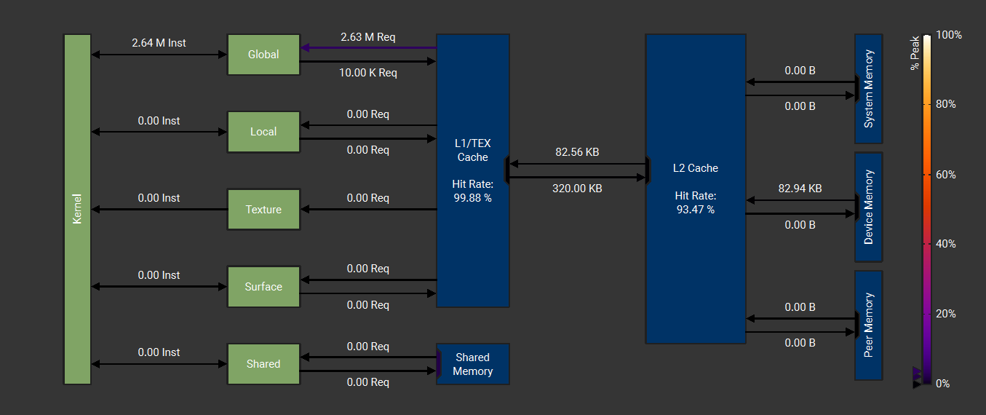
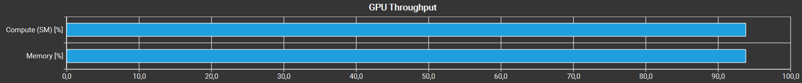

NSIGHT COMPUTE ANALYSIS
Strengths points of our algorithm:
- Troughput
- Warp occupancy
- Hit rate
- Execution time

Slide 16
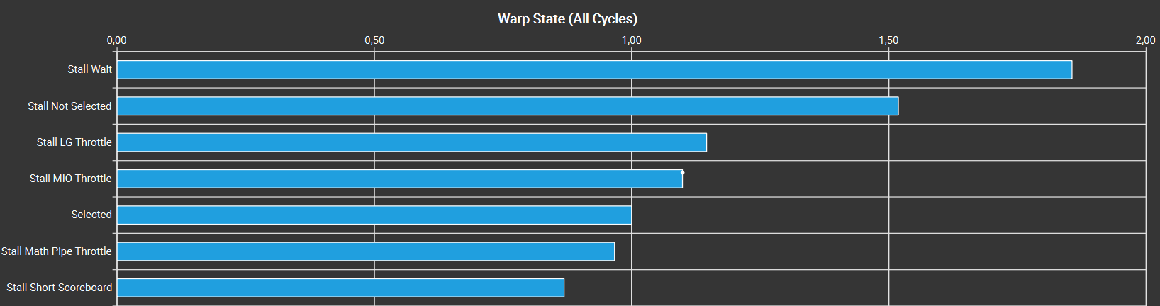
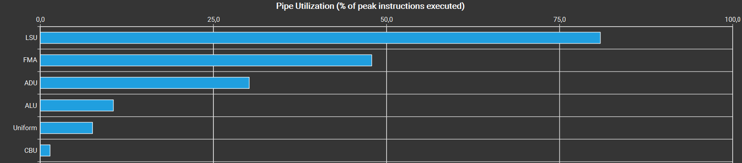
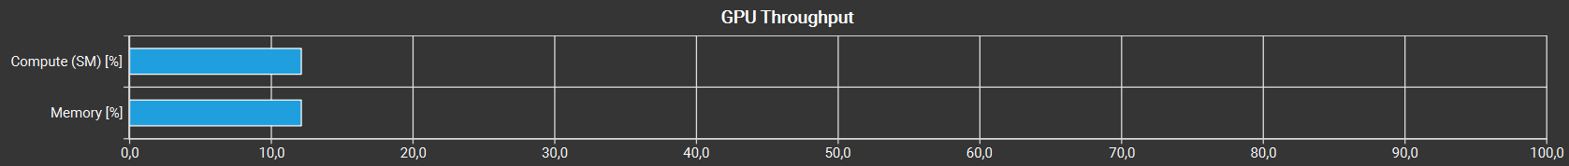
NSIGHT COMPUTE BOTTLENECK ANALYSIS
Bottlenecks of our algorithm:
- Sequential final merge
- Memory bound alghoritm

Slide 17
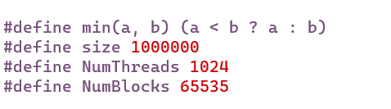
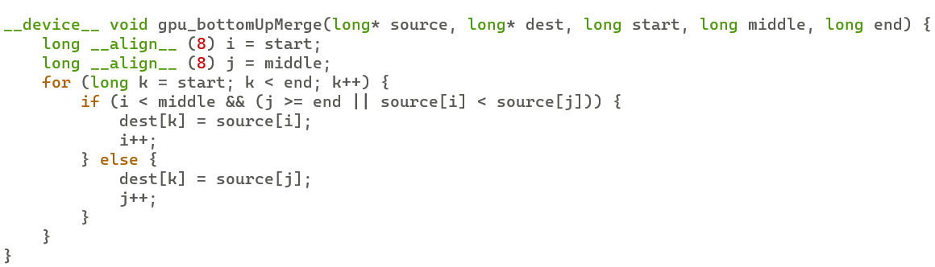
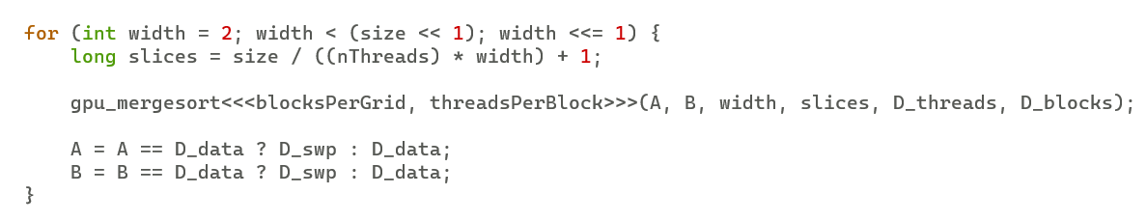
PERFORMANCE ANALYSIS
In order to improve our algorithm, we made the following changes:
- Define variable → avoid memory access
- align statement
- shift operand instead of multiplication

Slide 18
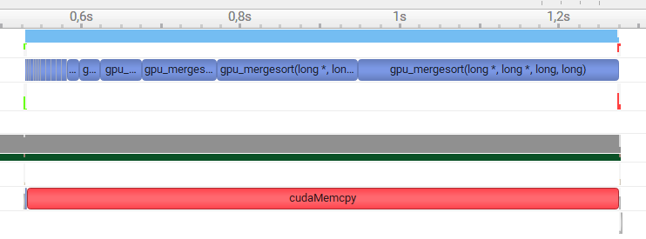
NSIGHT SYSTEMS ANALYSIS
Asyncrounous memory transfer CPU ↔ GPU
Overlapped CPU and GPU execution

Slide 19
PERFORMANCE ANALYSIS
#Max SpeedUP
Num blocks
8 32 64 128 256 512 1024
256
Num threads per block
Pre-optimization
Post-optimization

Slide 20
CONCLUSION
We achieved an 18x speed-up over the 8 thread, 1 block version.
Compared to the CPU version, the speed-up is slightly increased proportionally to the increase in the size of the array up to a maximum of 4 times with 100 million elements
OBSERVATIONS
The merge sort is therefore not optimal for execution on GPU because:
Perform operation only on one-dimensional arrays
Recursive calls not properly implemented
Sequential parts

