Slide 1

FOUNDATIONS OF CYBERSECURITY
A SECURE BANK APPLICATION
Barbieri Giovanni
Cavedoni Federico

Slide 2
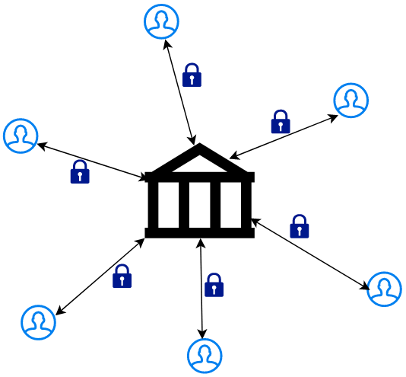
A SECURE BANK APPLICATION
Our application consists of a cryptographically secure banking application.
It is made up of a Server (The Bank) and various Clients that use the services made available by the bank.
The server is multithreaded to manage multiple clients simultaneously.
Communications are made secure using the OpenSSL library.

Slide 3
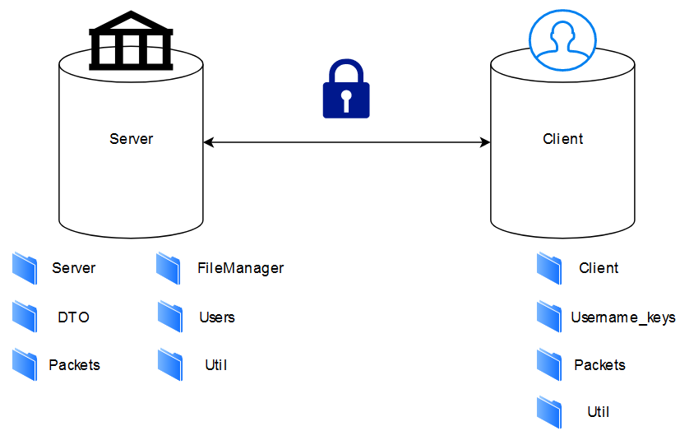
PROJECT ARCHITECTURE
The folders that make up the project are the following, some belong only to the Server, others to the client and others are shared between both.

Slide 4
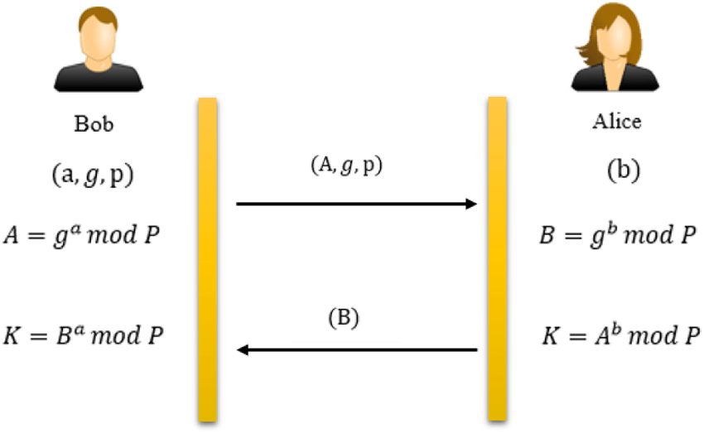
PROTOCOLS
Each user, as well as the server, is equipped with a pair of keys (private key, public key) used to manage authentication.
We generated for all users and the server a pair of keys. To perform the initial authentication between server and client we used the Diffie Hellman protocol thanks to which two shared secrets were derived.
We implemented a Station-to-Station protocol to ensure the direct authentication and we used ephemeral parameters to ensure the Perfect Forward Secrecy.

Slide 5


PROTOCOLS
One shared secret is used as a symmetric key for communications, using the AES256 protocol, and the other to generate the HMAC digest, using the SHA512 protocol.
The packets exchanged after authentication are therefore encrypted with the key to ensure confidentiality.
A signed HMAC digest is added to the package to ensure integrity and authenticity.
Then we have the Counter which guarantees freshness.

Slide 6
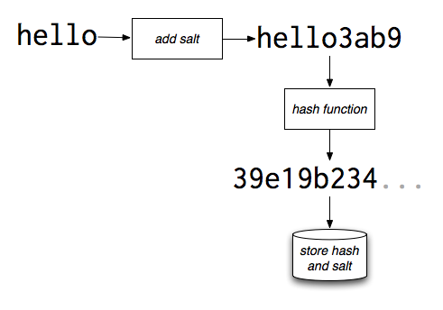
PROTOCOLS
User passwords are saved salted and hashed, to avoid saving keys in the clear and adding randomness to the hash.
Transactions are encrypted with a specific key dedicated to the files and decrypted when necessary.

Slide 7
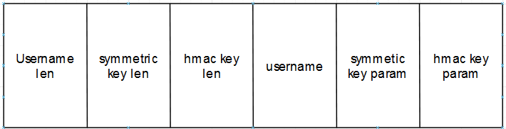
PACKETS FORMAT-STARTPACKET
The startpacket is used by the client to begin the authentication process on the server. The client generates the two Diffie-Hellmann parameters and sends username length, parameter length, username and parameters in clear.

Slide 8
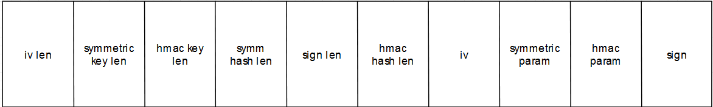
PACKETS FORMAT-AUTHENTICATIONPACKET
The Authentication packet is used from client to server and from server to client to authenticate each other. The server uses this packet to send its network parameters in the clear, so that the server can also construct symmetric keys.
The signature is also sent, which is formed by the concatenation of the two keys first hashed and then signed, so as to guarantee authentication and integrity.

Slide 9
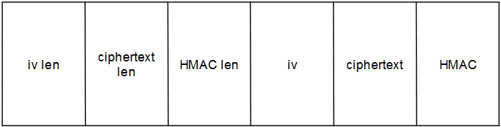
PACKETS FORMAT-GENERICPACKET
The Generic packet is used as a generic communication packet between client and server to manage the various functions offered by the server.
The packet is composed of the iv, used to encrypt and decrypt, the ciphertext encrypted with the symmetric key and the HMAC, used to guarantee integrity, encrypted with the HMAC key.

Slide 10
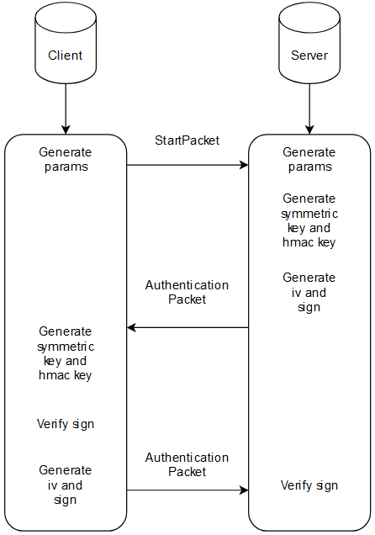
WORKFLOW-AUTHENTICATION
For the authentication between client and server, the workflow is managed using the startPacket and genericPacket packages.

Slide 11
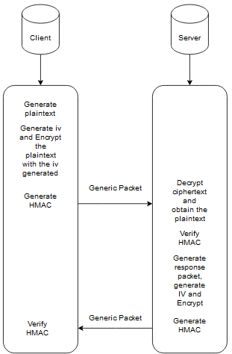
WORKFLOW-COMMUNICATIONS
Generic packets are used for communication between server and client in a symmetric key.
We used Encrypt then MAC

Slide 12
Thank YOU for THE attention
Barbieri Giovanni
Cavedoni Federico

