Slide 1
Large-Scale and Multi-Structured Databases Project
Project Presentation
MongoDBGG
Silano Gabriele
Cavedoni Federico
Labella Simone

Slide 2

Introduction
MONGODBGG is an application developed for managing and exploring board games.
Its core functionalities include presenting detailed information about various board games, writing reviews, and following other users to view their activities and interactions.
The app allows users to:
Search and filter games based on name, categories, mechanics, and ratings.
Write reviews with comments and ratings on board games.
Track personal statistics such as games played, win rates, and review activities.
For administrators, the application offers advanced analytics and the ability to manage user-generated data and perform specialized queries.

Slide 3
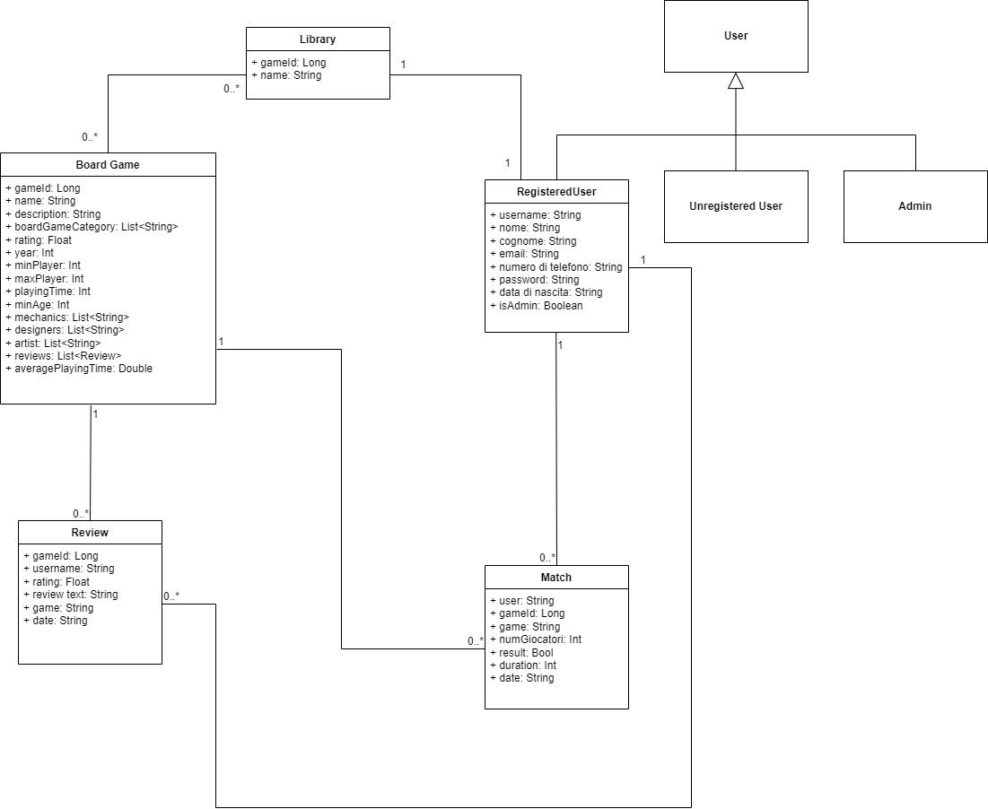
UML Class Diagram

Slide 4
Functional Requirements
Unregistered User:
Browse board games
View board game reviews
Registration and login capabilities
View other users
Registered User:
Manage their own matches and reviews
Manage likes, follows, and account information
View personal statistics
Admin:
Manage all user accounts, matches, reviews, and board games
View global statistics
Manage likes and follows

Slide 5
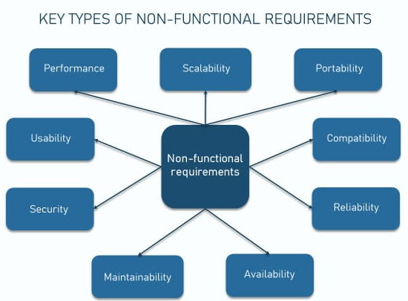
Non-Functional Requirements
Web application implementation
High availability to ensure uninterrupted service
Object-oriented programming for code maintainability
Encryption of user passwords for data security
Scalability to support increasing loads and databases growth
User-friendly interface for easy and intuitive navigation

Slide 6



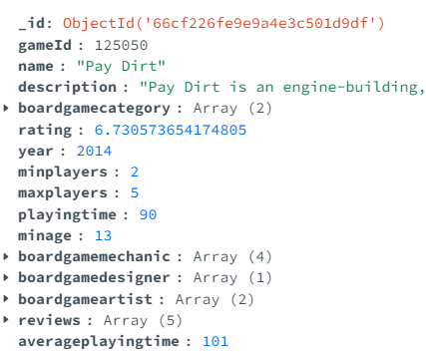
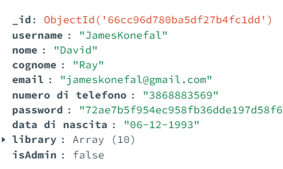
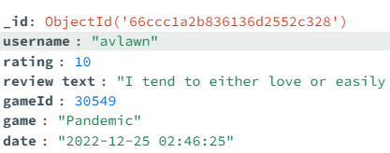
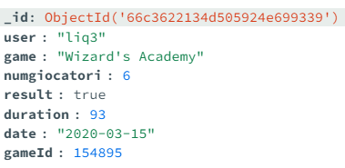
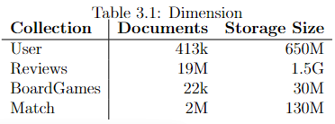
Data Modelling and Structure
Initial Dataset
scraping

Slide 7

Project Structure
Main Package: it.unipi.lsmsd.LSMSD_Project
Sub-packages Overview:
config: Configures MongoDB connection (MongoConfig class).
controller: Handles API requests for board games, matches, users, and reviews.
dao: Manages data access with MongoDB and Neo4j (CRUD operations and complex queries).
model: Defines core domain models (e.g., User, Review, Match, BoardGame).
projections: Defines interfaces for returning specific data subsets to optimize queries.
service: Implements business logic for the controllers (e.g., BoardGameService, UserService).
utils: Contains utility classes and custom exceptions (e.g., InvalidCredentialException).

Slide 8
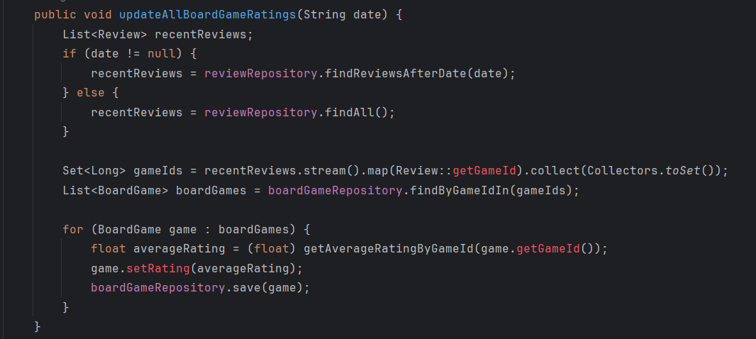
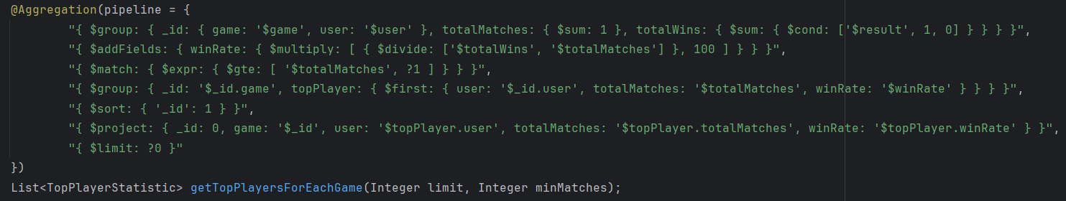
MongoDB Relevant Query
Update query:
UpdateReviews
UpdateRatings
UpdateAveragePlayingTime
Aggregation query:
GetGameStatistics
GetUserGameStatistics
GetTopPlayersForEachGame
FindUsersWithHighestAvgNumPlayers
findMostPlayedGameByMatches

Slide 9
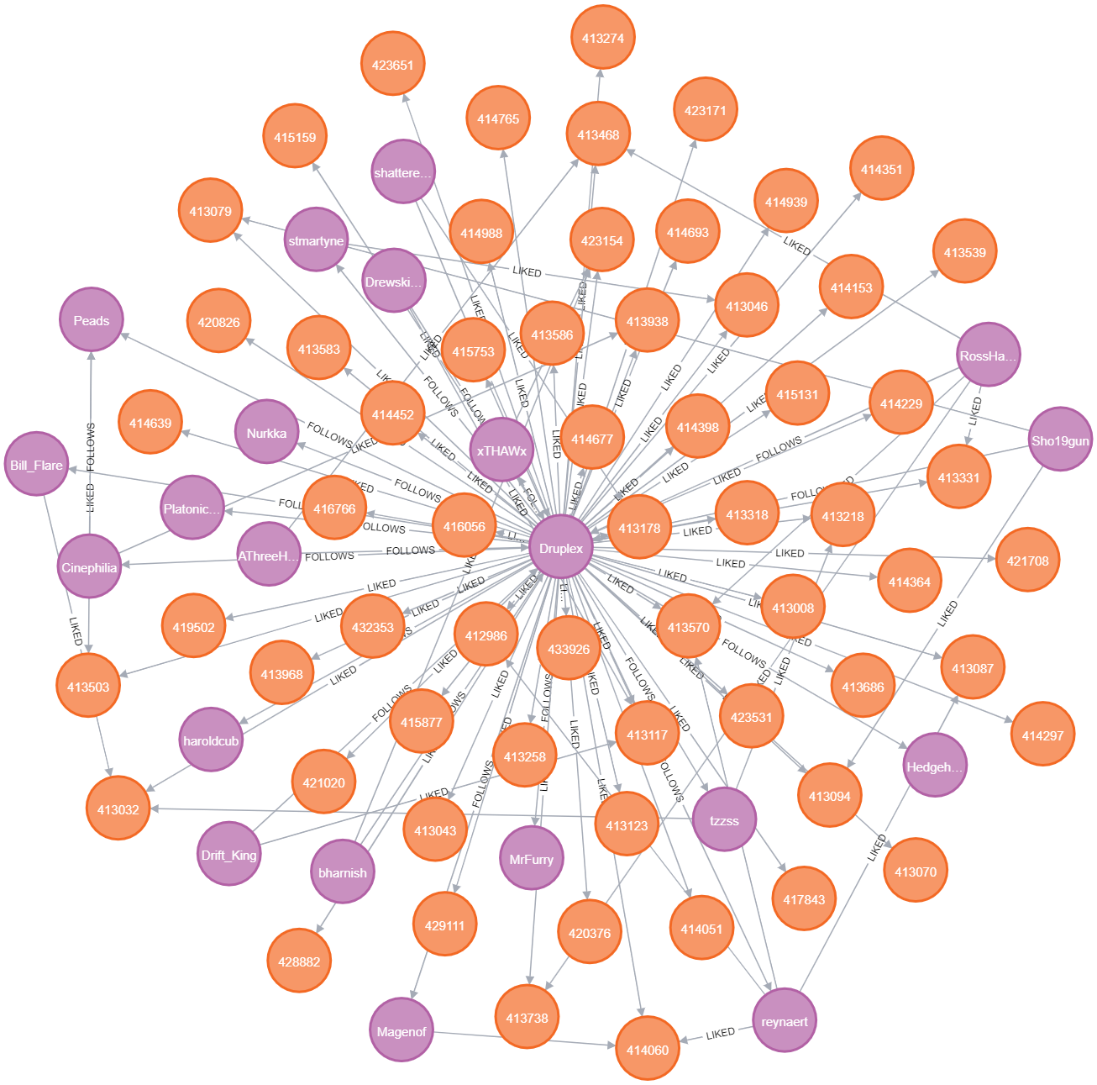
Neo4j Batabase
Entities:
User(username)[400,000]
BoardGame(id,name)[40 000]
Relationships:
FOLLOWS(User-User)[10M]
LIKED(User-BoardGame)[20M]

Slide 10
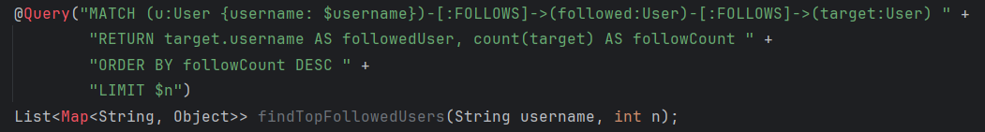
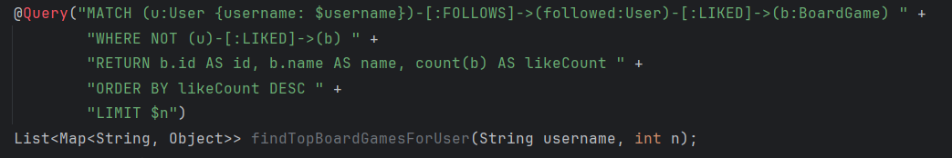
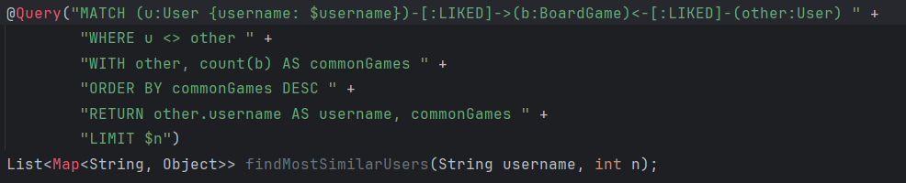
Neo4J Relevant Query
We have CRUD operation and tipical suggestion query of Neo4j database:
GetTopBoardGamesForUser
GetTopFollowedUsers
getUserMostSimilar

Slide 11
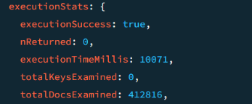
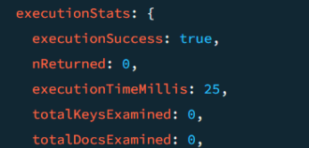
Indexing Strategy (1/2)
Purpose of Indexing:
Enhances query performance as the dataset grows.
User Collection:
Index on username: Speeds up checking if a game is in a user's library.
Impact: Reduces query time by enabling faster retrieval of user data.
Match Collection:
Index on user: Optimizes retrieval of all matches associated with a specific user.
Impact: Minimizes full collection scans, enhancing query efficiency.

Slide 12
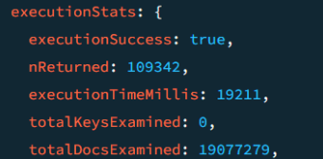
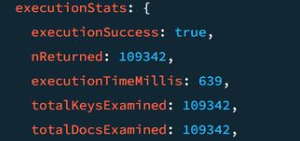
Indexing Strategy (2/2)
Purpose of Indexing:
Facilitates efficient updates of board game statistics.
Match Collection:
Index on gameId: Allows quick calculation of average playing time.
Review Collection:
Index on gameId: Enables fast retrieval of ratings and reviews.
Impact:
Faster data aggregation for updating board game statistics, maintaining system performance as data grows.

Slide 13
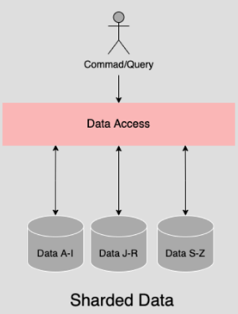
Sharding Strategy
Sharding for Scalability:
Distributes data across multiple servers to improve performance.
Shard Keys and Methods:
User Collection: username (hash-based sharding).
BoardGame Collection: gameId (hash-based sharding).
Match Collection: username (hash-based sharding).
Review Collection: gameId (hash-based sharding).
Benefits: Ensures even data distribution, avoids hotspots, and maintains performance.

Slide 14
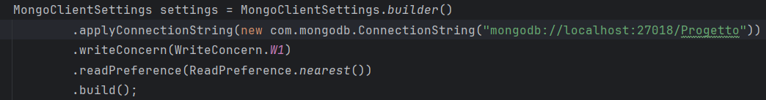
Write Concern & Read Preference
Write Concern:
Setting: 1
Description: Write acknowledged by the primary server, balancing performance and durability.
Read Preference:
Setting: nearest
Description: Reads directed to the closest replica, reducing latency and distributing read loads.
Impact on System:
Write Concern: Ensures data durability with efficient performance.
Read Preference: Enhances read performance and system responsiveness.

Slide 15
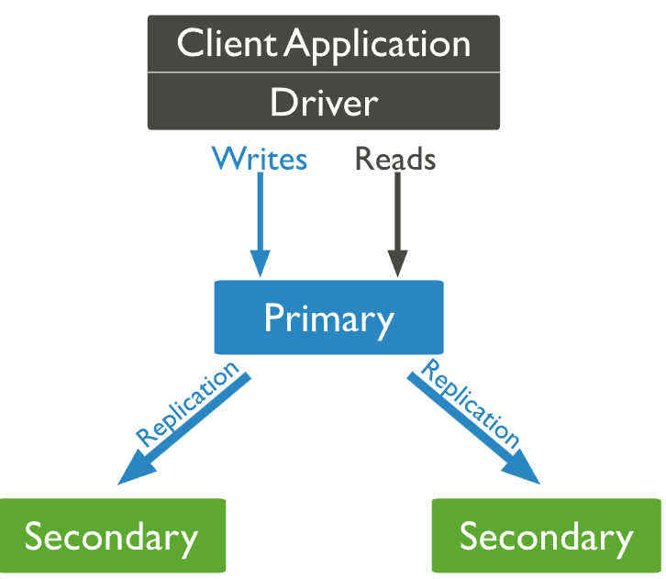
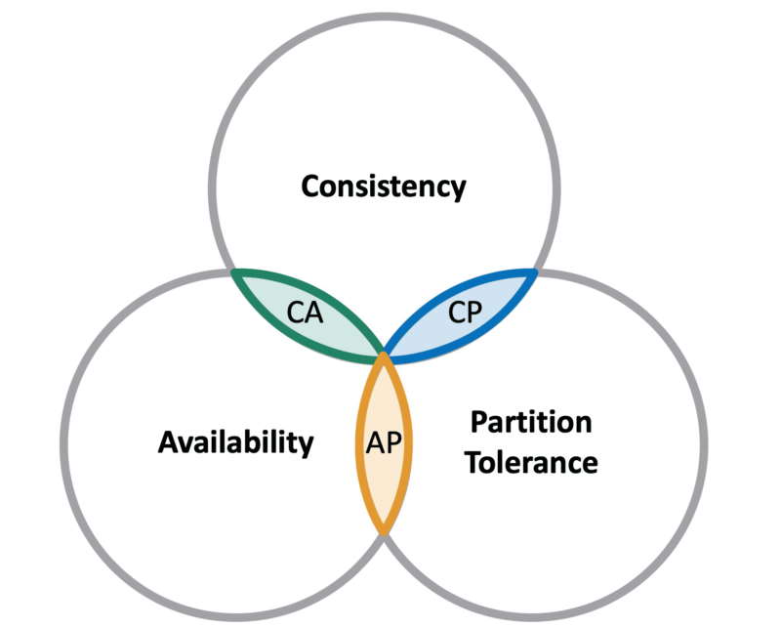
Replication & CAP Theorem
Replication in MongoDB:
Configuration: 1 primary, 2 secondary servers.
Advantages: High availability, data redundancy, read scalability, and automatic failover.
CAP Theorem Application:
Chosen Approach: Prioritize Availability and Partition Tolerance (AP) over Consistency.
Reason: Ensures system remains operational despite server failures or network issues, with a trade-off on consistency (potentially stale reads).

Slide 16



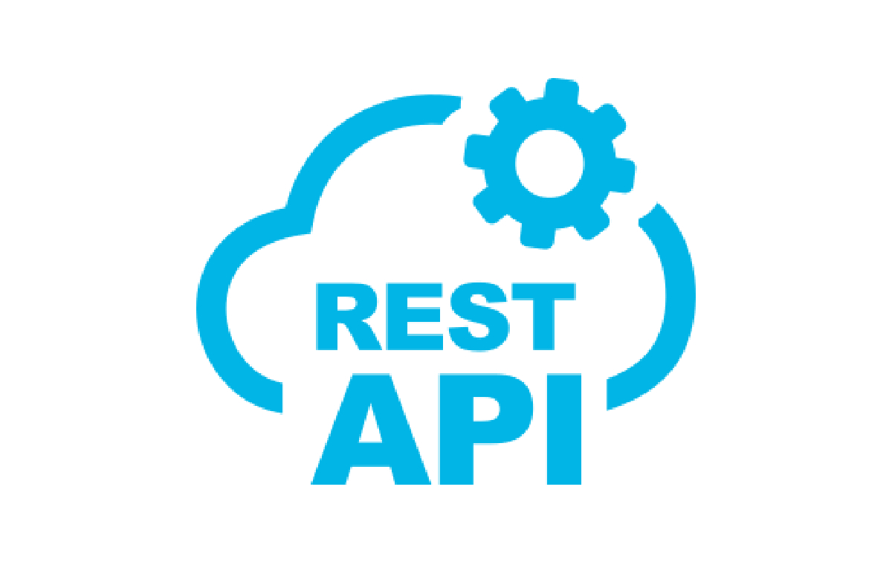


Software & Hardware Architecture
Implementation Frameworks:
Spring Boot
HttpSession & @RestController
Database Integration:
MongoDB
Neo4j
Testing and Deployment:
Postman

