Slide 1

EDGE COMPUTING NETWORK PROJECT
Performance evaluation of AN Edge computing-enabled cellular network
Federico Cavedoni, Lorenzo Monaci, Federico Pinna - PECSN
1

Slide 2
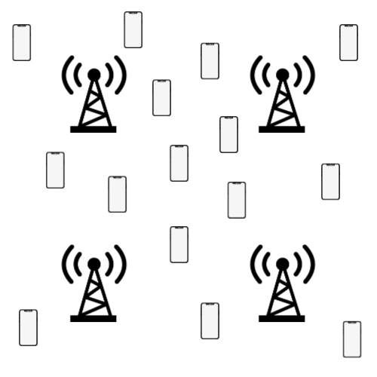
MODEL OF THE SYSTEM
ENTITIES:
M base stations
N users
INTERACTIONS:
A user sends a new task to the closest base station every T seconds;
A base station can either process the task locally or forward it to another one.
Federico Cavedoni, Lorenzo Monaci, Federico Pinna - PECSN
2

Slide 3
CASE STUDY
Behaviour of dropped packet count and the time required to complete a computing task.
Comparing two methods:
Method A: Local task execution at the receiving base station
Method B: Task forwarding to the less-loaded base station
With users placement following:
Uniform distribution
Lognormal distribution
Federico Cavedoni, Lorenzo Monaci, Federico Pinna - PECSN

Slide 4
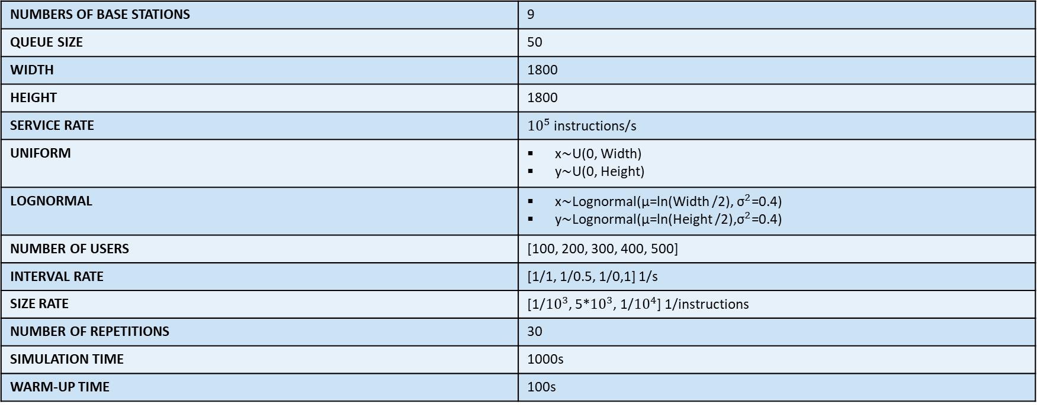
SIMULATIONS PARAMETERS
NUMBERS OF BASE STATIONS | 9
QUEUE SIZE | 50
WIDTH | 1800
HEIGHT | 1800
SERVICE RATE | ${10}^{5}$ instructions/s
UNIFORM | x∼U(0, Width) y∼U(0, Height)
LOGNORMAL | x∼Lognormal(μ=ln(Width /2), ${\text{σ}}^{2}$=0.4) y∼Lognormal(μ=ln(Height /2),${\text{σ}}^{2}$=0.4)
NUMBER OF USERS | [100, 200, 300, 400, 500]
INTERVAL RATE | [1/1, 1/0.5, 1/0,1] 1/s
SIZE RATE | [1/${10}^{3}$, 5*${10}^{3}$, 1/${10}^{4}$] 1/instructions
NUMBER OF REPETITIONS | 30
SIMULATION TIME | 1000s
WARM-UP TIME | 100s
Federico Cavedoni, Lorenzo Monaci, Federico Pinna - PECSN

Slide 5
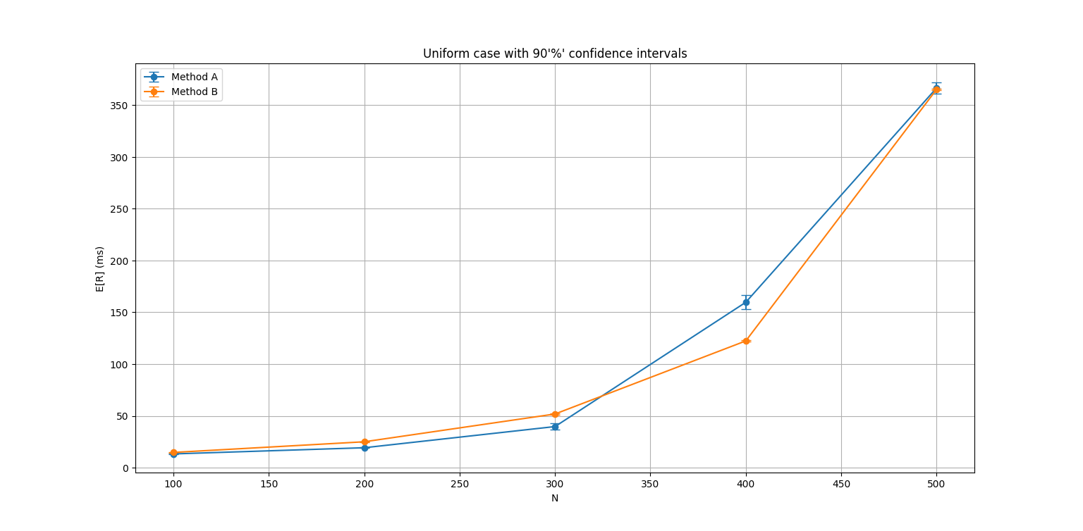
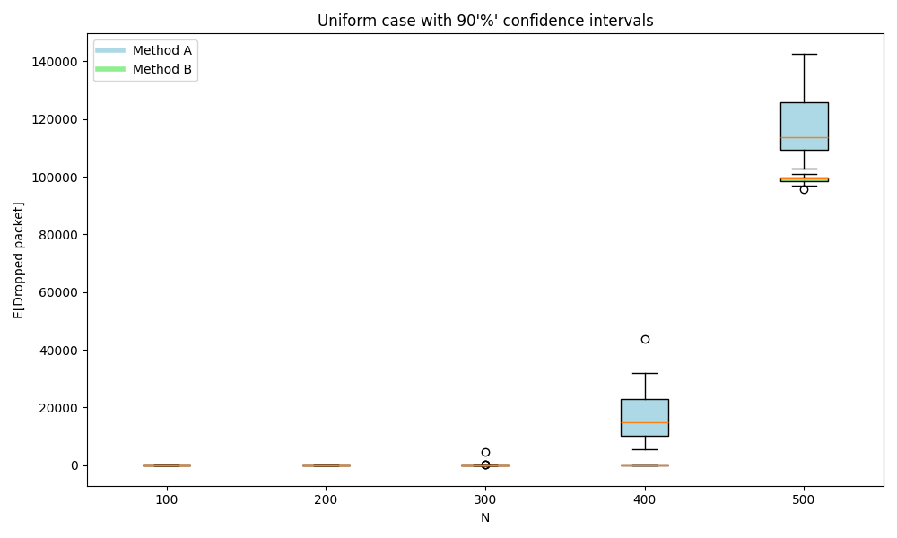
SIMULATION RESULTS: UNIFORM SCENARIO (N)
Federico Cavedoni, Lorenzo Monaci, Federico Pinna - PECSN

Slide 6
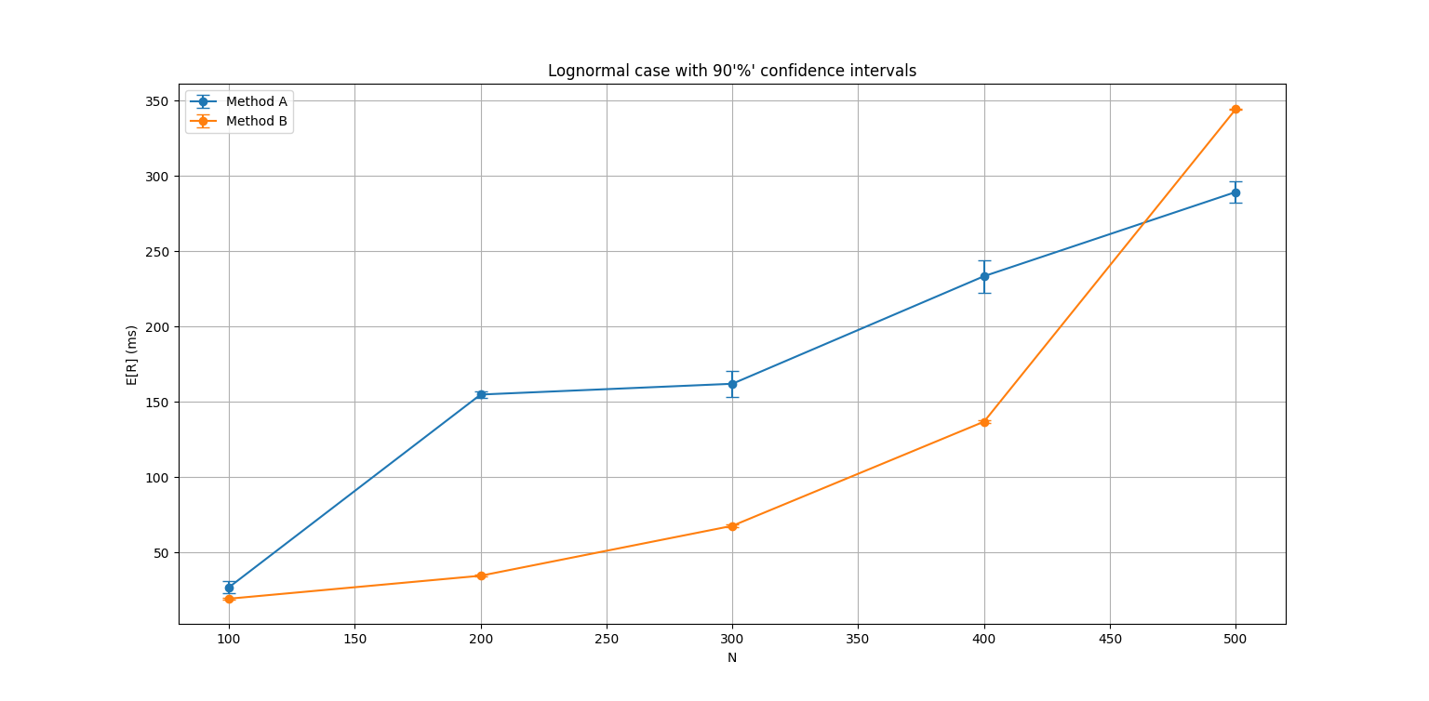
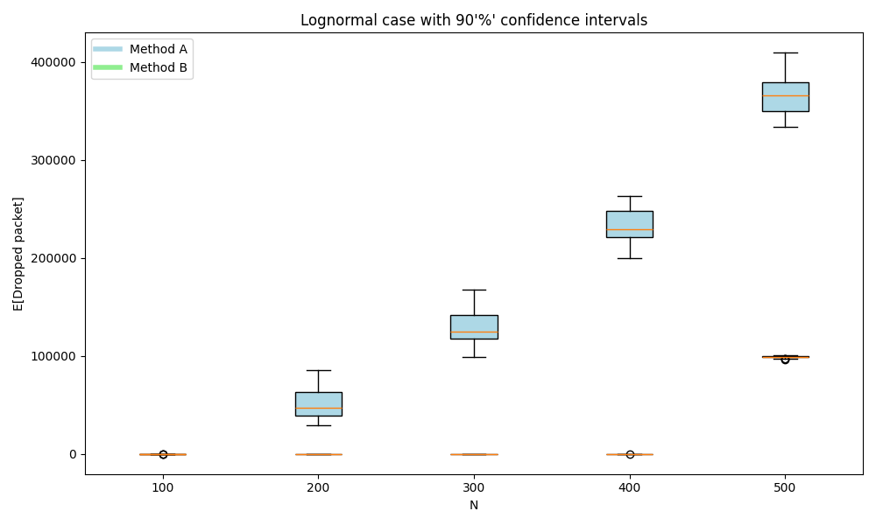
SIMULATION RESULTS: LOGNORMAL SCENARIO (N)
Federico Cavedoni, Lorenzo Monaci, Federico Pinna - PECSN

Slide 7
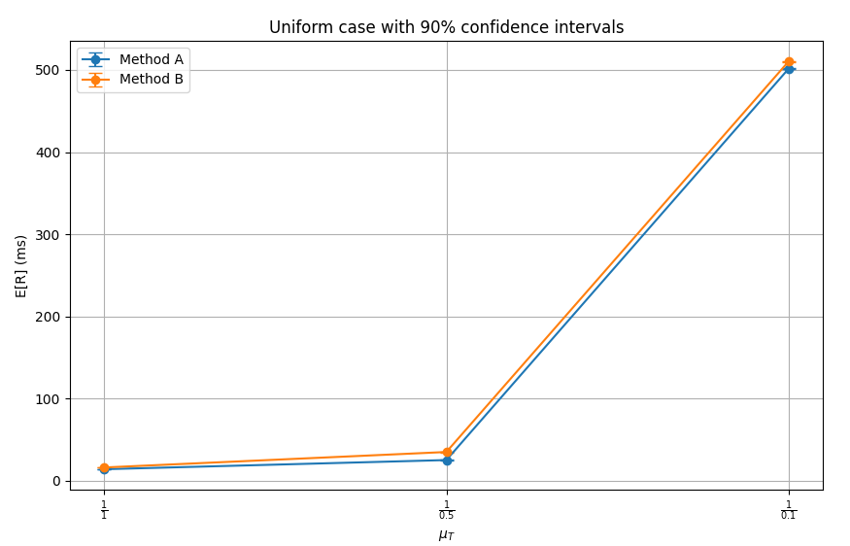
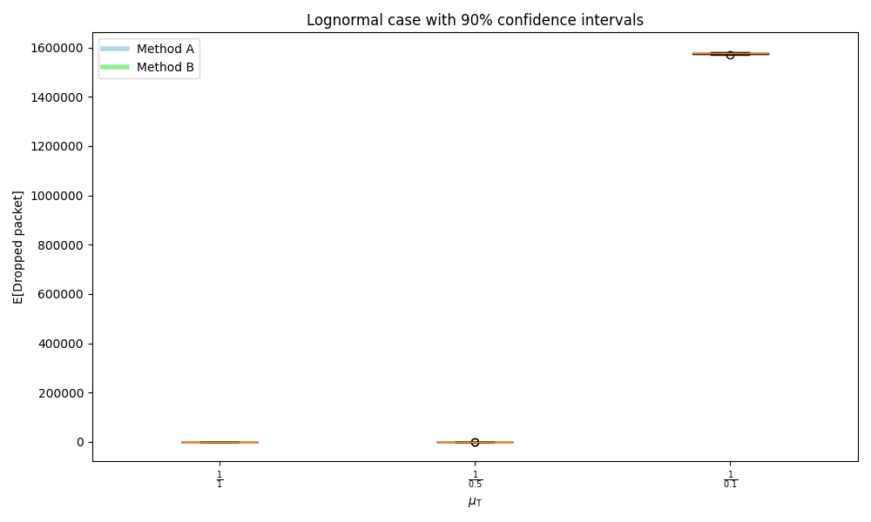
SIMULATION RESULTS: UNIFORM SCENARIO (T)
Federico Cavedoni, Lorenzo Monaci, Federico Pinna - PECSN

Slide 8
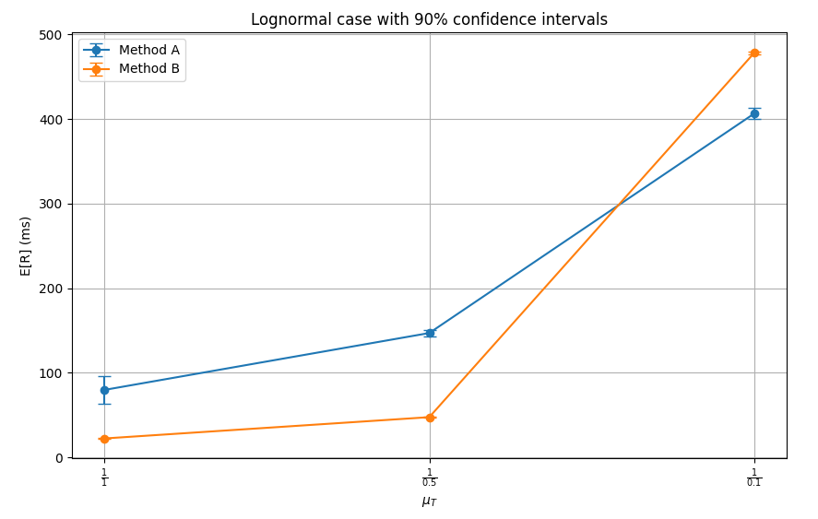
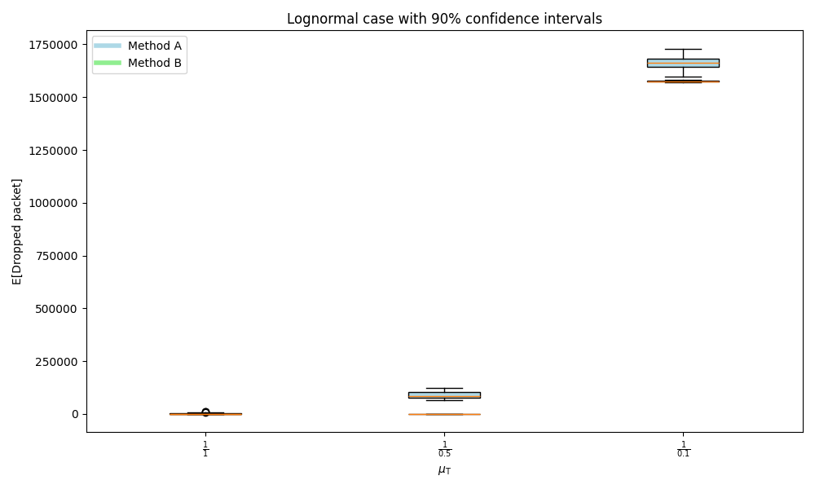
SIMULATION RESULTS: LOGNORMAL SCENARIO (T)
Federico Cavedoni, Lorenzo Monaci, Federico Pinna - PECSN

Slide 9
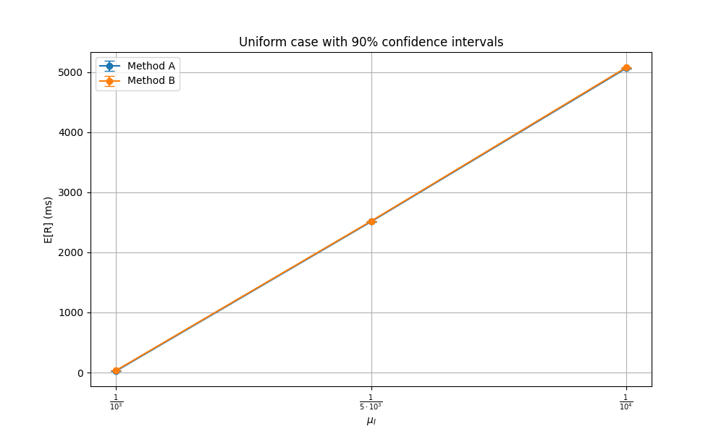
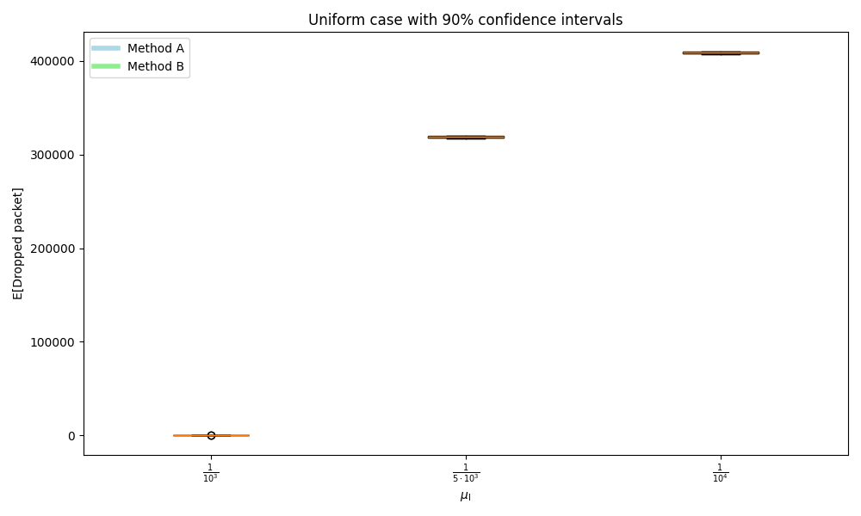
SIMULATION RESULTS: UNIFORM SCENARIO (I)
Federico Cavedoni, Lorenzo Monaci, Federico Pinna - PECSN

Slide 10
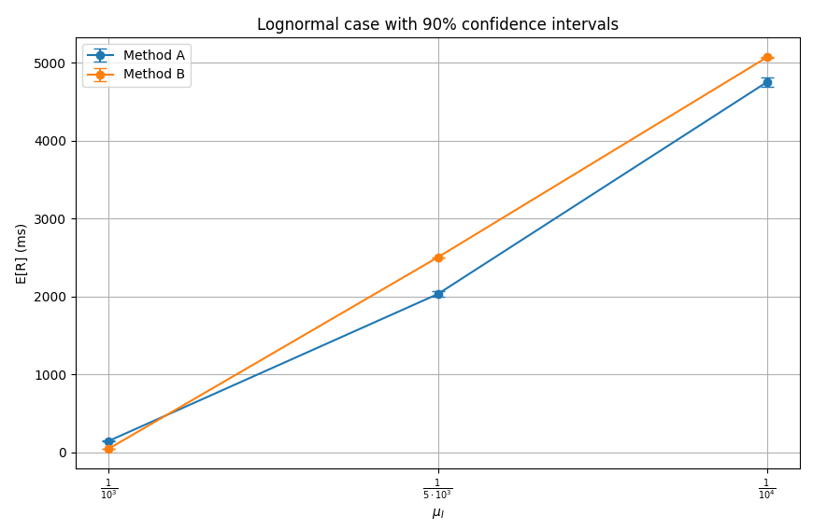
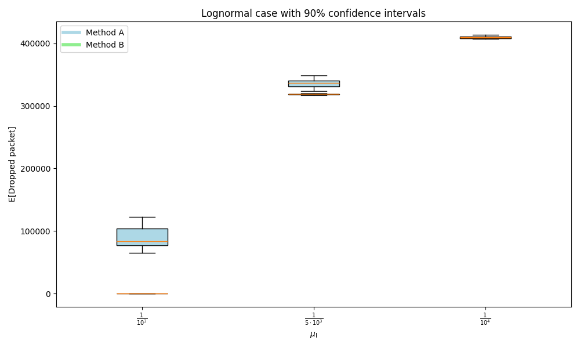
SIMULATION RESULTS: LOGNORMAL SCENARIO (I)
Federico Cavedoni, Lorenzo Monaci, Federico Pinna - PECSN

Slide 11
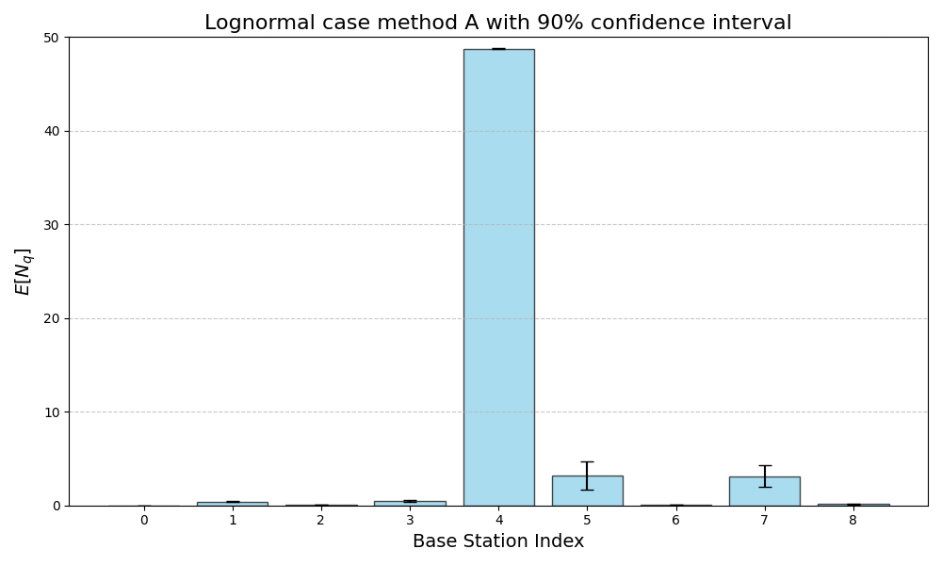
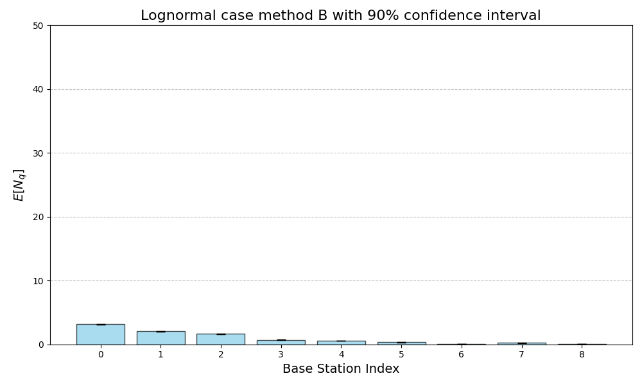
SIMULATION RESULTS: FAIRNESS
Federico Cavedoni, Lorenzo Monaci, Federico Pinna - PECSN

Slide 12
CONCLUSIONS – UNIFORM USER DISTRIBUTION
Since users are already evenly distributed, forwarding requests to a less-loaded base station does not provide significant benefits.
In fact, the additional latency introduced by the forwarding process in Method B, results in increased response times.

Slide 13
CONCLUSIONS – LOGNORMAL USER DISTRIBUTION
The load is highly imbalanced across the base stations when applying Method A.
A few base stations receive a disproportionate share of requests, becoming overloaded, whereas others remain largely unused.
The forwarding strategy of Method B alleviates this imbalance by distributing the workload more evenly, which substantially improves overall performance.

