Slide 1

UNIVERSITÀ DEGLI STUDI DI PERUGIA
International Doctoral Program in
Civil and Environmental Engineering
PYTHON FOR NUMERICAL COMPUTING AND DEVELOPMENT OF SCIENTIFIC APPLICATION
Prof. Federico Cluni
A. Y. 2022/23
Lesson #1 – April 19, 2023

Slide 2
Lesson plan
Day 1: Wednesday, 19 April, 8:30-11:30, 3 hours, Room F
Introduction and base functionality: interaction, data types, syntax, exceptions, functions.
Day 2: Thursday, 20 April, 16:30-19:30, 3 hours, Room 16
Advanced functionality: class and object programming.
Day 3: Wednesday, 26 April, 8:30-11:30, 3 hours, Room F
Notebooks for research sharing: creation, interactivity, sharing.
Day 4: Thursday, 27 April, 16:30-19:30, 3 hours, Room 16
Base packages. Tools for numerical computing: numerical array, linear algebra, MATLAB-like operativity with Numpy/Sympy.
Day 5: Wednesday, 3 May, 8:30-11:30, 3 hours, Room F
Tools for numerical computing (cont’d): time series management with Pandas, plot and visualization with Matplotlib, Data input and output.
Day 6: Friday, 5 May, 8:30-11:30, 3 hours, Room 17
Introduction to problem solving: Optimization, Integration, Equation solving, Signal processing.
Day 7: Wednesday, 10 May 8:30-11:30, 3 hours, Room F
Introduction to problem solving (cont’d): ODE solving, Statistics, Machine learning.
Day 8: Friday, 12 May, 8:30-11:30, 3 hours, Room 17
Performance enhancement with Numba.
Extendibility and interoperability: Fortran, C++, Excel.
Day 9: Wednesday, 17 May 8:30-11:30, 3 hours, Room F
GUI creation: base concept for creation of graphic user interface with Tkinter.
Day 10: Friday, 19 May, 8:30-11:30, 3 hours, Room 17
Web App Development: base concepts for creation of web app with Flask.

Slide 3
What is Python?
From the official web site:
http://www.python.org
“Python is an interpreted, interactive, object-oriented programming language. It incorporates modules, exceptions, dynamic typing, very high level dynamic data types, and classes. It supports multiple programming paradigms beyond object-oriented programming, such as procedural and functional programming. Python combines remarkable power with very clear syntax. It has interfaces to many system calls and libraries, as well as to various window systems, and is extensible in C or C++. It is also usable as an extension language for applications that need a programmable interface. Finally, Python is portable: it runs on many Unix variants including Linux and macOS, and on Windows.”
Remark
Python may be used with different programming paradigms:
- Procedural;
- Object oriented;
- Functional

Slide 4
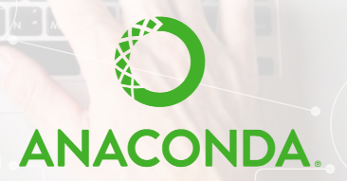
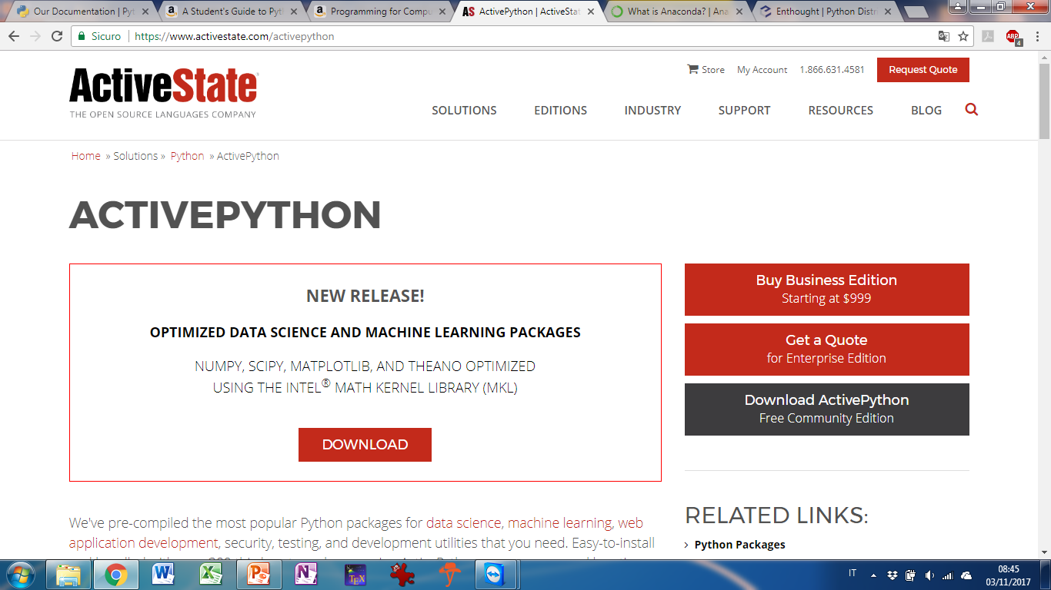

How to install
Download from official web site www.python.org (Python 3.11.3)
Available for different OS
- Windows;
- Mac OS
- Linux
- Android
- …
In order to use for scientific application, several packages are available (Numpy, Scipy, Matplotlib, Pandas,…)
Alternatively, a distribution…
 | https://www.anaconda.com/what-is-anaconda/
 | https://www.activestate.com/activepython
…or a live (Linux) distribution
 | https://labs.fedoraproject.org/it/scientific/

Slide 5
Essential bibliography
www.python.org/doc/
Beginner/Intermediate level
G. van Rossum, F.L. Drake Jr, "An introduction to Python", Network Theory Limited, 2011
M. Beri, "Python 3. Guida tascabile al linguaggio di Google, Star Wars e la NASA", Apogeo, 2010
K. A. Lambert, "Programmazione in Python", Maggioli Editore, 2013
J. M. Kinder, P. Nelson, "A Student's Guide to Python for Physical Modeling", Princeton University Press, 2015
S. Linge, H. P. Langtangen, "Programming for Computations - Python: A Gentle Introduction to Numerical Simulations with Python", Springer, 2016
Advanced level
J. Kiusalaas, "Numerical Methods in Engineering with Python 3 – 3rd ed", Cambridge University Press, 2013
R. Johansson, "Numerical Python: Scientific Computing and Data Science Applications With Numpy, Scipy and Matplotlib – 2nd ed ", Apress, 2018
H. P. Langtangen, "Python Scripting for Computational Science - 3rd ed", Springer, 2009
H. P. Langtangen, "A Primer on Scientific Programming with Python – 5th ed", Springer, 2016

Slide 6
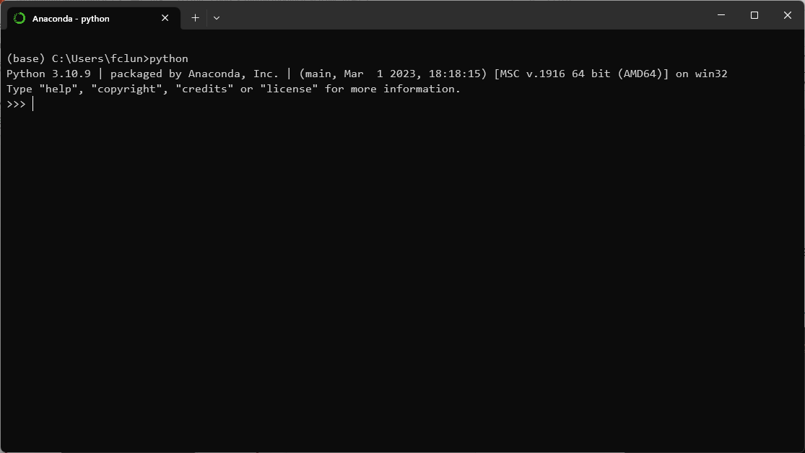
How to use
- From command line (system shell)
Opening a command line window (if Anaconda is installed, use «Anaconda prompt») and typing “python”.
It is also possible to execute a previously saved script.
To exit, exit()
A script file is a text file containing sequences of instructions

Slide 7
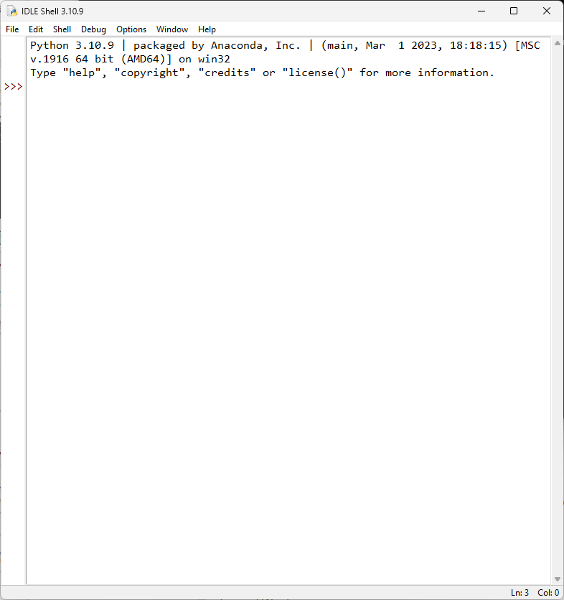
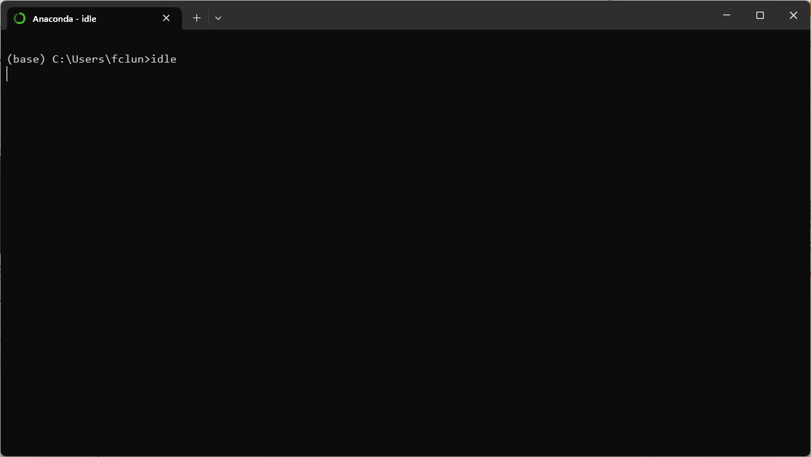
How to use
- Through IDLE (Integrated DeveLopment Environment)
Is essentially a command line interface, with several benefits (code completation, syntax hightlighting, …)

Slide 8
How to use
A script can be executed without starting a command line session.
In windows, write «python» followed by the name of the script.
In Linux/Unix/MacOS, the first line must be:
#!/usr/bin/python
To redirect the input/output:
python scriptname.py --> out.txt
To execute a script, then open the shell and work with the variables
python –i scriptname.py
To execute a script from the shell
exec(open(‘scriptname.py’).read())

Slide 9
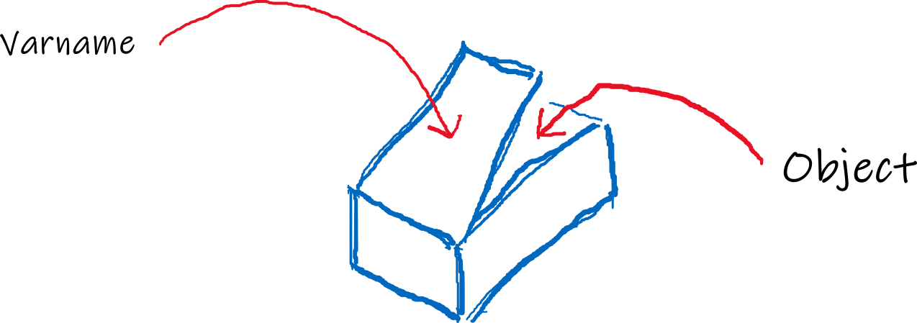
How to use
A variable can be seen as the reference to a box containing an object*
To assign an object to a box named varname
varname = Object
The «=» is an assignment operator
More precisely, «=» bind a name to an object [https://tinyurl.com/yah59c47]
* In Python, everything is an object
“In object-oriented programming languages like Python, an object is an entity that contains data along with associated metadata and/or functionality. In Python everything is an object, which means every entity has some metadata (called attributes) and associated functionality (called methods)” [https://tinyurl.com/ya29236w]
Remark
Python is case sensitive!

Slide 10
Data types
Python is dynamically typed, meaning that it is not necessary to define the type of a variable before assignment.
Integer number < type ‘int’ >
Sequences of digits without decimal part
i = 123
Floating point number < type ‘float’ >
Sequences of digits with decimal part
f = 6.75
f = 123.
Complex number < type ‘complex’ >
Imaginary part denoted with «j» or «J».
c = 2 + 1j
To extract real and imaginary parts:
realpart = number.real
imagpart = number.imag
1/10+1/10+1/10+1/10+1/10+1/10+1/10+1/10+1/10+1/10= ???
a dot «.» denotes an attribute or a method of an object!
Notes:
A complete list of types is here: https://docs.python.org/3/library/stdtypes.html

Slide 11
Data types
String < type ‘str’ >
Strings are sequences of characters.
The characters may be between single or double quotes:
s = "abc"
s = 'ab'
s = "What a nice day!"
s = 'Have you seen "titanic "?’
For multi-line string:
s = "Hello\nhow are you?"
or
string = """Hello
How are you?"""
Escape codes
\n | newline | \b | backspace
\t | tab | \r | linefeed
 |  | \a | bell

Slide 12
Data types
STRINGHE < type ‘str’ >
If we want to maintain the escape code in the string, it has to be defined as raw:
Note the command print(varname) to print the object!
To insert the «\»
s = "the slash: \\"
To insert a Unicode char
s = "go\u0020to\u0020directory\u0020\u007etemp"
(if needed, use 32 bit hex value)
s = "smile \U0001F600"
To codify a Unicode string to a specific format:
scod = s.encode(formato)
Note that the result is of < type ‘byte’ >
s1 = r"Hello\nHow are you?"
print(s1)
Hello\nHow are you?"
s2 = "Hello\nHow are you?"
print(s2)
Hello
How are you?
>>>
>>>
>>>
>>>
Notes:
See also https://docs.python.org/3/howto/unicode.html

Slide 13
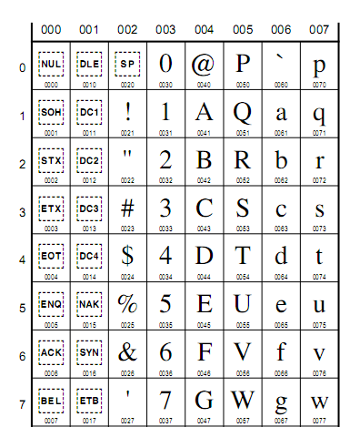
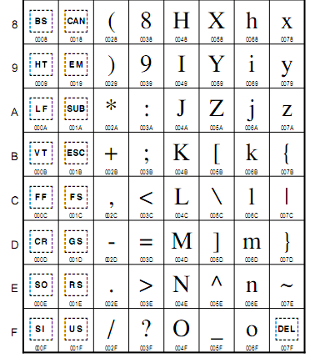
Data types
Unicode 5.2 Character Code Charts - Latin-1
from: http://www.unicode.org/charts/

Slide 14
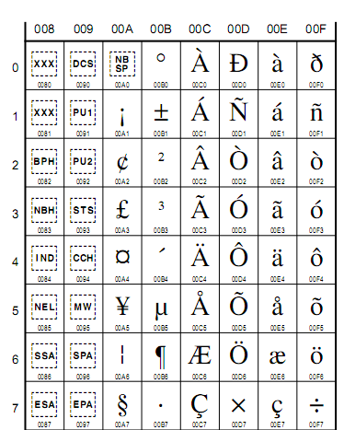
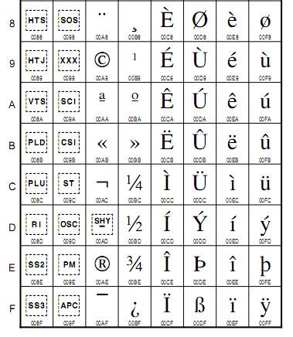
Data types
Unicode 5.2 Character Code Charts - Latin-1
from: http://www.unicode.org/charts/

Slide 15
Data types
String < type ‘str’ >
It is possible to format a string containing values of variables.
f"string"
string.format( )
a, b = 2, 3
f"{a} times {b} gives {a*b}"
'2 times 3 gives 6'
"{0} times {1} gives {2} ".format(a,b,a*b)
'2 times 3 gives 6'
"{0:^+12.3f}".format(3)
' +3.000 '
>>>
>>>
>>>
>>>
^,<,> | Alignment: center, left, right
+, □ | ‘+’ or blank before positive number
d | Show as integer
x.y | At least x digits, y after the decimal dot
e | Show in exponential form
f | Show in fixed form
Notes:
for formatting string, https://docs.python.org/3/tutorial/inputoutput.html#the-string-format-method and https://docs.python.org/3/library/string.html#formatstrings
or, for old style, https://docs.python.org/3/tutorial/inputoutput.html#old-string-formatting

Slide 16
Data types
String < type ‘str’ >
There is an "old way" for formatting strings, inherited from C.
a,b,c,d = 'ABC', 12, 894.9765, 1246.3
"%s \t %i \t %8.2f \t %12.4e \n" % (a, b, c, d)
'ABC \t 12 \t 894.98 \t 1.2463e+03 \n'
>>>
>>>
s | Show as string
d | Show as integer
x.y | At least x digits, y after the decimal dot
e | Show in exponential form
f | Show in fixed form
Notes:
for formatting string, https://docs.python.org/3/tutorial/inputoutput.html#the-string-format-method and https://docs.python.org/3/library/string.html#formatstrings
or, for old style, https://docs.python.org/3/tutorial/inputoutput.html#old-string-formatting

Slide 17
Data types
Fundamental mathematical operations
x + y | sum | -x | Sign change
x - y | difference | abs(x) | Absolute value
x * y | multiplication | x**y | power
x / y | division | pow(x,y) | power
x // y | Integer division | c.coniugate() | Complex conjugate
x % y | Remainder
divmod(x,y) | Integer part and remainder of division

Slide 18
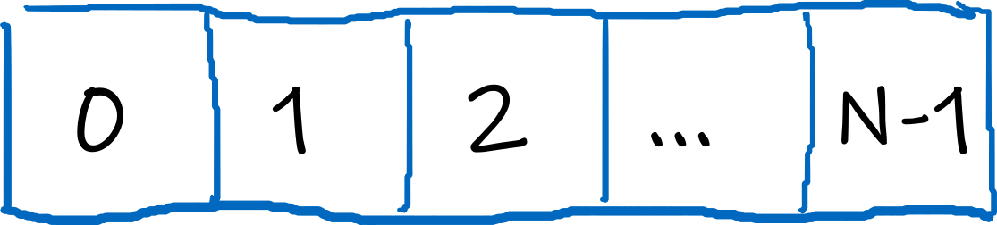
Data types
List < type ‘list’ >
It is an ordered list of heterogeneous elements; the elements can be modified.
The list is enclosed by share brackets, and the elements are separated by commas:
l = [ element0, element1, …, elementN-1]
To access an element of the list:
lista[0] → element0
lista[1] → element1
lista[N] → DO NOT EXIST!!!
lista[-1] → elementN-1
lista[-2] → elementN-2
lista[-N] → element0
To know the number of elements:
len(lista )
N.B in Python the count start from 0 !!!

Slide 19
Data types
List
To extract several elements from i included to j excluded.
lista[i:j]
Without first index, the first is intended, without the second, the last element is intended (included). If both are omitted, all the elements are extracted.
This operations are known as slicing.
To take one element every n:
lista[i:j:n]
To change an element
lista[i] = newvalue

Slide 20
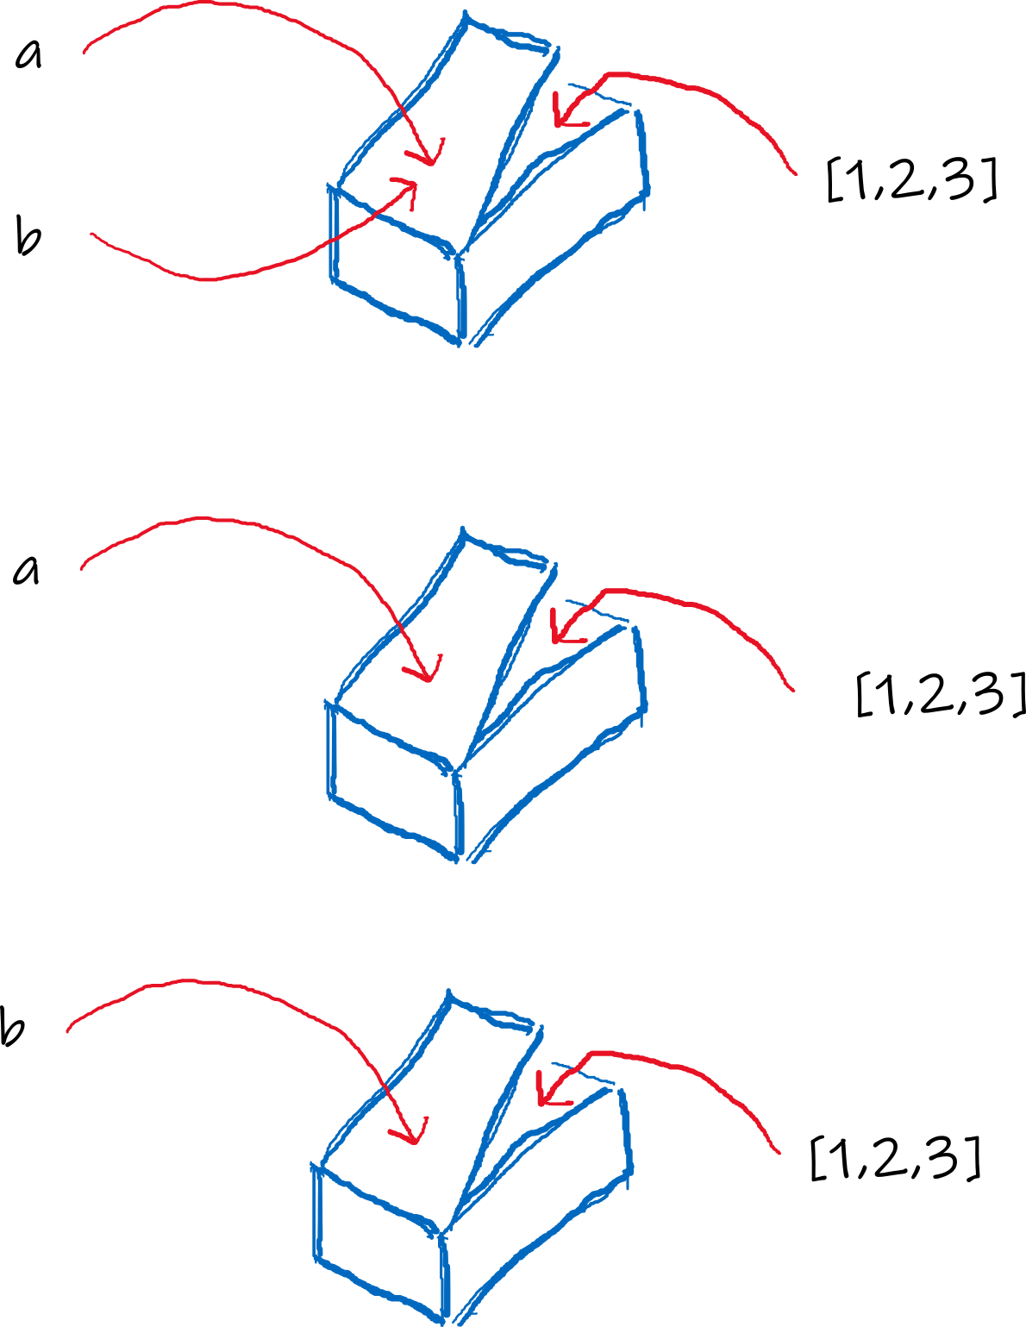
Data types
Remark
The syntax
newlist = oldlist[:]
is necessary to copy the list. Otherwise, the two variable names point to the same object!
a = [1,2,3]
b = a
a = [1,2,3]
b = a[:]

Slide 21
Data types
List
Some methods:
- list.insert( position, value )
- list.remove( value )
- list.append( value )
- list.extend( value )
- list.pop( index )
- list.count( value )
- list.index( value )
- list.reverse()
- list.sort()
Remark
To know all the methods available for a list (and for an object):
dir(object)

Slide 22
Data types
Tuple < type ‘tuple’ >
It is an ordered list of heterogeneous elements; the elements can’t be modified.
The list is enclosed by round brackets, and the elements are separated by commas:
tupla = ( element0, element1, …, elementN-1)
The operativity is the same as the list, but no method is defined (since it is not modifiable)
Anyway, note that if an element of the tuple is a list, it can be modified!
Remark
To define a list with a single element:
lista = [value]
but to define a tuple with a single element:
tupla = (value,)

Slide 23
Data types
Set < type ‘set’ >
It is an unordered list of heterogeneous elements; the elements can’t be modified.
The set is enclosed by curl brackets, and the elements are separated by commas
s = { element0, element1, …, elementN-1}
Tor alternatively an existing list/tuple/string* can be used to create a set:
s = set( list/tuple/string )
* each character is an element of the set
Only one instance of a value is considered.
Some operations
Difference: -
- Union: |
- Intersection: &
- Symmetric difference: ^

Slide 24
Data types
Dictionary < type ‘dict’ >
It is an unordered list of heterogeneous elements, each one associated to a immutable key; the elements can be modified.
To create a dictionary, curl brackets are used:
d = {key1:value1, key2:value2,...}
As an alternative,
d = dict()
d [ key1 ] = value1
d [ key2 ] = value2
...
To list the keys of the dictionary
list(d)
To list the pair key-value as tuples
d.items()

Slide 25
Data types
Boolean < type ‘bool’ >
Useful for boolean operation. Two possible values: True and False, without quotes!
val = True
Null < type ‘NoneType’ >
Special type, useful when defining functions and classes. One only possible value, None (without quotes!).
val = None

Slide 26
Data types
Byte objects < type ‘bytes’ and ‘bytearray’ >
Bytes and bytearrays are immutable/mutable sequences of bytes
b = b'ciao'
b = bytes('ciao è bello il ♫', 'utf-8’)
b = bytearray('ciao è bello il ♫', 'utf-8')

Slide 27
Data types
To know the type of a variable:
type(varname)
To know the identifier of a variable (which is unique, and in the standard implementation is the memory address)
id(varname)
To convert from a type to another:
str( int ) int ( string ) str( float )
float ( string ) int( float ) float ( int )
tuple( list ) list( tuple ) complex( realpart, imagpart)
list( string ) ''.join( list ) (from list to string)
Remark
Some data types are immutable (we can not change their value), some others are mutable:
Immutable: int, float, complex, string, tuple, bytes, Boolean, null
Mutable: list, dictionary, set, bytearray
Notes:
see also: https://realpython.com/python-mutable-vs-immutable-types/#:~:text=An%20object%20that%20allows%20you,value%20is%20an%20immutable%20object

