Slide 1

UNIVERSITÀ DEGLI STUDI DI PERUGIA
International Doctoral Program in
Civil and Environmental Engineering
PYTHON FOR NUMERICAL COMPUTING AND DEVELOPMENT OF SCIENTIFIC APPLICATION
Prof. Federico Cluni
A. Y. 2022/23
Lesson #2 – April 20, 2023

Slide 2
The syntax
Indentation
if voto < 18:
□□□□print("Exam NOT Passed")
□□□□invito = "Study more!"
elif voto < 30:
□□□□print ("Exam Passed")
□□□□if voto < 21:
□□□□□□□□print("Do you want to return?")
□□□□□□□□invito = "Study better!"
□□□□elif voto > 27:
□□□□□□□□print("Congratulations!")
□□□□□□□□invito = «Go out tonight!"
□□□□else:
□□□□□□□□print("Good job")
□□□□□□□□invito = "Relax!"
print(invito)
N.B tab or spaces?
Indifferent, but tabs are more sensitive to the editor used
Remark
The block of code is defined by means of indentation!

Slide 3
The syntax
Line continuation
If an instruction is too long, it can be continued in the next line
- explicitly, using \
s = "abc\
def"
a = 3*2+\
4
- implicitly, using round brackets ()
a = (3*2+
4)
print(3*2
+4
,"!")
Multiple instructions on the same line
Usually, each line is an instruction. If we want more instruction on the same line, we use ;
a = 2; b=3; print(a); print(b)

Slide 4
The syntax
IF statement
Execute a block of commands only when a condition is true.
if voto < 18:
print("Exam not passed")
elif voto < 21:
print("Do you want to return?")
elif voto < 27:
print("Good job!")
else:
print("Congratulations!")
Condition that can be used
- equality: ==
- comparison: <, <=, >=, >
- inequality: !=, <>
- included in list/tuple/set: in
- identity: is
- to build complex expressions: and, or, not

Slide 5
The syntax
MATCH statement
Compares an expression to one or more pattern.
Example: if point is a tuple with two elements:
match point:
case (0, 0):
print("Origin")
case (0, y):
print(f"Y={y}")
case (x, 0):
print(f"X={x}")
case (x, y):
print(f"X={x}, Y={y}")
case _:
raise ValueError("Not a point")

Slide 6
The syntax
FOR statement
To perform the block code for each element of a list/tuple/string:
for i in list/tuple/string:
print(i)
Otherwise, to evaluate the block of code N times:
for i in range(N):
print(i)
for i in range(i,j,k):
print(i)
Remark
range returns an iterator, an object whose values can be traversed through.
It can be used to create a list
list(range(1,10,2)

Slide 7
The syntax
FOR statement
The for statement can use several variables at the same time
A=[(1,'a'), (2,'b'), (3,'c')]
for i,j in A:
print(i, j)
A = {1:'a',2:'b',3:'c'}
for i,j in A.items():
print(i, j)
A = [1, 2, 3]
B = ['a', 'b', 'c']
for i,j in zip(A, B):
print(i, j)
for i,j in enumerate(A):
print(i,j)

Slide 8
The syntax
WHILE statement
To perform the block code as long as a condition is true.
i = 0
while i < 5:
print(i)
i += 1

Slide 9
The syntax
CONTINUE/BREAK/ELSE statements
A = [1, 1, 0, 0, 1, 3, 1, 0, 1, 1]
j = 0
for a in A:
j += 1
if a == 0:
continue
elif a ==1:
print("element ",j, " = ", a)
elif a == 3:
print("exit at element",j)
break
else:
print("end of list")
PASS statement
for a in A:
pass

Slide 10
How to use
GENERAL REMARKS
- Python is case sensitive
- Math operators: +, -, *, /, ** (use round parenthesis for the correct order)
- For integer operations, // gives integer part, % gives the remainder
/ gives the result with fractional part!
- In scripts, # begins a comment, until the end of the line.
- First two line of a script are usually:
#!/usr/bin/env python
# -*- coding: Latin-1 -*-
- It is possible to assign several variable at the same time:
a = b = c = 3
a, b = 4, 5
- The result of the last unassigned command is in the variable _ (underscore)
- To print, print( )

Slide 11
Functions
Functions are defined with def:
def raddoppia(x):
"""Double a number.
raddoppia(x)
Function to double the value of a number x.
"""
y = 2*x
return y
The information on the function can be seen with
print(raddoppia.__doc__)

Slide 12
Functions
Several arguments and/or results can be used:
def sommadifferenza(x,y):
"""
sommadifferenza(x,y)
Gives the sum and the difference of numbers x and y.
"""
somma = x + y
differenza = x - y
return somma, differenza

Slide 13
Functions
Default values can be assigned to any of the arguments:
def multiplo(x, N = 2):
"""Multiply a number.
multiplo(x[, N])
Function that, given x, gives Nx.
Default value of N is 2.
"""
y = N*x
return y
Remark
The value of the arguments can be assigned explicitly.
multiplo(3.2, 5)
multiplo(3.2, N = 5)
multiplo( x = 3.2, N = 5)
multiplo( x = 3.2, 5)
NO!

Slide 14
Functions
Advanced mode of argument passing
If the number of arguments is not known in advance:
- the arguments can be grouped in a tuple
def raddoppialista(*lista):
"""Double all the items of a list.
raddoppialista(*lista)
Function to double all the items of a list.
"""
y = []
for x in lista:
y.append( 2*x)
return y
Example of use
raddoppialista(1,'a',2)

Slide 15
Functions
Advanced mode of argument passing
If the number of arguments is not known in advance:
- the arguments can be grouped in a dictionary
def pubblicazioni(**lista):
"""Research unit publication.
pubblicazioni(**lista)
Function to print the number of pubblications
of each author and return the sum of the pubblications.
"""
N = 0
for autore, numero in lista.items():
print(autore, "ha pubblicato ", numero, "lavori")
N += numero
return N
Example of use
pubblicazioni(Mickey=9, Donald=11, Goofy = 3)

Slide 16
Functions
Advanced mode of argument passing
If some of the number of arguments are known in advance and some others not:
def funzione(argomenti, *lista1, **lista2):

Slide 17
Functions
Several functions can be defined in the same file, defined module. To import all the functions:
from modulename import *
To import some of the functions
from modulename import funcname1, funcname2
To import some of the functions changing their name
from modulename import funcname as newname
To import all the function in a separate namespace (than the global one):
import modulename
and to use a specific function:
modulename.funcname(…)
To list the content of a module
dir(ModuleName)
A module is a script containing function definition and, possibly, parameters.
Remark
Function are objects, and therefore they can be part of a list
A=[1, 2, raddoppia]
A[2](3.2)

Slide 19
Functions
One particular form of function definition is the lambda forms.
They are small (single command) anonymous (not named) functions:
def potenzasomma(a):
return lambda x, y: (x+y)**a
f = potenzasomma(2)
They can be used with map to apply a function to each element of a list
In such cases it may be convenient to use list comprehension:
a = [1,2,3]
b = list(map(lambda x: 2*x, a))
print(b)
[2, 4, 6]
>>>
>>>
>>>
a = [1, 2, 3]
b = [2*x for x in a]
print(b)
[2, 4, 6]
X = [3, 2, 3]
A = [2, 2, 4]
[x**a for (x,a) in zip(X, A)]
[9, 4, 81]
>>>
>>>
>>>
>>>
>>>
>>>

Slide 20
Functions
Another useful function which employ lambda forms is filter whose arguments are a function (returning a boolean value) and a list and return a list with the element for which function is true :
note the both map and filter return an iterator (as range) but they can be converted to list with
list(iterator)
list(filter(lambda x: x % 2 ==0, range(10)))
[0, 2, 4, 6, 8]X = [3, 2, 3]
>>>
Remark
Function can return functions!
>>>
>>>
>>>
>>>
>>>
>>>
>>>
def creaeq2(a,b,c):
def eq2(x):
return a*x**2+b*x+c
return eq2
f=creaeq2(1,-2,1)
print(f(2))
1

Slide 21
Functions
When a function is called, remember that a new name to the same object is defined in the local namespace.
This can be have side effects when the object bounded is mutable.
test.py
def modifylist(L):
L1 = L
if len(L1)< 3:
pass
else:
L1[1] = 99
return L1
>>>
>>>
>>>
>>>
from test import modifiylist
a = [1,2,3]
b = modifylist(a)
print("\n", a, "\n" b)
[1, 99, 3]
[1, 99, 3]

Slide 22
Functions
Namespaces and scopes in Python
Remember that «variables» are names bound to objects.
The same name can be bound to different objects belonging to different namespaces, which can be though as collections of names.
The bult-in namespace is the one defined at the Python start.
When a module is imported, it defines a global namespace for all the function defined in the module itself, however they are called.
When a variable is defined inside a function, it belong to the local namespace.
Please note that the statements executed in the shell, either read from a script file or interactively, are considered part of a module called __main__

Slide 23
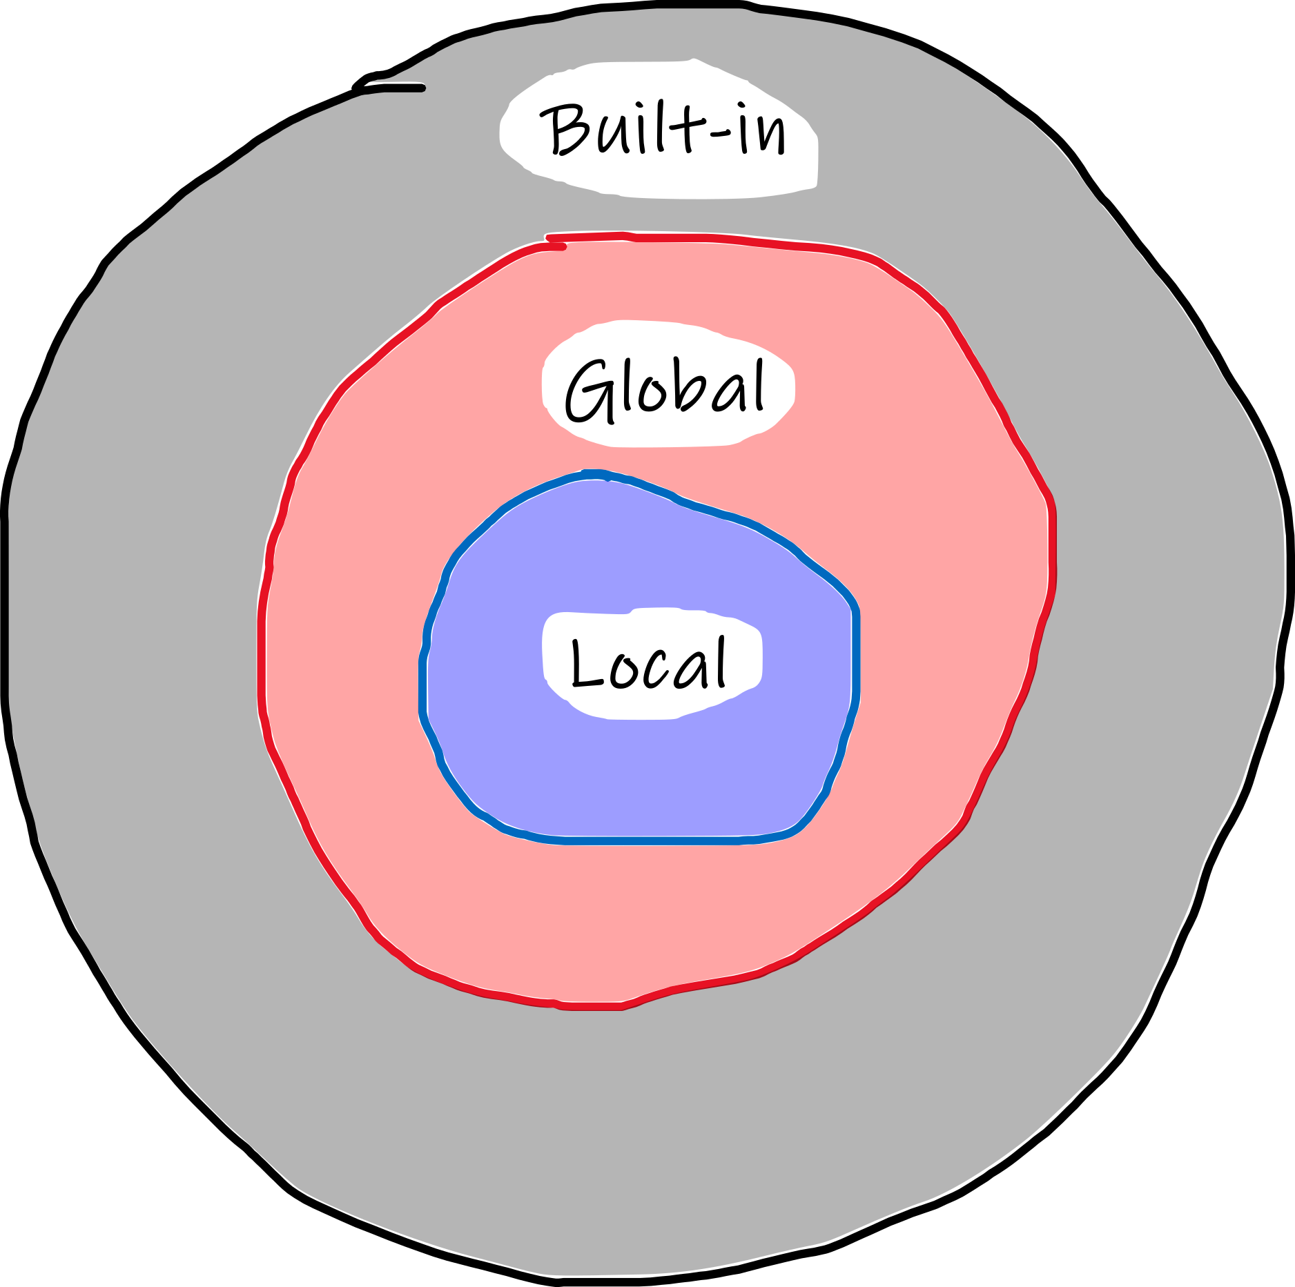
Functions
Scopes in Python
What it is a scope*? It can be though as the portion of a program from where a namespace can be accessed directly, without any prefix.
Tre are at least three nested namespaces at any given moment:
Current function (local)
Module containing the function (global)
...
Outermost with the built-in names
If a name is not found in the current namespace, it is searched for in the outer namespace, but not in the inner namespace (i.e., a variable defined inside a function can not be accessed from outside the function).
If a function want to change a variable in the global namespace, that variable has to be defined as global. (It is not necessary if the variable is only used)
See the official guide to learn more
https://docs.python.org/3/tutorial/classes.html#python-scopes-and-namespaces
* comes from Ancient Greek: σκοπεῖν, skopeîn, "to look" or "see"
Notes:
see also: https://www.programiz.com/python-programming/namespace
and: https://realpython.com/python-namespaces-scope/

Slide 24
Functions
Since the namespaces are kept separate, different variable with the same name can be used since they are bound to object in different scope.
test_scope.py
a = 3
def multiple(x):
return a*x
>>>
>>>
>>>
from test_scope import multiple
a = 4
multiple(3)
9

