Slide 1

UNIVERSITÀ DEGLI STUDI DI PERUGIA
International Doctoral Program in
Civil and Environmental Engineering
PYTHON FOR NUMERICAL COMPUTING AND DEVELOPMENT OF SCIENTIFIC APPLICATION
Prof. Federico Cluni
A. Y. 2022/23
Lesson #4 – April 27, 2023

Slide 2
Base functionality
Working with text files
To write to a file:
or
To read from a file:
or
>>>
>>>
...
>>>
fw = open("file.txt", "w")
fw.write("{:s} \t {:d} \t {:8.2f} \t {:12.4e} \n".format("A", 12,
894.9765, 1246.3) )
fw.close()
with open("file.txt", "w") as file:
file.write("{:s} \t {:d} \t {:8.2f} \t {:12.4e} \n".format("A", 12,
894.9765, 1246.3) )
>>>
...
...
>>>
>>>
>>>
>>>
fr = open("file.txt", "r")
fr.readline() # read a single line
fr.readlines() # read all the lines and put them in a list
fr.close()
>>>
...
...
with open("file.txt", "r") as file:
file.readline()
file.readlines()
Notes:
for formatting string, https://docs.python.org/3/tutorial/inputoutput.html#the-string-format-method and https://docs.python.org/3/library/string.html#formatstrings
or, for old style, https://docs.python.org/3/tutorial/inputoutput.html#old-string-formatting

Slide 3
Base functionality
Working with text files
Beside the slicing that works on the strings as works on the lists, there are some string operation that can be useful.
- To delete spaces and tabulations at the beginning and the end of the string:
" sono una stringa \n".strip()
- To divide a string where a space/tabulation is found:
"dato1 dato2 dato3".split(" ")
"dato1\tdato2\tdato3".split("\t")
- To join several strings:
"/".join(["23", "4", "2010"]) # equivalent to "23"+"/"+"4"+"/"+ "2010"
- To repeat a string:
5*"spam"
- To replace some portion of the string with another string
"Non mi piace il corso".replace("Non mi piace", "Mi piace molto")

Slide 4
Base functionality
Module pickle
The module convert objects into stream of byte that can be saved to a file and then be recovered.
- to pickle (save)
- to unpickle (load)
>>>
>>>
>>>
>>>
>>>
>>>
import pickle
a, b = 'ciao', 3.2
fw = open('prova.dat','wb')
pickle.dump(a, fw)
pickle.dump(b, fw)
fw.close()
>>>
>>>
>>>
>>>
>>>
import pickle
fr = open('prova.dat','rb')
A = pickle.load(fr)
B = pickle.load(fr)
fr.close()
N.B the object are loaded in the same order as they are saved

Slide 5
Some fundamental modules
Modulo shelve
The object can also be saved in a file which act as a dictionary.
- to save
- to load
>>>
>>>
>>>
>>>
>>>
import shelve
fw = shelve.open('prova1.dat')
fw['a'] = 'ciao'
fw['b'] = 3.2
fw.close()
>>>
>>>
>>>
>>>
>>>
import shelve
fr = shelve.open('prova1.dat')
a = fr['a']
b = fr['b']
fr.close()
WARNING!
Both with pickle and shelve, it is insecure to load from an untrusted source since it could be possible to execute arbitrary code.

Slide 6
Error handling
TRY/EXCEPT statement
In some situation the code can generate an error.
If the error was taken into account during programming, it can be handled without interrupting the flow of the code. Otherwise, the program interrupts its running.
Non handled error
>>>
>>>
>>>
...
...
...
N = [100., 80., 0., 90., 75.]
Namm = 80.
for n in N:
FS = Namm/n
print(f"Carico: {n:5.1f}, fattore di sicurezza {FS:4.2f}")
Carico: 100.0, fattore di sicurezza 0.80
Carico: 80.0, fattore di sicurezza 1.00
Traceback (most recent call last):
File "<stdin>", line 2, in <module>
ZeroDivisionError: float division by zero

Slide 7
Error handling
Handled error
We must indicate the possible cause of error
>>>
>>>
>>>
...
...
...
...
...
...
N = [100., 80., 0., 90., 75.]
Namm = 80.
for n in N:
try:
FS = Namm/n
print(f"Carico: {n:5.1f}, fattore di sicurezza {FS:4.2f}")
except ZeroDivisionError:
print("Carico nullo!")
Carico: 100.0, fattore di sicurezza 0.80
Carico: 80.0, fattore di sicurezza 1.00
Carico nullo!
Carico: 90.0, fattore di sicurezza 0.89
Carico: 75.0, fattore di sicurezza 1.07

Slide 8
Error handling
Handled error
We must indicate the possible cause of error
>>>
>>>
>>>
...
...
...
...
...
...
...
N = [100., 80., 0., 90., 75.]
Namm = 80.
for n in N:
try:
FS = Namm/n
except ZeroDivisionError:
print("Carico nullo!")
else:
print(f"Carico: {n:5.1f}, fattore di sicurezza {FS:4.2f}")
Carico: 100.0, fattore di sicurezza 0.80
Carico: 80.0, fattore di sicurezza 1.00
Carico nullo!
Carico: 90.0, fattore di sicurezza 0.89
Carico: 75.0, fattore di sicurezza 1.07
Remark
This is the preferred syntax, since the block of code which can generate the error is separated from the remaining part of the code.

Slide 9
BASE INTERACTIVITY
Command line interface interactivity
It is possible to build a script which interact with the user asking for specific data
def radici(a,b,c):
"solve a x^2 + b x + c"
delta = b**2-4*a*c
x1 = (-b-delta**0.5)/(2*a)
x2 = (-b+delta**0.5)/(2*a)
return x1, x2
a = float(input('Inserisci a: '))
b = float(input('Inserisci b: '))
c = float(input('Inserisci c: '))
x1, x2 = radici(a,b,c)
print('x1 = '+str(x1))
print('x2 = '+str(x2))
N.B input read a string from the command line

Slide 10
BASE INTERACTIVITY
Command line interface interactivity
Moreover, it is also possible to execute a script from the OS shell, and eventually to pass arguments directly from the shell
radici.py
import sys
def radici(a,b,c):
delta = b**2-4*a*c
x1 = (-b-delta**0.5)/(2*a)
x2 = (-b+delta**0.5)/(2*a)
return x1, x2
if __name__=='__main__':
if len(sys.argv)>1:
a = float(sys.argv[1])
b = float(sys.argv[2])
c = float(sys.argv[3])
else:
a = float(input('Inserisci a: '))
b = float(input('Inserisci b: '))
c = float(input('Inserisci c: '))
x1, x2 = radici(a,b,c)
print('x1 = '+str(x1))
print('x2 = '+str(x2))
$ python radici.py
$ python radici.py 1 1 -2
Notes:
__main__ — Top-level script environment
'__main__' is the name of the scope in which top-level code executes. A module’s __name__ is set equal to '__main__' when read from standard input, a script, or from an interactive prompt.
https://docs.python.org/3/library/__main__.html
see also: https://www.pythontutorial.net/python-basics/python-__name__/

Slide 11
IPYTHON
Another command line interface interactivity
IPython provides a rich toolkit to help you make the most of using Python interactively. Its main components are:
Comprehensive object introspection.
Input history, persistent across sessions.
Caching of output results during a session with automatically generated references.
Extensible tab completion, with support by default for completion of python variables and keywords, filenames and function keywords.
Extensible system of ‘magic’ commands for controlling the environment and performing many tasks related to IPython or the operating system.
A rich configuration system with easy switching between different setups.
Session logging and reloading.
Extensible syntax processing for special purpose situations.
Access to the system shell with user-extensible alias system.
Easily embeddable in other Python programs and GUIs.
Integrated access to the pdb debugger and the Python profiler.
real multi-line editing thanks to prompt_toolkit.
syntax highlighting as you type.
integration with command line editor for a better workflow.
from https://ipython.readthedocs.io/en/stable/
Notes:
__main__ — Top-level script environment
'__main__' is the name of the scope in which top-level code executes. A module’s __name__ is set equal to '__main__' when read from standard input, a script, or from an interactive prompt.
https://docs.python.org/3/library/__main__.html

Slide 12
IPYTHON
Magic commands
Some magic commands from IPython
%timeit evaluate the time of execution of a command
%run execute code in a script
%store varname save the variable
%store –r varname load the variable
%who list names in global scope
Notes:
for more information on %store https://ipython.org/ipython-doc/stable/config/extensions/storemagic.html

Slide 13
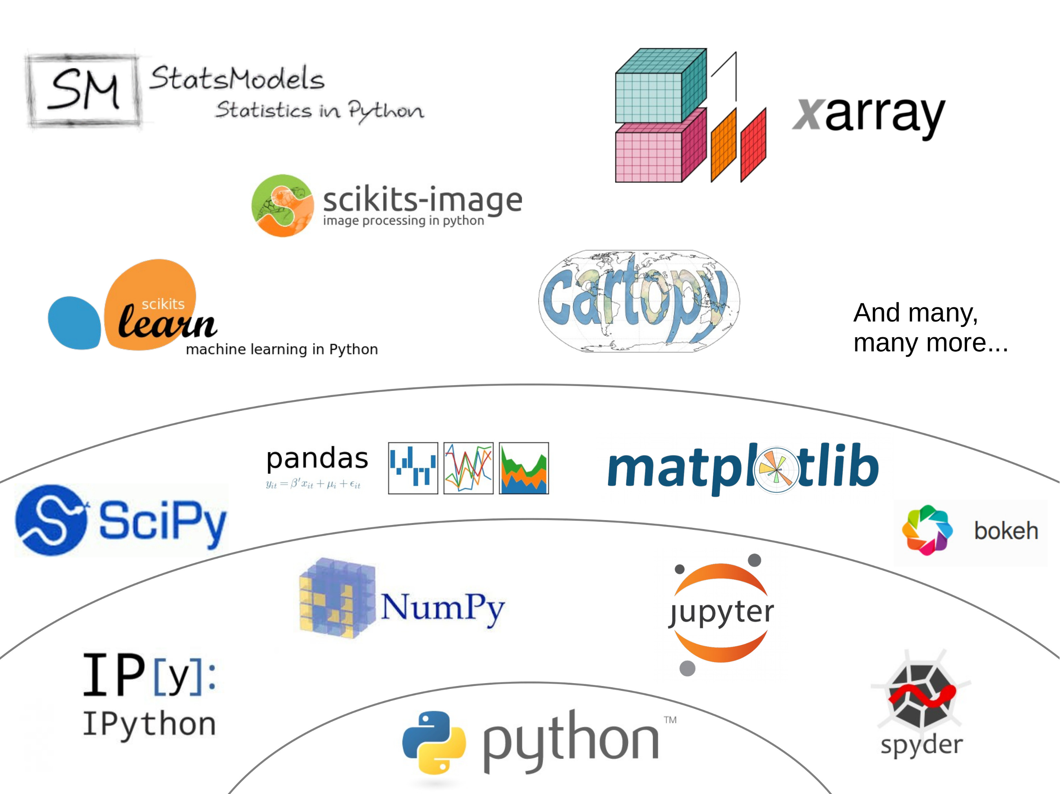
THE PYTHON’S SCIENTIFIC ECOSYSTEM
Notes:
image from here: https://tristansalles.github.io/EnviReef/3-scientific/pythonstack.html

Slide 14
NUMPY
ARRAY < type ‘ndarray’ >
It is a multi-dimensional (may have more than one index) with homogeneous elements and fixed dimension.
There are constructors for some typical cases:
import numpy as np
A = np.zeros(4) # array of zeros
A = np.ones((2,3,4)) # array of ones
A = np.arange(-5.,5.,1.) # array of elements from -5 to 4 (!)
A = np.linspace(-5.,5.,100)# array of linearly spaced elements from -5 to 5
Array can also be generated through list and tuples:
L = [1., 2., 3. ]
A = np.array(l)
N.B this is the conventional way of importing numpy
Remark
As usual with object, b=a create an alias and not a copy. To obtain a copy:
NewArray = OldArray.copy()

Slide 15
NUMPY
ARRAY < type ‘ndarray’ >
It is possible to redistribute the elements among dimension.
import numpy.random as rd
a = rd.randint(-10,10,(2,3,4))
a.shape = (2,12)
or
a.reshape(2,12)
Usual slicing operation to extract portions of the array:
a[indexes dim. 0, indexes dim. 1, :]
To take all elements of one dimension, use «:»
Note that slicing produce views of the array, i.e. a[:,:] does not produce a new array!
To access the element at place i
a.item(i)
The 1-dimensional representation (as a view) is given by
a.ravel()
N.B numpy.random module is more powerful than random

Slide 16
NUMPY
ARRAY < type ‘ndarray’ >
To iterate on the dimension
for i in range(a.shape[0]):
for j in range(a.shape[1]):
...
The usual operations
+, -, /, *, **
are possible, in such a case the operation is applied to all elements in the array
b = 2*a
Some useful methods
a.max() a.argmax()
a.min() a.argmin()
a.mean() a.std()

Slide 17
NUMPY
MATRIX < type ‘matrix’ >
To define matrices:
m = matrix( list/array )
or:
m = mat( list/array )
Usual matrix operations are defined (in particular, * is matrix multiplication).
To perform matrix multiplication using arrays, use @.
Inherited from old Python versions, to matrix multiply two array a and b: c=dot(a,b).

Slide 18
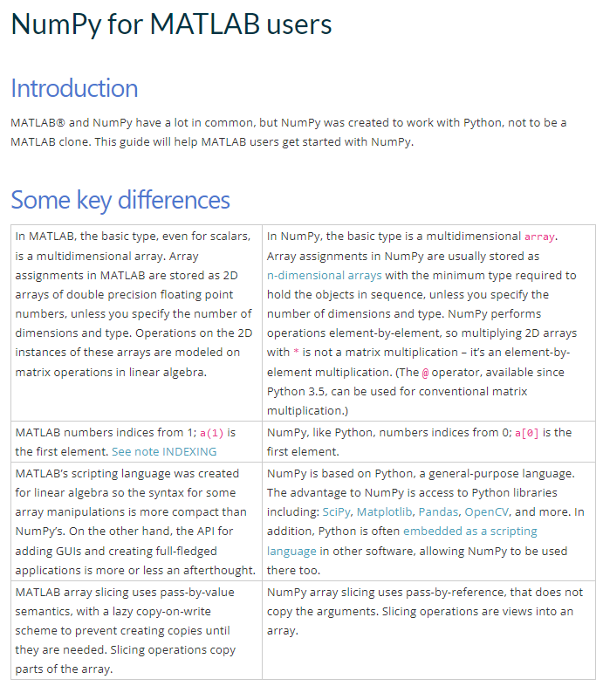
NUMPY
The “Rosetta stone” for Matlab users
https://numpy.org/doc/stable/user/numpy-for-matlab-users.html

Slide 19
NUMPY - VECTORIALIZATION
An array can be used as the argument of a function. Anyway, if there is a if condition, the condition can not be evaluated:
def funz(x):
if x < 0:
return -1
else:
return 2*x
In such cases, the command where can be used:
def funz(x):
return np.where( x < 0, -1, 2*x)
It is worth noting that this last function can be called with a scalar as an argument.
Otherwise
funzv = np.vectorize(funz)

Slide 20
NUMPY - USEFUL SUBMODULES/FUNCTIONS
There are several submodules in Numpy, for example random, fft, linalg
To import a submodule
import numpy.random as rd
import numpy.linalg as la
A = rd.randint(-10,10,(3,3))
b = rd.randint(-10,10,3)
if not np.isclose(la.det(A),0,atol=1e-12):
c = la.solve(A,b)
c1 = np.dot(la.inv(A),b)
w, v = la.eig( A ) # solution of A@v = wv

Slide 21
NUMPY - USEFUL SUBMODULES/FUNCTIONS
To write/read to a file (in text format)
import numpy as np
x = np.random.uniform(size=(10,3))
np.savetxt('dati.txt',x,'%7.4f',';')
y = np.loadtxt('dati.txt',delimiter=';')

Slide 22
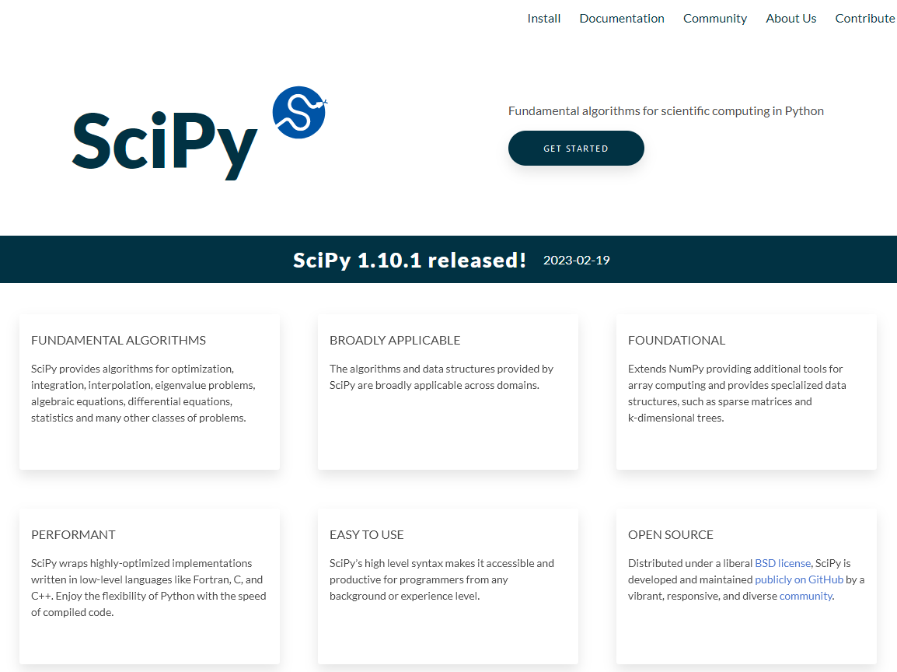
SCIPY

Slide 23
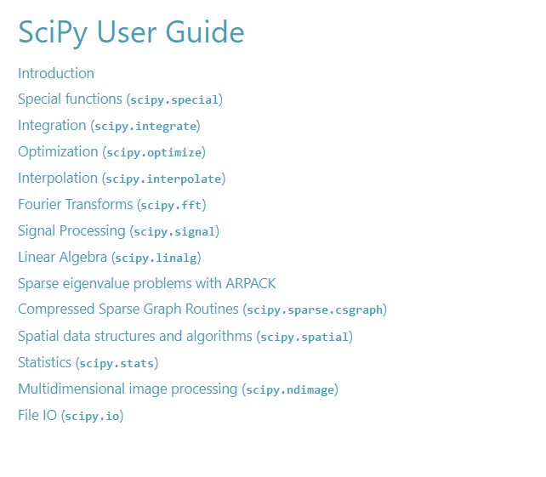
SCIPY
Modules of SciPy (https://docs.scipy.org/doc/scipy/tutorial/index.html)
Reference here: https://docs.scipy.org/doc/scipy/reference/

Slide 25
SCIPY - LINALG
A (very) simple example: solve the following system of linear equations
import numpy as np
import scipy
import scipy.linalg as la
A = np.array([[2.,-3.],[1., 4.]])
b = np.array([1., -2.])
xy = la.solve(A,b)
print('x = %f\ny = %f'%(x[0], x[1]))

Slide 26
SCIPY - LINALG
Another (very) simple example: solve the eigenproblem* associated to the following matrix
import numpy as np
import scipy
import scipy.linalg as la
A = np.array([[100.,-30.,0.],[-30.,-200.,0.],[0.,0.,50.]])
L, V = la.eig(A)
The eigenvalues are the entries of L, the corresponding eigenvectors are the columns of V. To verify for second eigenvalue/eigenvector:
A@V[:,1]-L[1]*V[:,1]
* it means: given matrix A, find scalar λ and vector v such that

Slide 27
PYLAB/MATPLOTLIB
To create graphs MatLab-like.
import numpy as np
import matplotlib
import matplotlib.pyplot as plt
x = np.linspace(0.,2*np.pi, 101)
y = np.sin(x)
ys = x-x**3/6+x**5/120-x**7/5040+x**9/362880
plt.plot( x, y, 'bo-', label='true')
plt.plot( x, ys, 'r-', label='serie 5 terms')
plt.xlabel('$t$')
plt.ylabel('$\sin(t^1)$')
plt.title('Graph of $\sin(t)$')
plt.legend()
plt.grid(True)
plt.show()
To see several examples of use
https://matplotlib.org/stable/gallery/index.html
N.B this is the “standard” way of importing pyplot
y
x

Slide 28
PYLAB/MATPLOTLIB
To plot 3d graphs
import numpy as np
import matplotlib
import matplotlib.pyplot as plt
from mpl_toolkits.mplot3d import Axes3D
X, Y = np.meshgrid( np.linspace(-np.pi,np.pi,51),
np.linspace(-np.pi,np.pi,51) )
Z = np.sin( X*Y )
fig = plt.figure()
ax1 = fig.add_subplot(1, 2, 1, projection='3d')
ax1.plot_surface(X,Y,Z)
ax2 = fig.add_subplot(1, 2, 2)
CS = ax2.contour(X, Y, Z, np.linspace(-1.,1.,10))
ax2.clabel( CS, fontsize=9, inline=1)
plt.show()

Slide 29
PYLAB/MATPLOTLIB
Going back to the first figure...
import numpy as np
import matplotlib
import matplotlib.pyplot as plt
x = np.linspace(0.,2*np.pi, 101)
y = np.sin(x)
ys = x-x**3/6+x**5/120-x**7/5040+x**9/362880
fig, ax = plt.subplots(1,1)
ax.plot( x, y, 'bo-', label='true')
ax.plot( x, ys, 'r-', label='serie 5 terms')
ax.set_xlabel('$t$')
ax.set_ylabel('$\sin(t^1)$')
ax.set_title('Graph of $\sin(t)$')
ax.legend()
ax.grid(True)
plt.show()
See also https://matplotlib.org/stable/tutorials/introductory/quick_start.html
Notes:
From the cited link: "Matplotlib's documentation and examples use both the OO and the pyplot styles. In general, we suggest using the OO style, particularly for complicated plots, and functions and scripts that are intended to be reused as part of a larger project. However, the pyplot style can be very convenient for quick interactive work."

