Slide 1

UNIVERSITÀ DEGLI STUDI DI PERUGIA
International Doctoral Program in
Civil and Environmental Engineering
PYTHON FOR NUMERICAL COMPUTING AND DEVELOPMENT OF SCIENTIFIC APPLICATION
Prof. Federico Cluni
A. Y. 2022/23
Lesson #5 – May 3, 2023

Slide 2
PANDAS
What is Pandas?
Pandas is a package that define objects useful to store and work with (a lot of) data.
The main objects defined are
date_range, which allows to create easily a list of dates
Series, which create a list of elements associated to an index
DataFrame, which create of table whose elements are grouped column-wise and indexed; the elements can be of (almost) any type
It is possible to easily manage missing elements and to group together DataFrames.

Slide 3
PANDAS
Creation of a Series
import numpy as np
import pandas as pd
s = pd.Series([0, 1.2, 4.2, np.nan, 3.8])
Create the following object
0 0.0
1 1.2
2 4.2
3 NaN
4 3.8
dtype: float64
N.B this is the “standard” way of importing pandas
Notes:
this part is based on the 10-min tutorial https://pandas.pydata.org/pandas-docs/stable/getting_started/10min.html

Slide 4
PANDAS
Creation of a date_range
import numpy as np
import pandas as pd
d = pd.date_range('20230505',periods=6,freq='4W-FRI')
Create the following object
DatetimeIndex(['2020-06-26', '2020-07-24', '2020-08-21', '2020-09-18', '2020-10-16', '2020-11-13'],
dtype='datetime64[ns]', freq='4W-FRI')
The freq argument specify how the starting date is repeated and it allows sohisticated specification, see here.

Slide 5
PANDAS
Creation of a DataFrame
It is the main object handled by Pandas:
import numpy as np
import numpy.random as rd
import pandas as pd
d = pd.date_range('20200626',periods=6,freq='4W-FRI')
df = pd.DataFrame(rd.randint(-10,10,(6,4)), index=d, columns=list('ABCD'))
Create the following object
A B C D
2020-06-26 2 -10 8 -8
2020-07-24 7 -2 -8 0
2020-08-21 -9 2 -9 -2
2020-09-18 1 -7 7 -9
2020-10-16 -8 9 -8 -8
2020-11-13 3 -5 1 2

Slide 6
PANDAS
Creation of a DataFrame
It is also possible to pass directly the columns
import numpy as np
import numpy.random as rd
import pandas as pd
df2 = pd.DataFrame({'A': 1.,
'B': pd.Timestamp('20130102'),
'C': pd.Series(1, index=list(range(4)), dtype='float32'),
'D': np.array([3] * 4, dtype='int32'),
'E': pd.Categorical(["test", "train", "test", "train"]),
'F': 'foo'})
Create the following object
A B C D E F
0 1.0 2013-01-02 1.0 3 test foo
1 1.0 2013-01-02 1.0 3 train foo
2 1.0 2013-01-02 1.0 3 test foo
1.0 2013-01-02 1.0 3 train foo
To copy a datafarame (which is a Python object!)
df2 = df.copy()

Slide 7
PANDAS
Viewing data
To display the first (default is 5) rows
df.head()
To display the last (default is 5) rows
df.tail(3)
To display row indices and columns heading
df.index
df.columns
If all elements in DataFrame are numerical they can be exported to a 2D numpy array
df.to_numpy()

Slide 8
PANDAS
Viewing data
The method describe perform some statistics on the data
df.describe()
results in
A B C D
count 6.000000 6.000000 6.000000 6.000000
mean -0.666667 -2.166667 -1.500000 -4.166667
std 6.408328 6.853223 7.867655 4.750439
min -9.000000 -10.000000 -9.000000 -9.000000
25% -5.750000 -6.500000 -8.000000 -8.000000
50% 1.500000 -3.500000 -3.500000 -5.000000
75% 2.750000 1.000000 5.500000 -0.500000
max 7.000000 9.000000 8.000000 2.000000

Slide 9
PANDAS
Viewing data
It is possible to sort
df.sort_values(by='B', ascending=False)
results in
A B C D
2020-10-16 -8 9 -8 -8
2020-08-21 -9 2 -9 -2
2020-07-24 7 -2 -8 0
2020-11-13 3 -5 1 2
2020-09-18 1 -7 7 -9
2020-06-26 2 -10 8 -8

Slide 10
PANDAS
Accessing and selecting data
To access a column
df['A']
to access rows
df[0:3]
df['20200626':'20200809']
The usual rules of slicing holds (first index is included, second index is not included).
Note that a sigle row can NOT be accessed in this way
df[0]
results in an error.

Slide 11
PANDAS
Accessing and selecting data
Slicing can be made using labels
df.loc['20200626':'20200821',['B','D']]
To access a single value
df.loc['20200626','B']
but in this case a faster way is
df.at['20200626','B']
The same operation can be made using position (in this case the usual rule of not including the second index holds)
df.iloc[0:2,[1,3]]
df.iat[0,'B']

Slide 12
PANDAS
Accessing and selecting data
It is possible to select the rows when a condition on a column is met
df[df['A']>0]
df2 = df.copy()
df2['E']=['apple','banana','apple','pear','peach','apricot']
df2[df2['E'].isin(['apple','pear'])]
The condition may be also checked in the whole dataframe
df[df>0]

Slide 13
PANDAS
Accessing and selecting data
Beside selecting and viewing, the previous operations can be used to set new values in the cells
df.loc['20200724','B']=99
df.iloc[2,1:3] = 1000
df[df<0] = -df
It is possible to assign whole columns
df.loc[:,1:3]=rd.randint(-10,10,(6,2))

Slide 14
PANDAS
Accessing and selecting data
In pandas, missing data are set to numpy.nan.
df1 = df.reindex(df.index, columns=['A','B','E'])
df1.loc[df1.index[1:3],'E'] = 1
The rows containing NaN can be dropped
df1.dropna(how='any')
The NaN can be set to a specific value
df1.fillna(99)
We can obtain a mask where the values are NaN
pd.isna(df1)
To obtain a DataFrame without a specific row/column
df1.drop(pd.Timestamp('20200821'),0) # row
df1.drop('E',1) # column
Note the use of Timestamp to obtain a date compatible with those used in row labels.
N.B .reindex rearrange the index, if a new index is introduced the values are set to NaN

Slide 15
PANDAS
Operations
Several operation are available in pandas dataframe.
df.mean() # mean column-wise
df.mean(1) # mean row-wise
Apply an operator (consider the column/rows as numpy array)
df.apply(np.cumsum) # column-wise
df.apply(np.cumsum,1) # row-wise
df.apply(lambda x: x.max()-x.min())
Creating a new column based on values from other columns
df['E'] = df['A']+df['B']

Slide 16
PANDAS
Operations
It is possible to concatenate two dataframes
d = pd.date_range('20200626',periods=6,freq='4W-FRI')
df = pd.DataFrame(rd.randint(-10,10,(6,4)), index=d, columns=list('ABCD'))
d1 = pd.date_range('20200930',periods=2,freq='M')
df1 = pd.DataFrame(rd.randint(-10,10,(2,4)), index=d1, columns=list('ABCD'))
pd.concat([df,df1])
It is worth noting that it is NOT necessary the dataframes have the same columns, since missing values are set to NaN
d2 = pd.date_range('20200930',periods=2,freq='M')
df2 = pd.DataFrame(rd.randint(-10,10,(2,4)), index=d2, columns=list('ABCE'))
pd.concat([df,df2])
If the index is not meaningful, the concatenated dataframe may be reindexed
df = pd.DataFrame(rd.randint(-10,10,(6,4)), columns=list('ABCD'))
df2 = pd.DataFrame(rd.randint(-10,10,(6,4)), columns=list('ABCE'))
d3=pd.concat([df,df2],ignore_index=True)

Slide 17
PANDAS
Grouping and pivot
It is possible to group the elements.
df = pd.DataFrame({'A': ['apple', 'pear', 'apple', 'pear',
'apple', 'pear', 'apple', 'apple'],
'B': ['one', 'one', 'two', 'three',
'two', 'two', 'one', 'three'],
'C': rd.randint(1,10,8),
'D': rd.randint(1,10,8)})
df.groupby('A').sum()
df.groupby(['A','B']).sum()

Slide 18
PANDAS
Grouping and pivot
It is possible to create pivot table.
df = pd.DataFrame({'A': ['apple', 'pear', 'apple', 'pear',
'apple', 'pear', 'apple', 'apple'],
'B': ['one', 'one', 'two', 'three',
'two', 'two', 'one', 'three'],
'C': rd.randint(1,10,8),
'D': rd.randint(1,10,8)})
pd.pivot_table(df, values='D', index=['A', 'B'], columns=['C'])
Notes:
see also https://pandas.pydata.org/pandas-docs/stable/user_guide/reshaping.html#reshaping-pivot

Slide 19
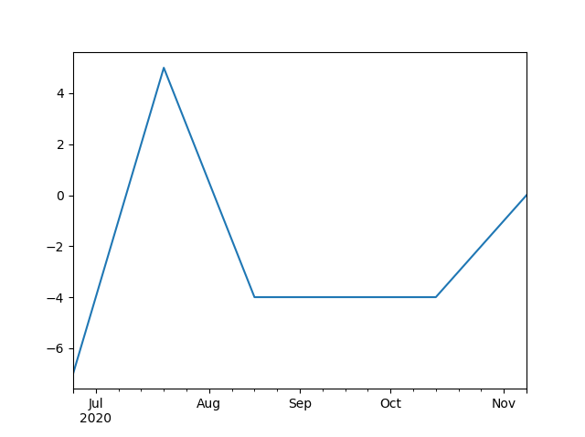
PANDAS
Plotting
It is possible to use using matplotlib.
import numpy as np
import numpy.random as rd
import pandas as pd
import matplotlib.pyplot as plt
d = pd.date_range('20200626',periods=6,freq='4W-FRI')
df = pd.DataFrame(rd.randint(-10,10,(6,4)), index=d, columns=list('ABCD'))
df['C'].plot()
plt.show()
Notes:
see also https://pandas.pydata.org/pandas-docs/stable/user_guide/reshaping.html#reshaping-pivot

Slide 20
PANDAS
Plotting
It is possible to have array as values!
import numpy as np
import numpy.random as rd
import pandas as pd
dates=pd.date_range('20200626',periods=6,freq='W')
a=rd.randn(6,10)
df=pd.DataFrame(columns=['dati'])
for r,c in zip(dates, a):
df.loc[r,'dati']=c
df['max']=df['dati'].apply(np.max)
df['dati'].apply(plt.plot)
Notes:
see also https://pandas.pydata.org/pandas-docs/stable/user_guide/reshaping.html#reshaping-pivot

Slide 21

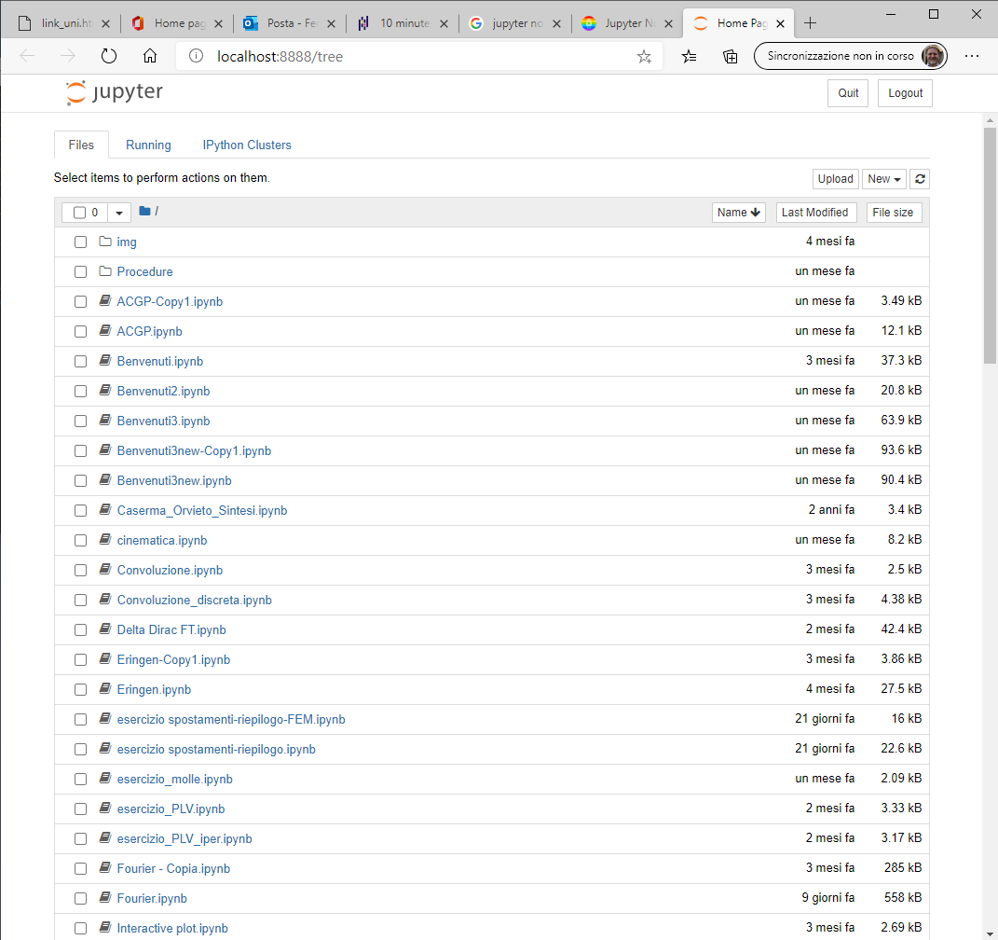
JUPYTER NOTEBOOKS
The notebook server
When launching Jupyter, a server providing the notebook functionality through the web browser is started.
Notes:
see also https://www.dataquest.io/blog/jupyter-notebook-tips-tricks-shortcuts/

Slide 22
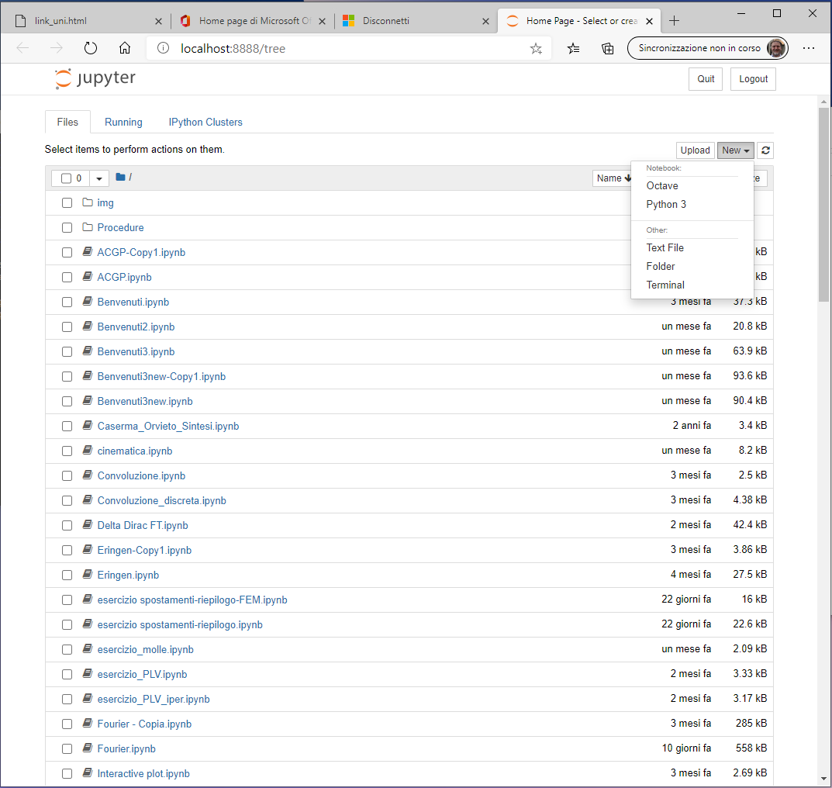
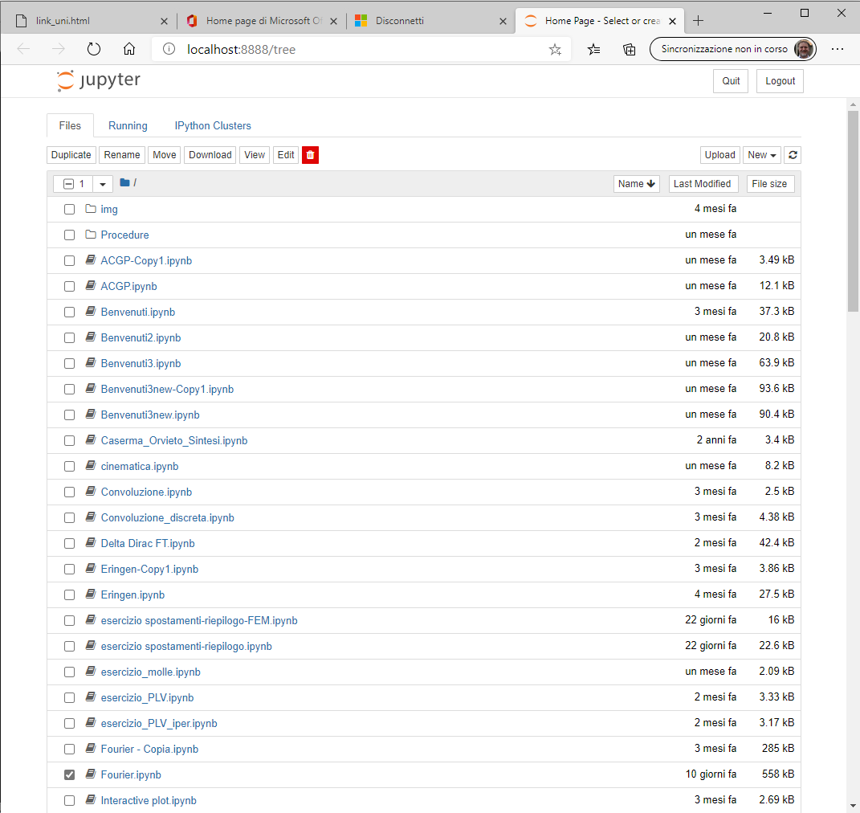
JUPYTER NOTEBOOKS
The notebook server
It is worth noting that several "kernels" may be used with Jupyter.
Moreover, the interface act as a "file explorer".

Slide 23
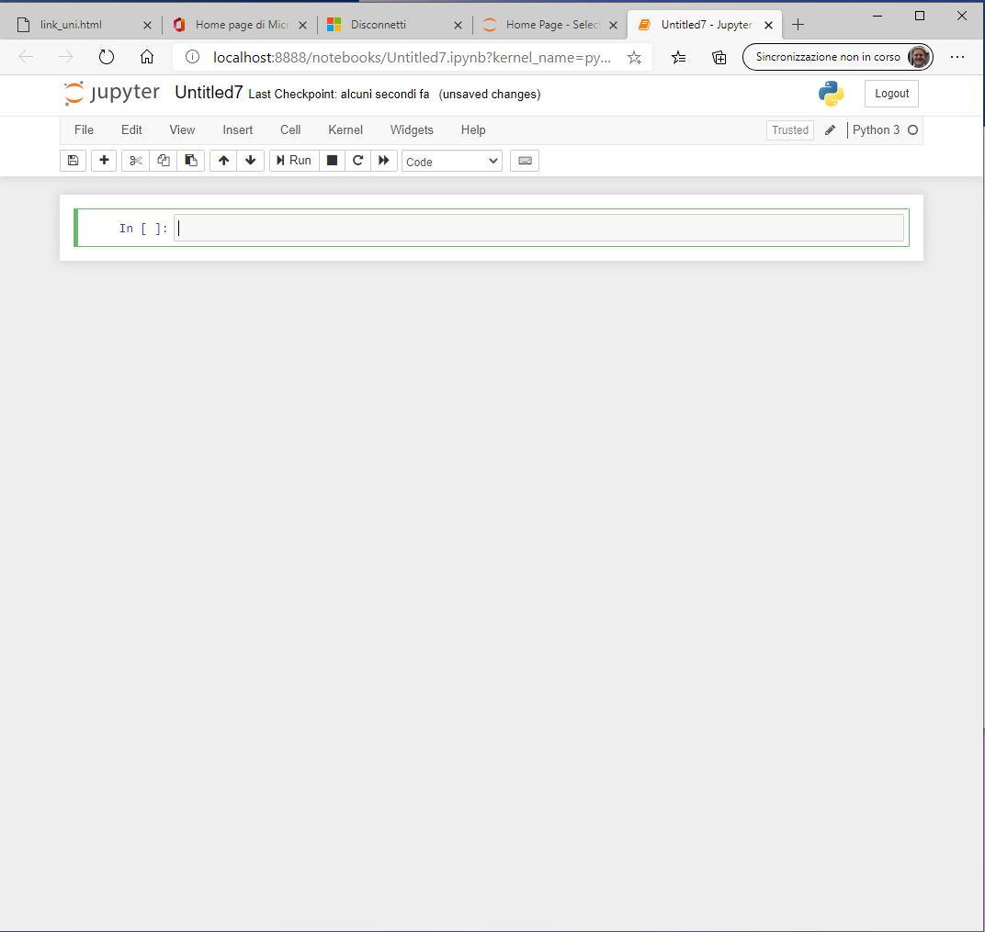
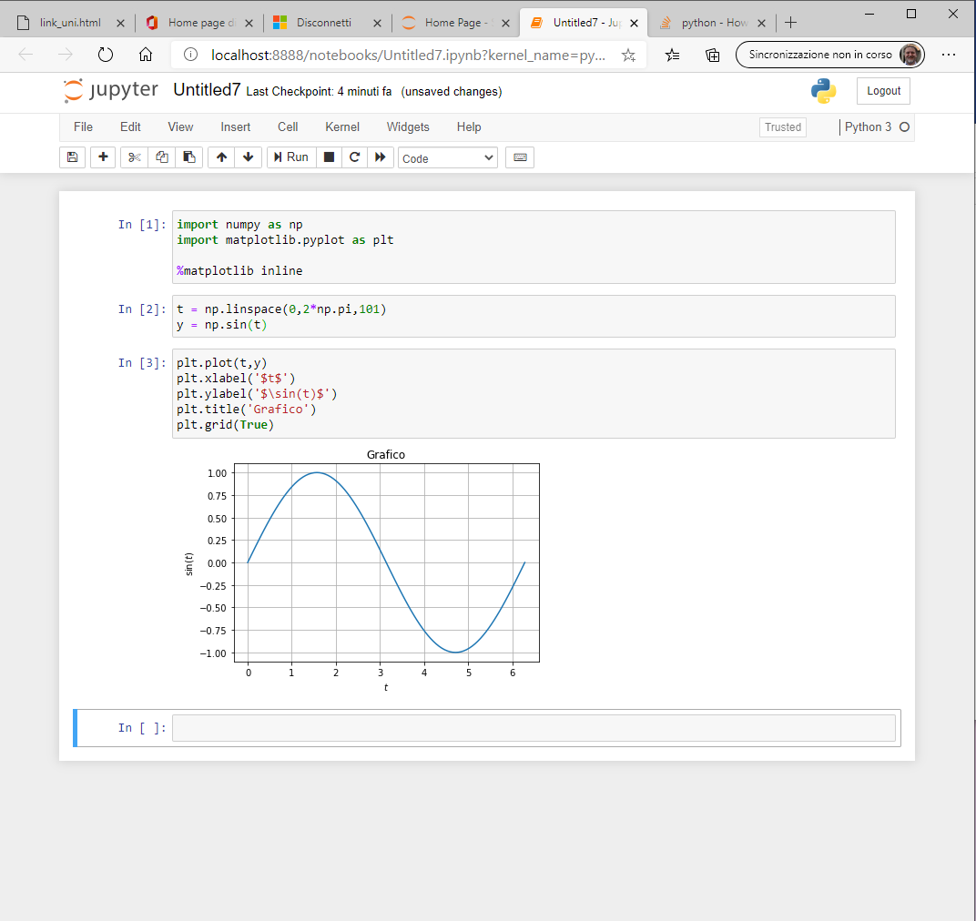
JUPYTER NOTEBOOKS
The notebook server
It is possible to insert Python code in the cell.
Note that "return" key allows to insert a new line of code, "shift"+"return" keys run the inserted code.

Slide 24
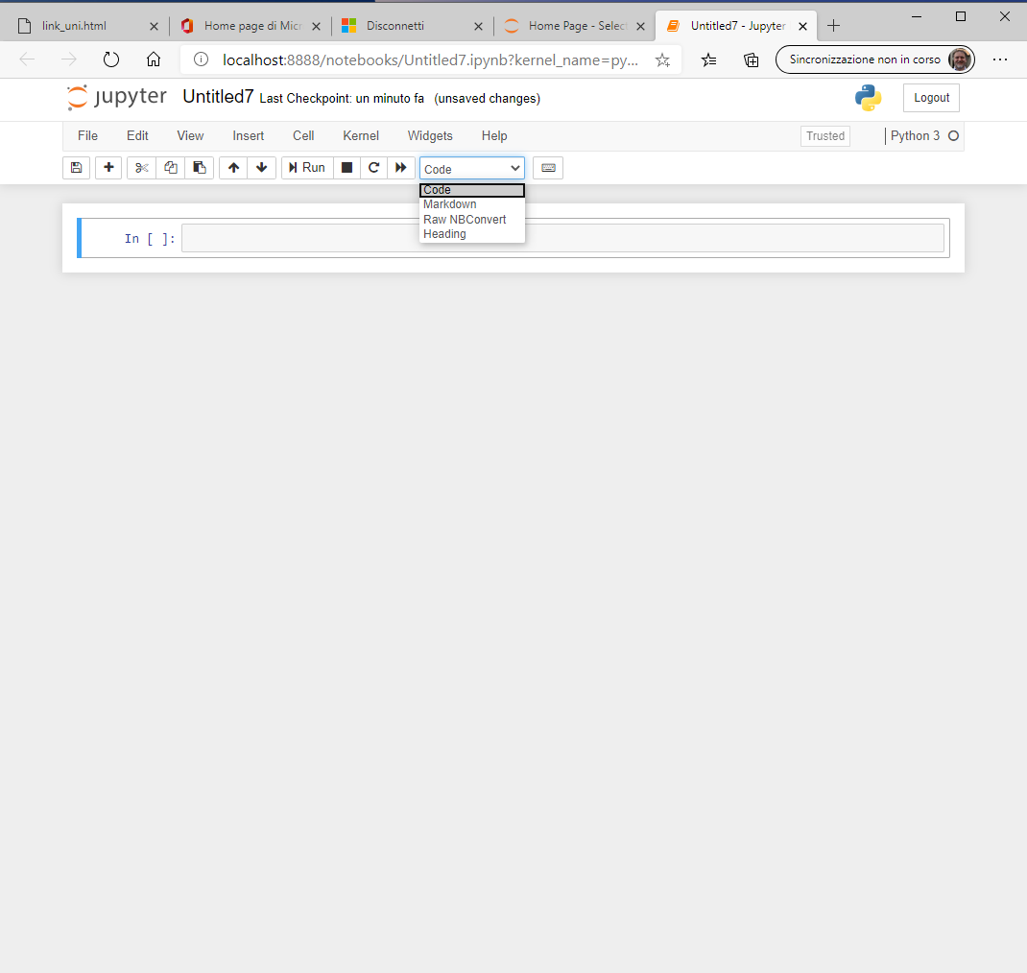
JUPYTER NOTEBOOKS
The notebook server
It is possible to insert Markdown code in the cell, which can also render math.
Notes:
https://markdown-it.github.io/

Slide 25
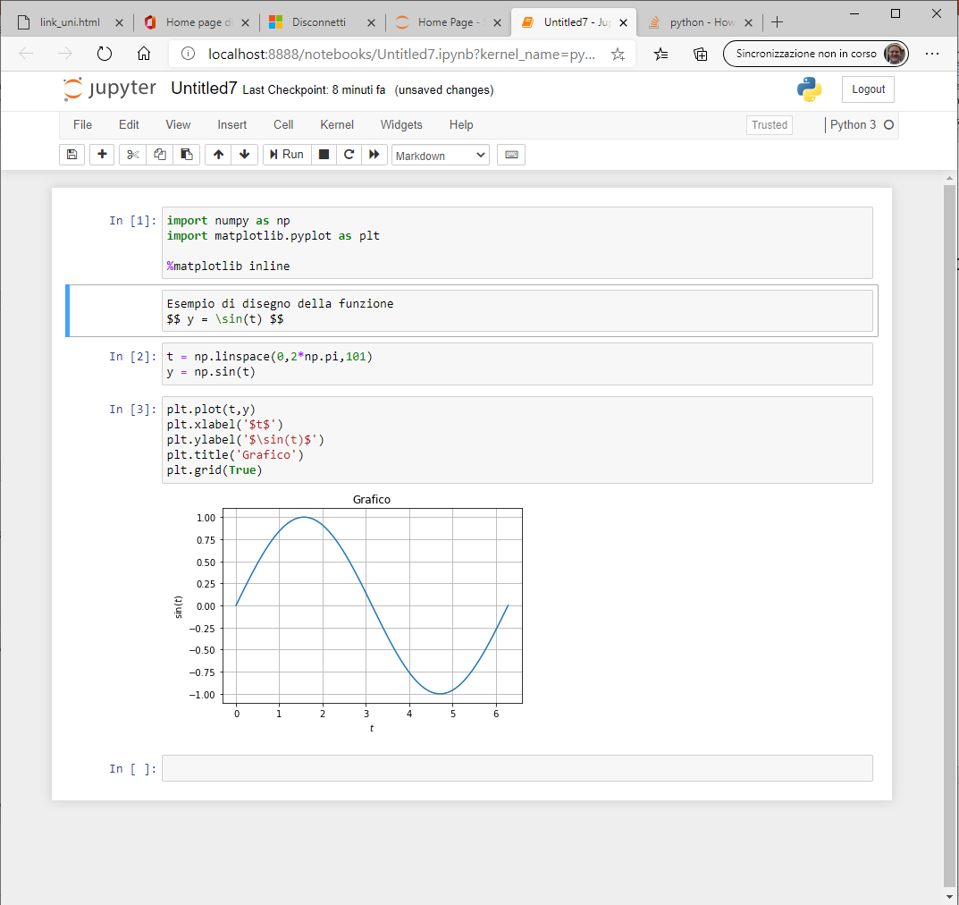
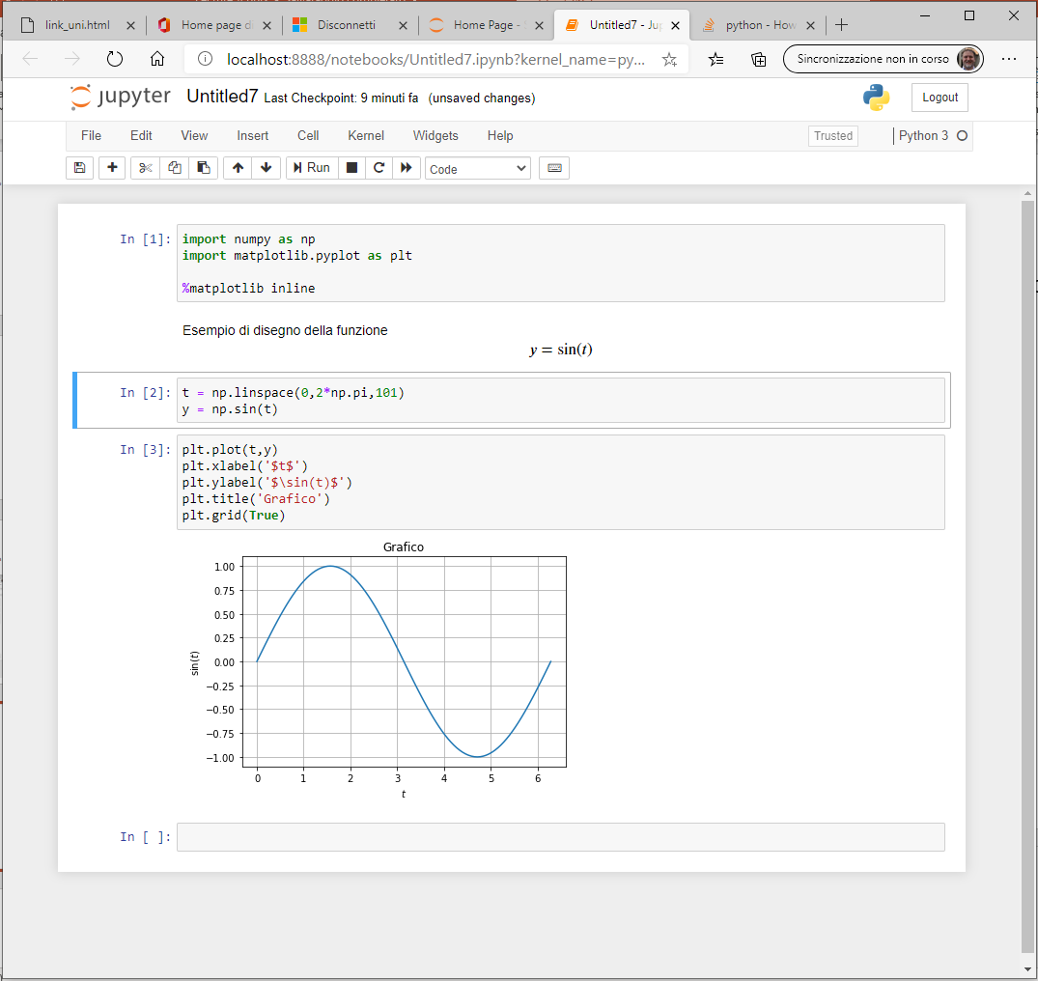
JUPYTER NOTEBOOKS
The notebook server
It is possible to insert Markdown code in the cell, which can also render math.
To see how to use markdown see here https://markdown-it.github.io/

Slide 26
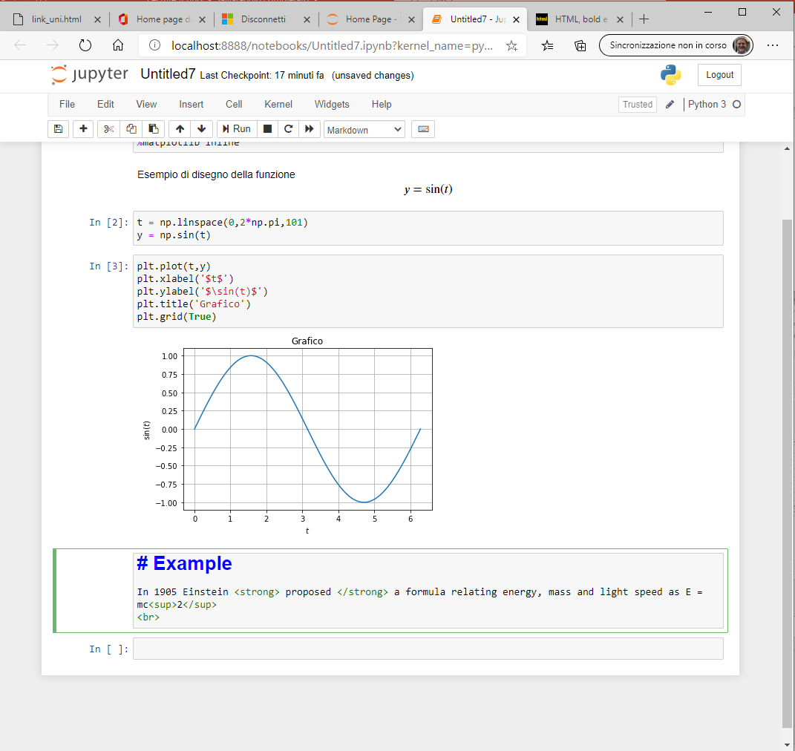
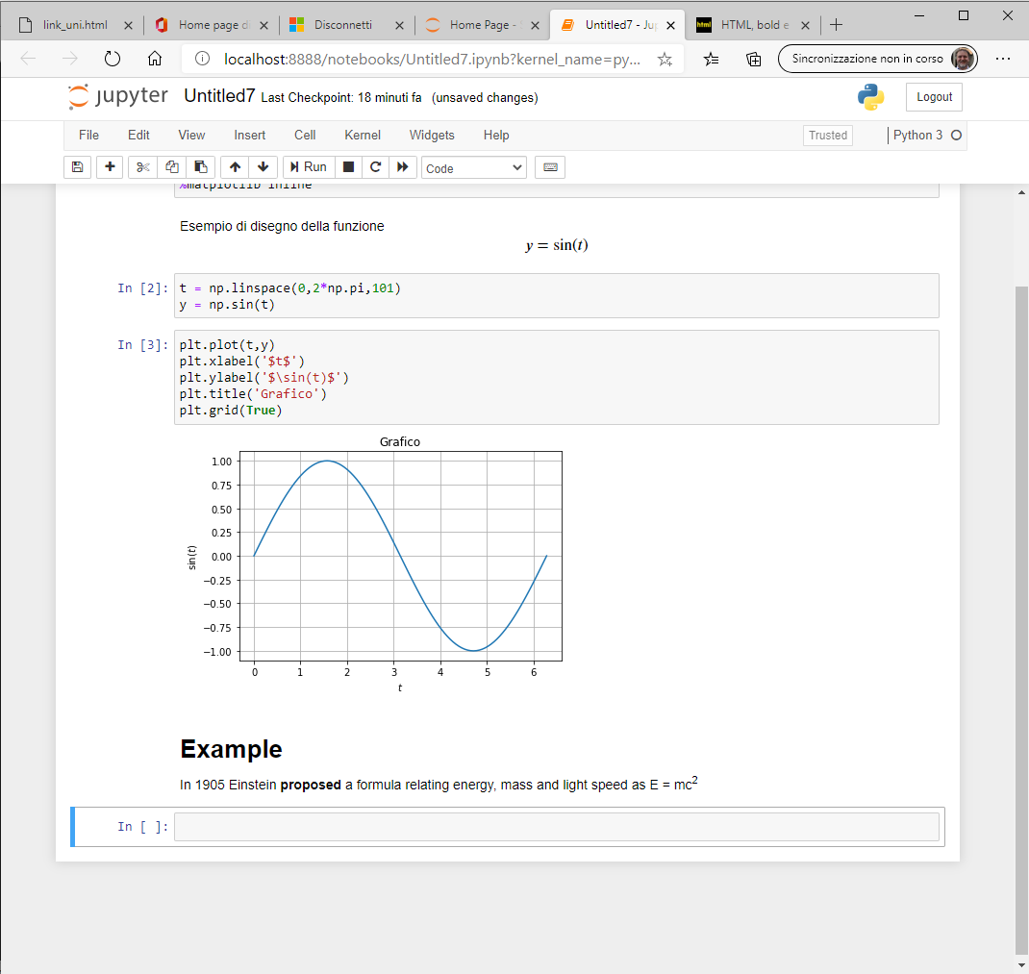
JUPYTER NOTEBOOKS
The notebook server
In Markdown cell html (markup) code can be executed.

Slide 27
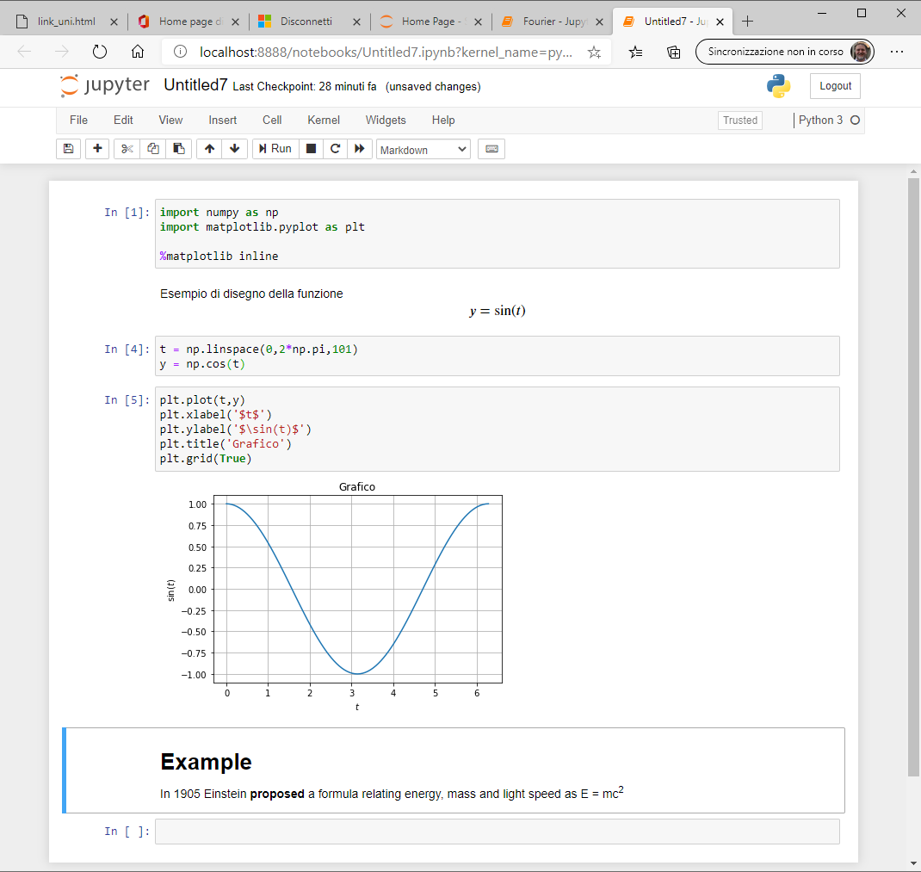
JUPYTER NOTEBOOKS
The notebook server
It is possible to edit the code previously inserted and see what happens!

Slide 28
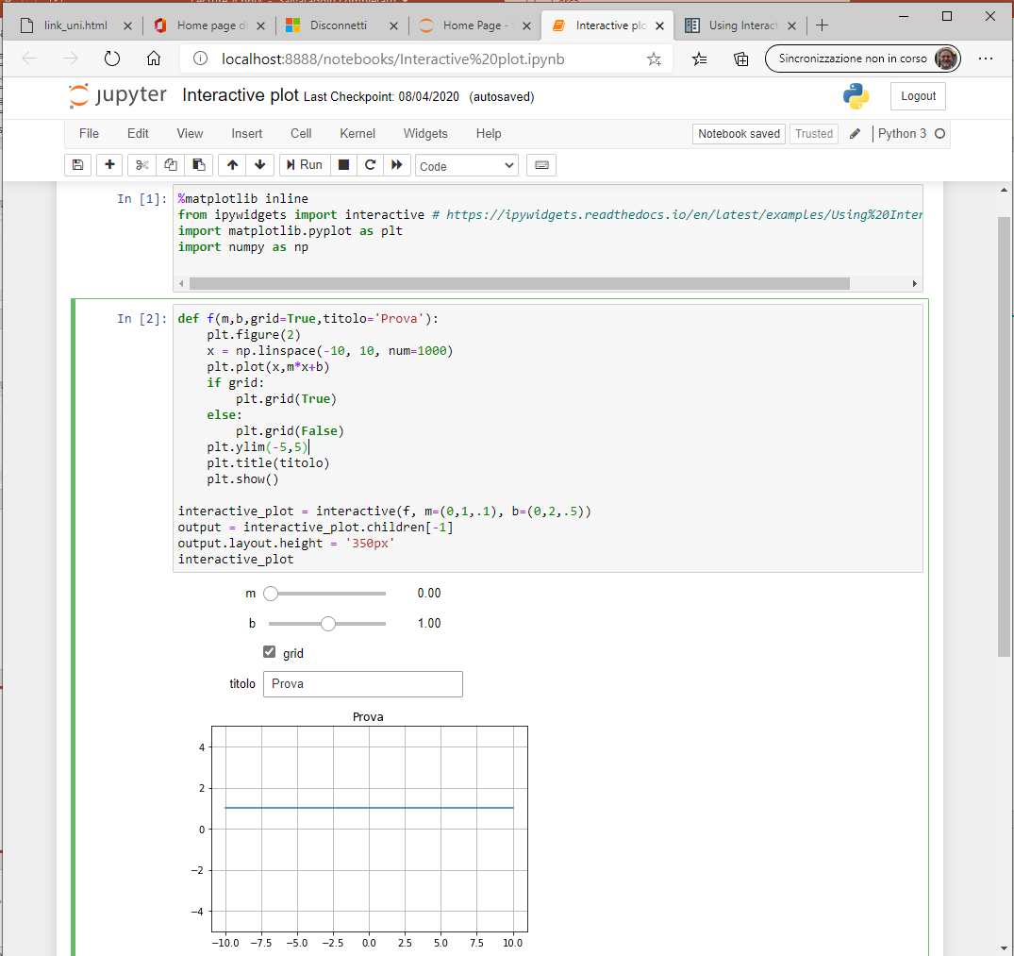
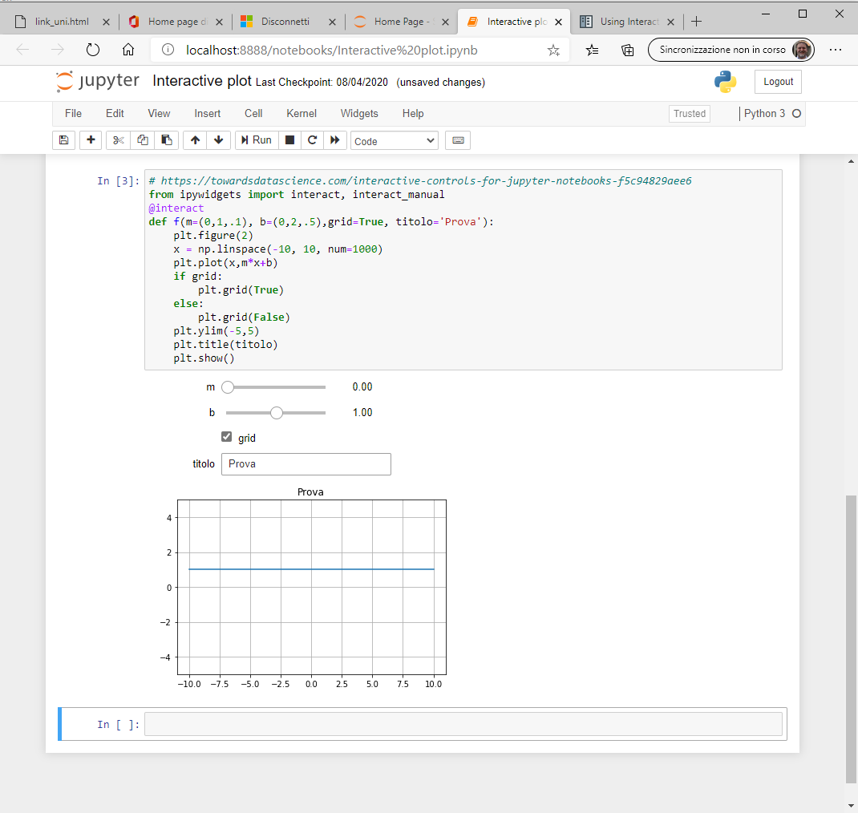
JUPYTER NOTEBOOKS
The notebook server
It is possible to define interactive controls.
See https://ipywidgets.readthedocs.io/en/latest/examples/Using%20Interact.htm
Notes:
«@interact is usefull if you are interested in exploring some data, and manipulating the "view" of some data.
Say you have precipitation graph per days for year 2000 to 2019, you don't want to plot 19 graph, you want to have 1 graph with a slider to select which year you want to see. Then you can do
@interact(year=(2000, 2019)) def plot_graph(year): ... That's it. You don't want to reuse the widget; you just interested in the interactivity and ability to change the "view". In this case we don't care about the user input. We really only care about changing some view parameters.
interactive() is there if you actually want to build something more tightly integrated; but for most data scientist inputing data via widgets is not that usefull. It is also a bad habit as this prevent the notebook from being reproducible with "restart and run all" as result depends from user input.» (from https://www.reddit.com/r/IPython/comments/cs4beg/whats_the_point_of_ipywidgets_interact_v/)

Slide 29
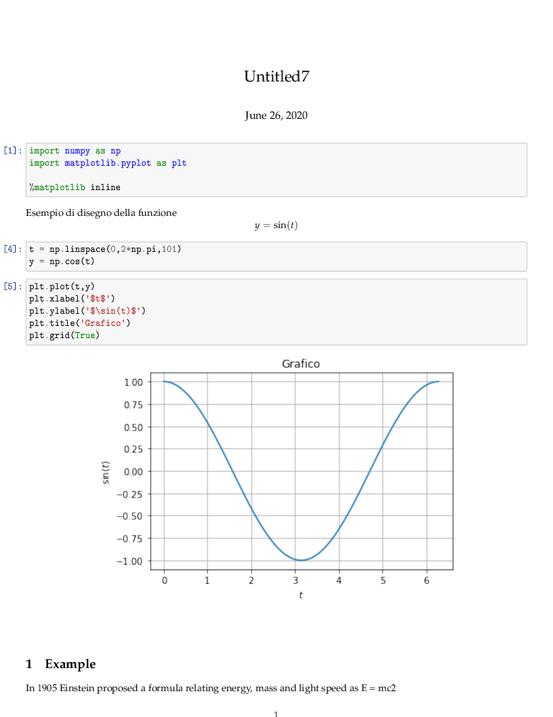
JUPYTER NOTEBOOKS
The notebook server
Note that several actions are possible on the notebook (for example, clear output and/or restart the cell).
Moreover, it is also possible to export the notebook, for example to LaTeX format

Slide 30
JUPYTER NOTEBOOKS
Magic commands
Jupyter Notebook inherits some magic commands from IPython
%timeit evaluate the time of execution of a command
%run execute code in a script
%store varname save the variable
%store –r varname load the variable
%who list names in global scope
%matplotlib inline plot the graphs in the notebook
%matplotlib notebook add interactive exploring tools to the plot
Notes:
for more information on %store https://ipython.org/ipython-doc/stable/config/extensions/storemagic.html

Slide 31
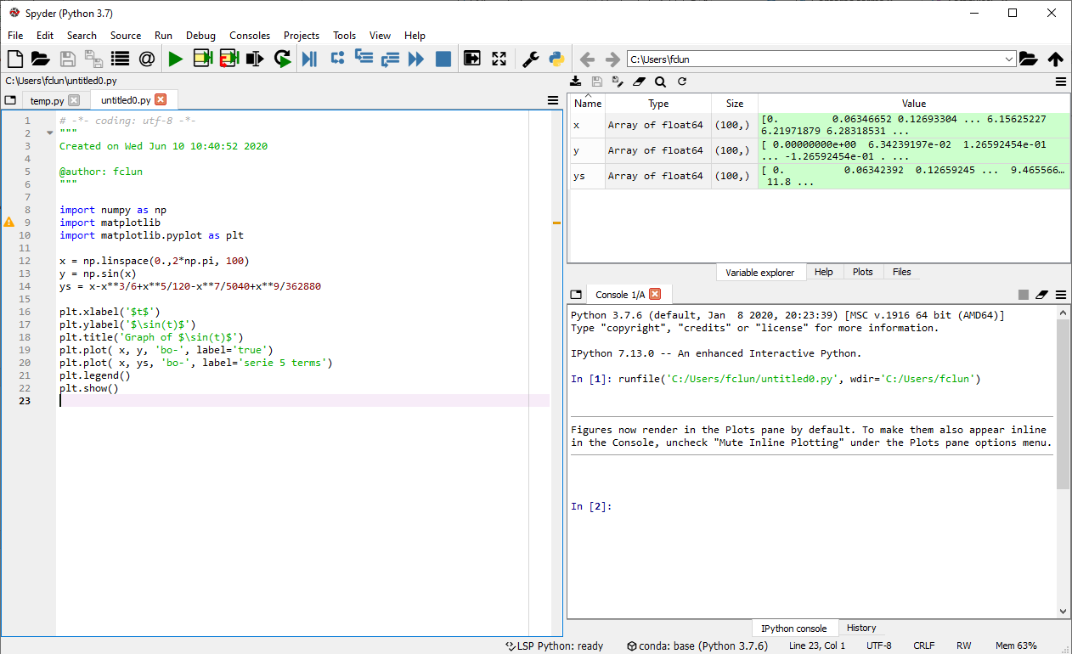
PYLAB/MATPLOTLIB
It is possible to have an interface (IDE) similar to that of Matlab through Spyder

