Slide 1

UNIVERSITÀ DEGLI STUDI DI PERUGIA
International Doctoral Program in
Civil and Environmental Engineering
PYTHON FOR NUMERICAL COMPUTING AND DEVELOPMENT OF SCIENTIFIC APPLICATION
Prof. Federico Cluni
A. Y. 2023/24
Lesson #8 – April 12th, 2024

Slide 2

NUMBA
Accelerating code execution
From the official website https://numba.pydata.org/
Numba translates Python functions to optimized machine code at runtime using the industry-standard LLVM compiler library. Numba-compiled numerical algorithms in Python can approach the speeds of C or FORTRAN.
You don't need to replace the Python interpreter, run a separate compilation step, or even have a C/C++ compiler installed. Just apply one of the Numba decorators to your Python function, and Numba does the rest.
The problem with Python, and with any interpreted programming language, is when nested for-loops are used.

Slide 3
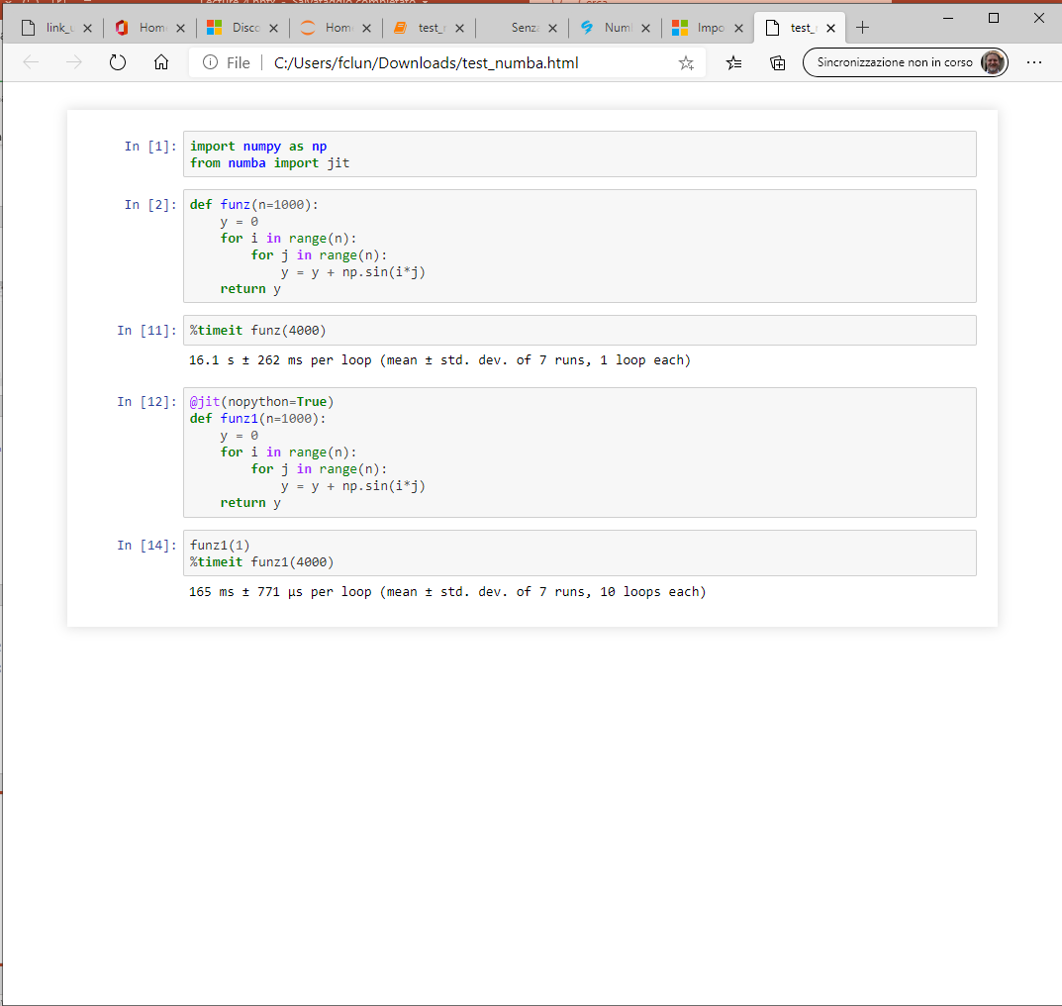
NUMBA
Accelerating code execution

Slide 4
EXTENDING PYTHON WITH FORTRAN/C++
Why?
Why physicists still use Fortran
Posted on July 16, 2015 by delton137 in programming research
“I don’t know what the programming language of the year 2000 will look like, but I know it will be called FORTRAN.” – Charles Anthony Richard Hoare, circa 1982
Fortran is rarely used today in industry — one ranking ranks it behind 29 other languages. However, Fortran is still a dominant language for the large scale simulation of physical systems, ie. for things like the astrophysical modeling of stars and galaxies, hydrodynamics codes (cf. Flash), large scale molecular dynamics, electronic structure calculation codes (cf. SIESTA), large scale climate models, etc. In the field of high performance computing (HPC), of which large scale numerical simulation is a subset, there are only two languages in use today — C++ and “modern Fortran” (Fortran 90/95/03/08). The popular Open MPI libraries for parallelizing code were developed for these two languages. So basically, if you want fast code that an run on many processors, you are limited to these two options. Modern Fortran also has a feature called ‘coarrays‘ which puts parallelization features directly into the language. Coarrays started as an extension of Fortran 95 and were incorporated into Fortran 2008 standard.
Extracted from here

Slide 5
EXTENDING PYTHON WITH FORTRAN/C++
What it is needed?
In order to extend Python with Fortran or C++ a compiler is needed.
Working with Windows OS, the suite MinGW can be used (the link direct to the fork available for 64 bit systems)*.
Moreover, even if we do not use it, some routines of Visual Studio are needed, a free version (the "Community" edition) can be downloaded here .
* The "bin" folder of MinGW64 must be added to environment variable "path" in order to access the compilers

Slide 6
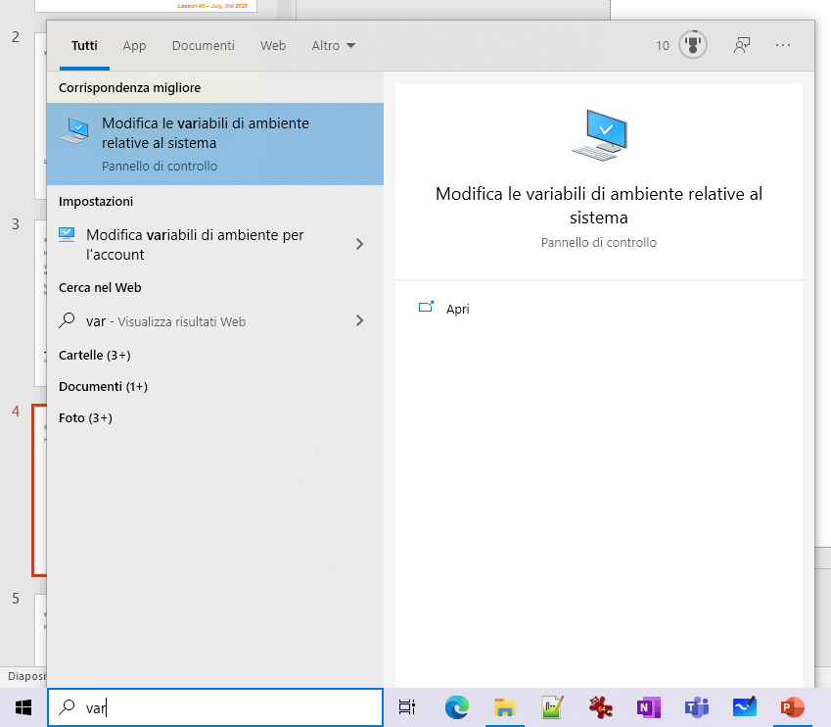
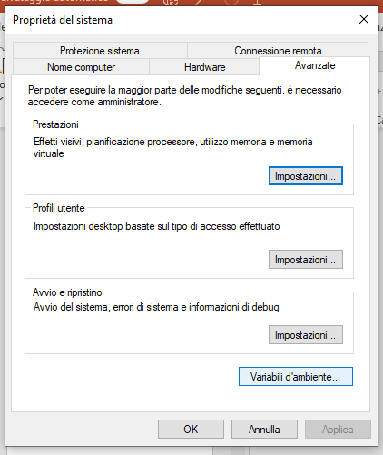
EXTENDING PYTHON WITH FORTRAN/C++
What it is needed?
How to add the folder of MingGW to system path
open the window to change environmental variable through finder of windows
click on "Environmental variables"

Slide 7
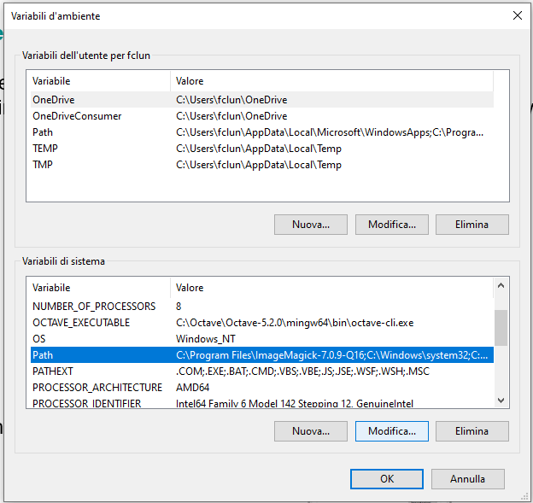
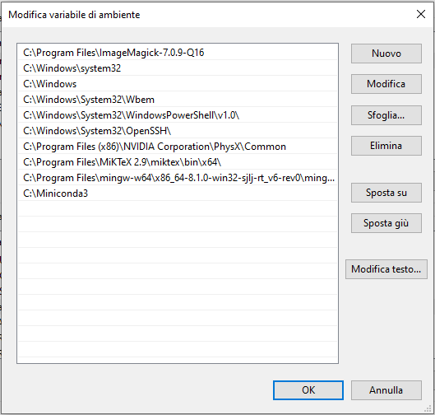
EXTENDING PYTHON WITH FORTRAN/C++
select "Path" in lower pane and click "modify"
click on "new"

Slide 8
EXTENDING PYTHON WITH FORTRAN/C++
select "Path" in lower pane and click "modify"
click on "new" and add the path to the folder "bin" of the folder where MinGW-64 has been installed
...which in my case was (select and copy from the address field)

Slide 9
EXTENDING PYTHON WITH FORTRAN/C++
What it is needed?
It is worth testing if everything work well testing a simple Fortran program
prova.f90
Program prova
Implicit none
integer(kind=4) :: n, i, j
real(kind=8) :: s
print*,"immetti n"
read (*,*) n
s = 0.
do i=0,n-1
do j=0,n-1
s = s + sin(dble(i)*dble(j))
end do
enddo
write(*,"('s = ',f20.3)") s
end program prova
$ gfortran -o prova prova.f90
Per eseguire
$ ./prova

Slide 10
EXTENDING PYTHON WITH FORTRAN
How it works?
Basically, all the job is performed by f2py
From the official web site
The purpose of the F2PY –Fortran to Python interface generator– is to provide a connection between Python and Fortran languages. F2PY is a part of NumPy (numpy.f2py) and also available as a standalone command line tool f2py when numpy is installed that facilitates creating/building Python C/API extension modules that make it possible
to call Fortran 77/90/95 external subroutines and Fortran 90/95 module subroutines as well as C functions;
to access Fortran 77 COMMON blocks and Fortran 90/95 module data, including allocatable arrays from Python.
For a very basic introduction to Fortran 90
"Beginner Fortran 90 tutorial"

Slide 11
EXTENDING PYTHON WITH FORTRAN
How it works?
The most convenient way is to change the source code introducing comments specific to f2py
test_f.f90
! test_f.f90
subroutine moltiplica( a, b, c, m, n )
integer(kind=4) :: m, n
real(kind=8),intent(in) :: a(m,n), b(m,n)
real(kind=8),intent(out) :: c(m, n)
real(kind=8), parameter :: r = 1.
integer(kind=4) :: i,j
do j=1,n
do i=1,m
c(i,j) = a(i,j) * b(i,j) * raddoppia(r)
end do
end do
contains
function raddoppia(x)
real(kind=8) :: raddoppia
real(kind=8), intent(in):: x
raddoppia = 2*x
end function raddoppia
end subroutine moltiplica
$ python -m numpy.f2py -c -m test_f test_f.f90

Slide 12
EXTENDING PYTHON WITH FORTRAN
How it works?
The subroutine defined in the source can be used as function of the module
It is interesting have a look at the documentation
import numpy as np
import test_f
a = np.array([[1.,2],[3,4]])
b=a*2.
test_f.moltiplica(a,b)
array([[ 2., 8.],
[18., 32.]])
>>>
>>>
>>>
>>>
>>>
print(test_f.moltiplica.__doc__)
c = moltiplica(a,b,[m,n])
Wrapper for ``moltiplica``.
Parameters
----------
a : input rank-2 array('d') with bounds (m,n)
b : input rank-2 array('d') with bounds (m,n)
Other Parameters
----------------
m : input int, optional
Default: shape(a,0)
n : input int, optional
Default: shape(a,1)
Returns
-------
c : rank-2 array('d') with bounds (m,n)
>>>
Notes:
Please note that we are passing numpy array as arguments!

Slide 13
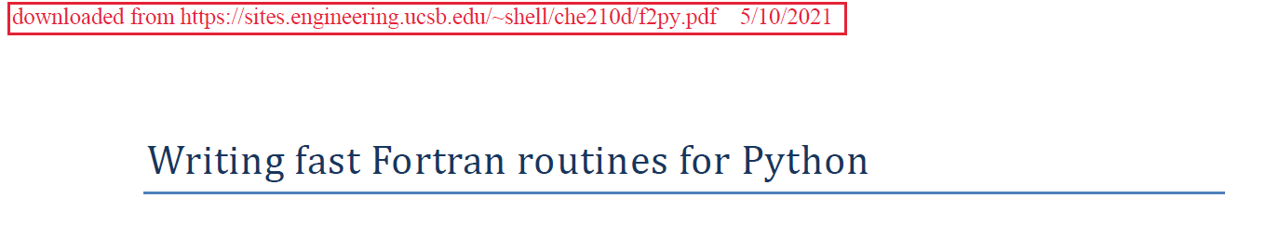
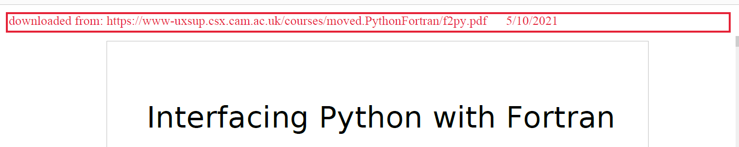
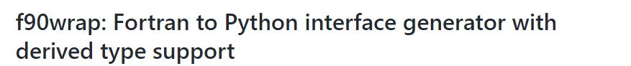
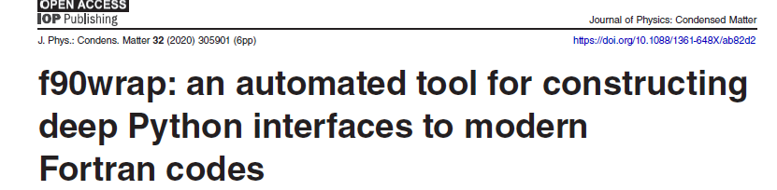
EXTENDING PYTHON WITH FORTRAN
Some more information
File f2py.pdf
File f2py(1).pdf
https://github.com/jameskermode/f90wrap
Paper: f90wrap_paper.pdf
Notes:
Please note that we are passing numpy array as arguments!

Slide 14
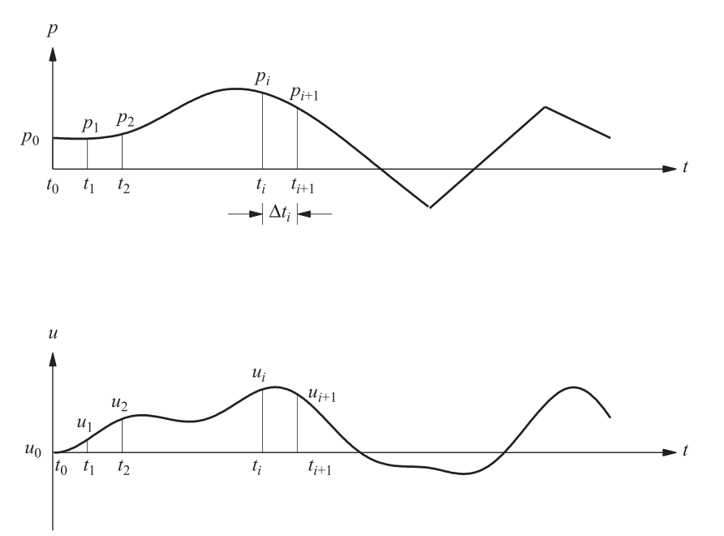
EXTENDING PYTHON WITH FORTRAN
Performance enhancement
How fast can be the code?
Notes:
See A.K. Chopra, "Dynamics of structures – Theory and Applications to Earthquake Engineering (4th Ed.)", Prentice Hall, Upper Saddle River, NJ – US (2012), Ch. 5.4

Slide 15
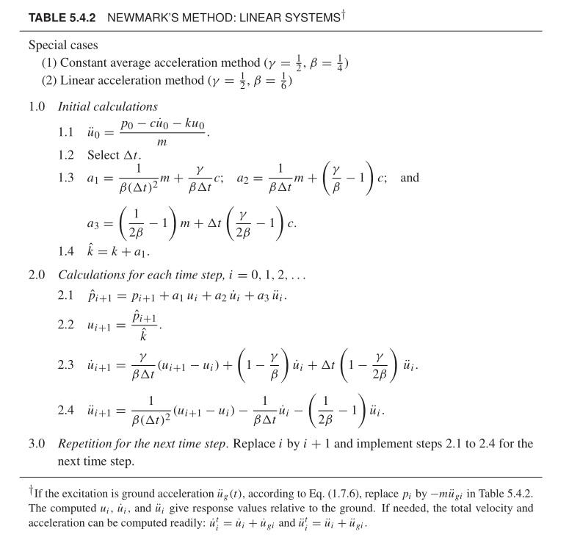
EXTENDING PYTHON WITH FORTRAN
Performance enhancement
How fast can be the code?
Notes:
See A.K. Chopra, "Dynamics of structures – Theory and Applications to Earthquake Engineering (4th Ed.)", Prentice Hall, Upper Saddle River, NJ – US (2012), Ch. 5.4

Slide 16
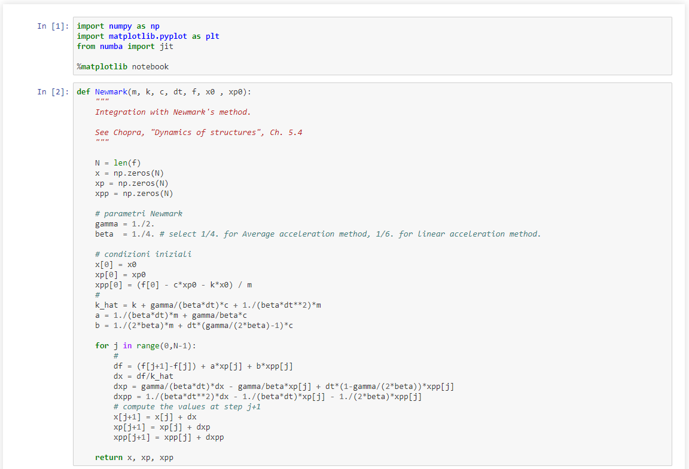
EXTENDING PYTHON WITH FORTRAN
Performance enhancement
How fast can be the code?
Notes:
Please note that we are passing numpy array as arguments!

Slide 17
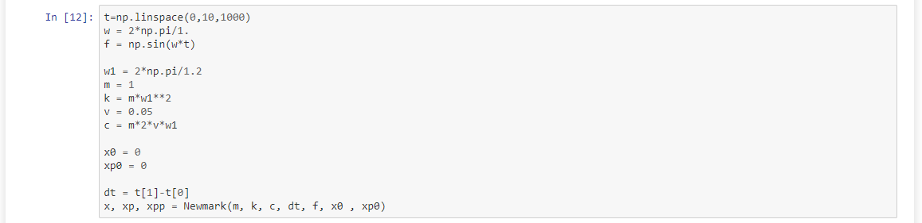
EXTENDING PYTHON WITH FORTRAN
Performance enhancement
How fast can be the code?
Notes:
Please note that we are passing numpy array as arguments!

Slide 18
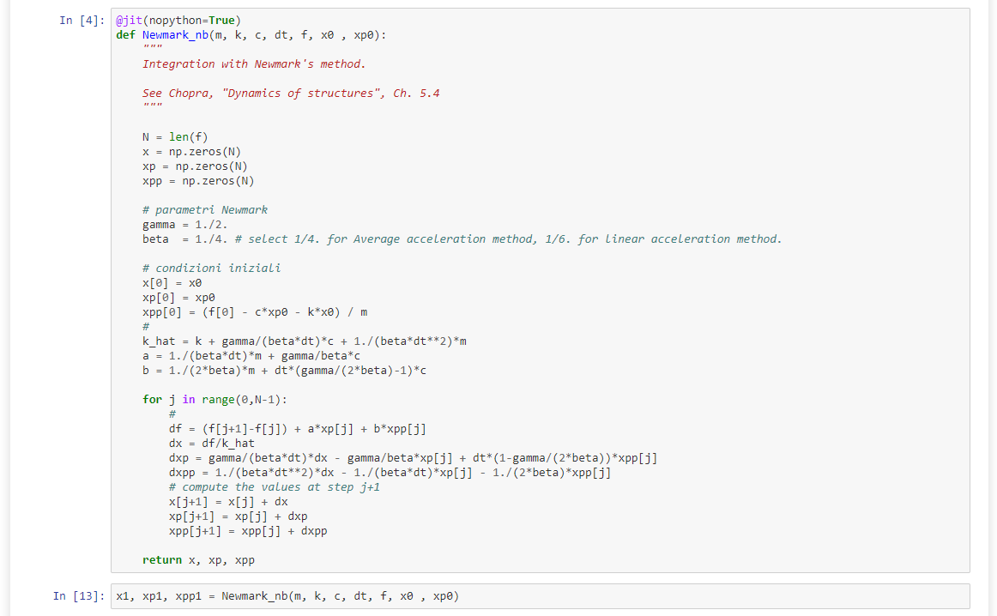
EXTENDING PYTHON WITH FORTRAN
Performance enhancement
How fast can be the code?
Notes:
Please note that we are passing numpy array as arguments!

Slide 19
EXTENDING PYTHON WITH FORTRAN
Performance enhancement
How fast can be the code?
newmark.f90
! newmark.f90
subroutine newmark( m, k, c, dt, f, x0 , xp0, n, x, xp, xpp)
Implicit none
integer(kind=4) :: i, n
real(kind=8) :: m, k, c
real(kind=8) :: dt, x0, xp0
real(kind=8) :: f(n)
real(kind=8) :: x(n), xp(n), xpp(n), dxx(n)
real(kind=8) :: gamma, beta, khat, a, b
real(kind=8) :: df, dx, dxp, dxpp
!f2py intent(in) m, k, c
!f2py intent(in) dt, f, xo, xp0
!f2py intent(out) x, xp, xpp
gamma = 1./2.
beta = 1./4.
x(1) = x0
xp(1) = xp0
xpp(1) = (f(1)-c*xp0-k*x0)/m
!continua slide successiva
Notes:
Please note that we are passing numpy array as arguments!

Slide 20
EXTENDING PYTHON WITH FORTRAN
Performance enhancement
How fast can be the code?
newmark.f90
! continua da slide precedente
khat = k + gamma/(beta*dt)*c + 1./(beta*dt**2)*m
a = 1./(beta*dt)*m + gamma/beta*c
b = 1./(2.*beta)*m + dt*(gamma/(2.*beta)-1.)*c
do i=1,n-1
df = (f(i+1)-f(i))+a*xp(i)+b*xpp(i)
dx = df/khat
dxp = gamma/(beta*dt)*dx - gamma/beta*xp(i) + dt*(1.-gamma/(2.*beta))*xpp(i)
dxpp = 1./(beta*dt**2)*dx - 1./(beta*dt)*xp(i) - 1./(2.*beta)*xpp(i)
x(i+1) = x(i)+dx
xp(i+1) = xp(i)+dxp
xpp(i+1) = xpp(i)+dxpp
end do
end subroutine
$ python -m numpy.f2py --compiler=mingw32 --fcompiler=gfortran -c -m newmark newmark.f90
Notes:
See here on how to use:
F2PY Users Guide and Reference Manual — NumPy v1.21 Manual
F2PY - Calling Fortran routines from Python (numfys.net)

Slide 21
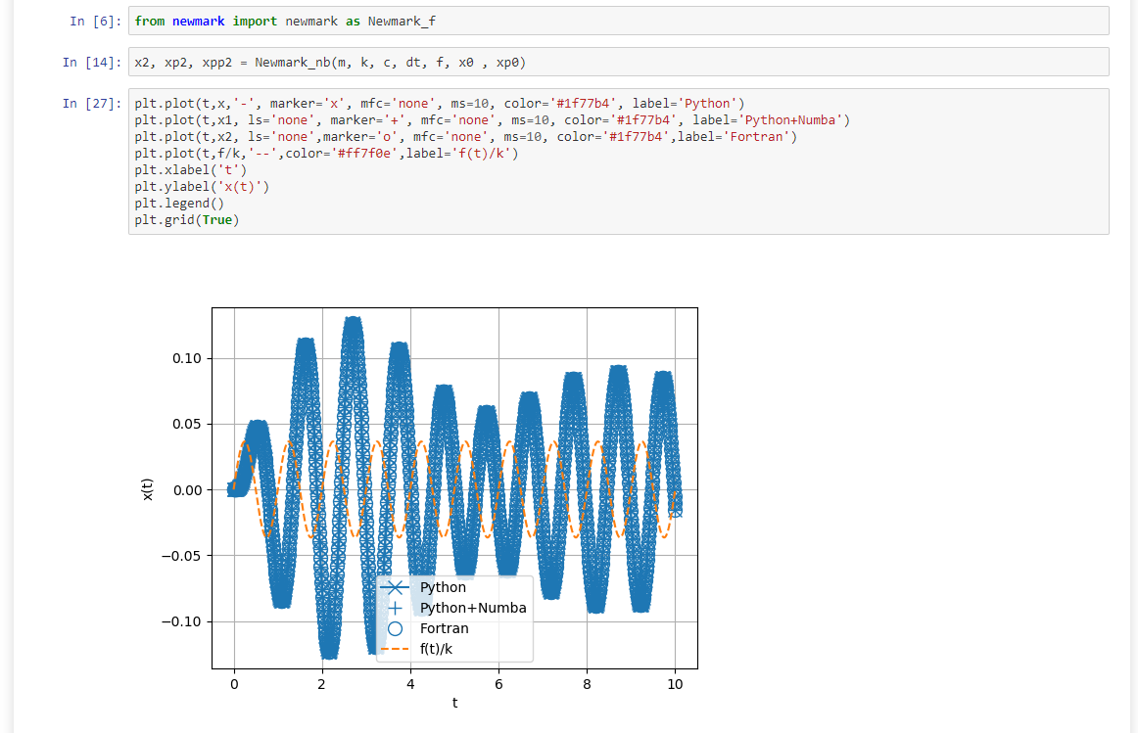
EXTENDING PYTHON WITH FORTRAN
Performance enhancement
How fast can be the code?
Notes:
Please note that we are passing numpy array as arguments!

Slide 22
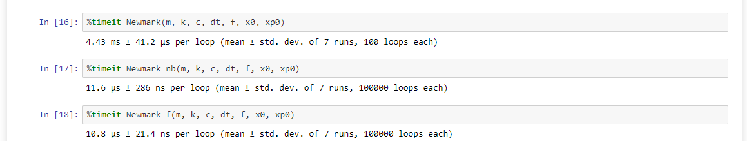
EXTENDING PYTHON WITH FORTRAN
Performance enhancement
How fast can be the code?
Notes:
Please note that we are passing numpy array as arguments!

Slide 23
EXTENDING PYTHON WITH C/C++
How does it work?
From the official web site of ctypes
ctypes is a foreign function library for Python. It provides C compatible data types, and allows calling functions in DLLs or shared libraries. It can be used to wrap these libraries in pure Python.
There is more work to do than with f2py.

Slide 24
EXTENDING PYTHON WITH C/C++
How it works?
Suppose the function is in the source file
The source is compiled to create a shared library
test_c.c
/* test_c.c */
double somma(int M, int N, double a[M][N], double b[M][N]) {
int i, j;
double s = 0.;
for (i=0; i<M; i++){
for (j=0;j<N;j++){
s = s + a[i][j] * b[i][j];
}
}
return s;
}
$ gcc -shared -o –fPIC libtest_c.so test_c.c

Slide 25
EXTENDING PYTHON WITH C/C++
How it works?
Then, a wrapper is created in Python using ctypes
wrap_c.py
import ctypes
_libc = ctypes.CDLL('./libtest_c.so')
c_double_p = ctypes.POINTER(ctypes.c_double)
_libc.somma.argtypes = [ ctypes.c_int, ctypes.c_int, c_double_p, c_double_p]
_libc.somma.restype = ctypes.c_double
def somma(a, b):
a.dtype = ctypes.c_double
b.dtype = ctypes.c_double
M, N = a.shape
s = _libc.somma( ctypes.c_int(M), ctypes.c_int(N),
a.ctypes.data_as(c_double_p),
b.ctypes.data_as(c_double_p))
return s

Slide 26
EXTENDING PYTHON WITH C/C++
How it works?
The subroutine defined in the source can be used as function of the module
import wrap_c
import numpy as np
a = np.random.rand(2,2)
b = np.random.rand(2,2)
wrap_c.somma(a,b)
>>>
>>>
>>>
>>>
>>>
Notes:
Please note that we are passing numpy array as arguments!

Slide 27
EXTENDING PYTHON WITH C/C++
How it works?
A subroutine style can also be used
The source is compiled to create a shared library
test_c2.c
/* test_c2.c */
void somma(int M, int N, double a[M][N], double b[M][N], double c[M][N]) {
int i, j;
for (i=0; i<M; i++){
for (j=0;j<N;j++){
c[i][j] = a[i][j] + b[i][j];
}
}
}
$ gcc -shared –fPIC -o libtest_c2.so test_c2.c

Slide 28
EXTENDING PYTHON WITH C/C++
How it works?
Then, a wrapper is created in Python using ctypes
Import numpy after use of ctypes.CDLL to avoid error?!
wrap_c2.py
import ctypes
_libc = ctypes.CDLL('./libtest_c2.so')
c_double_p = ctypes.POINTER(ctypes.c_double)
_libc.somma.argtypes = [ ctypes.c_int, ctypes.c_int, c_double_p, c_double_p, c_double_p]
from numpy import zeros
def somma(a, b):
a.dtype = ctypes.c_double
b.dtype = ctypes.c_double
M, N = a.shape
c = zeros(a.shape)
c.dtype = ctypes.c_double
_libc.somma( ctypes.c_int(M), ctypes.c_int(N),
a.ctypes.data_as(c_double_p),
b.ctypes.data_as(c_double_p),
c.ctypes.data_as(c_double_p))
return c

Slide 29
EXTENDING PYTHON WITH C/C++
How it works?
The subroutine defined in the source can be used as function of the module
import wrap_c2
import numpy as np
a = np.random.rand(2,2)
b = np.random.rand(2,2)
wrap_c2.somma(a,b)
>>>
>>>
>>>
>>>
>>>
Notes:
Please note that we are passing numpy array as arguments!

Slide 30
EXTENDING PYTHON WITH FORTRAN (AGAIN)
The same approach used with C can be used with fortran (using ctypes).
The source is compiled to create a shared library
test_f2.f90
subroutine risolvi(A,b,c,n) bind(c, name='risolvi')
! declarations
use iso_c_binding, only: c_double, c_int
integer(c_int), intent(in) :: n
real(c_double), dimension(n,n), intent(in) :: A
real(c_double), dimension(n), intent(in) :: b
real(c_double), dimension(n), intent(out) :: c
integer(c_int) :: pivot(n), ok
real(c_double), dimension(n,n) :: AA
! call LAPACK subroutine
c=b
AA = A
call DGESV(n, 1, AA, n, pivot, c, n, ok)
end subroutine risolvi
$ gfortran -O3 -funroll-loops -ffast-math -shared -fPIC -o libtest_f2.so test_f2.f90 -lflexiblas

Slide 31
EXTENDING PYTHON WITH FORTRAN (AGAIN)
Then, a wrapper is created in Python using ctypes
wrap_f2.py
from ctypes import CDLL, POINTER, c_int, c_double
import numpy as np
fortran = CDLL('./libwrap_f2.so')
fortran.risolvi.argtypes = [ POINTER(c_double),
POINTER(c_double),
POINTER(c_double),
POINTER(c_int) ]
def risolvi(A, b):
N = len(b)
c = np.zeros(N)
A = np.asfortranarray(A, dtype=c_double)
b = np.asfortranarray(b, dtype=c_double)
c = np.asfortranarray(c, dtype=c_double)
# call Fortran subroutine
fortran.risolvi( A.ctypes.data_as(POINTER(c_double)),
b.ctypes.data_as(POINTER(c_double)),
c.ctypes.data_as(POINTER(c_double)),
c_int(N) )
return c

Slide 32
EXTENDING PYTHON WITH C/C++
How it works?
The subroutine defined in the source can be used as function of the module
from wrap_f2 import risolvi
import numpy as np
from scipy.linalg import solve
import time
N = 100
A = np.random.rand(N,N)
b = np.random.rand(N)
c = np.zeros(N)
# Fortran call
start = time.time()
c_f = risolvi(A, b)
stop = time.time()
print('Fortran solution took ',stop - start,'seconds')
# Numpy
start = time.time()
c_py = solve(A,b)
stop = time.time()
print('Numpy solution took ',stop - start,'seconds')
# compare results
print(np.max(np.abs(c_f-c_py)))
>>>
>>>
>>>
>>>
>>>
>>>
>>>
>>>
>>>
>>>
>>>
>>>
>>>
>>>
>>>
>>>
>>>
>>>
>>>
>>>
>>>
Notes:
Please note that we are passing numpy array as arguments!

Slide 33
SUBPROCESS
Interaction with the shell
It is possible to "interact" with the shell by mean of subprocess module
It is also possible to execute shell commands
import subprocess
esegui=subprocess.run('./prova', capture_output=True, input='10', text=True)
if esegui.returncode==0: print(esegui.stdout)
>>>
>>>
...
>>>
import subprocess
esegui=subprocess.run('ls', shell=True)
>>>
>>>
Notes:
Please note that we are passing numpy array as arguments!

Slide 34

EXCEL & Python: xlwings
It is possible to interact (real time) with Excel
To install
$ pip install xlwings

Slide 35
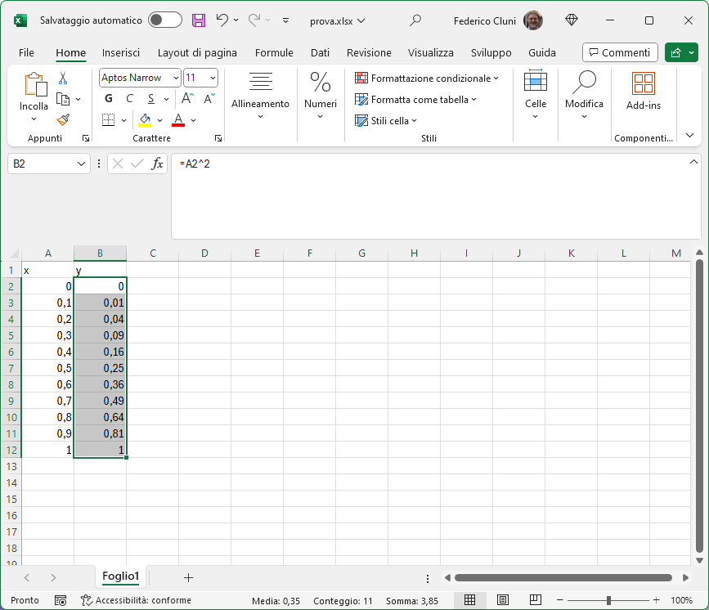
EXCEL & Python: xlwings
Interacting with an Excel file
Data on Excel, elaboration with Python from outside

Slide 36
EXCEL & Python: xlwings
Interacting with an Excel file
Data on Excel, elaboration with Python from outside
import xlwings as xw
import matplotlib.pyplot as plt
from functools import reduce
wb = xw.Book('prova.xlsx')
sht = wb.sheets['Foglio1']
x = sht.range('A2:A12').value
y = sht.range('B2:B12').value
fig = plt.figure()
plt.plot(x,y)
sht.pictures.add(fig,left=100,top=100,name='Grafico',update=True)
y_mean = reduce(lambda x,y: x+y, y) / len(y)
sht.range('B13').value = y_mean

Slide 37
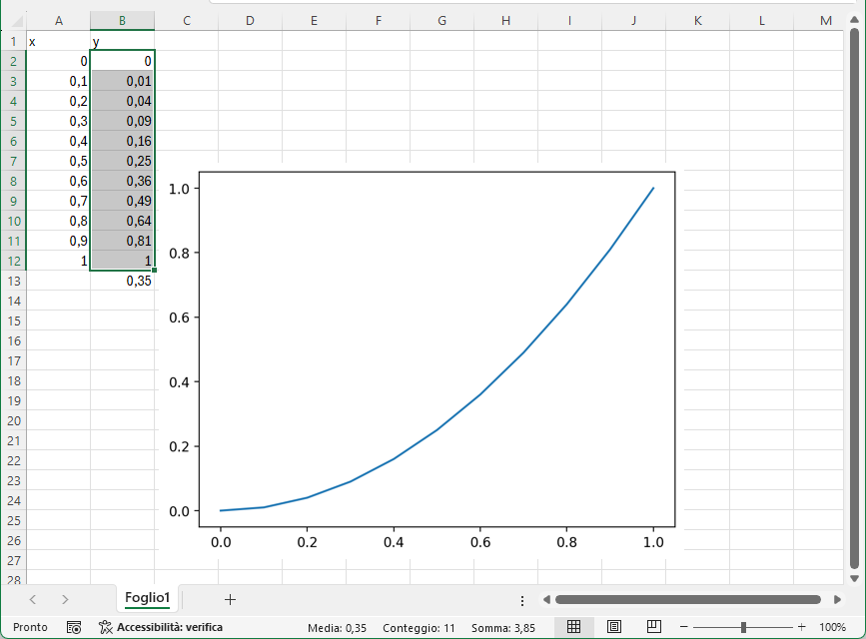
EXCEL & Python: xlwings
Interacting with an Excel file
Data on Excel, elaboration with Python from outside

Slide 38
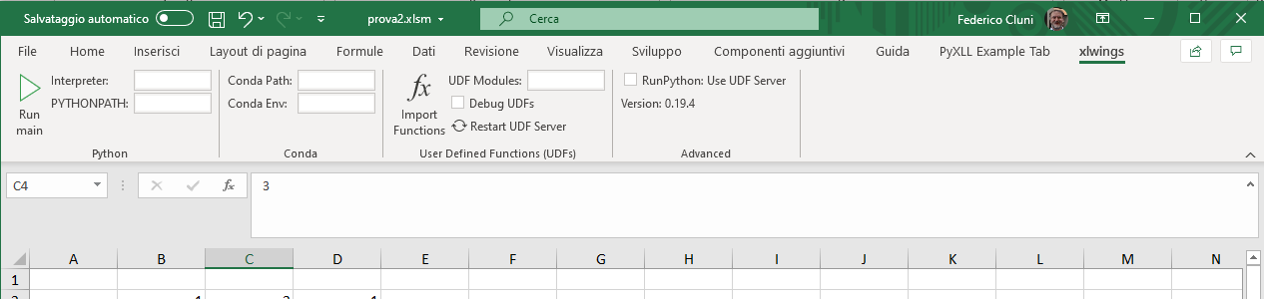
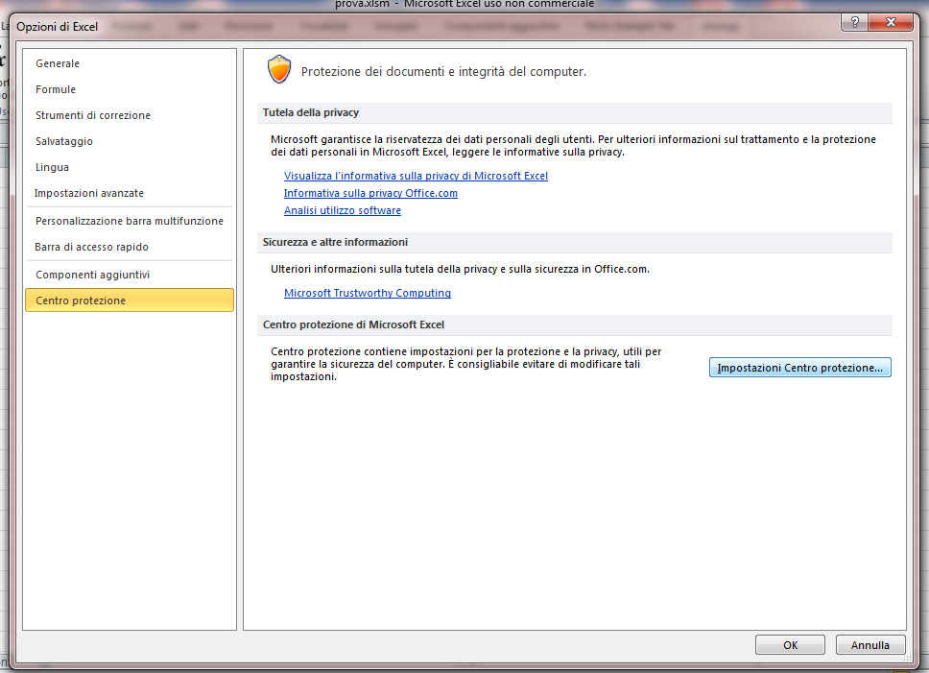
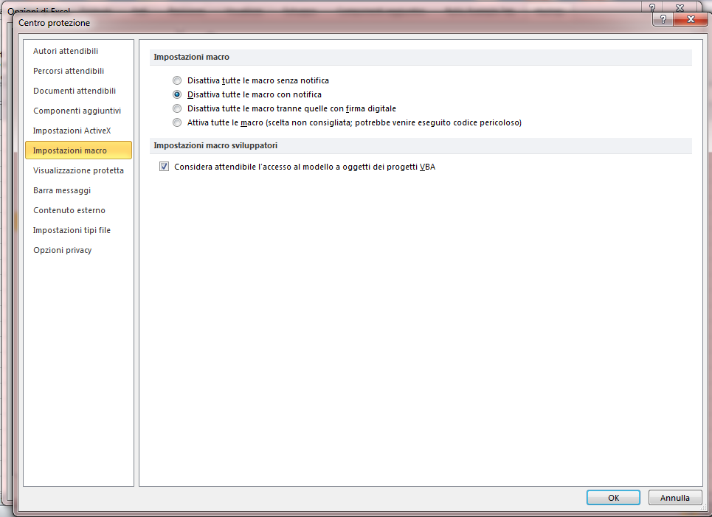
EXCEL & Python: xlwings
Interacting with an Excel file
It is possible to install the add-in which allows us to define Python function in Excel
$ xlwings addin install
Only the first time!

Slide 39
EXCEL & Python: xlwings
To create a file with support for xlwings
xlwings quickstart NomeFile
The file NomeFile.xlsx is the Excel file (macro have to be enabled).
The file NomeFile.py is where the functions can be defined
@xw.func
def test(x,y):
""" funzione di prova """
return 2*(x+y)

Slide 40
EXCEL & Python: xlwings
...or more interestengly, since numpy array are supported...
import xlwings as xw
import numpy as np
import numpy.linalg as la
...
@xw.func
@xw.arg('x', np.array, ndim=2)
def eig(x):
w, v = la.eig(x)
w = w.reshape((1,len(w)))
return np.concatenate((v,w),axis=0)

Slide 41
EXCEL & Python: xlwings
...the DataFrame/Series of Pandas are also supported!
import xlwings as xw
import pandas as pd
...
@xw.func
@xw.arg('A', pd.DataFrame, index=False, header=False)
@xw.ret(index=False, header=False)
def describe(A):
return A.describe()
and it is possible to add figures with Matplotlib
import matplotlib.pyplot as plt
...
@xw.func
@xw.arg('x', np.array, ndim=1)
def funzione(x, n, name='Figura'):
sht = xw.Book.caller().sheets.active
fig = plt.figure()
plt.plot(x,x**n)
sht.pictures.add(fig,name=name, update=True, left=sht.range('c3').left, top=sht.range('c3').top)
return 'Grafico per n={}'.format(n)

