Slide 1

UNIVERSITÀ DEGLI STUDI DI PERUGIA
International Doctoral Program in
Civil and Environmental Engineering
PYTHON FOR NUMERICAL COMPUTING AND DEVELOPMENT OF SCIENTIFIC APPLICATION
Prof. Federico Cluni
A. Y. 2023/24
Lesson #9 – April 19th, 2024

Slide 2
USER INTERFACES
Command Line Interface (CLI)
Text based interfaces with a command prompt
Users types in instructions at the command prompt using keyboard
The OS responds to the instructions keyed in
When the instruction has been processed the command prompt would be ready for the next instruction
A high level of knowledge is required to remember and constructs the instructions.
Notes:
tratto da https://www.slideserve.com/lindley/mr-c-johnston-ict-teacher-computechedu-co-uk

Slide 3
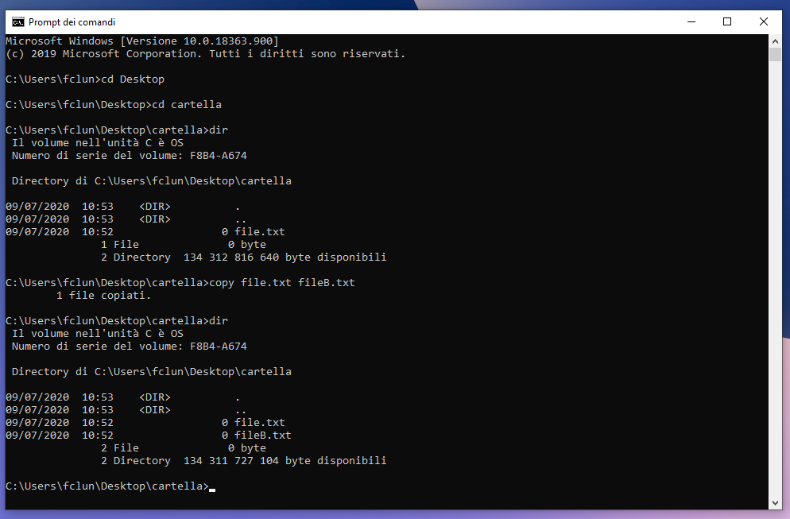
USER INTERFACES
Command Line Interface (CLI)
Notes:
tratto da https://www.slideserve.com/lindley/mr-c-johnston-ict-teacher-computechedu-co-uk

Slide 4
USER INTERFACES
Graphical User Interface (GUI)
Graphical based interface made up of WIMPs – Windows, Icons, Menus and Pointers
User enter instructions by clicking on an option in a menu, pressing a button or completing entry on a form
The interfaces is far more user-friendly and open the use of computers to people who had not learnt how to program or can't remember a lots of commands.
Notes:
tratto da https://www.slideserve.com/lindley/mr-c-johnston-ict-teacher-computechedu-co-uk

Slide 5
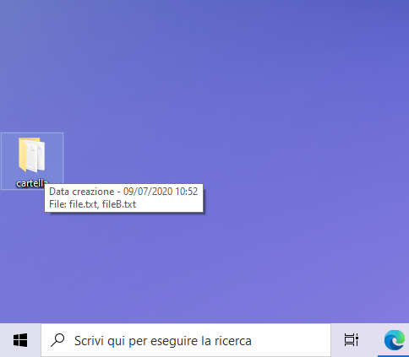
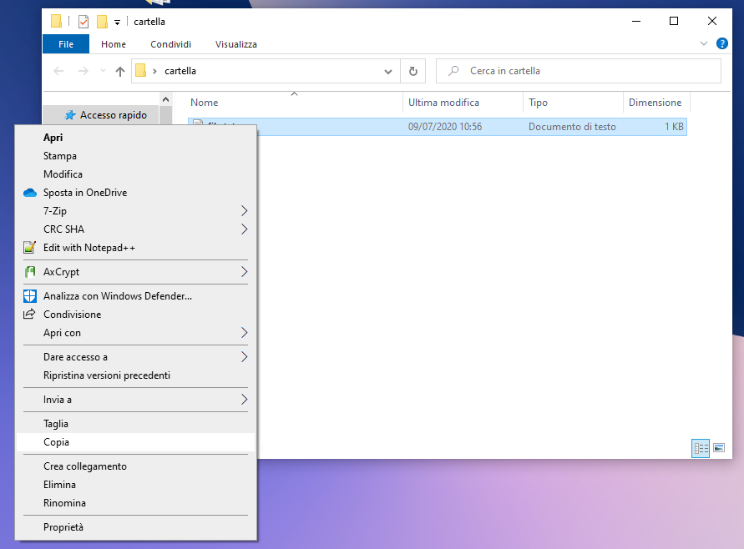
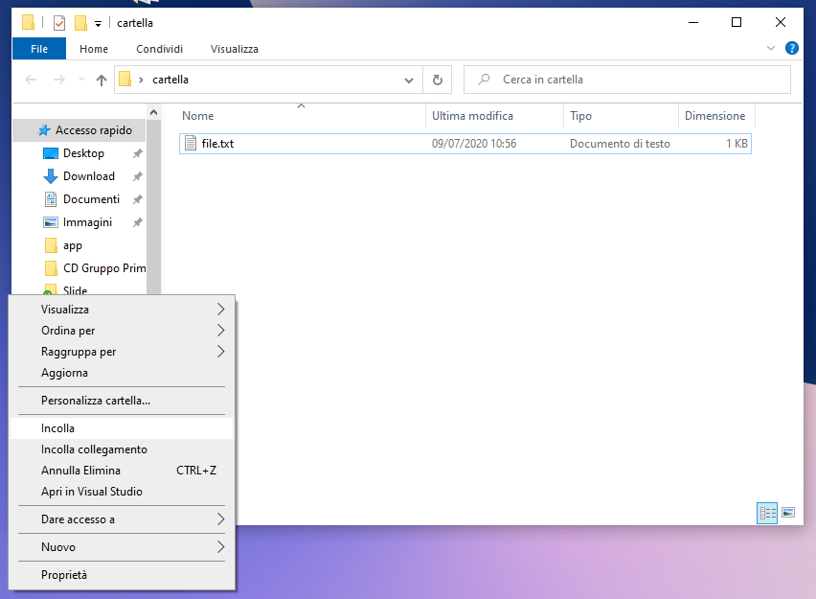
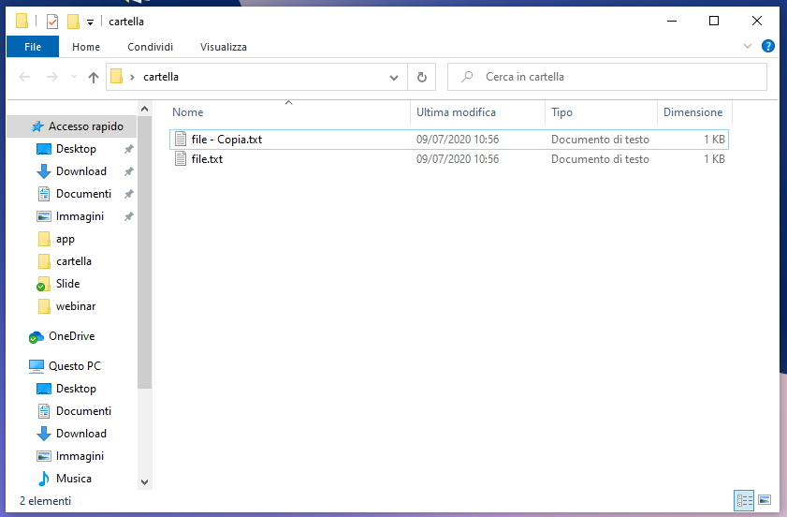
USER INTERFACES
Graphical User Interface (GUI)
Notes:
tratto da https://www.slideserve.com/lindley/mr-c-johnston-ict-teacher-computechedu-co-uk

Slide 6
USER INTERFACES
CLI | GUI
The user has to know the commands or look them up | The commands are much more intuitive
The commands usually have to be entered in full | Command shortcuts are possible such as <Ctrl-Z> C to copy
The user has to learn the commands and more training is neede | Less learning and training by the user is required
The interface can be daunting, more difficult to use and the user is more likely to make mistakes | The GUI is more user-friendly
There are no graphics | Graphics are used to represent tasks, files, etc-
There are no menus | Menus are used for making choices and selections
The user has complete control | The user choices are restricted to those on the menus
Commands have to be entered accurately with the correct spellings and syntax (rules) | Spelling and typing errors are avoided
No pointing device is used | A pointing device is used to select items and make choices
Notes:
tratto da https://www.slideserve.com/lindley/mr-c-johnston-ict-teacher-computechedu-co-uk

Slide 7
USER INTERFACES
Using a function
We have developed our code to perform some task, in this case evaluate the integral
mod_int.py
def integra(m, b, x1, x2):
"""Procedure to integrate between x1 and x2
the function f(x) = m*x + b
/\ x2
|
| (m x + b) dx
|
\/ x1
input arguments:
m: slope
b: intersection with y-axis
x1: left bound integration range
x2: right bound integration range
"""
I = (m*x2**2/2+b*x2) - (m*x1**2/2+b*x1)
return I

Slide 8
USER INTERFACES
Using a function
we can use it importing the module
and show information on its use
>>> import mod_int
>>> mod_int.integra(1,0,0,1)
0.5
>>> help(mod_int.integra)
Procedure to integrate between x1 and x2
the function f(x) = m*x + b
/\ x2
|
| (m x + b) dx
|
\/ x1
input arguments:
m: slope
b: intersection with y-axis
x1: left bound integration range
x2: right bound integration range

Slide 9
USER INTERFACES
Command line interface (shell level)
We can also have a code that can be run directly from the OS shell and asks the user to input data
cli_i.py
def integra(m, b, x1, x2):
I = (m*x2**2/2+b*x2) - (m*x1**2/2+b*x1)
return I
info = """Procedure to integrate between x1 and x2
the function f(x) = m*x + b
/\ x2
|
| (m x + b) dx
|
\/ x1
"""
def inserisci(var):
v = input("insert %s: "%var)
try:
v = float(v)
except ValueError:
print("Value not valid!")
return inserisci(var)
else:
return v
...
Notes:
Note the use of a recursive function

Slide 10
USER INTERFACES
Command line interface (shell level)
We can also have a code that can be run directly from the OS shell and asks the user to input data
cli_i.py
...
if __name__ == "__main__":
print(info)
m = inserisci("m")
b = inserisci("b")
x1 = inserisci("x1")
x2 = inserisci("x2")
I = integra(m, b, x1, x2)
print("The integral is %f"%I)

Slide 11
USER INTERFACES
Command line interface (shell level)
We can also have a code that can be run directly from the OS shell and asks the user to input data
C:\Users\fclun\Desktop\app>python cli_i.py
Procedure to integrate between x1 and x2
the function f(x) = m*x + b
/\ x2
|
| (m x + b) dx
|
\/ x1
insert m: 1
insert b: a
Value not valid!
insert b: 0
insert x1: 0
insert x2: 1
The integral is 0.500000

Slide 12
USER INTERFACES
Command line interface (shell level)
Alternatively, we can use an approach typical of shell commands and pass the arguments (in the correct order!) when the command is invoked
cli.py
import sys
def integra(m, b, x1, x2):
I = (m*x2**2/2+b*x2) - (m*x1**2/2+b*x1)
return I
info = """Procedure to integrate between x1 and x2
the function f(x) = m*x + b
/\ x2
|
| (m x + b) dx
|
\/ x1
Insert values of m, b, x1 and x2 separated by spaces
"""
...
Notes:
Note the use of a recursive function

Slide 13
USER INTERFACES
Command line interface (shell level)
Alternatively, we can use an approach typical of shell commands and pass the arguments (in the correct order!) when the command is invoked
cli.py
...
if __name__ == "__main__":
if len(sys.argv) == 1:
print(info)
elif len(sys.argv) < 5:
print("Insufficient arguments!")
elif len(sys.argv) > 5:
print("Too much arguments!")
else:
try:
m = float(sys.argv[1])
b = float(sys.argv[2])
x1 = float(sys.argv[3])
x2 = float(sys.argv[4])
except ValueError:
print("Values not valid!")
else:
I = integra(m, b, x1, x2)
print(I)
Notes:
Note the use of a recursive function

Slide 14
USER INTERFACES
Command line interface (shell level)
Alternatively, we can use an approach typical of shell commands and pass the arguments (in the correct order!) when the command is invoked
C:\Users\fclun\Desktop\app>python cli.py
Procedure to integrate between x1 and x2
the function f(x) = m*x + b
/\ x2
|
| (m x + b) dx
|
\/ x1
Insert values of m, b, x1 and x2 separated by spaces
C:\Users\fclun\Desktop\app>python cli.py 1
Insufficient arguments!
C:\Users\fclun\Desktop\app>python cli.py 1 0 0 1
0.5

Slide 15
USER INTERFACES
Graphical User Interface
There are several packages to build GUI in Python.
Among the main ones
Tkinter (its include in Python, it's the "default" one)
PyQt
WxPython
Tkinter is cross-platform, so the same code works on Windows, macOS, and Linux. Visual elements are rendered using native operating system elements, so applications built with Tkinter look like they belong on the platform where they’re run.
It is lightweight and relatively painless to use compared to other frameworks. This makes it a compelling choice for building GUI applications in Python, especially when top priority is to build something that’s functional and cross-platform quickly.
Remark
IDLE is programmed in Tkinter!
Notes:
see also https://opensource.com/resources/python/gui-frameworks
Tutorial Tkinter https://realpython.com/python-gui-tkinter/

Slide 16
Tkinter
Basic concepts
The foundational element of a Tkinter GUI is the window.
Windows are the containers in which all other GUI elements live.
These other GUI elements, such as text boxes, labels, and buttons, are known as widgets.
Widgets are contained inside of windows.
Widget Class | Description
Label | A widget used to display text on the screen
Button | A button that can contain text and can perform an action when clicked
Entry | A text entry widget that allows only a single line of text
Text | A text entry widget that allows multiline text entry
Frame | A rectangular region used to group related widgets or provide padding between widgets
Notes:
see also https://opensource.com/resources/python/gui-frameworks
Tutorial Tkinter https://realpython.com/python-gui-tkinter/
the official documentation https://docs.python.org/3.7/library/tk.html
on the use of widgets https://anzeljg.github.io/rin2/book2/2405/docs/tkinter/ttk-widget-set.html

Slide 17
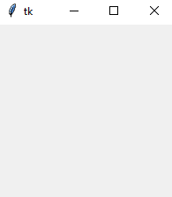
Tkinter
Basic concepts
To create a windows
>>> import tkinter as tk
>>> root = tk.Tk()

Slide 18

Tkinter
Basic concepts
To add a widget (in this case, a text label)
note that
the widget is NOT added to the window until .pack() is invoked!
once .mainloop() is invoked, the prompt disappear from the cli since the window is listening for events, such as button clicks or keypresses
>>> import tkinter as tk
>>> root = tk.Tk()
>>> saluto = tk.Label(text="ciao")
>>> saluto.pack()
>>> root.mainloop()

Slide 19
Tkinter
Basic concepts
A few tips:
enclose the code lines that manage the app in a class
it is better to include the widgets in a frame, since they can be managed easily
at first, design the layout of the app, for example thinking that the widgets are laid in a grid
remember the hierarchy of objects: base window ← frames ← ... ← widgets
in recent version the widgets have a basic version and one that match that of the OS gui, denoted "themed". To import them
import tkinter as tk
import tkinter.ttk as ttk

Slide 20
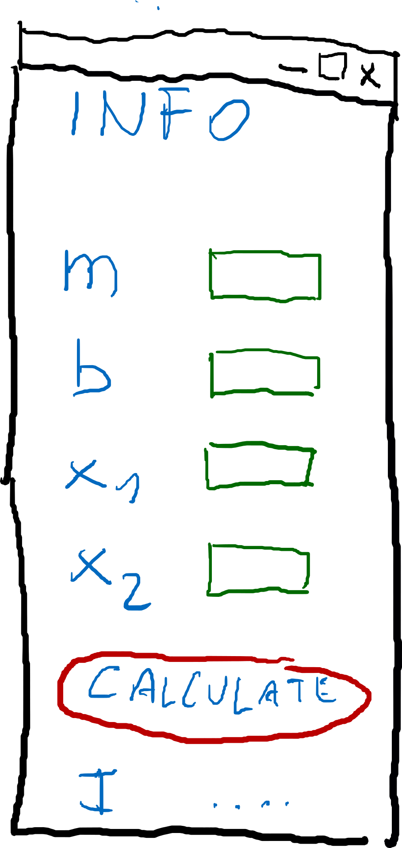
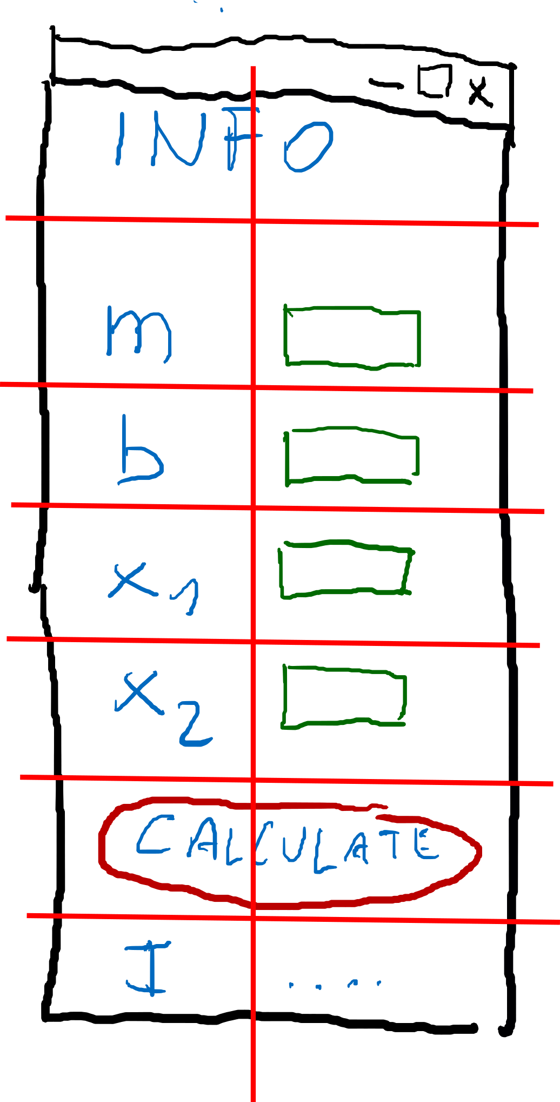
Tkinter
An example
Develop an app for our function, widget are placed inside a grid

Slide 21
Tkinter
An example
Develop an app for our function
gui_basic.py
import tkinter as tk
import tkinter.ttk as ttk
from modulo import integra
class App(ttk.Frame):
def __init__(self, master=None):
super().__init__(master)
self.master = master
self.m = tk.StringVar()
self.b = tk.StringVar()
self.x1 = tk.StringVar()
self.x2 = tk.StringVar()
self.I = tk.StringVar()
self.create_gui()
self.grid(column=0, row=0)

Slide 22
Tkinter
An example
Develop an app for our function
gui_basic.py
def create_gui(self):
Fr_com = ttk.Frame(self)
ttk.Label(Fr_com, text="Calcola l'integrale tra x\u2081 e x\u2082 della funzione\nf(x) = m x + b").grid(row=0, column=0, columnspan=2)
ttk.Label(Fr_com, text="m", width=10, anchor=tk.W).grid(row=1, column=0)
ttk.Entry(Fr_com, textvariable = self.m).grid(row=1, column=1)
ttk.Label(Fr_com, text="b", width=10, anchor=tk.W).grid(row=2, column=0)
ttk.Entry(Fr_com, textvariable = self.b).grid(row=2, column=1)
ttk.Label(Fr_com, text="x\u2081", width=10, anchor=tk.W).grid(row=3, column=0)
ttk.Entry(Fr_com, textvariable = self.x1).grid(row=3, column=1)
ttk.Label(Fr_com, text="x\u2082", width=10, anchor=tk.W).grid(row=4, column=0)
ttk.Entry(Fr_com, textvariable = self.x2).grid(row=4, column=1)
ttk.Button(Fr_com,text="Calcola", command=self.calcola).grid(row=5, column=0, columnspan=2)
ttk.Label(Fr_com, text="Integrale", width=10, anchor=tk.W).grid(row=6, column=0)
ttk.Label(Fr_com, textvariable=self.I).grid(row=6, column=1)
Fr_com.grid(row=0, column=0, sticky=tk.N)
Notes:
the layout is created in a method

Slide 23
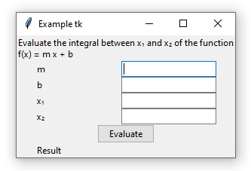
Tkinter
An example
Develop an app for our function
gui_basic.py
def calcola(self,*args):
m = float(self.m.get())
b = float(self.b.get())
x1 = float(self.x1.get())
x2 = float(self.x2.get())
I = integra(m, b, x1, x2)
self.I.set(str(I))
root = tk.Tk()
root.title("Esempio tk")
app = App(master=root)
root.mainloop()
Notes:
note that the method "calcola" si an interface to the function "integra" defined in module "mod_int"

Slide 24
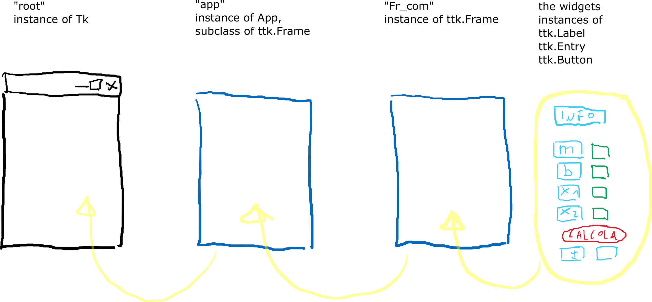
Tkinter
An example
The hierarchy of the Tkinter application

Slide 25
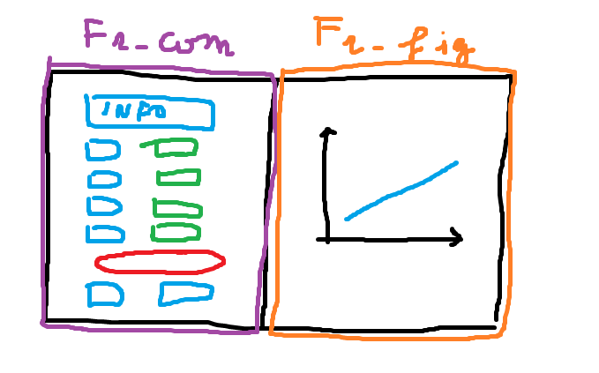
Tkinter
An example
It is possible to add a figure
Notes:
the layout is created in a method

Slide 26
Tkinter
An example
It is possible to add a figure
gui_basic.py
import tkinter as tk
import tkinter.ttk as ttk
from tkinter import messagebox
from matplotlib.backends.backend_tkagg import FigureCanvasTkAgg, NavigationToolbar2Tk
from matplotlib.figure import Figure
import numpy as np
from mod_int import integra
class App(ttk.Frame):
def __init__(self, master=None):
[...]
def create_var(self):
[...]
def create_widgets(self):
[...]
def disegna(self, frame):
[...]
def calcola(self,*args):
[...]
root = tk.Tk()
root.title("Example tk")
app = App(master=root)
root.mainloop()
Notes:
the layout is created in a method

Slide 27
Tkinter
An example
It is possible to add a figure
gui_basic.py
def create_widgets(self):
Fr_com = ttk.Frame(self)
[...]
Fr_com.grid(row=0, column=0, sticky=tk.N)
# ---------------------------------------------------------------------------
Fr_fig = ttk.Frame(self)
self.disegna(Fr_fig)
Fr_fig.grid(row=0, column=1)
# ---------------------------------------------------------------------------
self.master.bind('<Return>', self.calcola)
def disegna(self, frame):
fig = Figure(figsize=(5,4))
ax = fig.add_subplot(111)
m = float(self.m.get()); b = float(self.b.get())
x1 = float(self.x1.get()); x2 = float(self.x2.get())
x = np.linspace(x1,x2,100); y = m*x+b
self.line, = ax.plot(x,y)
ax.set_xlabel("$x$"); ax.set_ylabel("$m\cdot x + b$"); ax.grid(True)
self.canvas = FigureCanvasTkAgg(fig,master=frame); self.canvas.draw()
self.canvas.get_tk_widget().pack(side='top', fill='both', expand=1)
toolbar = NavigationToolbar2Tk(self.canvas, frame); toolbar.update()
self.canvas.get_tk_widget().pack(side='top', fill='both', expand=1)
Notes:
the layout is created in a method

Slide 28
Tkinter
An example
It is possible to add validation to input data
gui_basic.py
def checkfloat(self, input_text):
#if not input_text:
# return True
try:
float(input_text)
return True
except ValueError:
return False
[...]
def create_widgets(self):
Fr_com = ttk.Frame(self)
[...]
check_cmd = self.register(self.checkfloat)
ttk.Label(Fr_com, text="m", width=10, anchor=tk.W).grid(row=1, column=0)
ttk.Entry(Fr_com, textvariable = self.m, validate='key', validatecommand=(check_cmd, '%P')).grid(row=1, column=1)
[...]
self.master.bind('<Return>', self.calcola)
Notes:
the layout is created in a method

