Slide 1

UNIVERSITÀ DEGLI STUDI DI PERUGIA
International Doctoral Program in
Civil and Environmental Engineering
PYTHON FOR NUMERICAL COMPUTING AND DEVELOPMENT OF SCIENTIFIC APPLICATION
Prof. Federico Cluni
A. Y. 2023/24
Lesson #2 – March 1st, 2024

Slide 2
Functions
Functions are defined with def:
def raddoppia(x):
"""Double a number.
raddoppia(x)
Function to double the value of a number x.
"""
y = 2*x
return y
The information on the function can be seen with
print(raddoppia.__doc__)

Slide 3
Functions
Several arguments and/or results can be used:
def sommadifferenza(x,y):
"""
sommadifferenza(x,y)
Gives the sum and the difference of numbers x and y.
"""
somma = x + y
differenza = x - y
return somma, differenza

Slide 4
Functions
Default values can be assigned to any of the arguments:
def multiplo(x, N = 2):
"""Multiply a number.
multiplo(x[, N])
Function that, given x, gives Nx.
Default value of N is 2.
"""
y = N*x
return y
Remark
The value of the arguments can be assigned explicitly.
multiplo(3.2, 5)
multiplo(3.2, N = 5)
multiplo( x = 3.2, N = 5)
multiplo( x = 3.2, 5)
NO!

Slide 5
Functions
Advanced mode of argument passing
If the number of arguments is not known in advance:
- the arguments can be grouped in a tuple
def raddoppialista(*lista):
"""Double all the items of a list.
raddoppialista(*lista)
Function to double all the items of a list.
"""
y = []
for x in lista:
y.append( 2*x)
return y
Example of use
raddoppialista(1,'a',2)

Slide 6
Functions
Advanced mode of argument passing
If the number of arguments is not known in advance:
- the arguments can be grouped in a dictionary
def pubblicazioni(**lista):
"""Research unit publication.
pubblicazioni(**lista)
Function to print the number of pubblications
of each author and return the sum of the pubblications.
"""
N = 0
for autore, numero in lista.items():
print(autore, "has published ", numero, "papers")
N += numero
return N
Example of use
pubblicazioni(Mickey=9, Donald=11, Goofy = 3)

Slide 7
Functions
Advanced mode of argument passing
If some of the number of arguments are known in advance and some others not:
def funzione(argomenti, *lista1, **lista2):

Slide 8
Functions
Several functions can be defined in the same file, defined module. To import all the functions:
from modulename import *
To import some of the functions
from modulename import funcname1, funcname2
To import some of the functions changing their name
from modulename import funcname as newname
To import all the function in a separate namespace (than the global one):
import modulename
import modulename as newmodulename
and to use a specific function:
modulename.funcname(…)
To list the content of a module
dir(ModuleName)
A module is a script containing function definition and, possibly, parameters.
Remark
Function are objects, and therefore they can be part of a list
A=[1, 2, raddoppia]
A[2](3.2)

Slide 9
Functions
One particular form of function definition is the lambda forms.
They are small (single command) anonymous (not named) functions:
def potenzasomma(a):
return lambda x, y: (x+y)**a
f = potenzasomma(2)
They can be used with map to apply a function to each element of a list
In such cases it may be convenient to use list comprehension:
a = [1,2,3]
b = list(map(lambda x: 2*x, a))
print(b)
[2, 4, 6]
>>>
>>>
>>>
a = [1, 2, 3]
b = [2*x for x in a]
print(b)
[2, 4, 6]
X = [3, 2, 3]
A = [2, 2, 4]
[x**a for (x,a) in zip(X, A)]
[9, 4, 81]
>>>
>>>
>>>
>>>
>>>
>>>

Slide 10
Functions
Another useful function which employ lambda forms is filter whose arguments are a function (returning a boolean value) and a list and return a list with the element for which function is true :
note the both map and filter return an iterator (as range) but they can be converted to list with
list(iterator)
list(filter(lambda x: x % 2 ==0, range(10)))
[0, 2, 4, 6, 8] = [3, 2, 3]
>>>
Remark
Function can return functions!
>>>
>>>
>>>
>>>
>>>
>>>
>>>
def creaeq2(a,b,c):
def eq2(x):
return a*x**2+b*x+c
return eq2
f=creaeq2(1,-2,1)
print(f(2))
1

Slide 11
Functions
When a function is called, remember that a new name to the same object is defined in the local namespace.
This can have side effects when the object bounded is mutable.
test.py
def modifylist(L):
if len(L)< 3:
pass
else:
L[1] = 99
return L
>>>
>>>
>>>
>>>
from test import modifiylist
a = [1,2,3]
b = modifylist(a)
print("\n", a, "\n" b)
[1, 99, 3]
[1, 99, 3]
Notes:
see also here: https://www.geeksforgeeks.org/is-python-call-by-reference-or-call-by-value/

Slide 12
Functions
Namespaces and scopes in Python
Remember that «variables» are names bound to objects.
The same name can be bound to different objects belonging to different namespaces, which can be though as collections of names.
The bult-in namespace is the one defined at the Python start.
When a module is imported, it defines a global namespace for all the function defined in the module itself, however they are called.
When a variable is defined inside a function, it belong to the local namespace.
Please note that the statements executed in the shell, either read from a script file or interactively, are considered part of a module called __main__

Slide 13
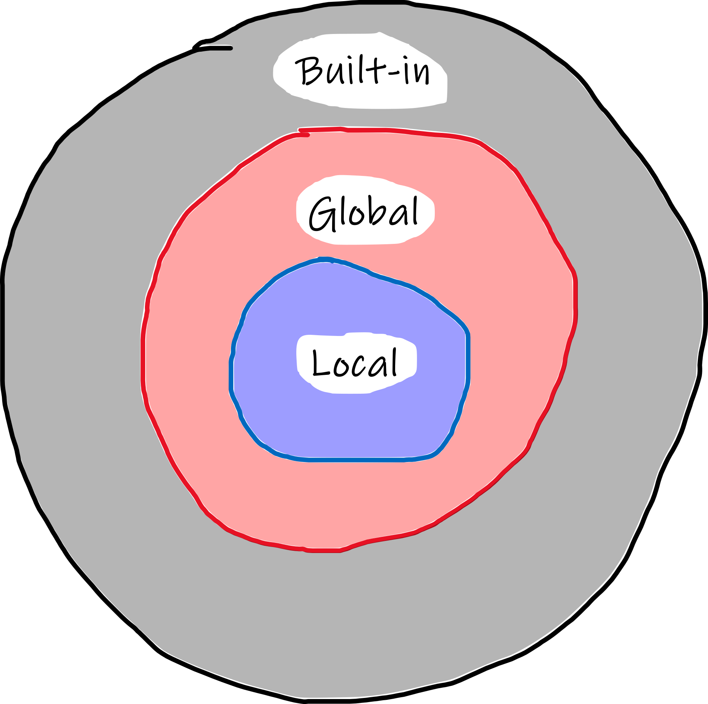
Functions
Scopes in Python
What it is a scope*? It can be though as the portion of a program from where a namespace can be accessed directly, without any prefix.
Tre are at least three nested namespaces at any given moment:
Current function (local)
Module containing the function (global)
...
Outermost with the built-in names
If a name is not found in the current namespace, it is searched for in the outer namespace, but not in the inner namespace (i.e., a variable defined inside a function can not be accessed from outside the function).
If a function want to change a variable in the global namespace, that variable has to be defined as global. (It is not necessary if the variable is only used)
See the official guide to learn more
https://docs.python.org/3/tutorial/classes.html#python-scopes-and-namespaces
* comes from Ancient Greek: σκοπεῖν, skopeîn, "to look" or "see"
Notes:
see also: https://www.programiz.com/python-programming/namespace
and: https://realpython.com/python-namespaces-scope/

Slide 14
Functions
Since the namespaces are kept separate, different variable with the same name can be used since they are bound to object in different scope.
test_scope.py
a = 3
def multiple(x):
return a*x
>>>
>>>
>>>
from test_scope import multiple
a = 4
multiple(3)
9

Slide 15
Execution of script
To execute a script, i.e. as we typed all the instruction, it is sufficient to
$ python –i ModuleName.py
which is equivalent to
$ python
>>> from ModuleName import *
As an example
test.py
def raddoppia(x):
return 2*x
x = 2; y = raddoppia(x)
$
>>>
python –i test.py
y
4
$
>>>
>>>
python
from test import *
y
4
python
import test
test.y
4
$
>>>
>>>

Slide 16
Execution of script
If we want that the script act as we typed some instructions except when it is imported as a module, we add at the end of it
if __name__=="__main__":
instruction here

Slide 17
Execution of script
As an example
Executed as a script
Imported as a module
test.py
def raddoppia(x):
return 2*x
if __name__=="__main__":
x = 2
y = raddoppia(x)
$
>>>
python –i test.py
y
4
$
>>>
>>>
python
from test import *
y
Traceback (most recent call last):
File "<stdin>", line 1, in <module>
NameError: name 'y' is not defined

Slide 18
Classes
A class is an entity which has attributes, that can be variables storing data and methods, i.e. functions with operates on the data of the class or on external objects.
class Punto:
"Classe per gestire un punto geometrico."
def __init__(self,x,y,z=0):
self.x=x
self.y=y
self.z=z
def Distanza(self):
"Determina la distanza del punto dall'origine."
return ( self.x**2 + self.y**2 + self.z**2 )**0.5
Once a class has been defined, we can define an instance of that class through the name of the class and, in round bracket, the arguments that are passed to the method which is the constructor for the class, __init__
The string literal is assigned to the method __doc__
Note that the first argument for all the methods must be the entity itself, usually named self.
Tip
Usually, we define classes in modules and then import them. If we change the class definition, the module must be re-imported
import importlib
importlib.reload(ModuleName)
Notes:
See https://docs.python.org/3/tutorial/classes.html#a-first-look-at-classes for a detailed description

Slide 19
Classes - Inheritance
New classes can be defined by existing ones.
class Punto:
"Classe per gestire un punto geometrico."
def __init__(self,x,y,z):
self.x=x
self.y=y
self.z=z
def Distanza(self):
"Determina la distanza del punto dall'origine."
return ( self.x**2 + self.y**2 + self.z**2 )**0.5
def Trasla(self,Dx,Dy,Dz):
self.x += Dx
self.y += Dy
self.z += Dz
def Ruota(self,x0,y0,z0,ax,ay,az):
self.x, self.y, self.z = self.x-x0, self.y-y0, self.z-z0
self.x, self.y, self.z = self.x*cos(az)-self.y*sin(az), \
self.x*sin(az)+self.y*cos(az), self.z
self.x, self.y, self.z = self.x, self.y*cos(ax)-self.z*sin(ax), \
self.y*sin(ax)+self.z*cos(ax)
self.x, self.y, self.z = self.x*cos(-ay)-self.z*sin(-ay), self.y, \
self.x*sin(-ay)+self.z*cos(-ay)
self.x, self.y, self.z = self.x+x0, self.y+y0, self.z+z0

Slide 20
Classes - Inheritance
New classes can be defined by existing ones.
class Punto2D(Punto):
"Classe per gestire un punto geometrico nel piano x, y."
def __init__(self,x,y):
Punto.__init__(self,x,y,0)
def Trasla(self,Dx,Dy):
Punto.Trasla(self,Dx,Dy,0)
def Ruota(self,x0,y0,az):
Punto.Ruota(self,x0,y0,0.,0.,0.,az)
def Anomalia(self):
return atan2(self.y, self.x)
Remark
- the method «Distanza» has NOT be redefined!
- if the class belong to a different module,
class NewClass(ModulName.BaseClass):

Slide 21
Classes – Private attributes/method
To define attributes and method as private, i.e. that can not be accessed from outside the class, a special naming convention is used.
.__name_
class Punto2D(Punto):
"Classe per gestire un punto geometrico nel piano x, y."
def __init__(self,x,y):
Punto.__init__(self,x,y,0)
self.__rho = self.Distanza()
def Trasla(self,Dx,Dy):
Punto.Trasla(self,Dx,Dy,0)
def Ruota(self,x0,y0,az):
Punto.Ruota(self,x0,y0,0.,0.,0.,az)
def Anomalia(self):
return arctan2(self.y, self.x)
The attribute/method is anyway accessible as
InstanceName._ClassName__name_
max 1 underscore
2 underscore

Slide 22
Classes – special methods
The special methods define predefined functionality.
class Punto2D(Punto):
"Classe per gestire un punto geometrico nel piano x, y."
def __init__(self,x,y):
Punto.__init__(self,x,y,0)
[...]
def __str__(self):
return "Punto 2D di coordinate ( %f, %f )" % (self.x,self.y)
def __repr__(self):
return "Punto2D(x=%f,y=%f)" % (self.x,self.y)
def __lt__(self,altro):
return self.Distanza() < altro.Distanza()
def __le__(self,altro):
return self.Distanza() <= altro.Distanza()
def __eq__(self,altro):
return self.Distanza() == altro.Distanza()
def __ge__(self,altro):
return self.Distanza() >= altro.Distanza()
def __gt__(self,altro):
return self.Distanza() > altro.Distanza()
Notes:
For difference between __str__ and __repr__ see: https://www.journaldev.com/22460/python-str-repr-functions

Slide 23
Classes – iterator
It is possible to define how a for statement act when an instance of a class is used
class Punto:
"Classe per gestire un punto geometrico nel piano x, y."
def __init__(self,x,y):
Punto.__init__(self,x,y,0)
...
def __iter__(self):
return self
def __next__(self):
if not hasattr(self,'index'):
self.index = 0
if self.index == 3:
self.index = 0
raise StopIteration
elif self.index == 0:
self.index += 1
return self.x
elif self.index == 1:
self.index += 1
return self.y
elif self.index == 2:
self.index += 1
return self.z

Slide 24
Classes – call as a function
It is possible to allow the class's instance to be called as a function.
class Parabola:
def __init__(self, a, b = 0, c = 0):
"""Parametri dell'equazione della parabola
y(x) = a x ^2 + b x + c
"""
self.a = a
self.b = b
self.c = c
def __call__(self, x):
return self.a*x**2 + self.b*x + self.c
Tip
This can be useful to define parametric functions!

Slide 25
Classes – copy and aliases
Remember that defining a variable means binding a name to an object
So, if A is a class
>>> a=A()
>>> b=a
results in two names which refer to the same object!
In other words, we have an alias.

Slide 26
Classes – copy
To copy the object, we should use the module copy
NewObject = copy.copy(OldObject)
NewObject = copy.deepcopy(OldObject)
>>>
...
...
...
...
...
...
>>>
>>>
>>>
>>>
>>>
class A:
def __init__(self,x,y):
self.x = x
self.y = y
def __repr__(self):
return "{0:s}, {1:d}".format(str(self.x),self.y)
import copy
a=A([1,2,3],10); print(a)
[1, 2, 3], 10
b=a; b.y=20; b.x[0]=2; print(a);print(b)
[2, 2, 3], 20
[2, 2, 3], 20
c=copy.copy(a);c.y=30;c.x[0]=3;print(a);print(b);print(c)
[3, 2, 3], 20
[3, 2, 3], 20
[3, 2, 3], 30
d=copy.deepcopy(a);d.y=40;d.x[0]=4;print(a);print(b);print(c);print(d)
[3, 2, 3], 20
[3, 2, 3], 20
[3, 2, 3], 30
[4, 2, 3], 40

Slide 27
Error handling
TRY/EXCEPT statement
In some situation the code can generate an error.
If the error was taken into account during programming, it can be handled without interrupting the flow of the code. Otherwise, the program interrupts its running.
Non handled error
>>>
>>>
>>>
...
...
...
N = [100., 80., 0., 90., 75.]
Namm = 80.
for n in N:
FS = Namm/n
print(f"Carico: {n:5.1f}, fattore di sicurezza {FS:4.2f}")
Carico: 100.0, fattore di sicurezza 0.80
Carico: 80.0, fattore di sicurezza 1.00
Traceback (most recent call last):
File "<stdin>", line 2, in <module>
ZeroDivisionError: float division by zero

Slide 28
Error handling
Handled error
We must indicate the possible cause of error
>>>
>>>
>>>
...
...
...
...
...
...
N = [100., 80., 0., 90., 75.]
Namm = 80.
for n in N:
try:
FS = Namm/n
print(f"Carico: {n:5.1f}, fattore di sicurezza {FS:4.2f}")
except ZeroDivisionError:
print("Carico nullo!")
Carico: 100.0, fattore di sicurezza 0.80
Carico: 80.0, fattore di sicurezza 1.00
Carico nullo!
Carico: 90.0, fattore di sicurezza 0.89
Carico: 75.0, fattore di sicurezza 1.07

Slide 29
Error handling
Handled error
We must indicate the possible cause of error
>>>
>>>
>>>
...
...
...
...
...
...
...
N = [100., 80., 0., 90., 75.]
Namm = 80.
for n in N:
try:
FS = Namm/n
except ZeroDivisionError:
print("Carico nullo!")
else:
print(f"Carico: {n:5.1f}, fattore di sicurezza {FS:4.2f}")
Carico: 100.0, fattore di sicurezza 0.80
Carico: 80.0, fattore di sicurezza 1.00
Carico nullo!
Carico: 90.0, fattore di sicurezza 0.89
Carico: 75.0, fattore di sicurezza 1.07
Remark
This is the preferred syntax, since the block of code which can generate the error is separated from the remaining part of the code.

Slide 31
Some fundamental modules
Module os
Allows the interaction with the operating system
import os
os.getcwd()
os.chdir(NewDirectory)
os.listdir(Directory)
Module shutil
Allows a high-level operativity on files.
import shutil
shutil.copy(Source,Destination/DestinationDirectory)
shutil.move(filename, Directory)
Notes:
See also here: Python OS and Shutil Modules. The OS module in Python provides… | by TechFitLab | Techfitlab | Medium

Slide 32
Some fundamental modules
Module glob
Allow to search for files and directory
import glob
glob.glob('*.pdf')
Module sys
To interact with OS shell
import sys
- to pass values to arguments through command line: a list is generated named sys.argv, the first element (index 0!) is the name of the script!
- to add temporarily a directory in the environment variable where Python look for the modules
sys.path.append(Directory)

Slide 33
Some fundamental modules
Module math
Frequently used math operators.
acos
asin
atan
atan2
ceil
cos
cosh
degrees
e
exp
floor
hypot
log
log10
pi
pow
radians
sin
sinh
sqrt
tan
tanh
Module random
To work with (pseudo) random numbers.
betavariate
choice
expovariate
gammavariate
gauss
getrandbits
lognormvariate
normalvariate
paretovariate
random
sample
seed
shuffle
uniform
vonmisesvariate
weibullvariate

Slide 34
Some fundamental modules
Module decimal
Allows an exact representation of real numbers. It also implement significant places evaluation and it is possible to define an arbitrary precision .
>>>
>>>
...
...
>>>
x = 0
for i in range(10):
x = x+1/10
print(x)
0.9999999999999999
>>>
>>>
>>>
...
...
>>>
import decimal
x = decimal.Decimal(0)
for i in range(10):
x = x +decimal.Decimal(1)/decimal.Decimal(10)
print(x)
1.0

Slide 35
Some fundamental modules
Module struct
Allows the conversion from C struct to Python byte objects.
As an example, to show the double precision representation of the value 5.1
>>>
>>>
>>>
>>>
>>>
import struct
value = 5.1
ba = bytearray(struct.pack(">d", value))
print(ba)
bytearray(b'@\x14ffffff')
print([ "0x%02x" % b for b in ba ])
['0x40', '0x14', '0x66', '0x66', '0x66', '0x66', '0x66', '0x66']
Module keyword
To get a list of Python keywords (which can not be used as object names).
>>>
>>>
import keyword
print(keyword.kwlist)
['False', 'None', 'True', 'and', 'as', 'assert', 'async', 'await', 'break', 'class', 'continue', 'def', 'del', 'elif', 'else', 'except', 'finally', 'for', 'from', 'global', 'if', 'import', 'in', 'is', 'lambda', 'nonlocal', 'not', 'or', 'pass', 'raise', 'return', 'try', 'while', 'with', 'yield']
N.B some commands, such as print, are not keywords, i.e. they can be redefined!
Notes:
documentation here https://docs.python.org/3/library/struct.html
for representation in binary of numbers, https://www.binaryconvert.com/

