Slide 1

UNIVERSITÀ DEGLI STUDI DI PERUGIA
International Doctoral Program in
Civil and Environmental Engineering
PYTHON FOR NUMERICAL COMPUTING AND DEVELOPMENT OF SCIENTIFIC APPLICATION
Prof. Federico Cluni
A. Y. 2023/24
Lesson #4 – March 15th, 2024

Slide 2
MATPLOTLIB
To create graphs MatLab-like.
import numpy as np
import matplotlib as mpl
import matplotlib.pyplot as plt
x = np.linspace(0.,2*np.pi, 101)
y = np.sin(x)
ys = x-x**3/6+x**5/120-x**7/5040+x**9/362880
plt.plot( x, y, 'bo-', label='true')
plt.plot( x, ys, 'r-', label='serie 5 terms')
plt.xlabel('$x$')
plt.ylabel('$y$')
plt.title('Graph of $y = \\sin(x)$')
plt.legend()
plt.grid(True)
plt.show()
To see several examples of use
https://matplotlib.org/stable/gallery/index.html
N.B this is the “standard” way of importing pyplot
y
x

Slide 3
MATPLOTLIB
with an object-oriented approach
import numpy as np
import matplotlib as mpl
import matplotlib.pyplot as plt
x = np.linspace(0.,2*np.pi, 101)
y = np.sin(x)
ys = x-x**3/6+x**5/120-x**7/5040+x**9/362880
fig, ax = plt.subplots(1,1,num='Test figure')
ax.plot( x, y, 'bo-', label='true')
ax.plot( x, ys, 'r-', label='serie 5 terms')
ax.set(xlabel='$x$', ylabel='$y$', title='Graph of $y = \\sin(x)$')
ax.legend()
ax.grid(True)
plt.show()
In IPython, if we digit
%matplotlib
we can omit the plt.show()
To close existing figures
plt.close('all')
Notes:
From official documentation: "Matplotlib's documentation and examples use both the OO and the pyplot styles. In general, we suggest using the OO style, particularly for complicated plots, and functions and scripts that are intended to be reused as part of a larger project. However, the pyplot style can be very convenient for quick interactive work."

Slide 4
MATPLOTLIB
Defining subplots
import numpy as np
import matplotlib as mpl
import matplotlib.pyplot as plt
from fractions import Fraction
x = np.linspace(0.,2*np.pi, 101); y1 = np.sin(x); y2 = np.cos(x); y3 = np.sin(x)*np.cos(x)
fig, ax = plt.subplots(1, 2, figsize=(8,5), sharey=True, num='Test figure')
ax[0].plot( x, y1, color='C1', linestyle = 'dashed', marker = 'o',
markerfacecolor = 'r', markeredgecolor='b')
ax[1].plot( x, y2, color='C3', linestyle = '--' )
ax[1].plot( x, y3, color='CadetBlue', linestyle = '-' )
ax[1].plot( x, -y3, color='#BDB76B', linestyle = '-' )
ax[0].set(xlabel='$x$', ylabel='$y$', title='Graph of $y = \\sin(x)$',
xticks = np.arange(5)/2*np.pi,
xticklabels = [f"${n:s}\\pi$" for n in [str(Fraction(n,2)) for n in np.arange(5)]],
xlim = (0, 2*np.pi))
ax[1].set(xlabel='$x$', title='Graph of $y = \\cos(x)$')
ax[0].grid(True)
ax[1].grid(True)
To save to a file
plt.savefig('test_fig.png', dpi = 300)
Notes:
For HTML Color names: https://www.w3schools.com/tags/ref_colornames.asp
For Matplotlib default color cycle: https://matplotlib.org/stable/gallery/color/color_cycle_default.html

Slide 5
MATPLOTLIB
To plot 3d graphs
import numpy as np
import matplotlib
import matplotlib.pyplot as plt
from mpl_toolkits import mplot3d
z = np.linspace(0,4*np.pi, 101)
x = np.cos(z)
y = np.sin(z)
fig = plt.figure(figsize=(8,6))
ax = fig.add_subplot(projection='3d')
ax.plot3D(x,y,z)
ax.set(xlabel='x', ylabel='y', zlabel='z')
plt.show()

Slide 6
MATPLOTLIB
To plot 3d graphs
import numpy as np
import matplotlib
import matplotlib.pyplot as plt
from mpl_toolkits import mplot3d
X, Y = np.meshgrid( np.linspace(-np.pi,np.pi,51),
np.linspace(-np.pi,np.pi,51) )
Z = np.sin( X*Y )
fig = plt.figure()
ax1 = fig.add_subplot(1, 2, 1, projection='3d')
ax1.plot_surface(X,Y,Z)
ax2 = fig.add_subplot(1, 2, 2)
CS = ax2.contour(X, Y, Z, np.linspace(-1.,1.,10))
ax2.clabel( CS, fontsize=9, inline=1)
plt.show()

Slide 7
MATPLOTLIB
Some references
Official quick start
https://matplotlib.org/stable/tutorials/introductory/quick_start.html
From Python Data Science Handbook by Jake VanderPlas
https://jakevdp.github.io/PythonDataScienceHandbook/04.00-introduction-to-matplotlib.html
... and the page Example on the official website!
https://matplotlib.org/stable/gallery/index.html
Moreover, the book Python Graphics: A Reference for Creating 2D and 3D Images by Bernand Korites (Apress, 2023 2nd ed.)
which has also a GitHub repository (for the 1st edition)
https://github.com/Apress/python-graphics

Slide 8
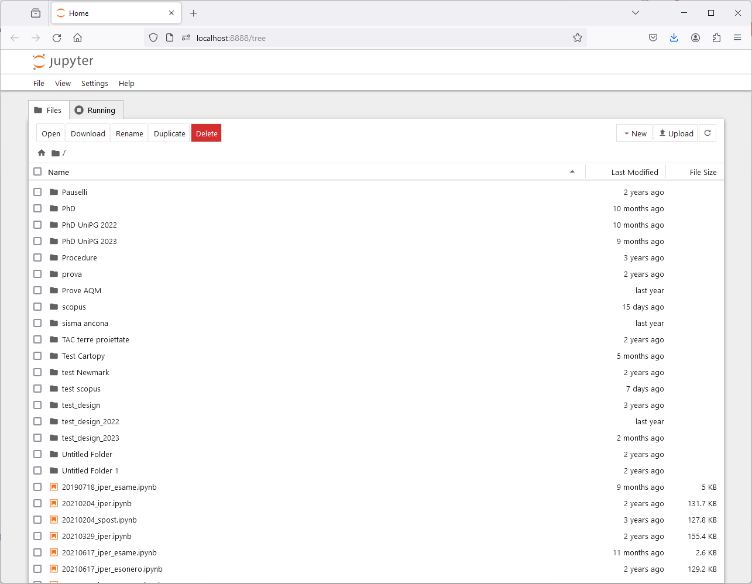
JUPYTER NOTEBOOKS
The notebook server
When launching Jupyter, a server providing the notebook functionality through the web browser is started.
Notes:
see also https://www.dataquest.io/blog/jupyter-notebook-tips-tricks-shortcuts/

Slide 9
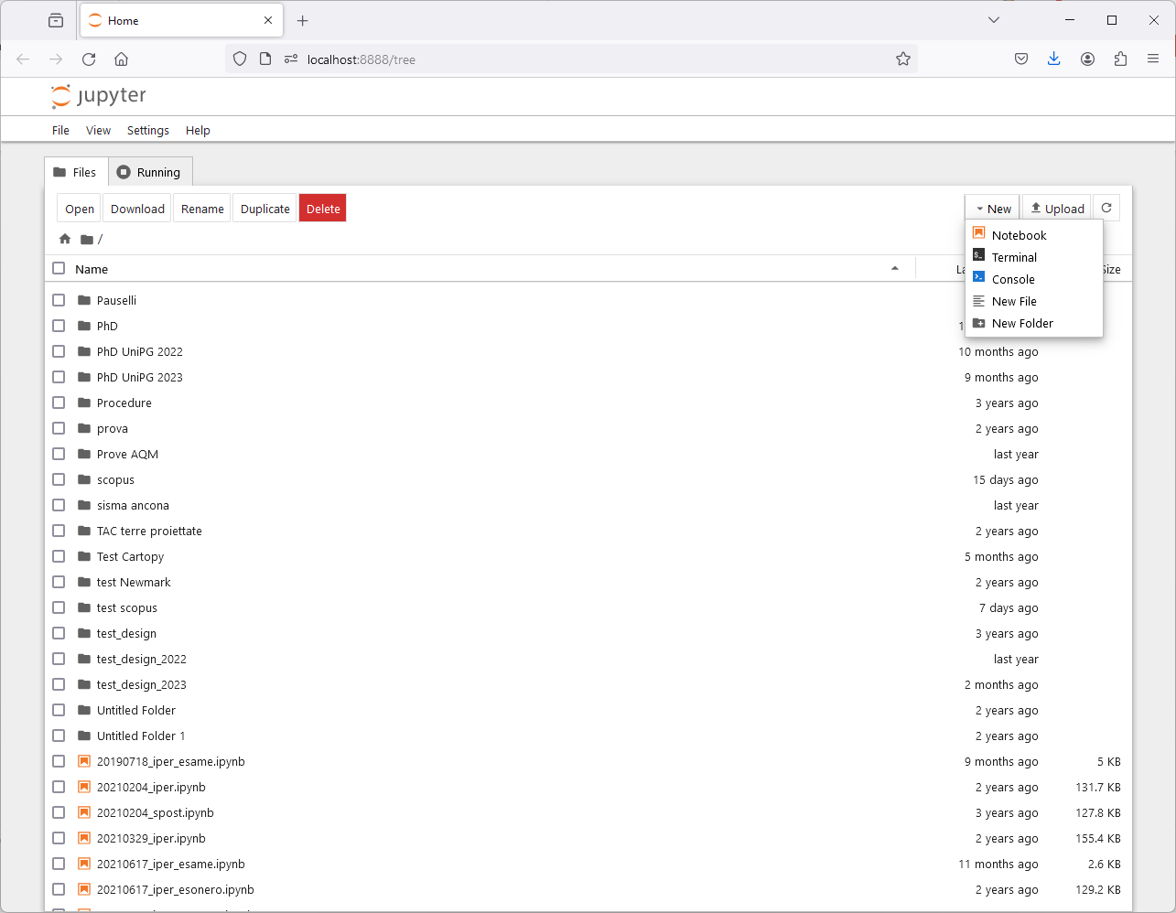
JUPYTER NOTEBOOKS
The notebook server
The interface act as a "file explorer".

Slide 10
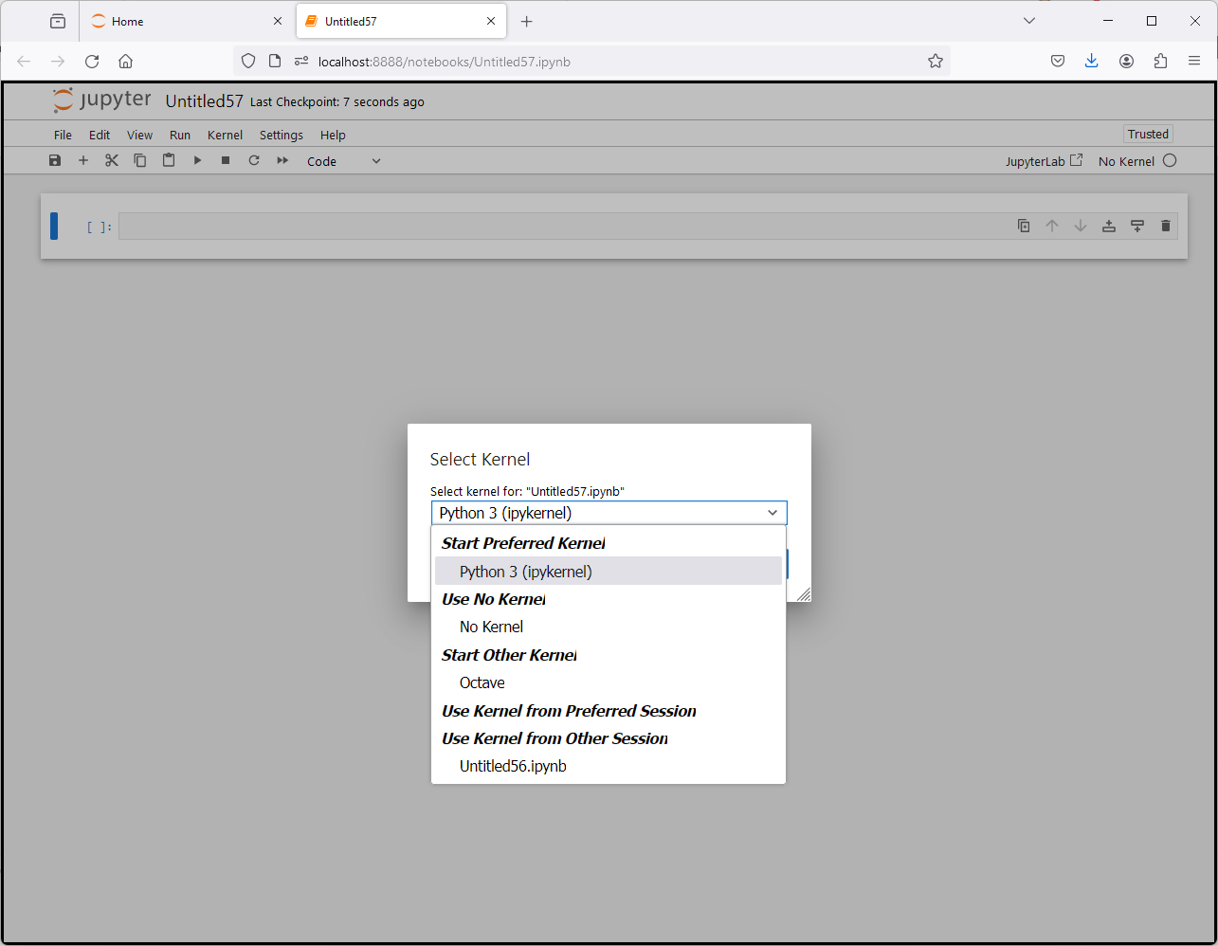
JUPYTER NOTEBOOKS
The notebook server
It is worth noting that several "kernels" may be used with Jupyter.

Slide 11
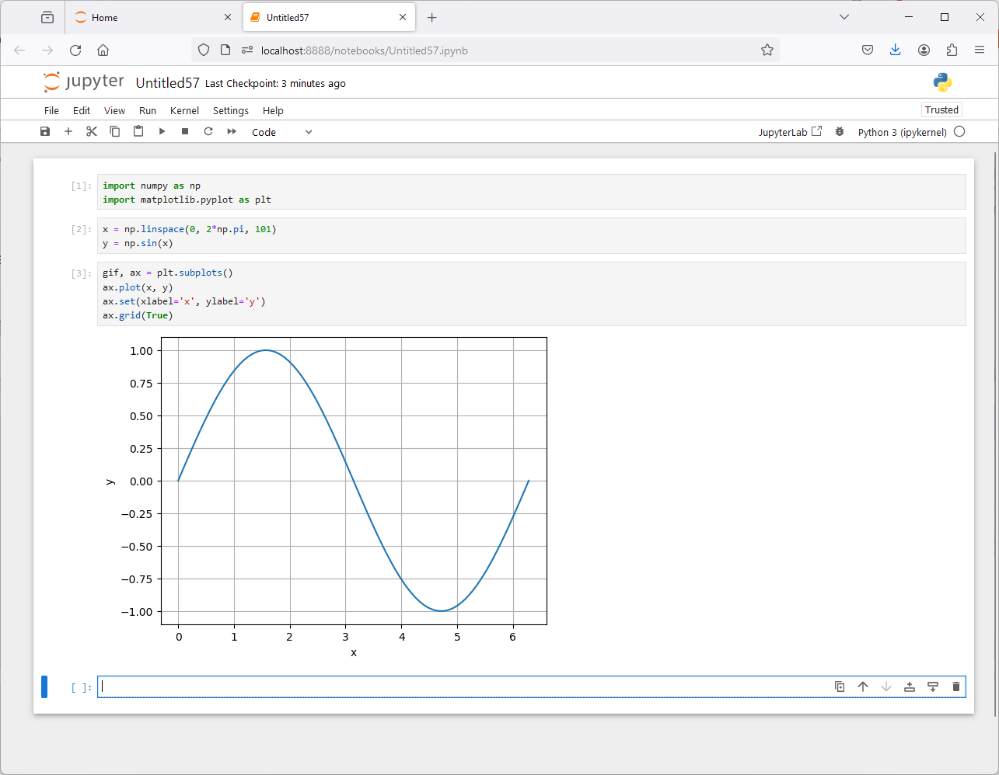
JUPYTER NOTEBOOKS
The notebook server
It is possible to insert Python code in the cell.
Note that "return" key allows to insert a new line of code, "shift"+"return" keys run the inserted code.

Slide 12
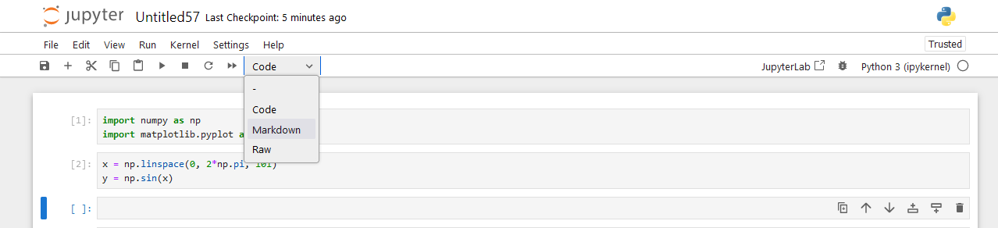
JUPYTER NOTEBOOKS
The notebook server
It is possible to insert Markdown code in the cell, which can also render math.
Notes:
https://markdown-it.github.io/

Slide 13
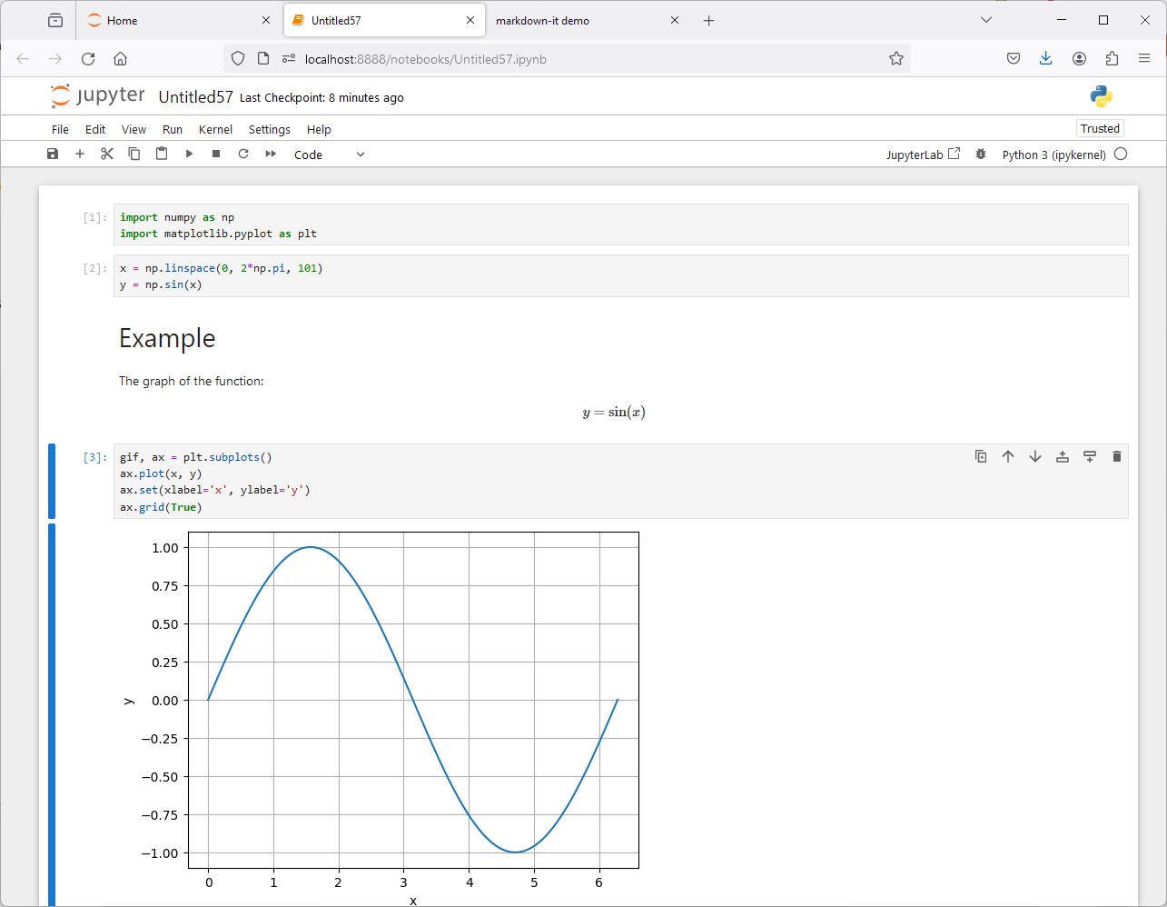
JUPYTER NOTEBOOKS
The notebook server
It is possible to insert Markdown code in the cell, which can also render math.
To see how to use markdown see here https://markdown-it.github.io/

Slide 14
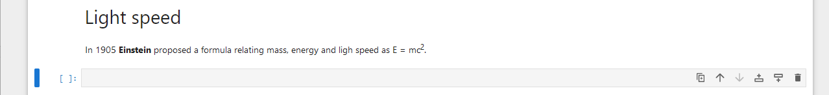
JUPYTER NOTEBOOKS
The notebook server
In Markdown cell html (markup) code can be executed.

Slide 15
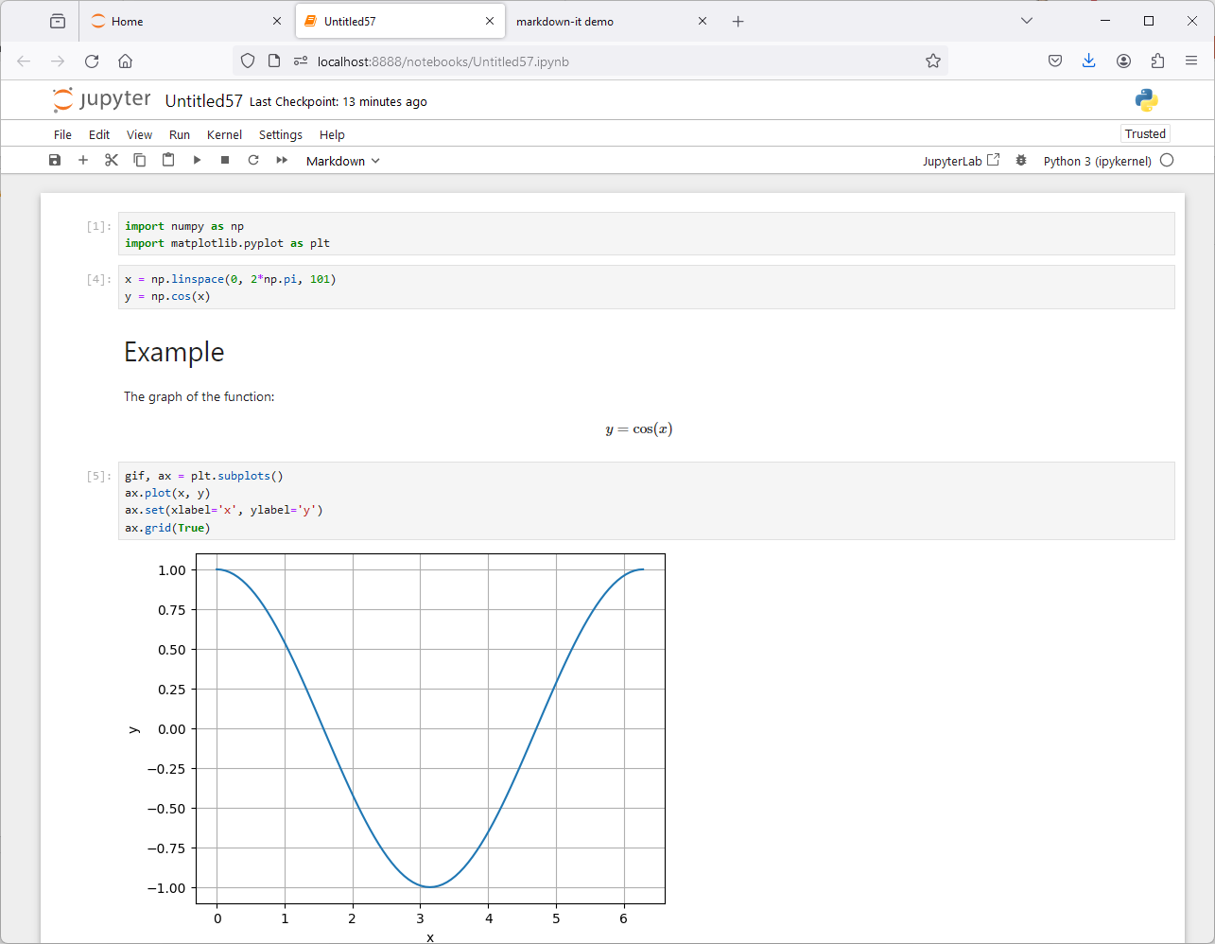
JUPYTER NOTEBOOKS
The notebook server
It is possible to edit the code previously inserted and see what happens!

Slide 16
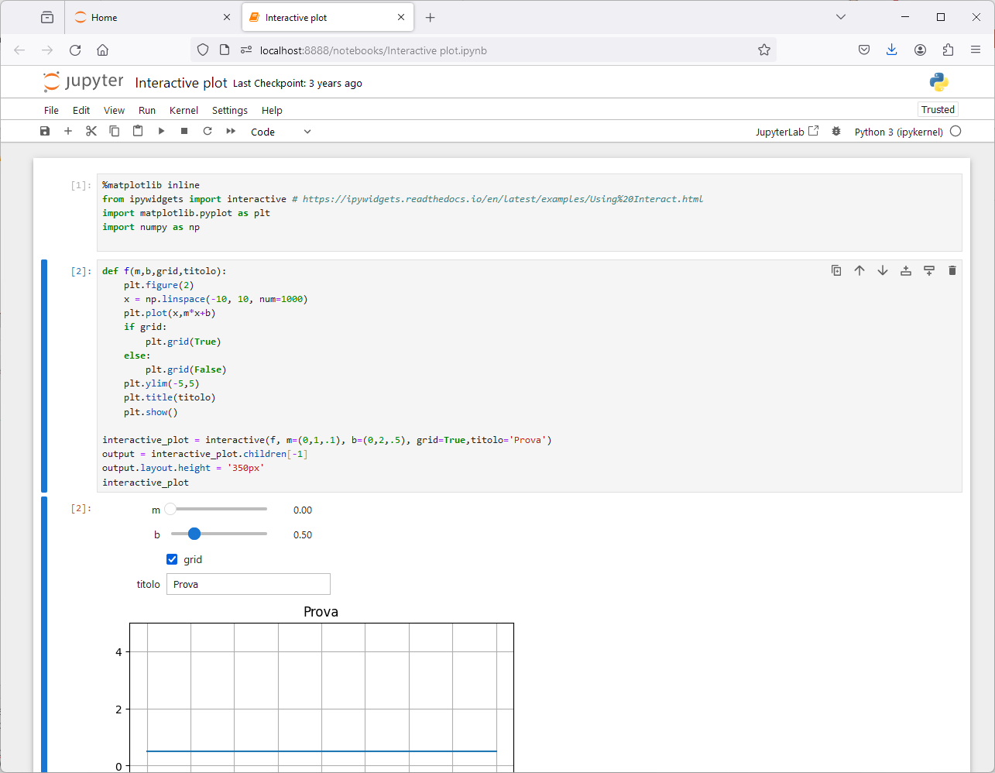
JUPYTER NOTEBOOKS
The notebook server
It is possible to define interactive controls.
See https://ipywidgets.readthedocs.io/en/latest/examples/Using%20Interact.htm
Notes:
«@interact is usefull if you are interested in exploring some data, and manipulating the "view" of some data.
Say you have precipitation graph per days for year 2000 to 2019, you don't want to plot 19 graph, you want to have 1 graph with a slider to select which year you want to see. Then you can do
@interact(year=(2000, 2019)) def plot_graph(year): ... That's it. You don't want to reuse the widget; you just interested in the interactivity and ability to change the "view". In this case we don't care about the user input. We really only care about changing some view parameters.
interactive() is there if you actually want to build something more tightly integrated; but for most data scientist inputing data via widgets is not that usefull. It is also a bad habit as this prevent the notebook from being reproducible with "restart and run all" as result depends from user input.» (from https://www.reddit.com/r/IPython/comments/cs4beg/whats_the_point_of_ipywidgets_interact_v/)

Slide 17
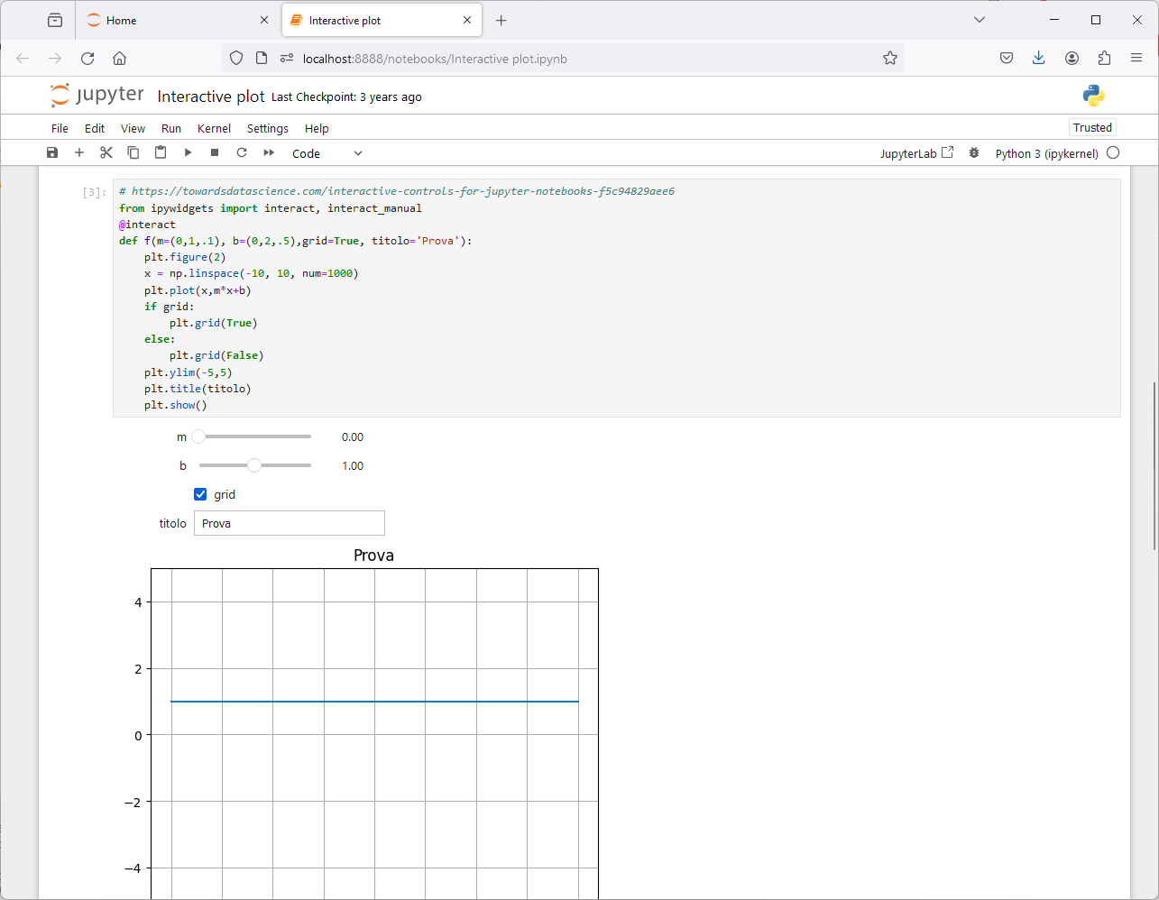
JUPYTER NOTEBOOKS
The notebook server
It is possible to define interactive controls.
See https://ipywidgets.readthedocs.io/en/latest/examples/Using%20Interact.htm
Notes:
«@interact is usefull if you are interested in exploring some data, and manipulating the "view" of some data.
Say you have precipitation graph per days for year 2000 to 2019, you don't want to plot 19 graph, you want to have 1 graph with a slider to select which year you want to see. Then you can do
@interact(year=(2000, 2019)) def plot_graph(year): ... That's it. You don't want to reuse the widget; you just interested in the interactivity and ability to change the "view". In this case we don't care about the user input. We really only care about changing some view parameters.
interactive() is there if you actually want to build something more tightly integrated; but for most data scientist inputing data via widgets is not that usefull. It is also a bad habit as this prevent the notebook from being reproducible with "restart and run all" as result depends from user input.» (from https://www.reddit.com/r/IPython/comments/cs4beg/whats_the_point_of_ipywidgets_interact_v/)

Slide 18
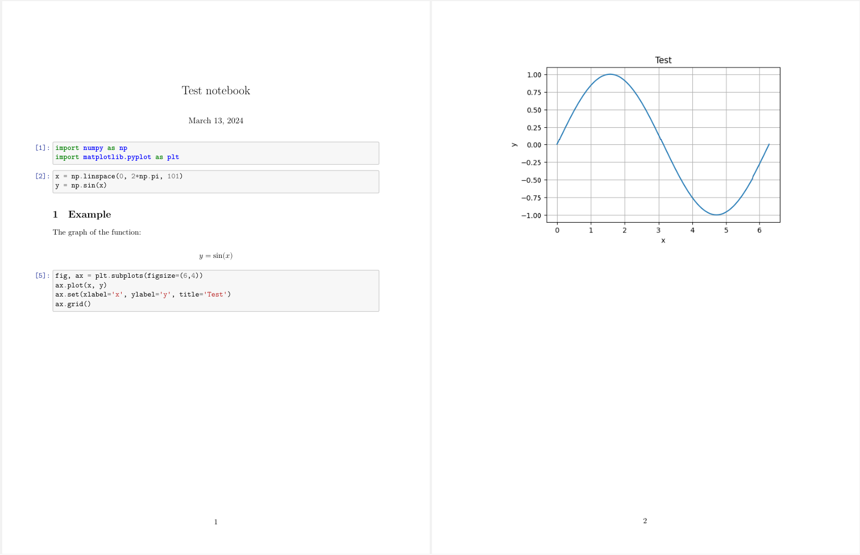
JUPYTER NOTEBOOKS
The notebook server
Note that several actions are possible on the notebook (for example, clear output and/or restart the cell).
Moreover, it is also possible to export the notebook, for example to LaTeX format
Notes:
https://colab.research.google.com/drive/1Ss8oeR_y0bTNUUP7Tm8Kz1BLvn-tO_Na?usp=sharing

Slide 19
JUPYTER NOTEBOOKS
Sharing notebooks
Sharing notebooks
https://coderefinery.github.io/jupyter/sharing/
Google colab
Example: https://colab.research.google.com/drive/1Ss8oeR_y0bTNUUP7Tm8Kz1BLvn-tO_Na?usp=sharing
Notes:
https://colab.research.google.com/drive/1Ss8oeR_y0bTNUUP7Tm8Kz1BLvn-tO_Na?usp=sharing

Slide 20
JUPYTER NOTEBOOKS
Magic commands
Jupyter Notebook inherits some magic commands from IPython
%timeit evaluate the time of execution of a command
%run execute code in a script
%store varname save the variable
%store –r varname load the variable
%who list names in global scope
%matplotlib inline plot the graphs in the notebook
%matplotlib notebook add interactive exploring tools to the plot
Notes:
for more information on %store https://ipython.org/ipython-doc/stable/config/extensions/storemagic.html

Slide 21
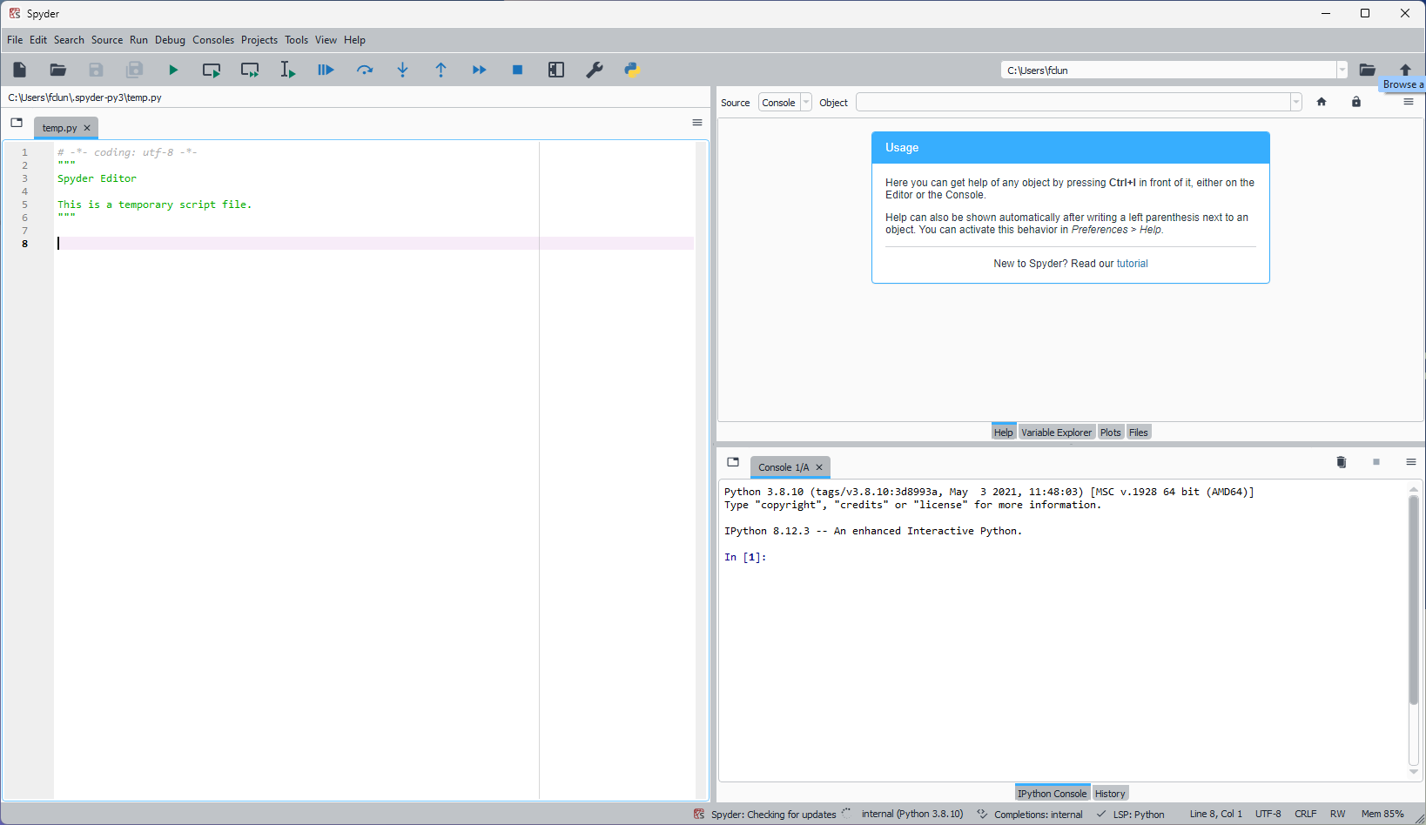
SPYDER
It is possible to have an interface (IDE) similar to that of Matlab through Spyder

Slide 22
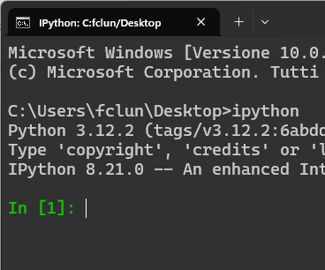
SPYDER
It is possible to have an interface (IDE) similar to that of Matlab through Spyder

Slide 23
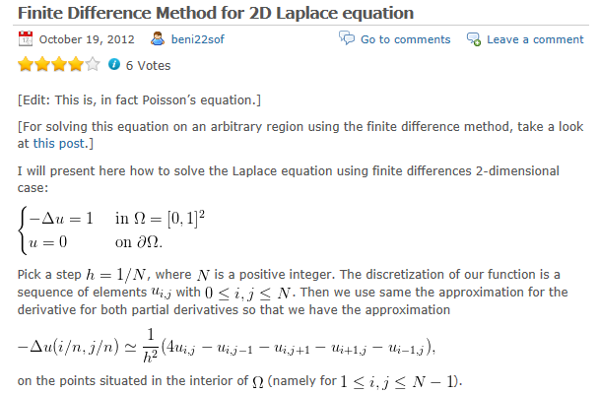
EXAMPLE: NUMPY + MATPLOTLIB
https://mathproblems123.wordpress.com/2012/10/19/finite-difference-method-for-2d-laplace-equation/

Slide 24
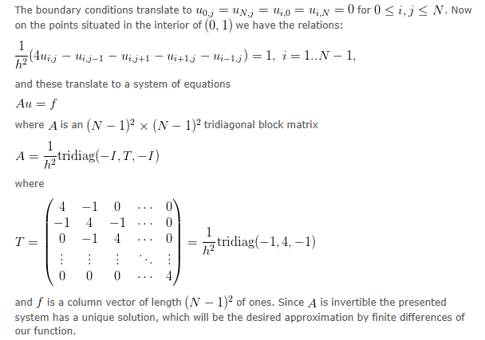
EXAMPLE: NUMPY + MATPLOTLIB

Slide 25
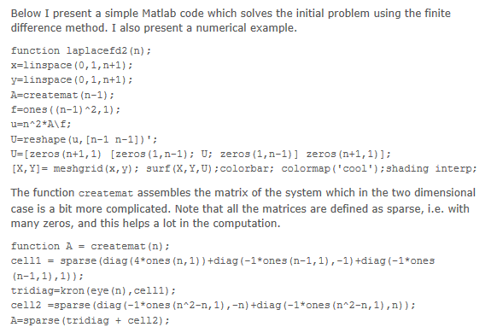
EXAMPLE: NUMPY + MATPLOTLIB

Slide 26
EXAMPLE: NUMPY + MATPLOTLIB
In Python…
import numpy as np; import sys; import numpy.linalg as la
from mpl_toolkits import mplot3d
from matplotlib import cm; import matplotlib.pyplot as plt
def createmat(n):
cell1 = np.diag(4*np.ones(n))+np.diag(-1*np.ones(n-1),-1)+np.diag(-1*np.ones(n-1),1)
tridiag = np.kron(np.eye(n),cell1)
cell2 = np.diag(-1*np.ones(n**2-n),-n)+np.diag(-1*np.ones(n**2-n),n)
return tridiag + cell2
def laplacefd2(n):
x = np.linspace(0,1,n)
y = np.linspace(0,1,n)
h = 1./n
A = createmat(n-2)
A = A/h**2
f = np.ones((n-2)**2)
u = la.solve(A,f)
Ui = np.reshape(u, (n-2,n-2))
U = np.zeros((n,n))
U[1:n-1,1:n-1] = Ui[:]

Slide 27
EXAMPLE: NUMPY + MATPLOTLIB
#
# plot the solution
#
fig = plt.figure(figsize=(8,6))
ax = fig.add_subplot(projection='3d')
[X,Y] = np.meshgrid(x,y)
surf = ax.plot_surface(X, Y, U, rstride=1, cstride=1, cmap=cm.coolwarm,
linewidth=0, antialiased=False)
cset = ax.contour(X, Y, U, zdir='z', offset=-0.05, cmap=cm.coolwarm)
ax.set_zlim(-0.05,0.1)
fig.colorbar(surf, shrink=0.5, aspect=5)
ax.set(xlabel='x', ylabel='y', zlabel='u')
plt.show()
#
return U
if __name__ == "__main__":
n = int(sys.argv[1])
U = laplacefd2(n)

Slide 28
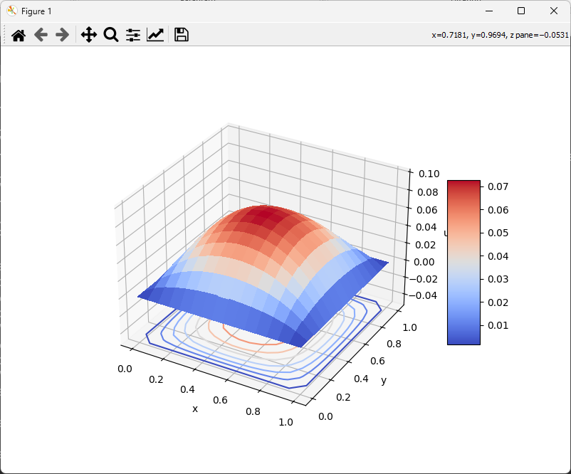
EXAMPLE: NUMPY + MATPLOTLIB
From command line
python lap.py 15

