Slide 1
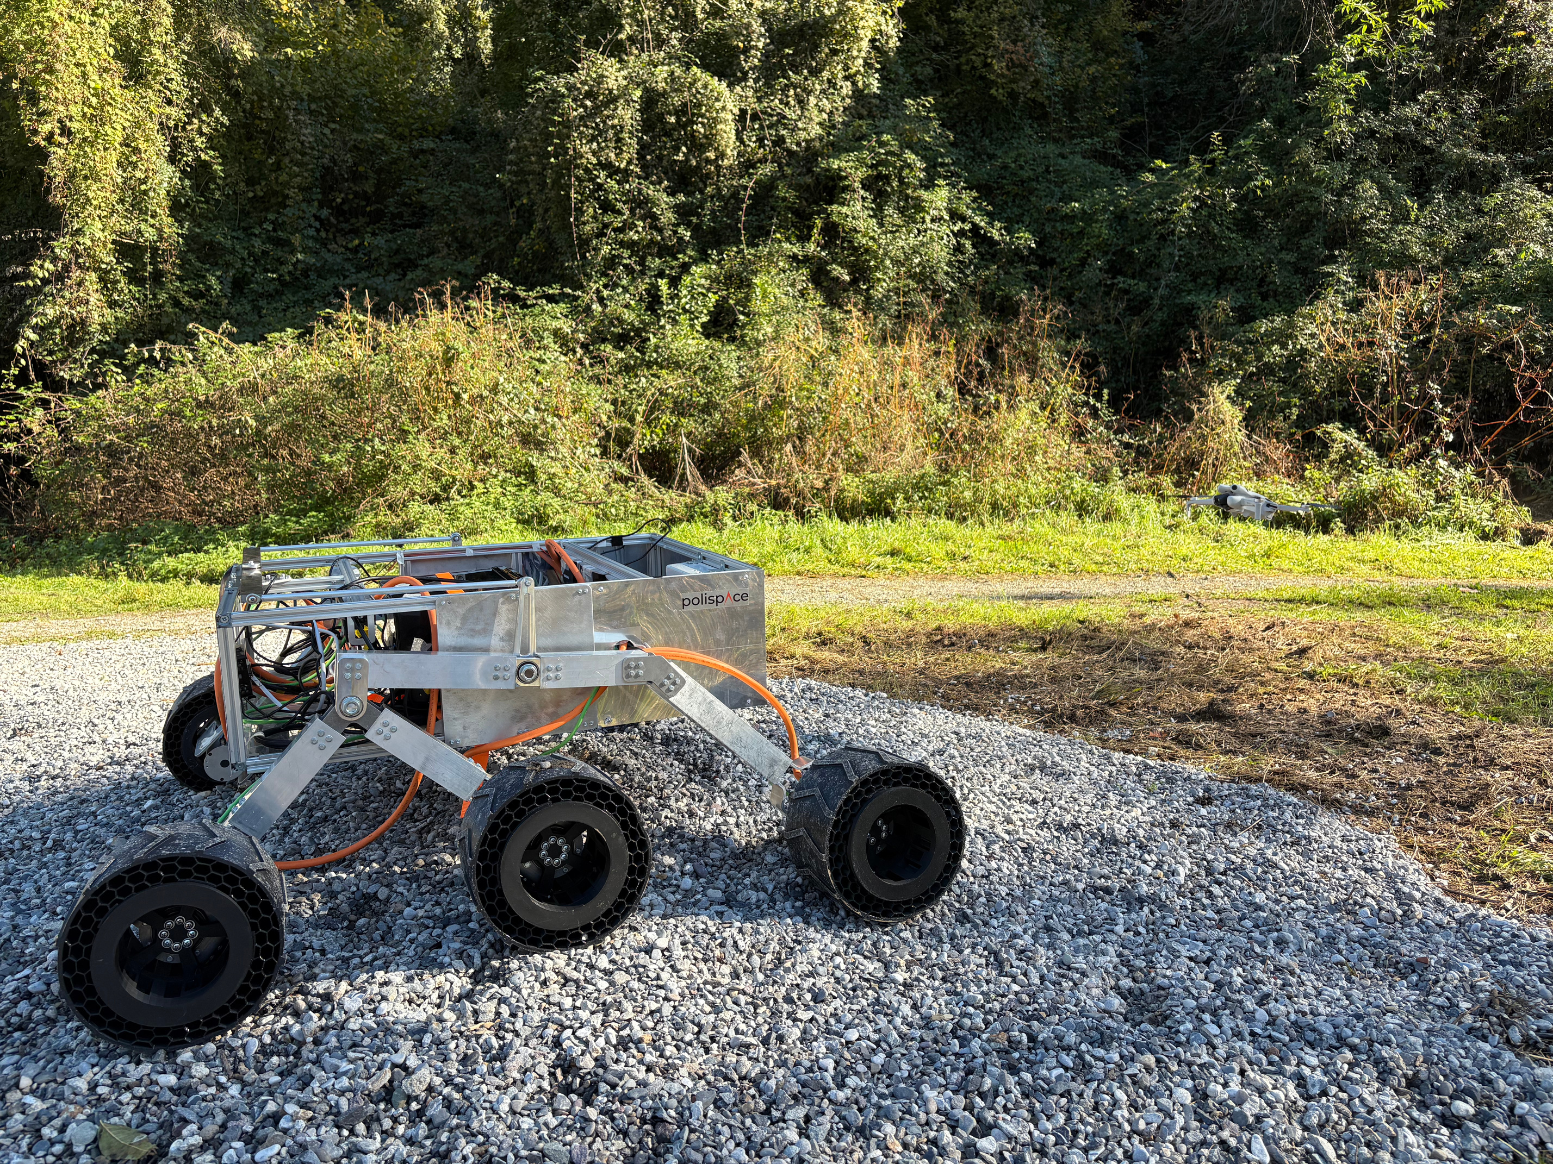


RoverTech
[R]overTech x Polispace x Suncubes Workshop
Autonomous Drones and Perception
[ ]
R
Federico De Donatis
Luca Attorrese
RoverTech

Slide 2
RoverTech
Lesson 3
FROM PIXELS
TO MOTION
Camera Models, Calibration and Visual Odometry

Slide 3
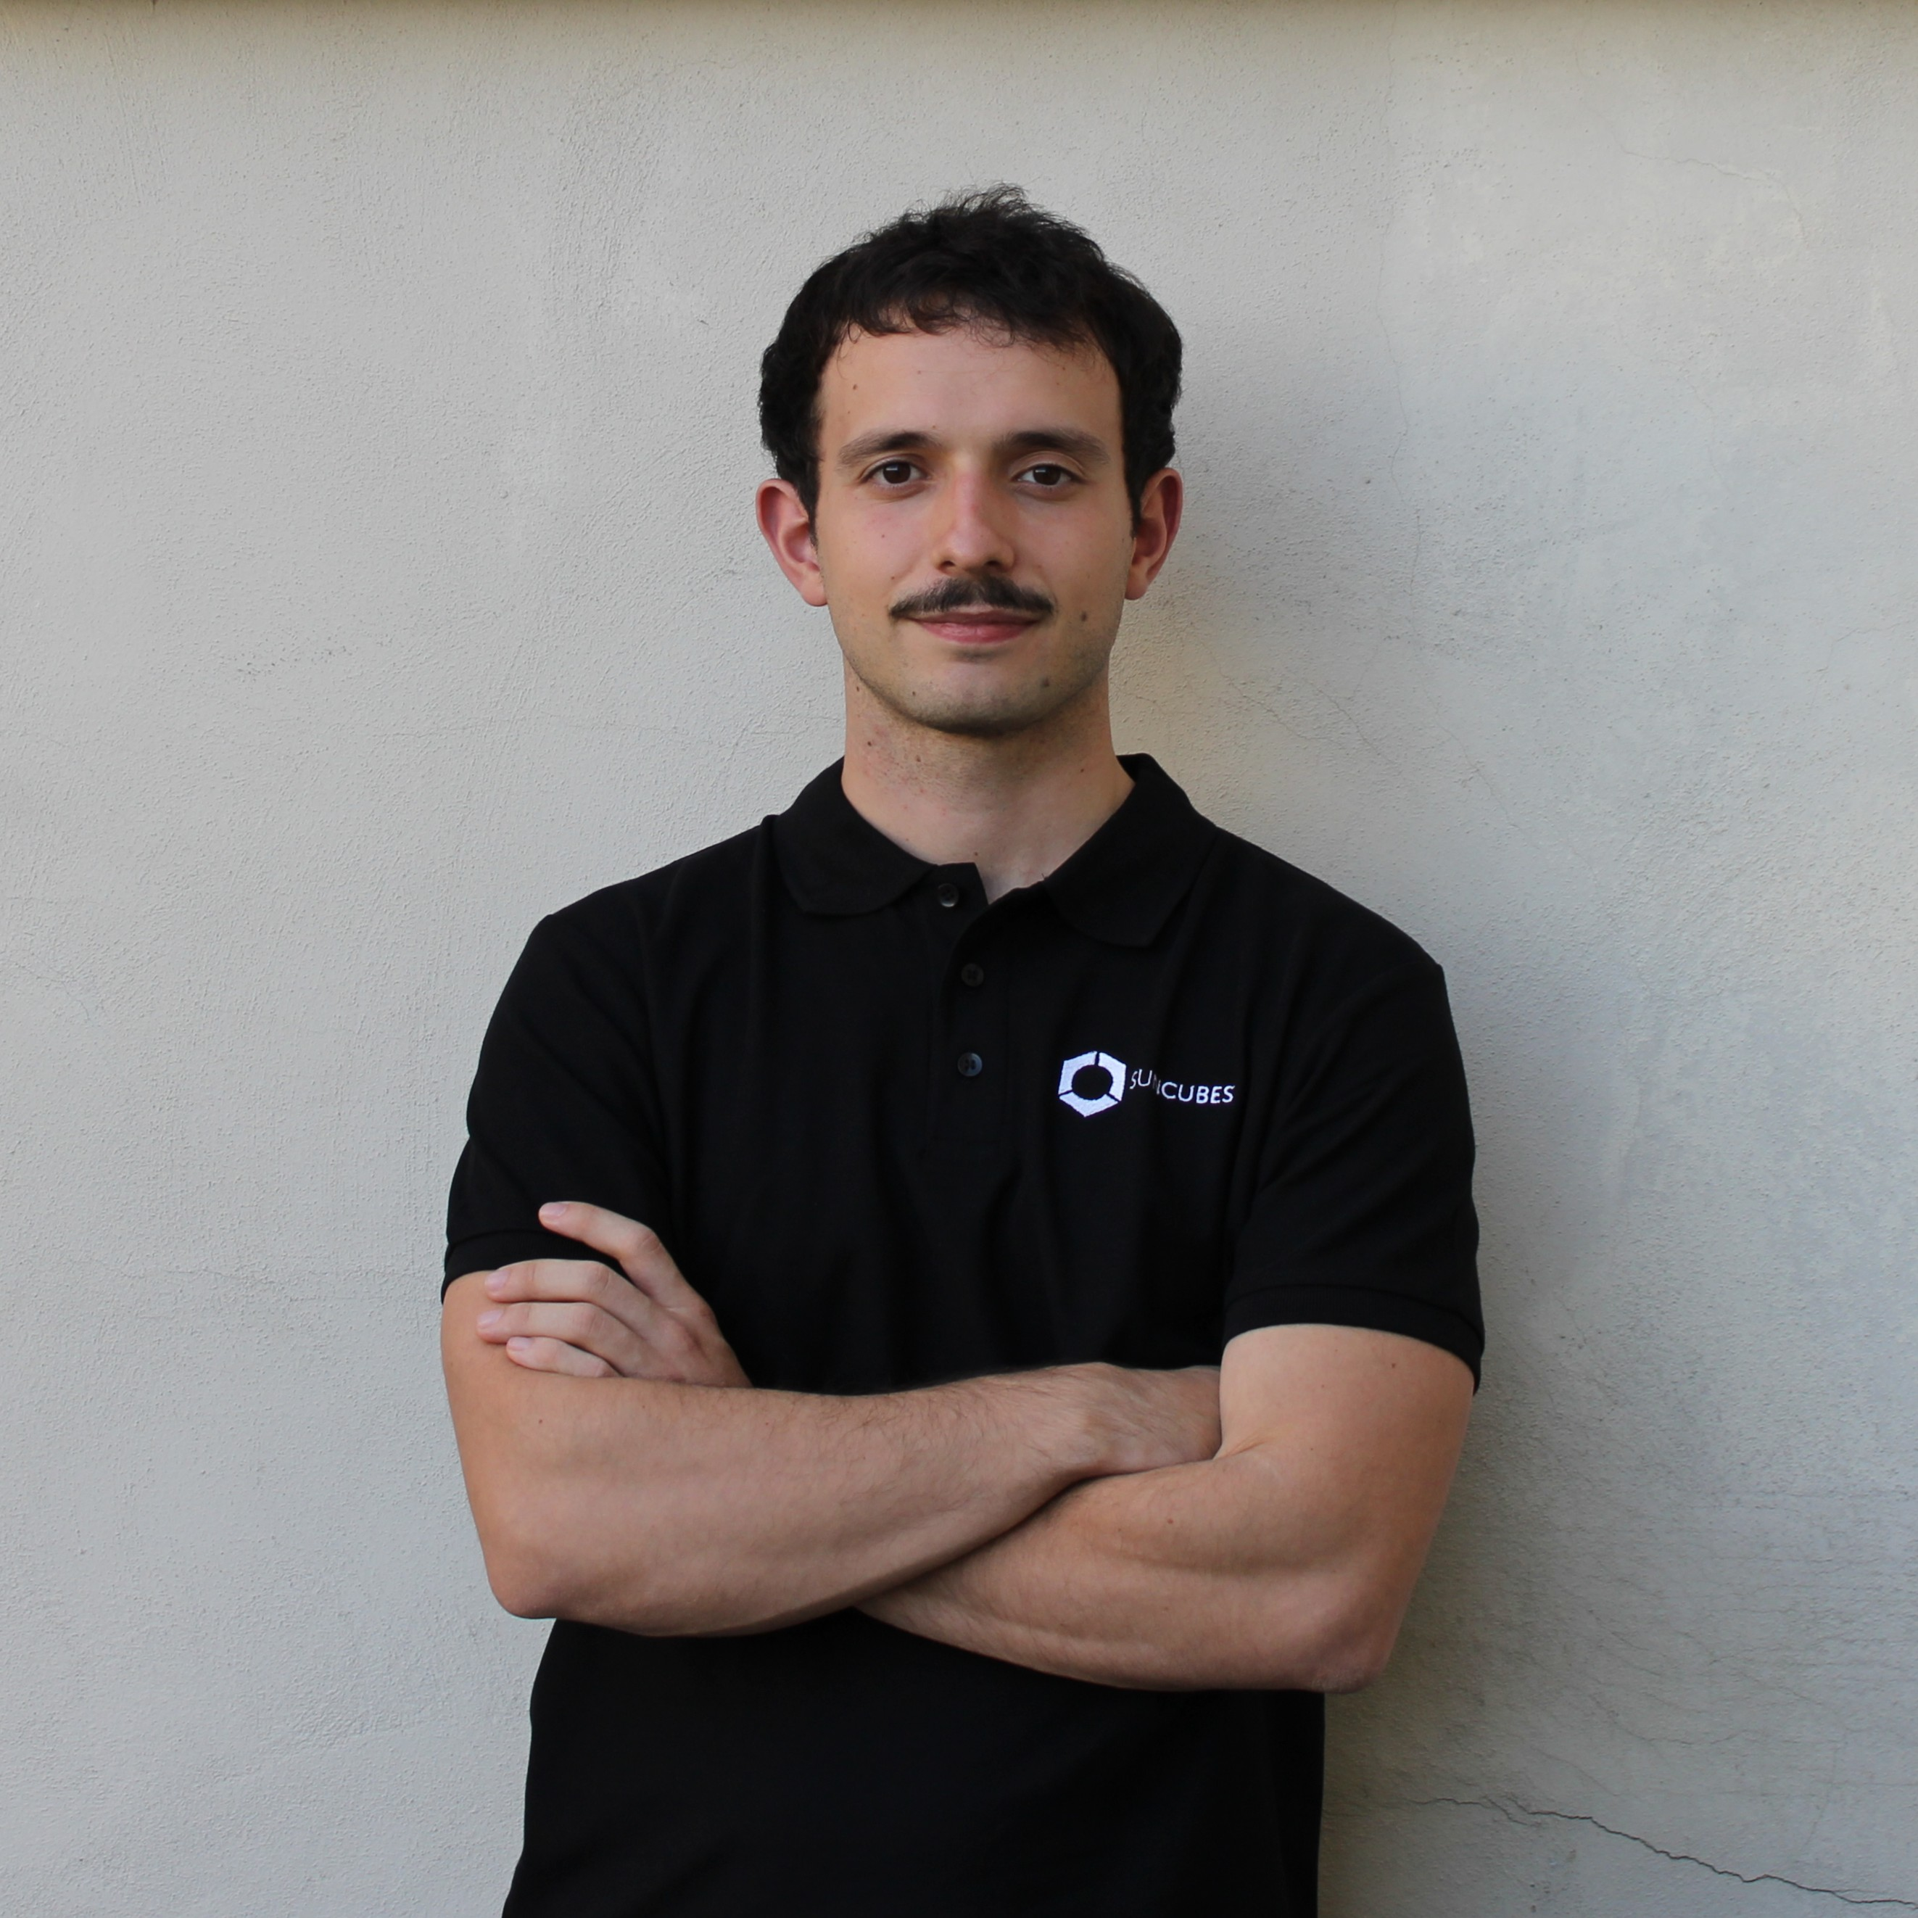
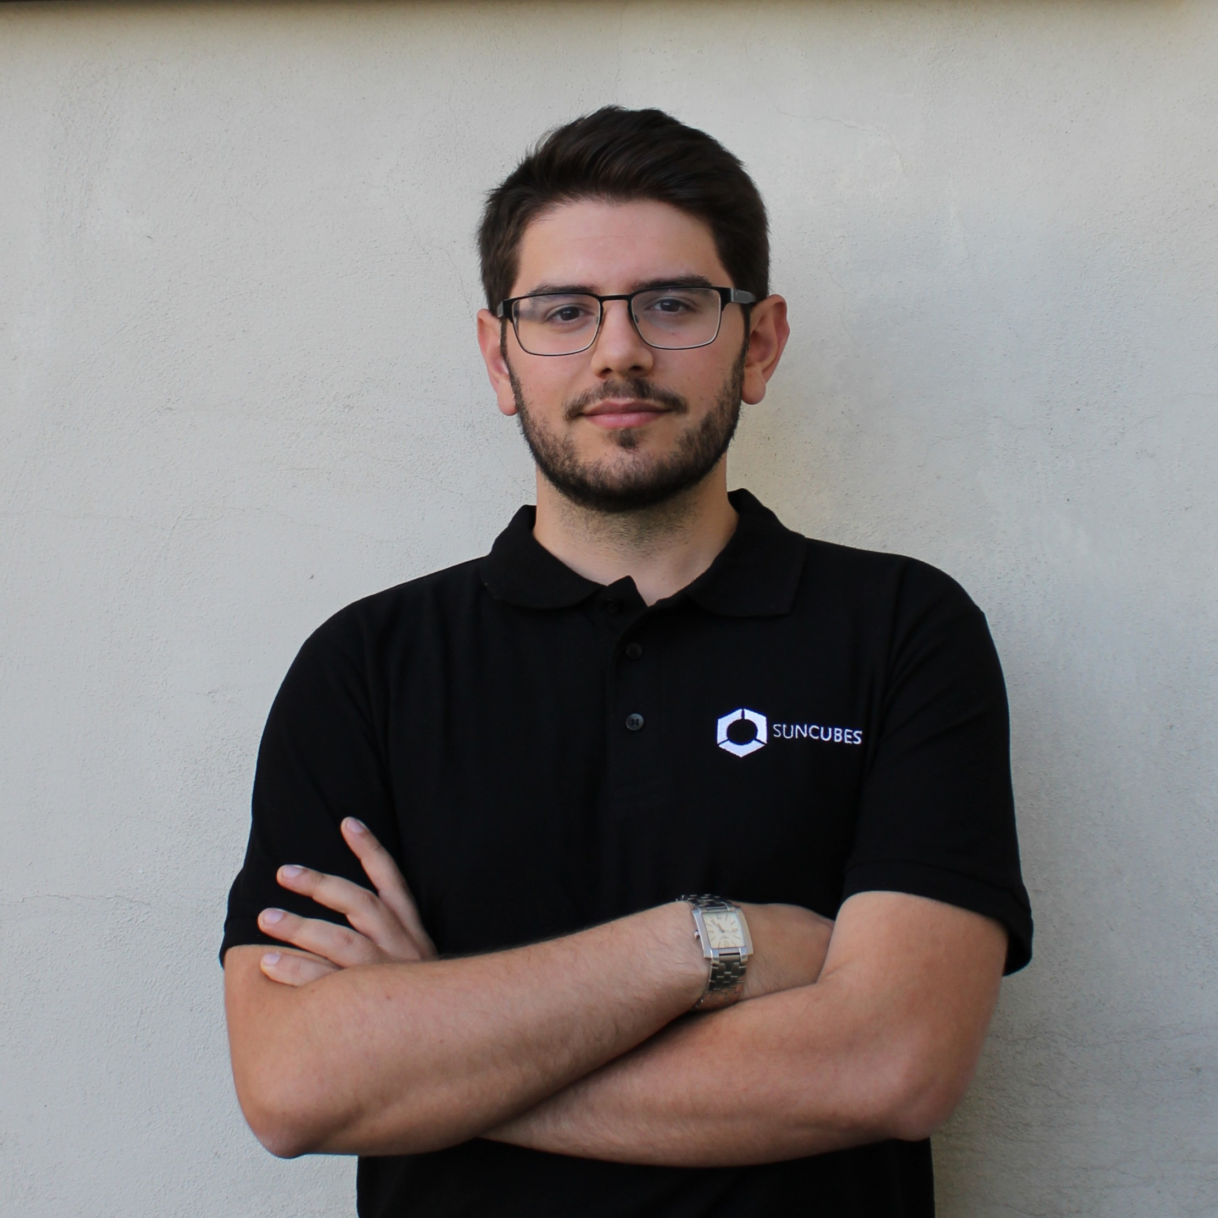
Your Speakers
Federico De Donatis
Luca Attorrese
Systems architecture & avionics integration
Robotics and perception

Slide 4

Workshop Map
Lesson 1
Lesson 2
Lesson 3
BUILD
ESTIMATE
PERCEIVE
Hardware, PX4
IMU + EKF
Camera +
Visual Odometry
07/10
14/10
21/10

Slide 5

Navigation
What is still missing?
WHERE IT IS
HOW FAST IT MOVES
HOW IT IS ORIENTED
What does it know about the world around it?
PERCEPTION
CAMERA
DEPTH
LiDAR
Notes:
Bridge from Lesson 2: the drone knows its own state. Today: what can a camera tell it about motion and about the world?

Slide 6
Sensors
One state, many sources
ATTITUDE
←
GYRO
GRAVITY
MAGNETIC FIELD
VISION
HEIGHT
←
BAROMETER
GNSS
RANGE
VISION
HORIZONTAL MOTION
←
GNSS
OPTICAL FLOW
VIO
If every sensor is incomplete, maybe the information is in the combination.
SENSOR FUSION
Notes:
Recall: VISION appears in every row. Today we open that box.

Slide 7
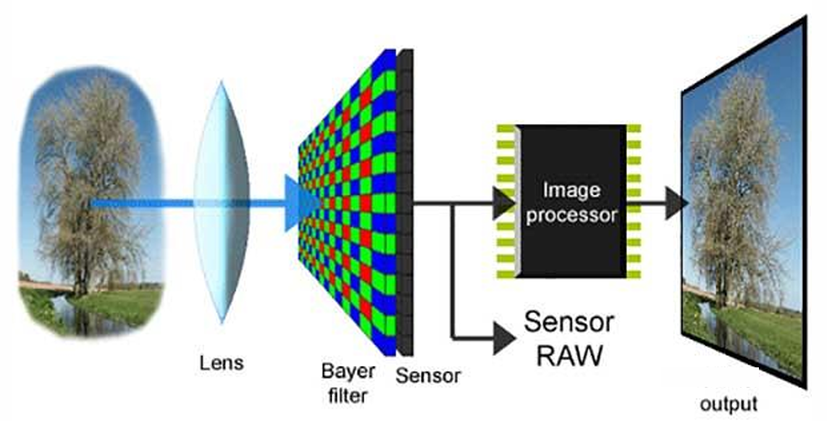
Camera
From photons to pixels
LIGHT
LENS
SENSOR
READOUT
IMAGE
scene radiance
focus · FOV · distortion
CMOS pixels · exposure
shutter · gain · ADC
pixels + timestamp
Same chain as Lesson 2: transduction → conditioning → sampling → digital measurement
Notes:
Mirror of the 'What is a sensor?' slide of Lesson 2. Insist on timestamp at capture (mid-exposure), not at arrival on the companion computer.

Slide 8
Camera
How do I choose a camera?
DYNAMIC WINDOW
RESOLUTION
FIELD OF VIEW
FRAME RATE
ERROR BEHAVIOUR
NOISE / LOW LIGHT
MOTION BLUR
ROLLING SHUTTER
INTEGRATION
LATENCY
TIME SYNC WITH OTHER SENSORS (EG. IMU)
INTERFACE
For visual odometry, global shutter and good timestamps beat megapixels.
Notes:
Same three-column frame as the sensor-selection slides of Lesson 2. FOV trade-off: wide FOV keeps features in view during fast motion but lowers angular resolution.

Slide 9
RoverTech
CAMERA MODEL

Slide 10
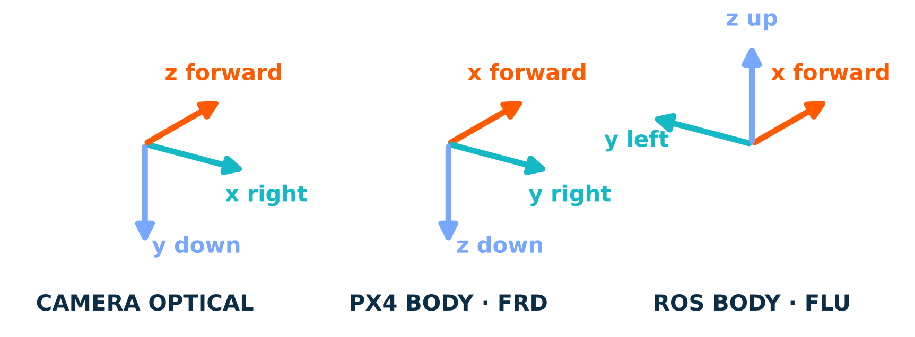
Camera model
Don't confuse the frames
A forward-looking camera's z axis is the body's x axis
World frames too: PX4 uses NED, ROS uses ENU (REP-105). Every boundary needs an explicit rotation.
Notes:
Number one source of bugs in practice. Suggest: always write the transform name as T_target_source and check with a pure-yaw and a pure-pitch test.

Slide 11
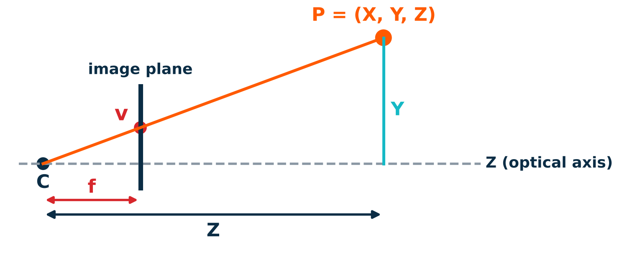
Camera model
The pinhole model
u = f_{x} · X / Z + c_{x}
v = f_{y} · Y / Z + c_{y}
PERSPECTIVE DIVISION
dividing by Z is exactly where depth disappears
Ideal camera: an infinitely small hole, no lens, no distortion.
Notes:
Derive by similar triangles: v/f = Y/Z. Coordinates in the camera optical frame (x right, y down, z forward). Then convert metric image coordinates to pixels with fx, fy, cx, cy.

Slide 12
Camera model
Step 1 · Extrinsics: where is the camera?
WORLD · NED
BODY · FRD
CAMERA
PIXEL
3D point P_{W}
vehicle frame
optical frame
(u, v)
vehicle pose
estimated · Lesson 2
extrinsics T_{CB}
calibrated · fixed
intrinsics K
+ distortion
p = π( K · T_{CB} · T_{BW} · P_{W} )
Lesson 1 again: same vector but different coordinates. Extrinsics are one more fixed frame.
Notes:
T_CB = rotation + translation from body to camera. For a forward-looking camera the rotation is a fixed axis permutation (next slide). The translation matters for lever-arm effects when the drone rotates.

Slide 13
Camera model
Step 2 · Intrinsics K: from rays to pixels
K =
f_{x}
s
c_{x}
f_{x}, f_{y}
c_{x}, c_{y}
focal length in pixels = f / pixel size
principal point: where the optical axis hits the sensor
0
f_{y}
c_{y}
0
0
1
640 px wide, 90° HFOV → f_{x} = 320 / tan 45° = 320 px
s = skew ≈ 0 for modern sensors
K belongs to the camera alone: it doesn't change when the drone moves (it does if you zoom or refocus).
Notes:
fx = (W/2)/tan(HFOV/2). Worked example useful for the Gazebo camera in the exercise, which is defined by its horizontal FOV and resolution.

Slide 14
Camera model
Homogeneous coordinates: one matrix product
λ · (u, v, 1) = K · [ R | t ] · (X_{W}, Y_{W}, Z_{W}, 1)
K · INTRINSICS
[ R | t ] · EXTRINSICS
λ = Zc · SCALE
3×3 · camera → image: focal length and principal point
3×4 · world → camera: the rigid-body pose T without its last row
divide by λ to get pixels: this is where depth is lost
Linear until the last division: a pixel gives back a ray, not a point.
Homogeneous coordinates are scale-invariant: (u, v, 1) and λ(u, v, 1) are the same pixel.
Notes:
The conceptual bridge of the lesson. A camera enters a Kalman filter exactly like the accelerometer did: predicted measurement vs actual measurement, innovation, gain.

Slide 15
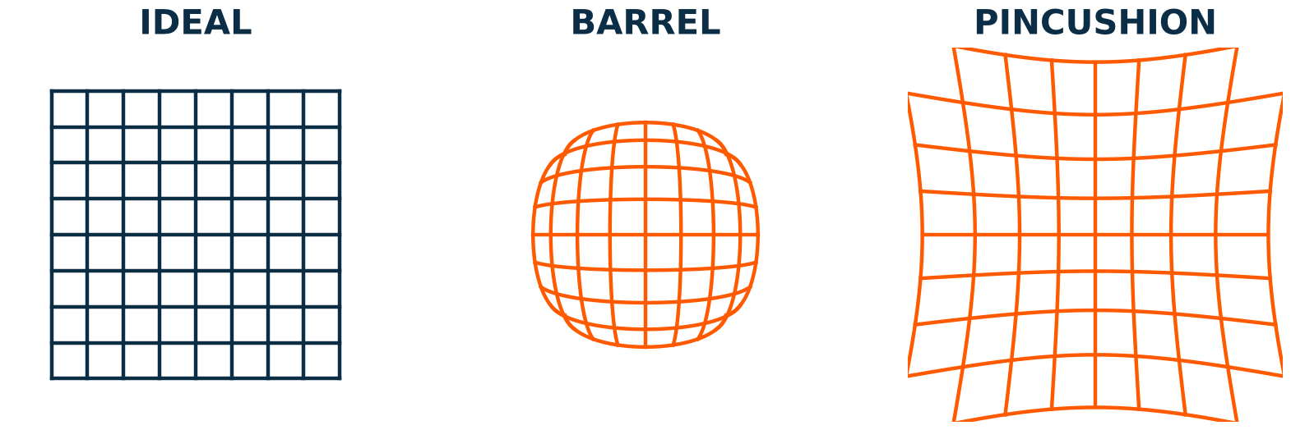
Camera model
Lens distortion
RADIAL–TANGENTIAL
k₁, k₂, k₃ radial · p₁, p₂ tangential · normal lenses
FISHEYE / EQUIDISTANT
r = f · θ (1 + k₁θ² + k₂θ⁴ + …) · very wide FOV
Wide-angle drone lenses make distortion non-negligible!
Notes:
Distortion is applied in normalized image coordinates, between the perspective division and K. OpenCV: plumb_bob / rational model and cv::fisheye. Kalibr: radtan and equidistant.

Slide 16
Camera model
The camera is just another h(x)
z = π( K, T_{CB}, T_{BW} · P_{W} ) + b + n
h(x) · IDEAL RELATIONSHIP
b · BIAS
n · RANDOM NOISE
calibration errors · camera–IMU time offset
feature localization ≈ 0.5–1 px
projection: pose + 3D point → pixel
Same estimator, richer measurement.
Notation follows the minimum measurement model of Lesson 2: z = h(x) + b + n
Notes:
The conceptual bridge of the lesson. A camera enters a Kalman filter exactly like the accelerometer did: predicted measurement vs actual measurement, innovation, gain.

Slide 17
Camera model
Calibration: measuring K, distortion and extrinsics
CAPTURE
DETECT
OPTIMIZE
CHECK
checkerboard / AprilGrid · many poses · cover corners
corners with sub-pixel accuracy
K, distortion, board poses
reprojection error < ~0.5 px
CAMERA ONLY
CAMERA + IMU
OpenCV calibrateCamera · ROS camera_calibration
Kalibr: T_{CI} extrinsics + time offset
Bad calibration is a bias: no filter can average it away.
Notes:
Demo idea: calibrate a webcam live with OpenCV and show the reprojection error. Suggested image: Kalibr AprilGrid. The 0.5 px threshold is a rule of thumb, not a standard.

Slide 18
RoverTech
CAMERA TYPES

Slide 19
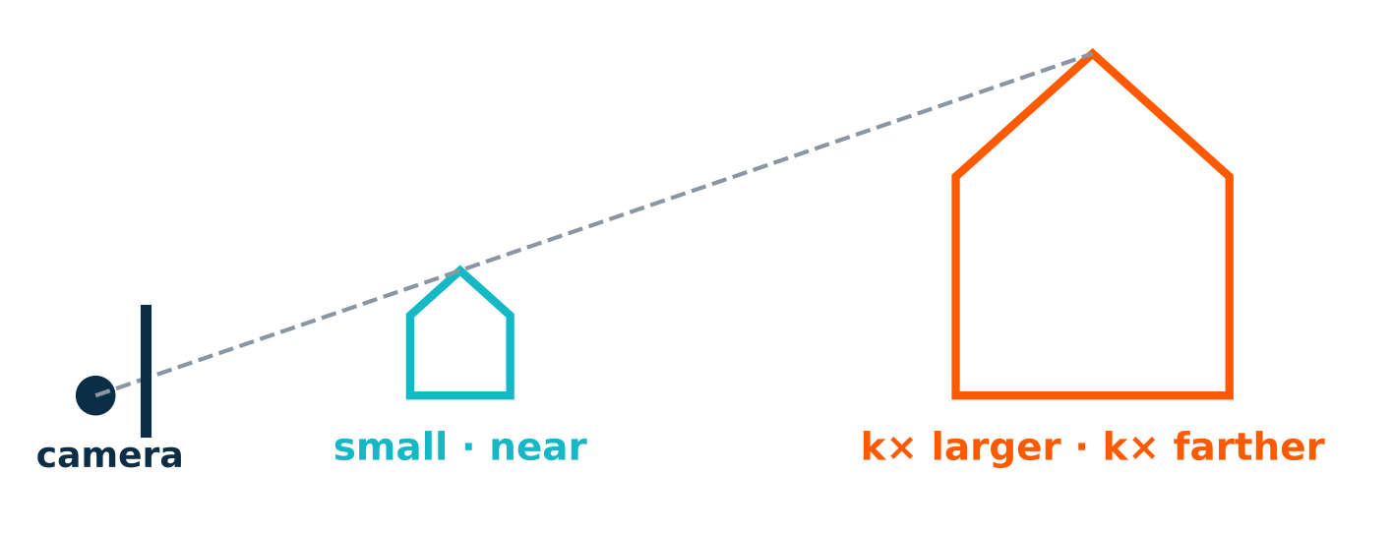
Camera types
Monocular: scale is not observable
LESSON 2
rotating around gravity doesn't change gravity → yaw unobservable
LESSON 3
scaling the world doesn't change the image → scale unobservable
Fix the scale with: IMU · rangefinder height · stereo baseline · known object size
Notes:
Same observability argument as the yaw slide of Lesson 2: a transformation of the state that leaves the measurement unchanged is invisible to the estimator.

Slide 20
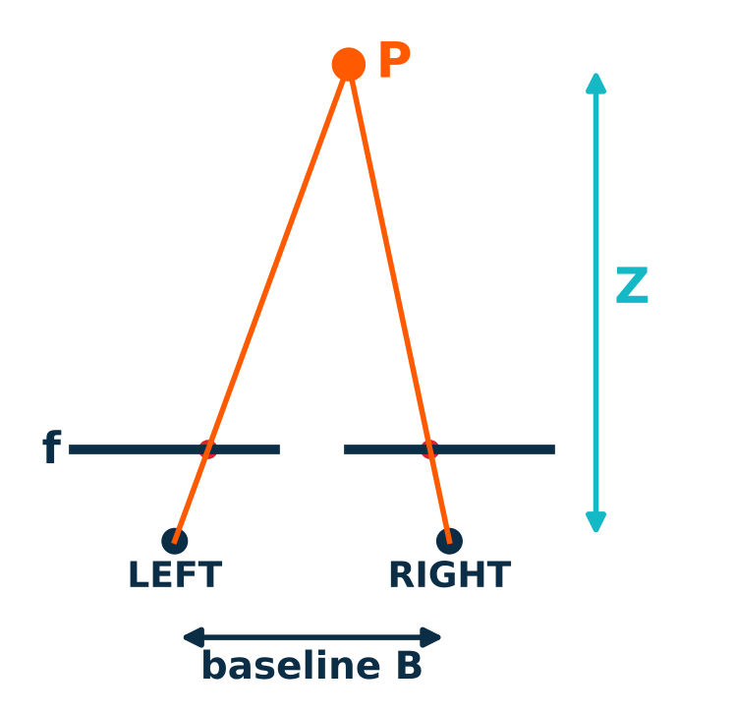
Camera types
Stereo: depth from disparity
Z = f · B / d
d = u_{L} − u_{R} (disparity, pixels)
DEPTH ERROR
MATCHING
δZ ≈ Z² · δd / (f · B)
grows with Z²
the hard part: find the same point in both images
Two calibrated cameras + known baseline = metric depth in a single frame.
Notes:
Derivative of Z = fB/d with respect to d gives dZ = -Z^2/(fB) dd. Stereo also needs rectification: both images warped so that matches lie on the same row.

Slide 21
Camera types
Stereo error grows with Z²
ASSUMPTIONS
f = 400 px · δd = 0.25 px
DESIGN LESSON
the frame limits the baseline: on a small drone, stereo is short-range
At 10 m, a 6 cm baseline gives about ±1 m of depth error.
Notes:
Numbers from dZ = Z^2 dd / (f B). With f=400 px, dd=0.25 px, B=0.06 m, Z=10 m: dZ ≈ 1.04 m. Ask the class what baseline they would need for 10 cm at 10 m (≈ 0.6 m).

Slide 22
Camera types
Choosing a camera model
 | MONOCULAR | STEREO | RGB-D (ToF · STRUCTURED LIGHT) | FISHEYE
Depth per frame | no | yes · passive | yes · active | only if stereo
Metric scale | needs IMU / prior | yes | yes | needs IMU / prior
Range | any (bearing only) | short–medium | short | any (bearing only)
Outdoor sunlight | good | good | often poor | good
Mass · power | lowest | medium | medium–high | low
Best for | light VIO | depth + VIO | indoor mapping | robust tracking
Design lesson: no universal winner. The mission sets the camera.
Notes:
Fisheye is a lens/projection model rather than a sensor type, but it is a common design choice for VIO (wide FOV keeps features visible during fast rotation). Event cameras can be mentioned as a research direction.

Slide 23
RoverTech
ESTIMATION

Slide 24
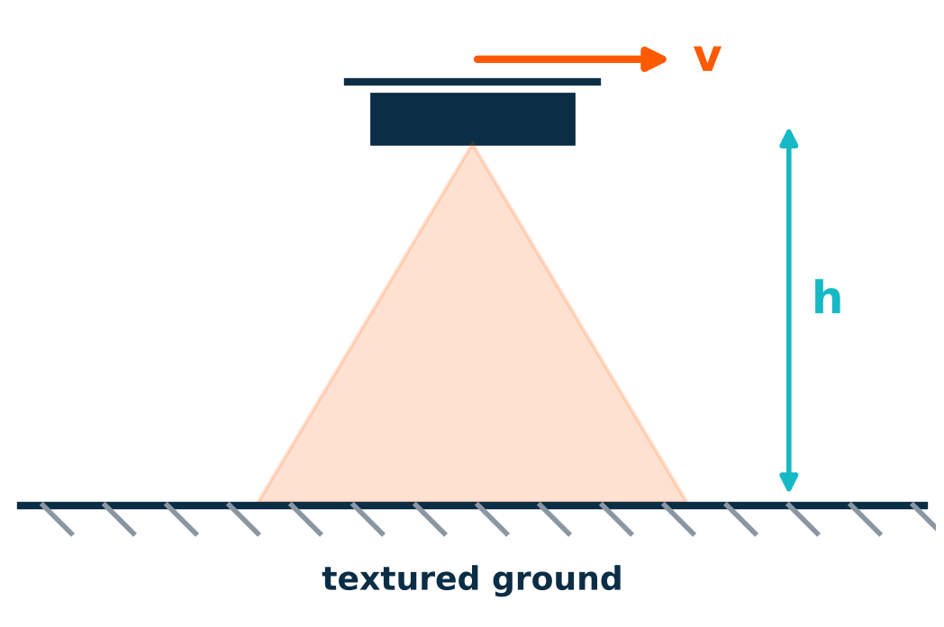
Estimation
Optical flow: the simplest visual velocity
v ≈ (ω_{flow} − ω_{gyro}) · h
GYRO removes the rotational part of the flow
RANGEFINDER gives h: no height, no metric velocity
TEXTURE + LIGHT no features, no flow
Lesson 2: optical flow listed among horizontal-motion sources
Notes:
Downward camera: angular flow rate times height gives ground speed, after subtracting body rotation measured by the gyro. This is why flow sensors are paired with a rangefinder.

Slide 25
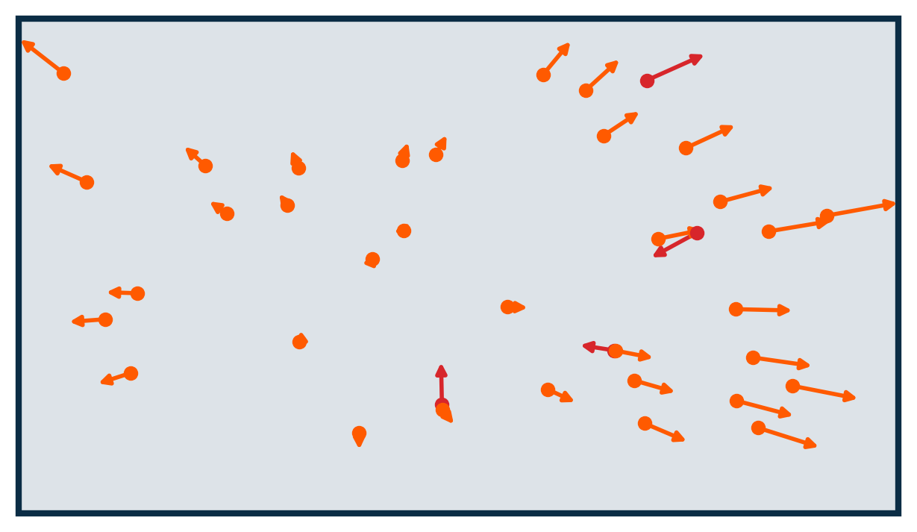
Estimation
The visual odometry pipeline
FEATURES
TRACKING
OUTLIERS
MOTION
REFINE
FAST · ORB · Shi-Tomasi
KLT · descriptor matching
RANSAC rejects wrong matches
essential matrix · PnP
local bundle adjustment
orange: tracked features consistent with one camera motion
red: outliers from wrong matches or moving objects
Motion is estimated from the inliers only.
Notes:
Suggested demo: run OpenCV goodFeaturesToTrack + calcOpticalFlowPyrLK on a short drone video and show the tracks live.

Slide 26
Estimation
Three ways to recover motion
2D – 2D
3D – 2D
3D – 3D
essential matrix
5-point + RANSAC
R and t up to scale
PnP
known 3D points → full metric pose
markers, maps
point-cloud alignment
ICP · Umeyama
stereo, RGB-D
PnP is today's exercise: a marker of known size gives a metric pose from one image.
Notes:
2D-2D: monocular initialization, scale unknown. 3D-2D: once a map or a marker exists. 3D-3D: when depth is measured directly.

Slide 27
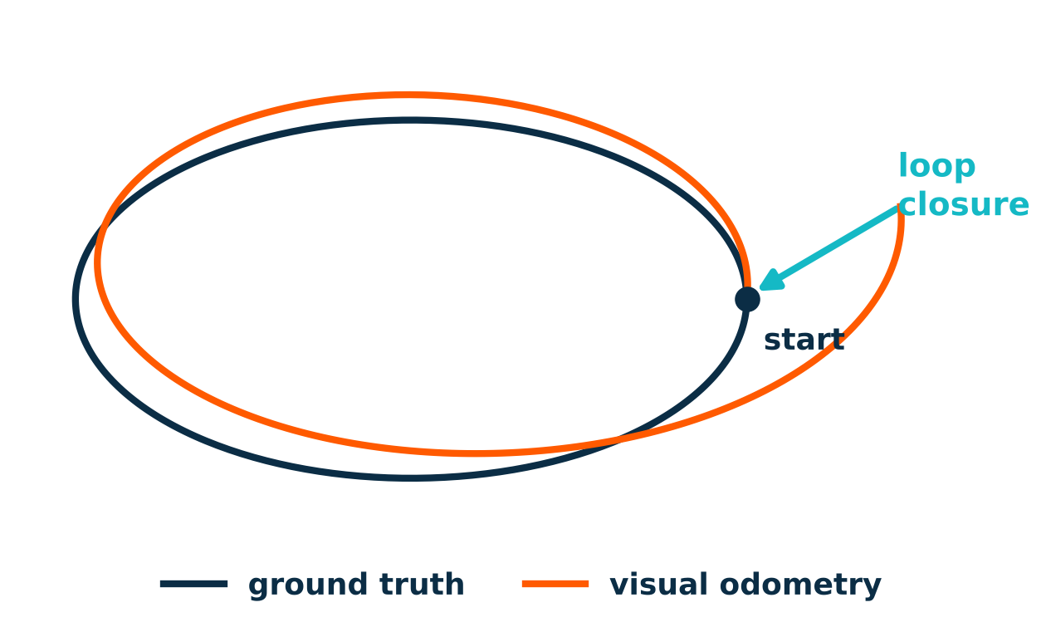
Estimation
VO is a gyroscope for position
GYROSCOPE · LESSON 2
integrates rate → attitude drifts
VISUAL ODOMETRY
integrates relative motion → pose drifts with distance
SLAM
recognizes places: loop closure is an absolute correction
Odometry is relative. Something absolute must eventually correct it.
Notes:
Parallel with gyro integration in Lesson 2. Absolute references: GNSS, loop closure on a map, known landmarks or markers.

Slide 28
Estimation
VIO: no sensor is enough, again
IMU
CAMERA
VIO
high rate · gravity direction
metric scale (with motion)
but bias drifts in seconds
rich geometry
low drift with texture
but low rate, blur and no texture break it
IMU bridges the gaps
camera bounds the drift
complementary by design
No sensor is wrong BUT no sensor is enough.
Notes:
Exact callback to the 'Why one sensor is not enough' slide of Lesson 2.

Slide 29
Estimation
Loosely vs tightly coupled
LOOSELY COUPLED
TIGHTLY COUPLED
VO outputs a pose → the filter fuses it as a measurement
PRO simple, modular: PX4 EKF2 + external vision
CON VO errors and correlations hidden from the filter
feature observations enter the estimator directly
PRO more accurate and robust; IMU helps tracking
CON complex, compute-heavy, needs precise calibration
OpenVINS · MSCKF filter
VINS-Fusion · optimization
ORB-SLAM3 · visual-inertial SLAM
VOXL · qVIO
Today's PX4 integration is loosely coupled: the VIO runs outside, EKF2 fuses its output.
Notes:
Examples are well-known open-source or commercial VIO systems; check current status before the lesson. The Intel RealSense T265 tracking camera was discontinued.

Slide 30
Estimation
When vision fails
LOW TEXTURE
LIGHTING
MOTION BLUR
white walls · water · snow
darkness · backlight · exposure jumps
fast motion · long exposure
DYNAMIC SCENES
VIBRATION
FAST ROTATION
people, vehicles, moving shadows
propellers + rolling shutter
features leave the image
The estimator must notice: quality metrics + innovation gating (Lesson 2).
Notes:
Ask the class which failure modes apply to the reference mission (remote site inspection). Large innovations are the symptom; gating is the defense.

Slide 31
RoverTech
PX4

Slide 32
PX4
Where does VIO run?
CAMERA
COMPANION
LINK
uORB
EKF2
images + timestamps
VIO / SLAM soft real time
MAVLink ODOMETRY · uXRCE-DDS
vehicle_visual_
odometry
fuse · gate hard real time
HIGH-LEVEL AUTONOMY
HARD REAL TIME
Safety rule (Lesson 1): if VIO dies, PX4 must still stabilize, fall back and land.
PX4 v1.17 docs · Using Vision or Motion Capture Systems for Position Estimation
Notes:
Timing domains from Lesson 1. MAVLink ODOMETRY with frame_id MAV_FRAME_LOCAL_FRD (or VISION_POSITION_ESTIMATE) maps to vehicle_visual_odometry; with ROS 2 the companion publishes /fmu/in/vehicle_visual_odometry via uXRCE-DDS.

Slide 33
PX4
Vision into EKF2: the parameters
EKF2_EV_CTRL
EKF2_HGT_REF
what to fuse: horizontal position · vertical position · velocity · yaw
set to Vision to use it as the height reference
EKF2_EV_DELAY
EKF2_EV_POS_X/Y/Z
vision delay relative to the IMU [ms] · tune from logs
sensor position in the body frame: the extrinsics again
GNSS, baro and rangefinder can be disabled with EKF2_GPS_CTRL, EKF2_BARO_CTRL, EKF2_RNG_CTRL.
PX4 v1.17 docs · Using Vision or Motion Capture Systems for Position Estimation
Notes:
EKF2_EV_DELAY: difference between the vision timestamp and the actual capture time on the IMU clock. Rough estimate from logs by comparing IMU rates and EV rates (SDLOG_PROFILE bit 7).

Slide 34
PX4
The interface: frames, delay, uncertainty
FRAMES
DELAY
UNCERTAINTY
ODOMETRY in MAV_FRAME_LOCAL_FRD · ROS ENU/FLU must be rotated to NED/FRD
timestamp at capture, not at arrival · residual → EKF2_EV_DELAY
the covariance you send becomes R in the Kalman update (Lesson 2)
Overconfident VIO is worse than no VIO: the filter will trust it.
PX4 v1.17 docs · Using Vision or Motion Capture Systems for Position Estimation
Notes:
Check from the docs: velocities in ODOMETRY are expressed in the body FRD frame. Sanity test: yaw the vehicle until the streamed quaternion is close to identity, then move along each axis.

Slide 35
PX4
Perception beyond self-localization
DEPTH CAMERA
OBSTACLE_DISTANCE
COLLISION PREVENTION
stereo / ToF on the companion
MAVLink · distances by sector
CP_DIST · Position mode
MARKER
LANDING_TARGET
PRECISION LANDING
ArUco / AprilTag + PnP
MAVLink · MAV_FRAME_LOCAL_NED
PLD_* parameters
Navigation estimates the vehicle. Perception interprets the environment.
PX4 v1.17 docs · Collision Prevention · Precision Landing
Notes:
Closes the loop opened at the end of Lesson 2. Both features run in PX4 with perception on the companion computer.

Slide 36


Material
FedericoDD/workshop-PX4/

Slide 37
Recap
MODEL A CAMERA: K, DISTORTION, EXTRINSICS
CHOOSE THE RIGHT CAMERA FOR THE MISSION
TURN PIXELS INTO MOTION AND FEED PX4

Slide 38
Workshop complete
Lesson 1
Lesson 2
Lesson 3
BUILD
ESTIMATE
PERCEIVE
Hardware, PX4
IMU + EKF
Camera + Visual Odometry
07/10
14/10
21/10
Notes:
Build → Estimate → Perceive: from the system, to the state, to the world.

Slide 39
What's next
Where to go from here
SLAM & MAPPING
DEEP PERCEPTION
PLANNING
REAL HARDWARE
ORB-SLAM3 · occupancy and voxel maps
from maps to safe trajectories
calibrate, log, fly: HIL, then field tests
detection and segmentation on Jetson-class compute
Build → Estimate → Perceive. Now close the loop on a real drone.

Slide 40
RoverTech
Thank you!

