Slide 1
XAI
Data Processing and Analysis
2023/2024

Slide 2
Struttura
Caricamento Dataset -> One-Hot-Encoding
Exploratory Data Analysis
Preprocessing -> Modelling
XAI (Main Topic)

Slide 3
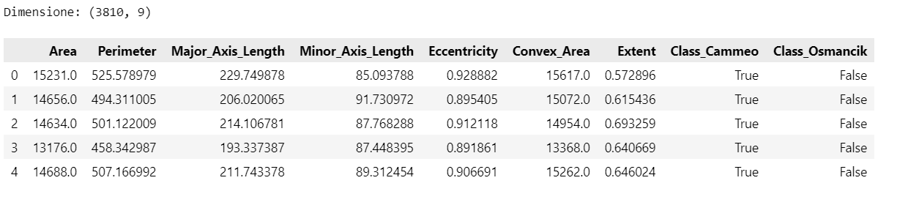
Dataset

Slide 4
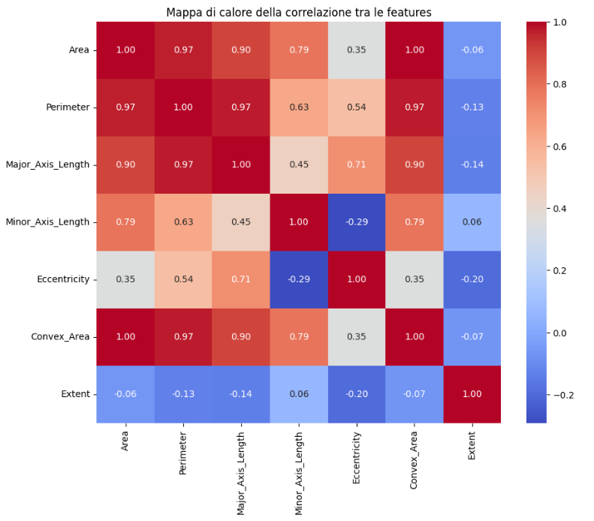
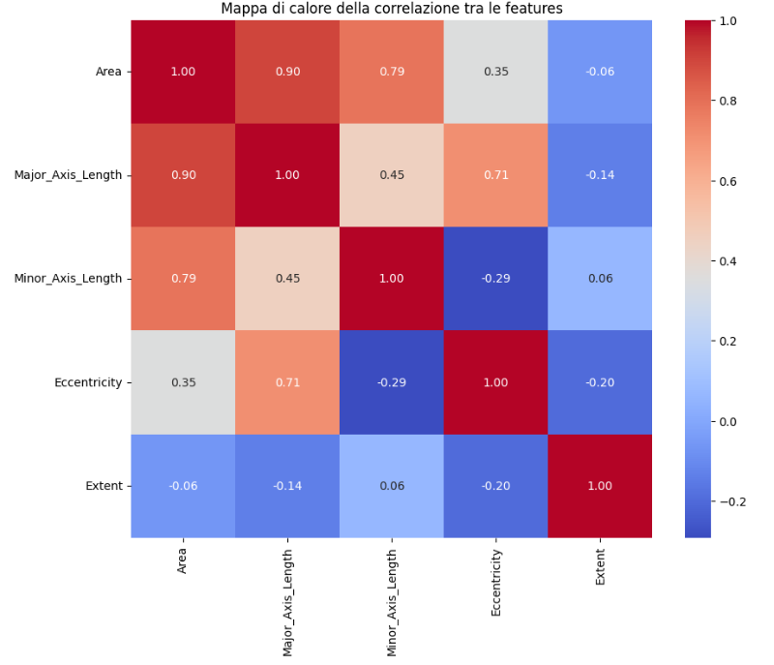
Exploratory Data Analysis

Slide 5
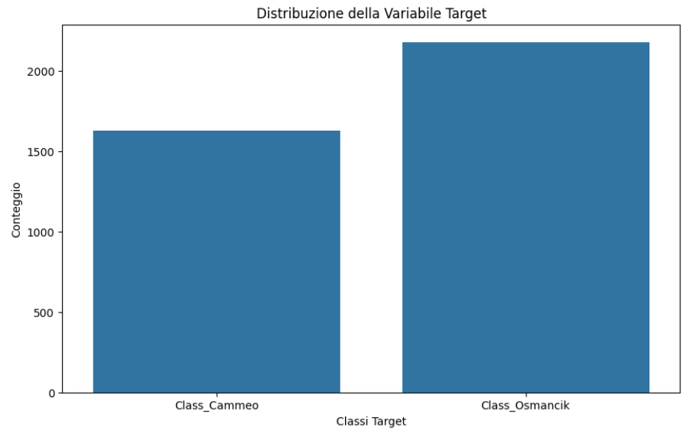
Binary Target???? No Problem

Slide 6
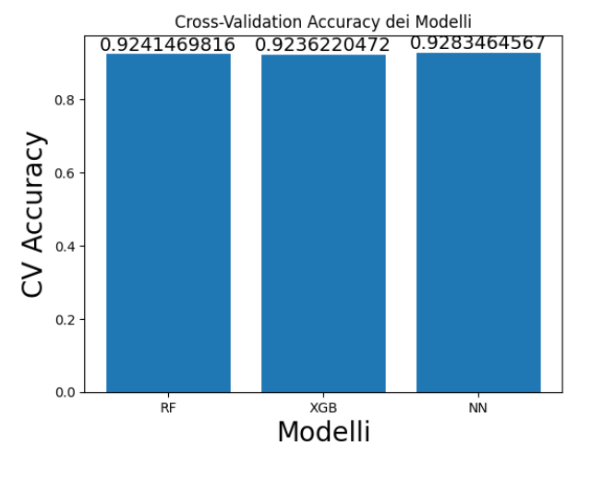
Modelling

Slide 7
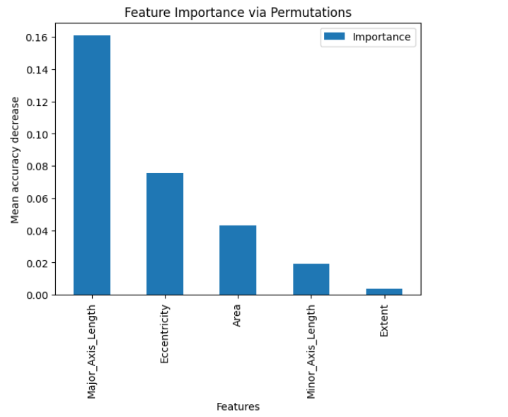
XAI : Global Explanation

Slide 8
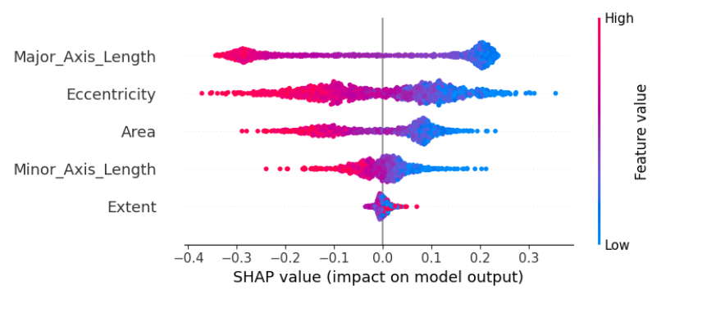
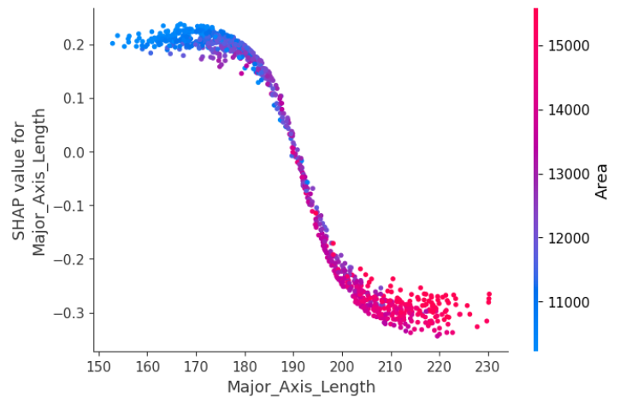
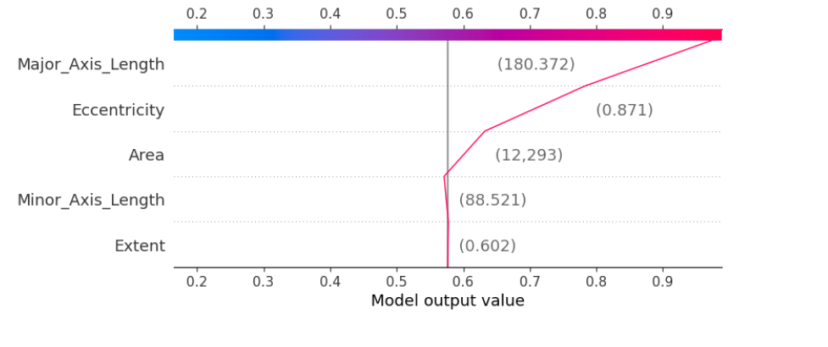
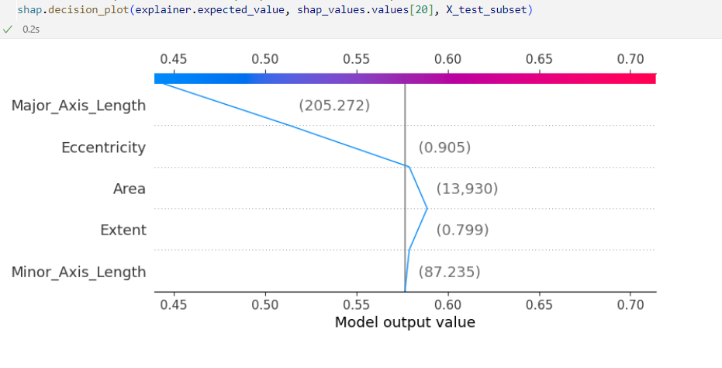
SHAP: LOCAL EXPLANATION

Slide 9
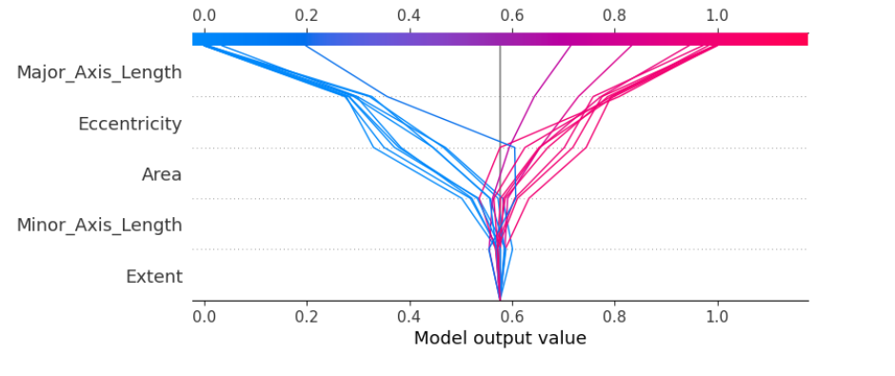

Slide 10
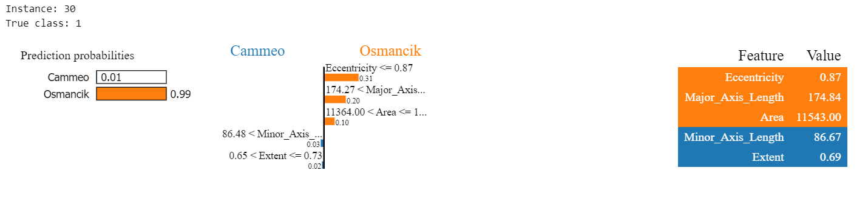
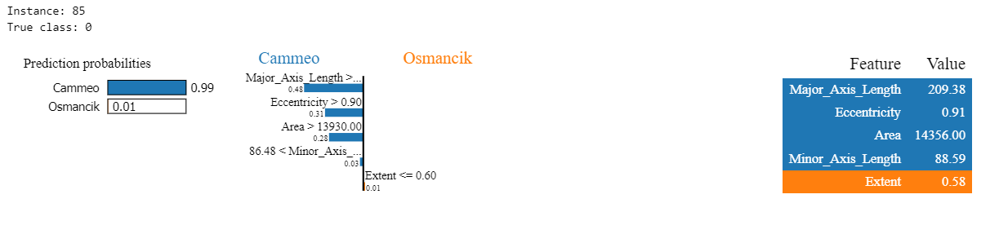
LIME : Local Explanation

Slide 11
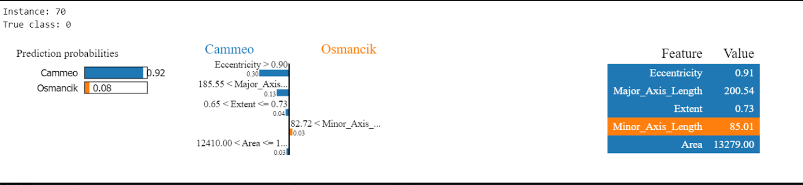
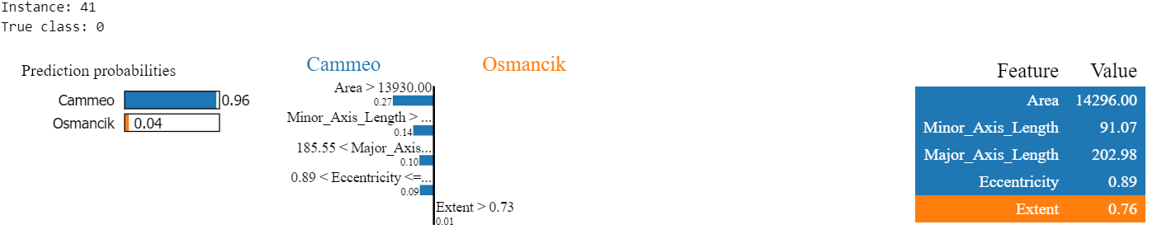
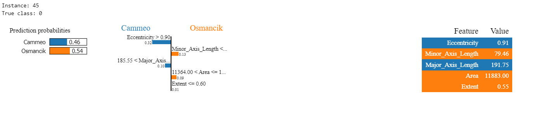
CASO INDECISO:

Slide 12
CONLUSIONE…

