Slide 1
PHYTON DRIVING LICENSE Exam project
Supervisors of the course:
Students ID:
Prof. Raos, Guido
Prof. Miglio, Edie
Prof. Bruschi, Francesco
Piccagli, Federico [10801916]
Leonardis, Giacomo [10801916]
Academic year: 2022 - 2023

Slide 2
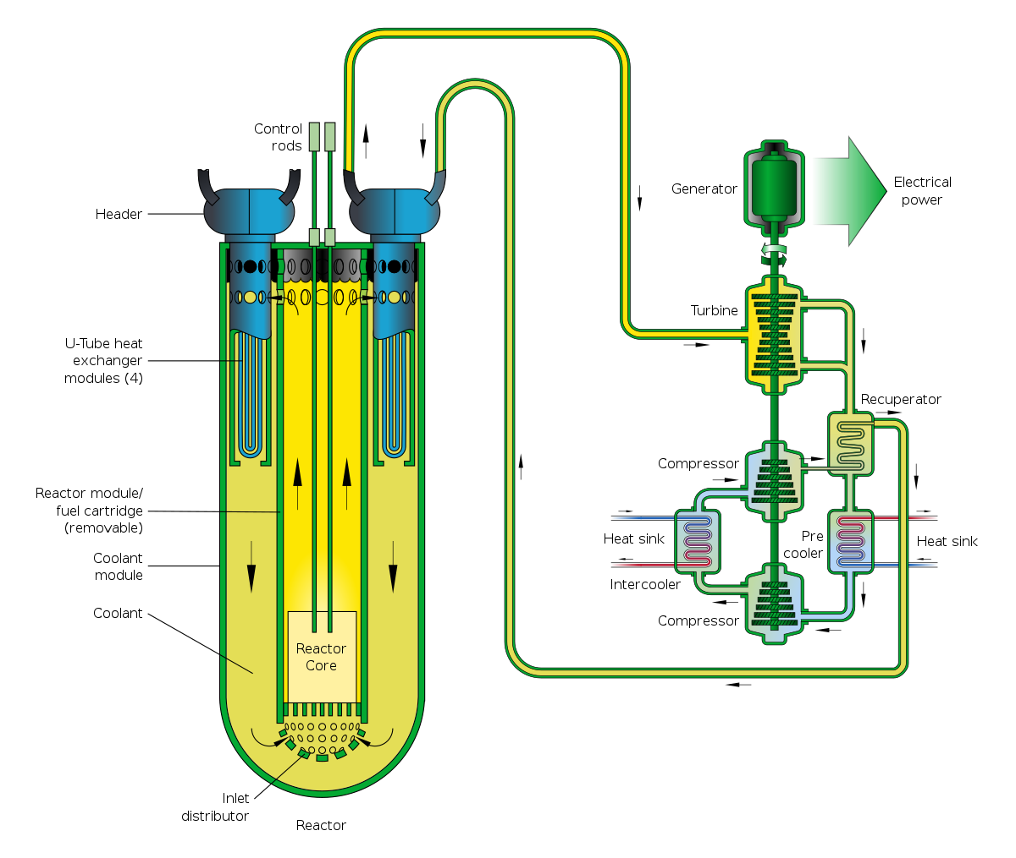
Introduction
IVth generation nuclear reactors
Next generation nuclear reactors
Materials challenges
Troubleshooting solutions
Materials requirements
Aim of the current PhD project
Materials solutions
GEN-IV FBRs
Materials solutions
GEN-IV FBRs
Materials challenges
Materials challenges
Fast Breeder Reactor (FBR) concepts
Lead-cooled fast reactor (LFR) technology
[2]
[1] M. Vanazzi, PhD Thesis, Politecnico di Milano, 2019. [2] https://en.wikipedia.org/wiki/Lead-cooled_fast_reactor.

Slide 3
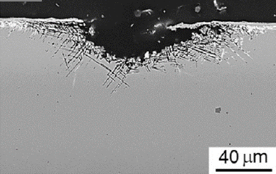
Introduction
IVth generation nuclear reactors
Next generation nuclear reactors
Materials challenges
Troubleshooting solutions
Materials requirements
Aim of the current PhD project
Materials solutions
GEN-IV FBRs
Materials solutions
GEN-IV FBRs
Materials challenges
Materials challenges
Heavy Liquid Metal (HLM) dissolution
Integrity of reactor’s in-core steel parts
[1]
[1] M. Vanazzi, PhD Thesis, Politecnico di Milano, 2019.

Slide 4
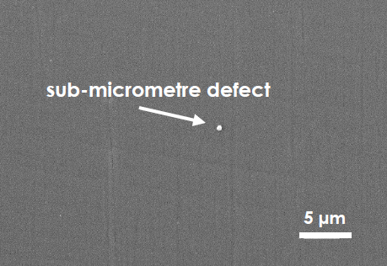
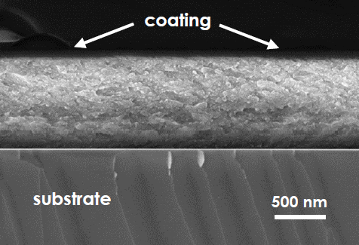
Introduction
IVth generation nuclear reactors
Next generation nuclear reactors
Materials challenges
Troubleshooting solutions
Materials requirements
Aim of the current PhD project
Materials solutions
GEN-IV FBRs
Materials solutions
GEN-IV FBRs
Materials challenges
Materials challenges
Ceramic protective barriers
PLD-grown a-Al₂O₃ coatings
[1]
[1] M. Vanazzi, PhD Thesis, Politecnico di Milano, 2019.

Slide 5
Introduction
IVth generation nuclear reactors
Next generation nuclear reactors
Materials challenges
Troubleshooting solutions
Materials requirements
Aim of the current PhD project
Materials solutions
GEN-IV FBRs
Materials solutions
GEN-IV FBRs
Materials challenges
Materials challenges
Preservation of the film’s integrity
Corrosion-damage exposure
Radiation-damage exposure
Mechanical deformation
Focus of the project hereby presented
[1]
[1] M. Vanazzi, PhD Thesis, Politecnico di Milano, 2019.

Slide 6
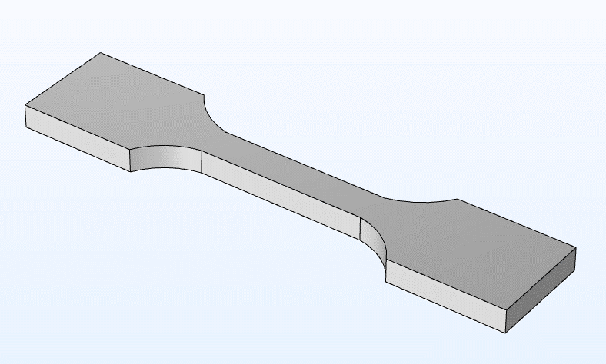
Introduction
IVth generation nuclear reactors
Next generation nuclear reactors
Materials challenges
Troubleshooting solutions
Materials requirements
Aim of the current PhD project
Materials solutions
GEN-IV FBRs
Materials solutions
GEN-IV FBRs
Materials challenges
Materials challenges
TENSILE TESTS experimental campaign
z
x
y
74 mm
Planar dog-bone geometry
Externally imposed strain/stress
Evaluate the coating’s response upon mechanical deformations
4 mm
15 mm

Slide 7
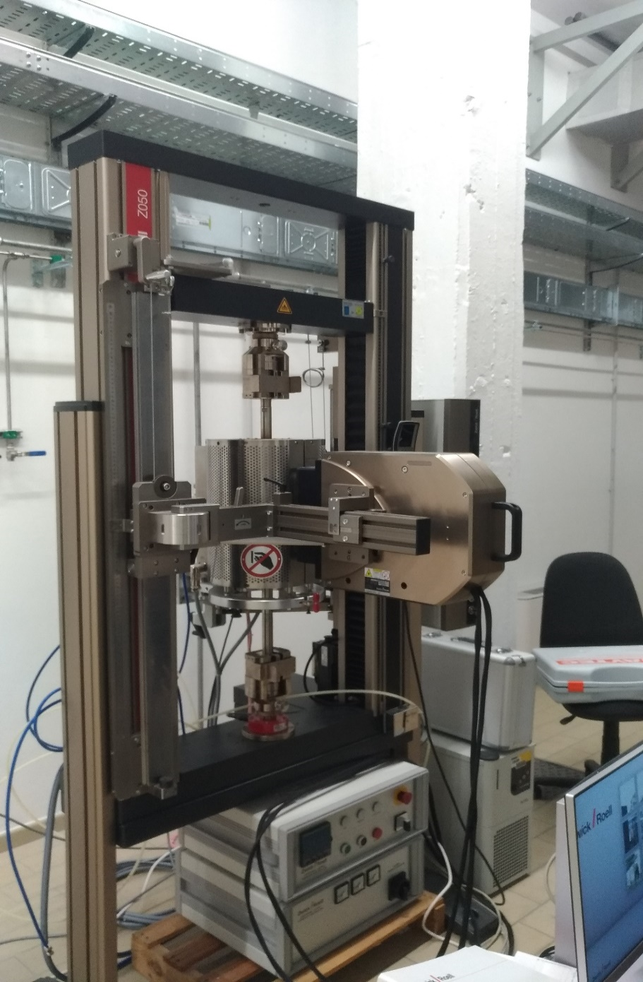
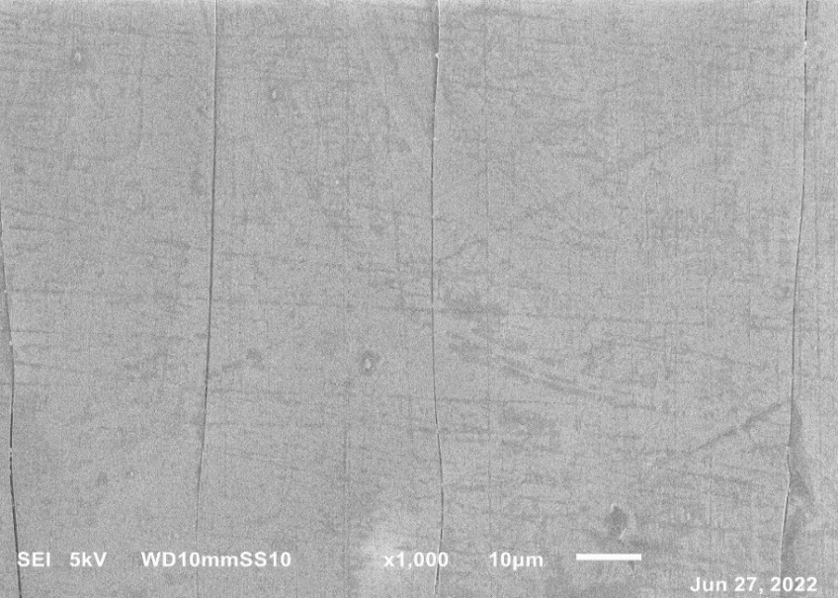
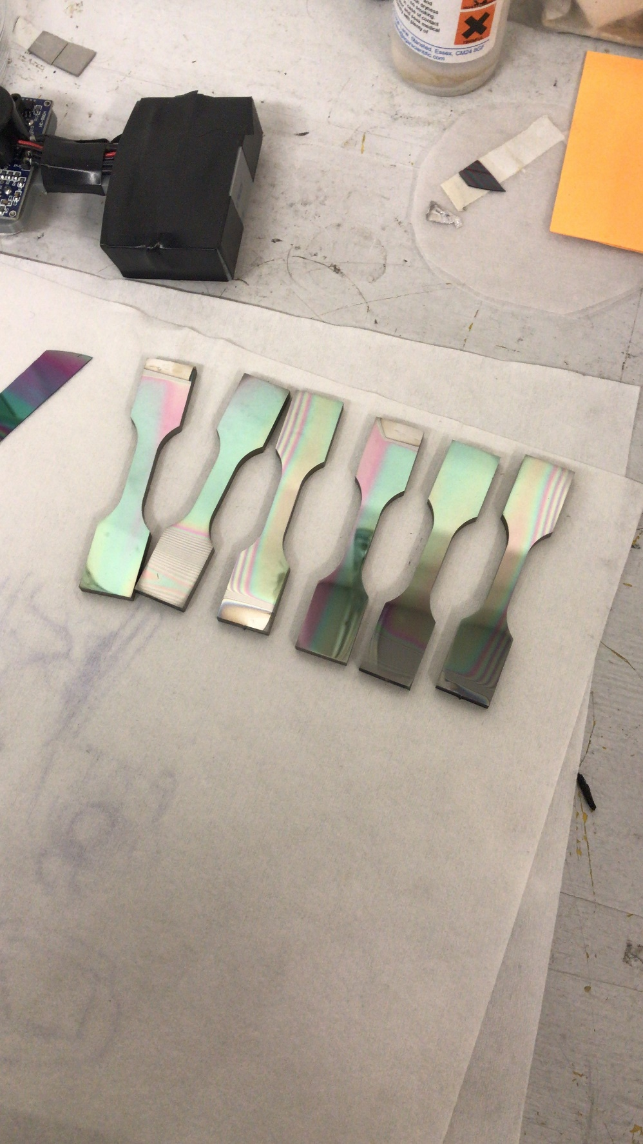
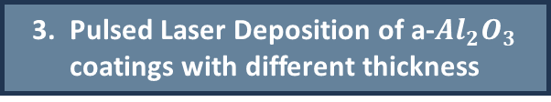
Experimental
Experimental analysis
4. Mechanical tests with diverse tensile loads
5. Ex-situ characterization and analysis
Generation of dog-bone substrates from a cold-rolled AISI316 metal sheet
Pre-deposition treatments (grinding, polishing, ultrasonic cleaning, ion gun cleaning)
Retrive the conditions (stress or strain) upon which the coating failed i.e., cracked or delaminated
SEM image of a cracked coating
3. Pulsed Laser Deposition of a-$Al_{2}O_{3}$ coatings with different thickness

Slide 8


How Phyton is useful for?
Study of the fracture mechanics of the coating
Raw data as resulting from each tensile test
Stress-strain characteristics
Incremental modulus of the composite
Linear elastic approximation
Study of the mechanics of the whole composite

Slide 9
Phyton Project
General overview of the assignment
Sequence of the operations leading to the expected result:
Creation of a test script for a random case study
Adjustment of the previous script to all case studies
Generation of re-elaborated scripts
Focus on:
DATABASE ANALYSIS
MANIPULATION OF RAW DATA
PLOTS AND DIAGRAMS
Phyton libraries adopted for the purpose:
MatPlotLib
NumPy/SciPy
Scikit-Learn/Statistics
Pandas
Graphics
Mathematics
Data analysis
Data manipulation

Slide 10


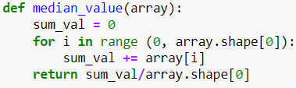

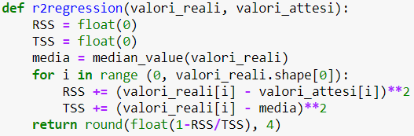


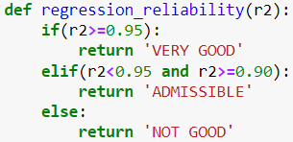

Phyton project
Test script
Definition of useful functions
$R^{2}$ analytical definition:
[3]
[3] https://it.wikipedia.org/wiki/Coefficiente_di_determinazione

Slide 11
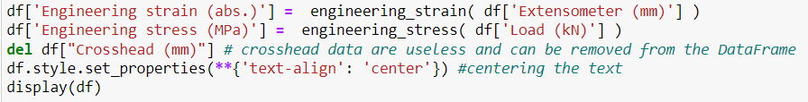

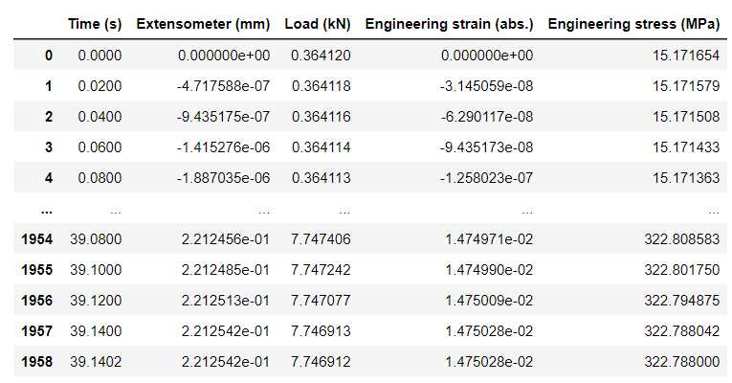
Phyton project
Test script
Definition of useful functions
Raw data import from an excel file
Creation of a DataFrame containing the data to be analyzed
Raw data
Processed data

Slide 12
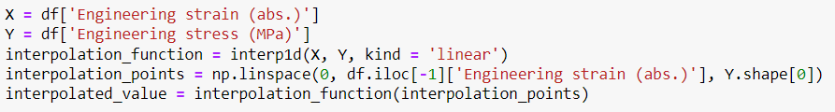
Phyton project
Test script
Definition of useful functions
Raw data import from an excel file
The entire strain and stress columns of the DataFrame are collected into an array-like parameter (X and Y, respectively)
Creation of a DataFrame containing the data to be analyzed
The “interp1d” class generates the interpolation function
Linear interpolation
The “linspace” class creates the interpolation points by specifying evenly spaced numbers over a specified interval (the entire strain column of the DataFrame)
The interpolated value is obtained by computing the interpolation function all over the prescribed interpolation points

Slide 13
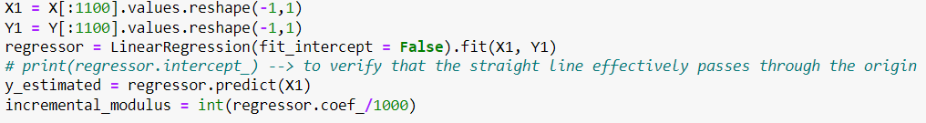
Phyton project
Test script
Definition of useful functions
Raw data import from an excel file
The entire strain and stress columns of the DataFrame are collected into a reshaped matrix-like parameter (X1 and Y1 respectively)
Creation of a DataFrame containing the data to be analyzed
The “LinearRegression” class fits the x- and y- data (X1 and Y1, respectively) generating a straight line passing through the origin (specified by the “fit_intercept” parameter)
Linear interpolation
Linear regression
The estimated y-value as resulting from the linear regression is obtained by way of the “predict” method, applied to all the x-values (X1, in this case)
The incremental modulus is the slope of the linear regression straight line passing through the origin (divided by 1000 to have the result in GPa)

Slide 14
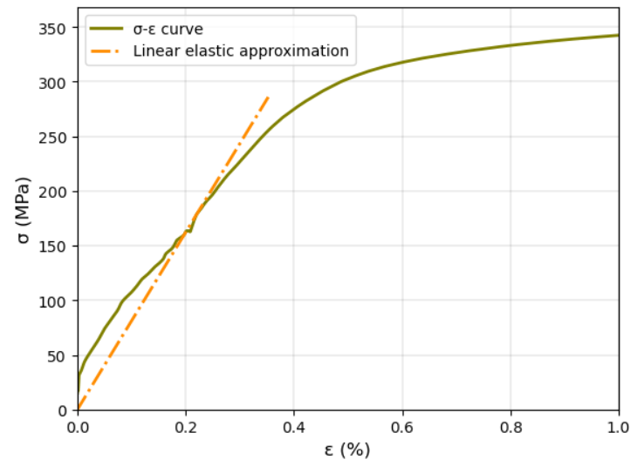
Phyton project
Test script
“pyplot” class is used to display the stress-strain curve and the linear elastic approximation
Definition of useful functions
Raw data import from an excel file
Creation of a DataFrame containing the data to be analyzed
Linear interpolation
Linear regression
Graphical analysis of the results

Slide 15
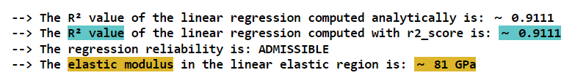
Phyton project
Test script
Definition of useful functions
Raw data import from an excel file
Creation of a DataFrame containing the data to be analyzed
The $R^{2}$ value of the linear regression has been computed analytically by calling the “r2regression” function and with a specific class belonging to the scikit-learn library
Linear interpolation
A function determines the goodness of the linear elastic approximation performed so far
Linear regression
The incremental (elastic) modulus is returned as an integer, whose magnitude is in GPa
Graphical analysis of the results
Determination of the numerical results
An additional library (“colorama”) is used to display colored text

Slide 16
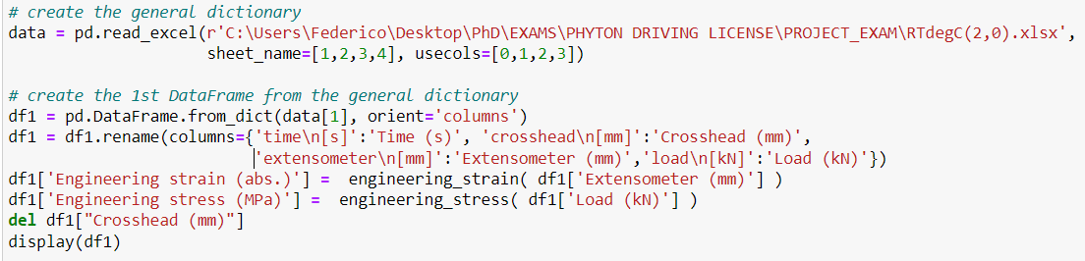
Phyton project
Analysis_RTdegC(2,0)
Adjustment of the test script to analyse 2 µm–thick coatings tensile tested at 25°C
Definition of useful functions
Raw data import from an excel file
Creation of a DataFrame containing the data to be analyzed
If multiple sheets are imported contemporarily, the Pandas library creates a general dictionary
Each sheet corresponds to a diverse tensile load (experimental condition)
Every DataFrame must be extracted from the dictionary singularly

Slide 17
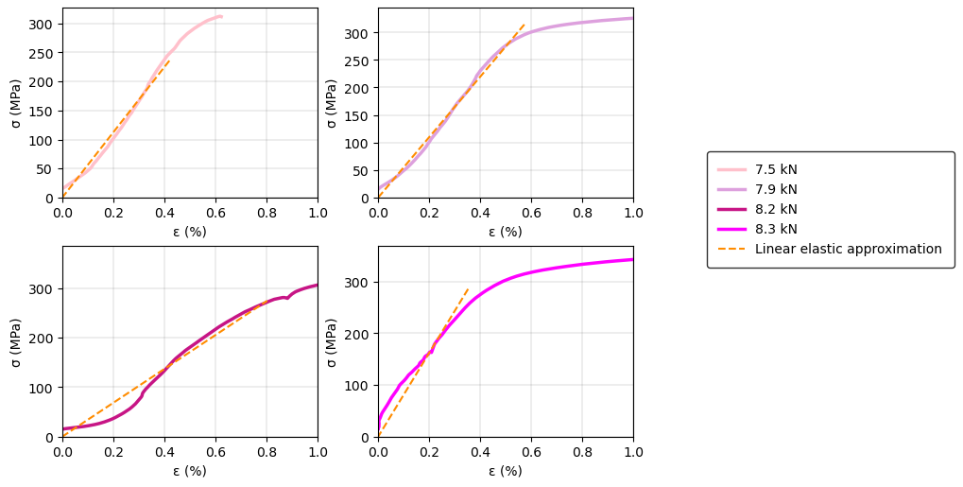
Phyton project
Analysis_RTdegC(2,0)
Adjustment of the test script to analyse 2 µm–thick coatings tensile tested at 25°C
Definition of useful functions
“pyplot” class (subplot method) is used to display the stress-strain curve and the linear elastic approximation for every tensile load applied by the tensile machinery
Raw data import from an excel file
Creation of a DataFrame containing the data to be analyzed
Linear interpolation
Linear regression
Graphical analysis of the results

Slide 18
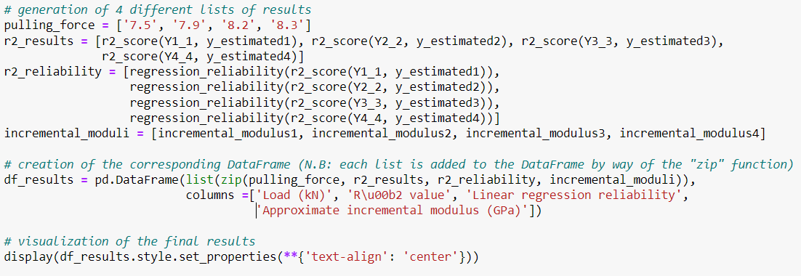
Phyton project
Analysis_RTdegC(2,0)
Adjustment of the test script to analyse 2 µm–thick coatings tensile tested at 25°C
Definition of useful functions
Raw data import from an excel file
Creation of a DataFrame containing the data to be analyzed
Linear interpolation
Linear regression
Numerical results are saved into appropriate lists (arrays)
Graphical analysis of the results
Determination of the numerical results
A DataFrame collecting the results is then generated by adding each list one next the other

Slide 19
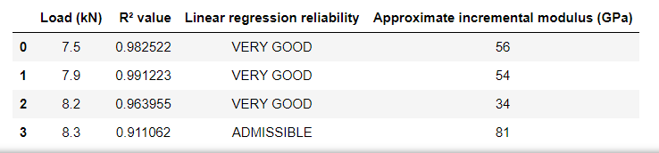
Phyton project
Analysis_RTdegC(2,0)
Adjustment of the test script to analyse 2 µm–thick coatings tensile tested at 25°C
Definition of useful functions
Raw data import from an excel file
Creation of a DataFrame containing the data to be analyzed
Linear interpolation
Linear regression
Graphical analysis of the results
Determination of the numerical results

Slide 20
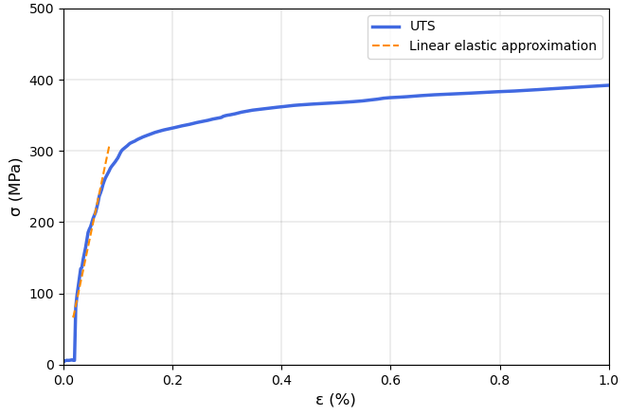

Phyton project
Analysis_RTdegC(3,0)
Adjustment of the test script to analyse 3 µm–thick coatings tensile tested at 25°C
Definition of useful functions
“pyplot” class is used to display the stress-strain curve and the linear elastic approximation
Raw data import from an excel file
Creation of a DataFrame containing the data to be analyzed
Linear interpolation
Linear regression
Graphical analysis of the results
Determination of the numerical results

Slide 21
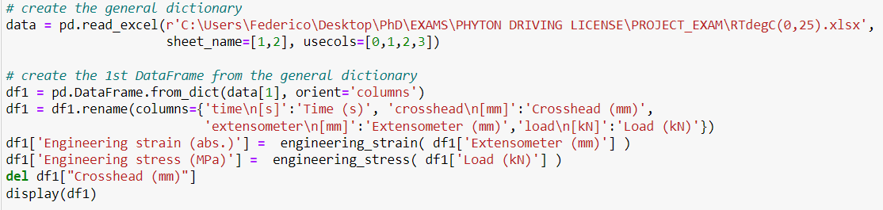
Phyton project
Analysis_RTdegC(0,25)
Adjustment of the test script to analyse 250 nm–thick coatings tensile tested at 25°C
Definition of useful functions
Raw data import from an excel file
Creation of a DataFrame containing the data to be analyzed
If multiple sheets are imported contemporarily, the Pandas library creates a general dictionary
Each sheet corresponds to a diverse tensile load (experimental condition)
Every DataFrame must be extracted from the dictionary singularly

Slide 22
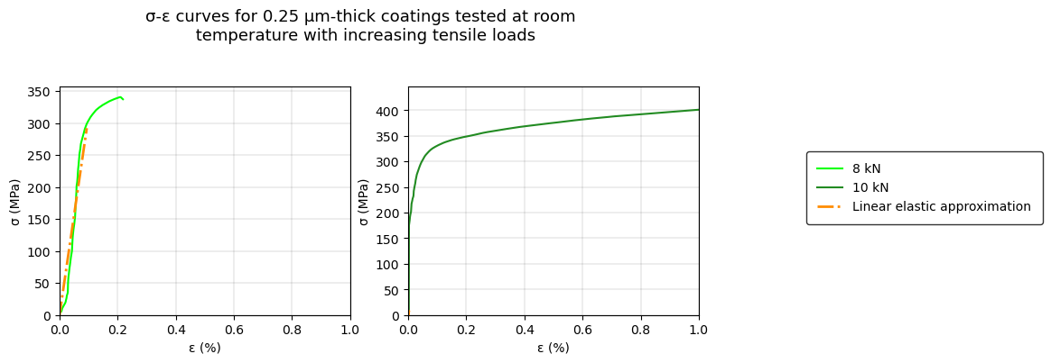
Phyton project
Analysis_RTdegC(0,25)
Adjustment of the test script to analyse 250 nm–thick coatings tensile tested at 25°C
Definition of useful functions
“pyplot” class (subplot method) is used to display the stress-strain curve and the linear elastic approximation for every tensile load applied by the tensile machinery
Raw data import from an excel file
Creation of a DataFrame containing the data to be analyzed
Linear interpolation
Linear regression
Graphical analysis of the results

Slide 23
Phyton project
Analysis_RTdegC(0,25)
Adjustment of the test script to analyse 250 nm–thick coatings tensile tested at 25°C
Definition of useful functions
Raw data import from an excel file
Creation of a DataFrame containing the data to be analyzed
Linear interpolation
Linear regression
Numerical results are saved into appropriate lists (arrays)
Graphical analysis of the results
Determination of the numerical results
A DataFrame collecting the results is then generated by adding each list one next the other

Slide 24
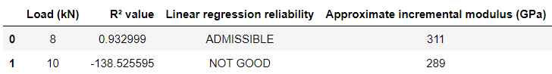
Phyton project
Analysis_RTdegC(0,25)
Adjustment of the test script to analyse 250 nm–thick coatings tensile tested at 25°C
Definition of useful functions
Raw data import from an excel file
Creation of a DataFrame containing the data to be analyzed
Linear interpolation
Linear regression
Graphical analysis of the results
!!!
Determination of the numerical results
The linear regression is not always possible and may run into errors in fitting the linear elastic regime

Slide 25
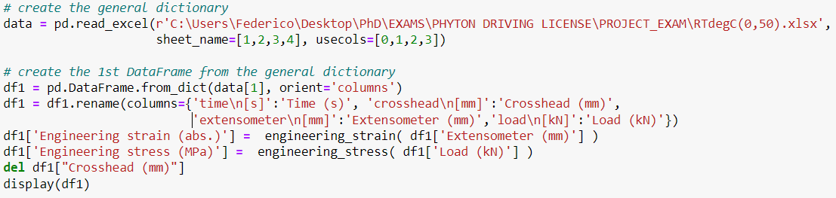
Phyton project
Analysis_RTdegC(0,5)
Adjustment of the test script to analyse 500 nm–thick coatings tensile tested at 25°C
Definition of useful functions
Raw data import from an excel file
Creation of a DataFrame containing the data to be analyzed
If multiple sheets are imported contemporarily, the Pandas library creates a general dictionary
Each sheet corresponds to a diverse tensile load (experimental condition)
Every DataFrame must be extracted from the dictionary singularly

Slide 26
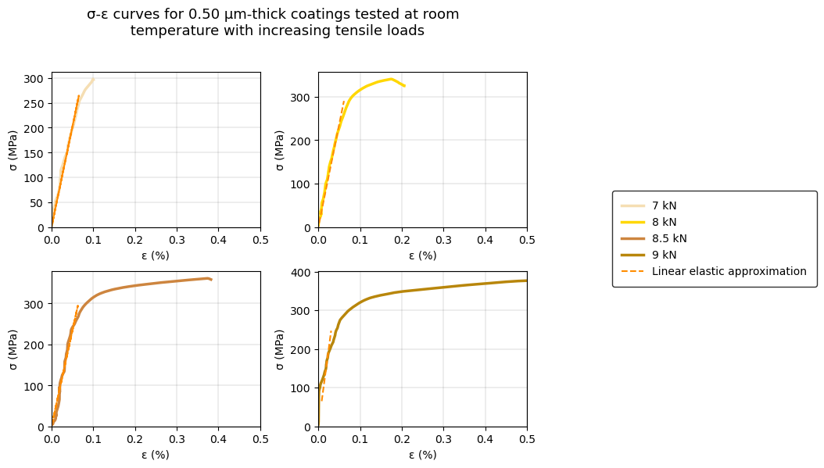
Phyton project
Analysis_RTdegC(0,5)
Adjustment of the test script to analyse 500 nm–thick coatings tensile tested at 25°C
Definition of useful functions
“pyplot” class (subplot method) is used to display the stress-strain curve and the linear elastic approximation for every tensile load applied by the tensile machinery
Raw data import from an excel file
Creation of a DataFrame containing the data to be analyzed
Linear interpolation
Linear regression
Graphical analysis of the results

Slide 27

Phyton project
Analysis_RTdegC(0,5)
Adjustment of the test script to analyse 500 nm–thick coatings tensile tested at 25°C
Definition of useful functions
Raw data import from an excel file
Creation of a DataFrame containing the data to be analyzed
Linear interpolation
Linear regression
Numerical results are saved into appropriate lists (arrays)
Graphical analysis of the results
Determination of the numerical results
A DataFrame collecting the results is then generated by adding each list one next the other

Slide 28
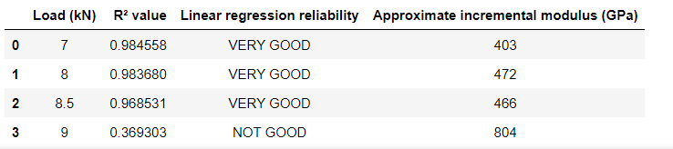
Phyton project
Analysis_RTdegC(0,5)
Adjustment of the test script to analyse 500 nm–thick coatings tensile tested at 25°C
Definition of useful functions
Raw data import from an excel file
Creation of a DataFrame containing the data to be analyzed
Linear interpolation
Linear regression
Graphical analysis of the results
Determination of the numerical results
!!!

Slide 29

Conclusions of the project
Results obtained with Phyton are in line with the MS Excel™ ones computed in a previous analysis
Phyton is an efficient and ready-to-use programming language
The broad range of libraries permits to cover every aspect of data processing and graphical analysis
Phyton permits to manage huge quantity of data with negligible computational times
A large community and a thorough online documentation can easily support programmers

Slide 30
THANK YOU FOR YOUR KIND ATTENTION

