Slide 1
Introduction to Machine Learning
Seminar 1
Introduction to machine
learning concepts
2024
s.lytkin@kbtu.kz, z.zhiyenbekov@kbtu.kz

Slide 2

How to convert hours to minutes?

Slide 3
How to convert hours to minutes?
X - watch
F X = 60X - conversion to minutes, function

Slide 4
What force is applied to the body?
Known body weight m and its acceleration a
What is the force F?

Slide 5
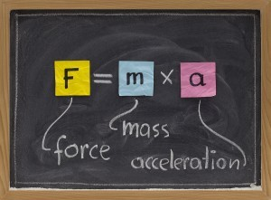
What force is applied to the body?
Known body weight m and its acceleration a
What is the force F?

Slide 6
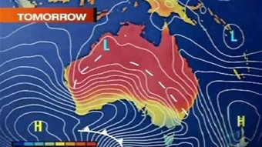
How to predict the weather?

Slide 7

Navier-Stokes equations

Slide 8
Navier-Stokes equations
Differential Equations
Allows you to find the air speed and pressure at any point
Very hard to decide

Slide 9
Text Sentiment Analysis
What is the emotional color of the text?
Options: positive, neutral, negative
Application: automatic analysis of user reviews

Slide 10
Text Sentiment Analysis
"Thank you very much! Apparently, this is exactly what all foreign courses on Machine Learning and Knowledge
Discovery lack. It's a theory, a math, an explanation of what
how it is arranged “in the guts”.»
What color?

Slide 11
Text Sentiment Analysis
"I see a very big minus that the course will be on the finished sci-kit library. The course from Andrew is better because the student himself
writes an algorithm and sees from the inside how it works.»
What color?

Slide 12
Text Sentiment Analysis
x - text in Kazakh language
f(x) — its color (takes the values -1, 0, 1)
Is it possible to write out a formula for f(x) ?
The input is not numbers at all
Exact dependency may not exist

Slide 13
More challenging tasks!
What will be the demand for the product next month?
How much money will the store make in a year?
Will the client return the loan?
Will the patient get cancer?
Will the student pass the next session?
Is there a humanist or a techie in the photo?
Who will win the battle in an online game?

Slide 14
More challenging tasks!
Everywhere - very complex implicit dependencies
Cannot be expressed by formula
But there are a number of examples
Texts with known colors
We will approximate dependencies using examples

Slide 15
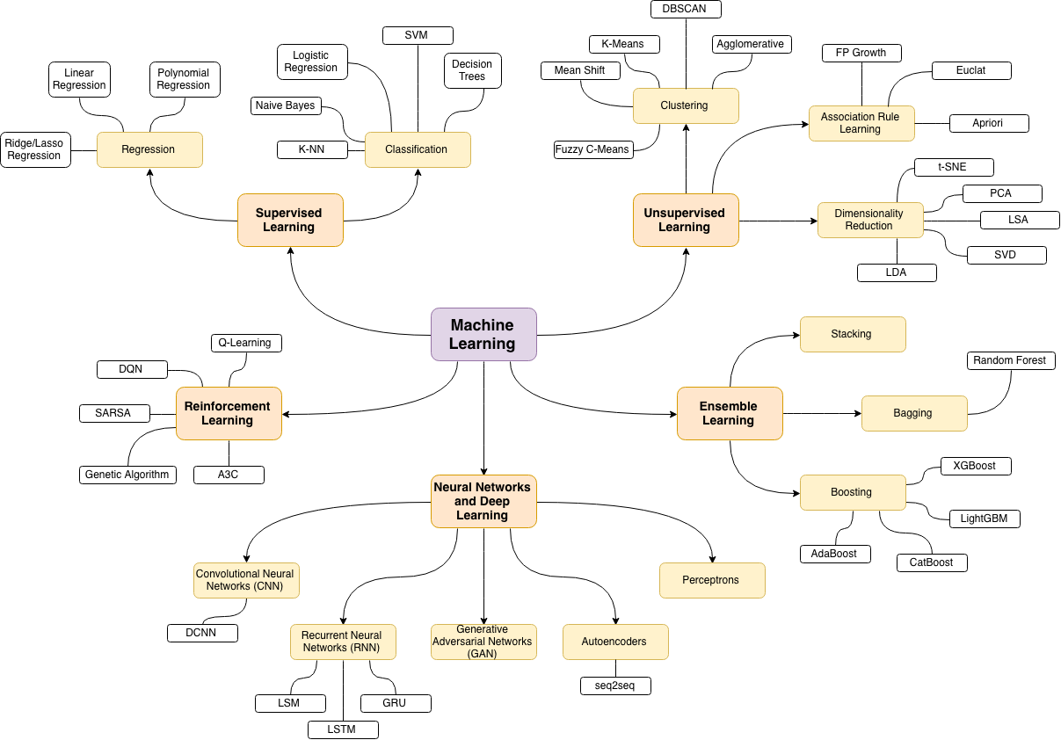
To learn more:
https://vas3k.blog/blog/machine_learning/

Slide 16
Basic terms

Slide 17
Task example
Chain of restaurants
We want to open another
Multiple accommodation options
Which of the options will bring the maximum profit?
* see kaggle.com, TFI Restaurant Revenue Prediction

Slide 18
Notation
X - an object, sample - what we want to make predictions for
Specific restaurant location
XX - is the space of all possible objects
All possible restaurant locations
y - response, target variable,target - what we predict
Profit during the first year of operation
YY - response space - all possible response values
All real numbers

Slide 19
Training sample
We don't understand anything about economics
But we have many objects with known answers
X = x_{i}, y_{i} _{I}ℓ — training sample
ℓ - sample size

Slide 20








Features
Objects - abstract entities
Computers only work with numbers
Special characters, factors,features - numerical characteristics of objects
d - number of signs
X = (x¹, …, x^{d})— indicative description

Slide 21

Features
Objects - abstract entities
Computers only work with numbers
Signs, factors,features - numerical characteristics of objects
d - number of signs
X = (x¹, …, x^{d})— indicative description
Vector

Slide 22
Features
Objects - abstract entities
Computers only work with numbers
Signs, factors,features - numerical characteristics of objects
d- number of signs
X = (x¹, …, x^{d})— indicative description
Numbers

Slide 23
Features
About demographics:
Average age of residents of the nearest quarters
Dynamics of the number of inhabitants
About real estate:
Average cost per square meter of housing nearby
Number of schools, banks, shops, gas stations
Distance to the nearest competitor
About roads:
Average number of cars passing by per day

Slide 24
Algorithm
a x - algorithm, model - a function that predicts the answer for any object
Displays XX in YY
Linear model: a x = w₁x¹ + … + w_{d}x^{d}

Slide 25
Loss function
Not all algorithms are useful
a (x) = 0 - will not bring any benefit
Loss function - a measure of the correctness of the algorithm's answer
Predicted $10,000 profits, actually $5,000 - good or bad?
Standard deviation: a x - y ²
^{E} = (10 000 – 5000)^2 = y

Slide 26
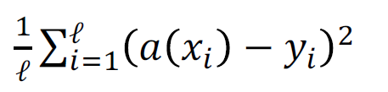
Quality functional
Quality functional, quality metric - measure of the quality of work sample algorithm
Root mean square error (Mean Squared Error, MSE):
Less is better

Slide 27
Quality functional
Must meet business requirements
One of the most important components of data analysis

Slide 28

Algorithm training
There is a training sample and a quality functional
Family of algorithms -
From what we choose an algorithm
Example: all linear models
Training: search for the optimal algorithm in terms of quality functional

Slide 29







Machine learning
educational
sample
extraction signs
Education
algorithm
New object
a(x)
Prediction

Slide 30
House value prediction
House- entity from real
peace
features— quantitative characteristics
Model—
function from
features
Forecast
Predicted House
prices

Slide 31
House value prediction
Training sample:
Possible signs:
square
square ²
Square ³
sin(square)
Possible models:
w ₁ ∗ square
w ₁ ∗ square
w ₁ ∗ square + w ₁ ∗ square
and so on
Model view- Job expert or full search.
Scale selection w ₁ w ₂— automatic process (based on data)
Square | Price
50 | 250
60 | 340
10 | 20
90 10 120 | 800 1000 ?
square
and so on

Slide 32
House value prediction
Model a(x) = 5 * square
Model a(x) = 0.1 * square ²
Square | Forecast | Price | a – y ²
50 | 250 | 250 | 0
60 | 300 | 340 | 1600
10 | 50 | 20 | 900
90 | 450 | 800 | 122500
Square | Forecast | Price | a – y ²
50 | 250 | 250 | 0
60 | 360 | 340 | 400
10 | 10 | 20 | 100
90 | 810 | 800 | 100
MSE: 31250
RMSE: 176.78
MSE: 150
RMSE: 12.25

Slide 33
House value prediction
Signs may be more:
Square
Year of construction
Availability of a swimming pool
Number of rooms
Distance from the center
Cop Rating
site
And so on
Possible models:
Linear: w₁ ₅₀∗ area + w₂ ₅₀ ∗ year + w₃ ∗ 10 pool + w₄ ∗ room + w₅ ∗ remoteness + w₆ ∗ Police
Decision Trees
Neural networks
Method k nearest neighbors
And so on

Slide 34
What you need to know
How to formulate the problem?
What signs to use?
Where to get the training sample?
How to choose a quality metric?
How to train the algorithm?
How to evaluate the quality of an algorithm?
How to formulate the problem?
What signs to use?
Where to get the training sample?
How to choose a quality metric?
How to train the algorithm?
How to evaluate the quality of an algorithm?

Slide 35
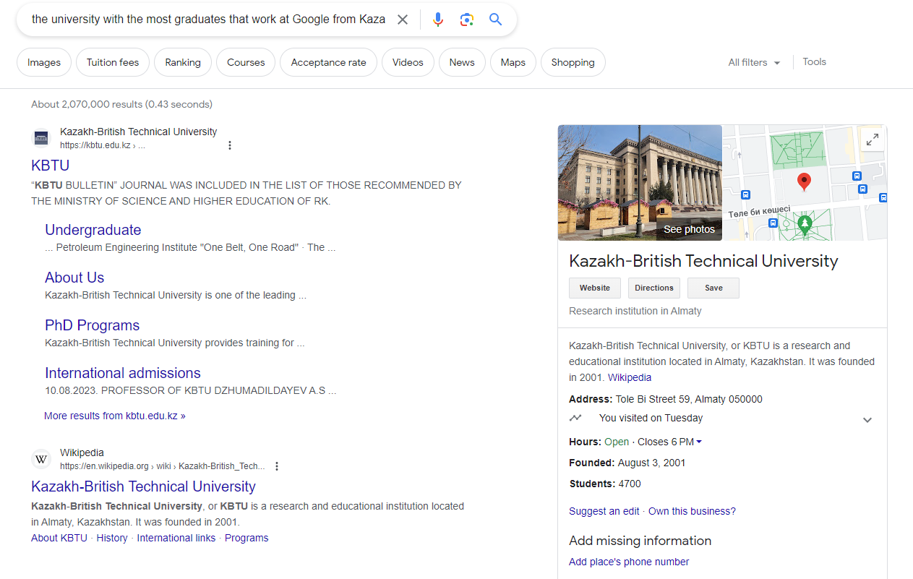

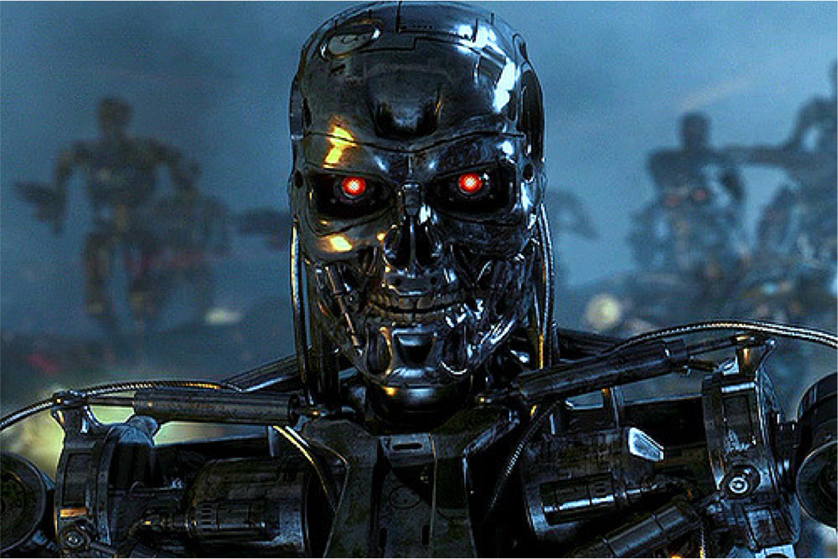
Artificial intelligence
Strong AI
Specialized AI
now
in 20-100 years

Slide 36
Machine learning in HR
Searching for candidates and predicting the outcome of the interview
Help with rotation
Employee departure prediction
Analysis of internal forums, highlighting complaints

Slide 37
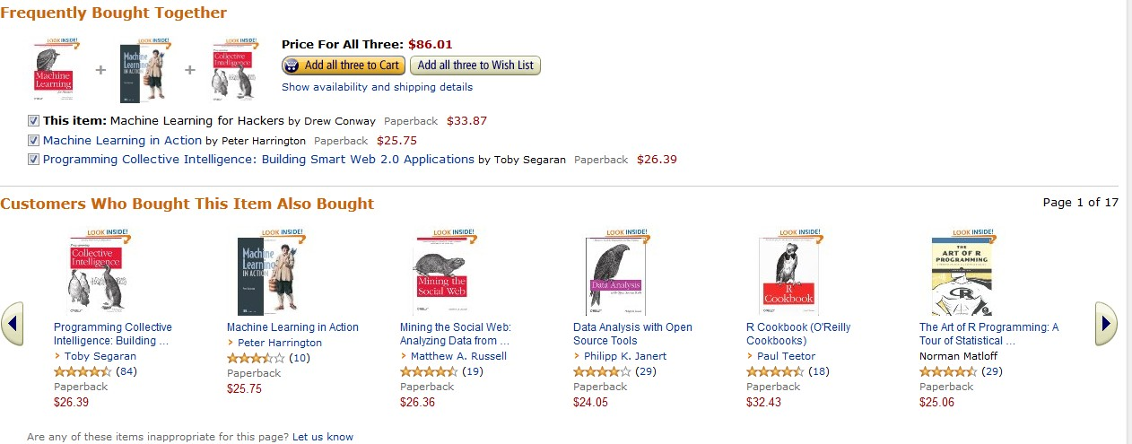
Recommender systems
Shelves of recommendations onAmazon generate 35% of all purchases
Recommendations based on machine learning and analysis big data

