Slide 1
COMP3342
Health Systems
Interoperability
& Integration
Cardiac Emergency Patient Journey
Demonstrating Structural, Syntactic & Semantic Interoperability
Across 5 Healthcare Providers & 5 Integration Channels
HL7 v2
FHIR R4
DICOM
ICD-10
LOINC
SNOMED CT
RxNorm
Group 8 • June 17, 2026

Slide 2


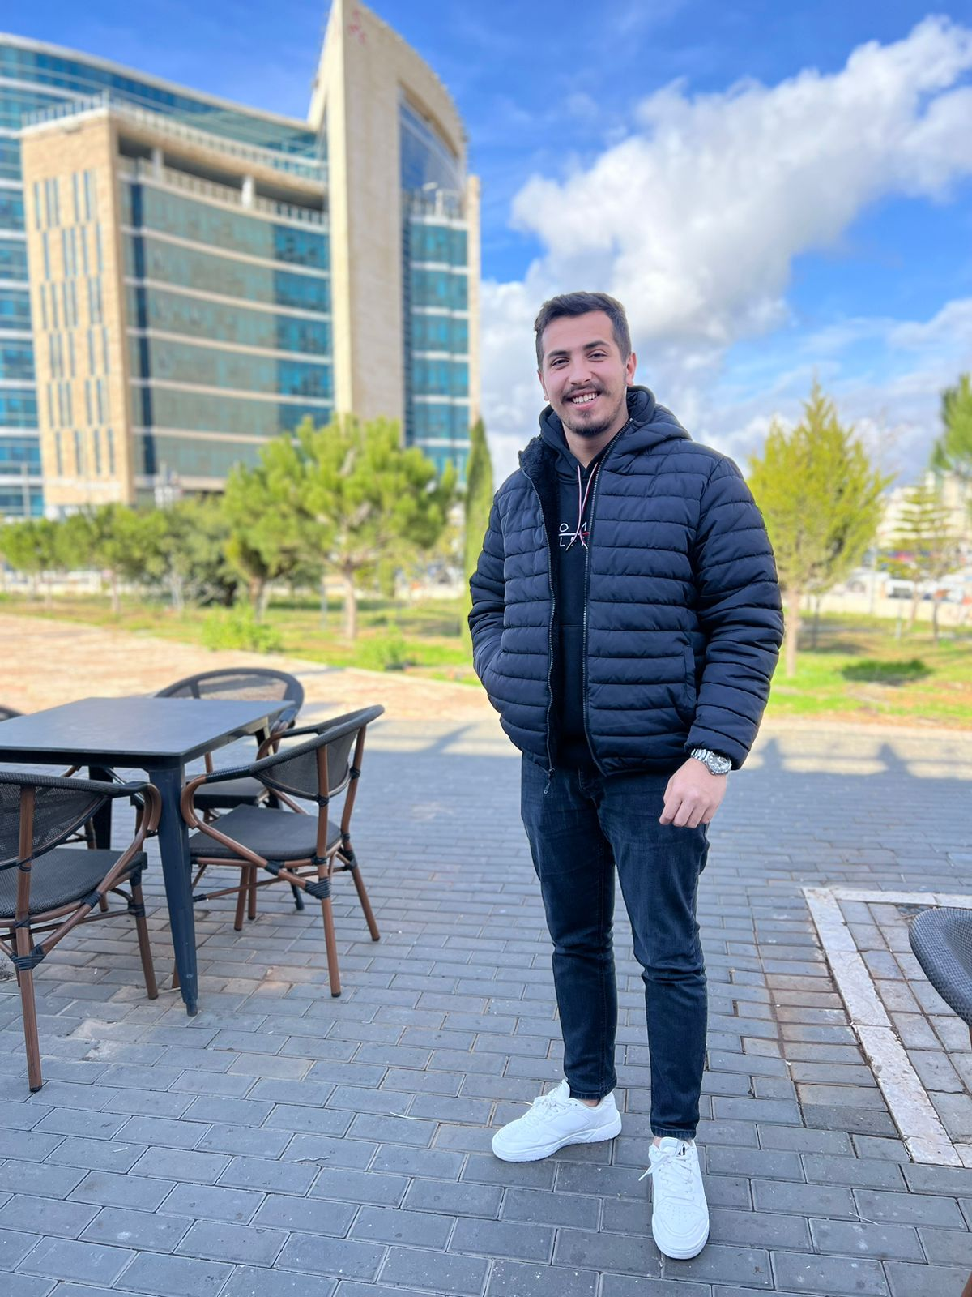
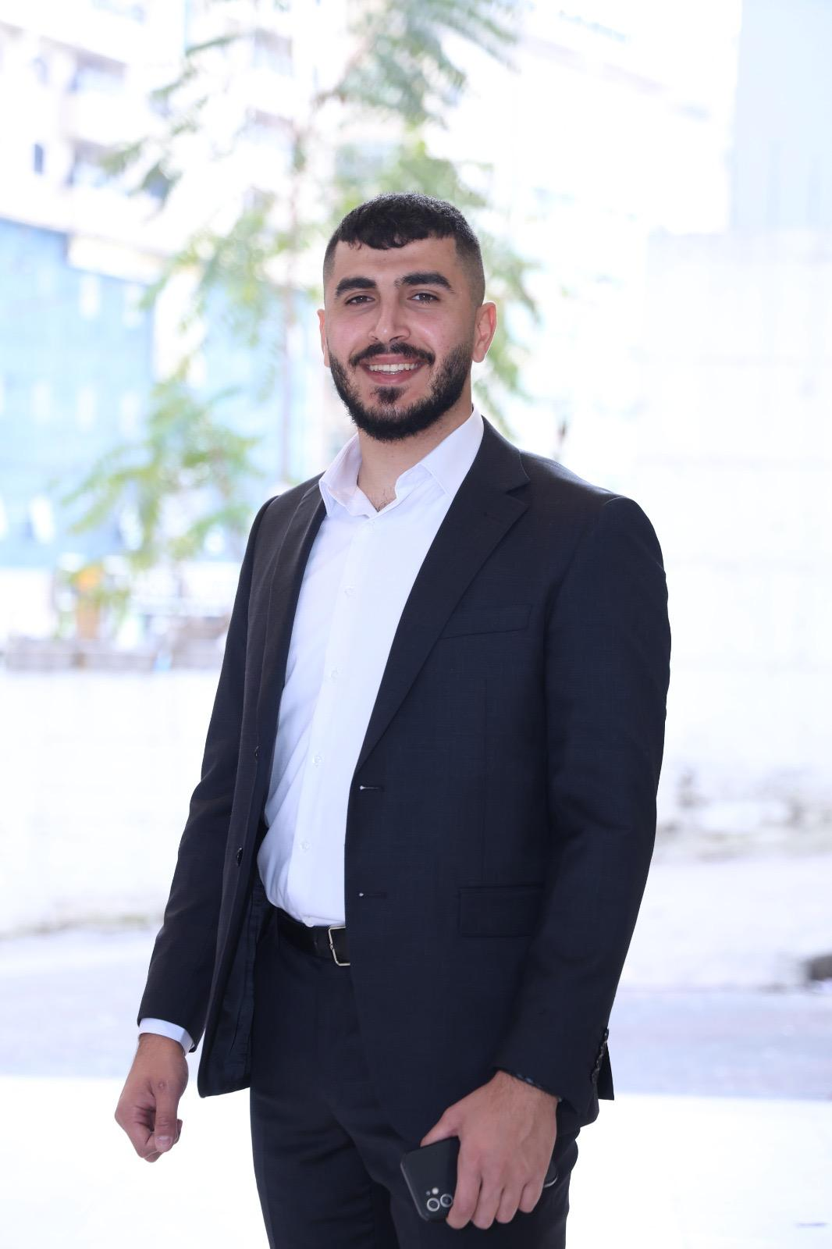

Group Members
COMP3342 Project Team
Tariq Makho
Omar Diebas
Qais Alqarem
Omar Taweel
Fadi Halaweh
Scenario Design
& Timeline
Dataset Creation
& Databases
Interoperability
Channels 1 & 2
Channels 3, 4 & 5
& Transformations
Demo Application
& Report
1
2
3
4
5
COMP3342 — Health Systems Interoperability & Integration

Slide 3
Patient Scenario
Cardiac Emergency — Fadi Halaweh (DOB: 1985-03-12)
Fadi Halaweh, 41-year-old male, presents at Al-Nour GP Clinic with chest pain radiating to the left arm (local code: CP-05). His GP refers him immediately to the Hospital Emergency Department. The ED orders urgent cardiac labs and imaging, then prescribes medication. Each handoff requires data exchange between systems using different standards and terminologies.
GP
ED
LAB
RAD
RX
1. GP Clinic
2. Hospital ED
3. Laboratory
4. Radiology
5. Pharmacy
Al-Nour Clinic
SQLite DB
City Hospital
SQLite DB
Central Lab
SQLite DB
Imaging Centre
SQLite DB
City Pharmacy
SQLite DB
Structural Interoperability
Syntactic Interoperability
Semantic Interoperability
Different data formats converted
(CSV → HL7, JSON → FHIR, etc.)
Encoding & structure rules
(HL7 v2 pipes, FHIR JSON, DICOM tags)
Terminology mapping
(ICD-10, LOINC, SNOMED CT, RxNorm)
COMP3342 — Health Systems Interoperability & Integration

Slide 4
Data Exchange Timeline
5 interoperability points — source, destination, and data type at each
Channel From → To
Standard
Terminology
1
GP Clinic
→
Hospital ED
HL7 v2 ADT^A01
ICD-10
Patient demographics + diagnosis
2
Hospital ED
→
Laboratory
HL7 v2 ORM^O01
LOINC
Lab order (Troponin, CBC, Lipid panel)
3
Laboratory
→
Hospital ED
HL7 v2 ORU^R01
SNOMED CT
Lab results with flags
4
Hospital ED
→
Radiology
DICOM Metadata
SNOMED CT
Imaging request (chest X-ray)
5
Hospital ED
→
Pharmacy
FHIR R4 MedicationRequest
RxNorm
Medication order (Aspirin 75mg)
COMP3342 — Health Systems Interoperability & Integration

Slide 5
Simulated Datasets
5 SQLite databases — each with different structure, content, and terminology
gp_clinic.db
hospital_ed.db
laboratory.db
radiology.db
pharmacy.db
table: patients
table: admissions
table: orders
table: requests
table: medications
FIELDS
FIELDS
FIELDS
FIELDS
FIELDS
→ id
→ id
→ id
→ id
→ id
→ name
→ patient_name
→ patient_name
→ patient_name
→ patient_name
→ dob
→ icd10_code
→ loinc_code
→ modality
→ rxnorm_code
→ gender
→ diagnosis_text
→ test_name
→ snomed_procedure_code
→ drug_name
→ local_diagnosis_code
→ attending_physician
→ result_value
→ procedure_name
→ dose
→ diagnosis_text
→ admission_date
→ unit
→ report_text
→ frequency
→ referred_to
→ reference_range
→ prescriber
→ status
Local GP codes (CP-01…)
ICD-10 (I20.0, I21.9…)
LOINC (10839-9, 718-7…)
SNOMED CT (399208008)
RxNorm (1191, 308460…)
COMP3342 — Health Systems Interoperability & Integration

Slide 6
CH 1
Channel 1: GP Clinic → Hospital ED
HL7 v2 ADT^A01 | ICD-10 terminology mapping
SOURCE
DESTINATION
GP Clinic — Flat SQLite record
Hospital ED — HL7 v2 ADT^A01 message
id: 000001
name: Fadi Halaweh
dob: 1985-03-12
gender: M
local_diagnosis_code: CP-05
diagnosis_text: Chest pain radiating to left arm
referred_to: Cardiology
MSH|^~\&|GP_CLINIC|AL-NOUR|HOSPITAL_ED|CITY_HOSP|...|ADT^A01
PID|1||000001^^^GP_CLINIC||Fadi^Halaweh||19850312|M
PV1|1|E|ED^01^A|||||||Cardiology
DG1|1||I21.9^Acute myocardial infarction^ICD10|...|A
→
STRUCTURAL
SYNTACTIC
SEMANTIC
Flat CSV-style SQLite row → HL7 v2 ADT^A01 message with MSH, PID, PV1, DG1 segments
Pipe-delimited HL7 v2.5 encoding; ^ component separator; \r segment terminator
Local GP code 'CP-05' → ICD-10 'I21.9' (Acute myocardial infarction, unspecified)
COMP3342 — Health Systems Interoperability & Integration

Slide 7
CH 2
Channel 2: Hospital ED → Laboratory
HL7 v2 ORM^O01 | LOINC terminology mapping
SOURCE
DESTINATION
Hospital ED — Internal admission record (JSON)
Laboratory — HL7 v2 ORM^O01 order message
patient_name: Fadi Halaweh
icd10_code: I21.9
diagnosis: Acute myocardial infarction
attending_physician: Dr. Khalid Mansour
tests_ordered: Troponin I, CBC, Lipid Panel, BMP
MSH|^~\&|HOSPITAL_ED|CITY_HOSP|LABORATORY|LAB_SYS|...|ORM^O01
PID|1||000001|||Fadi^Halaweh||19850312|M
PV1|1|E|ED^01^A|||Dr. Khalid Mansour
OBR|1||0001A|10839-9^Troponin I^LN|||...|||STAT
OBR|2||0001B|58410-2^CBC panel^LN|||...|||STAT
→
STRUCTURAL
SYNTACTIC
SEMANTIC
ED admission dict with ordered tests → HL7 v2 ORM^O01; each test becomes an OBR segment
HL7 v2.5 pipe-delimited; OBR-4 holds LOINC code^name^LN; priority STAT in OBR-27
ED test name 'Troponin I' → LOINC '10839-9'; 'CBC' → LOINC '58410-2'
COMP3342 — Health Systems Interoperability & Integration

Slide 8
CH 3
Channel 3: Laboratory → Hospital ED
HL7 v2 ORU^R01 | SNOMED CT terminology mapping
SOURCE
DESTINATION
Laboratory — SQLite result record
Hospital ED — HL7 v2 ORU^R01 result message
patient_name: Fadi Halaweh
loinc_code: 10839-9
test_name: Troponin I
result_value: 0.08 ng/mL
reference_range: <0.04
status: FINAL
result_date: 2026-06-10
MSH|^~\&|LABORATORY|LAB_SYS|HOSPITAL_ED|...|ORU^R01
PID|1||000001^^^LAB||Fadi^Halaweh
OBR|1|0001|0001A|10839-9^Troponin I^LN|||...
OBX|1|NM|10839-9^Troponin I^LN||0.08|ng/mL|<0.04|H|||FINAL
OBX|2|CWE|414916001^Elevated troponin^SCT
→
STRUCTURAL
SYNTACTIC
SEMANTIC
Lab SQLite result → HL7 v2 ORU^R01; numeric result in OBX-5; SNOMED finding in second OBX
HL7 v2.5 OBX segments: OBX-6 units, OBX-7 reference range, OBX-8 abnormal flag (H/L/N)
LOINC '10839-9' (Troponin I) + abnormal value → SNOMED CT '414916001' (Elevated troponin finding)
COMP3342 — Health Systems Interoperability & Integration

Slide 9
CH 4
Channel 4: Hospital ED → Radiology
DICOM Metadata | SNOMED CT procedure coding
SOURCE
DESTINATION
Hospital ED — Admission record (JSON)
Radiology — DICOM attribute dataset (Key=Value)
patient_name: Fadi Halaweh
dob: 1985-03-12
icd10_code: I21.9
diagnosis: Acute myocardial infarction
attending_physician: Dr. Khalid Mansour
(0008,0060) Modality = CR
(0008,1030) StudyDescription = Plain chest X-ray
(0010,0010) PatientName = Fadi^Halaweh
(0010,0020) PatientID = 000001
(0010,0030) PatientBirthDate = 19850312
(0008,0100) CodeValue (SNOMED) = 399208008
(0008,0104) CodeMeaning = Plain chest X-ray
→
STRUCTURAL
SYNTACTIC
SEMANTIC
JSON admission → DICOM-style attribute dataset; (gggg,eeee) tag notation per DICOM PS 3.3
DICOM attribute tag format with group/element numbers; Modality, UIDs, and PatientName set per DICOM standard
ICD-10 'I21.9' (Acute MI) → SNOMED CT procedure '399208008' (Plain chest X-ray); modality = CR
COMP3342 — Health Systems Interoperability & Integration

Slide 10
CH 5
Channel 5: Hospital ED → Pharmacy
FHIR R4 MedicationRequest | RxNorm drug coding
SOURCE
DESTINATION
Hospital ED — Admission record (JSON)
Pharmacy — FHIR R4 MedicationRequest (JSON)
patient_name: Fadi Halaweh
icd10_code: I21.9
diagnosis: Acute myocardial infarction
attending_physician: Dr. Khalid Mansour
admission_date: 2026-06-10
{
"resourceType": "MedicationRequest",
"status": "active",
"medicationCodeableConcept": {
"coding": [{ "system": "...rxnorm",
"code": "308460",
"display": "Clopidogrel" }]
},
"dosageInstruction": [{
"text": "1 tablet once daily",
"route": { "coding": [{"code":"26643006"}] }
}]
}
→
STRUCTURAL
SYNTACTIC
SEMANTIC
ED admission dict → FHIR R4 MedicationRequest JSON resource with medicationCodeableConcept, subject, requester, reasonCode, dosageInstruction
FHIR RESTful JSON; resource type, status, intent, coding per HL7 FHIR R4 spec; route coded in SNOMED CT (26643006 = oral)
ICD-10 'I21.9' (Acute MI) → RxNorm '308460' (Clopidogrel 75mg once daily); oral route = SNOMED 26643006
COMP3342 — Health Systems Interoperability & Integration

Slide 11
Interoperability Framework
Complete data exchange architecture across all providers
Hospital ED
CH2 HL7 ORM
Laboratory
CH3 HL7 ORU
GP Clinic
CH1 HL7 ADT
PATIENT
Fadi Halaweh
Pharmacy
Radiology
CH5 FHIR R4
CH4 DICOM
5
Healthcare
Providers
5
Integration
Channels
6
Simulated
Patients
4
Standards
Used
5
SQLite
Databases
COMP3342 — Health Systems Interoperability & Integration

Slide 12
LIVE DEMO
Health Interoperability Demo Application
Open the dashboard
Select Fadi Halaweh
1
localhost:5000 — all 6 patients listed
2
View his GP record (local code CP-05)
Channel 1: Send to Hospital ED
Channel 2: Order Lab Tests
3
Watch CP-05 → ICD-10 I21.9 in HL7 ADT^A01
4
Troponin I → LOINC 10839-9 in HL7 ORM^O01
Channel 3: Receive Lab Results
Channels 4 & 5
5
Result 0.08 ng/mL → SNOMED 414916001 in ORU^R01
6
DICOM imaging request + FHIR R4 MedicationRequest
COMP3342 — Health Systems Interoperability & Integration

Slide 13
Conclusion
Developed a realistic multi-provider healthcare scenario (Cardiac Emergency) with 6 simulated patients across 5 SQLite databases
Demonstrated structural interoperability: flat records → HL7 v2, FHIR R4, and DICOM formats
Demonstrated syntactic interoperability: correct encoding rules for HL7 v2 pipe delimiters, FHIR JSON, and DICOM tag notation
Demonstrated semantic interoperability: ICD-10, LOINC, SNOMED CT, and RxNorm terminology mappings across all 5 channels
Built a live Python/Flask demo application showing before-and-after transformation at each data exchange point
COMP3342 — Health Systems Interoperability & Integration • Group 8 • June 17, 2026

