Slide 1

The history of UI architecture design approaches. From code-behind to MVVM. Part 2: Moving to patterns. MVC.
By: Fedor Reznik

Slide 2
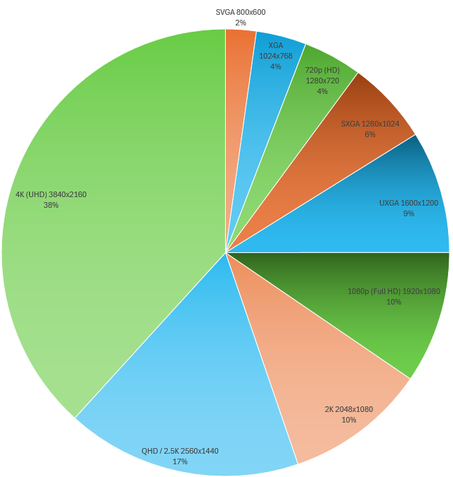
What changed the UI (and architecture approach).
KEY FACTORS:
“I want integration”. Telejet Finance story.
Displays: ~17x more space
UX Designers. Natural complexity.

Slide 3
Moving to patterns.
“TERMS & CONDITIONS”:
Definition – important!
Won’t discuss all pattern variations.
Not even a main (ASP.Net MVC sample).
Won’t use heavy FWs.

