Slide 1

The history of UI architecture design approaches. From code-behind to MVVM. Part 2: Moving to patterns. MVC.
By: Fedor Reznik

Slide 2
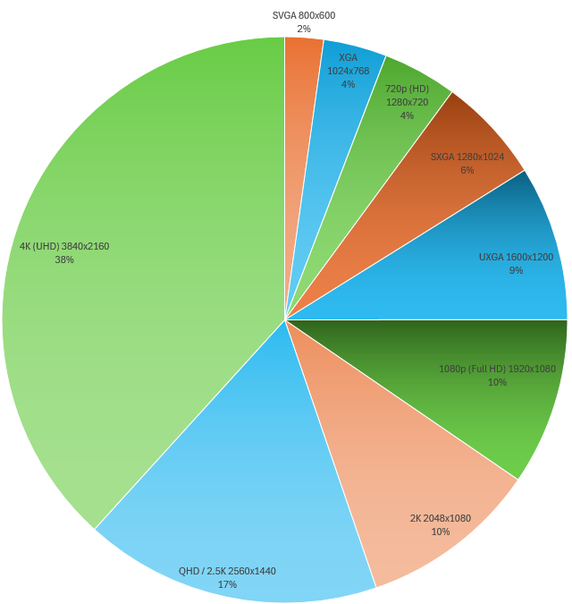
What changed the UI (and architecture approach).
KEY FACTORS:
“I want integration”. Finance module story.
Displays: ~17x more space
UX Designers. Natural complexity.

Slide 3
Moving to patterns.
“TERMS & CONDITIONS”:
Definition – important!
Won’t discuss all pattern variations.
Not even a main (ASP.Net MVC sample).
Won’t use heavy FWs.

Slide 4
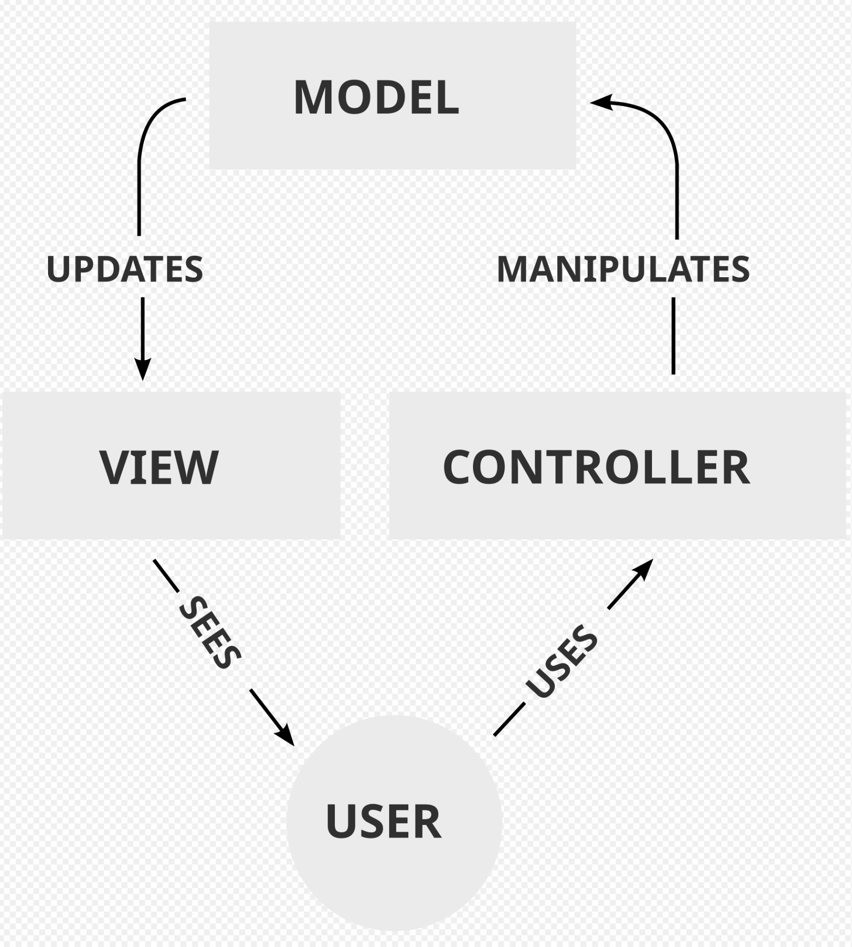
Moving to patterns. MVC
DEFINITION:
The Model represents the data in the application in a logical way; it is in charge of carrying the data and making other objects aware of data changes. May also adapt external services in more “consumable” way for View technology.
The View is the graphical representation of the Model; it is responsible for displaying the Model data in suitable form.
The Controller is the orchestrator of this pattern; it is in charge of intercepting user input (mouse and keyboard) and interacting with the Model and/or the View.

Slide 5
Moving to patterns. MVC
VARIATION:
How user should actually interact with Controller? View knows about Controller
Should we de-couple Model from the View? Controller knows about View; View uses Model as state.
LET’S CODE!

Slide 6
Moving to patterns. MVC
SIMPLE IMPLEMENTATION:
A word on DI.
A word on folder structure – vertical slices.
Simple engine overview.
Model adapts driver – no more exception handling for consumer. IDisposable.
Controller adapts concurrency and manages lifetime.
View states it’s possibilities and uses controller to process user input. View also guards the MT, not bother consumers.

Slide 7
Moving to patterns. MVC
SECOND USER STORY:
We want to get rid of modals and have the embedded screens.
LET’S CODE!

Slide 8
Moving to patterns. MVC with Routing
SIMPLE IMPLEMENTATION:
Router. Complexity is on DI container.
Further decoupling of Views and Controllers via Routes.

Slide 9
Moving to patterns. MVC with Routing
OUTCOME:
Model, View and Controller are more focused on their duties.
Improved testability. Not w/o problems with mocks.
More complex scenarios are supported.

Slide 10
Moving to patterns. MVC with Routing
NFR | CB | COMMENT
Testability | 😐 | Heavy usage of mocks. Testing implementation.
Extensibility | 😐 | Much easier support of complex scenarios.
Adaptability | 😐 | Logic knows about UI. 2x work.
Effectiveness | 😐 | Both should agree on interfaces.
Reusability | 😐 | Controller and View are bound.
Readability | ☹ | Controller/View “spaghetti” code.
Legend: ☹ - low, 😐 - moderate, ☺ - high

Slide 11
Moving to patterns. MVC. What’s next?
IF ONLY WE COULD DECOUPLE CONTROLLER FROM VIEW…

