Slide 1

Data Analytics and Mining
Variables, Frequency Distribution, Central Tendency
Data Analytics and Mining, 2026
Fedor Shlyakhov
National Research University Higher School of Economics
September 18, 2026

Slide 2
Variables

Slide 3
Constructs
Some variables, such as height, weight, and eye color are well-defined, concrete entities that can be observed and measured directly.
Variables like intelligence, anxiety, and hunger are called constructs, and because they are intangible and cannot be directly observed, they are often called hypothetical constructs.

Slide 4
Numerical Variables
Some variables, such as height, weight, and eye color are well-defined, concrete entities that can be observed and measured directly.
Variables like intelligence, anxiety, and hunger are called constructs, and because they are intangible and cannot be directly observed, they are often called hypothetical constructs.
When measuring a continuous variable, it should be very rare to obtain identical measurements for two different individuals. Because a continuous variable has an infinite number of possible values, it should be almost impossible for two people to have exactly the same score. -> We use intervals.

Slide 5
Categorical Variables
A nominal scale consists of a set of categories that have different names. Measurements on a nominal scale label and categorize observations, but do not make any quantitative distinctions between observations.
An ordinal scale consists of a set of categories that are organized in an ordered sequence. Measurements on an ordinal scale rank observations in terms of size or magnitude.
With measurements from an ordinal scale, you can determine whether two individuals are different and you can determine the direction of difference. However, ordinal measurements do not allow you to determine the size of the difference between two individuals.

Slide 6
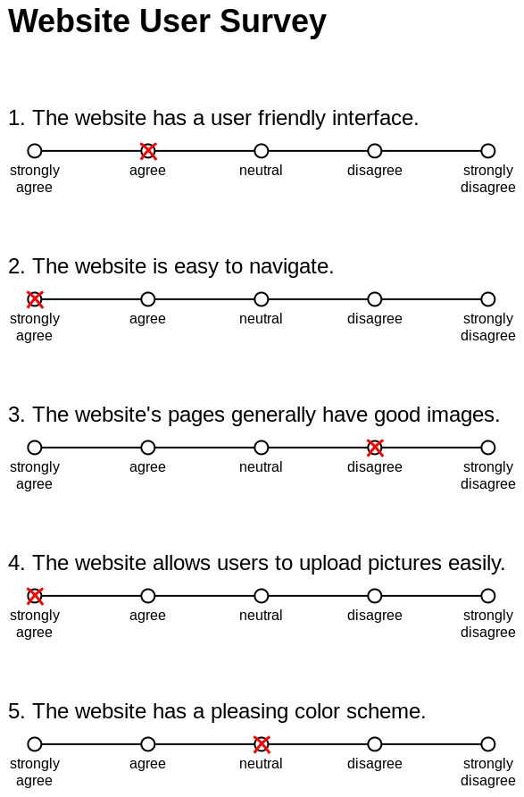
Variables’ types
Numerical
Likert scale (ordinal scale)
Continuous
Discrete
number of students gpa
Categorical
Ordinal
Nominal
Department name teacher grading
Binary (Dummies)
student of Social Science program

Slide 7
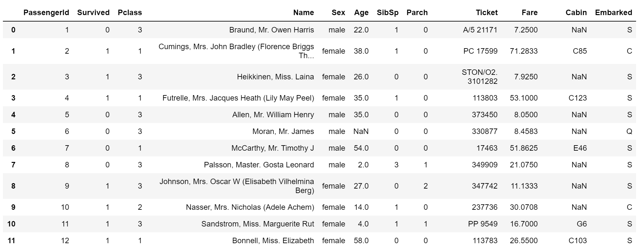
Variables’ types
Variable | Key | Variable | Key
survival | 0 = Yes, 1 = No | age | -
pclass | 1 = 1st, 2 =2nd, 3 = 3rd | fare | -
sex | М = male, F = female | cabin | -
embarked | C = Cherbourg, Q = Queenstown, S = Southampton c

Slide 8
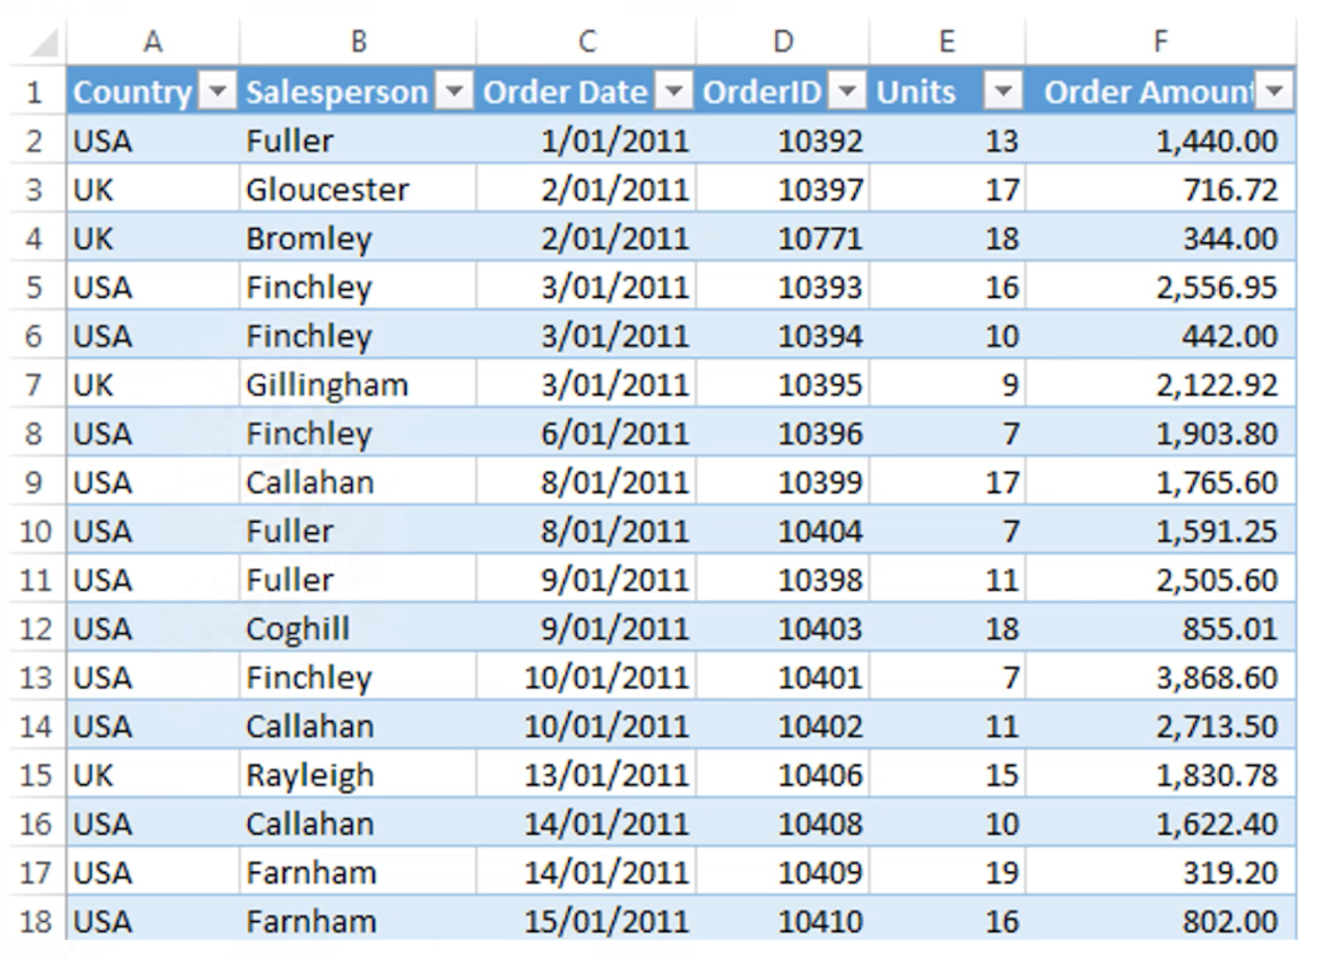
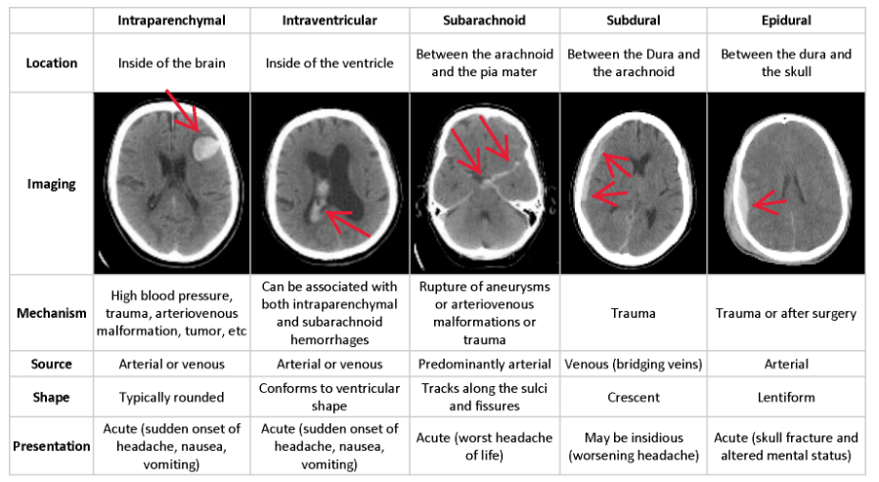
World of Data

Slide 9
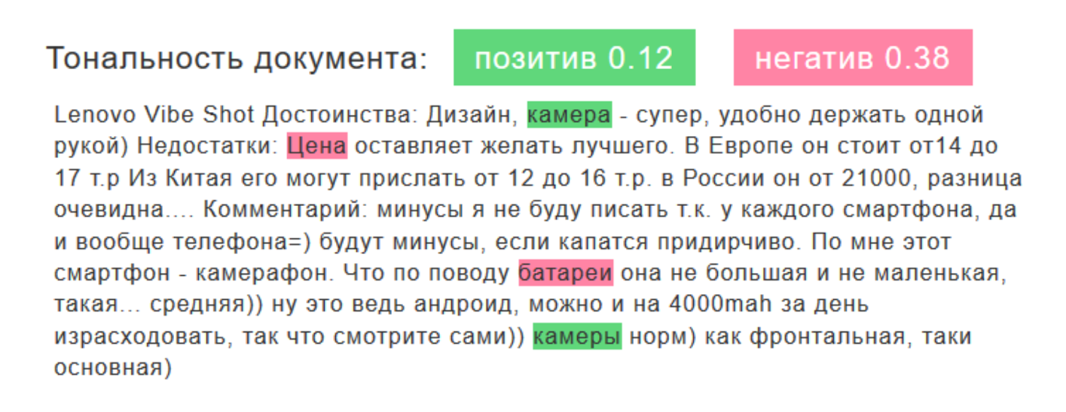
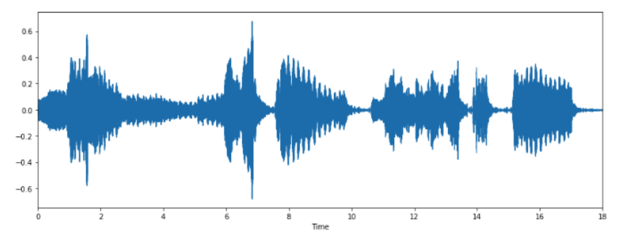
World of Data
https://blog.br-analytics.ru/kak-rabotaet-analiz-tonalnosti-soobshhenij-v-brand-analytics/

Slide 10
Distributions

Slide 11

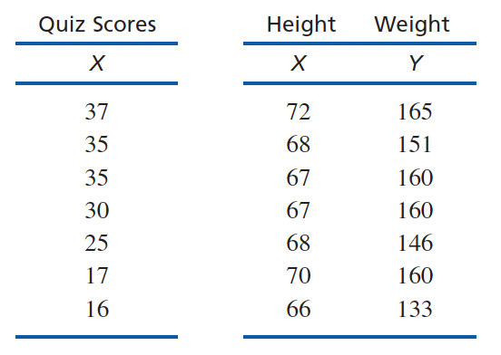
Statistical notation
Table:
row — observation
column — variable
Summation notation:
X — variable value
N — number of observations in population
*n — number of observations in sample
What is the value of Σ(X – 2) for the following scores: 6, 2, 4, 2?

Slide 12

Frequency distribution
A frequency distribution is an organized tabulation of the number of individuals located in each category on the scale of measurement.
What is the frequency distribution for the following data?

Slide 13
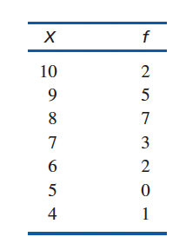

Frequency distribution
A frequency distribution is an organized tabulation of the number of individuals located in each category on the scale of measurement.
What is the frequency distribution for the following data?

Slide 14
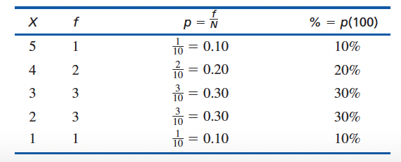
Proportions and Percentage

Slide 15
Proportions and Percentage

Slide 16
Proportions and Percentage

Slide 17
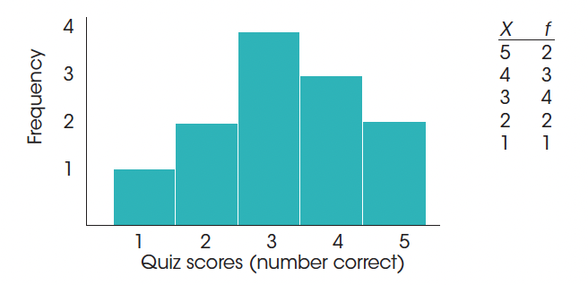
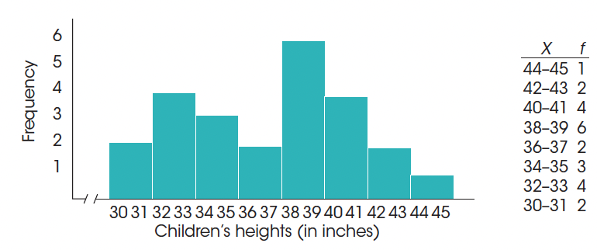
Frequency distribution graphs: histogram

Slide 18
Histogram
To construct a histogram, you first list the numerical scores (the categories of measurement) along the X-axis. Then you draw a bar above each X value so that
The height of the bar corresponds to the frequency for that category.
For continuous variables, the width of the bar extends to the real limits of the category. For discrete variables, each bar extends exactly half the distance to the adjacent category on each side.

Slide 19
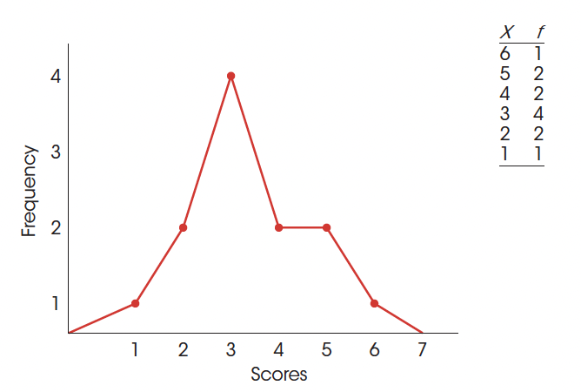
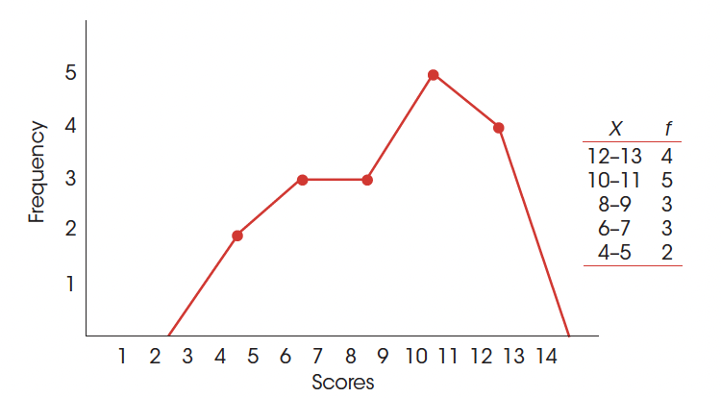
Frequency distribution graphs: polygons
Here dots are placed in the middle of the interval

Slide 20
Polygons
To construct a polygon, you begin by listing the numerical scores (the categories of measurement) along the X-axis. Then,
A dot is centered above each score so that the vertical position of the dot corresponds to the frequency for the category.
A continuous line is drawn from dot to dot to connect the series of dots.
The graph is completed by drawing a line down to the X-axis (zero frequency) at each end of the range of scores.

Slide 21
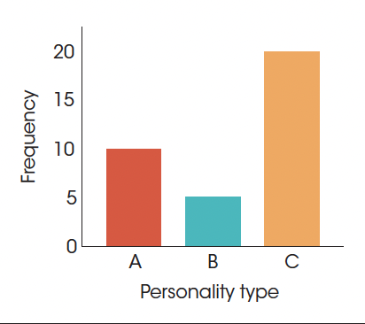
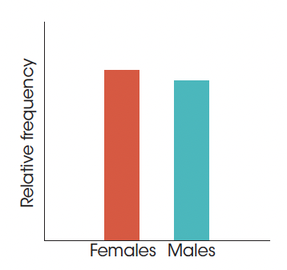
Bar Graph (Chart)
A bar graph is essentially the same as a histogram, except that spaces are left between adjacent bars.
For a nominal scale, the space between bars emphasizes that the scale consists of separate, distinct categories. For ordinal scales, separate bars are used because you cannot assume that the categories are all the same size.
To construct a bar graph, list the categories of measurement along the X-axis and then draw a bar above each category so that the height of the bar corresponds to the frequency for the category.
Frequency distribution graphs: bar chart

Slide 22
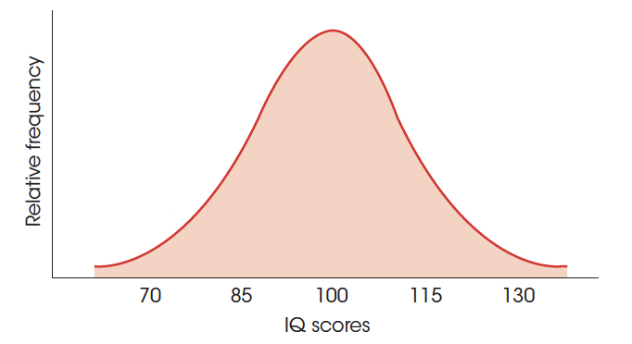
Smooth curves
When a population consists of numerical scores, it is customary to draw the distribution with a smooth curve instead of the jagged, step-wise shapes that occur with histograms and polygons. The smooth curve indicates that you are not connecting a series of dots (real frequencies) but instead are showing the relative changes that occur from one score to the next.

Slide 23
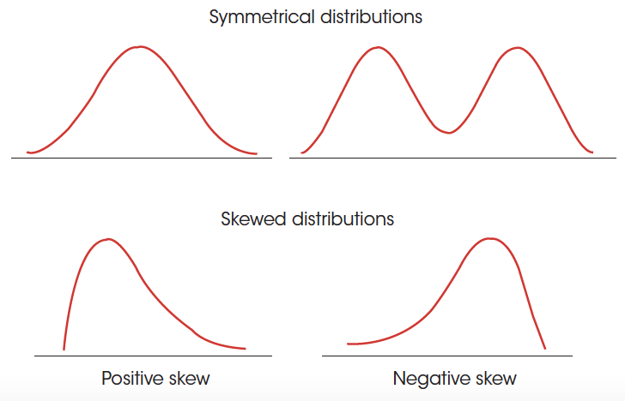
Shape of a Frequency Distribution
- In a symmetrical distribution, it is possible to draw a vertical line through the middle so that one side of the distribution is a mirror image of the other.
- In a skewed distribution, the scores tend to pile up toward one end of the scale and taper off gradually at the other end.
- The section where the scores taper off toward one end of a distribution is called the tail of the distribution.
- A skewed distribution with the tail on the right-hand side is positively skewed because the tail points toward the positive (above-zero) end of the X-axis. If the tail points to the left, the distribution is negatively skewed.

Slide 24
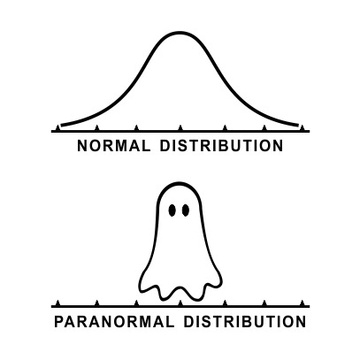
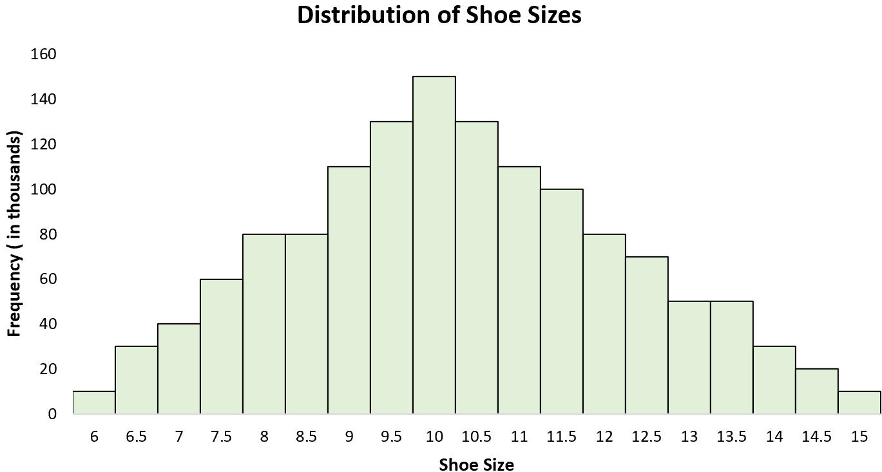
Normal distribution

Slide 25
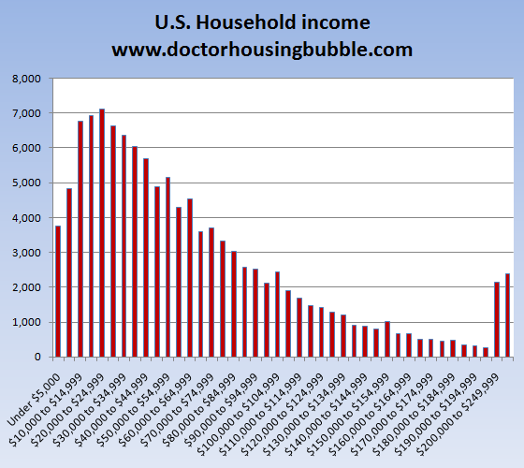
Skewed distribution

Slide 26
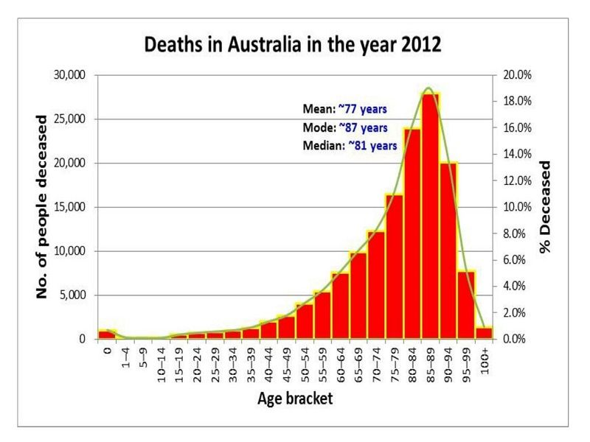
Skewed distribution

Slide 27
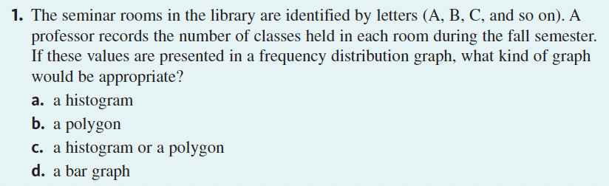
Learning check

Slide 28
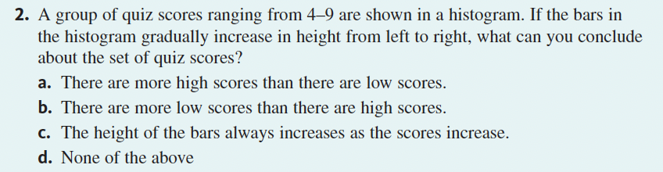
Learning check

Slide 29
Measures of central tendency

Slide 30
Central tendency
Central tendency is a statistical measure to determine a single score that defines the center of a distribution. The goal of central tendency is to find the single score that is most typical or most representative of the entire group.
Examples of central tendency metrics:
Mean
Median
Mode

Slide 31
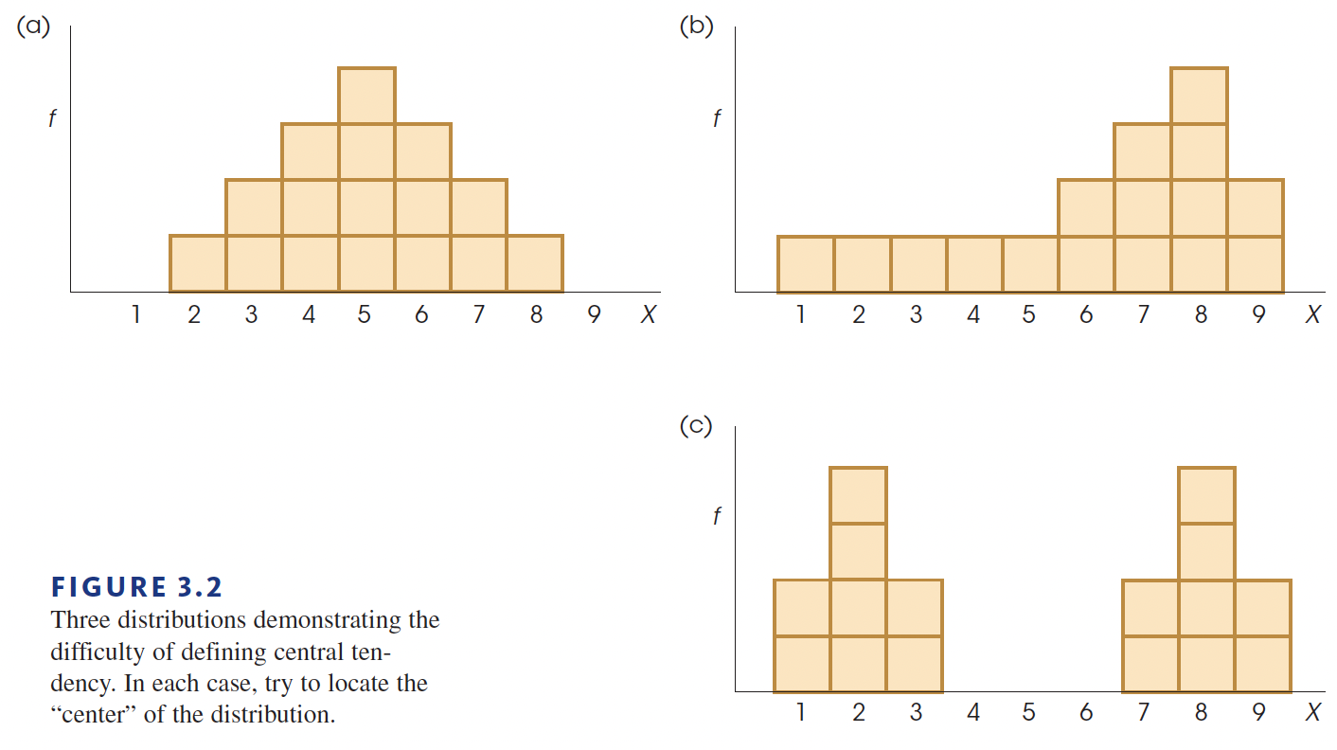
No central tendency measure is good for every situation

Slide 32


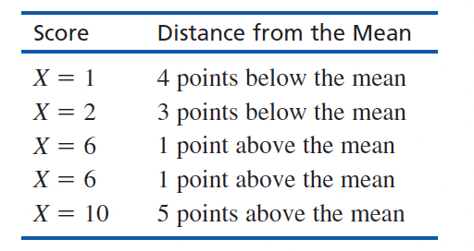
Mean
The mean for a distribution is the sum of the scores divided by the number of scores.
Population formula:
Sample formula:
The mean as a balance point:
Notice that the mean balances the distances. That is, the total distance below the mean is the same as the total distance above the mean:
below the mean: 4 + 3 = 7 points
above the mean: 1 + 1 + 5 = 7 points

Slide 33
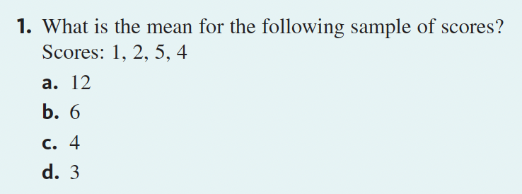
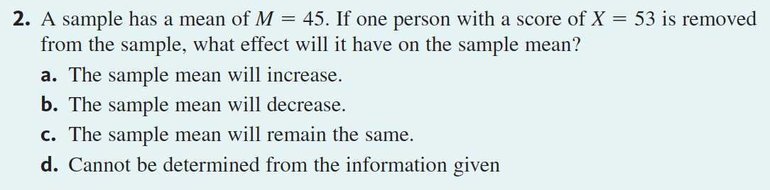
Learning check

Slide 34

Finding the median

Slide 35
Finding the median

Slide 36

Finding the median

Slide 37
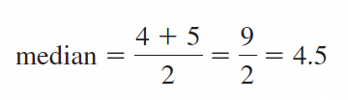
Finding the median

Slide 38
Median
If the scores in a distribution are listed in order from smallest to largest, the median is the midpoint of the list. More specifically, the median is the point on the measurement scale below which 50% of the scores in the distribution are located.
Defining the median as the midpoint of a distribution means that the scores are being divided into two equal-sized groups. We are not locating the midpoint between the highest and lowest X values. To find the median, list the scores in order from smallest to largest. Begin with the smallest score and count the scores as you move up the list. The median is the first point you reach that is greater than 50% of the scores in the distribution.

Slide 39
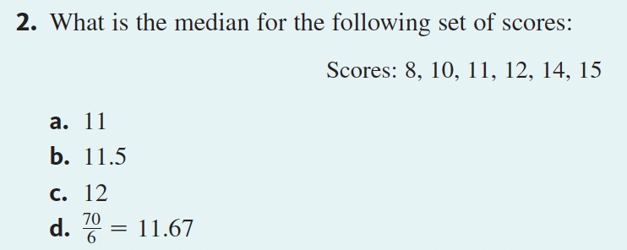
Learning check

Slide 40
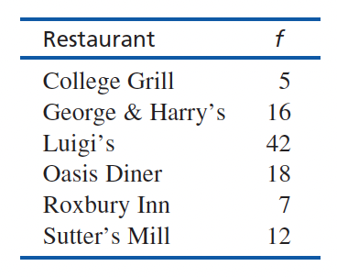
Mode
In a frequency distribution, the mode is the score or category that has the greatest frequency.
Although a distribution will have only one mean and only one median, it is possible to have more than one mode. Specifically, it is possible to have two or more scores that have the same highest frequency.
In a frequency distribution graph, the different modes will correspond to distinct, equally high peaks. A distribution with two modes is said to be bimodal, and a distribution with more than two modes is called multimodal. Occasionally, a distribution with several equally high points is said to have no mode.

Slide 41
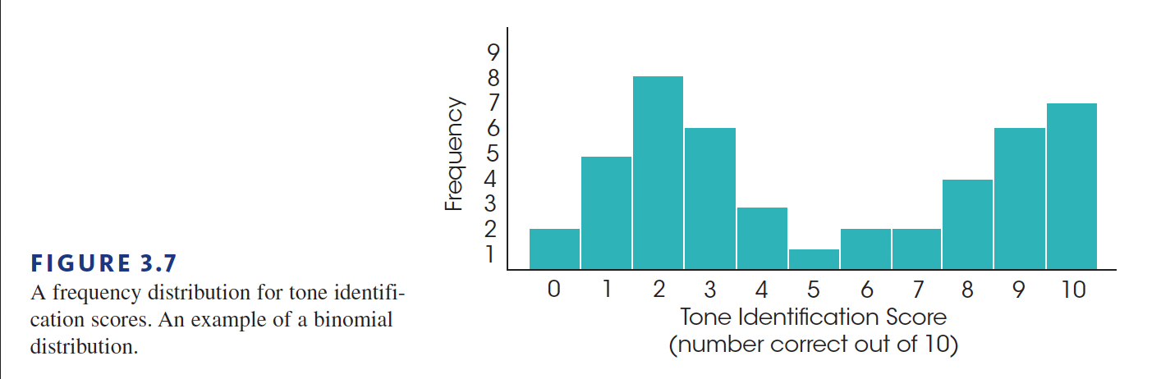
Bimodal distribution

Slide 42
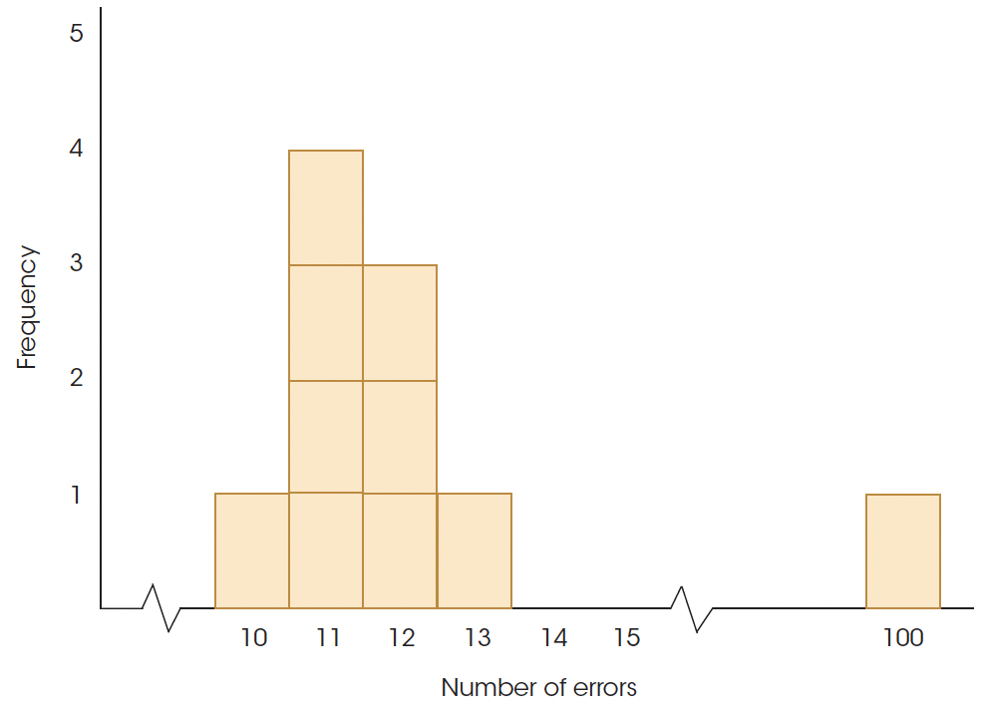
Selecting a measure of central tendency
You can use mean for numerical features and for symmetrical distributions since it can be easily affected by extreme values and become less representative.
It’s better to use the median for skewed distributions. Also do not use mean but median, when you have undetermined values in your data. The median is also suitable for an ordinal scale when the mean is not!
The mode you can find for any distribution, but most likely you will use it with nominal data since it is the only central tendency metric that can be calculated for those. Also, it makes sense for discrete variables.

Slide 43
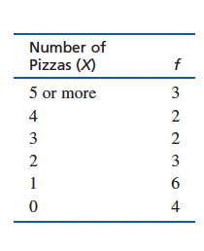
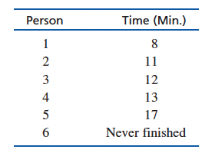
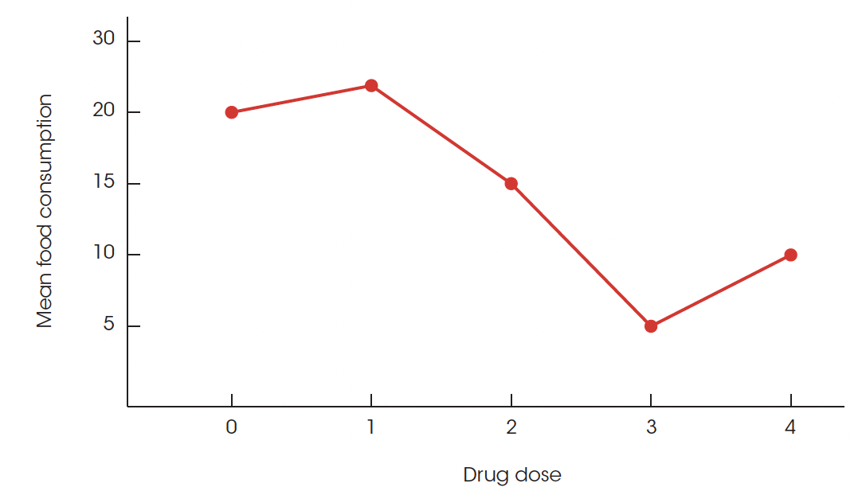
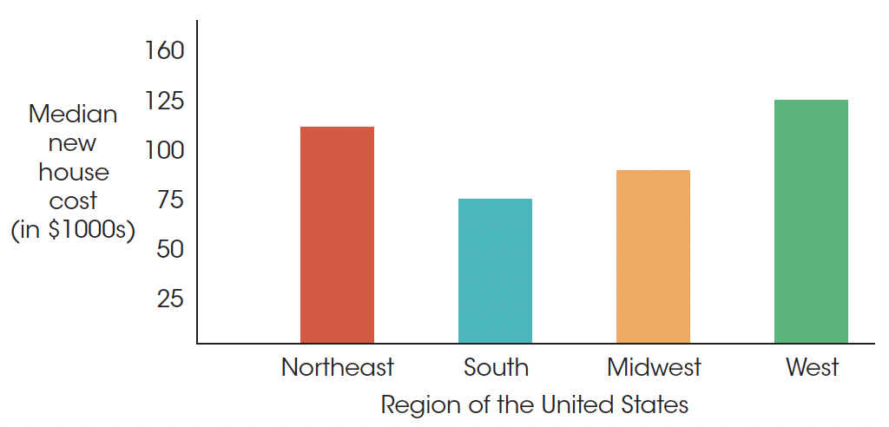
Undetermined values & Open-ended data
Mean and median’s in graphs:

Slide 44
Central Tendency and the Shape of the Distribution
There are situations in which all three measures will have exactly the same value. On the other hand, there are situations in which the three measures are guaranteed to be different. In part, the relationships among the mean, median, and mode are determined by the shape of the distribution.

Slide 45
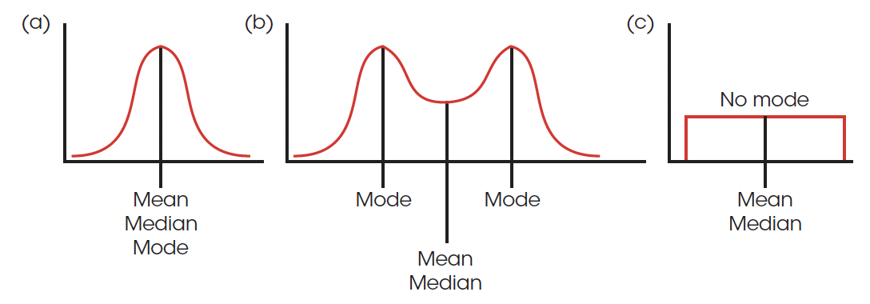
Symmetrical distribution
For a perfectly symmetrical distribution with one mode, all three measures of central tendency —
the mean, median, and mode — have the same value.
However, there will be cases that are different.

Slide 46
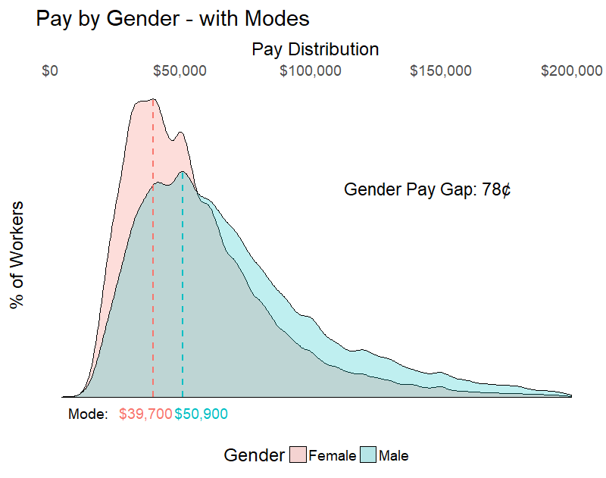
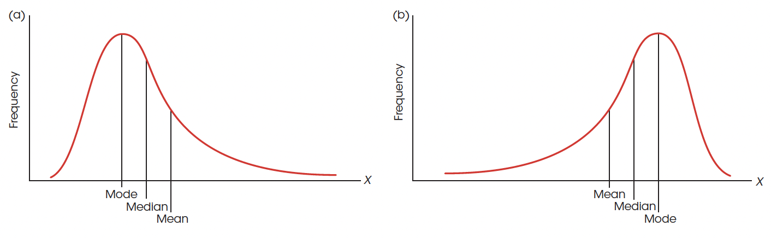
Skewed distribution
In skewed distributions, especially distributions for continuous variables, there is a strong tendency for the mean, median, and mode to be located in predictably different positions.

Slide 47
Selecting a measure of central tendency
 | Mean | Median | Mode
Nominal variables | No | No | Yes
There are extreme values | No | Yes | Yes
Distribution is symmetrical | Yes (with caution) | Yes | Yes
Distribution is skewed | No | Yes | No
Ordinal variables | No | Yes | Yes

Slide 48
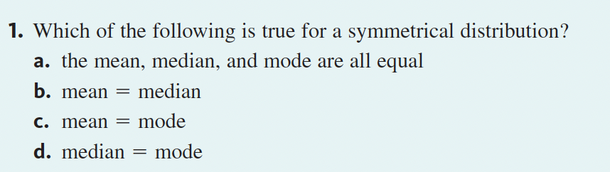
Learning check

Slide 49

Thank you!
Fedor Shlyakhov fshlyahov@hse.ru

