Slide 1
Photo Gallery
Integrated Backbone.js module

Slide 2
Task
Integrate into specified HTML 5 content
page a simple photo gallery, based on
Backbone.js framework.

Slide 3
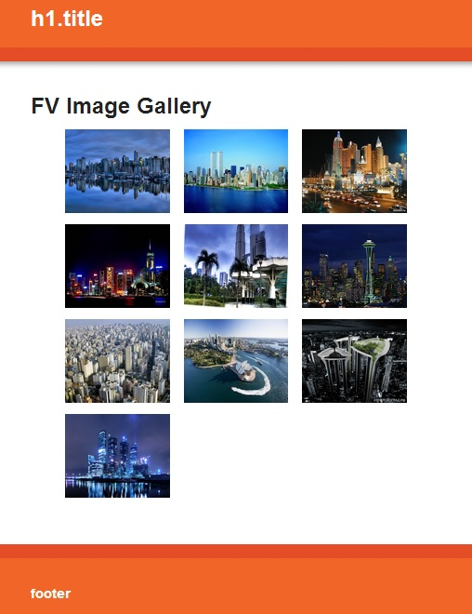
Photo Gallery (thumbnails view)

Slide 4
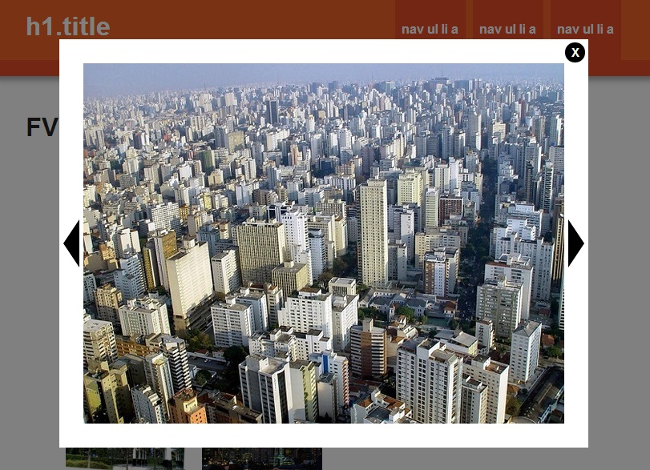
Photo Gallery (full size view)

Slide 5
Photo Gallery functionality
10 images-previews (thumbnails), showed as gallery,
popup with full size image - shows by clicking on an image-preview,
“scrolling” images in full size mode by pushing buttons "back" and "forward",
circle scrolling images in full size mode (after last image shows first one, and before first – last one):
closing full image size mode popup by clicking button "close" and by pushing button "esc".

Slide 6
Performance methods
1- technologies
In application was implemented following JavaScript libraries:
jQuery,
backbone.js,
underscore.js,
require.js - AMD modules,
ajax,
JSON

Slide 7
Performance methods
2 - files structure
www/
js/
app/
common.js (main code)
gallery-images.json (gallery images data)
lib/
backbone.js
jquery.js
require.js
underscore.js
config.js

Slide 8
Performance methods
3 – Backbone MVC structure implementation
Application structure bases on MVC paradigm, implemented by Backbone.js framework:
Model
Thumb – entity, described single photo,
Thumbs – collection of photos (personal models “Thumb”)
View
ThumbView - single photo view,
ThumbnailsView – gallery view; combines and renders a set of views from collection data (functions: “render”, “show fullsize image”),
ImageFullSize – view, representates selected photo in full size mode
(functions: “render”, “show next Image”, “show previous image”, “close popup”)
Controller
(in backbone.js represents as entity “Router”)

Slide 9
Performance methods
4 – methods and features
Model HTML code integrates into the specified HTML 5 content web-page and also supplies a basic page adaptive styles,
views elements inserts into DOM by underscore-templates technology,
javascript libraries "underscore.js", "backbone.js", "modernizr.js" loads by Require.js
in AMD module "common.js“; jQuery.js file loads directly in the head of the page,
main application scripts performed in AMD module "common.js" (currently MVC entities implemented in one file (mainly because they have a small size),
but easily can be splitted to 3 modules - "Model", "View", "Controller" if it will be required),
gallery Images data stores in JSON file and loads to collection via AJAX,
"show next image" and "show previous image" functions implements by manipulation with backbone collections.

