Slide 1

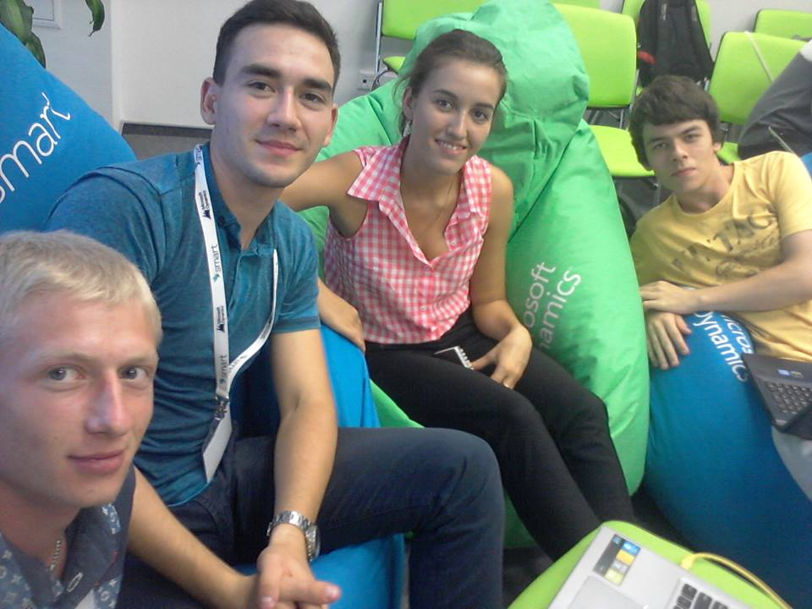
SMART academy .NET 2016
SMART chat
Team 3
Yuliia Shpak
Dmytro Katrychuk
Roman Andriyenko
Fedir Petrenko

Slide 2

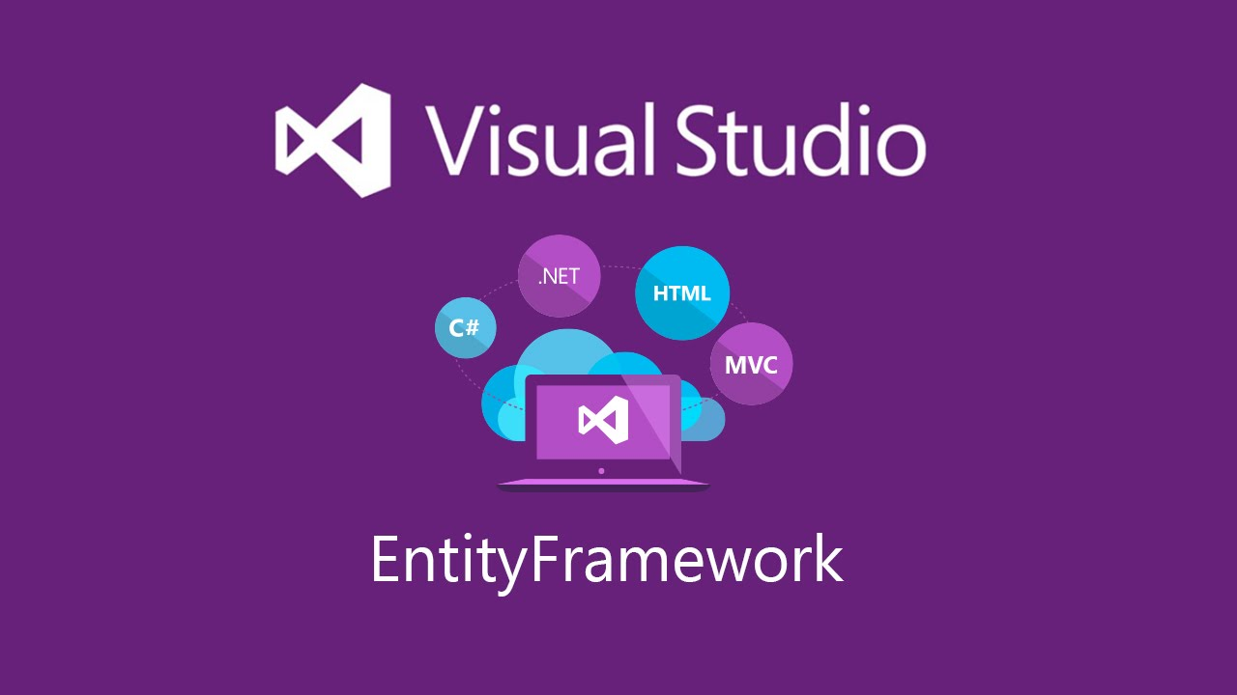
Technologies in the project
ASP.NET MVC 5
Entity Framework 6
Patterns and techniques
Unit of Work -
Dependency injection - (IoC-container Ninject)
Unit testing -

Slide 3
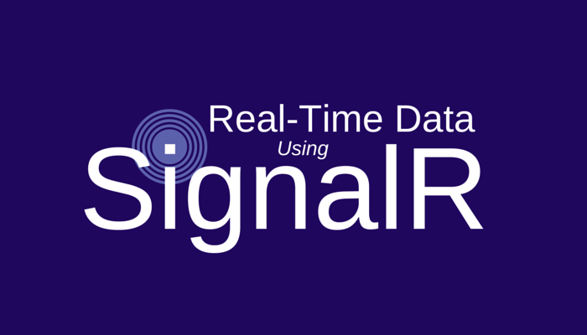



Libraries and frameworks
SignalR 2
JQuery
Moq
Microsoft Test Framework

Slide 4


Join the chat through
Facebook and Google accounts…
or sign up quickly in our system.

Slide 5
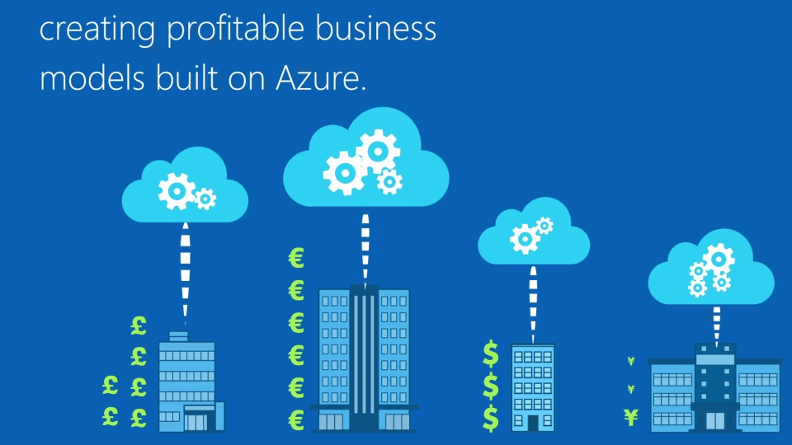
Azure will make your business applications more productive

Slide 6
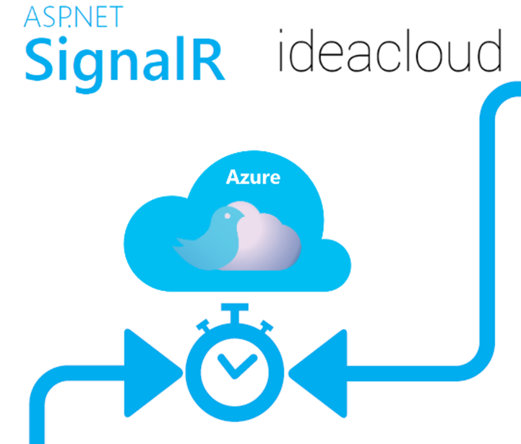
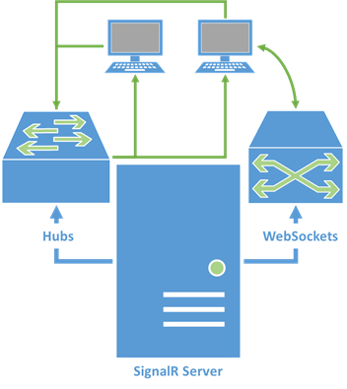
Real – time application
for easy communication
in your company

Slide 7
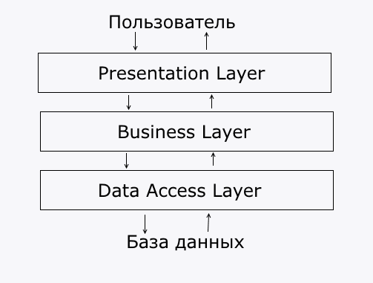
Application architecture

Slide 8
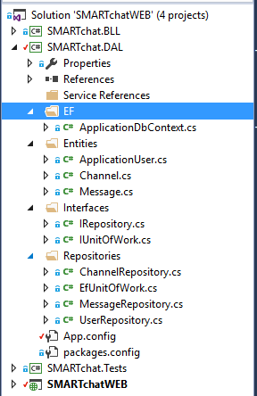
Data Access Layer
Entity Framework Code First
Repositories
Unit of Work

Slide 9
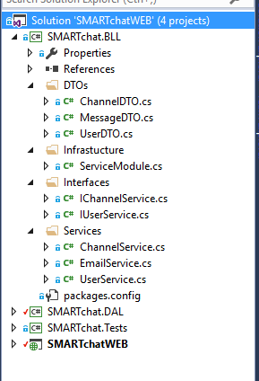
Business Logic Layer
Data Transfer Object
Dependency injection

Slide 10
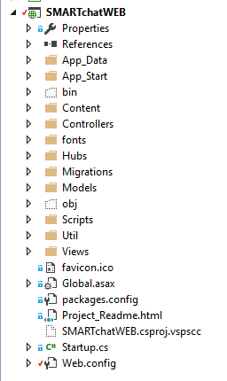
Presentation Layer
ChatHub
Dependency injection
JQuery

Slide 11


